Slide 1
Under floor Heating
Graduation Project
submitted By:
Adli Mosleh
Husam weld Ali
Supervisor:
Eng.luqman Herzallah

Slide 2
Presentation outline:
Abstract
Introduction
Constrains
Literature review
Methodology
Discussion and analysis
Future plan
Conclusion

Slide 3
Abstract
Under Floor Heating system is central heating system that use three modes of heat transfer radiation, convection and conduction by embedded pipes.
Under Floor Heating system is widely adopted by residential and commercial sectors.
compatibility with different heating device.
heat pumps (Air/water, geothermal heat pumps) with high efficiency, solar power and fuels.

Slide 4
Introduction
Problem
Heating the house
by environmental friendly and cost effective system.
system
Under floor Heating system
Source of Energy
Air to water Heat Pump vs Gas boiler
Target
Design a UFS for a house in Nablus with minimum cost

Slide 5
Constraints
choosing a suitable architectural plan
designing the UFH system according to ASHRAE codes.
finding catalogs heat pumps and PEX pipes.
Method of comparison between devices.
How to estimate running cost.
Team management.

Slide 6
Literature review
Under Floor Heating
Heat Transfer Modes
Thermal Comfort
UFH Parameters
Heat Pumps
Gas Boiler
History

Slide 7
Methodology
Heat load calculation
Panel Design
Pipe Design
MATLAB
Codes
Economic
Study

Slide 8
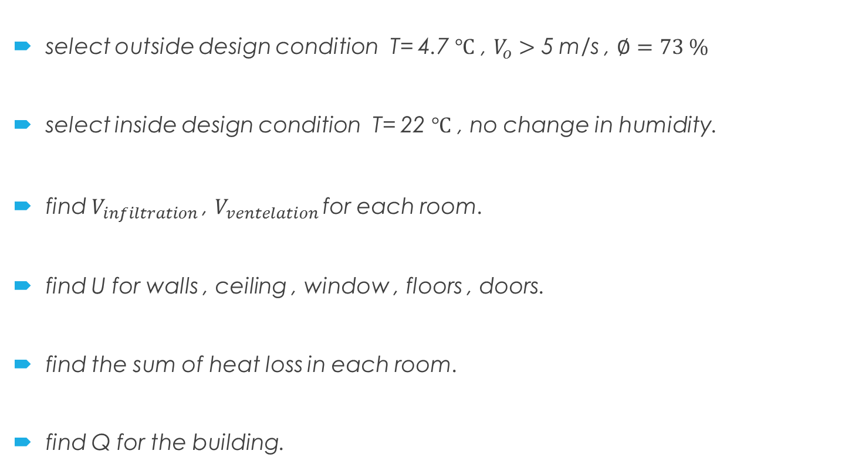
Heat load calculation
select outside design condition T= 4.7 $℃$ , $V_{o}>$ 5 m/s , $∅=73 \%$
select inside design condition T= 22 $℃$ , no change in humidity.
find $V_{infiltration }$, $V_{ventelation }$for each room.
find U for walls , ceiling , window , floors , doors.
find the sum of heat loss in each room.
find Q for the building.

Slide 9
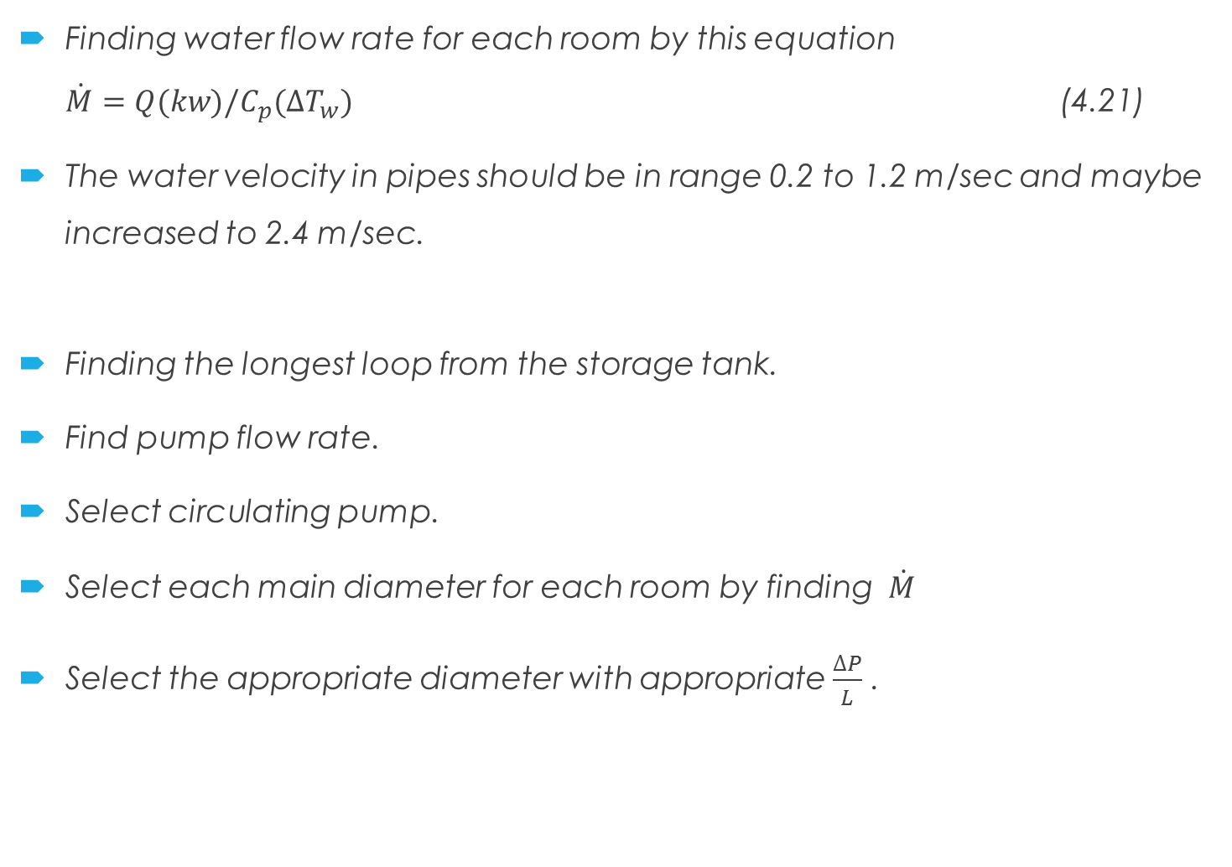
Finding water flow rate for each room by this equation
$\dot{M}=Q(kw)/C_{p}(∆T_{w})$ (4.21)
The water velocity in pipes should be in range 0.2 to 1.2 m/sec and maybe increased to 2.4 m/sec.
Finding the longest loop from the storage tank.
Find pump flow rate.
Select circulating pump.
Select each main diameter for each room by finding $\dot{M}$
Select the appropriate diameter with appropriate $\frac{∆P}{L}$ .

Slide 10
Infiltration load calculation
Room | Area (m^2) | Volume(m^3) | ACH
Guest | 22.74 | 90.96 | 1.5
bed 1 | 20.41 | 81.64 | 1
bed 2 | 23.52 | 94.08 | 2
bed 3 | 20.7 | 82.8 | 1
C 1 | 9.75 | 39 | 1.5
C 2 | 14.1 | 56.4 | 2
Living | 27 | 108 | 1.5
Kitchen | 23.6 | 94.4 | 1.5
Dining | 22.6 | 90.4 | 1
Room | l/s | Q (W)
Guest | 40 | 830.4
bed 1 | 30 | 622.8
bed 2 | 50 | 1038
bed 3 | 25 | 519
C 1 | 20 | 415.2
C 2 | 31 | 643.56
Living | 40 | 830.4
Kitchen | 40 | 830.4
Dining | 40 | 830.4

Slide 11
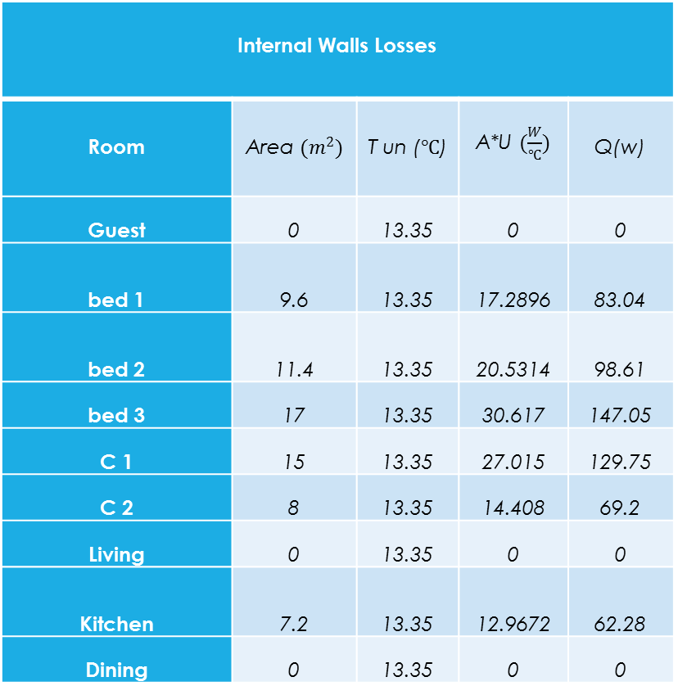
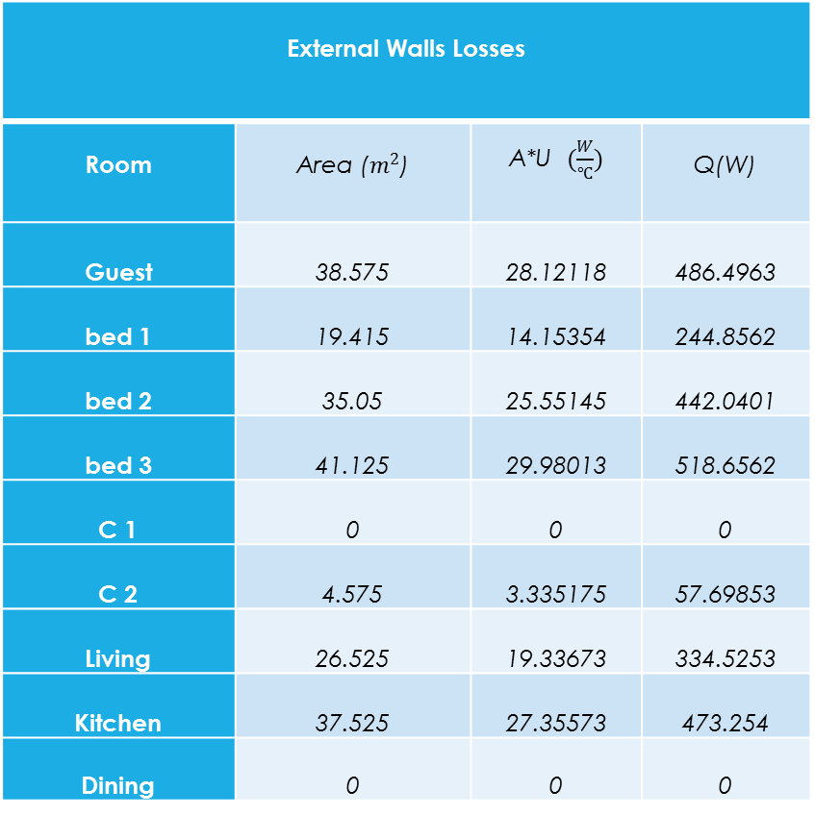
External and internal wall losses
External Walls Losses
Room | Area ($m^{2}$) | A*U $(\frac{W}{℃})$ | Q(W)
Guest | 38.575 | 28.12118 | 486.4963
bed 1 | 19.415 | 14.15354 | 244.8562
bed 2 | 35.05 | 25.55145 | 442.0401
bed 3 | 41.125 | 29.98013 | 518.6562
C 1 | 0 | 0 | 0
C 2 | 4.575 | 3.335175 | 57.69853
Living | 26.525 | 19.33673 | 334.5253
Kitchen | 37.525 | 27.35573 | 473.254
Dining | 0 | 0 | 0
Internal Walls Losses
Room | Area $(m^{2})$ | T un (℃) | A*U $(\frac{W}{℃})$ | Q(w)
Guest | 0 | 13.35 | 0 | 0
bed 1 | 9.6 | 13.35 | 17.2896 | 83.04
bed 2 | 11.4 | 13.35 | 20.5314 | 98.61
bed 3 | 17 | 13.35 | 30.617 | 147.05
C 1 | 15 | 13.35 | 27.015 | 129.75
C 2 | 8 | 13.35 | 14.408 | 69.2
Living | 0 | 13.35 | 0 | 0
Kitchen | 7.2 | 13.35 | 12.9672 | 62.28
Dining | 0 | 13.35 | 0 | 0

Slide 12
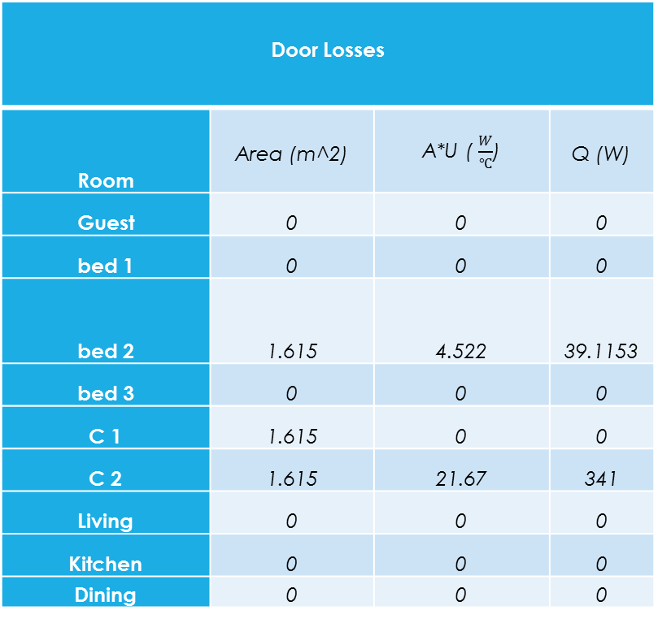
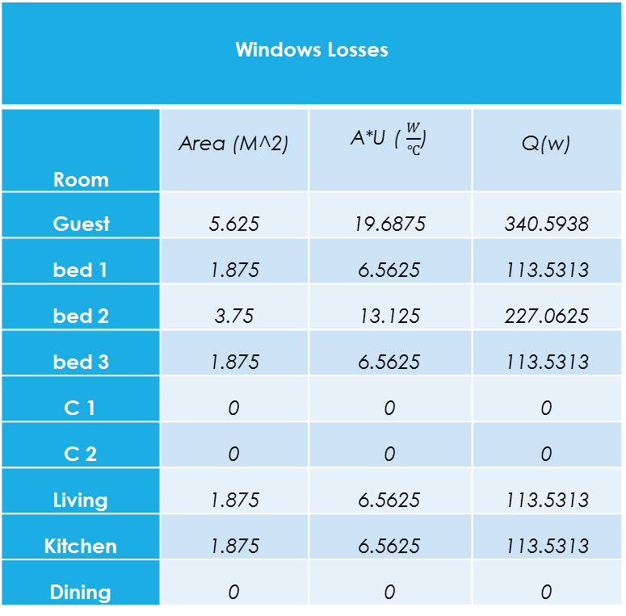
Window and door losses
Windows Losses
Room | Area (M^2) | A*U ( $\frac{W}{℃}$) | Q(w)
Guest | 5.625 | 19.6875 | 340.5938
bed 1 | 1.875 | 6.5625 | 113.5313
bed 2 | 3.75 | 13.125 | 227.0625
bed 3 | 1.875 | 6.5625 | 113.5313
C 1 | 0 | 0 | 0
C 2 | 0 | 0 | 0
Living | 1.875 | 6.5625 | 113.5313
Kitchen | 1.875 | 6.5625 | 113.5313
Dining | 0 | 0 | 0
Door Losses
Room | Area (m^2) | A*U ( $\frac{W}{℃}$) | Q (W)
Guest | 0 | 0 | 0
bed 1 | 0 | 0 | 0
bed 2 | 1.615 | 4.522 | 39.1153
bed 3 | 0 | 0 | 0
C 1 | 1.615 | 0 | 0
C 2 | 1.615 | 21.67 | 341
Living | 0 | 0 | 0
Kitchen | 0 | 0 | 0
Dining | 0 | 0 | 0

Slide 13
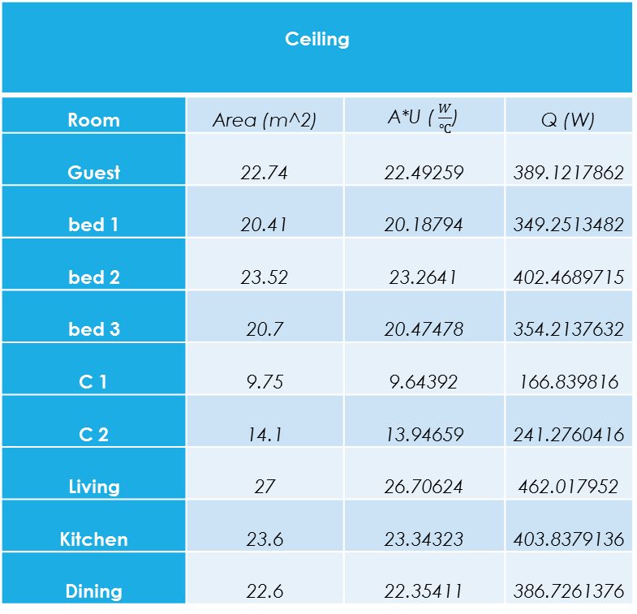
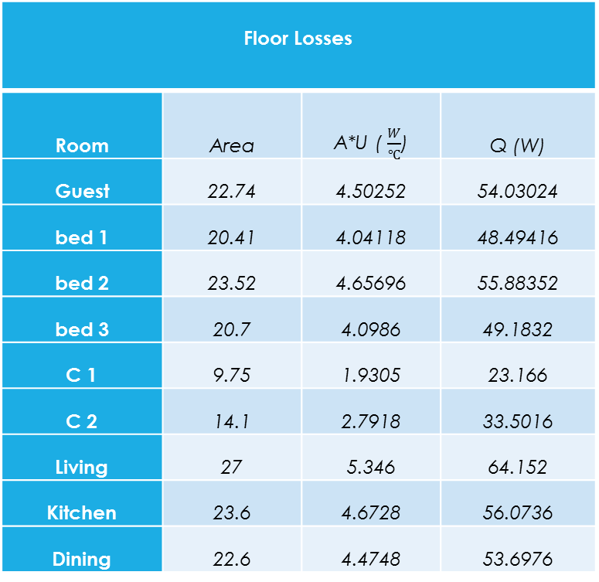
Floor and Ceiling losses
Floor Losses
Room | Area | A*U ( $\frac{W}{℃}$) | Q (W)
Guest | 22.74 | 4.50252 | 54.03024
bed 1 | 20.41 | 4.04118 | 48.49416
bed 2 | 23.52 | 4.65696 | 55.88352
bed 3 | 20.7 | 4.0986 | 49.1832
C 1 | 9.75 | 1.9305 | 23.166
C 2 | 14.1 | 2.7918 | 33.5016
Living | 27 | 5.346 | 64.152
Kitchen | 23.6 | 4.6728 | 56.0736
Dining | 22.6 | 4.4748 | 53.6976
Ceiling
Room | Area (m^2) | A*U ( $\frac{W}{℃}$) | Q (W)
Guest | 22.74 | 22.49259 | 389.1217862
bed 1 | 20.41 | 20.18794 | 349.2513482
bed 2 | 23.52 | 23.2641 | 402.4689715
bed 3 | 20.7 | 20.47478 | 354.2137632
C 1 | 9.75 | 9.64392 | 166.839816
C 2 | 14.1 | 13.94659 | 241.2760416
Living | 27 | 26.70624 | 462.017952
Kitchen | 23.6 | 23.34323 | 403.8379136
Dining | 22.6 | 22.35411 | 386.7261376

Slide 14
Total heat load
Total heat load for each room
Room | Q(w) | Q(KW) | A (m^2) | q (W/M^2)
Guest | 2100.642 | 2.100642 | 22.74 | 92.37652
bed 1 | 1461.973 | 1.461973 | 20.41 | 71.63023
bed 2 | 2303.18 | 2.30318 | 23.52 | 97.92434
bed 3 | 1701.634 | 1.701634 | 20.7 | 82.20456
C 1 | 734.9558 | 0.734956 | 9.75 | 75.38008
C 2 | 1386.236 | 1.386236 | 14.1 | 98.31462
Living | 1804.627 | 1.804627 | 27 | 66.83802
Kitchen | 1939.377 | 1.939377 | 23.6 | 82.17698
Dining | 1270.824 | 1.270824 | 22.6 | 56.23114
summation | 14703.45 | 14.70345 | 184.42 | 80.34183

Slide 15
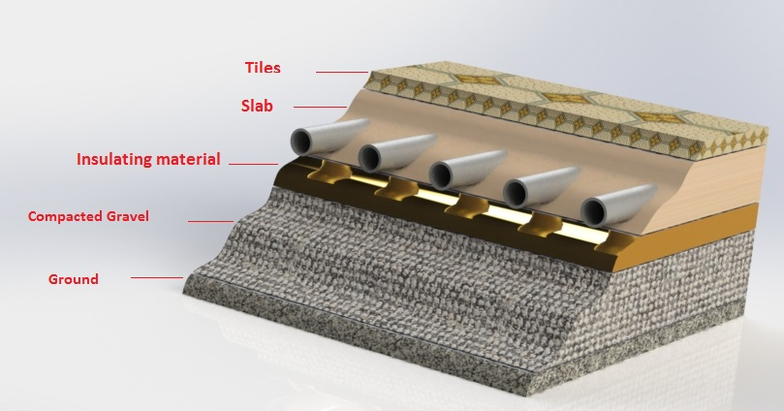
Panel design

Slide 16
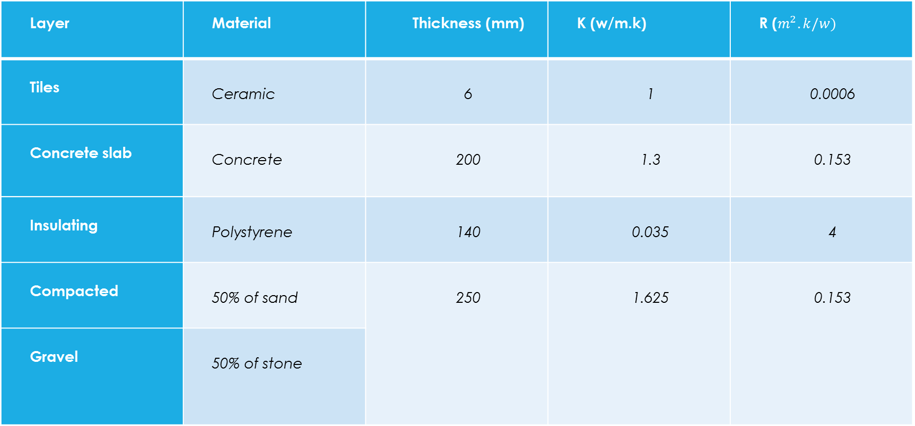
It composed of four main layers :
Layer | Material | Thickness (mm) | K (w/m.k) | R ($m^{2}.k/w)$
Tiles | Ceramic | 6 | 1 | 0.0006
Concrete slab | Concrete | 200 | 1.3 | 0.153
Insulating | Polystyrene | 140 | 0.035 | 4
Compacted | 50% of sand | 250 | 1.625 | 0.153
Gravel | 50% of stone

Slide 17
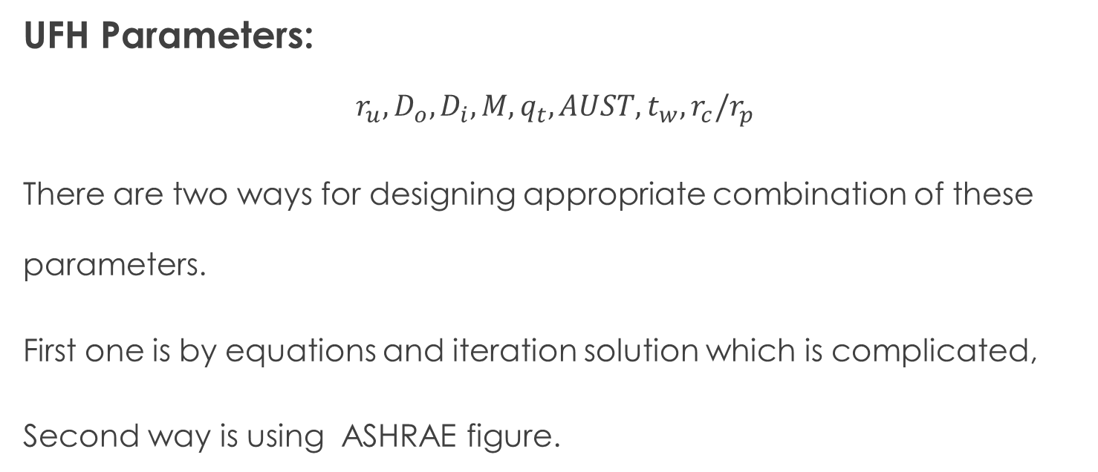
Pipe design
UFH Parameters:
$$r_{u},D_{o},D_{i},M,q_{t},AUST,t_{w},r_{c}/r_{p}$$
There are two ways for designing appropriate combination of these parameters.
First one is by equations and iteration solution which is complicated,
Second way is using ASHRAE figure.

Slide 18
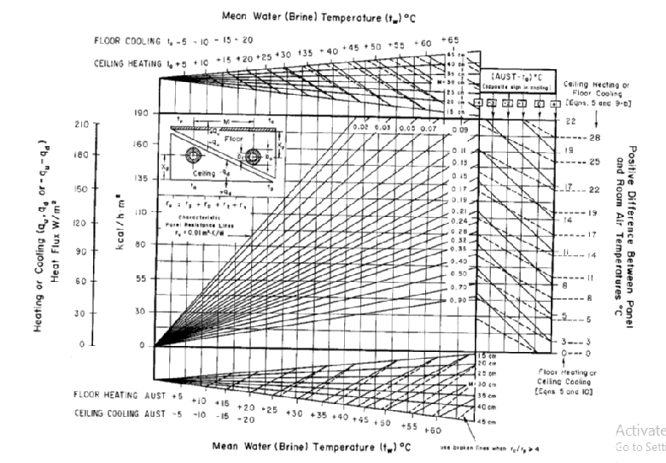

Slide 19
Final results
Room | AUST | Q | AUST - T in
Guest | 20.56881 | 92.37652 | -1.431188885
bed 1 | 20.78135 | 76.71597 | -1.218649577
bed 2 | 20.34693 | 97.92434 | -1.653072402
bed 3 | 19.98063 | 97.24804 | -2.019373548
C 1 | 20.28009 | 75.38008 | -1.71991393
C 2 | 20.89079 | 118.9274 | -1.10921219
Living | 21.35759 | 82.2158 | -0.642409518
Kitchen | 20.31633 | 77.77868 | -1.683668185
Dining | 21.95294 | 83.78866 | -0.047056
Room | q̋ | Tf | M | Tw | Di | Do
Guest | 92.37652 | 29 | 25 | 47.5 | 21.5 | 25
Bed Room 1 | 71.63023 | 28 | 35 | 47.5 | 21.5 | 25
Bed Room 2 | 97.92434 | 29.5 | 20 | 47.5 | 21.5 | 25
Bed Room 3 | 82.20456 | 28 | 20 | 47.5 | 21.5 | 25
C 1 | 75.38008 | 27 | 35 | 47.5 | 21.5 | 25
C 2 | 98.31462 | 29.5 | 22.5 | 47.5 | 21.5 | 25
Living | 66.83802 | 27 | 30 | 47.5 | 21.5 | 25
Kitchen | 82.17698 | 27.5 | 35 | 47.5 | 21.5 | 25
Dining | 56.23114 | 27.5 | 30 | 47.5 | 21.5 | 25

Slide 20
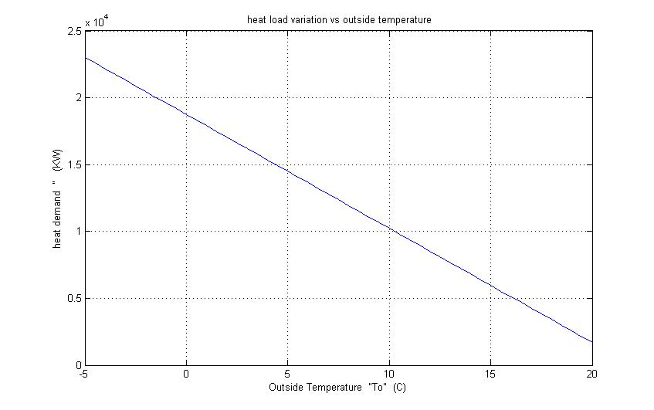
MATLAB Results

Slide 21
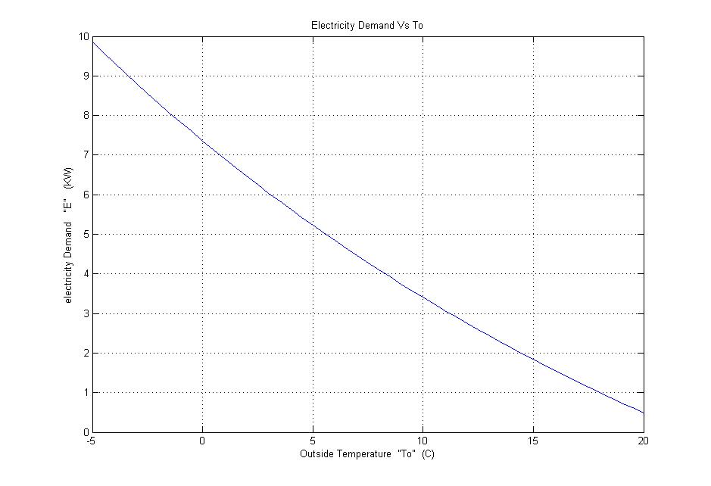
Electricity demand of the heat pump

Slide 22
Heat Pump consumption
Month | Period | To | COP | heat load | kwh/10 days | kwh/month
Nov | 1st 10 days | 9 | 2.99786 | 18.75456 | 1030.39713 | 1632.34738
 | 2nd 10 days | 16.1 | 3.88043536 | 5.11488 | 217.102141
 | 3rd 10 days | 12.1 | 3.64841264 | 8.5248 | 384.848109
Dec | 1st 10 days | 14.6 | 3.79253787 | 6.3936 | 277.667242 | 1281.80156
 | 2nd 10 days | 11.2 | 3.59159226 | 9.37728 | 430.030211
 | 3rd 10 days | 7.8 | 3.42397584 | 11.93472 | 574.104106
Jan | 1st 10 days | 13.1 | 3.70570714 | 7.67232 | 341.008123 | 1492.68177
 | 2nd 10 days | 9.6 | 3.50725067 | 10.656 | 500.42214
 | 3rd 10 days | 6.2 | 3.34176779 | 13.21344 | 651.251503
Feb | 1st 10 days | 14.4 | 3.79253787 | 6.3936 | 277.667242 | 1382.05777
 | 2nd 10 days | 10.5 | 3.56335987 | 9.80352 | 453.139024
 | 3rd 10 days | 6.7 | 3.34176779 | 13.21344 | 651.251503
Mar | 1st 10 days | 17.2 | 3.96939963 | 3.83616 | 159.17725 | 1024.79417
 | 2nd 10 days | 13 | 3.70570714 | 7.67232 | 341.008123
 | 3rd 10 days | 8.8 | 3.47937386 | 11.08224 | 524.608792
The total electricity consumption is 6813.618 KWH/Season.
The total running cost is 6813.618*0.55 = 3747.524 Nis

Slide 23
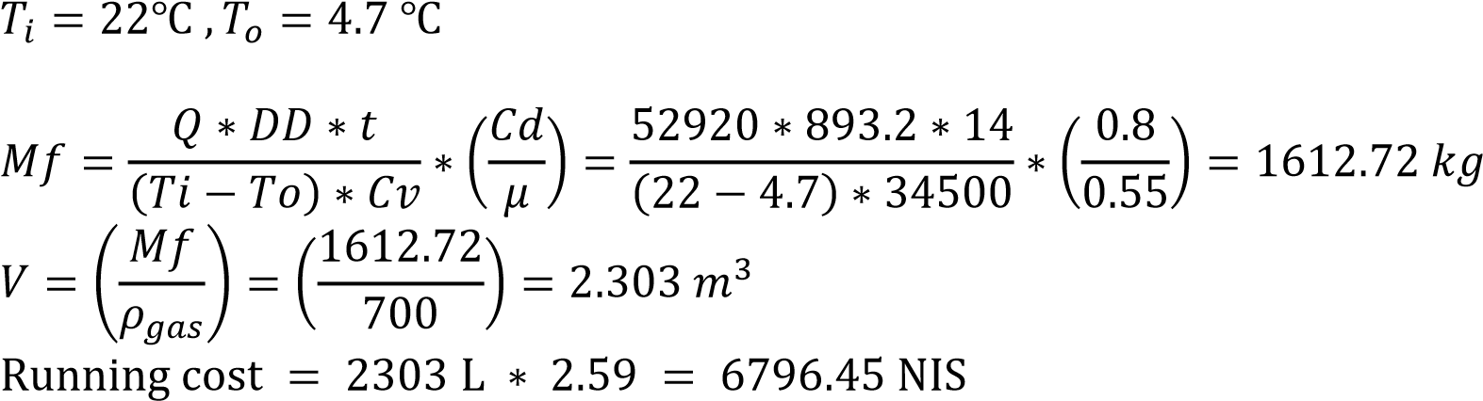
Gas boiler Degree Day
Month | Nov | Dec | Jan | Feb | Mar | summation
temp | 16.1 | 11.2 | 9.6 | 10.5 | 13 | 893.2
days | 30 | 31 | 31 | 28 | 31
DD | 57 | 210.8 | 260.4 | 210 | 155

Slide 24
Economic study
HEAT PUMP:
the average investment cost with installation were obtained from contracting companies as 37000 Nis. From calculations the seasonal running cost for the system were 3747 Nis.
GAS BOILER:
the average investment cost with installation were obtained from contracting companies as 6500 Nis. From calculations the seasonal running cost for the system were 6800 Nis.
RUNNING COST PERCENTAGE AND PAYBACK PERIOD
3747/6800 *100% = 55% .
Payback period is 9.99

Slide 25
Conclusion
UFH is environmental friendly “it works on low operating temperature”
Electric air to water heat pump is safe for local environment.
UFH is profitable investment.
Air to water heat pump is good investment !!

Slide 26
Any question !!

