Slide 1
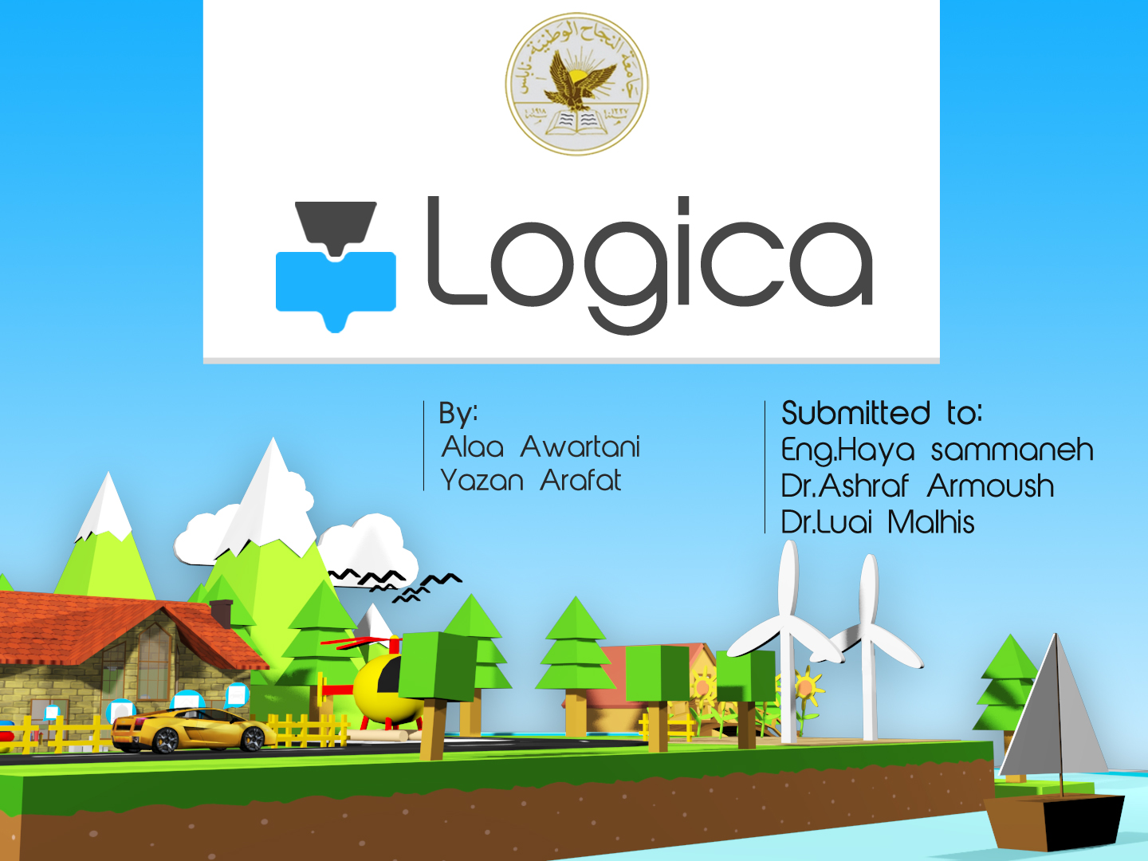

Slide 2
Outline
Introduction
Overview
Gameplay Techniques
Gameplay Phases
Gameplay Modes
Demos
Testing and Conclusion

Slide 3
Introduction
The need of programming is increasing.
Educational games.
Last massive event was hour of code provided by code.org .
We decided to be involved in this field.

Slide 4
Logica
what is Logica ?
Game’s Target ?
What are the goals of Logica ?
How to achieve these goals ?
Notes:
Cross platform, visual programming, non written, target,
Goals : Cretical, Reallife applications, logical thinking
How : Eeasyto use, friendly, gradually teaching step by step
___________________________________________________________
It’s a cross-platform educational app in a shape of game that allows any one to build and understand real life systems, specially children as they are our target.
Building systems without written programming.
The main target for this game is children of ages between 8-13 years old.
Teach the concepts of logical thinking and how real life algorithms built and work
Gameplay in Logica will provide Gradual way of teaching concepts of logic as well as how to build and understand real life systems algorithms.
The game built and designed in a way to be easy to use and play.

Slide 5
Technologies
Unity 3D as game engine.
C# as programming language.
Adobe Photoshop, Illustrator for 2D design.
Autodesk 3DS Max for 3D design.
Adobe Audition for audio editing.
Notes:
In the designing and development of this project we used:

Slide 6
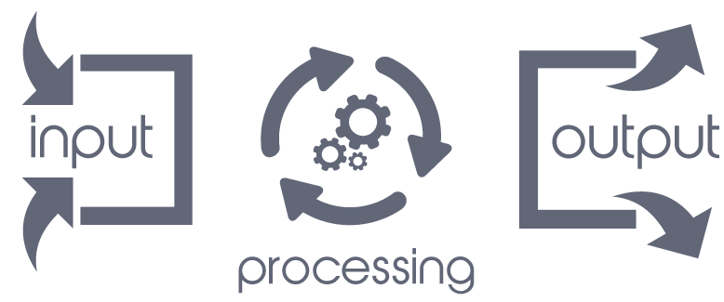
Gameplay Technique
Input-processing-output
Notes:
To simplify the gameplay technizue in logica, we can divide it into three stages:
Input: Getting data, signals and events from input sources
Processing: make logic operations on input data to build the desired system
Output: user will send events to output objects to reflect the system results

Slide 7

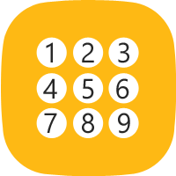


Gameplay Components - Inputs
What are the Input sources?
Examples:
Temperature
Sensor
keypad
Smoke
Sensor
Button
Notes:
Input sources: the user can get data from various inputs, such as sensors(temp and smoke), btn, keypad

Slide 8




Gameplay Components - Processing
How to control?
Examples:
mathematical
operations
condition
statement
function
loops
Notes:
How: the processing units are logic operations such as memories, function, loops, condition statement, mathematical operations

Slide 9




Gameplay Components - Output
What to control (output objects)?
Examples:
car
screen
fan
Fire alarm
Notes:
Output: the results can be shown on 3d objects such as car, screen, fan, fire and water alarm and others

Slide 10
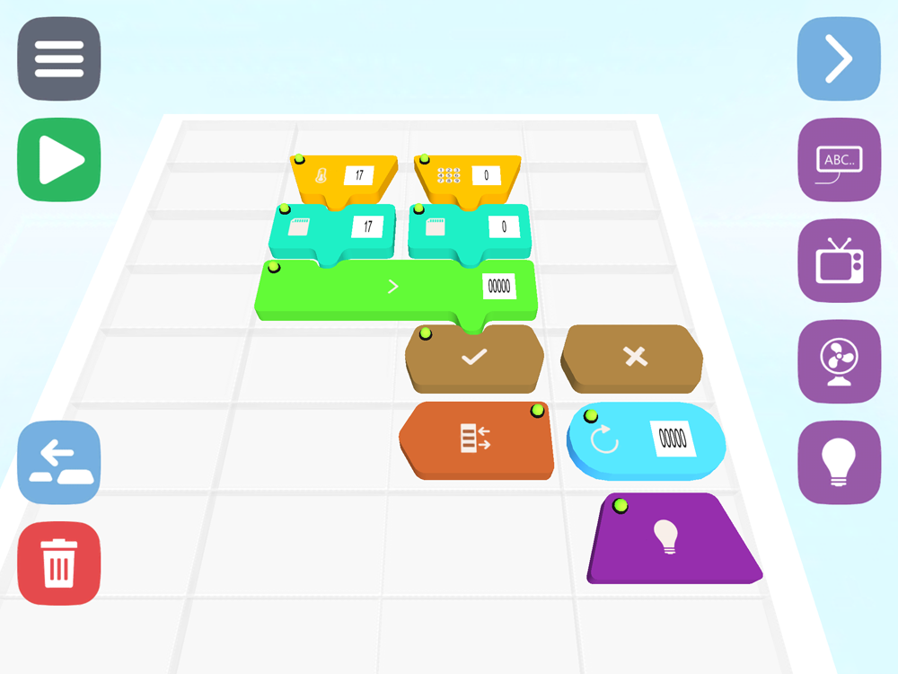
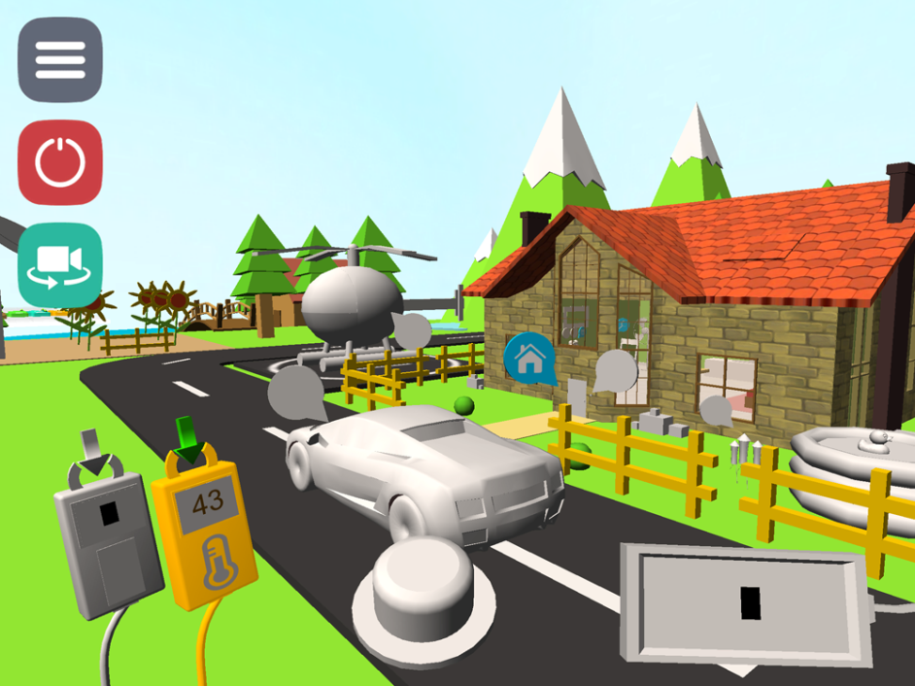
Gameplay Phases
Programming phase:
  Building, Drag-and-drop blocks, components
Running phase:
  switch to virtual environment to see the results
Notes:
Programming phase: in which the user will build the system by drag-and-drop blocks on a grid to use the components of the game
Blocks: each input, output, logic operation has block can be used in the programming phase
Running phase: after building the system, the user will be taken to a virtual environment that contains the input-output objects to see the results of the system and to interact with the objects

Slide 11
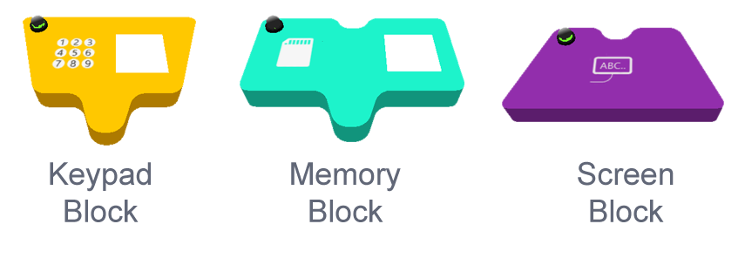
Gameplay Phases
Blocks:
  Each component has a block.
  Used to build the system.
For example:
Notes:
Blocks: each input, output, logic operation has block can be used in the programming phase

Slide 12
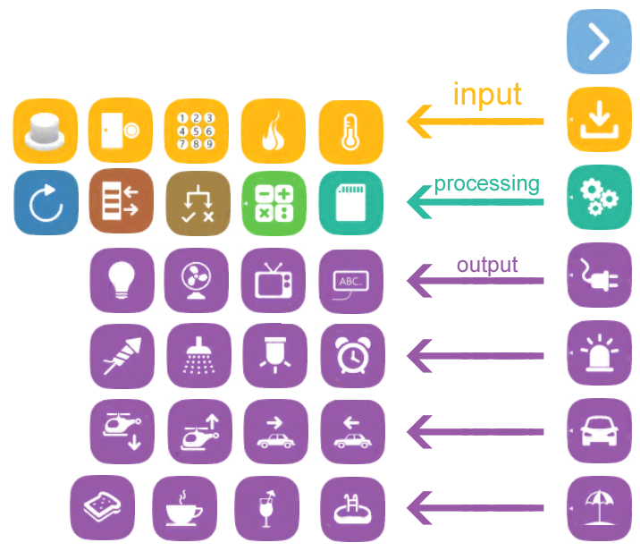
Graphical User Interface
Easy to use and simple
Meaningful
Dynamic
Categories
Notes:
Graphical user interface was designed to be easy to use
Meaningful, so every icon and button explains the purpose of its usage
As logica is crossplatform, the GUI was built to be dynamic regardless of the running device
Input, processing and output components are categorize in an easy to access way

Slide 13
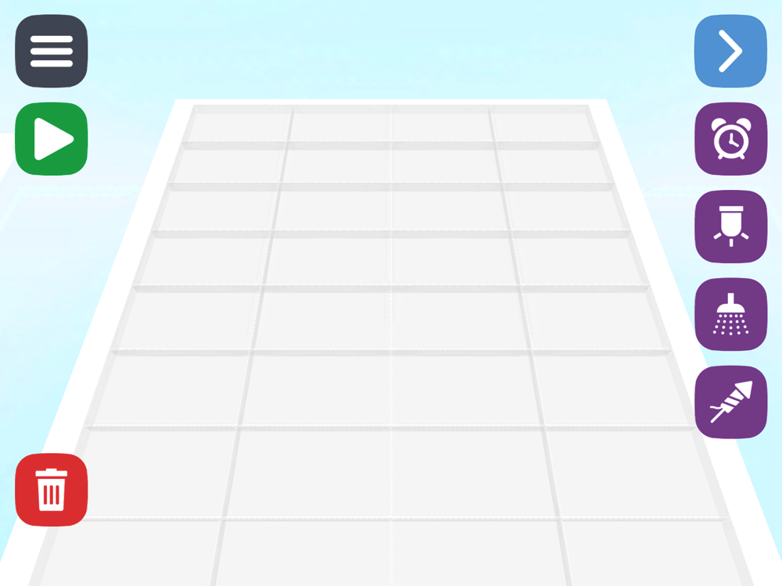
Programming Phase - Grids
Notes:
Programming your system is done on one of the two grids we have, main, fun….

Slide 14
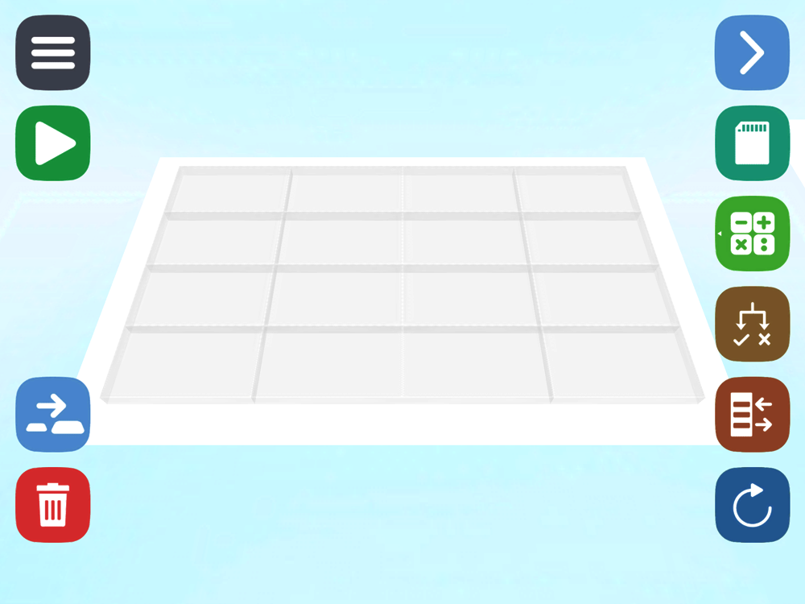
Programming Phase - Grids

Slide 15
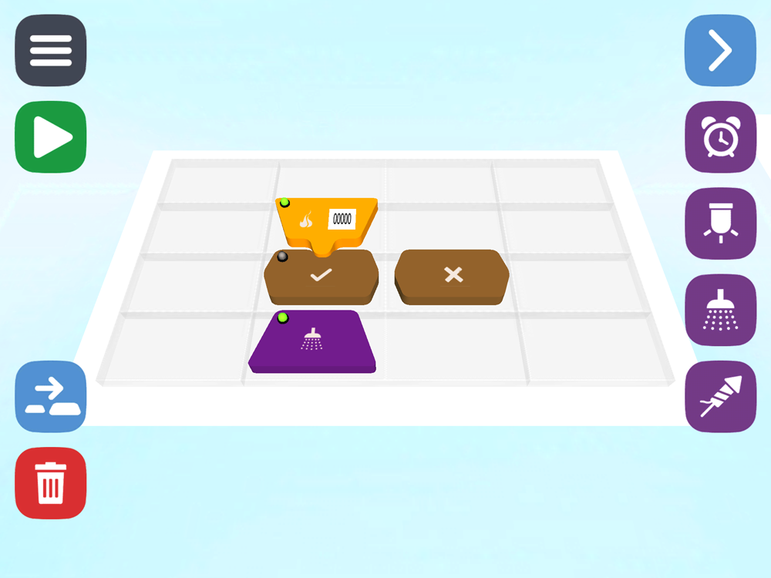
Programming Phase - Grids

Slide 16
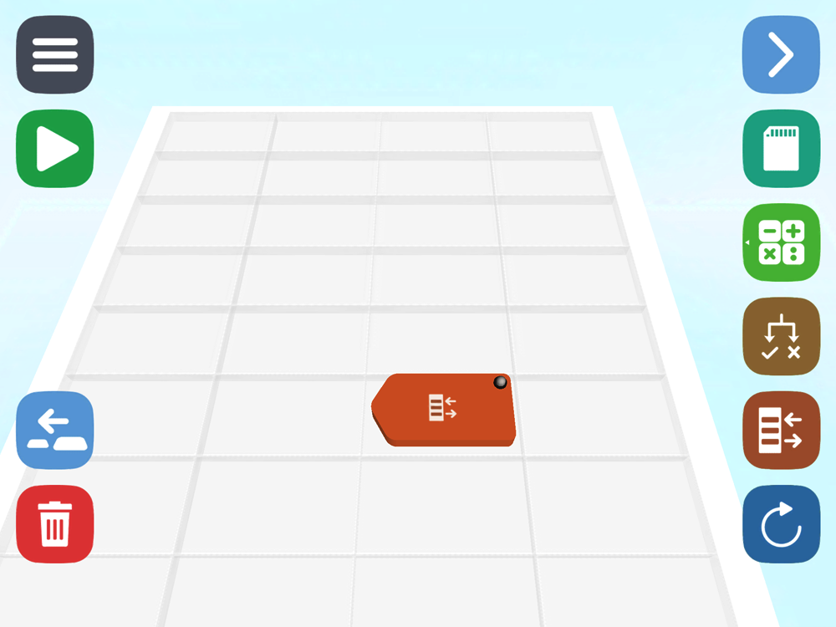
Programming Phase - Grids

Slide 17

Programming Phase - Snipping

Slide 18
Programming Phase - Snipping

Slide 19
Programming Phase – Block’s LED

Slide 20
Programming Phase – Grid’s Alert

Slide 21
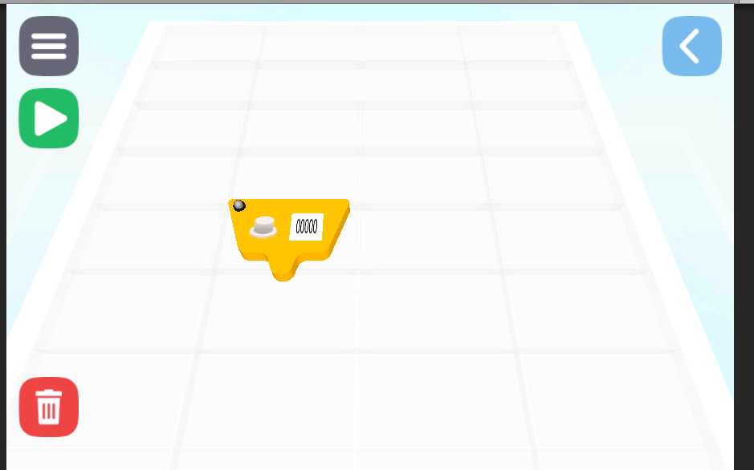
Programming Phase – Dynamic execution

Slide 22
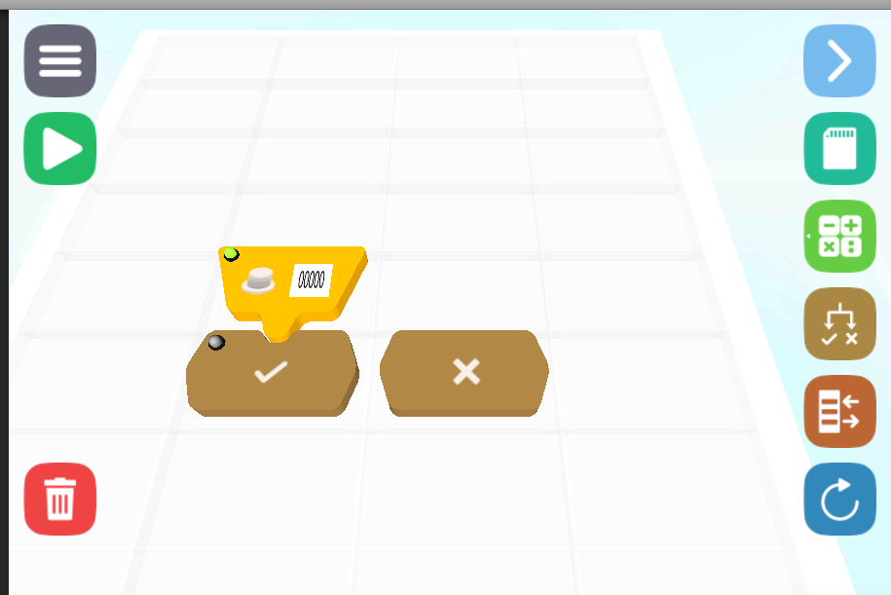
Programming Phase – Dynamic execution

Slide 23
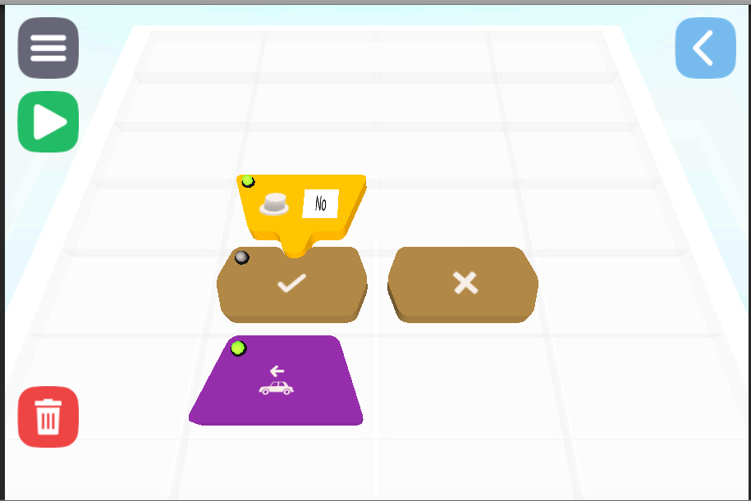
Programming Phase – Dynamic execution

Slide 24
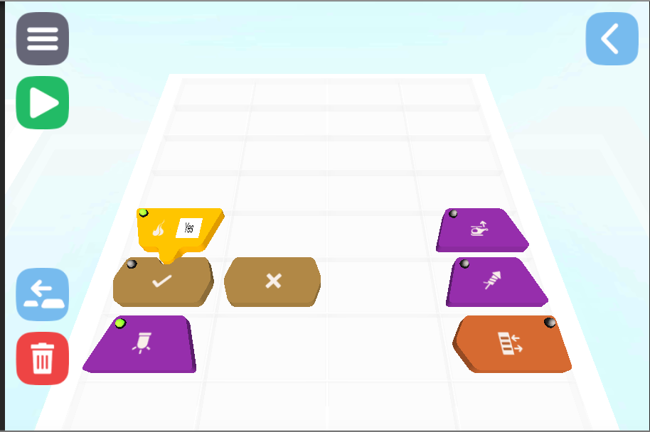
Programming Phase – Parallel execution

Slide 25
Programming Phase – Parallel execution

Slide 26
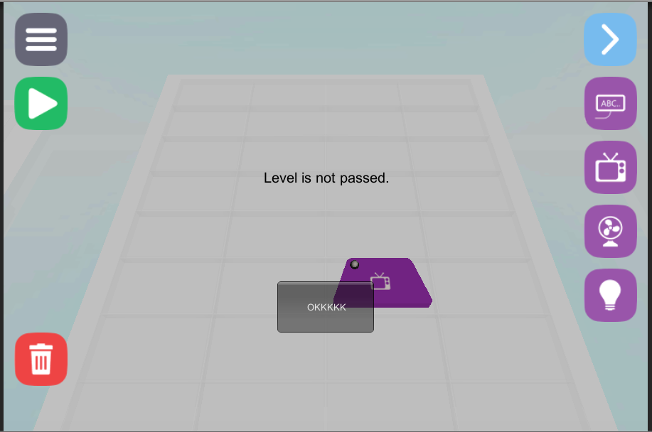
Programming Phase – Correctness assurance

Slide 27
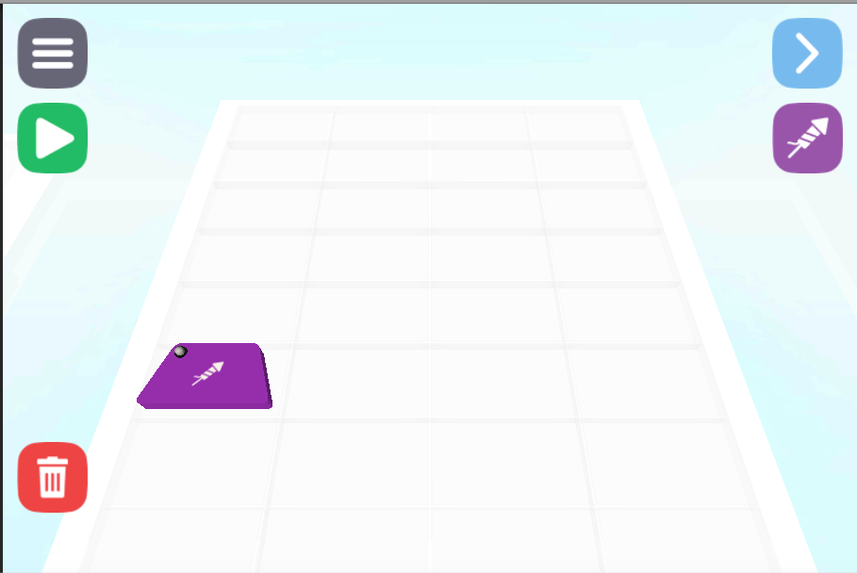
Programming Phase – Correctness assurance

Slide 28
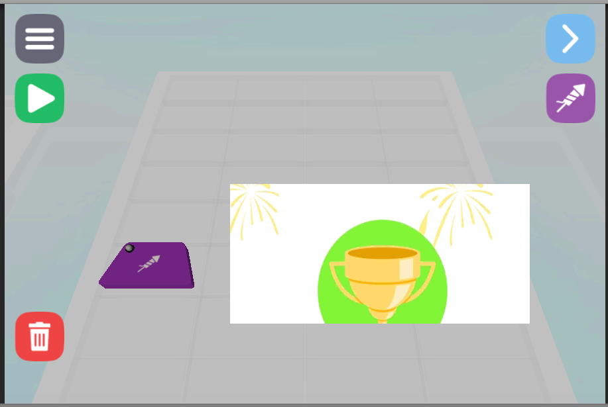
Programming Phase – Correctness assurance

Slide 29
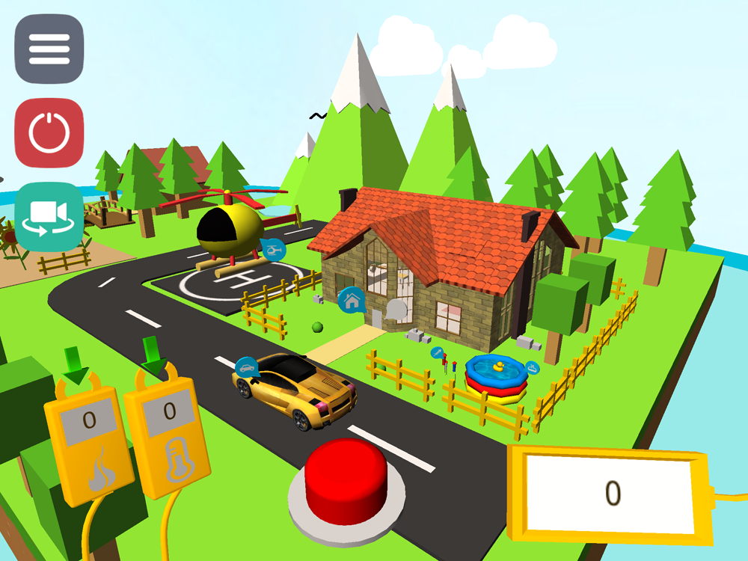
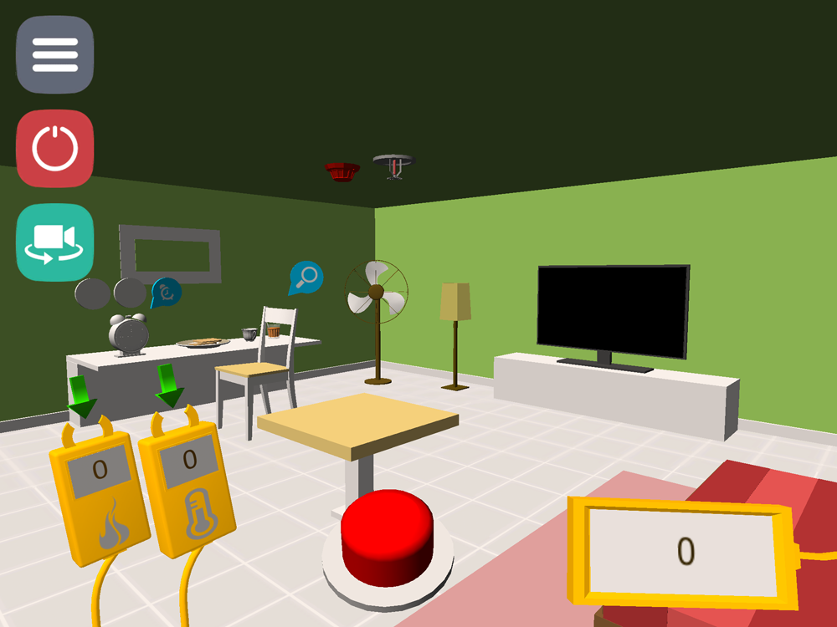
Running Phase
Virtual environment:
  Suitable for kids, have all of the components
Notes:
Virtual environment: we designed a virtual environment that’s suitable for kids and have all of the input and output objects that can be used in the system building
So the user will see visual sources and results

Slide 30
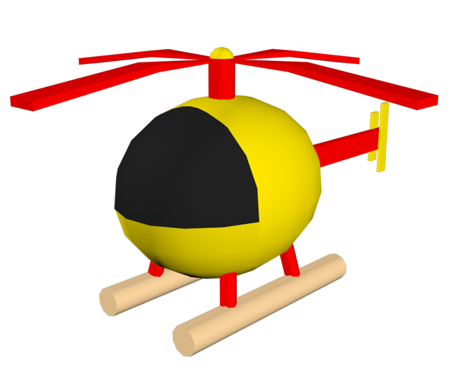

Running Phase – Output Examples
Some of the input and output objects
3D Object
Control Blocks
Notes:
For example here we have the helicopter, there are 2 blocks to control it, move it upward and downward
the button is an input source so the user can interact with i

Slide 31
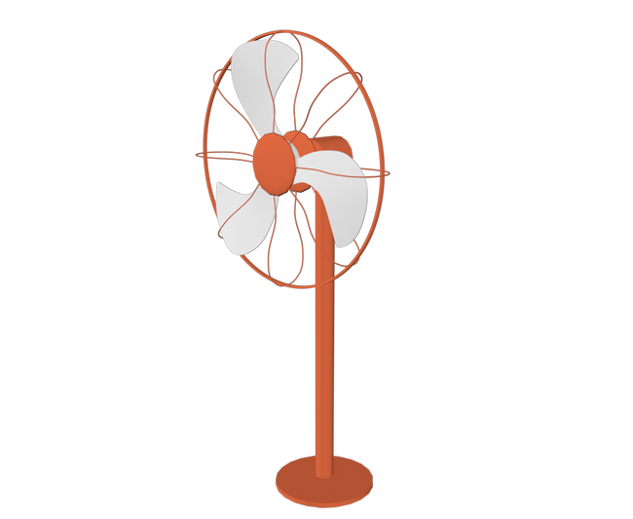
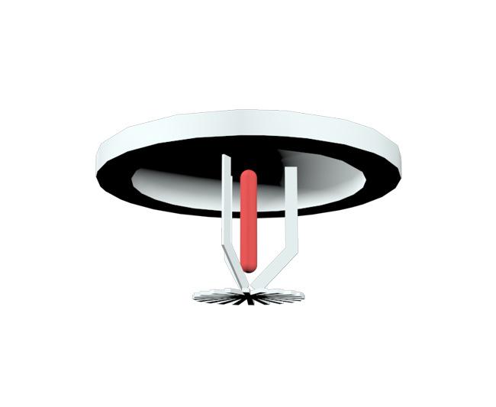
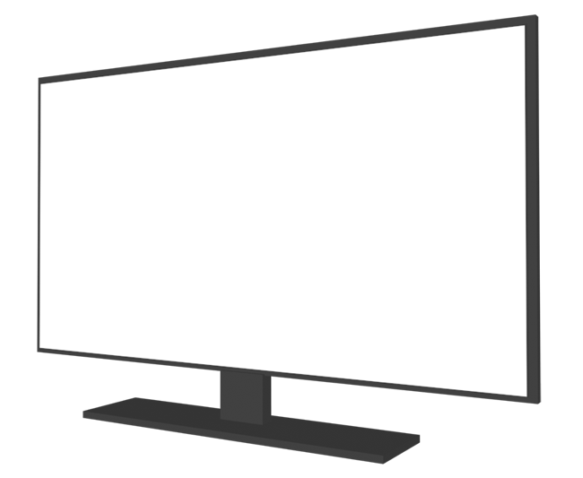
Running Phase – Output Examples
More 3D objects examples
Fan
TV
Fire alarm
Notes:
Some of the outputs are: screen, fan, firealarm, tv

Slide 32
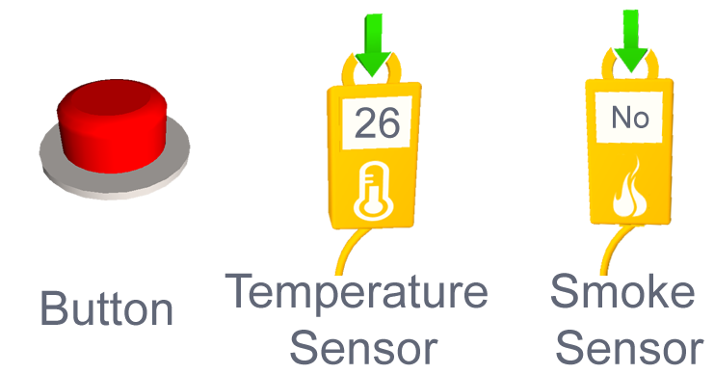
Running Phase – Input examples
More 3D objects examples
Notes:
Some of the outputs are: screen, fan, firealarm, tv

Slide 33
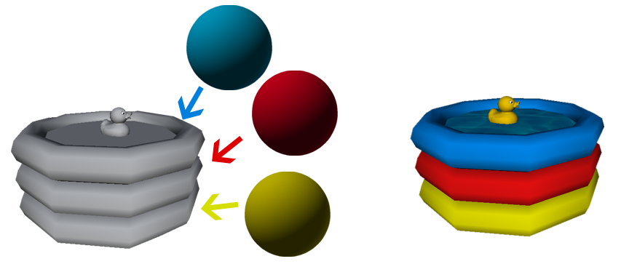
Running Phase
Active and not active objects
Not Active Object
Active Object
Notes:
Active and not active objects: to make it easy to the user to know what exactly he is trying to control, the objects that used in the system will have material
Others wont have material and will be in gray
And that’s will attract the user to learn and play more to be able to use these objects

Slide 34
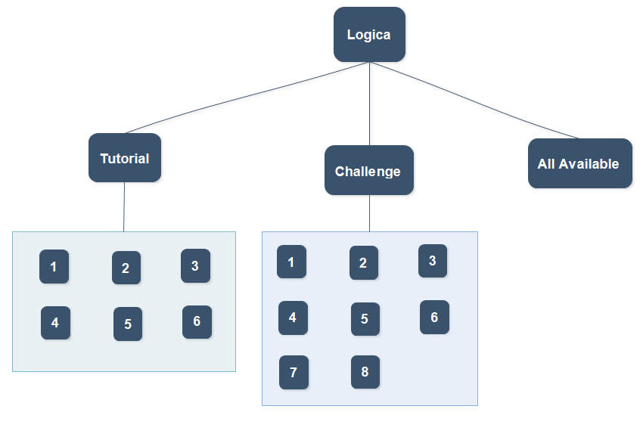
Gameplay Modes
Tutorial mode
Challenge mode
All available mode
Notes:
Tutorial mode: in this mode, the game will provide a new concept to the user in each tutorial, so he can learn gradually
I’ll show a live example for that
Challenge mode: the challenge mode will test the concept that provided in the tutorial
Tutorial and challenge modes will have limited access to the components
All available mode: in this mode the user will have full access to all of the components so he can build any system he wants

Slide 35
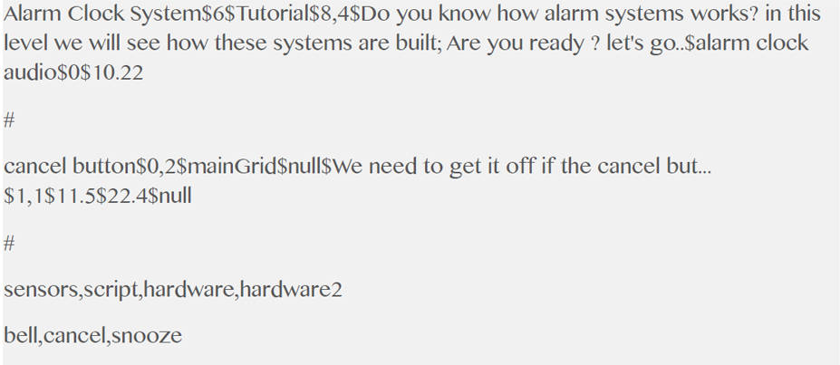
Building levels Algorithm
Algorithm for building the level dynamically
To build a new level, just create a new txt file.
Notes:
We devolved an algorithm for building the levels dynamically, now we have 6 tutorials and 8 challenges
Building a new level is achieved by creating a new txt file with the correct order of information

Slide 36
Gameplay Modes
Demo for the three modes

Slide 37
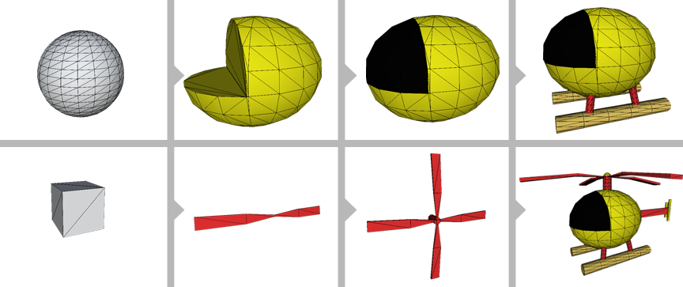
3D Designing
Designed from scratch.
low poly style and bright materials => better performance.
Designing of a 3D object
Notes:
The designed of the environment objects from scratch using 3DS max,
We choose the low-poly style and bright materials to be attractive to the users as they are kids
The design process continued to the blocks, as u can tell each block have deferent shape to indicate its functionality

Slide 38

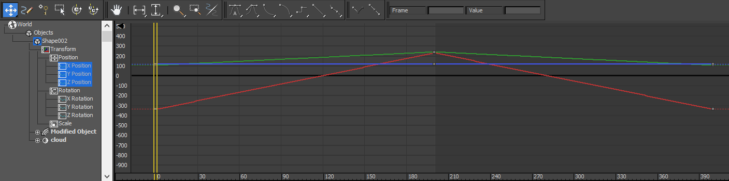
Animating 3D Objects
Infinite-loop animation
Output objects animation depending on the system
Notes:
Animation of the objects is done in 3DS max as well,
Some of the objects have infinite loop animation such as trees and clouds
Output objects have animation as well, but it will be activated depending on the system that user built it

Slide 39

Animating 3D Objects
Exporting from 3DS Max to Unity 3D using FBX format
Notes:
The models with its textures and animations are exported from 3ds max to unity 3d using the fbx format
After that, we control these objects by scripts in unity

Slide 40
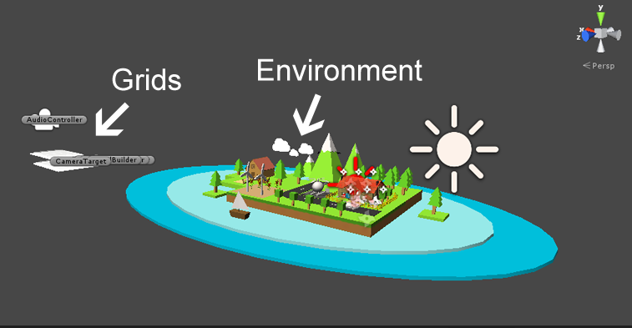
Scenes
One main scene.
Other scene for menus.
Notes:
The game have 1 main scene, which will be dynamically built to serve the tutorials, challenges and all available modes
The other scene is used to display the menus and the level numbers

Slide 41
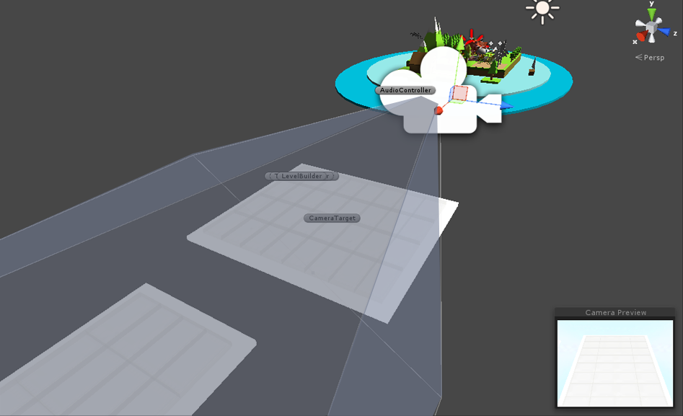
Camera and lighting
One main camera.
One directional light, affects all elements.
One directional light => better performance
Notes:
The main scene has only one camera that moves between the grids and the virtual environment
We have only 1 directional light that affects all of the elements,
we used only 1 directional light to have better performance, since other types of lights are expensive on mobile devices

Slide 42
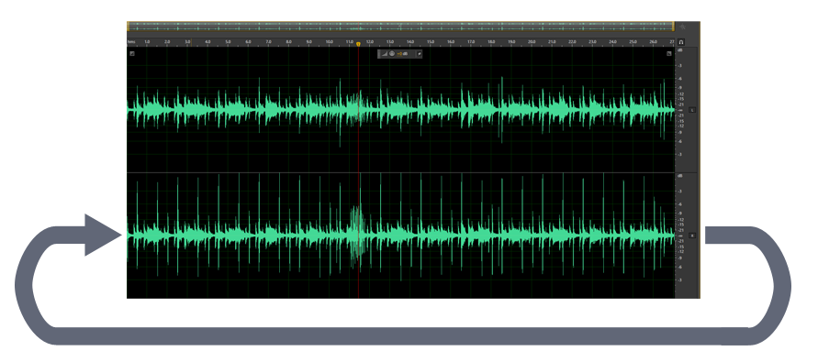
Audio
Two audio listeners.
Sound passed through levels files
Music infinite-loop
Notes:
We used two audio listeners, one for background music, the other for sound in tutorial and challenge modes
Levels sound passed through the txt files.
Background music is edited to be played as a loop without being cut

Slide 43
Testing
IOS:
  iphone 4 with IOS 7
  ipad 3 with IOS 8
Andoid:
  Galaxy tab 3 with android 4.4
Good performance on mobiles.
Very good performance on tablets.
Notes:
We test the game on varicose devices including iphone 4 and ipad 3 under ios
And on android version 4
As well as on pc and mac
The result was very good and satisfying

Slide 44
Result and Conclusion
Logica is a platform that teaches kids the basic concepts of programming in a fun and interactive way.

Slide 45
