Slide 1

Smart Home Automation System
Done By:
Suzan Bani Fadel
Shuaa’ Abdoh
Supervisors:
Asmaa’ Afeefi

Slide 2
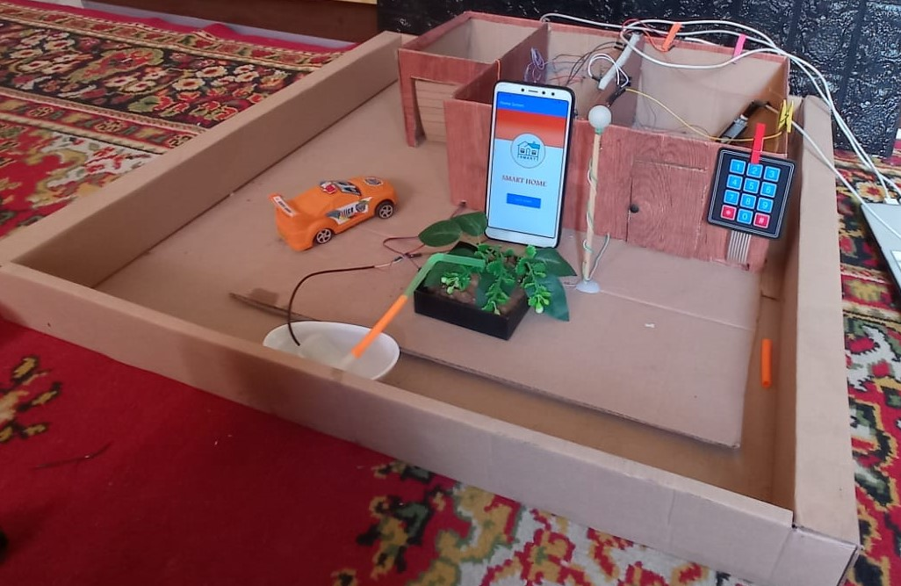
OUR SMART HOME

Slide 3
Requirements: Hardware and Software

Slide 4





Software Requirements

Slide 5
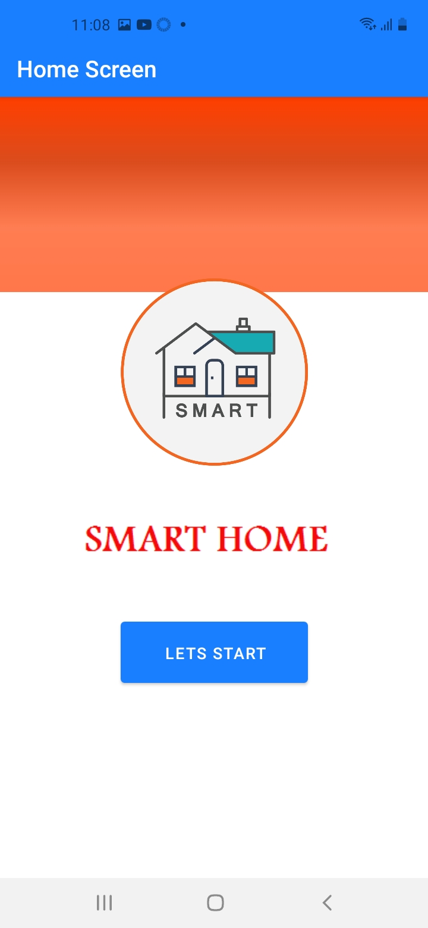
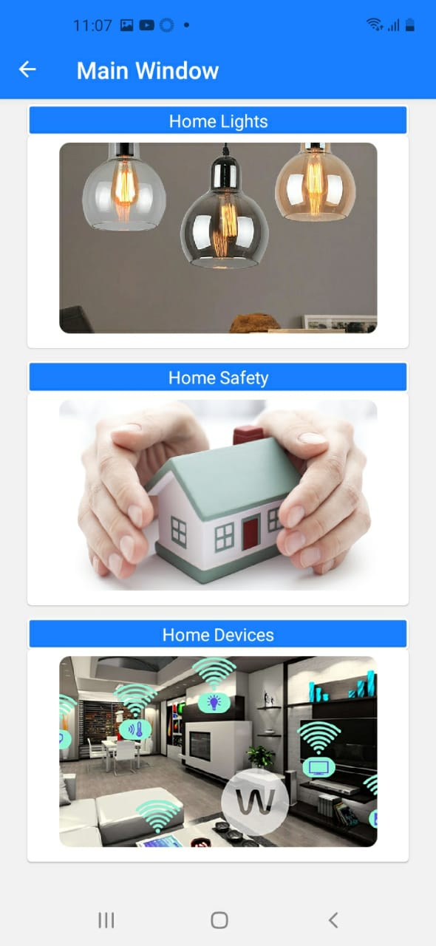
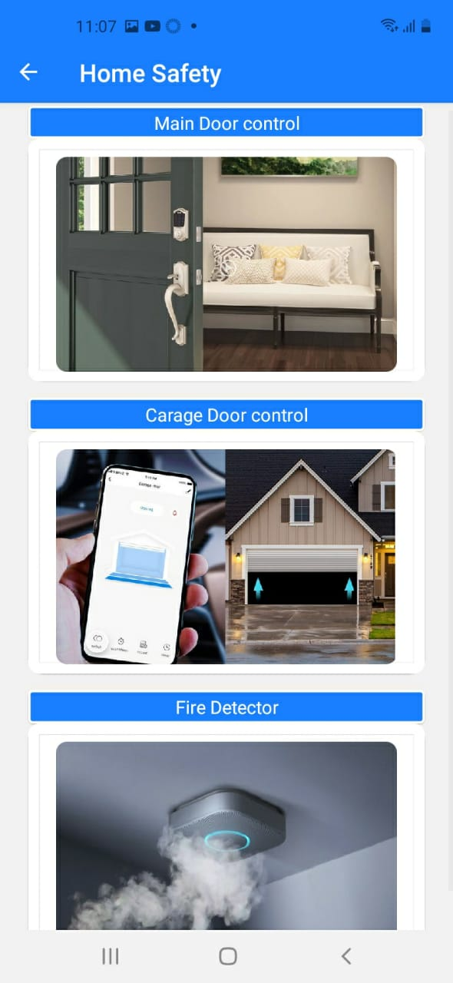
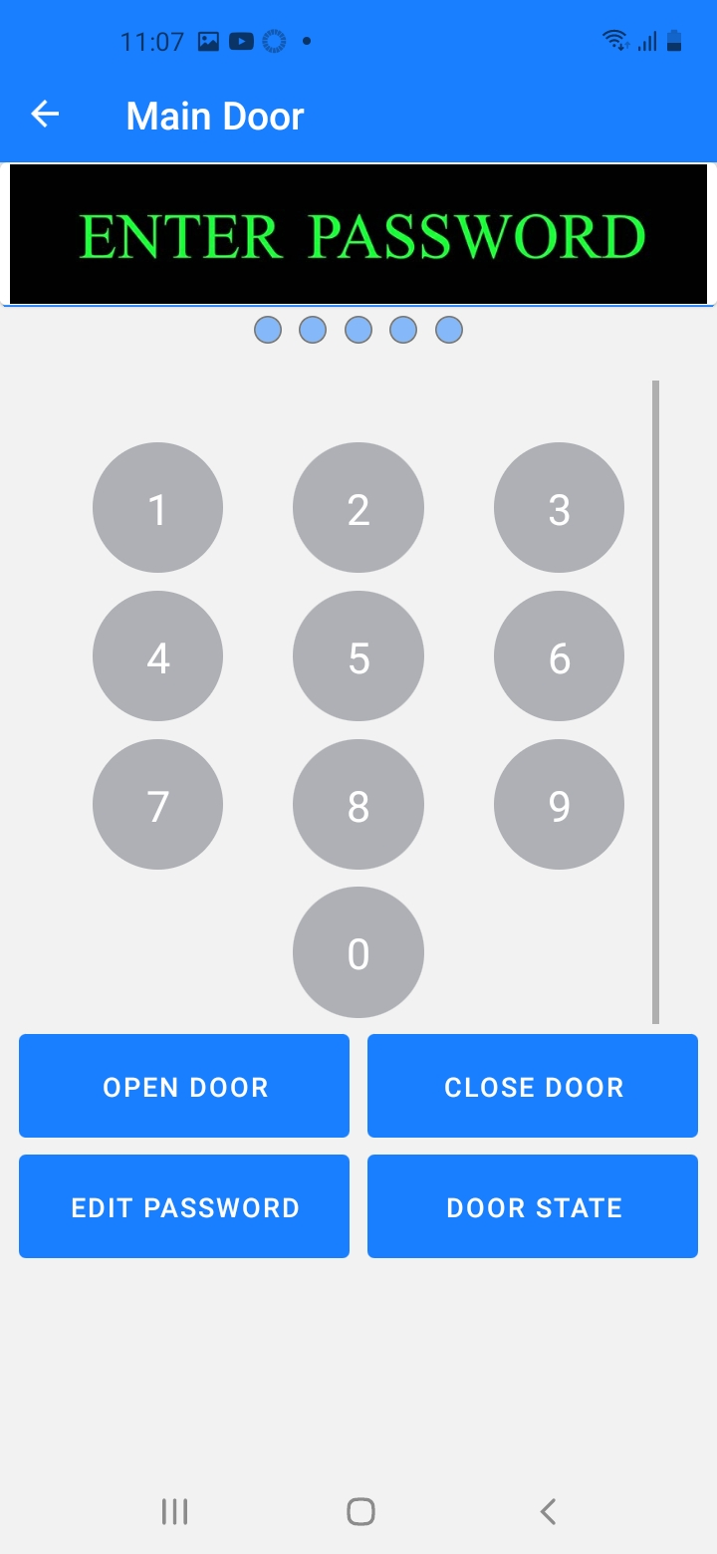

Slide 6
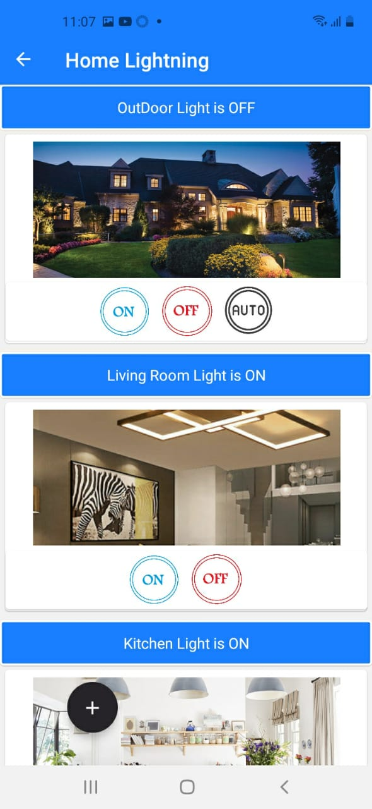
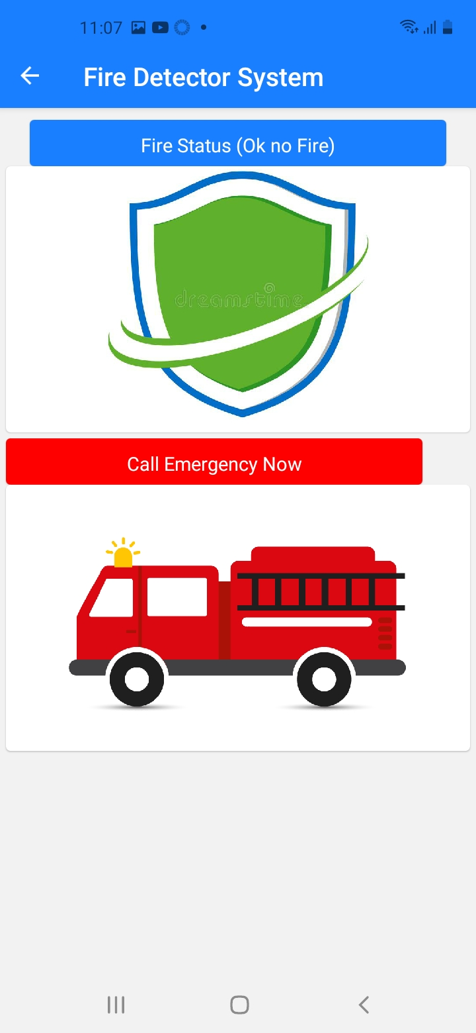
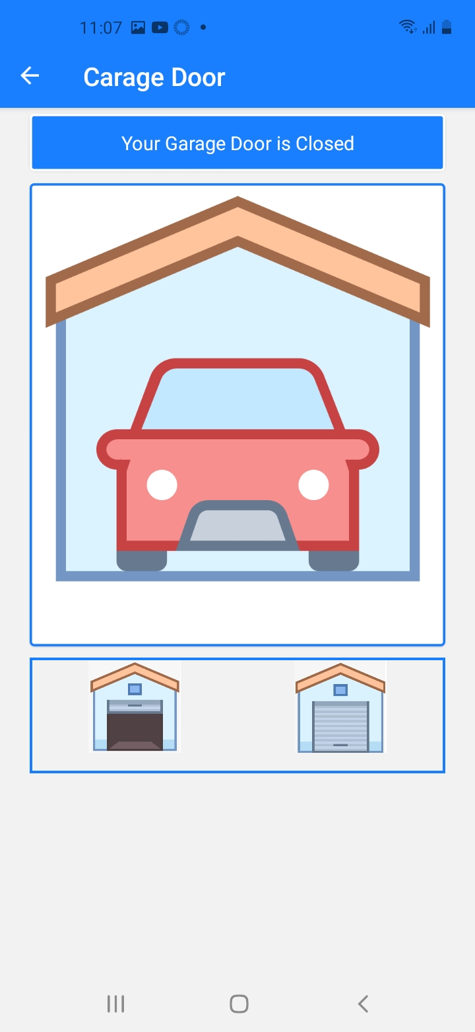
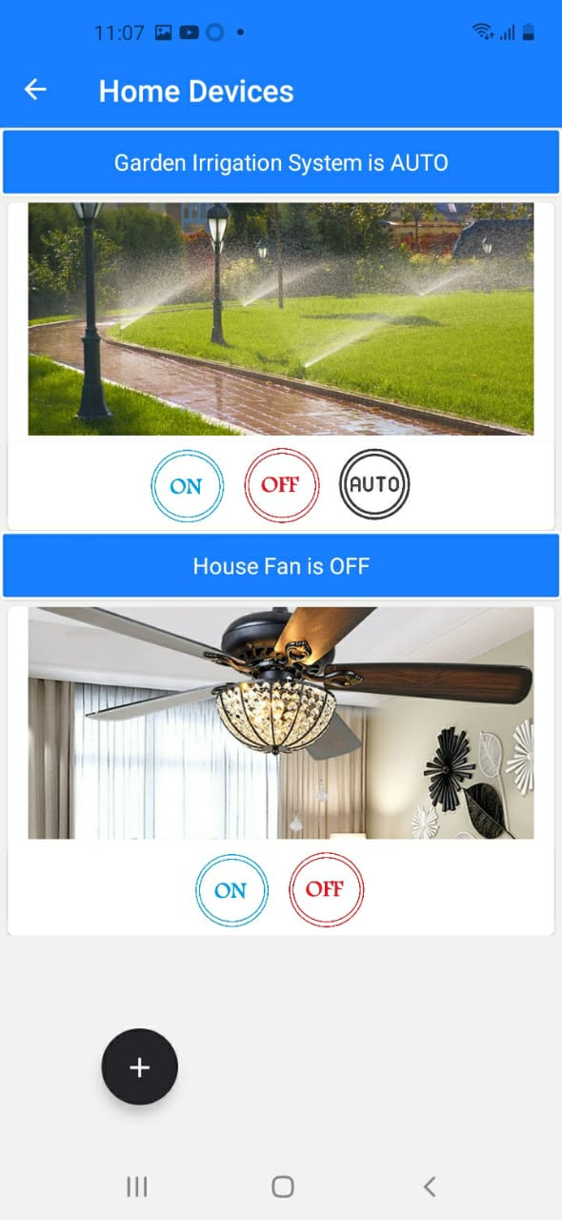
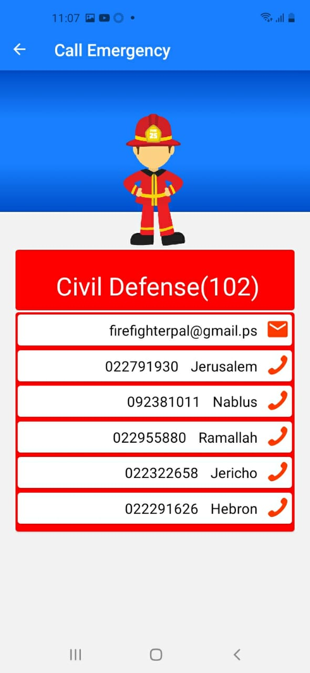

Slide 7
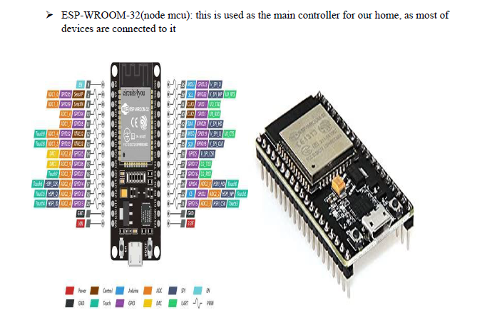
Hardware Requirements 1-Controllers

Slide 8
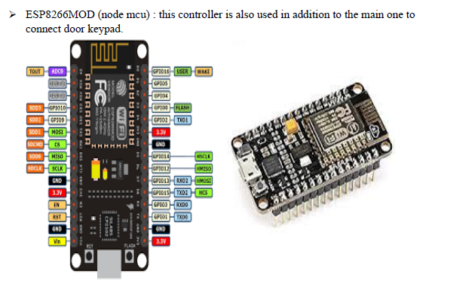

Slide 9
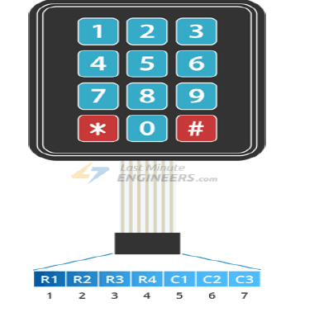
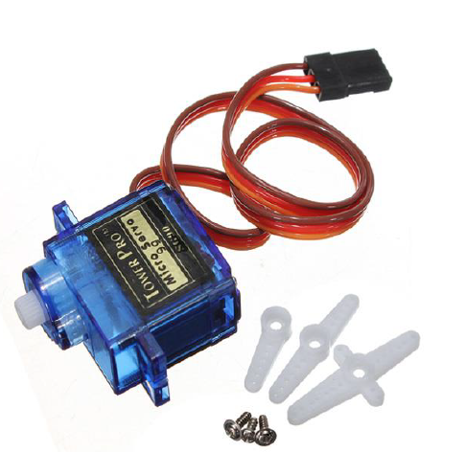
Password Door Components
Keypad
Servo Motor

Slide 10
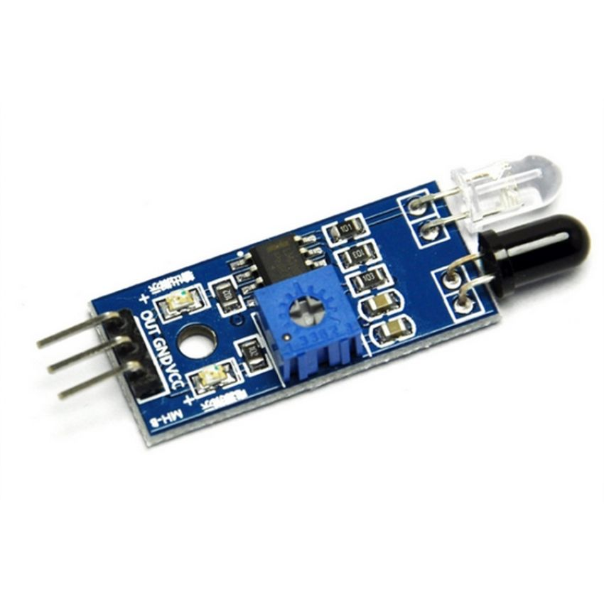
Garage Door Components
Servo Motor
Infra-Red

Slide 11
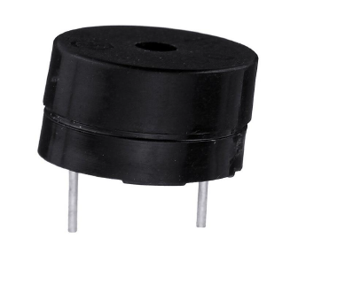
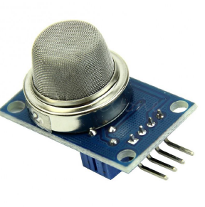
Fire Detection Sys Components
Buzzer
Smoke and Gas Sensor

Slide 12
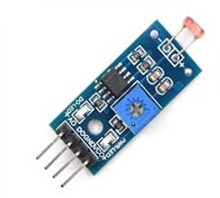
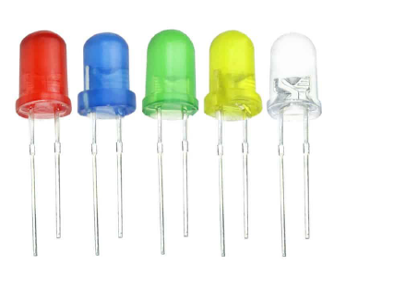
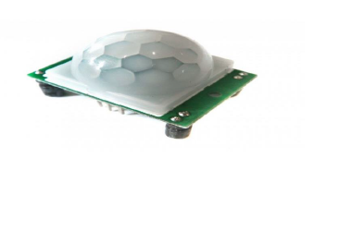
Lightning Sys Components
Light Sensor
Motion Sensor
Leds

Slide 13
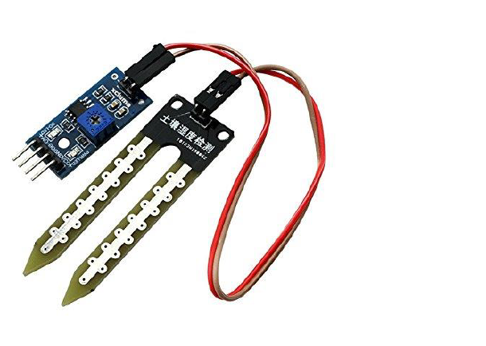
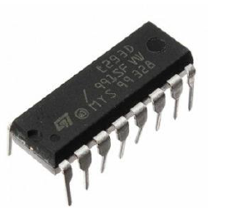

Irrigation Sys Components
Humidity Sensor
L293D MOTOR DRIVER
Pump-DC Motor

Slide 14
Final Look
Smart Lightning System
Main Door Security with Password
Garage Control System
Fire Detection System
Irrigation Control System

Slide 15
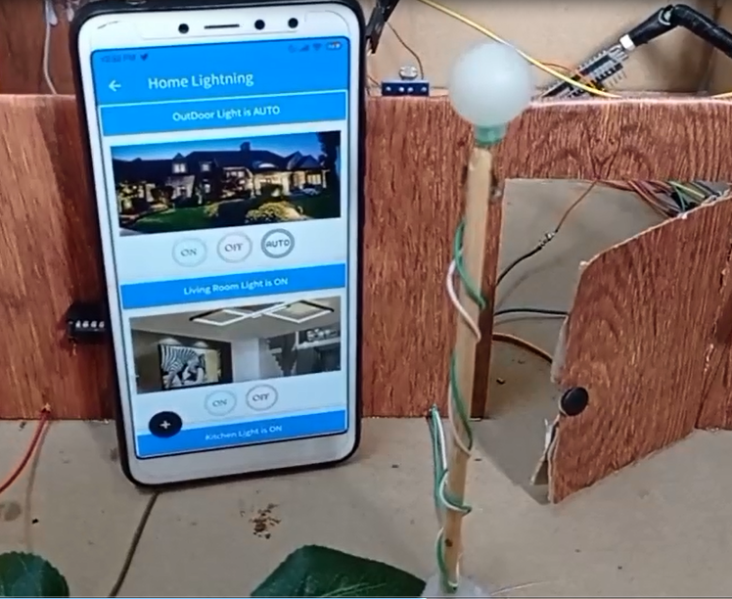
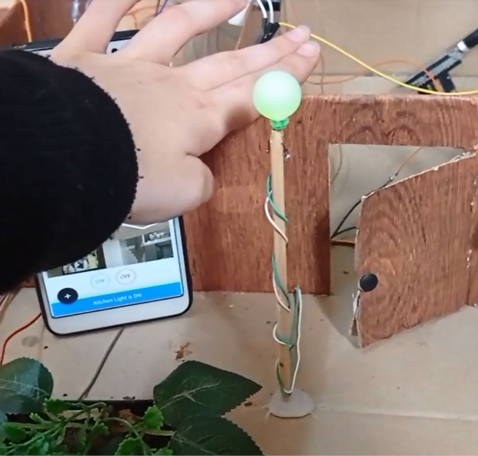
Smart Lightning System

Slide 16
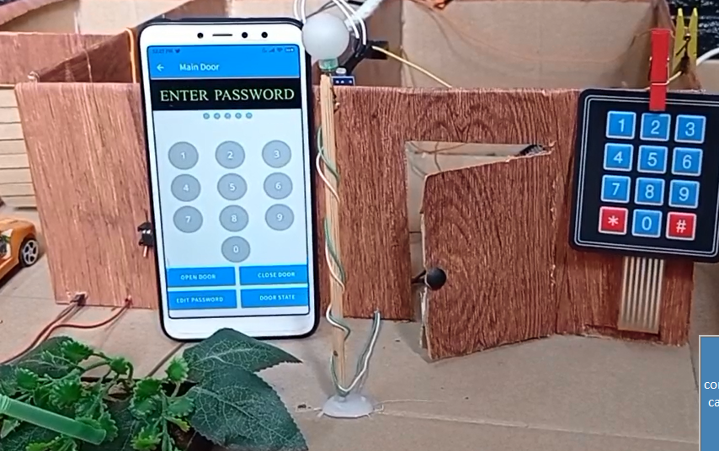
Main Door Security with Password

Slide 17
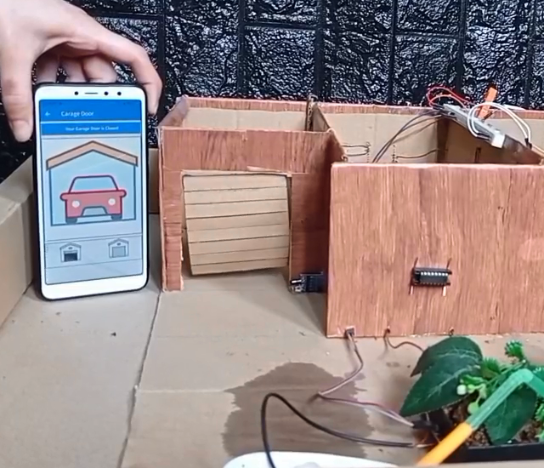
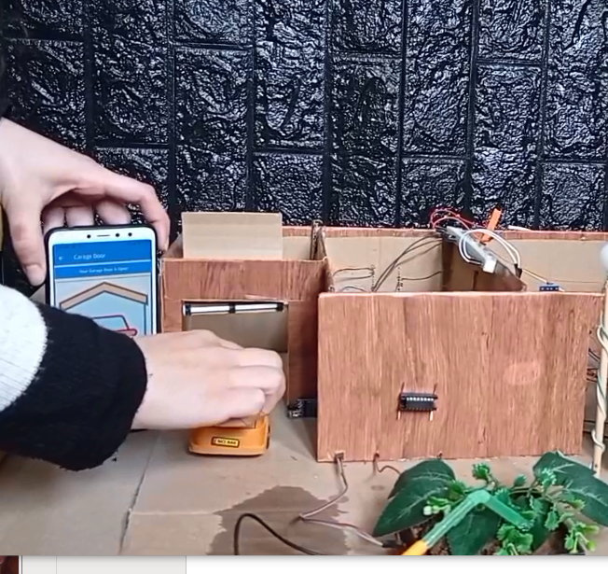
Garage Door System

Slide 18
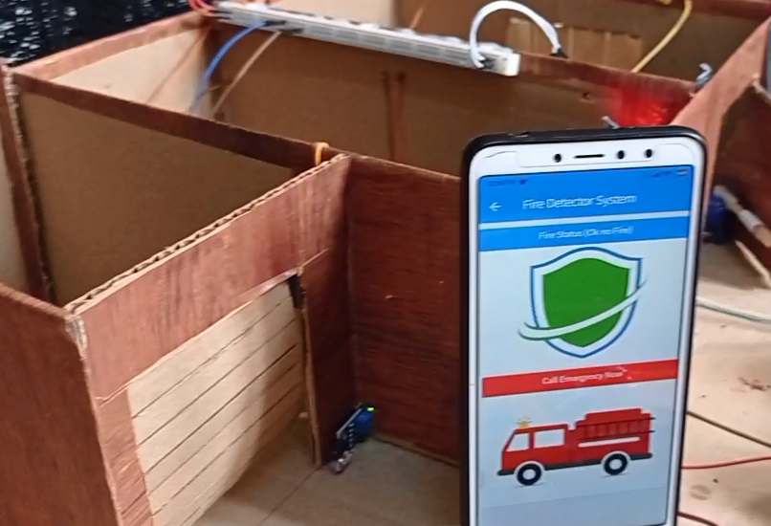
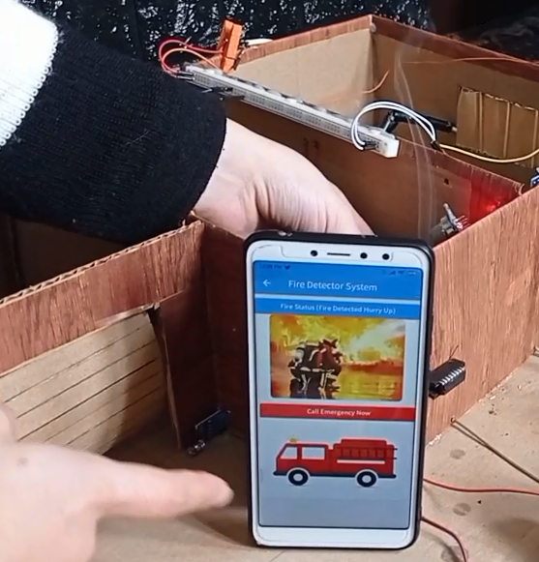
Fire Detection System

Slide 19
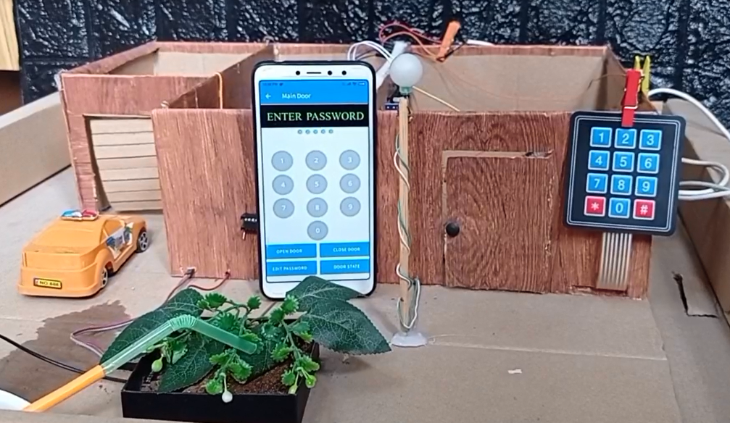
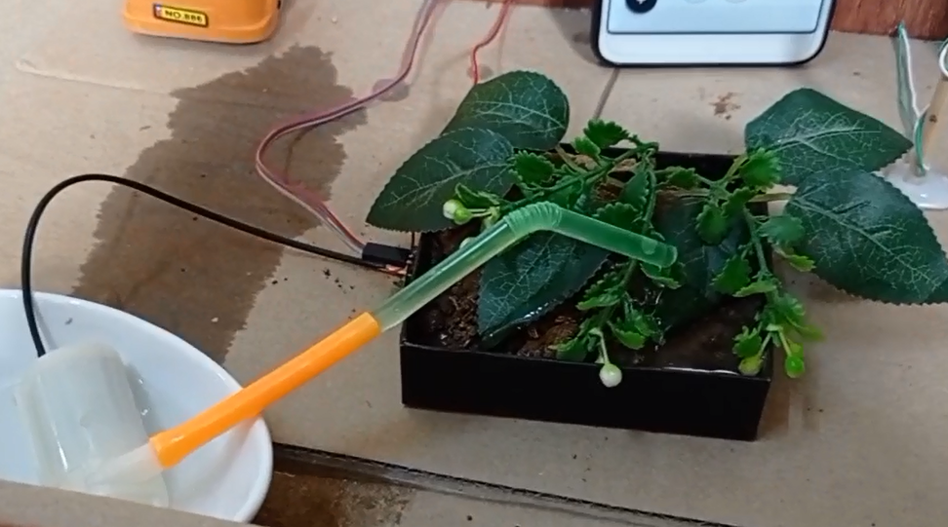
Irrigation System

Slide 20



1- Bad network connection
2- Long time wasted on uploading code
using Arduino IDE
3-Delay when executing user commands
(Bad Response Time)
Limitations

Slide 21
Future Work:
Add Connection between systems in the home
Add smart Lightning based on motion and room scanning
Add more systems ex: a system to watch house temperature and update it as needed

Slide 22
Conclusion
This was our simple Smart Home
Many Thanks For Your Attention

