Slide 1

An-Najah National University
Faculty of Engineering & Information Technology
Building Engineering Department
Graduation Project II
Green Residential Building in Hebron
Supervised by: Dr. Mutasim Baba
Prepared by: Duha Hijab
Noor Subbagh
Saja Rabayaa
Zeina Qamhia

Slide 2
Outline
Introduction
Comparative study
Architectural design
Environmental design
Structural design
Electro-Mechanical design
Survey and cost estimate

Slide 3
Introduction
This project is aim to redesign a three residential buildings located in Hebron as green buildings. Because the classical buildings are neither energy efficient nor comfortable for their resident due to lack of environmental design of these buildings and insufficient thermal insulation.
Green residential means applying the houses with a minimum energy, water and natural resources that provide good air quality, comfort environment and reduce wastes.

Slide 4
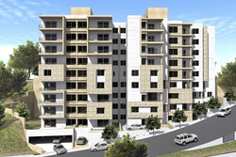
Comparative study
Location: Alma'ajen area in Nablus.
Part of our project was to conduct a study on typical residential buildings and to evaluate their energy performance and the comfort for their residents.

Slide 5
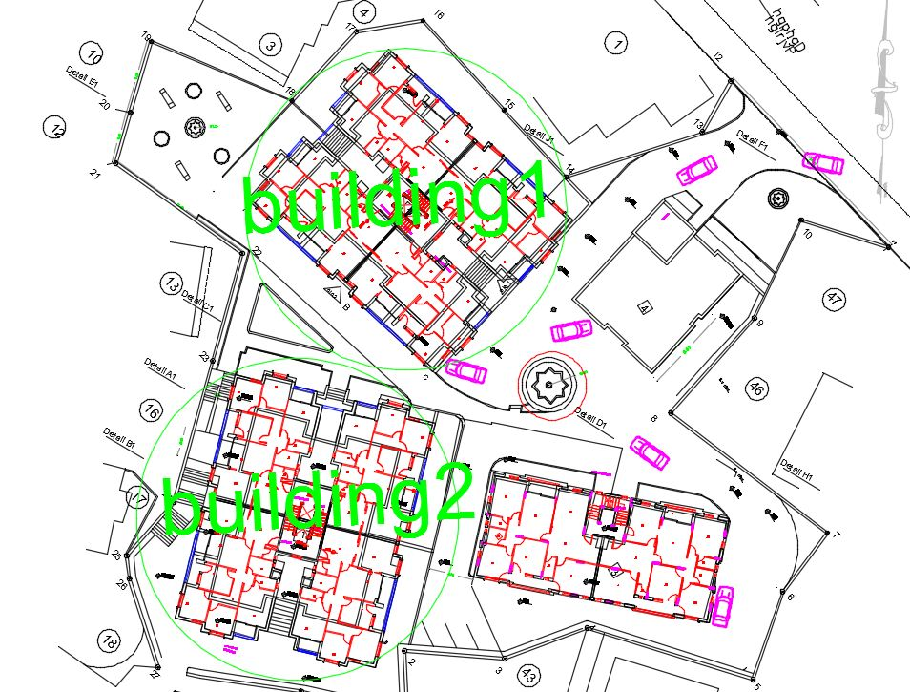
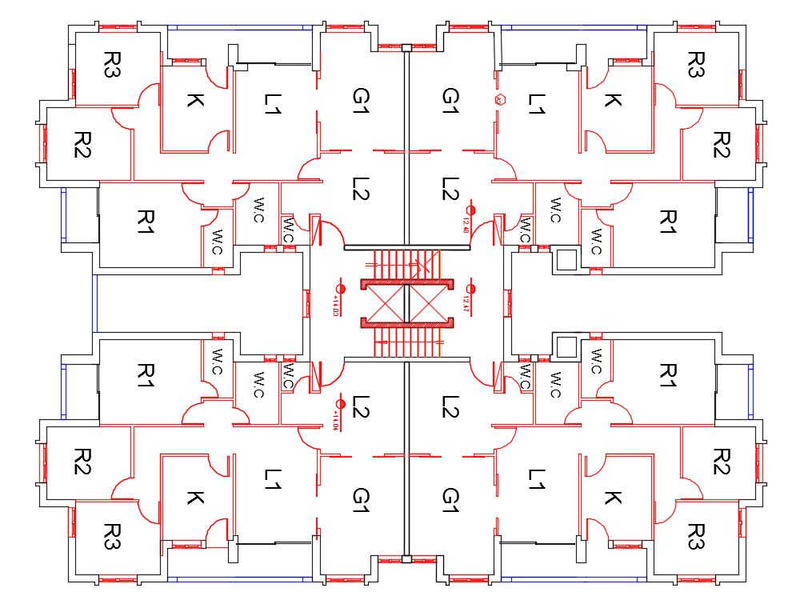
Site plan
plan

Slide 6
Questionnaire results
summer
winter

Slide 7
In summer

Slide 8
In winter

Slide 9
Energy consumption

Slide 10
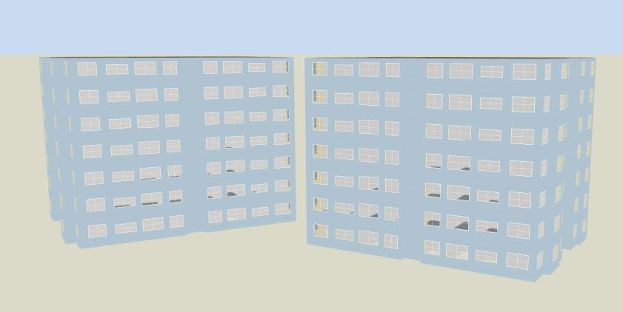
    Environmental analysis
Design builder model

Slide 11
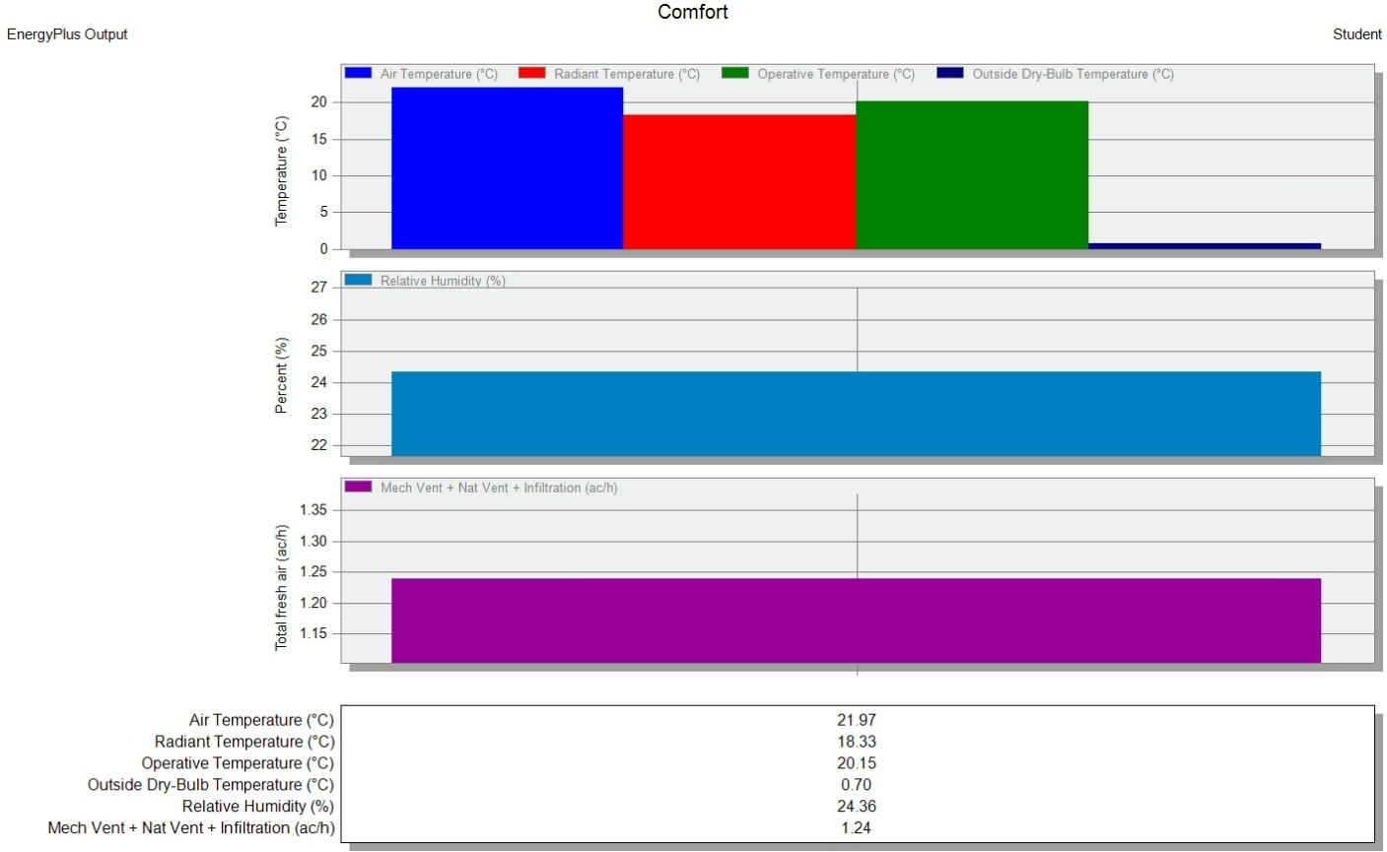
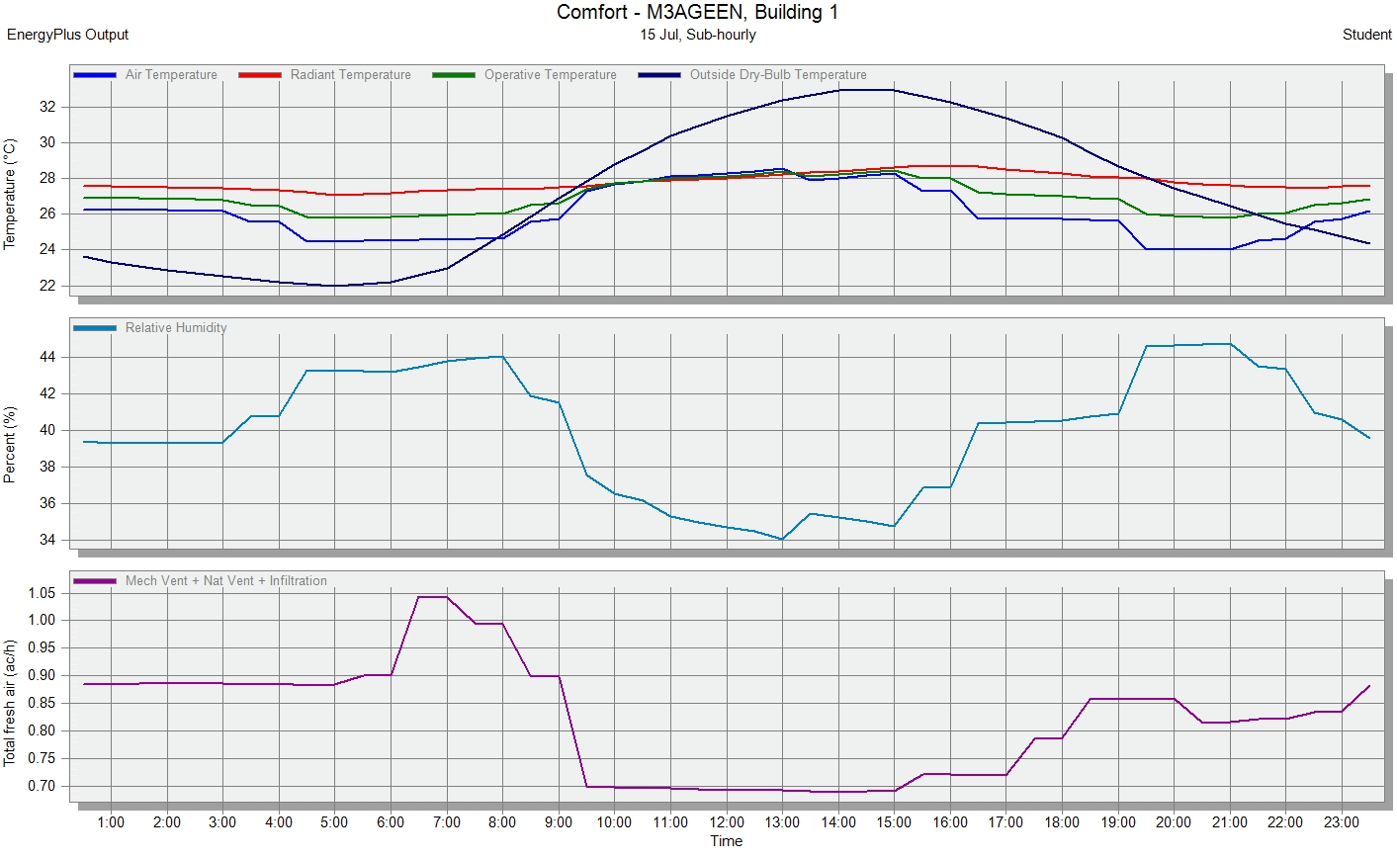
Building 1 heating & cooling design

Slide 12
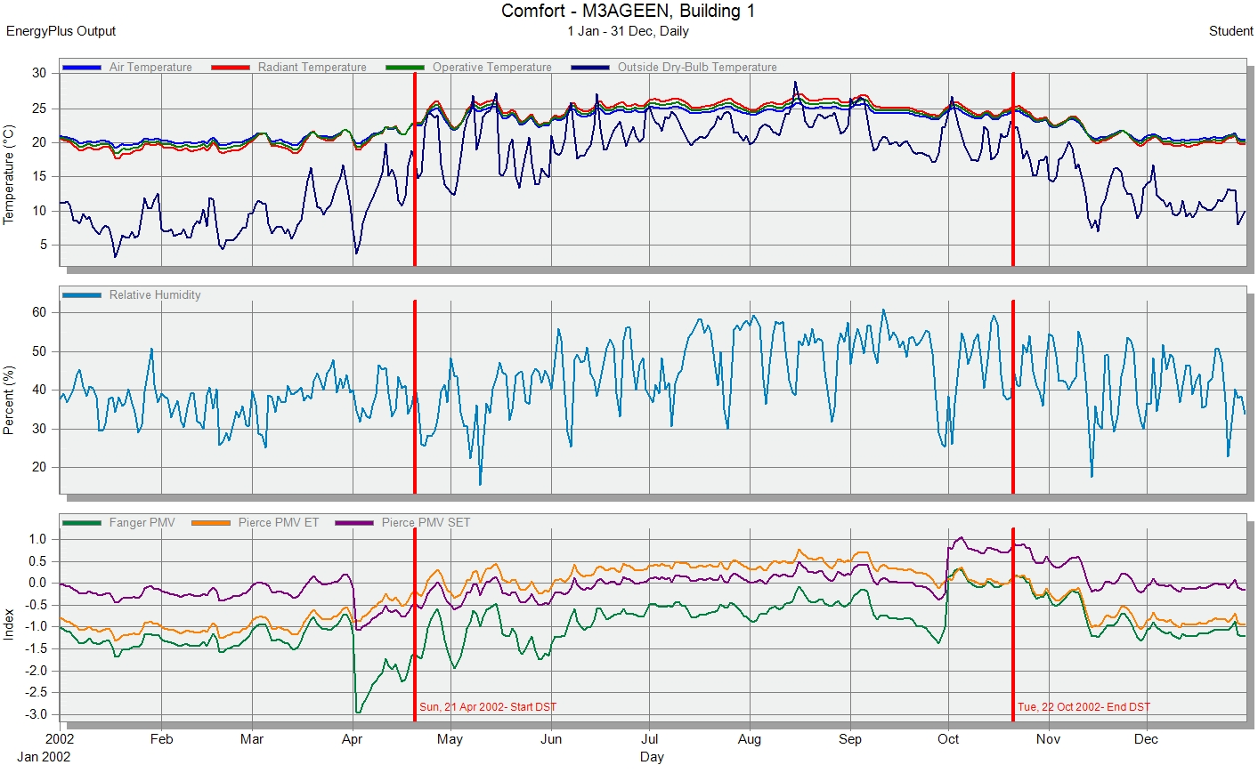
Building 1 simulation
Site and Source Energy
 | Total Energy [kWh] | Energy Per Total Building Area [kWh/m2] | Energy Per Conditioned Building Area [kWh/m2]
Total Site Energy | 471593.86 | 140.66 | 140.66
Net Site Energy | 471593.86 | 140.66 | 140.66
Total Source Energy | 1359313.48 | 405.45 | 405.45
Net Source Energy | 1359313.48 | 405.45 | 405.45

Slide 13
Time Not Comfortable Based on Simple ASHRAE 55-2004
 | Winter Clothes [hr] | Summer Clothes [hr] | Summer or Winter Clothes [hr]
Facility | 6144.00 | 7038.50 | 3872.50
End Uses
 | Electricity [kWh] | Natural Gas [kWh] | Additional Fuel [kWh] | District Cooling [kWh] | District Heating [kWh] | Water [m3]
Heating | 0.00 | 0.00 | 0.00 | 0.00 | 215022.95 | 0.00
Cooling | 0.00 | 0.00 | 0.00 | 123449.77 | 0.00 | 0.00
Interior Lighting | 59300.73 | 0.00 | 0.00 | 0.00 | 0.00 | 0.00
Interior Equipment | 5603.59 | 0.00 | 0.00 | 0.00 | 0.00 | 0.00
Water Systems | 0.00 | 0.00 | 0.00 | 0.00 | 68216.82 | 1068.21
Total End Uses | 64904.32 | 0.00 | 0.00 | 123449.77 | 283239.77 | 1068.21

Slide 14
Our project design
Architectural design
The three buildings are symmetrical in shape but different orientations.
We changed the dimensions and orientations of internal zoning to satisfy the standards.

Slide 15
To make energy efficient buildings:
Change the orientation of the buildings to achieve the optimum usage of the south direction as possible as we can.
Use a sufficient thermal insulation.
Use solar window in the south elevation by providing adequate shading.

Slide 16
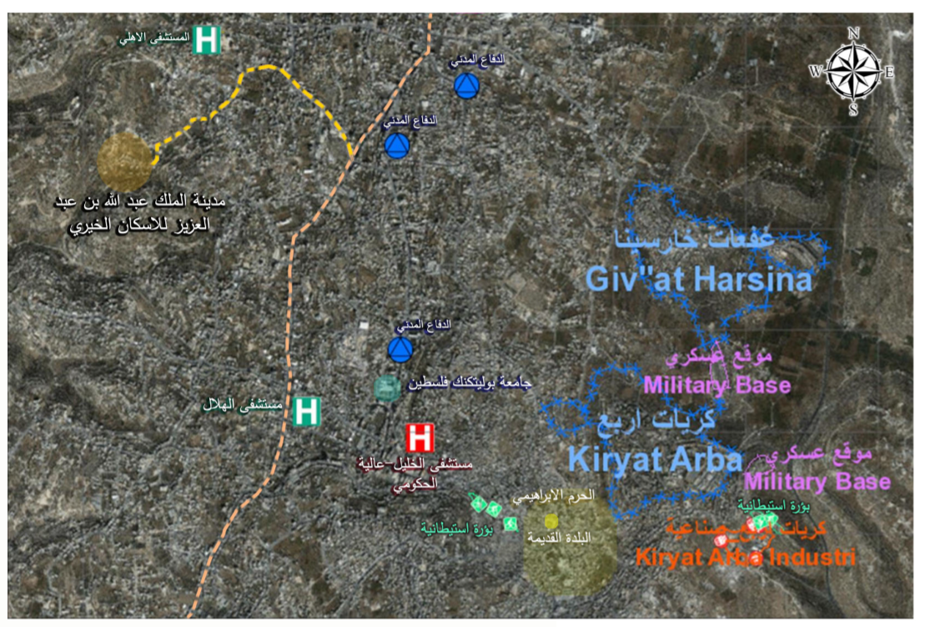
Site and location

Slide 17
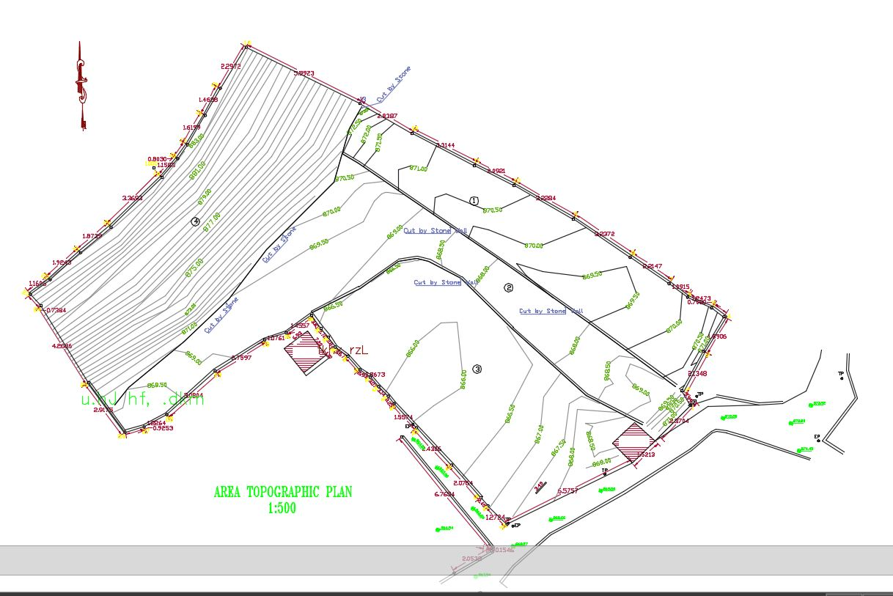
Contour plan

Slide 18
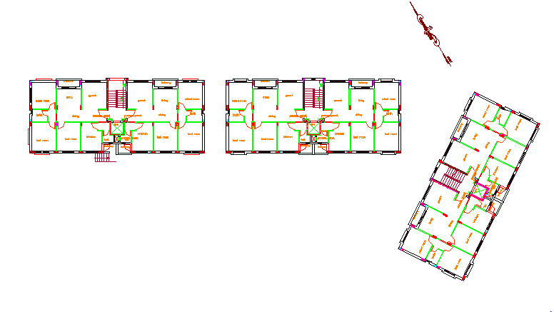
Site and orientation of the original buildings

Slide 19
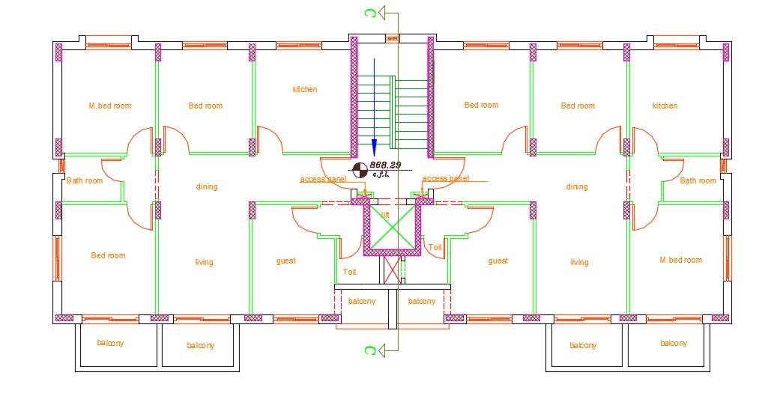
Plan of the original buildings

Slide 20
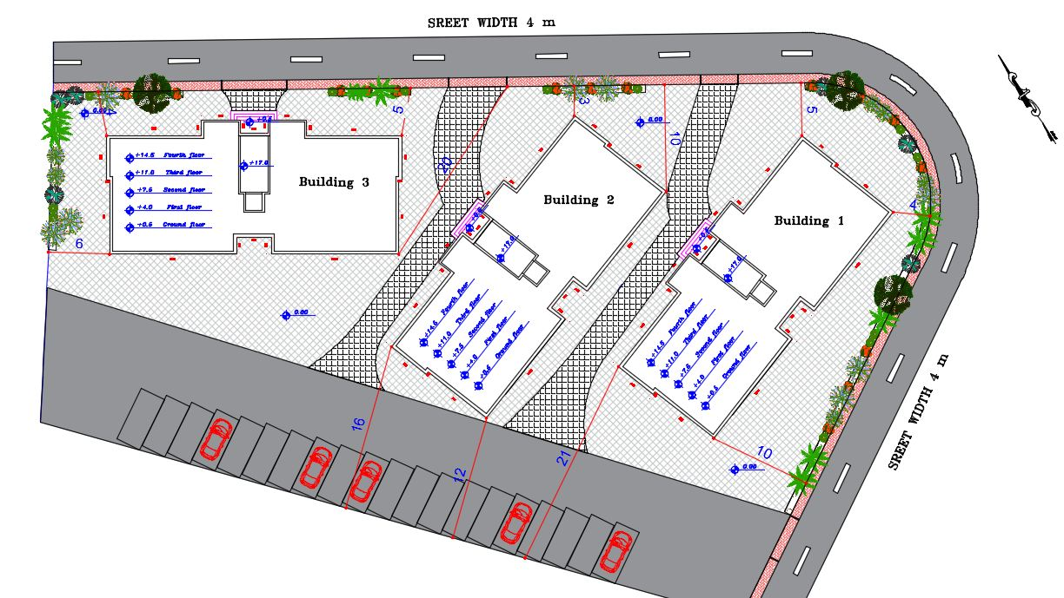
Site plan and orientation after modification

Slide 21
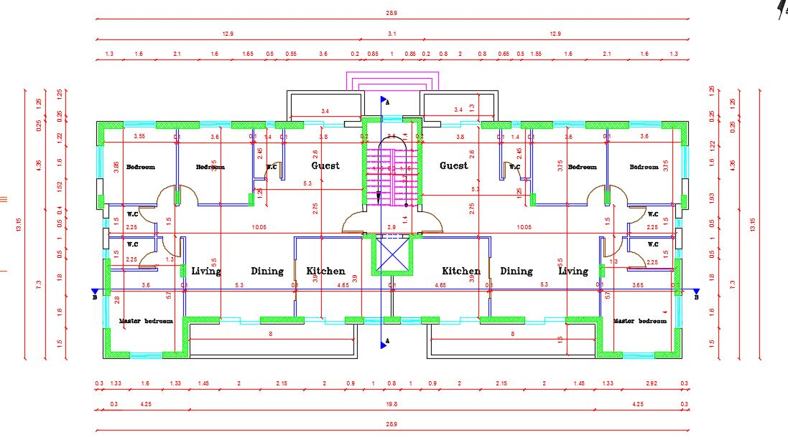
Internal zoning after modification

Slide 22
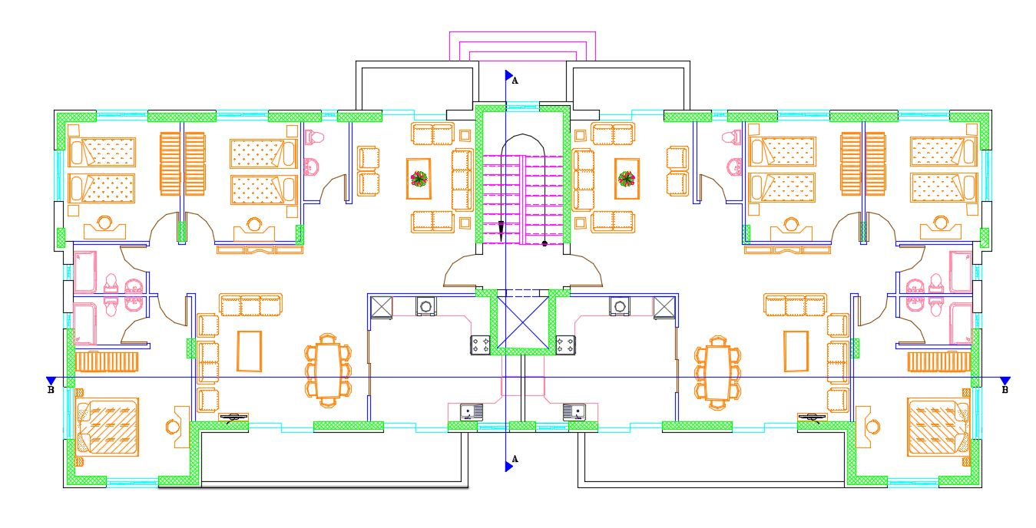
Furniture plan

Slide 23
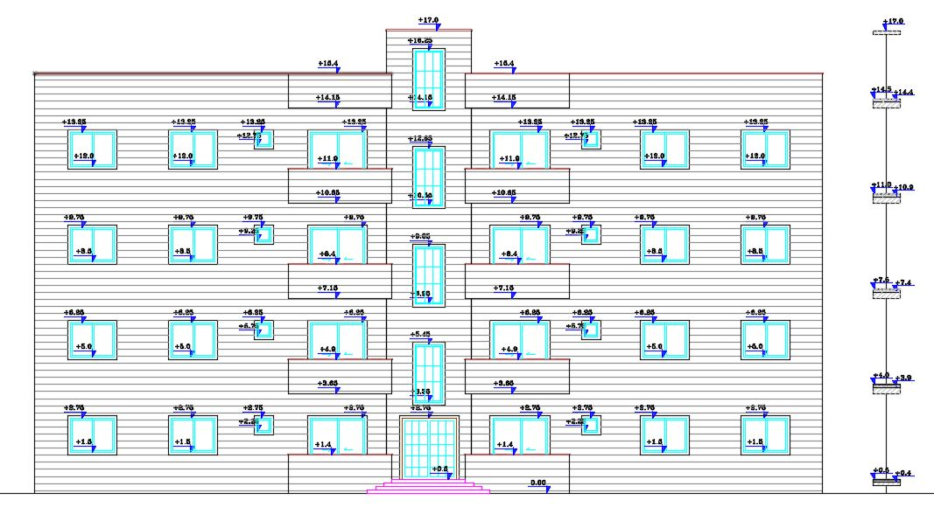
North elevation

Slide 24
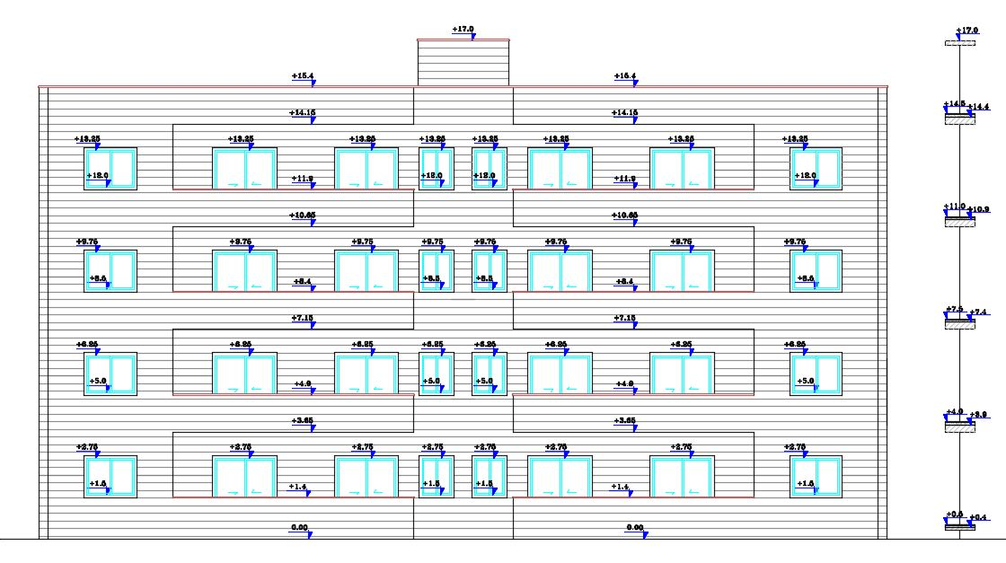
South elevation

Slide 25
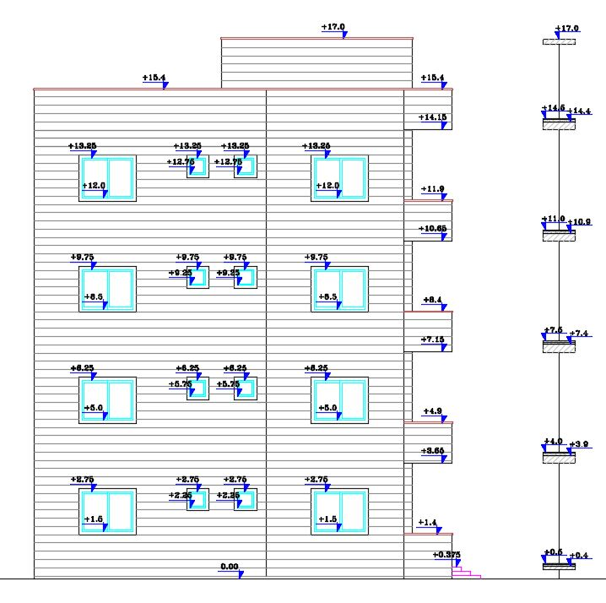
East elevation

Slide 26
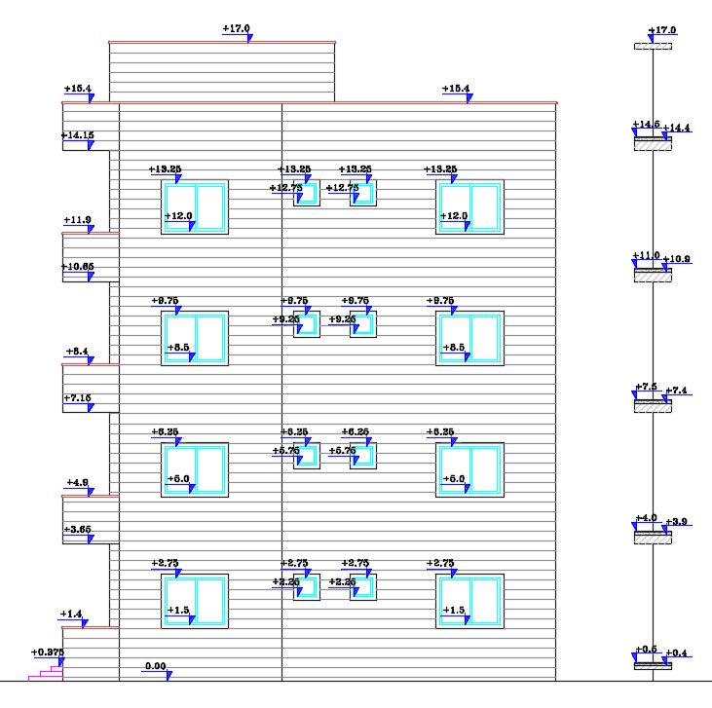
West elevation

Slide 27
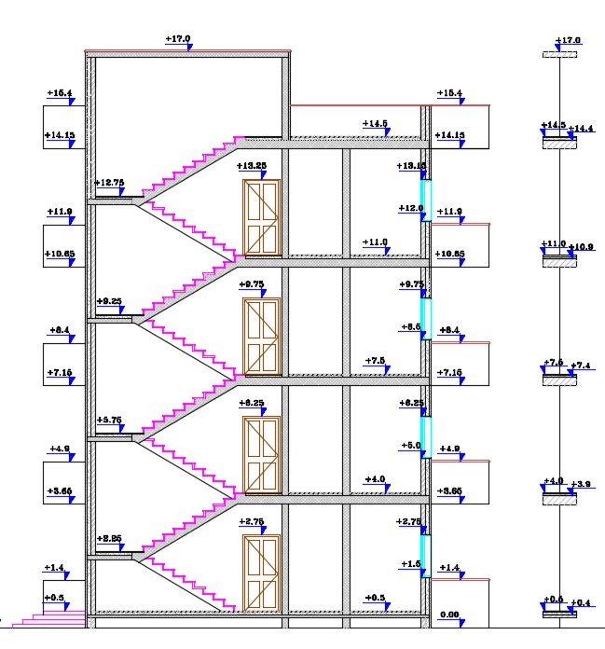
Section A-A

Slide 28
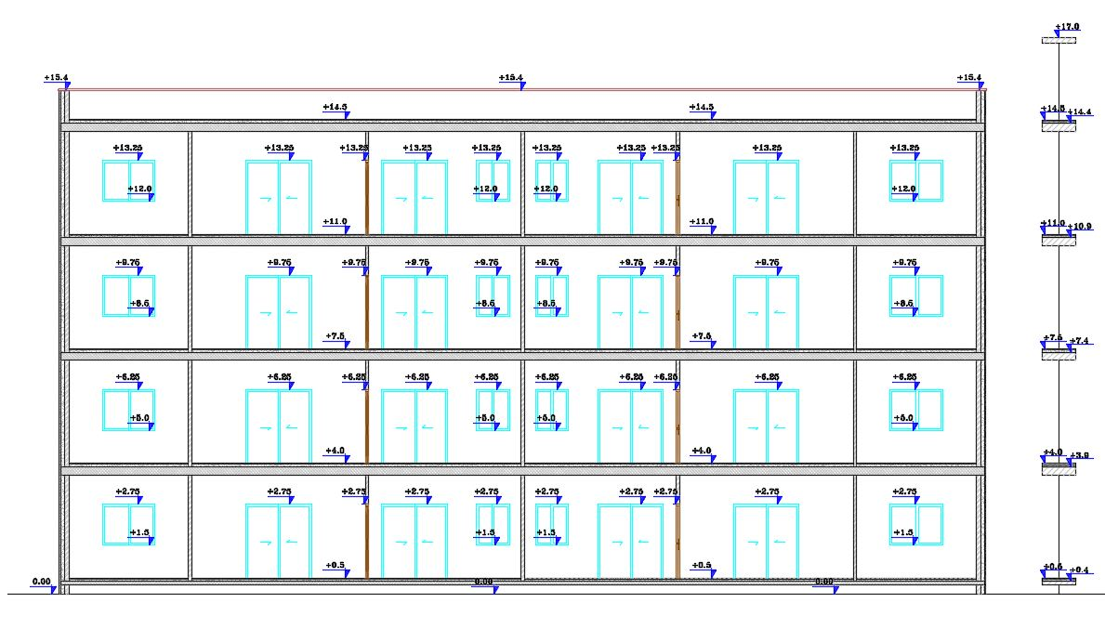
Section B-B

Slide 29
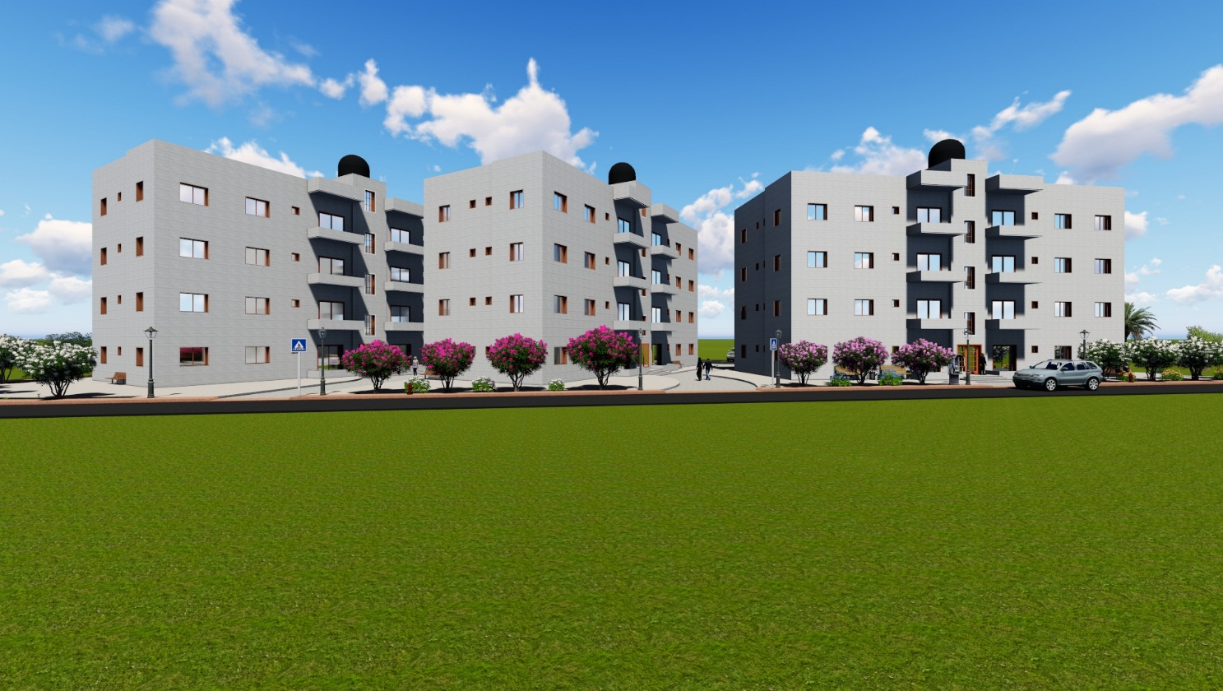
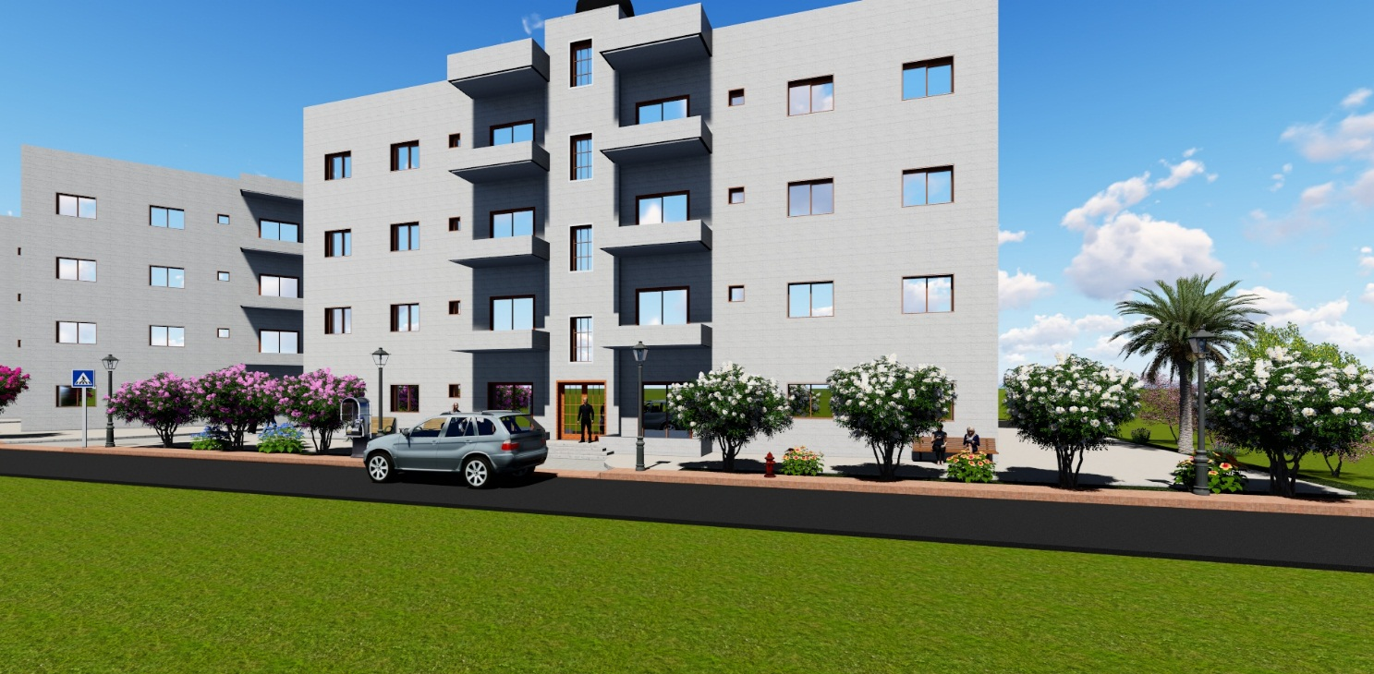
3D model

Slide 30
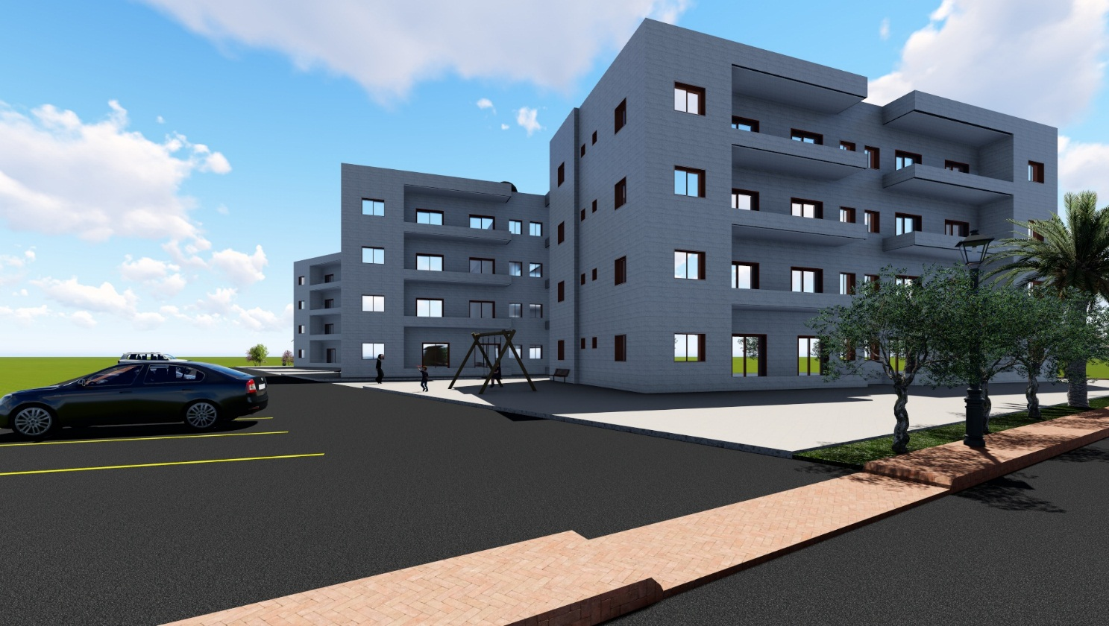
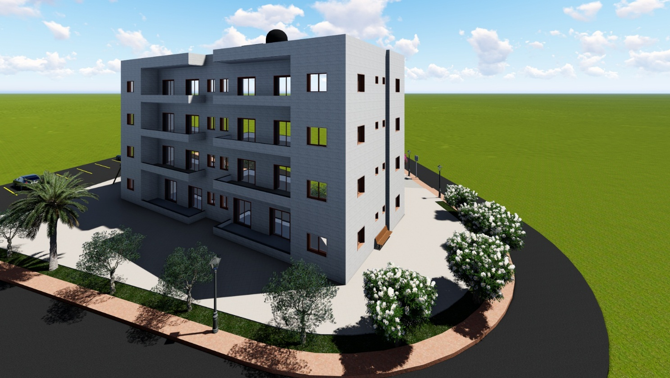
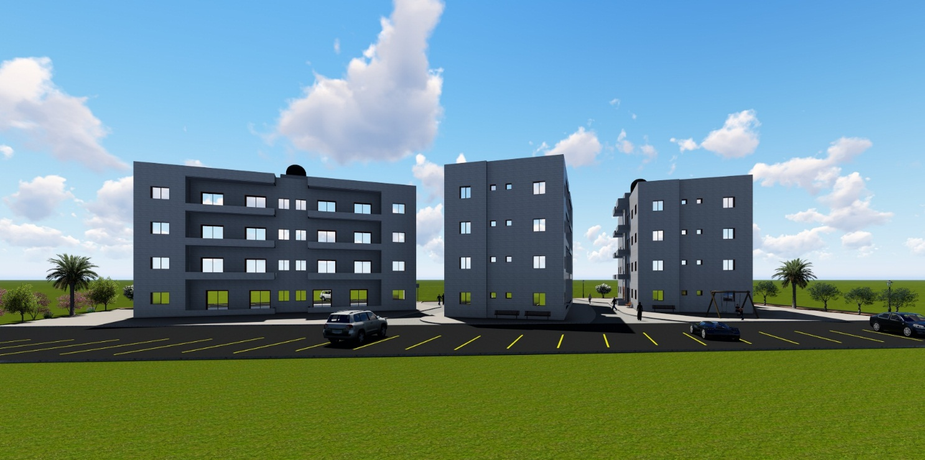
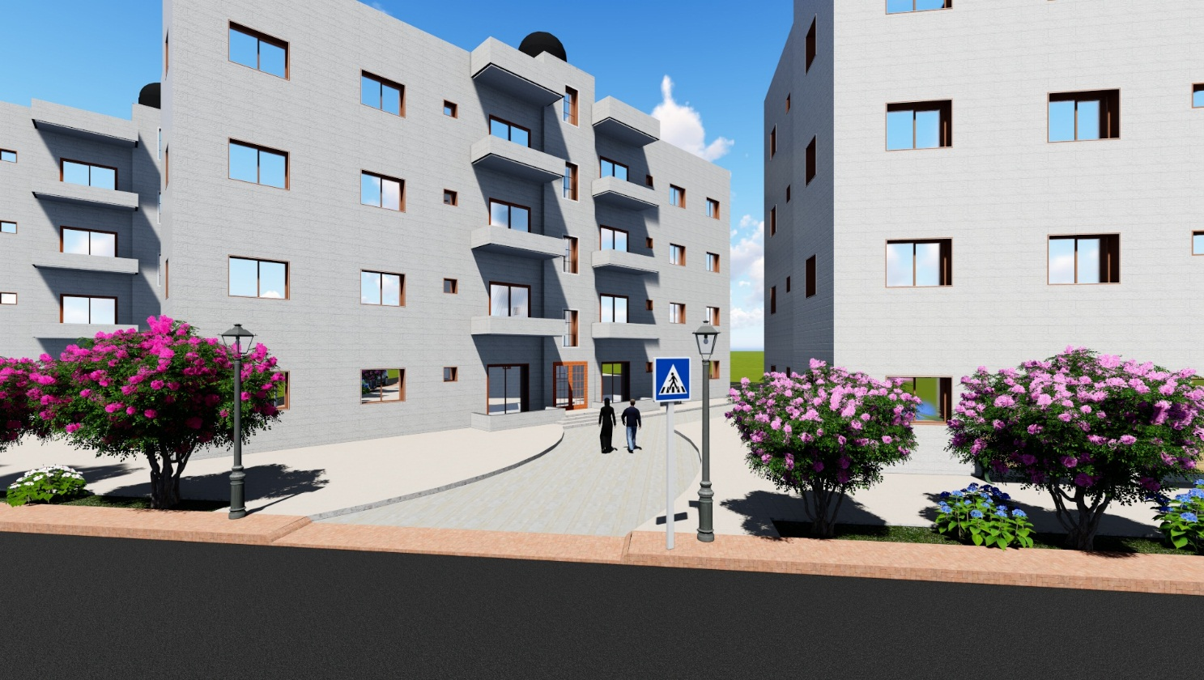

Slide 31
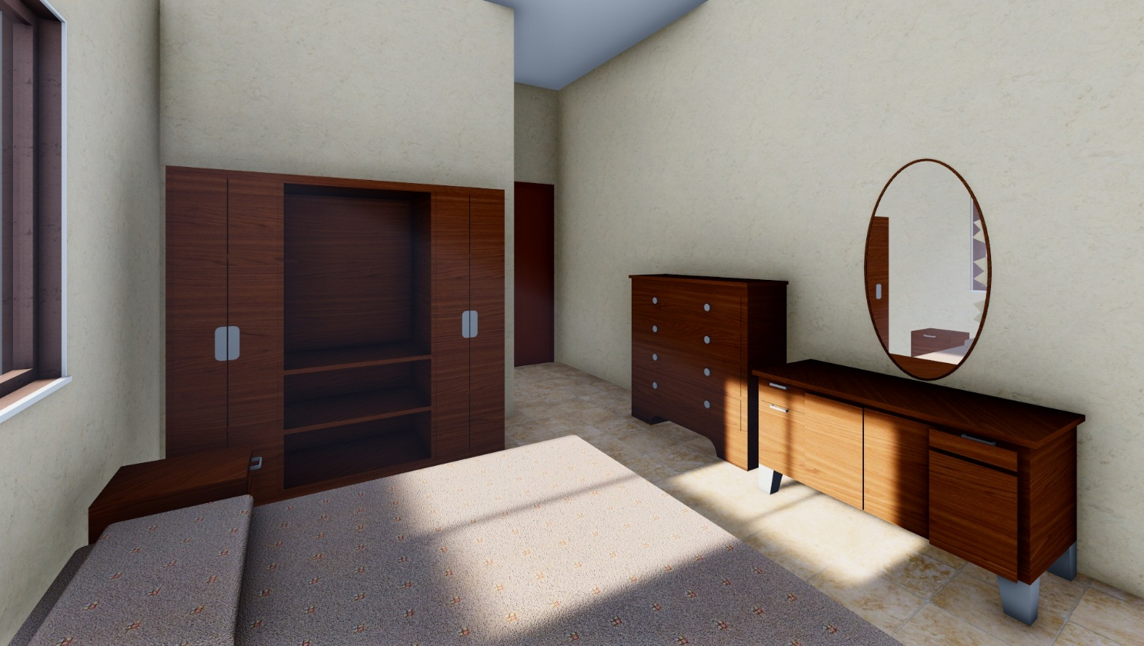
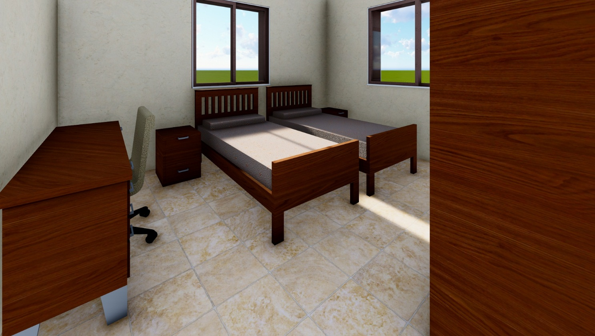
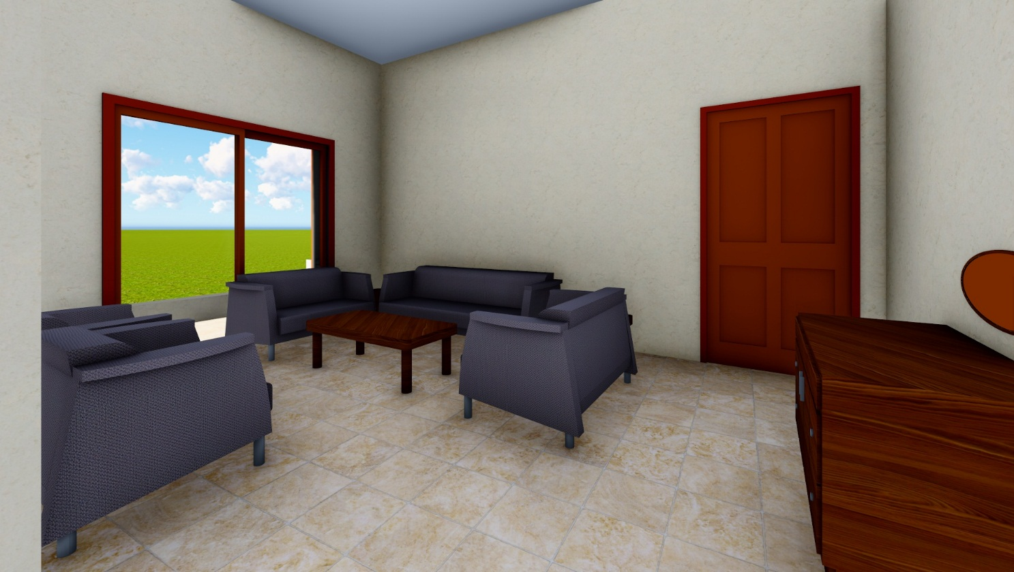
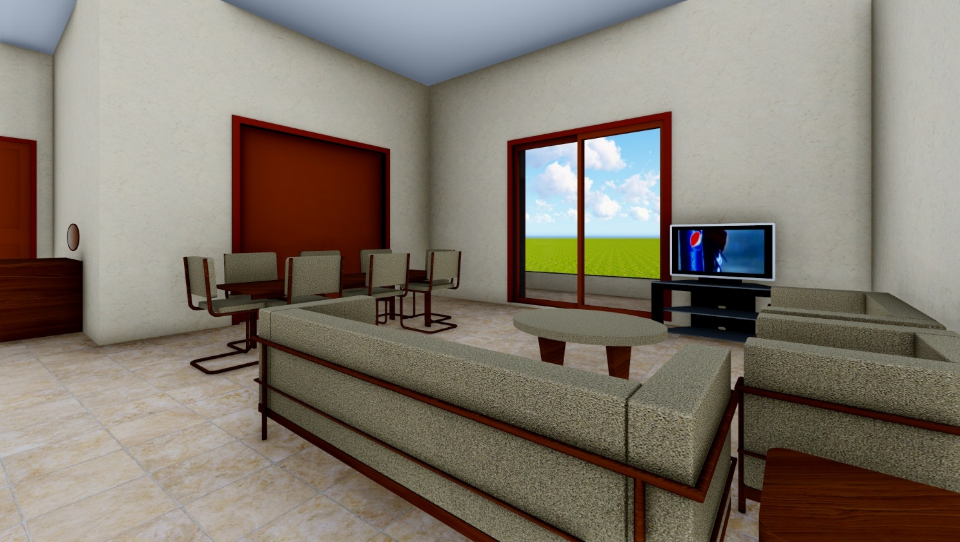

Slide 32
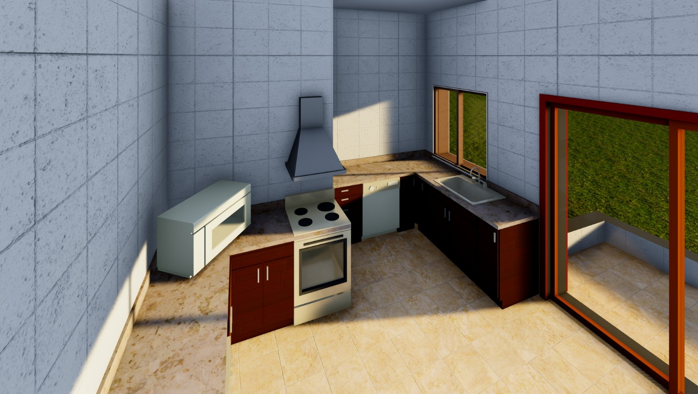
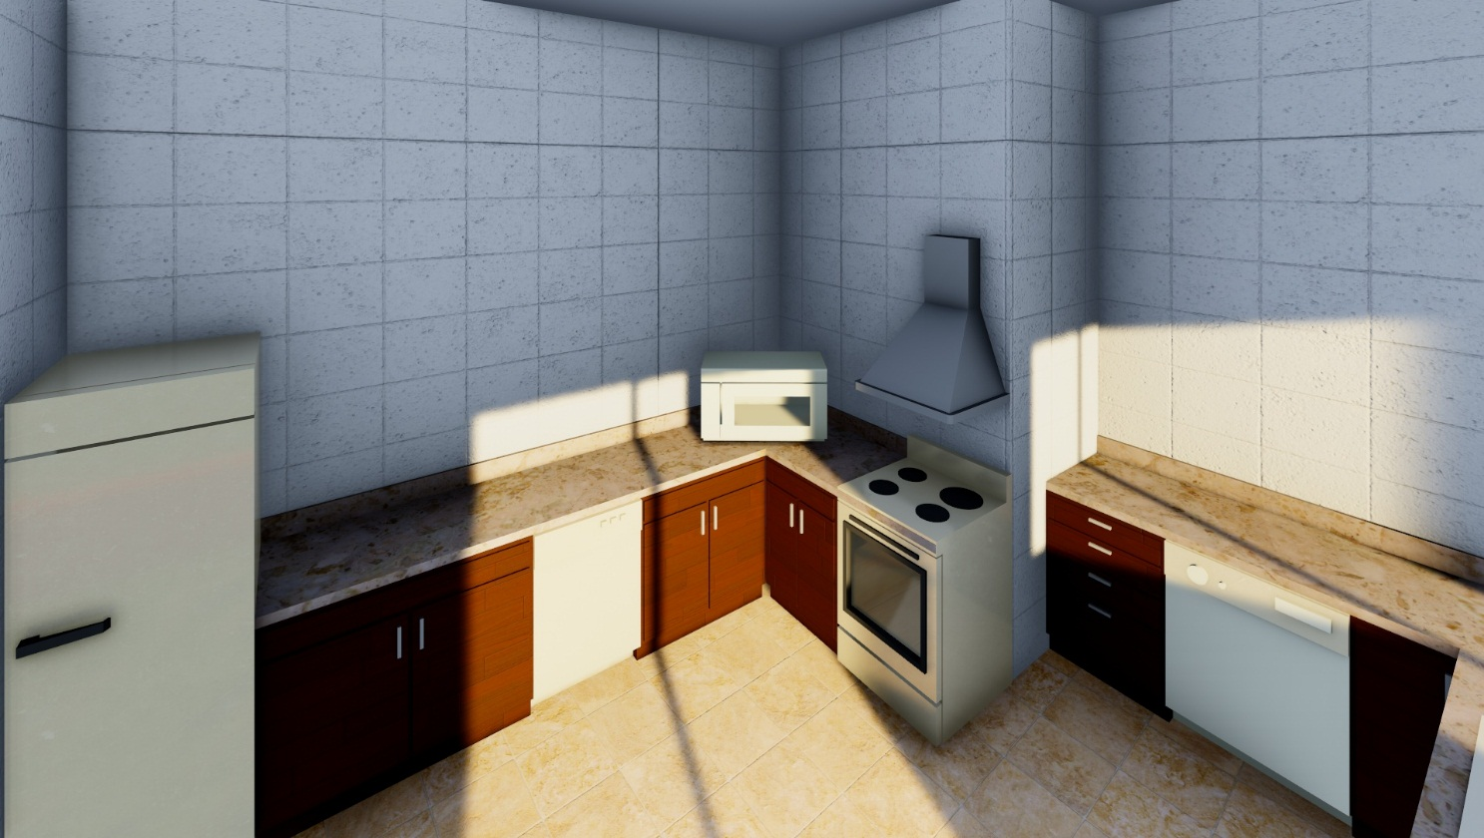

Slide 33
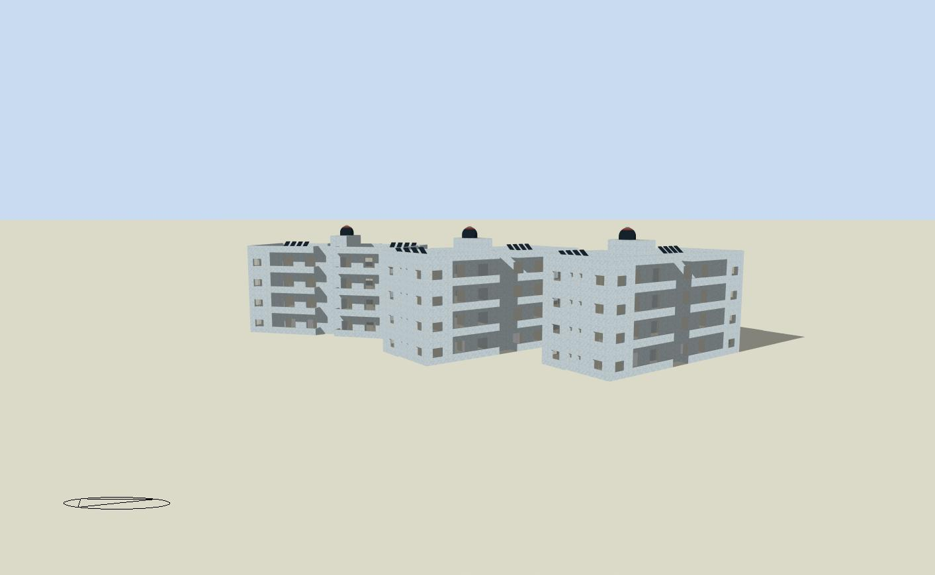
Environmental design

Slide 34
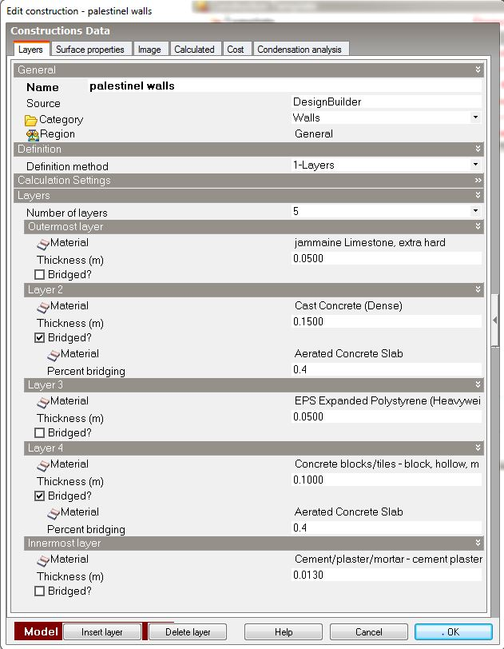
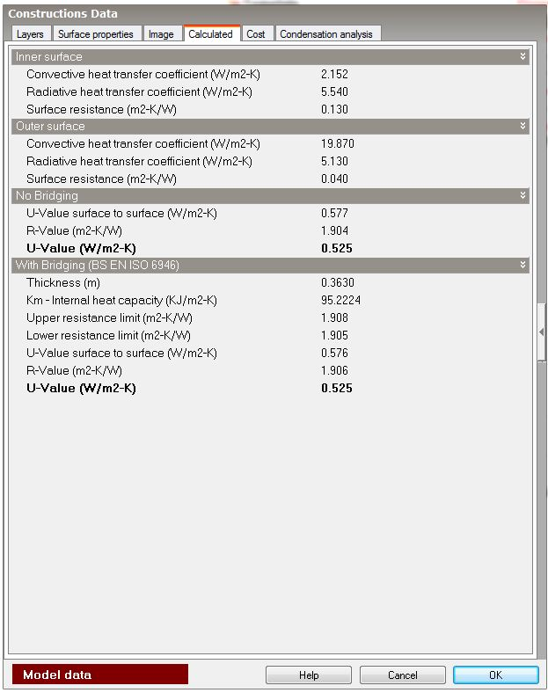
Insulations
External walls

Slide 35
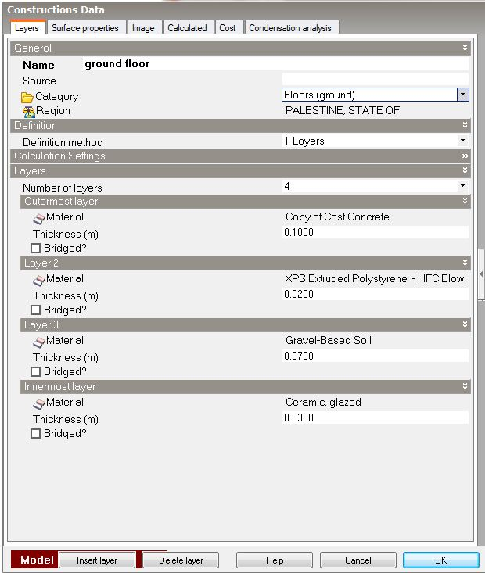
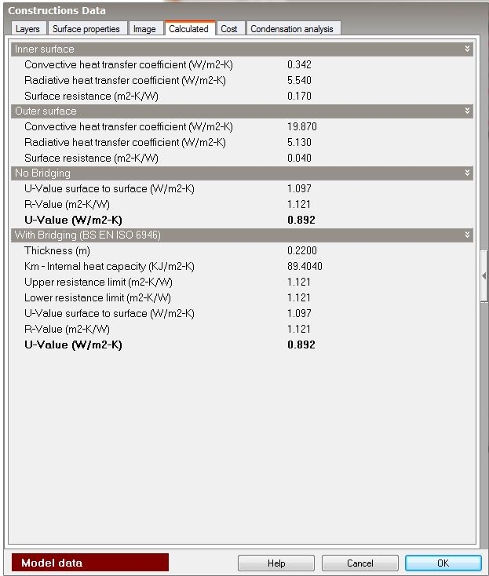
Ground floor

Slide 36
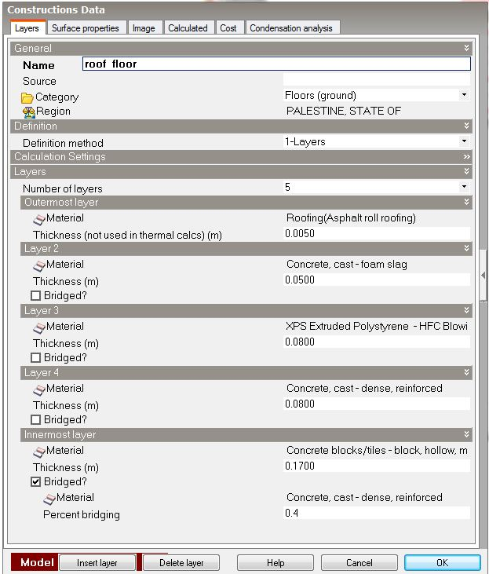

Flat roof

Slide 37
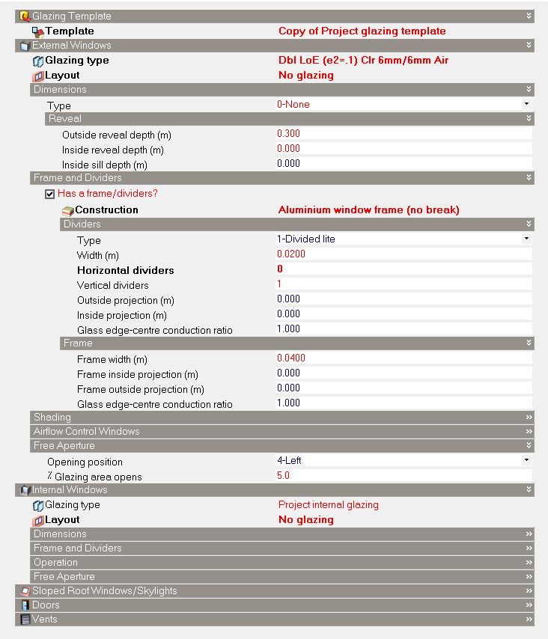
Glazing detention

Slide 38
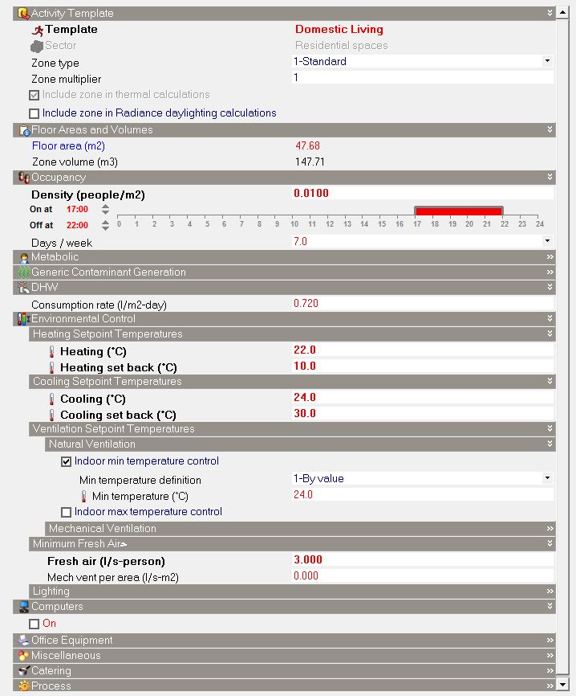
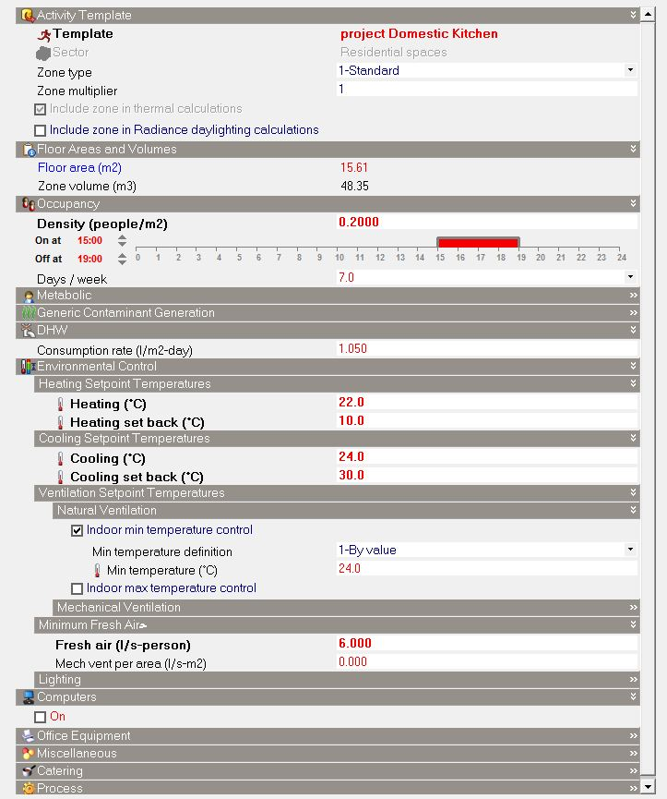
Activity and schedule

Slide 39
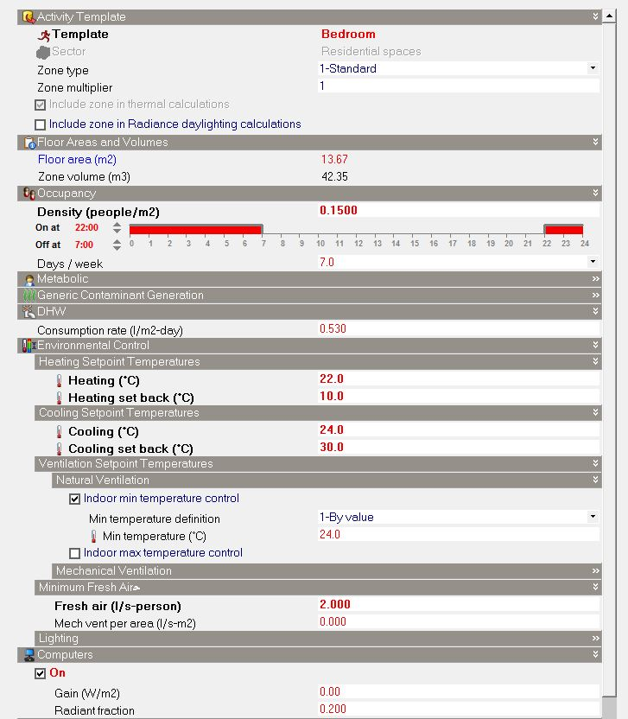

Slide 40
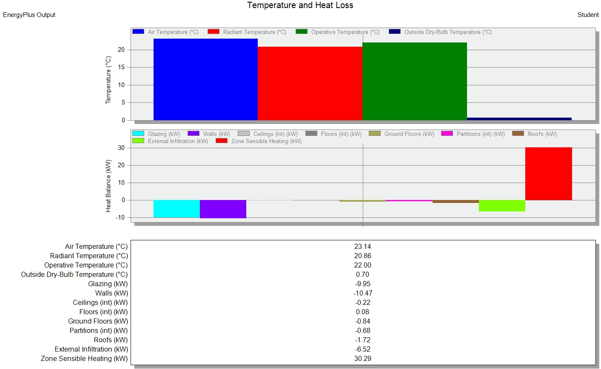
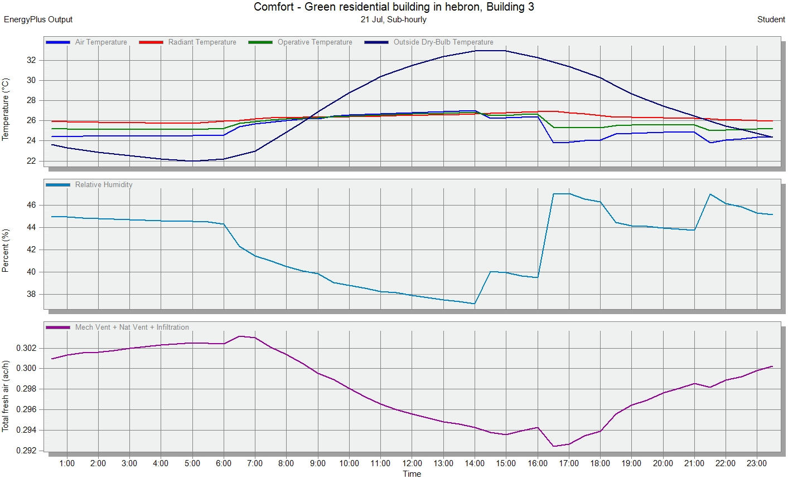
Building 3 heating & cooling design

Slide 41
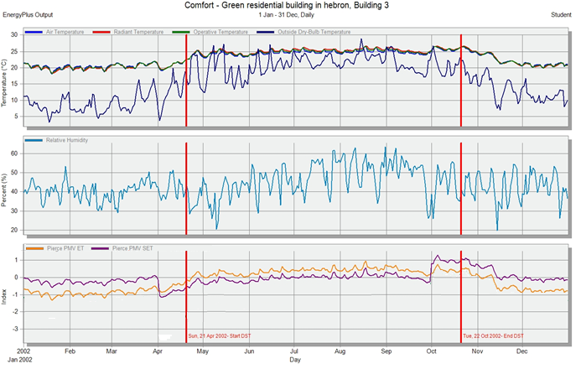
Building 3 simulation
Site and Source Energy
 | Total Energy [kWh] | Energy Per Total Building Area [kWh/m2] | Energy Per Conditioned Building Area [kWh/m2]
Total Site Energy | 66381.78 | 72.21 | 72.21
Net Site Energy | 66381.78 | 72.21 | 72.21
Total Source Energy | 167308.10 | 181.99 | 181.99
Net Source Energy | 148878.12 | 161.95 | 161.95

Slide 42
Time Not Comfortable Based on Simple ASHRAE 55-2004
 | Winter Clothes [hr] | Summer Clothes [hr] | Summer or Winter Clothes [hr]
Facility | 3389.50 | 5617.50 | 2506.50
End Uses
 | Electricity [kWh] | Natural Gas [kWh] | Additional Fuel [kWh] | District Cooling [kWh] | District Heating [kWh] | Water [m3]
Heating | 0.00 | 0.00 | 0.00 | 0.00 | 15574.55 | 0.00
Cooling | 0.00 | 0.00 | 0.00 | 24540.59 | 0.00 | 0.00
Interior Lighting | 7091.81 | 0.00 | 0.00 | 0.00 | 0.00 | 0.00
Interior Equipment | 8153.02 | 0.00 | 0.00 | 0.00 | 0.00 | 0.00
Water Systems | 0.00 | 0.00 | 0.00 | 0.00 | 11021.82 | 172.59
Total End Uses | 15244.83 | 0.00 | 0.00 | 24540.59 | 26596.37 | 172.59

Slide 43
Also we make simulation for building 1 before rotate it to the south direction to compare the results between two cases
New orientation | Old orientation
61.32 | 80.34 | Site energy intensity (KWh/m²)
13739.42 | 30776.19 | Heating capacity (KWh)
16363.87 | 19462.32 | Cooling capacity (KWh)
2988 | 5542 | Uncomfortable hour (hr.)

Slide 44
Structural design
Structural system
One way ribbed slab with hidden beams.
Slab thickness = 25 cm
Site And geology
The soil profile is a soft soil, with 250 KN/m² Bearing Capacity.
Structural elements
Structural elements | Dimensions
Main beams | 60*25 cm
Secondary beams | 40*25 cm
Columns | 60*25 cm

Slide 45
Loads
Super imposed dead & live loads values
Type of load | Load (KN/m²)
Super Imposed Dead | 4.5
Live Load | 3
Materials
The material that used for beams, slabs and shear walls is concrete B300 (24 MPa) and for columns is concrete B350 (28MPa).
Reinforcing steel yield strength (𝐹𝑦) = 420 MPa.
Design codes
1. ACI -318-08 for reinforced concrete structural design.
2. UBC -97 for earthquake load computations.

Slide 46
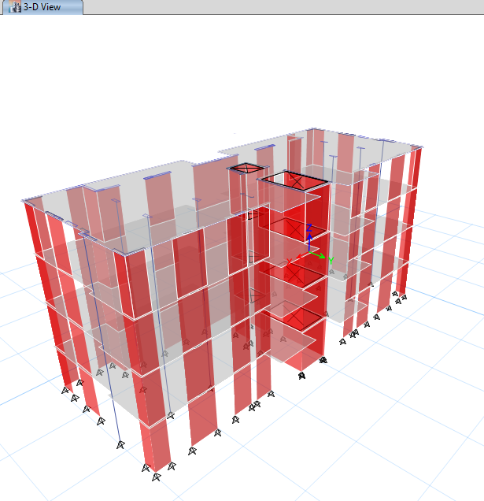
3D ETABS model

Slide 47
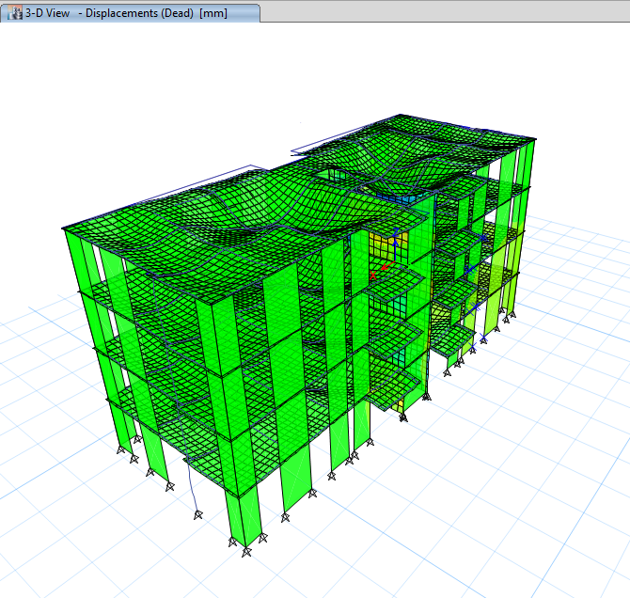
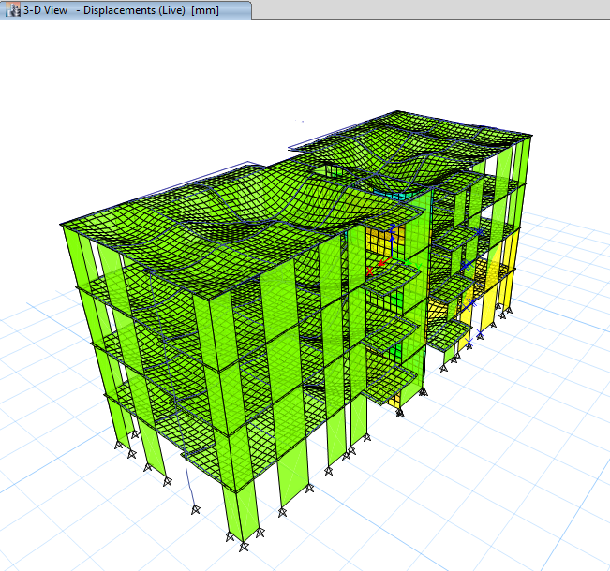
Checks :
Compatibility Check :
The following figures explain the compatibility check from ETABS:
Deformed shape from dead load
Deformed shape from live load
Check is OK.

Slide 48
Equilibrium check :
Results of error %
Loads | Manual | ETABS | %Error
live load | 3994.6687 KN | 3847.8316 KN | 3.675%
Dead load | 13907.664 KN | 13358.9227 KN | 3.94%
Super Imposed Dead | 10521.4 KN | 10983.6343 KN | 4.39%
Internal forces check (Stress – Strain Check):
Results of error %
Structural elements | Manual moment(KN.m) | ETABS moment(KN.m) | Error %
Secondary beam | 3.93 | 3.8653 | 1.64%
Main beam | 23.69 | 23.5131 | 0.74%
Slab | 4.77 | 4.034 | 15.4%

Slide 49
For Columns:
Error % for two columns
Columns | Manual force(KN) | ETABS force(KN) | Error %
C1 | 26.736 | 21.5 | 4.48%
C2 | 714.56 | 718.113 | 0.5%
Dynamic Analysis (Response spectrum analysis):
To perform the dynamic analysis and design for building we need this parameters using UBC97 design code:
I = 1
PGA = 0.15g
Cv = 0.15
Ca = 0.15
R = 5.5

Slide 50
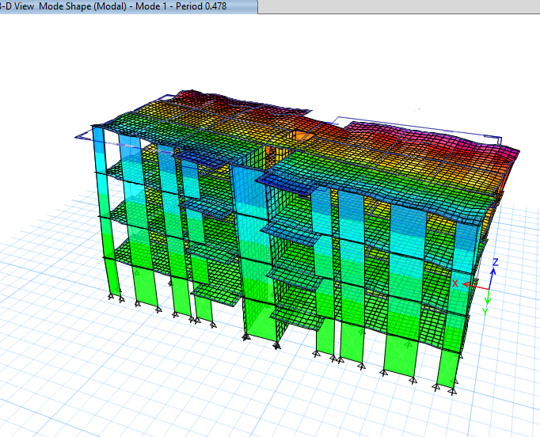
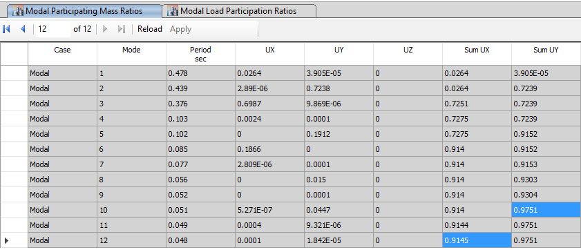
Checks :
1. Period
Manual solution:
T = 0.48 sec.
The period from ETABS found to be:
T = 0.478 sec.
Check is OK
2. Manual Base shear
Time period from ETABS
Weight of the building = 25826.92 KN
Base shear (V) = 2027.5 KN.
Mass participation ratio is larger than 90% in X, Y.
Check is OK.
Modal participating mass ratios

Slide 51
3. Drift :
For X-direction :
∆m = 6.63 mm.
Maximum deflection ∆m = (L/400) for ( T < 0.7 sec)
6.63mm < (3500/400) = 8.75mm …OK
For Y-direction :
∆m = 7.91 mm.
7.91mm < 8.75 mm …OK
Check is OK.

Slide 52


Design for flexure moment
Slab reinforcement
Section of ribbed slab
Slab reinforcement

Slide 53
Beams reinforcement
Main Beams
Beams | As(top) (mm²) | Reinforce | As(Bottom) (mm²) | Reinforce
B1 | 495 | 3Ø16mm | 495 | 3Ø16mm
B2 | 560 | 3Ø16mm | 495 | 3Ø16mm
B3 | 800 | 4Ø16mm | 755 | 4Ø16mm
Secondary Beams
Beams | As(top) (mm²) | Reinforce | As(Bottom) (mm²) | Reinforce
B8 | 330 | 3Ø14mm | 330 | 3Ø14mm
B9 | 386 | 3Ø14mm | 330 | 3Ø14mm

Slide 54



Beams layout
main beam :
Cross section in beam
Beam detailing

Slide 55


Columns reinforcement :
As from ETABS = 1500 mm².
Use 8Ø16 mm/m for each one.
Cross section in column
Stirrups detailing in column

Slide 56

Stair reinforcement :
Section in staircase

Slide 57
Footing reinforcement :
Longitudinal and transverse reinforcement
Footing | No. of footing | Dimensions | Longitudinal reinforcement | Transverse reinforcement
F1(isolated footing for middle columns ) | 6 | 3*2.65*0.45 | 9Ø12 mm/m | 9Ø12 mm/m
F2(isolated footing for edge column ) | 2 | 1.5*1.15*0.47 | 8Ø12 mm/m | 8Ø12 mm/m
F3(wall footing) | 16 | Ex: 2.1*1*0.4 2.15*1.6*0.4 | 7Ø12 mm/m | 7Ø12 mm/m
F4(combined footing) | 2 | 4.7*1 *0.41 | 9Ø20 mm/m | 7Ø12 mm/m

Slide 58



Footings layout
Isolated footing :
Cross section in footing
Reinforcement details for footing

Slide 59




Wall footing :
Combined footing :
Cross section in footing
Cross section in footing
Reinforcement details for footing
Reinforcement details for footing

Slide 60
Shear wall reinforcement :
This table shows the reinforcement for shear walls:
Longitudinal and transverse reinforcement
Shear wall | Vertical steel (for one side) | Boundary steel (for one side) | Horizontal steel (for one side)
S.W.1 | 10Ø12mm/m | 10Ø12mm/m | 3Ø12mm/m
S.W.2 | 4Ø12mm/m | 3Ø12mm/m | 3Ø12mm/m
S.W.3 | 4Ø12mm/m | 3Ø12mm/m | 3Ø12mm/m
S.W.4 | 10Ø12mm/m | 5Ø12mm/m | 3Ø12mm/m

Slide 61

Shear wall layout

Slide 62


Shear wall reinforcement :
Shear wall reinforcement
Stirrups detailing in shear wall

Slide 63
Electro-Mechanical design
Electric and lighting design
HVAC design
Drainage design
Water supply design
Acoustical design
Safety design
Elevator design

Slide 64
Electrical and lighting design
Artificial Lighting system is essential in residential building design because of huge usage in every area in building especially at night, it must distribution in good way with contain energy efficient to provide comfortable, relaxed and good visibility without glare for people

Slide 65


Recommended illumination
Reflection factor

Slide 66

We used DIALux program to design artificial lighting for each room.
For Guest room :
Guest room form by DIALux

Slide 67

Luminaires used :
Luminaires used with details

Slide 68

Guest room isolines:
Guest room isolines

Slide 69

3D For Model Guest room :

Slide 70
Electrical wiring
1.5 mm diameter electrical wires used for lighting system.
2.5mm diameter for sockets and special loads from circuit breakers to the lighting system in the house.
Use 6 mm² cross section area for main wire.
Total number of sockets in each space
Number of sockets | Room
3 | Master Bedroom
3 | Bedroom
3 | Living room
1 | Bathroom1
4 | kitchens
3 | Bed room
3 | Guest room2

Slide 71

lighting distribution

Slide 72

Main distribution board

Slide 73

Distribution board

Slide 74

HVAC system design
Split Air Conditioner System
A split air conditioner consists of two main parts: the outdoor unit and the indoor unit. The outdoor unit is installed on or near the wall outside of the room or space that you wish to cool. The unit houses the compressor, condenser coil and the expansion coil or capillary tubing.
The indoor unit contains the cooling coil, a long blower and an air filter.

Slide 75

Split unit distribution

Slide 76
Drainage system
In drainage water system, drained water movement depends on the natural flow and diameter of pipe. Manholes were used to collect the water pipes that come from W.C's, lavatories, bathtub and floor drains. In our building we separated between black and gray water, each connected to a stack through the shafts but both are connected to the public sewage.
Each floor contain 3 water closet – Flash valve each one has 4dfu with 4″ pipe, 3 lavatory each one has 2dfu with a 2″ pipe, 1 kitchen sink has 2dfu with 2″ pipe, 1 Dish washer has 2dfu with 2″ pipe, 2 shower has 2dfu with2″ pipe, 1 washing machine has 2dfu with2″ pipe, and the water from all of the pipes go out with a 4″ pipe with a total of 25dfu.
Stack diameter is 4 ˝
Slope for pipe 4 ˝ (horizontal pipe) = 1 %
Slope for pipe 2 ˝ = 2 %

Slide 77

Drainage pipes distribution

Slide 78

Water drainage in roof

Slide 79
Water supply design
Water lines:
we will use five water tank, the first main tank under the ground with dimension of (5 * 3 * 2)) capacity 30 m3) and the second one is a roof tank to be installed above the roof of the stairs with dimension of (2.5 * 2 * 1) (capacity 5 m3) the tank on the stair will be faded of water from the main tank located under the ground, we also use gray water tank under the ground (3 m3 capacity ) and another on the roof with (1 m3 capacity ) we will also use storm water tank under the ground with (120 m3 capacity ).

Slide 80
water system :
we use water system (Gray water , fresh water and storm water) to reduce fresh water usage and to reduce output sewage .
We use Gray water for flushing the toilet after filtered and disinfections , storm water for domestic purposes it's going to be filtered and disinfected then it will be .pumped to fresh water tank

Slide 81

Water lines

Slide 82
Total FUs for feeders and there demand in G.P.M.
 | Main feeder | Flat feeder | Branch B.T W.C LAV
FU | 72 | 18 | 2 3 2
gpm | 36 | 14 | 2 3 2

Slide 83
Main feeder pipe loss
Main feeder pipe:-
Equivalent length = 55.5ft
Diameter | 3.5 | 3 | 2.5 | 2 | 1.5 | 1.25
Loss/100 | .13 | .2 | .5 | 1.5 | 5 | 12
Loss/90.75 | .12 | .18 | .45 | 1.36 | 4.54 | 10.89
Flat feeder pipe loss
Flat feeder pipe
Equivalent length = 5.85ft.
Diameter | 2 | 1.5 | 1.25 | 1 | 3/4
Loss/100 | .25 | .8 | 2 | 6 | 20
Loss/5.85 | .02 | .05 | .12 | .35 | 1.17
Branch feeder pipe loss
Branch pipe :-
Equivalent length = 12.87ft.
Diameter | 1 | 3/4 | .5 | 3/8
Loss/100 | .2 | .65 | 3.9 | 12
Loss/12.87 | .03 | .08 | .50 | 1.54

Slide 84
Loss in meter:
meter loss
 | Diameter | Diameter | Diameter
Options (dim) inch | 1 | 3/4 | 5/8
Loss (psi) | 8 | 4 | .4

Slide 85
Pressure =17.37 Psi,
Critical pressure = 12Psi (shower) from table above.
Maximum loss = 17.37-12 = 5.37Psi.
In meter, loss = 0.4 at 5/8 in.
In main feeder, loss = 1.36 at 2 in.
In flat feeder, loss = 0.35 at 1 in.
In branch, loss = 0.5 at 0.5in for shower, and 0.08 at 3/4in for lavatory.
Total loss = 0.4 + 1.36 + 0.35 + 0.5
= 2.61 Psi < 5.37Pis ACCEPTED.

Slide 86

Water layout
Water supply pipes distribution inside flat

Slide 87


Water supply pipes distribution for one apartment
water supply pipes distribution inside bathroom

Slide 88


External wall STC about (52) dB.
The back ground noise in our site about (65) dB
For external wall with window:
We use aluminum window with (double glazing low eminency 6mm air gap) which will have STC of (29) dB according to specification.
Acoustical design
Sound insulation for external wall
Transmission loss of a two-element composite barrier

Slide 89

Sound insulation for Internal wall
Transmission loss of a two-element composite barrier as a function of the relative transmission loss of the components.
TL1 - TL2 = 52 – 29 = 23dB
(S2 / S1) * 100% = ((200 * 225) / (525 * 300)) * 100% = 28.6%
TL1 – TLC = 16
52 – 16 = TLC = 36dB
65 – 36 = 29dB
This is acceptable and quite.

Slide 90


According to specification we can assume that the internal wall STC (48) dB
and if we add plaster in both side it will give 48 + 4 = 52 dB which is enough in our cause .
STC Rating of Walls
Improvements in STC Rating of
Lightweight Concrete Block

Slide 91
Actual and real STC for internal walls
result | Actual | Real STC | partition
OK | 52 | 48 | Bedroom-Bedroom
OK | 52 | 50 | Living room-Bedroom
OK | 52 | 52 | Bathroom-Bedroom
OK | 52 | 48 | Corridor-Bedroom
OK | 52 | 48 | Kitchen-Living room
OK | 52 | 50 | Bathroom-Living room
OK | 52 | 48 | Corridor-Living room
OK | 52 | 48 | Bathroom-Kitchen
OK | 52 | 48 | Corridor-Kitchen
OK | 52 | 46 | Corridor-Bathroom

Slide 92

Sound insulation for Slab
Actual and real IIC for slabs
result | Actual | Real IIC | partition
OK | 52 | 52 | Bedroom-Bedroom
OK | 52 | 52 | Living room-Living room
OK | 52 | 50 | Bathroom-Bathroom
OK | 52 | 48 | Corridor-Corridor
OK | 52 | 52 | Kitchen-Kitchen
The slab IIC about (48)dB and with carpet in the floor it will give above 52dB which is enough in our cause according to specification.

Slide 93

Safety design
  It is process to minimize the risks of injury.
  cars parking we found that the safety can be achieved by take in consideration the circulation movement of cars outside and inside the buildings.
  Inside the buildings we choose Fire extinguishers to be used.
Hose and extinguishers cabinet

Slide 94
Elevators
According to the tables, we need three elevators. One elevator for each building.
The recommended speed of the elevator is 100 foot per minutes.
The recommended capacity is 1500 pounds which it mean 6 persons.

Slide 95
Survey and cost estimation
The total cost for one building = 601945 $. Thus, the total cost for the three buildings approximately in USD $ 1805835.
Total cost per meter square = 601945/1335 = 450 $/m².
The total cost for one apartment equal in USD $ 75245.
( with out the cost of the land )
When we take the land cost in consideration the total cost for one apartment equal 85324 $

