Slide 1
Nablus Municipality Reporting System (NMRS)
Dr.Loai Malhis
Dr.Samer Arandi
Abed Abo Salah
Noura shenawi

Slide 2
Outlines
Introduction
Tools
Procedure
Constraints
Future work
Demo

Slide 3
Introduction
Nablus Municipality Problems:
Lack of Complaint System.
Water reachable problem.
Solution:
NMRS Application.

Slide 4

NMRS Application
Cross platform mobile application
Ionic3, NodeJS
Firebase database.

Slide 5
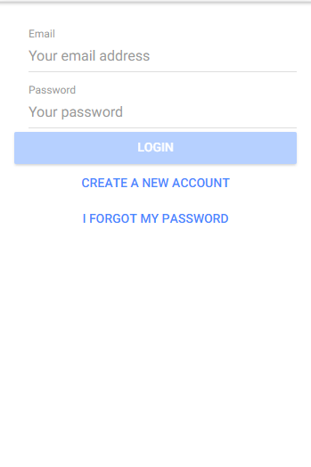
NMRS Application pages
Login
Sign up
Add complaint
Menu
Detect location
Attached photos
Add inquiry
Anonymous complaint

Slide 6
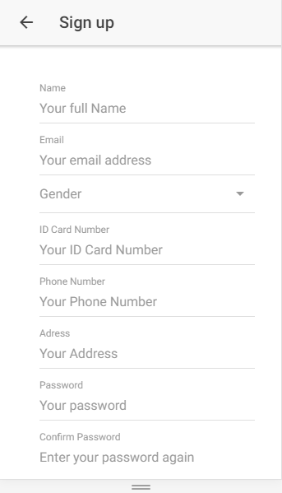
Sign up
Add user information inorder
To use when replay
And working on problem
Solving.

Slide 7
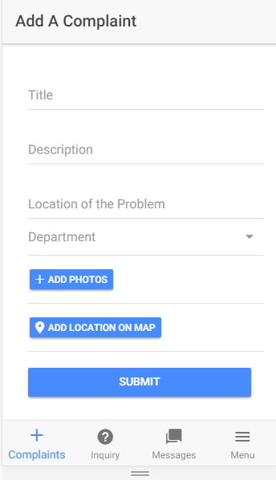
Add complaint
Add short explanation
Add title
Detect department that
Belongs to
Attached photo and
Detect location.

Slide 8
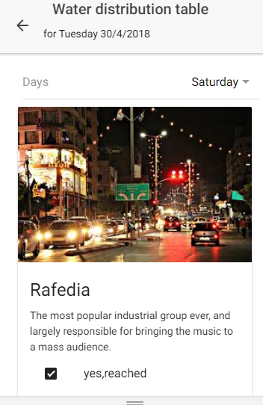
Water distribution table
Select day and
A list of regions that provided
With water in this day
Will appear.

Slide 9
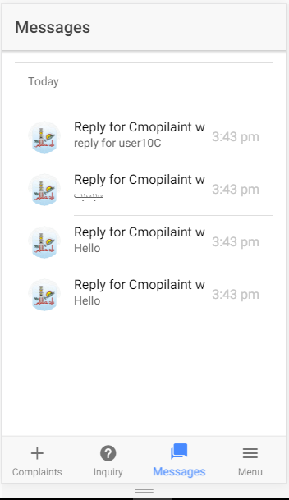
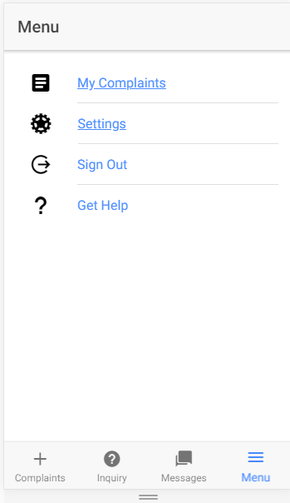
Menu & Messages

Slide 10
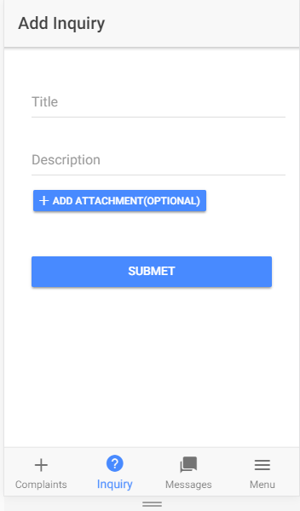
Add inquiry
It could be from Known
Person
Or anonymous inquiry.

Slide 11
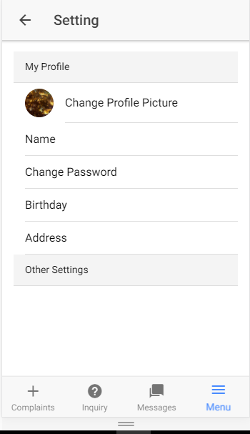
Settings
User can update his
Information: name,
Password, birthday, etc.

Slide 12
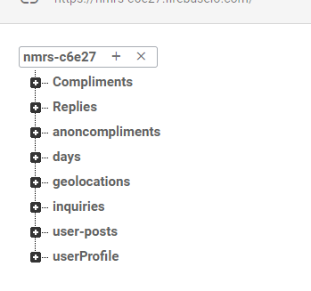

Database
Done using firebase database

Slide 13
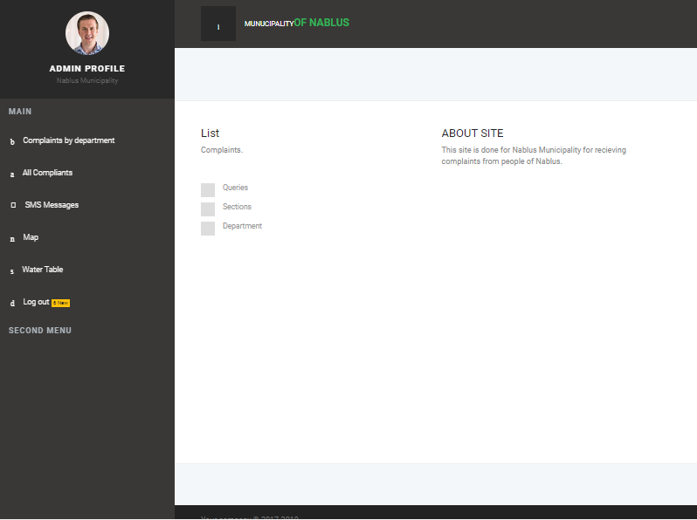
Municipality Website:

Slide 14
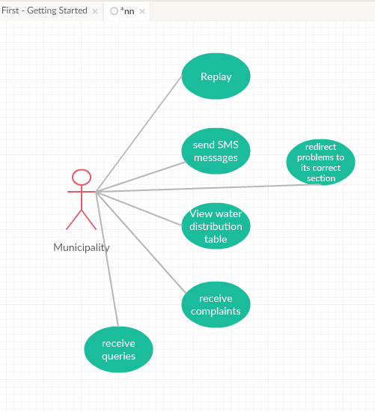
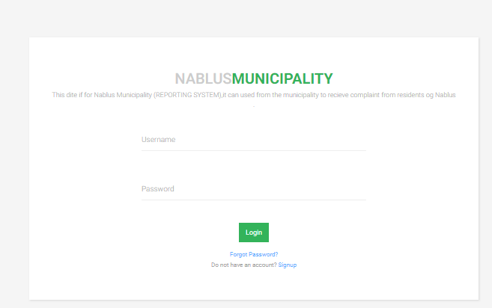
Municipality Website
Login
Reply to complaint.
Answer to questions
Set Water distribution
table.

Slide 15




Tools and languages

Slide 16
Constraints

Slide 17
Future work
Use it by other cities.
Solve more problems.

Slide 18
Demo

