Slide 1
Estimating pavement maintenance priority using computer vision.
(Road Services)
Academic Year: 2020/2021
Group Members: Areej Imair & Shima Osamah
Department Name: Computer Engineering
Project Type: Software
Supervisor Name: Dr. Anas Toma

Slide 2
Outline:
Whats is Pavement maintenance priority.
What is Road services application.
Features.
Road services built on.
Database.
Mobile Application
Future work.

Slide 3
1-Whats is Pavement maintenance priority index.
Pavement Maintenance Index (PI) is used by the Palestinian Municipalities to measure the priority of the roads to be maintained based on the Operation Maintenance Manual (OMM).
it depends on four indicators:
Pavement Condition index (PCI)
People Complains (C)
Importance of the Road (I)
Functional Classification of the road (FC)

Slide 4
2- What is Road services Application
It's a cross platform application that help the workers which work in civil field to calculate PI value through image processing and AI model to cut short a big part of the maintaining operation done without the application.

Slide 5
3-Features
Administrator
Technichen
Divide tasks
Map
Find PCI value through image processing
Finding PI value through Fuzzy Model

Slide 6
4-Road services built on.
Flutter cross-platform.
PHP
Python
FLASK
Wamp server

Slide 7
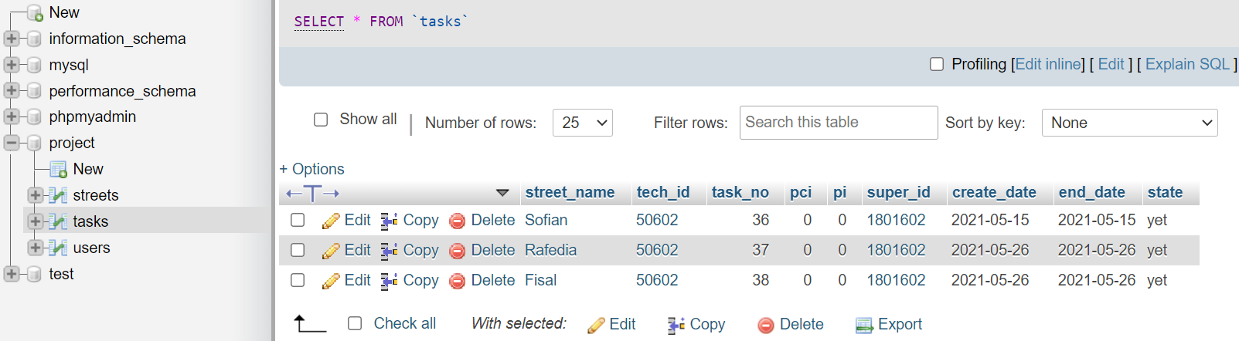
5-Database.

Slide 8
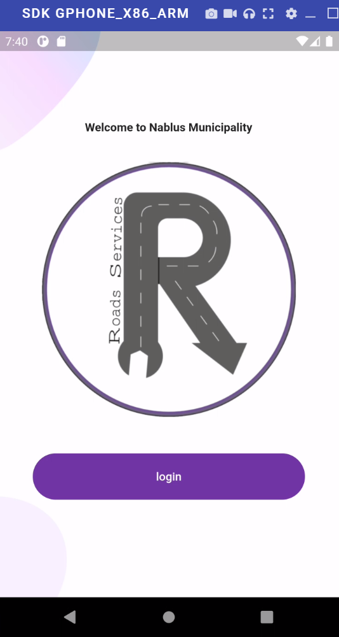
Main Screen:

Slide 9
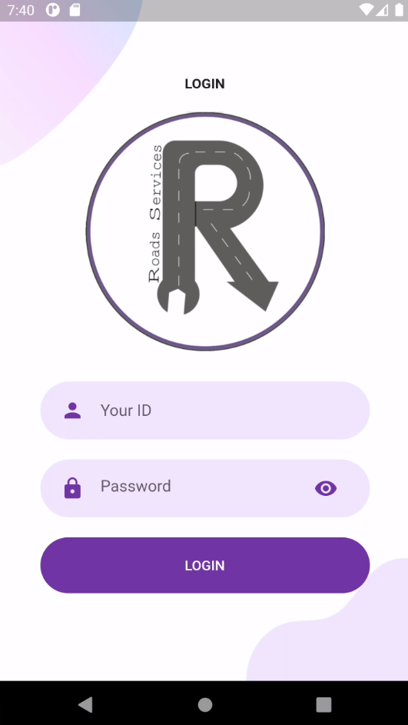
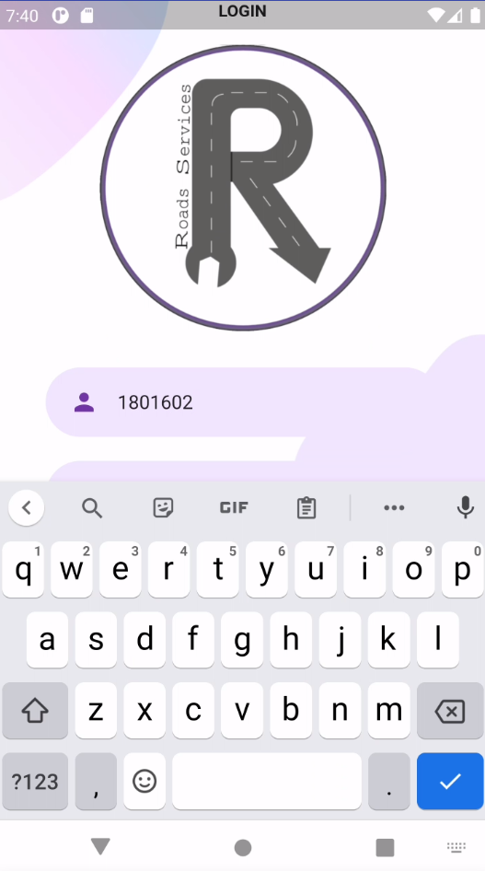
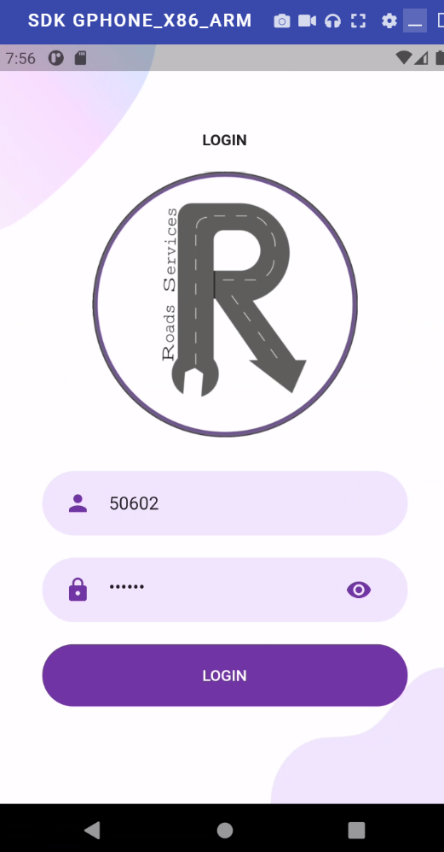
Login Screen:

Slide 10
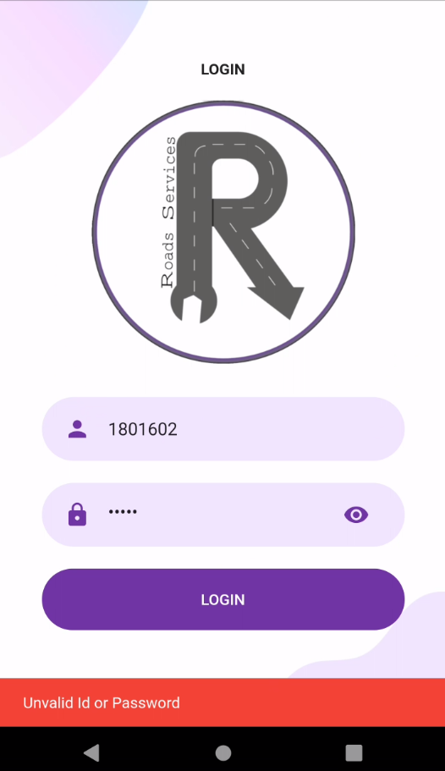
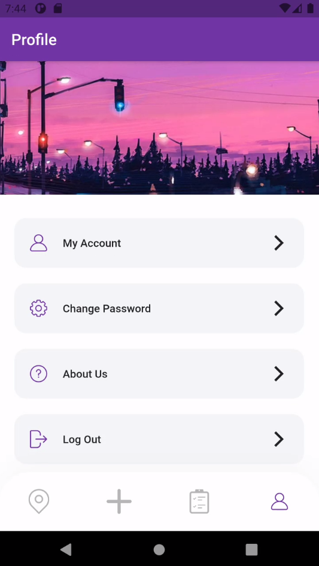
Login Screen:

Slide 11
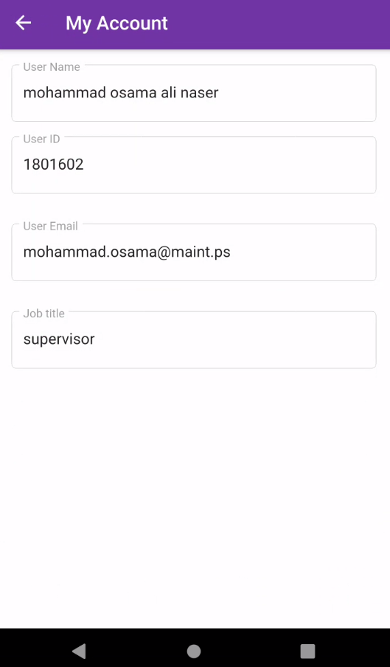
Profile Screen:

Slide 12
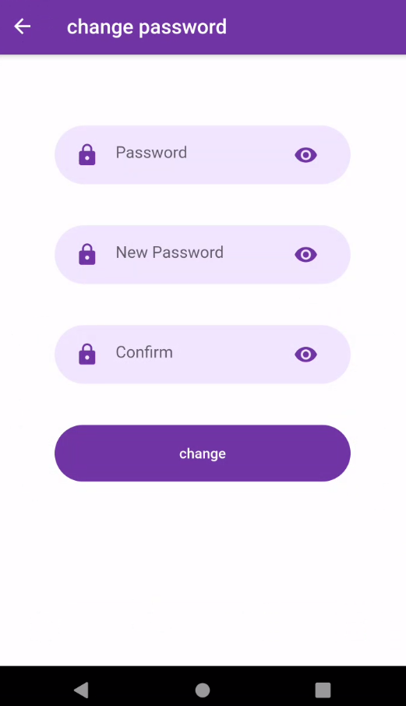
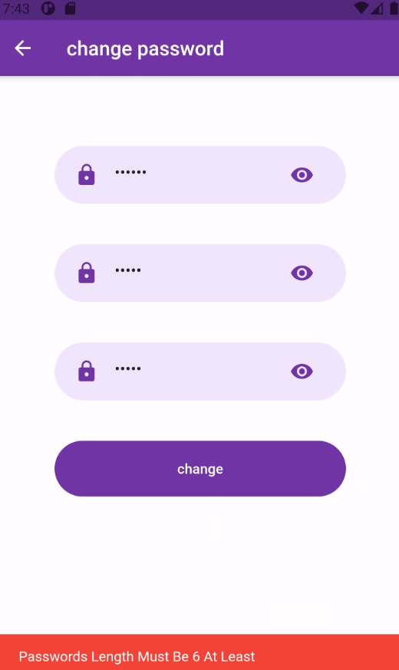
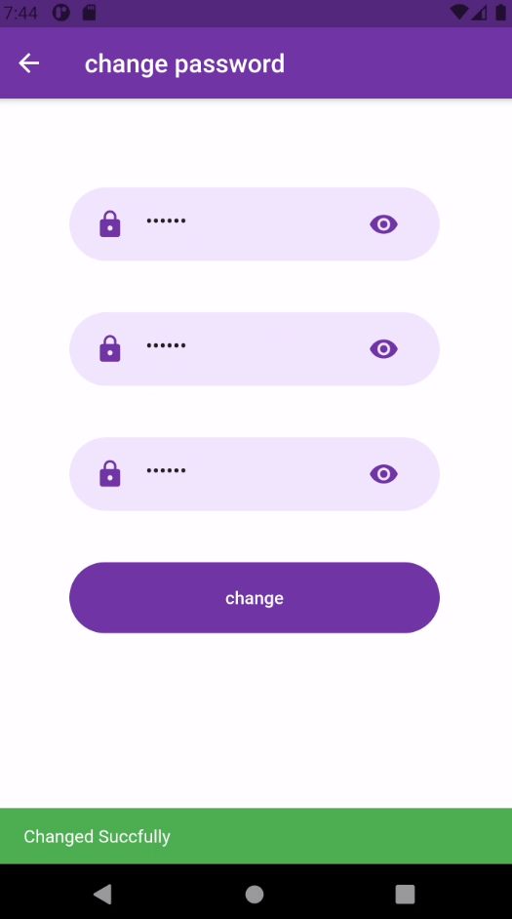
Change Password:

Slide 13
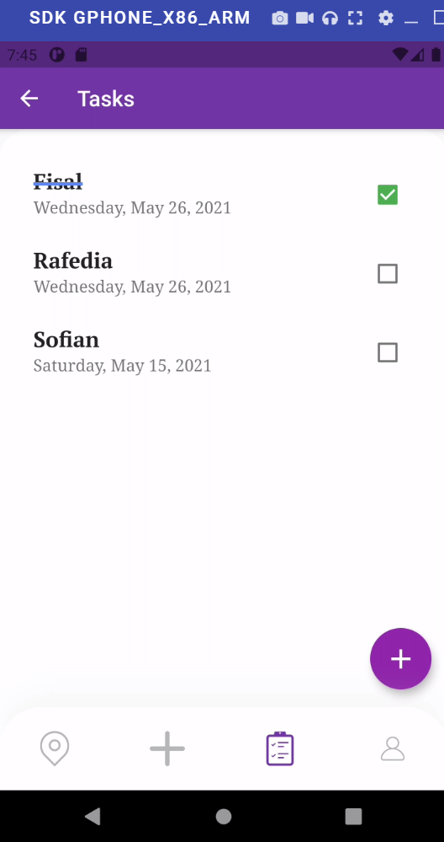
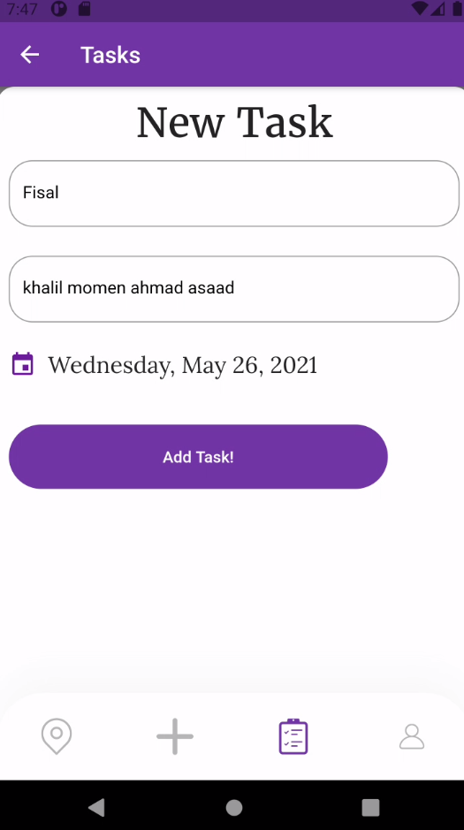
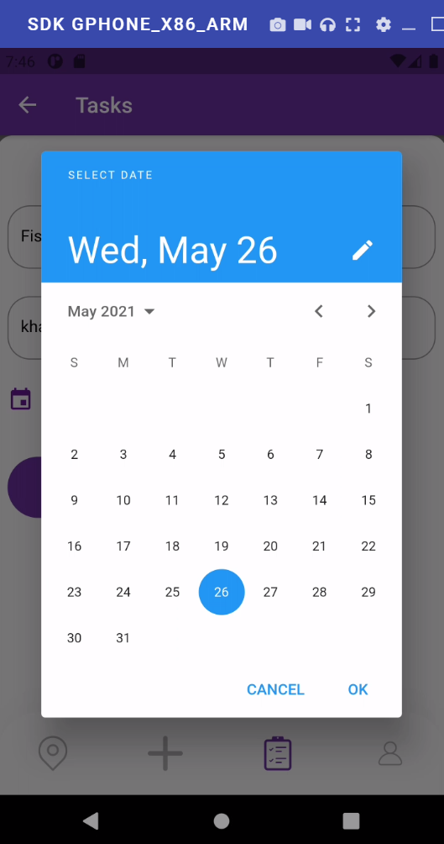
Task Screen

Slide 14
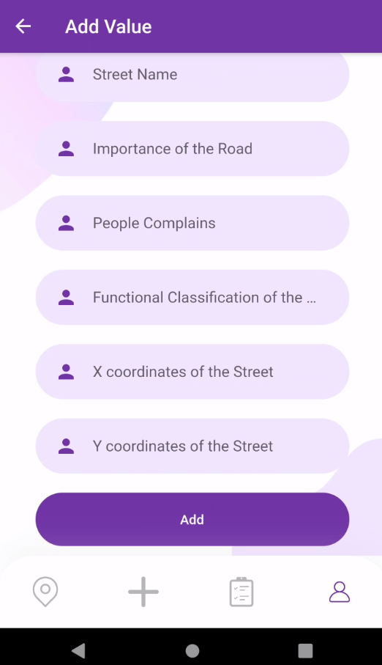
Add new Street

Slide 15
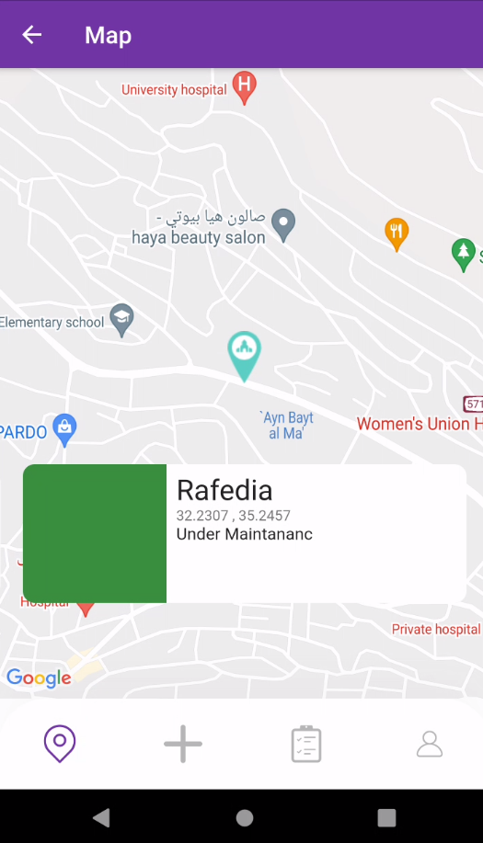
Map:

Slide 16
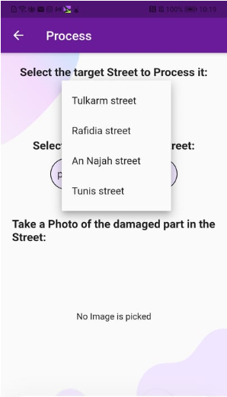
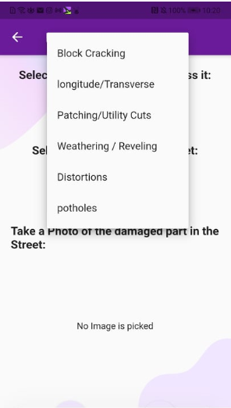
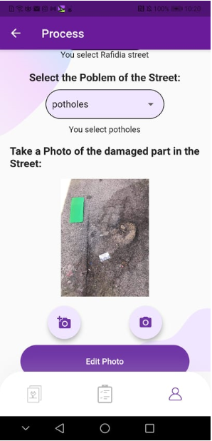
Image Screen:

Slide 17
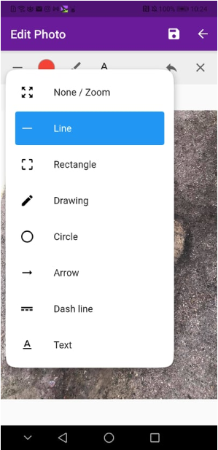
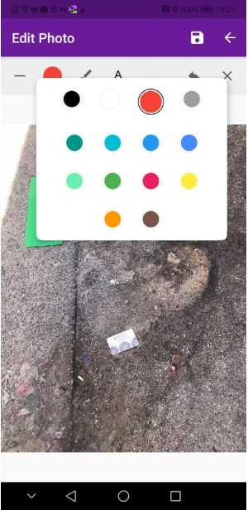
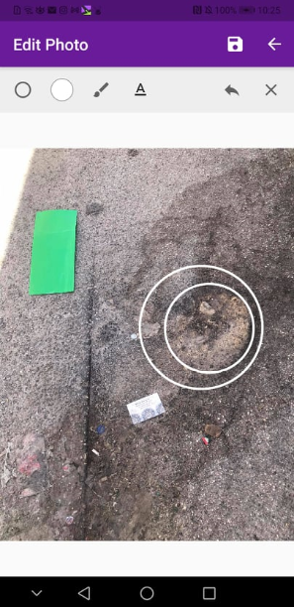
Edit Photo:

Slide 18
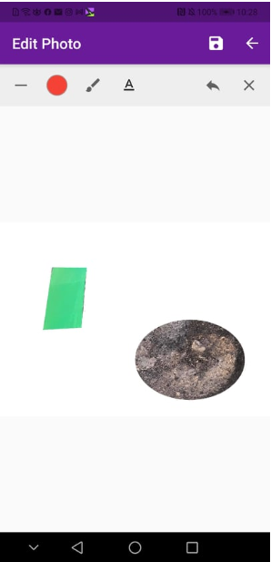
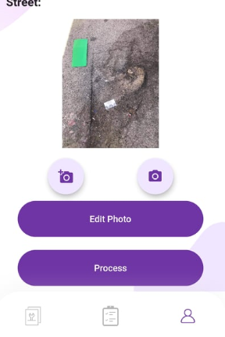
Edit Photo

Slide 19
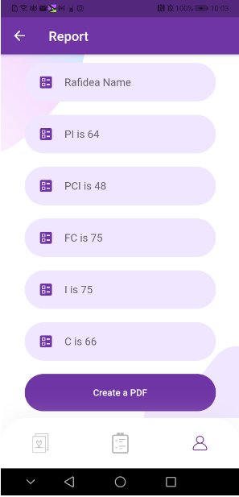
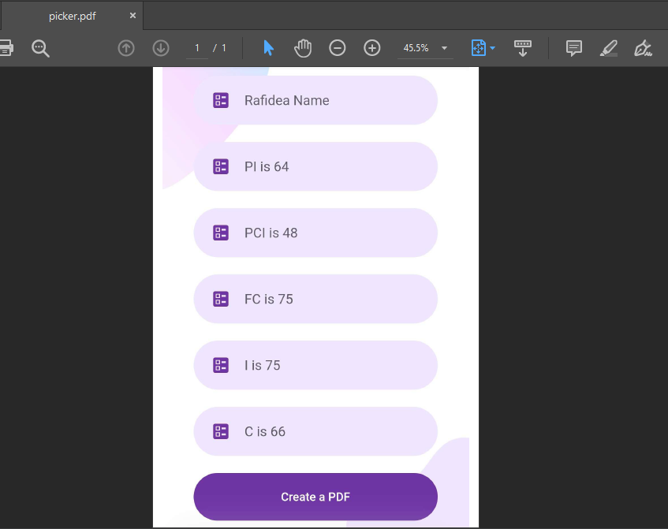
Show result

Slide 20
Future Work:
create an automated system to recognize the type of the problem in the street.
Create an automated system to find the boundaries of the area without
surrounding it with shape.
Testing the Fuzzy system with a real dataset.

