Slide 1

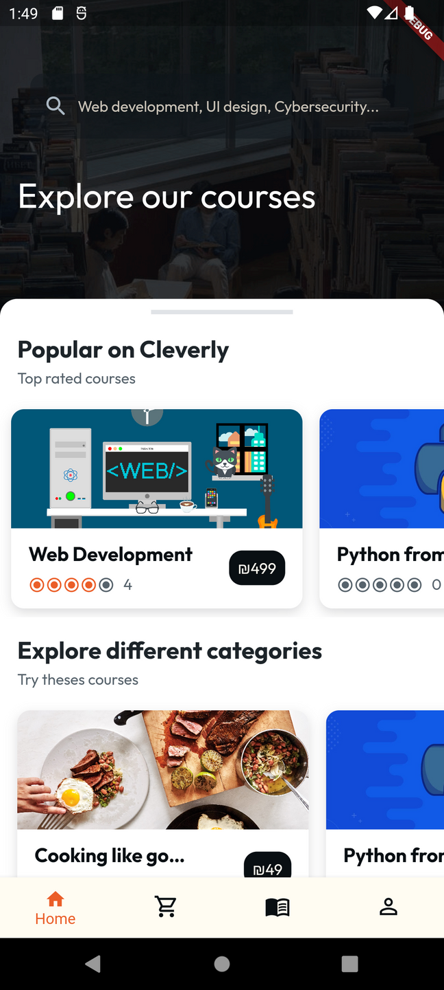
Cleverly: Online Education
Gradutation Project discussion
Supervisor
Done By:
Dr. Ashraf Armoush
Ahmed jalamneh
Yahia Arafat

Slide 2

01
What is Cleverly?
02
Cleverly's Features and services
Contents:
03
Technologies used in Cleverly
04
Cleverly's user's interface and experience
05
Future work in Cleverly

Slide 3
What is Cleverly?
Cleverly:
What Makes Cleverly Better?
Cleverly is an online education platform which enables users to both learn and share their experience and also benefit from that experience
With the use of latest technologies and a modern design, Cleverly provides users with a personalized learning experience and user-friendly interface that makes the learning journey much better

Slide 4
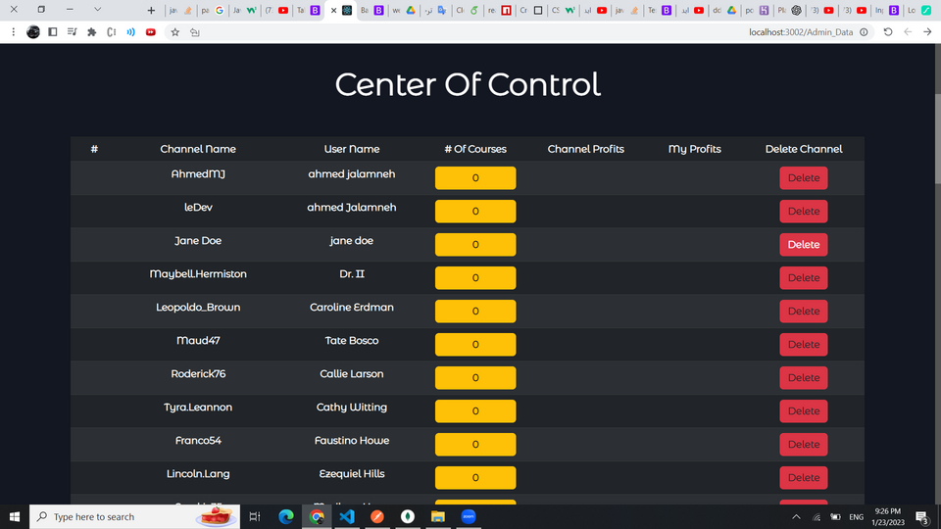
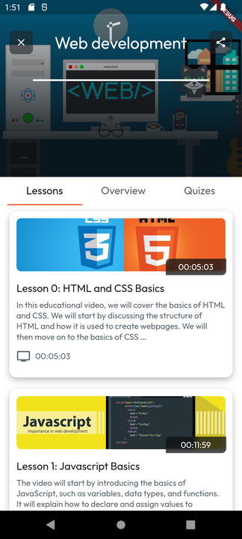
Features and Services

Slide 5

01
Personalized:
  Recommendations
  Customized Profile
Features and Services
02
Secure:
  Penetration tested
  latest security practices in coding
  Scanned by Snyk*
03
Cloud based:
  MongoDB Atlas
  Google cloud storage
  Heroku hosting
*Snyk is a platform allowing you to scan, prioritize, and fix security vulnerabilities in your projects

Slide 6
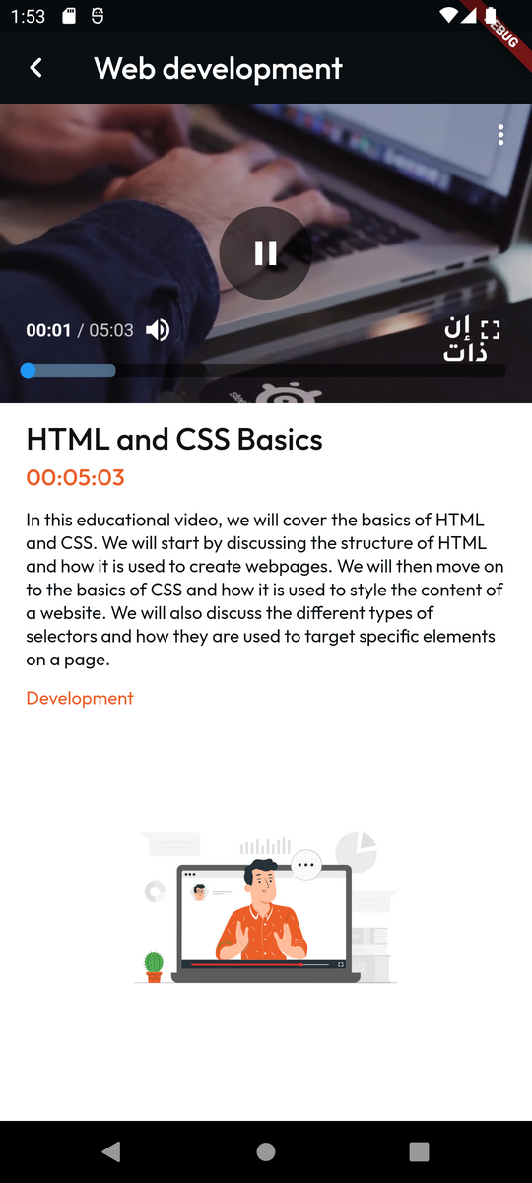
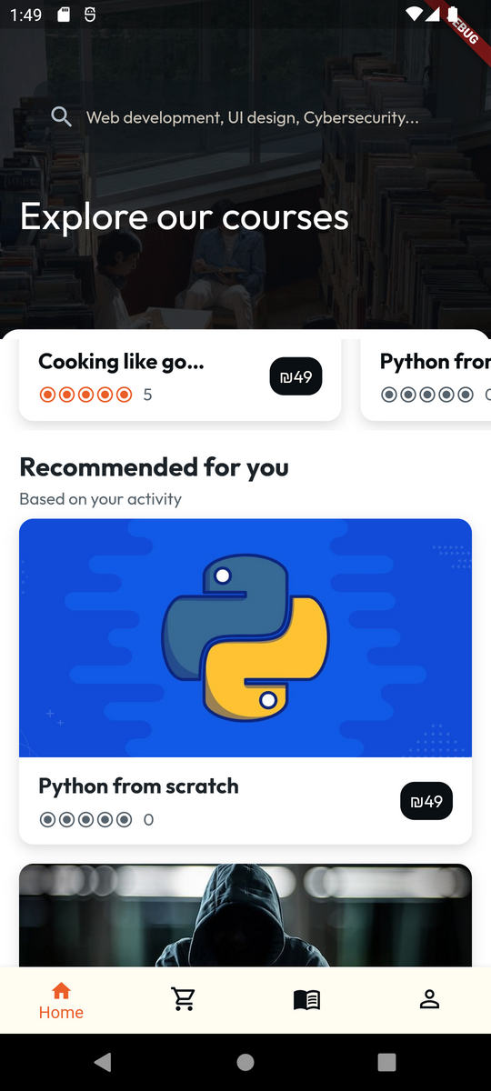
Technologies
Used in Cleverly

Slide 7










Technologies in Cleverly:

Slide 8
User experience
Teacher:
Student:
Admin:
  Create and edit Courses
  Add and edit videos to their courses
  Add and edit quizzes to their courses
  Add promotions and discount codes
  Personalize their profile
  Enroll in courses
  Attend and watch educational videos
  Take quizzes and Review their attempt
  Dashboard for owned courses
  Review and access courses reviews
  Monitoring and auditing platform content
  Delete and edit users
  Delete and edit courses
  Summaries of platform's usage

Slide 9
Future Work:
Improved Recommendation:
Diverse learning:
More Features:
With the future growth of Cleverly a better Recommendation systems like Retail AI or Recommender AI can be implemented
Include more learning sources like flashcards, slides that will make the user's experience a lot more fun
Chatting and support services are main features which will be added to Cleverly in the future along with more personalization.

Slide 10
Thank You

