Slide 1

An-Najah National University
Faculty of engineering and information technology
Building engineering department
Graduation project 2
MEDICAL CENTER
Prepared by:
1- Baraa Hamdallah.
2- Raneen Daraghmeh .
3- Roa Mosa.
4- Tamar Samara.
Supervisor:
Dr. Muhannad Haj Hussein

Slide 2
Presentation Contents:
Introduction.
Site analysis.
Architectural design.
Environmental design.
Structural design.
Mechanical design.
Electrical design.
Safety and fire design.
BOQ .

Slide 3
Introduction:
What is the medical center ?
The necessity of need such facilities .

Slide 4
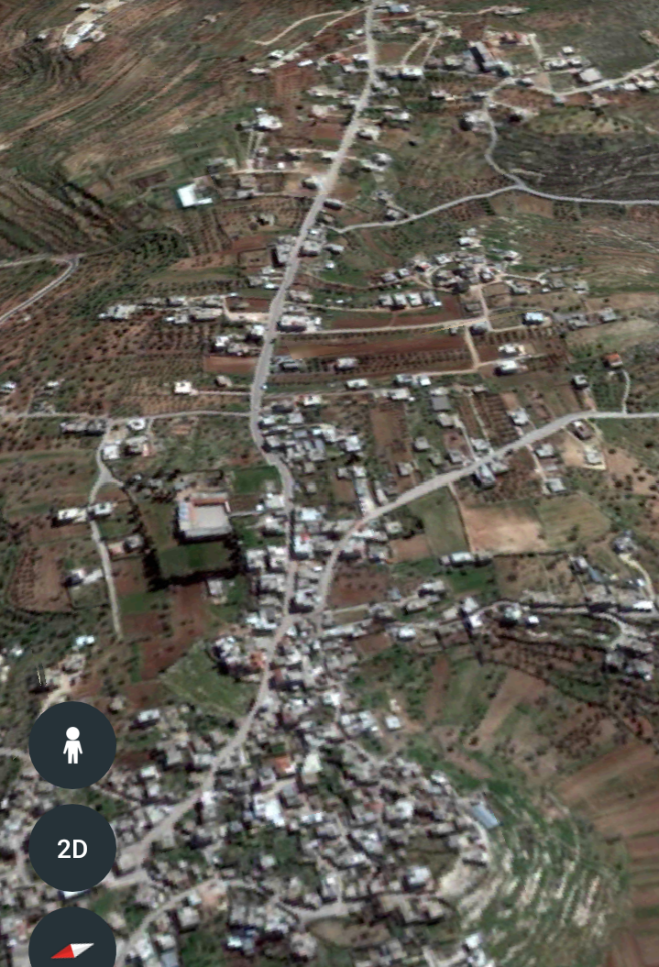
Site location :

Slide 5
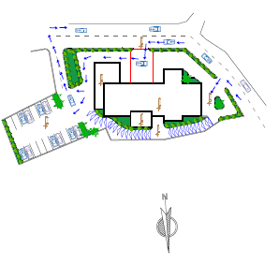
Architectural design: site plan :

Slide 6
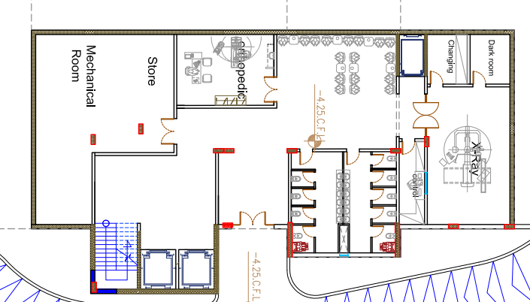
Architectural design:
Basement :

Slide 7
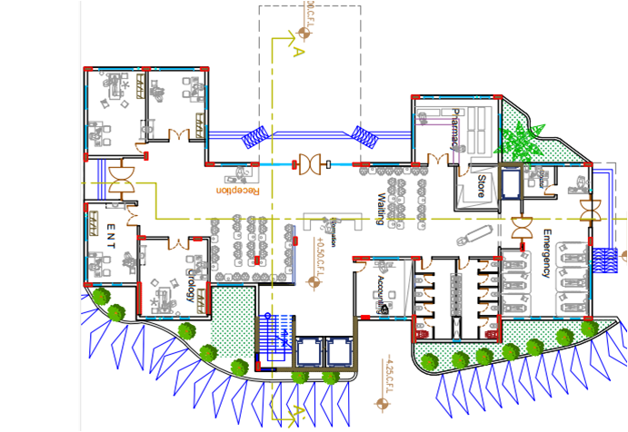
Architectural design:
Ground floor :

Slide 8
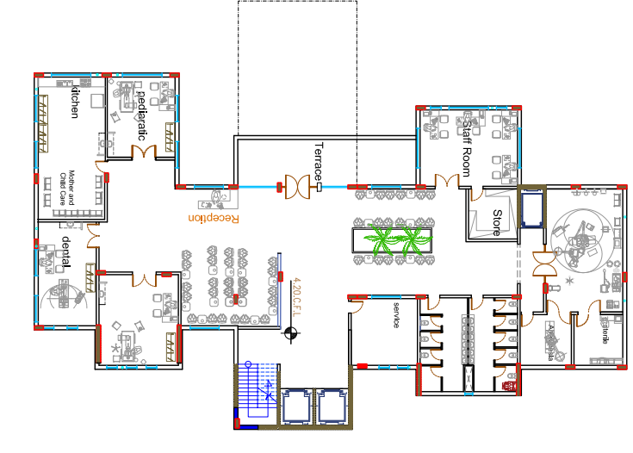
Architectural design:
First floor :

Slide 9
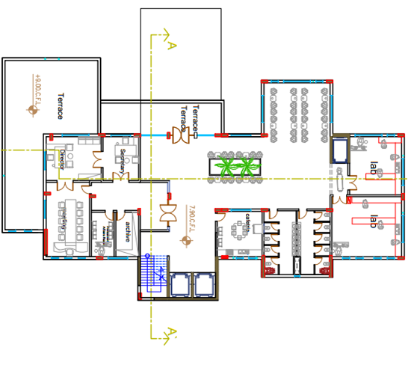
Architectural design:
Second floor :

Slide 10
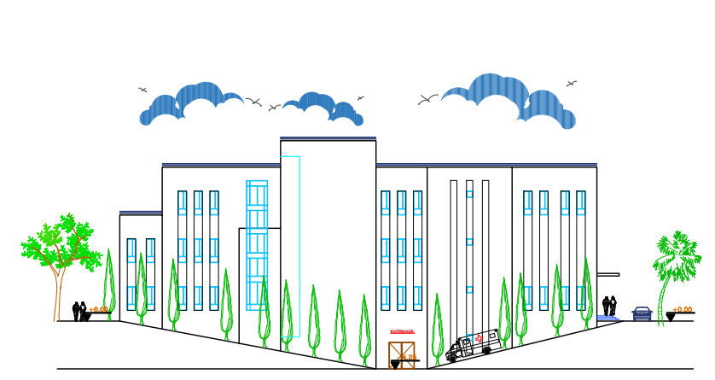
Architectural design:
North elevation

Slide 11
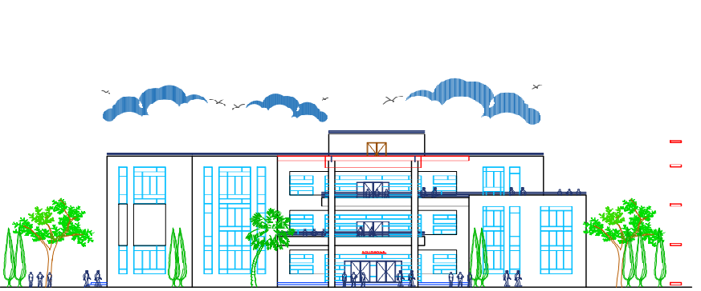
Architectural design:
South elevation

Slide 12
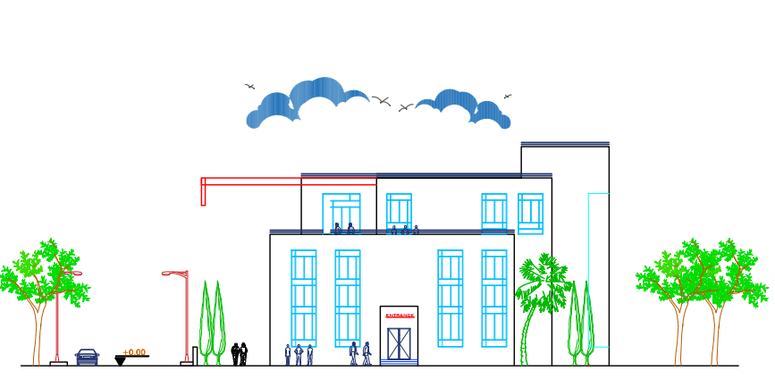
Architectural design:
East elevation

Slide 13
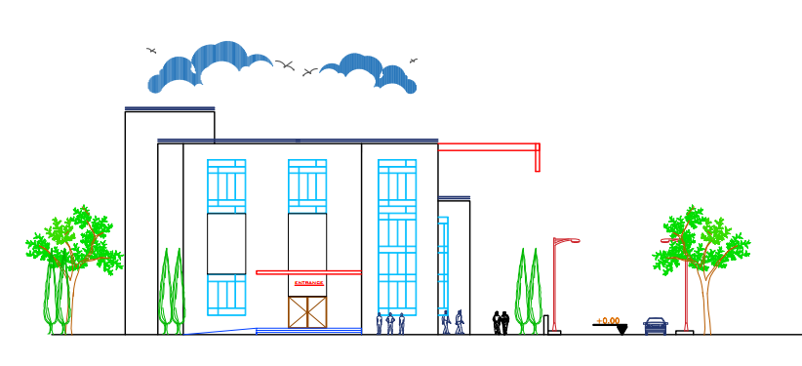
Architectural design:
West elevation

Slide 14
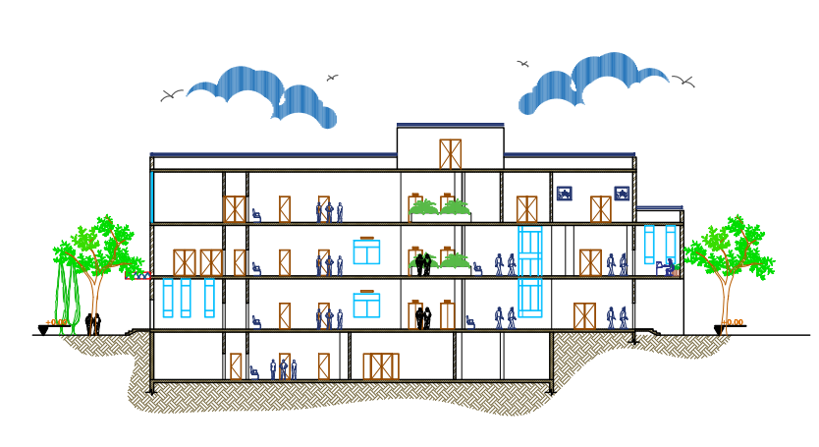
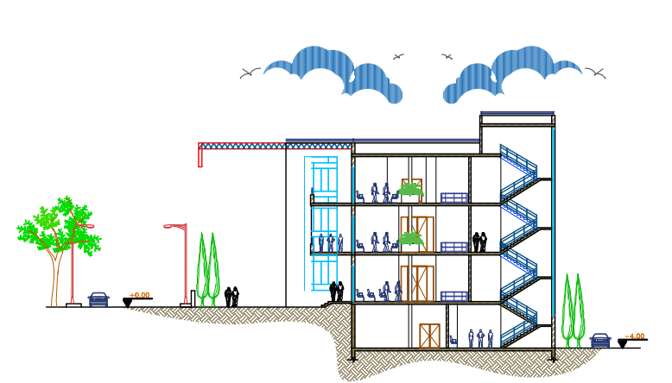
Architectural design:
Section A-A
Section B-B

Slide 15
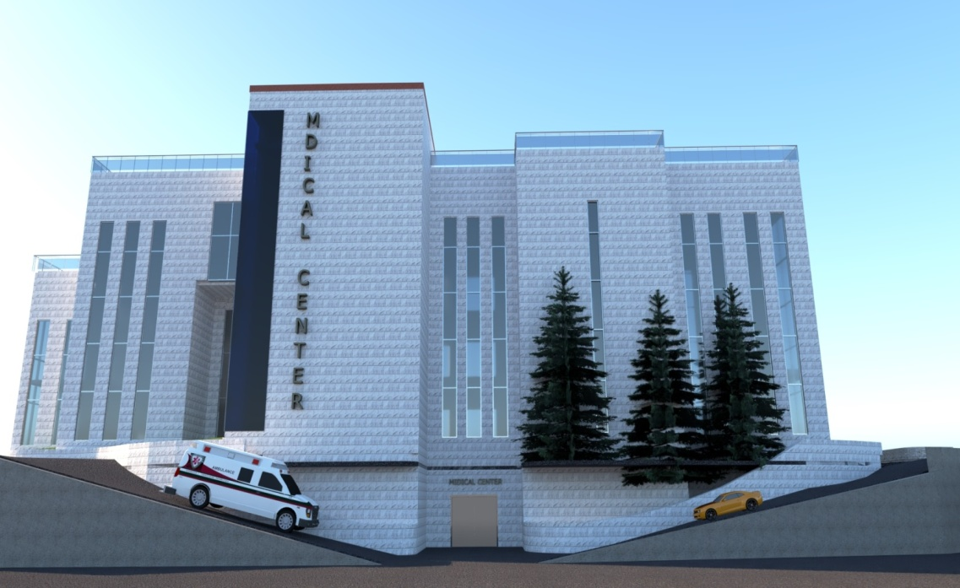
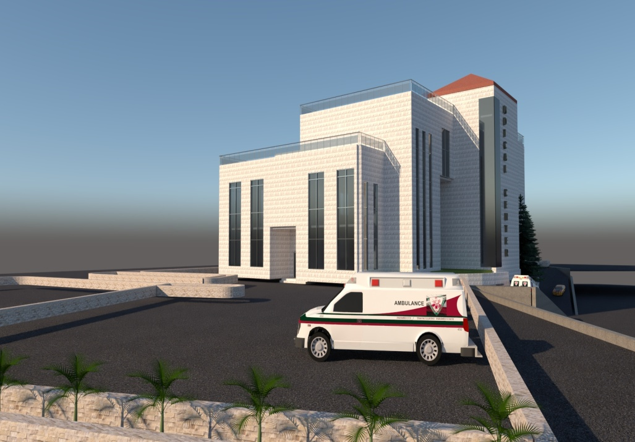
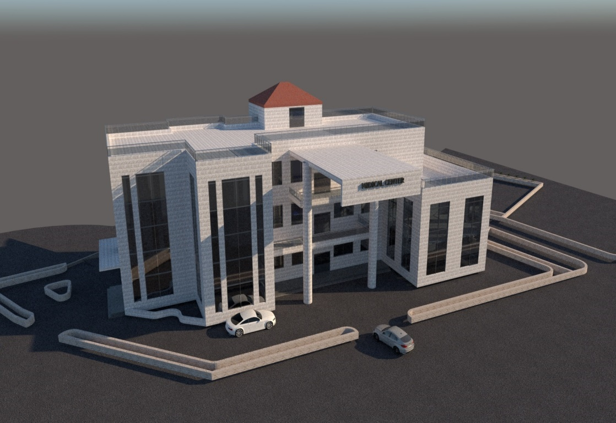
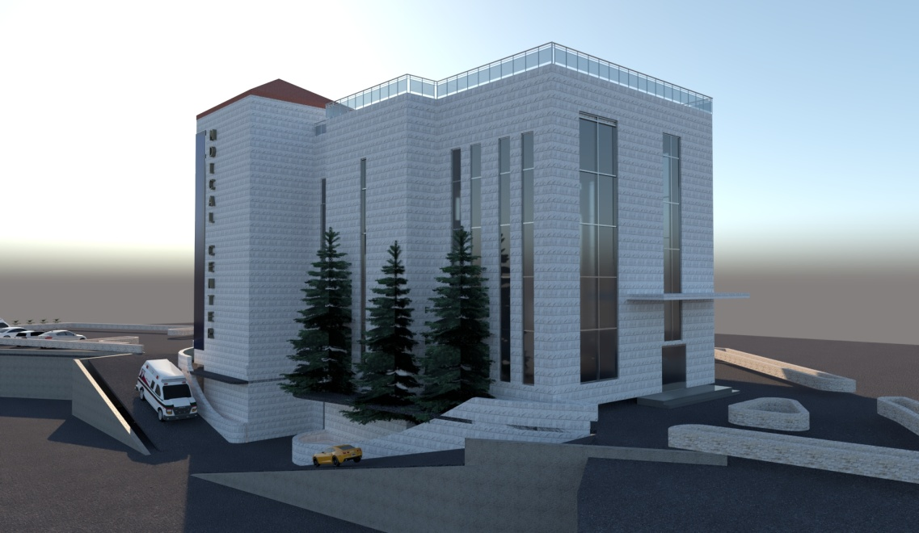
Architectural design:
3D View

Slide 16
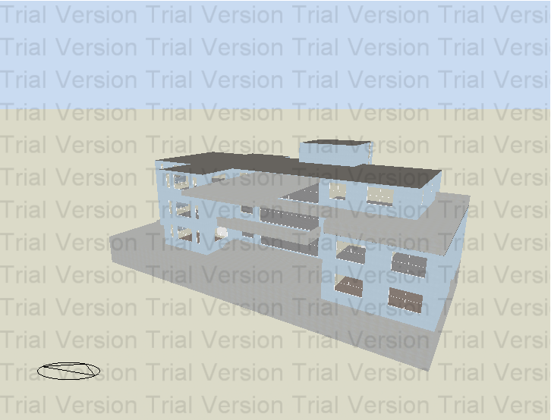
Environmental design:

Slide 17
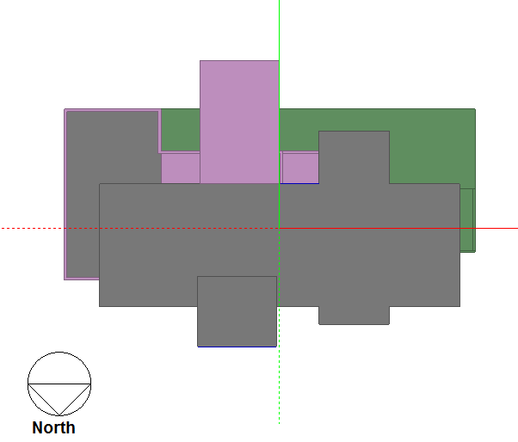
Environmental design:
Building orientation: the orientation of the building is decided to look as follows.

Slide 18
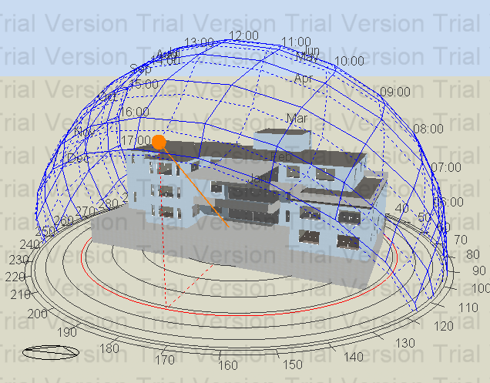
Shading in winter:
@ 12:00 AM

Slide 19
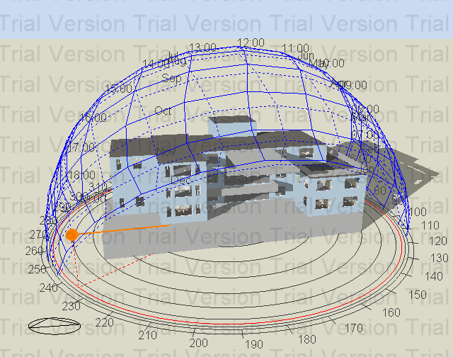
@ 4:00 PM

Slide 20
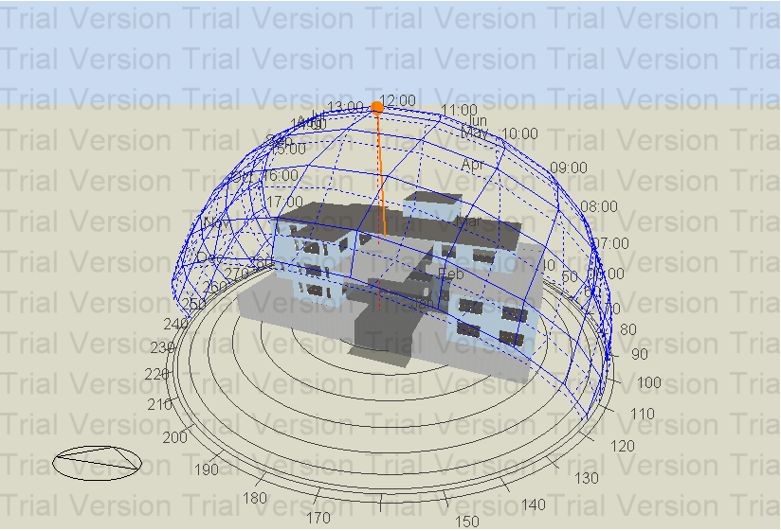
Shading in summer:
@ 12:00 AM

Slide 21
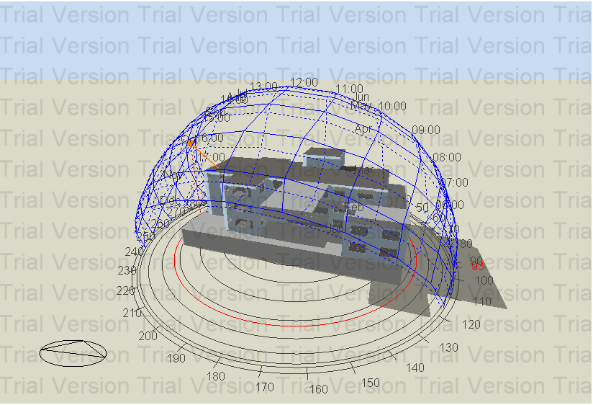
@ 4:00 PM

Slide 22
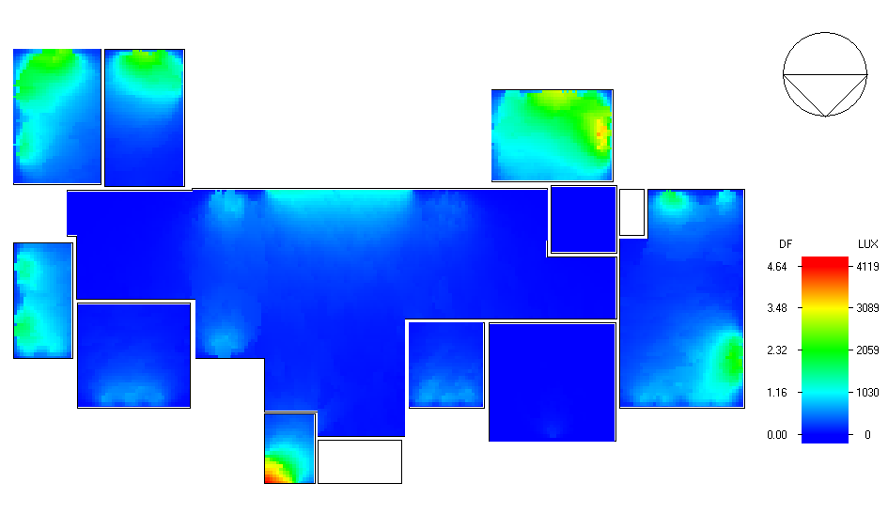
Day light factor: the day light and artificial lighting are good in the building as it looks below.
Ground floor’s daylight.

Slide 23
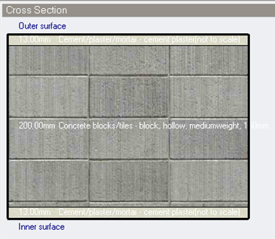
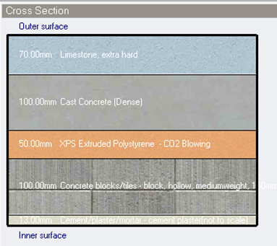
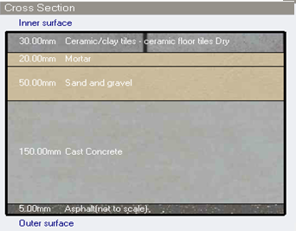
Materials:
Internal wall layers
(U-value =1.616 W/m².K)
External wall layers
(U-value =0.35 W/m².K)
Ground floor layers
(U-value =2.298 W/m².K)

Slide 24
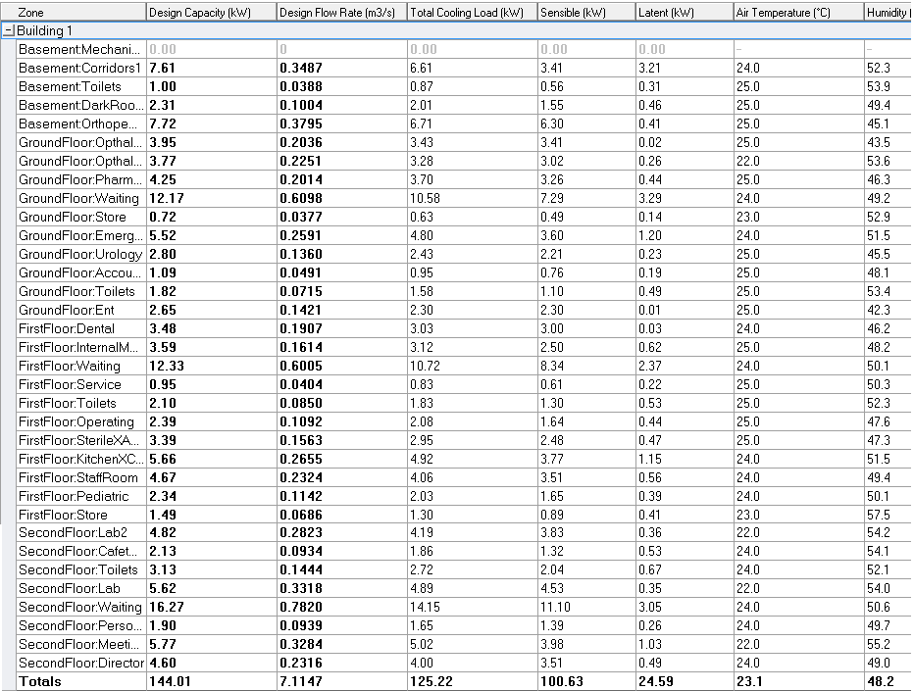
Thermal analysis:
Cooling design
Total cooling load capacity = 144.01 kW

Slide 25
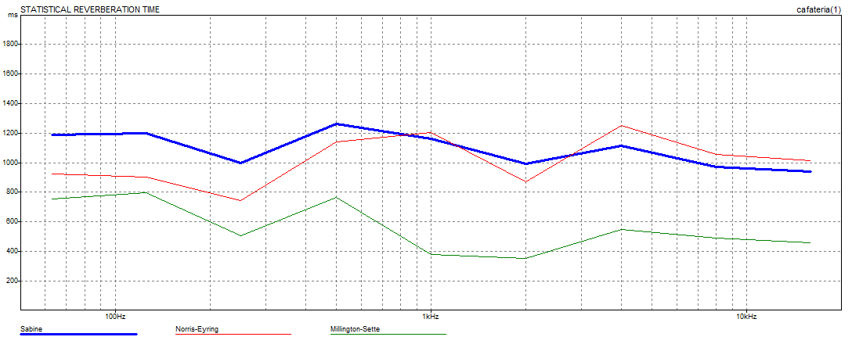
Acoustical design:
The optimum reverberation time (RT60)
For a mini cafeteria is
( 0.6-1.3).
A concrete block coarse in wall and acoustics al board ¾ in thick in suspension system in the ceiling are used to get required RT60.
Freq. | Total Absorption. | Sabine RT(60) | NOR-ER RT(60) | MIL-SE RT(60)
63Hz | 327.210 | 0.78 | 0.67 | 0.52
125Hz | 327.118 | 0.78 | 0.65 | 0.54
250Hz | 399.314 | 0.64 | 0.50 | 0.35
1kHz | 321.810 | 0.79 | 0.82 | 0.29
2kHz | 381.914 | 0.66 | 0.57 | 0.26
4kHz | 296.875 | 0.82 | 0.93 | 0.42
8kHz | 304.225 | 0.76 | 0.83 | 0.38
16kHz | 314.552 | 0.73 | 0.80 | 0.36

Slide 26
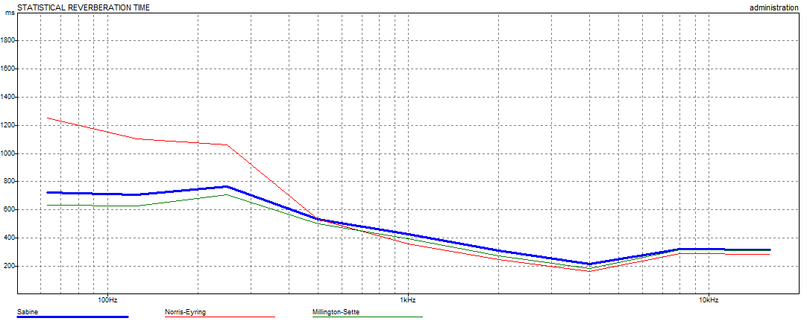
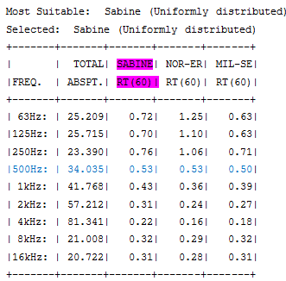
Acoustical design:
The optimum reverberation time (RT60)
for meeting room
is ( 0.3-.9).
Light weight drapery,10oz/yd^2,on , a special type of wallPlaster ,3/8in thick are used for ceiling to get required RT60.

Slide 27
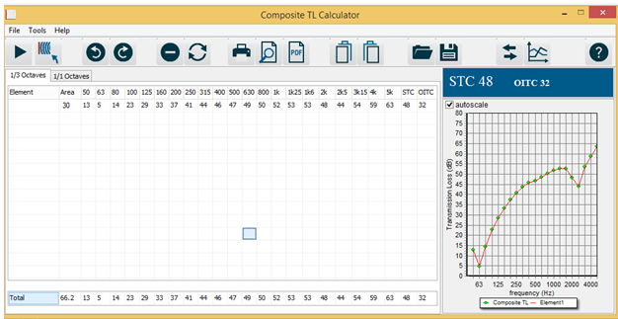
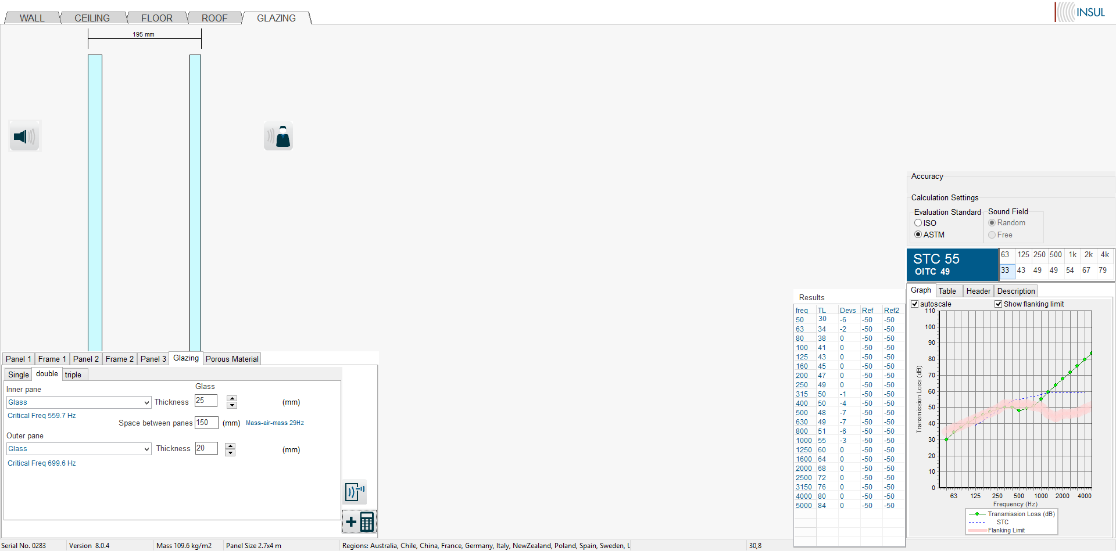
Acoustical design:
The value of STC for wall equals 48dB.
After treatment we used 6mm glaze and 130mm air gap of window then STC become 55db and it equal Required value

Slide 28
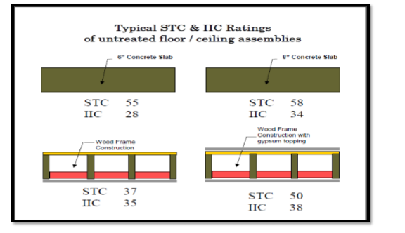
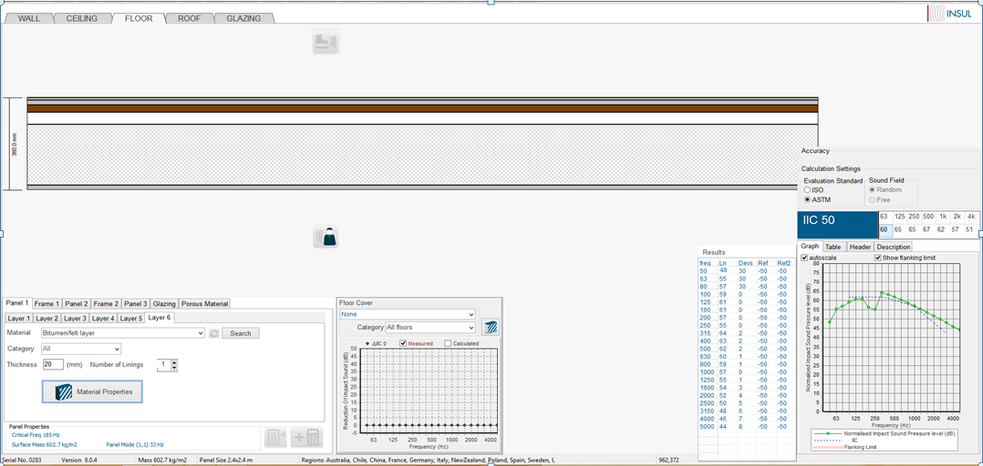
Acoustical design:
The value of IIC equals 34 because
the floor has two way solid slab.
When the ceiling designed in INSUL program gives a IIC value equals to 50 Db.

Slide 29
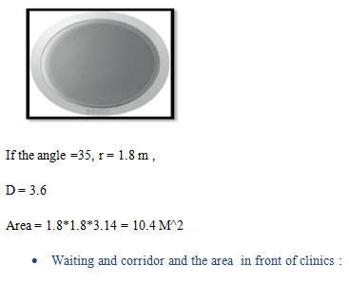
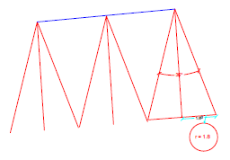
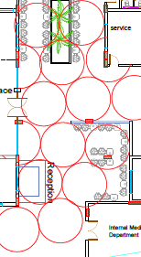
Acoustical design:
Distribution of speakers for waiting

Slide 30
Structural design:
Codes and Standards:
ACI -318-11 for reinforced concrete structural design.
UBC -97 for earthquake design.
ASCE 7 2010 for load combinations

Slide 31
Structural Design
The medical center 4 floors are made completely of reinforced concrete.

Slide 32
Structural Design
Codes and Standards:
ACI -318-11 for reinforced concrete structural design.
UBC -97 for earthquake design.
ASCE 7 2010 for load combinations
For the design of the structure and its elements ETABS , SAP and hand calculations were used .

Slide 33
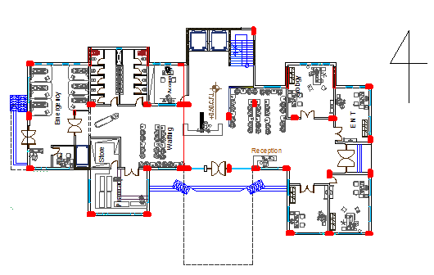
Structural Design

Slide 34
Structural Design
Design data:
Concrete strength, f’_{c}=24 MPa.
Steel yield strength f_{y}=420 MPa.
Bearing capacity for soil = 250 kN/m²

Slide 35
Structural Design
Vertical Loads:
Live Load (kN/m²) 4 kN / m²
SID ( kN /m²) 6 kN / m²

Slide 36
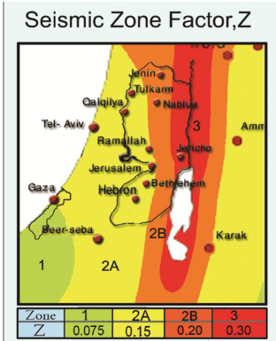
Structural Design
Seismic Design data :
The city of structure is talfet.
The seismic zone factor. Z=0.2.
The soil profile is type Sd.
The acceleration seismic coefficient Ca=0.28
The velocity seismic coefficient Cv=0.4.
The Seismic importance factor is 1.25
The structural design type is intermediate, R=5.5

Slide 37
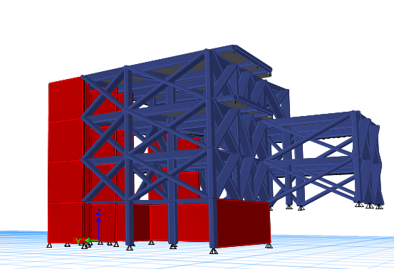
Modeling

Slide 38
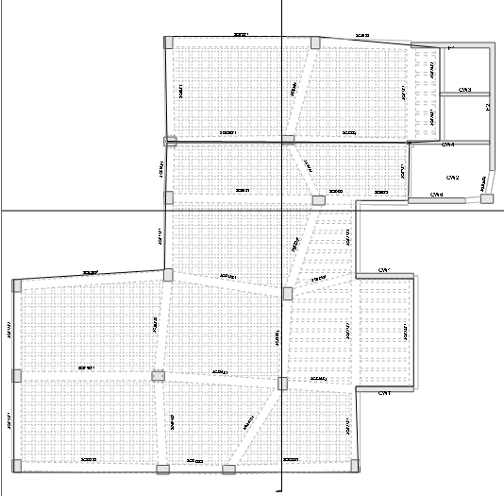

Slide 39
Sections Dimensions
Structural Element | Dimensions
Ribbed Slab | 30 cm thickness
Columns | (70X30) and ( 70X50)
Beams | ( 50X60) , ( 40 X 30 ) , ( 30 X 30 )

Slide 40
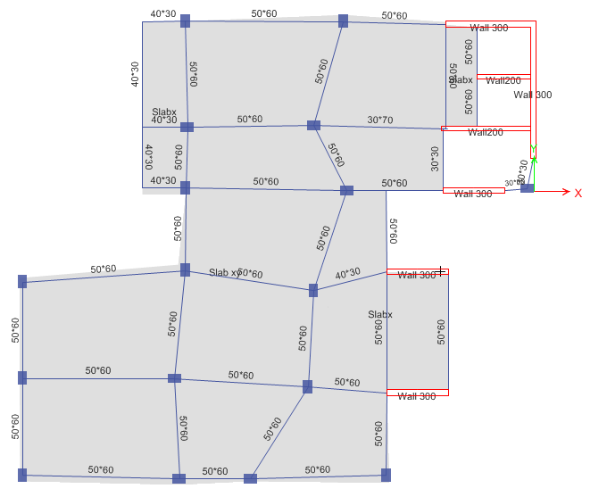

Slide 41
Verification of the model
Compatibility check
Equilibrium check
Stress – strain (local check)

Slide 42
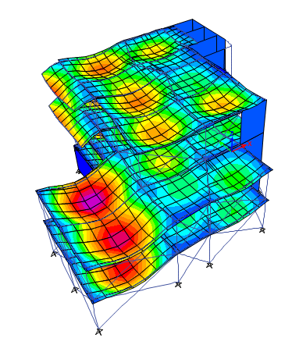
Verification of the model
Compatibility check

Slide 43
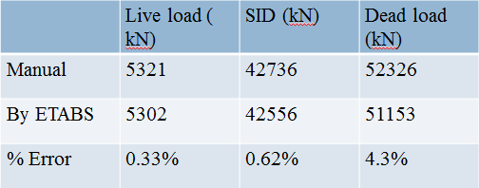
Verification of the model
Equilibrium Check

Slide 44
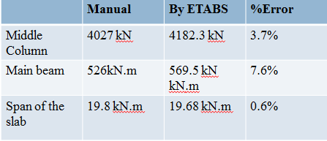
Verification of the model
Stress- strain (local check)

Slide 45
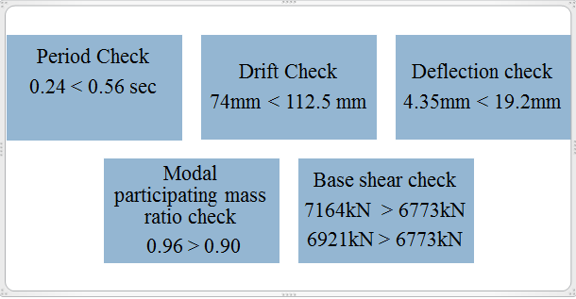
Design checks

Slide 46
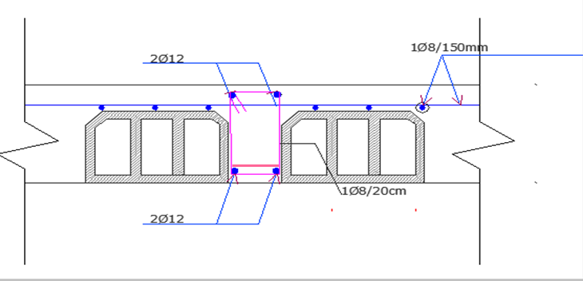
Slab Reinforcement

Slide 47
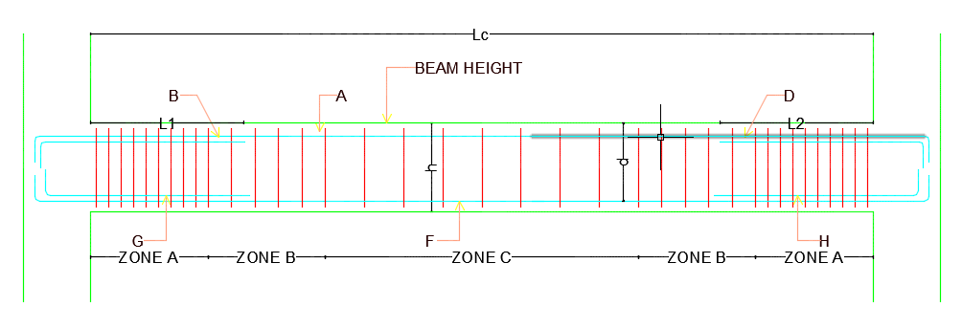
Beams Reinforcement

Slide 48
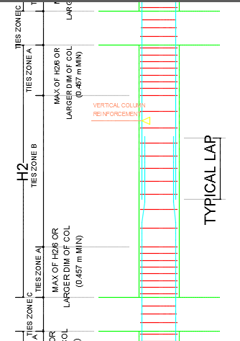
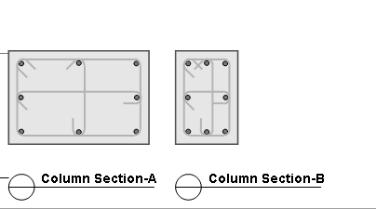
Columns Reinforcement

Slide 49

Footing Reinforcement

Slide 50


Shear Wall Reinforcement

Slide 51

Stair Reinforcement

Slide 52
Mechanical design:
Water supply.
Drainage.
HVAC.
Firing system.

Slide 53


Water supply design:(left part)
Water consumption in medical center is 5L/PERSON :
#floor/fixture | Wc | Lavatory | Kitchen sink
Basement | 9 | 13 | 0
Ground floor | 9 | 17 | 0
1st floor | 9 | 19 | 4
2nd floor | 9 | 14 | 2
Total | 36 | 63 | 6

Slide 54

Water supply design:(right part)

Slide 55


distribution of water supply

Slide 56





drainage system design :

Slide 57

Layout for drainage in all building:

Slide 58

Drainage system for the rainwater

Slide 59
HVAC design:
VRF system is chosen to be used .
All of the components are chosen from (Toshiba) and they are shown as follows:
Main unit (outdoor unit)
Controller
The indoor unit

Slide 60




Components

Slide 61


HVAC
Room | Volumetric flow rate (m3/s) | # of diffusers
Emergency (G.F) | 0.2591 | 2
Waiting ( first floor) | 0.6005 | 4
Lab ( second floor) | 0.3318 | 2

Slide 62

Electrical design:

Slide 63


Electrical design:

Slide 64


Electrical design:

Slide 65

Electrical design:
Visual glare area
Max = 15.1 <19 ok
glare description

Slide 66


Electrical design:

Slide 67

Electrical design:

Slide 68


Electrical design:

Slide 69




Fire and safety:
Warning signs

Slide 70




Fire and safety:
.
:.
Dry and Wet Chemical Extinguishers
CO2 or Dry Chemical and Carbon Dioxide Extinguisher
Multi-purpose -Dry Chemical Extinguisher
Sprinkler

Slide 71

Fire and safety:

Slide 72

Reflecting ceiling :

Slide 73

Quantity and surveying
Total unit cost = 1750NIS/M^2

Slide 74


