Slide 1
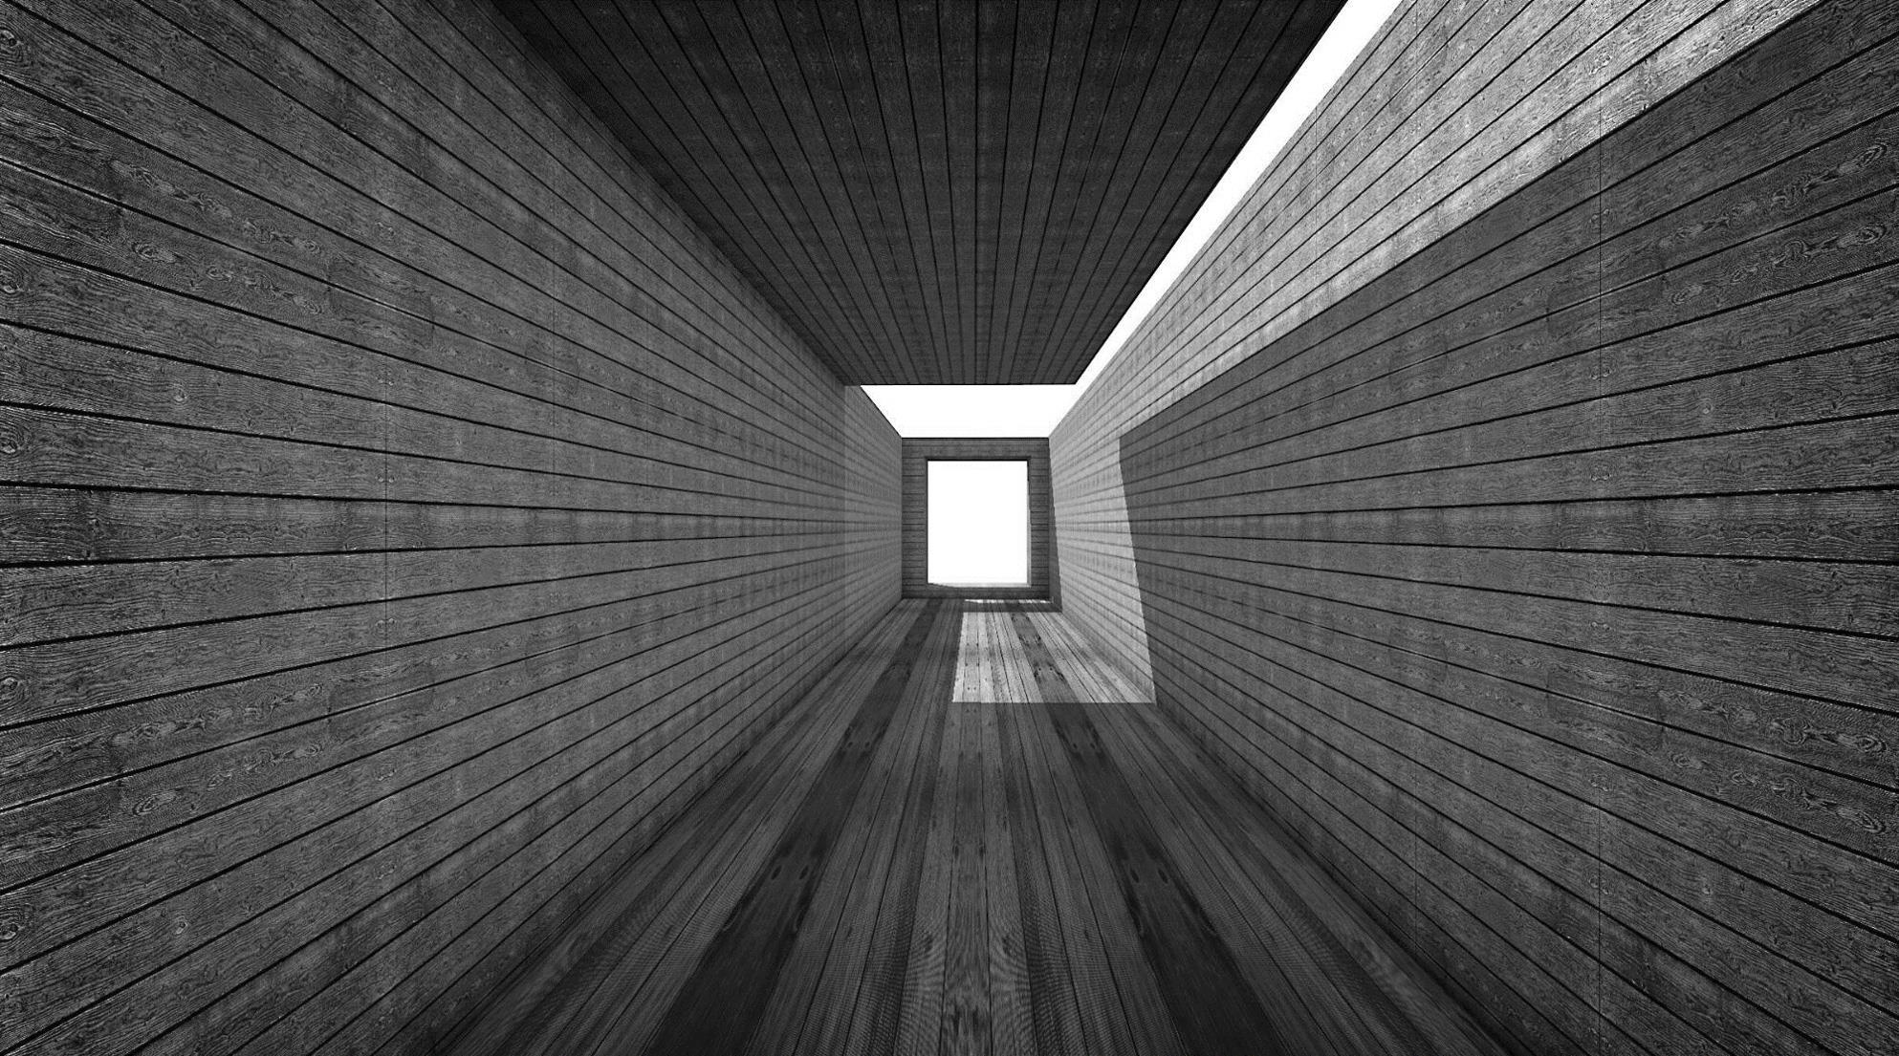
Assessment of Al-Manara Mall
Basel Aker.
Fadi Melhem.
Hala Khayyat.
Tasneem Mletat.
Quantity Surveying & Cost Estimate.

Slide 2

INTRODUCTION
Construction is one of the most important economic sectors in the world and it plays a major role in the development of any nation.
The construction industry is different from other industries because of its unique characteristics, which include the construction process, project management methods, working environment and conditions and worker behaviors.

Slide 3
Objectives
Calculate the budgeted cost and price for foundation, structural elements, partitions, stone and plastering after estimated the quantities takeoff for it.
Calculate the optimal period needed to finish works by depending on productivity rate for resources.

Slide 4
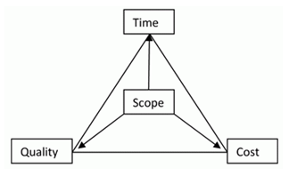
Project Management
Project management is the application of processes, methods, knowledge,
skills and experience to achieve the project objectives.
Function of Management:
Planning.
Organizing.
Staffing.
Controlling.

Slide 5




Key Participant
Owner
Contractor
Consultant

Slide 6
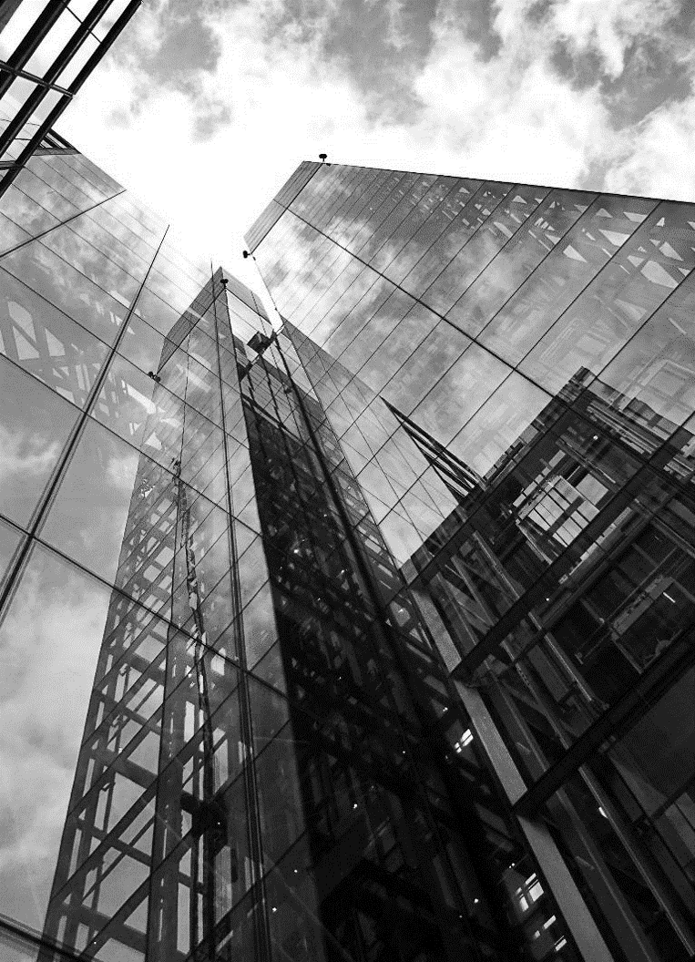


Delivery System
Project delivery systems refer to the overall processes by which a project is designed, constructed, and/or maintained.
Design bid build design
is the traditional delivery system for the public sector, in which an agency will use in-house staff (or, alternatively, use consultants) to prepare fully completed plans and specifications that are then incorporated into a bid package.
Design build
is a project delivery system involving a single contract between the project owner and a design-build contractor covering both the design and construction of a project

Slide 7

Construction Contract
Formal agreement for construction, alteration, or repair of buildings or structures.
A construction contract is distinct from a contract to assemble, fabricate, or manufacture.
Types of contract
Lump sum.
Unit rate.
Cost plus fee.

Slide 8
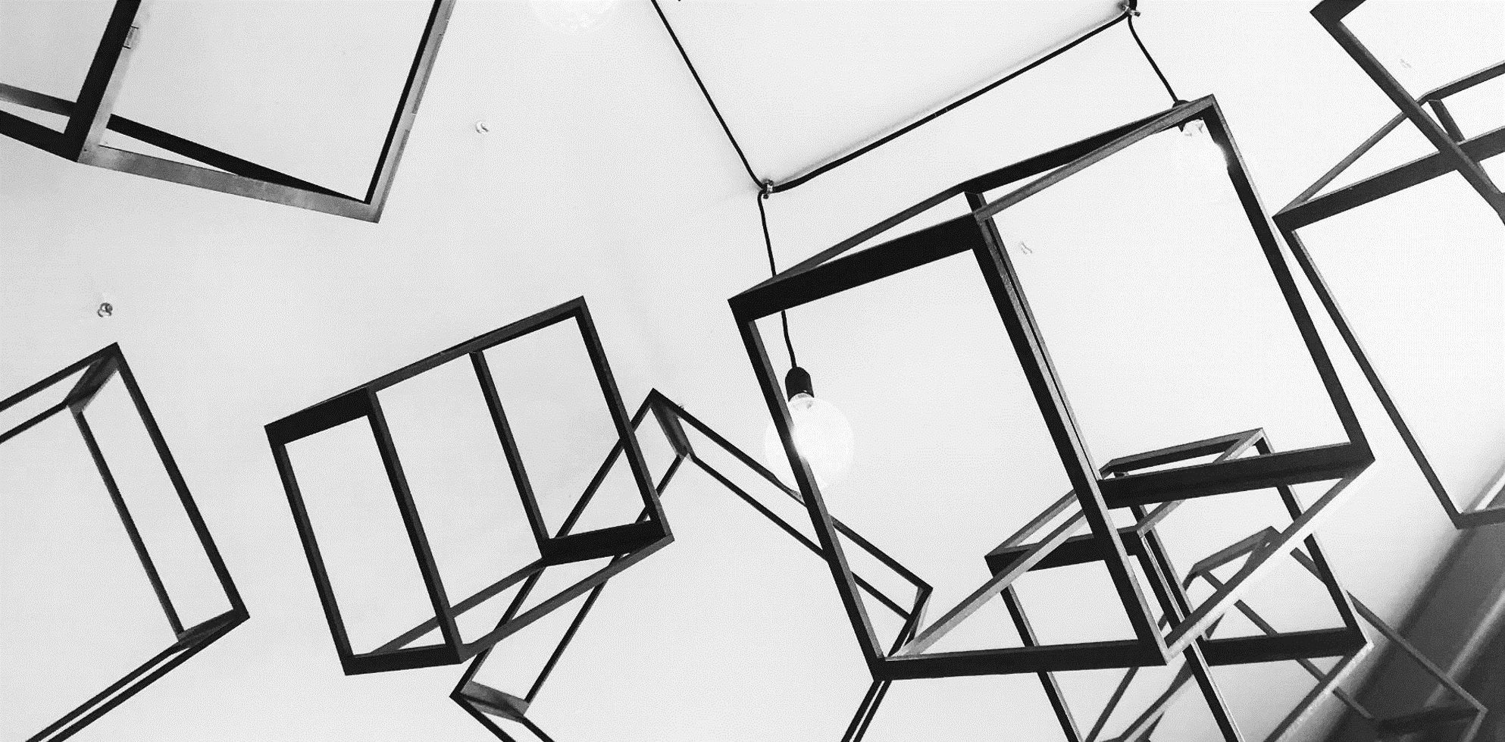
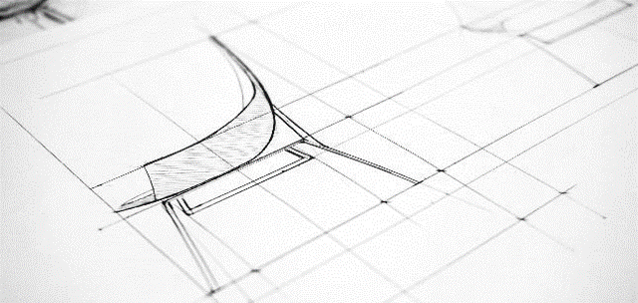
1.Work Break Down Structure.
Quantity surveying
Is a key project deliverable that organizes the team's work into manageable sections also it is a hierarchical decomposition of the total scope of work to be carried out by the project team to accomplish the project objectives and create the required deliverables.

Slide 9



Work Break Down Structure
WHAT
WHO
HOW MUCH
Things that will be done?
The contractor, labor and the crows.
The most important thing in management, how much will cost with our specifications.

Slide 10
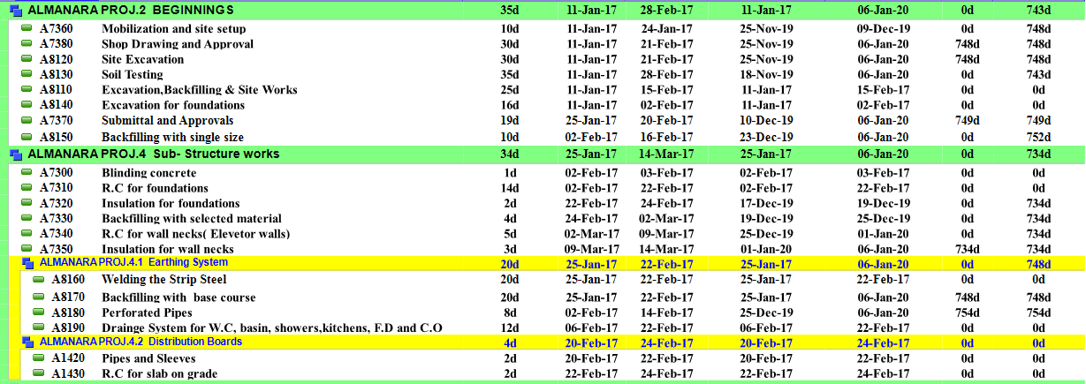
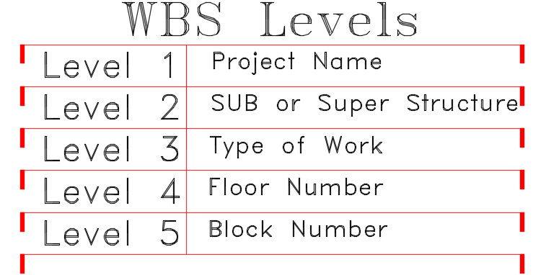
Work Break Down Structure
This two pictures shows how we make our WBS for the project.

Slide 11
2.Importance of Quantity Survey
Variations
Costing
Quality

Slide 12
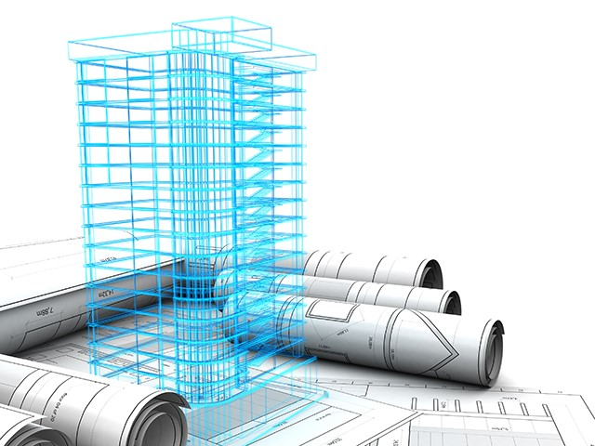
3.Quantity Take-off
Quantity take-offs (QTO) is an in-depth construction estimation of materials and labor required to complete a construction project.

Slide 13
Project Description
Al -Manara Mall is located in downtown Ramallah city in a lot of 2632 m2 area, the building is boarded from the northeast side "YohannaMemadan" street and from the southwest side "GourgeSaa" street.
Al-Manara Mall consist of 15 floors which will contains car parking, police station and offices.
The building has many entries which reaches different floors to make the accessibility easier, also it contains two stairwells, 5 elevators and electrical drawer to move between first and second floor.

Slide 14
Height | Area | Description | Floor
3.12 | 1886 m² | Contains car parking which can accommodate 17 cars, and electrical mechanical control rooms also contains entrance and exit for car movement. | Fifth basement
3.12 | 1875 m² | Contains car parking which can accommodate 44 cars. | Fourth basement
3.12 | 1875 m² | Contains car parking which can accommodate 44 cars. | Third Basement
3.12 | 1882 m² | Contains car parking which can accommodate 44 cars. | Second Basement
3.76 | 1986 m² | Contains car parking which can accommodate 34 cars. also contains police station, bathrooms and 7 commercial shops. | First Basement
3.64 | 1895 m² | Contains police station, internal commercial shops and chute for cars movement between the floors. | Ground Floor
3.64 | 1939 m² | Contains public service center and chute for cars movement. | First Floor
3.12 | 1908 m² | Contains car parking which can accommodate 35 cars and service rooms. | Second Floor
3.12 | 1732 m² | Contains car parking which can accommodate 45 cars. | Third Floor
4.12 | 1492 m² | Contains car parking which can accommodate 45 cars. | Fourth Floor
3.12 | 1732 m² | Contains car parking which can accommodate 35 cars. | Fifth Floor
3.38 | 1482 m² | Contains offices. | Sixth Floor
3.38 | 1419 m² | Contains offices. | Seventh Floor
3.38 | 1193 m² | Contains offices and terrace. | Eighth Floor
3.64 | 1193 m² | Contains offices. | Ninth Floor
2.86 | 90 m² |  | Roof exit (staircase)

Slide 15

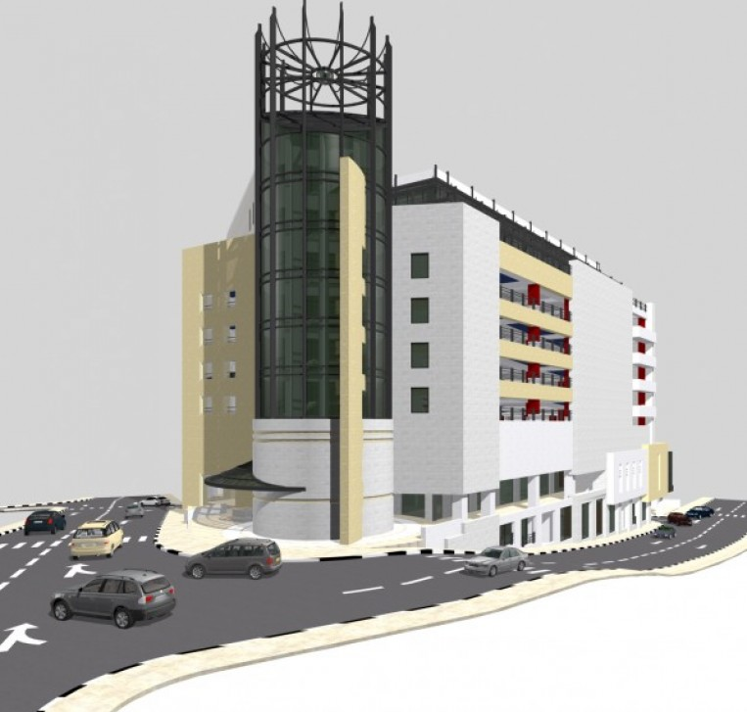
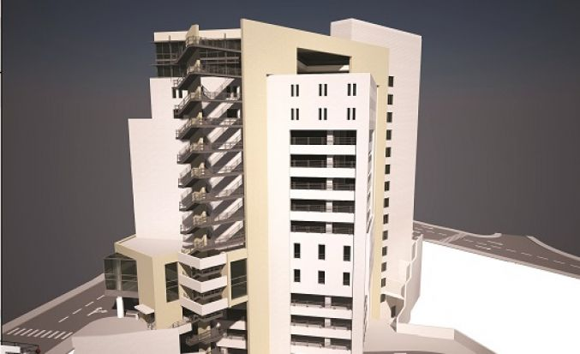
Contoso Ltd.

Slide 16

Autodesk Revit Architecture is a robust architectural design and documentation software application created by Autodesk for architects and building professionals. The tools and features that make up Revit Architecture are specifically designed to support building information modeling (BIM) workflows.

Slide 17
How we use Revit software in our project?
3D Model
Video
Concrete Quantity survey
By using the Revit functions for drawing we drew:
Mat Foundation
Columns
Shear walls
Slabs
Beams
Making the video for the project by using the model from Revit and using (LUMION 9) to complete the video.
:We calculate
( Mat foundation, beasm, slabs .(and columns concret

Slide 18
Time Management
Time management is important in any construction project
Without proper time management, many problems will occur such as extension of time or time overrun.
Delay or time overrun will affect all parties involved in the project.
It will affect the profits which would be obtained if the project can be completed on the schedule.
But due to the time overrun, contractors had to spend more money on labor, plant and may lose the opportunity to get the next project.
Scheduling Systems:
Gantt Chart Scheduling
Network Diagramming
Line-of-Balance Scheduling

Slide 19
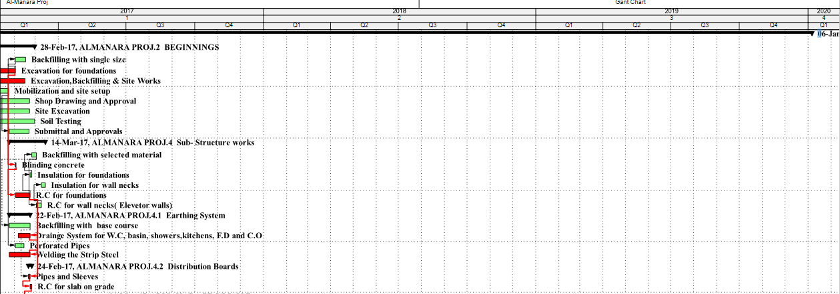
We used Gantt chart in our project

Slide 20
Delay
It is the amount of the difference among the planned time for the construction project on the actual time of completion.
Non-Excusable Delays
Excusable delays

Slide 21

Resources
A resource is a necessary asset whose main role is to help carry out a certain task or project.

Slide 22

Time and Cost Management Using
Primavera Software

Slide 23
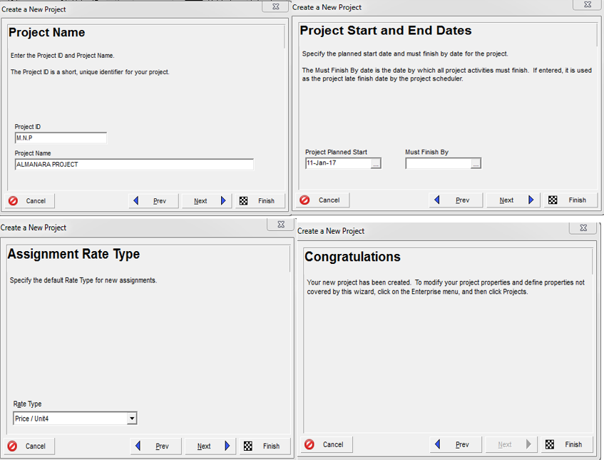
Project Definition In Primavera

Slide 24
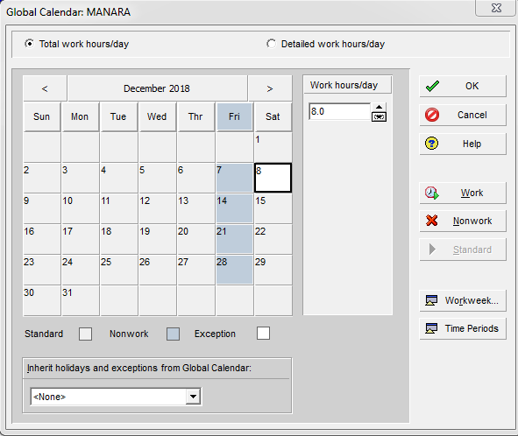
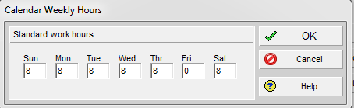
Calendar Definition

Slide 25
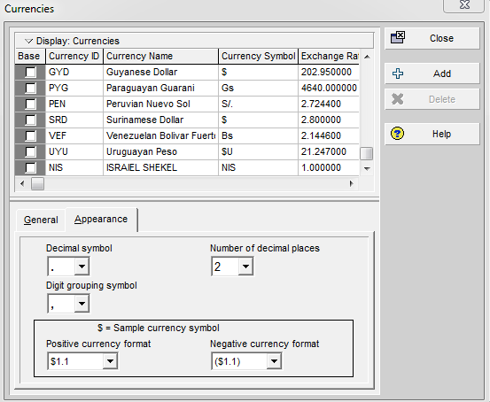
Currency Definition

Slide 26
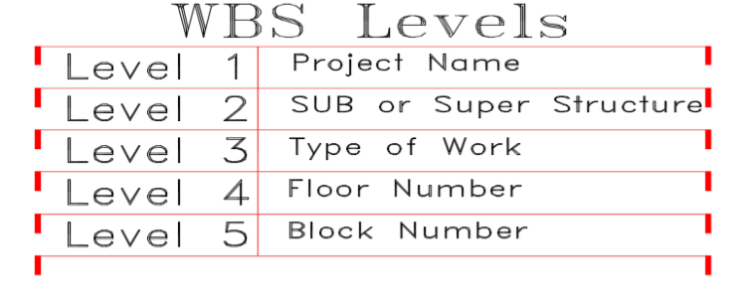
Work Breakdown Structure
(WBS) Assignment

Slide 27
Activities Definition

Slide 28
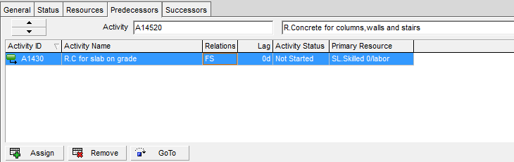
Activities Relationships Assignment

Slide 29
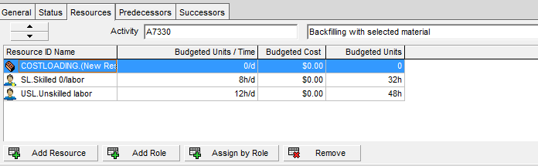
Resources Assignment

Slide 30
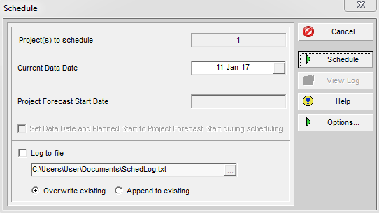
Schedule (Run)

Slide 31
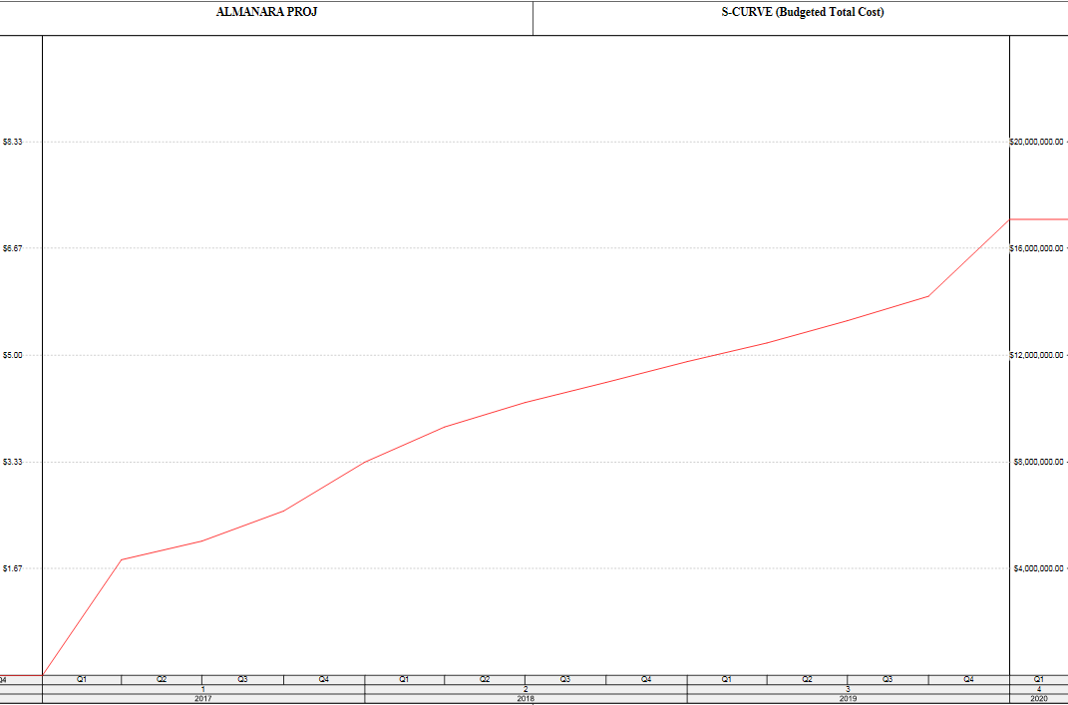
S-Curve

Slide 32
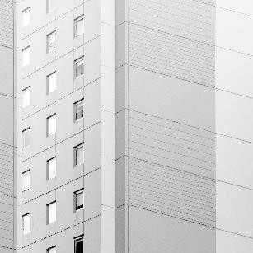

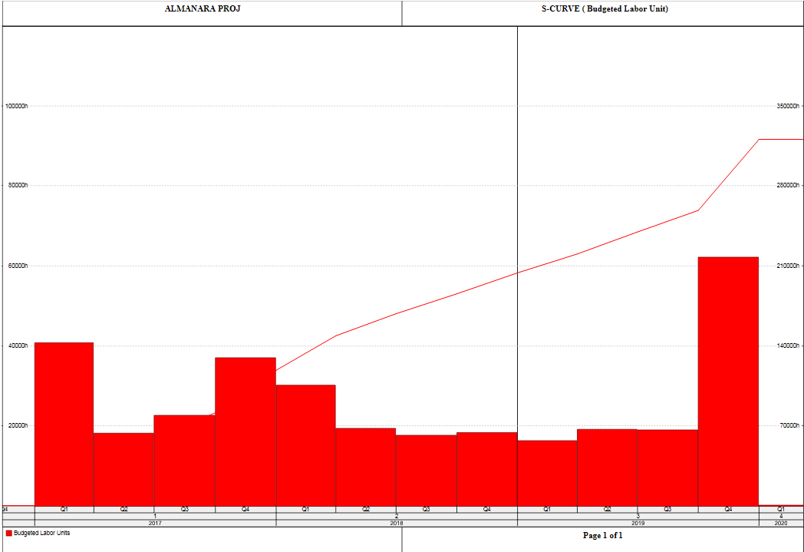
Resource management using Primavera.
*By using primavera we distribute the labors on activites and the histogram shows the labors distributions each quarter.

Slide 33

Hand calculations
We calculate the steel quantities using the traditional way. The general equation is (diaˆ2* L*#Bars/162 ).

Slide 34

Cost and Price Estimate

Slide 35
Cost and Price Estimate
After we calculate the quantities for the project we multiply the quantities with its unit rate.
The unit rate contains (labor +material+ benefit).
The direct and indirect cost are calculated within unit rate.
Making BOQ for the project which will contain the final cost for project.

Slide 36
AMOUNT (NIS) | RATE (NIS) | Quantity |  | unit | Item Description
618620.8 | 28.00 |  | 22093.6 | C.M | Site Leveling and Excavation to reduced level.
144730.8 | 45.00 |  | 3216.24 | C.M | Excavation for Foundation
296972.5 | 50.00 |  | 5939.45 | C.M | Imported fill
96698.88 | 432.00 |  | 223.84 | C.M | Supply and cast plain concrete, blinding concrete grade B 200 under foundations and tie beams
3486000 | 1162.00 |  | 3000 | C.M | Mat foundation
256425 | 1315.00 |  | 195.00 | C.M | Ground & Tie beams including concrete nibs for stone building where needed.
541800 | 1400.00 |  | 387.00 | C.M | Column Necks.
2962980 | 1593.00 |  | 1860.00 | C.M | Supply and cast reinforced concrete grade B400 for Columns
2537500 | 1015.00 |  | 2500 | C.M | Reinforced Fair Face Concrete walls; (Shear walls)
29900 | 650.00 |  | 46.00 | C.M | Slab on Grade for Landscape and site works (15 cm) thick.
139320 | 430.00 |  | 324.00 | C.M | 18 cm Solid Slab
151200 | 420.00 |  | 360.00 | C.M | 20 cm Solid Slab
189000 | 420.00 |  | 450.00 | C.M | 25 cm Solid Slab
293760 | 510.00 |  | 576.00 | C.M | 32 cm Solid Slab
495000 | 550.00 |  | 900.00 | C.M | 50 cm Solid Slab
196650 | 345.00 |  | 570.00 | C.M | Supply and Cast Reinforced Concrete Grade 'B300', with a minimum cement content of 300 Kg. per cubic meter for 28 cm thick suspended ribbed slabs
141600 | 354.00 |  | 400.00 | C.M | Supply and Cast Reinforced Concrete Grade 'B300', for 50 cm thick suspended Waffle slab
27000 | 18.00 |  | 1500.00 | C.M | supply and apply monolithic surface hardener on the surface of parking floors
654080 | 1022.00 |  | 640.00 | C.M | Supply and Cast Reinforced Concrete Grade B300 for stairs
1053000 | 1350.00 |  | 780.00 | C.M | Supply and Cast Reinforced Concrete Grade B300 for Circular stairs.
191079.00 | 81.00 |  | 2359.00 | M.S | 10 cm thick walls ( 10X20X40 )
4407.00 | 113.00 |  | 39.00 | M.S | 15 cm thick walls ( 20X20X40 )
111644.00 | 113.00 |  | 988.00 | M.S | 20 cm thick walls ( 20X20X40 )
165100.00 | 100.00 |  | 1651.00 | M.S | 10 cm thick for Exterior Walls thermal insulation inner side (10X20X40),
193400.00 | 100.00 |  | 1934.00 | M.S | 10 cm thick for Exterior Walls for Basement outer side (10X20X40), specifications and Engineer's instructions.
898380.00 | 420.00 |  | 2139.00 | M.S | Stone Works : (25+1) cm course height stone façade for Building.
 |  |  |  |  | Supply and build stone walls local stone
2220700.00 | 530.00 |  | 4190.00 | M.S | (25+1) cm course height stone façade for Building.
195050.00 | 470.00 |  | 415.00 | M.S | (25+1) cm course height stone for Landscape walls and planters, at any size and texture as required by drawings.
381745.00 | 455.00 |  | 839.00 | M.S | Copings, Supply and build 5 cm Stone Copping, for roof and terraces, openings, parapets
17100.00 | 570.00 |  | 30.00 | M.S | Supply and build stone site walls
20210.00 | 470.00 |  | 43.00 | M.S | Supply and Build 5 cm Stone Copping, for landscape walls, parapets, and other tops,
173660.00 | 380.00 |  | 457.00 | M.S | Supply and install Stone Tiling Floor with Local stone tiles and granite
18884712.98 |  |  |  |  | Total cost

Slide 37
Results
The total concrete quantity =13860 m3
The total steel quantity =1274000 kg
The total cost for project= 18,884,712.98 NIS
By using Primavera the project will start at 11 Jan 2017, and the latest finish date is 1 Jan 2020.
The duration for the project is 1091 calendar days and 778 working days.

Slide 38


