Slide 1

An-Najah National University
Faculty of Engineering and Information Technology
Graduation Project Presentation II
Analysis and Design of An-Najah Modern Complex for Gravity and Dynamic Forces
Prepared By : Mohammad Iramthat Jadallah
Emran Mohammad Janem
Omar Imad Rajab
Presented to :Dr. Mahmoud M.S. Dwaikat
Dr. Mohammad Samaaneh
Eng. Fawzi Abu-Adas

Slide 2
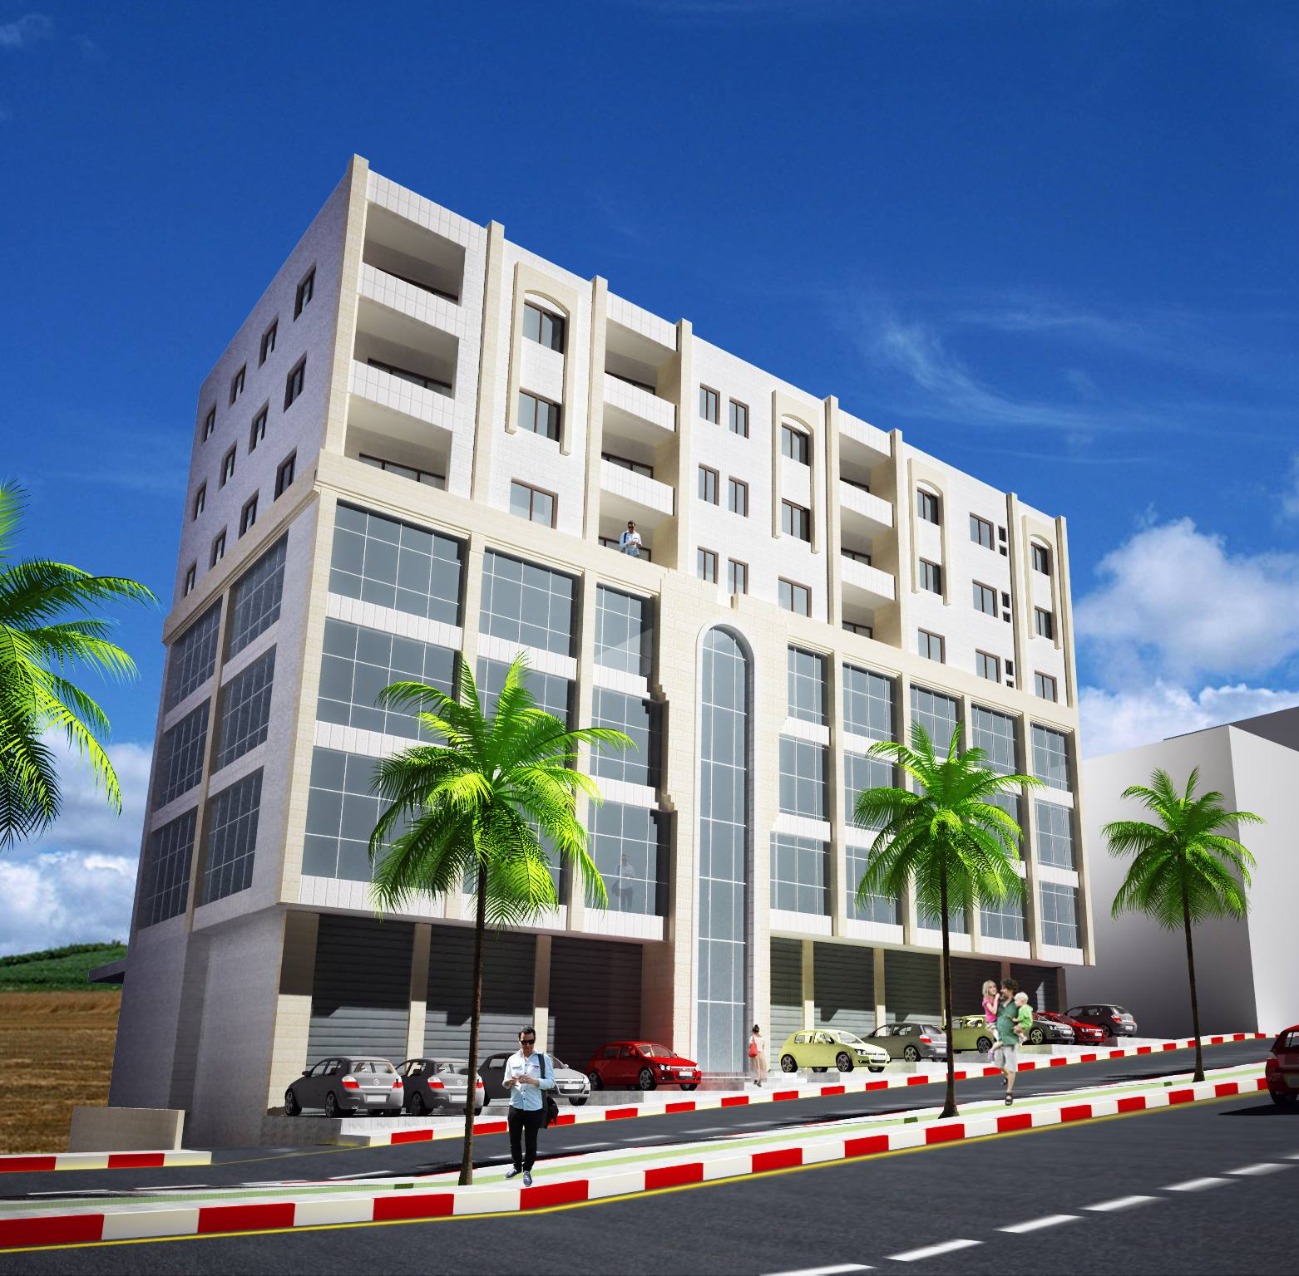

Slide 3
Outline
Abstract.
Introduction.
Model Checks.
Analysis Checks
Dynamic analysis.
Design For Gravity and Lateral Forces.

Slide 4
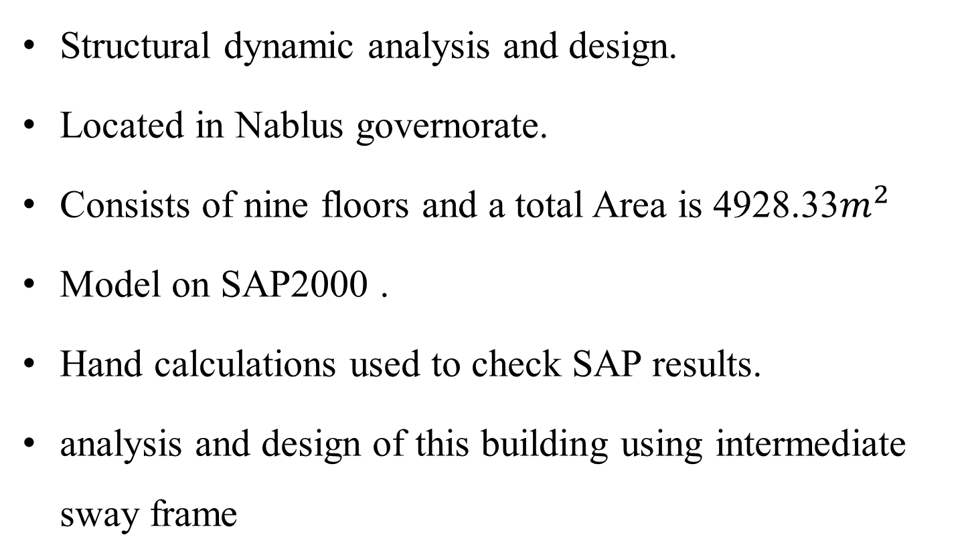
Abstract

Slide 5
Introduction
Ultimate Design Method to be used.
For Design will Use ACI 318-11 code
For Seismic Design UBC 97 Code.

Slide 6
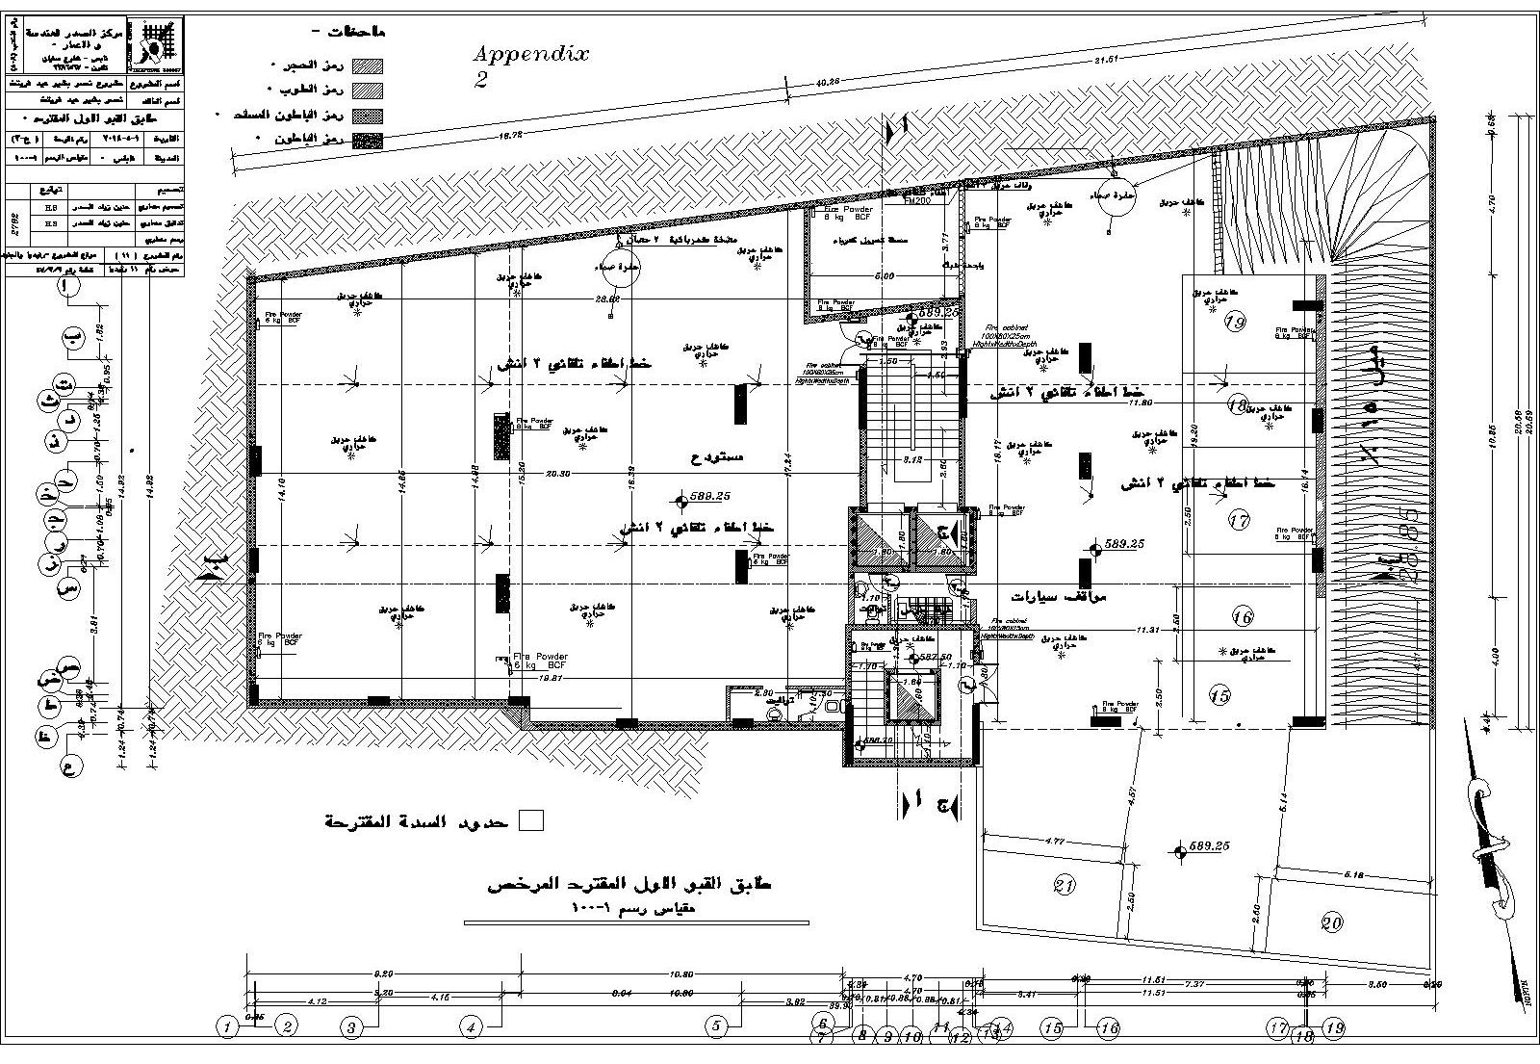

Slide 7
Introduction
Stories Properties
Story Number | Story Name | Purpose | Area | Maximum Height *
1 | Basement 2 | Parking | 649.707 | 2.85
2 | Basement 1 | Big Story + Parking | 649.707 | 5.45
3 | Ground Floor | Stores | 514.17 | 5.7
4 | First Floor | Stores | 514.17 | 4.45
5 | Second Floor | Mall | 514.17 | 3.4
6 | Third Floor | Mall | 514.17 | 3.4
7 | Fourth Floor | Restaurant | 514.17 | 3.4
8 | Fifth Floor | Residential | 514.17 | 3.4
9 | Sixth Floor | Residential | 514.17 | 3.4

Slide 8
Introduction
Challenges
The main challenges in the original design of the building are:
The Building has an irregular shape in both horizontal and vertical direction.
Each level in the Building has different uses.
Some floors have variable levels.
In one direction the building has high slenderness ratio.
The Load of stair does not seem to have a safe route to transfer.

Slide 9
Introduction
Significance of the work
The importance of the project, mainly
apply what learned in engineering courses
improve skills in analysis and design by using computer especially SAP2000. Secondly
how communicate with engineering office and with contractor through producing skeleton and drawings.

Slide 10
Material
Concrete :
Concrete strength for Slabs and Beams is B300 ( f'_{c}=24 MPa).
Concrete strength for Columns and Shear walls is B350 (f'_{c}=28 MPa).
Unit weight is 25 KN/m³.

Slide 11
Material
Reinforcing Steel :
For steel reinforcement, use Grade A60
Modulus of elasticity : 2×10⁵MPa
Steel yield strength: 420 MPa.

Slide 12
Material
Other Materials
Density(KN/m³) | Material
12 | Bricks
15 | Filler
27 | Masonry
25 | Tiles
23 | Mortar
23 | plastering
5 | Y-tong Block

Slide 13
Loads
used ACSE 7-10
Live load :
Floor | Live Load (KN/ m2)
Basement 2 | 5
Basement 1 | 5
Ground Floor | 5
First Floor | 5
Second Floor | 5
Third Floor | 5
Fourth Floor | 3
Fifth Floor | 3
Sixth Floor | 2

Slide 14
Loads
Dead load
Consist of own weight of structural elements and superimposed loads .
superimposed is coming from four sources as follows:
Internal wall (partition) is 3.1 KN/m²
External wall (masonry wall) is 2.6 KN/m²
Doors and windows is 0.8 KN/m²
Tiles is 2.6 KN/m²

Slide 15
Loads
Story Name | Snow Load (KN/ m2) | Superimposed Load (KN/ m2) | Live Load (KN/ m2)
Basement 2 | 0 | 0.8 | 5
Basement 1 | 0 | 0.8 | 5
Ground Floor | 0 | 2.8 | 5
First Floor | 0 | 2.8 | 5
Second Floor | 0 | 2.8 | 5
Third Floor | 0 | 2.8 | 5
Fourth Floor | 0 | 2.8 | 5
Fifth Floor | 0 | 2.8 | 3
Sixth Floor | 0 | 2.8 | 3
Roof | 1.5 | 0 | 2

Slide 16
Loads
Snow Load
Assumed to be 0.5 m thickness snow on the roof so the load will be = 3 KN / m3 * 0.5 = 1.5 KN/m2.
Wind Load
Neglected the effect of wind Load since it’s too much small.

Slide 17
Load Combinations
As per ACI318-11 code :
U = 1.4D
U = 1.2D + 1.6L + 0.5 (Lr or S or R)
U = 1.2D + 1.6 (Lr or S or R) + (1.0L or 0.5W)
U = 1.2D + 1.0W+1.0L+ 0.5 (Lr or S or R)
U = 1.2D + 1.0E +1.0L+ 0.2S
U = 0.9D+1.0W
U = 0.9D+1.0E

Slide 18
Project constrains
Architectural constrains.
Shape of land.
Material and tools available.
Expertise in building.

Slide 19
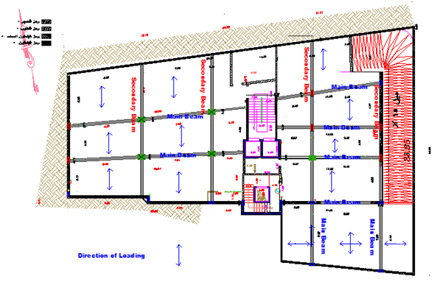
Structural Systems
Structural System in Basement 1 Floor after modifications.

Slide 20
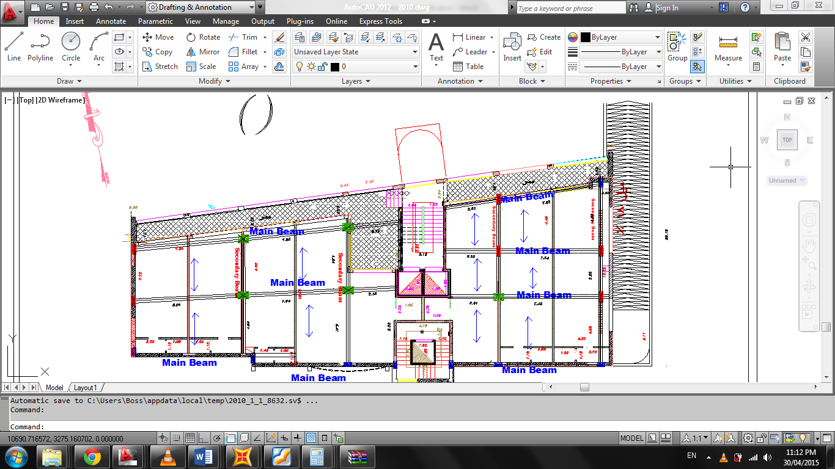
Structural Systems
Structural System in Ground Floor after modifications.

Slide 21
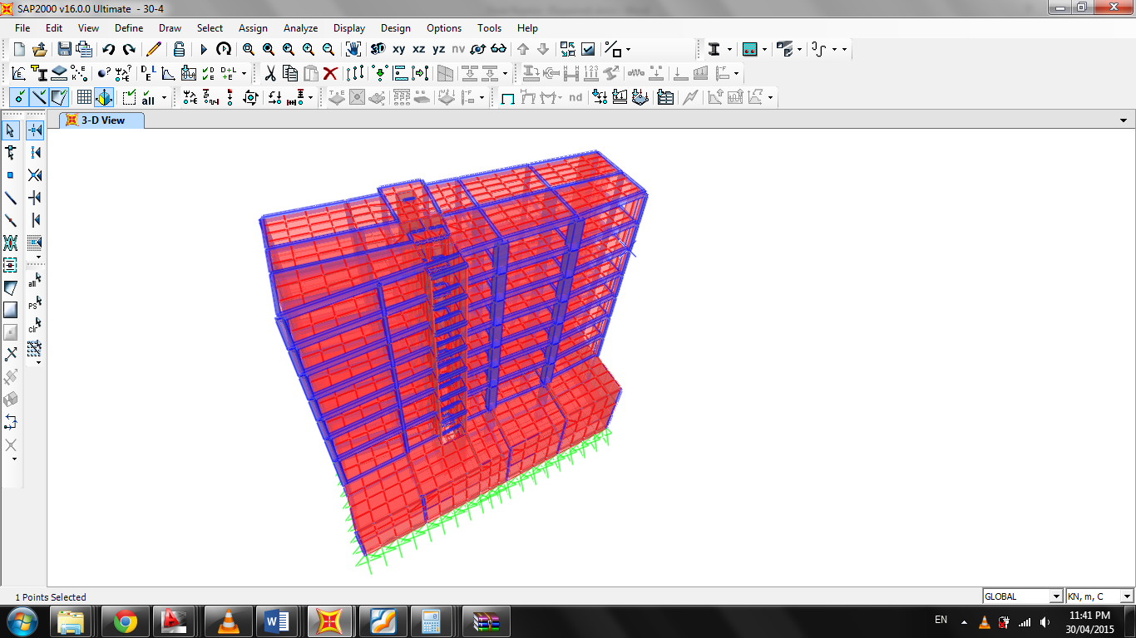
MODELING

Slide 22
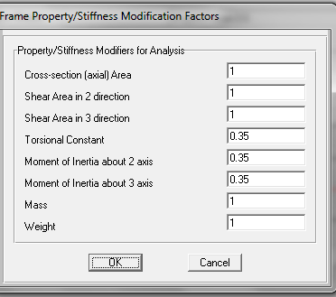
Input Data
Set modifiers for Beam Section

Slide 23

Input Data
Set modifiers for column Section

Slide 24
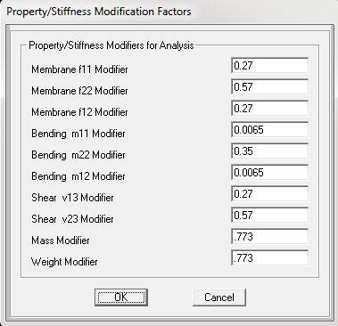
Input Data
Set modifiers for one way Ribbed Slab

Slide 25
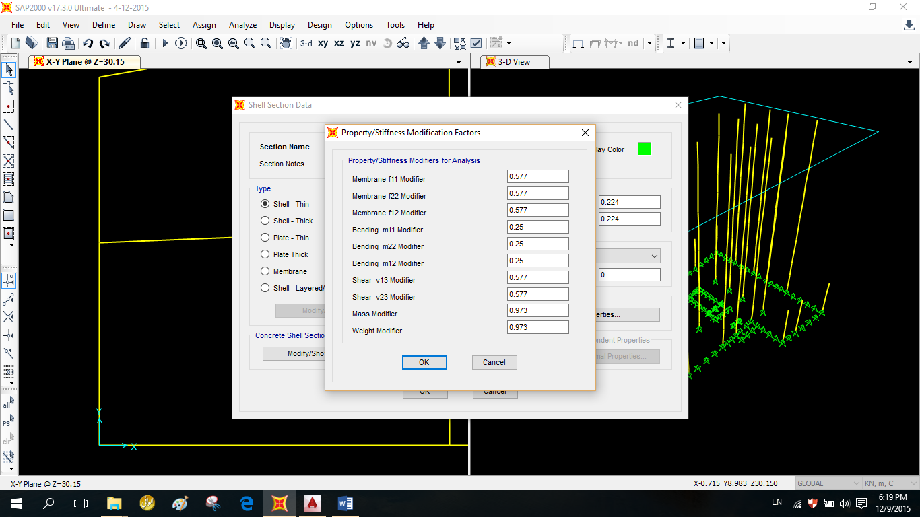
Input Data
Set modifiers for two way Ribbed Slab

Slide 26
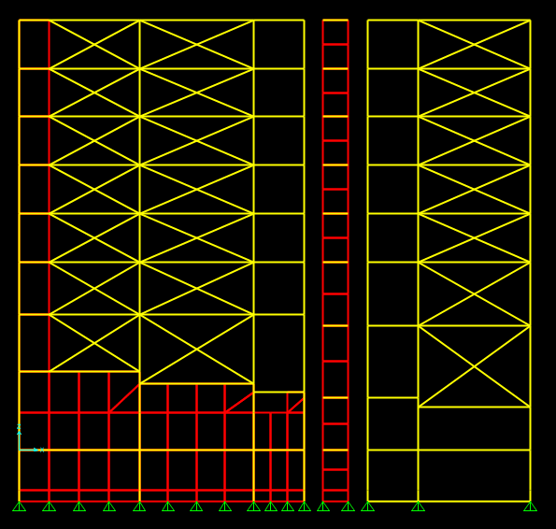
Input Data
Bracing
Type | Wall dimension(m) | H(m) | B
1 | 3.50*3.40 | 1.00 | 0.20
2 | 5.00*3.40 | 1.20 | 0.20
3 | 5.00*5.00 | 1.42 | 0.20
4 | 8.00*3.40 | 1.74 | 0.20
5 | 8.00*5.00 | 1.88 | 0.20

Slide 27
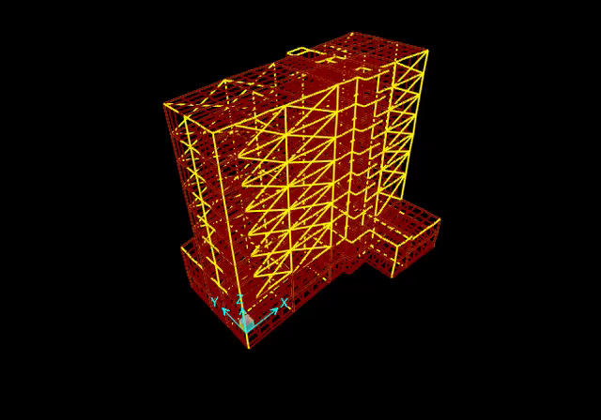
First mode (Y-direction)

Slide 28

Second mode (X-direction)

Slide 30
Dynamic analysis
Parameters of Seismic Force
Base shear Force
Structure irregularity

Slide 31
Parameters of Seismic Force
Soil profile type = S_{D}
Zone factor for Nablus city from Palestine seismic map = 0.2
Seismic coefficients C_{a} = 0.28, C_{v} = 0.40
Importance factor Special occupancy structure: I = 1
Response modification coefficient (R)=5.5 for both directions.
Structure period (T_{y}) =0.85 sec

Slide 32
Base shear Force
Equivalent static method
Direction | V_{max} (KN) | V_{min} (KN) | V (KN)
X | 5499 | 1330 | 3732
Y | 5499 | 1330 | 3930

Slide 33
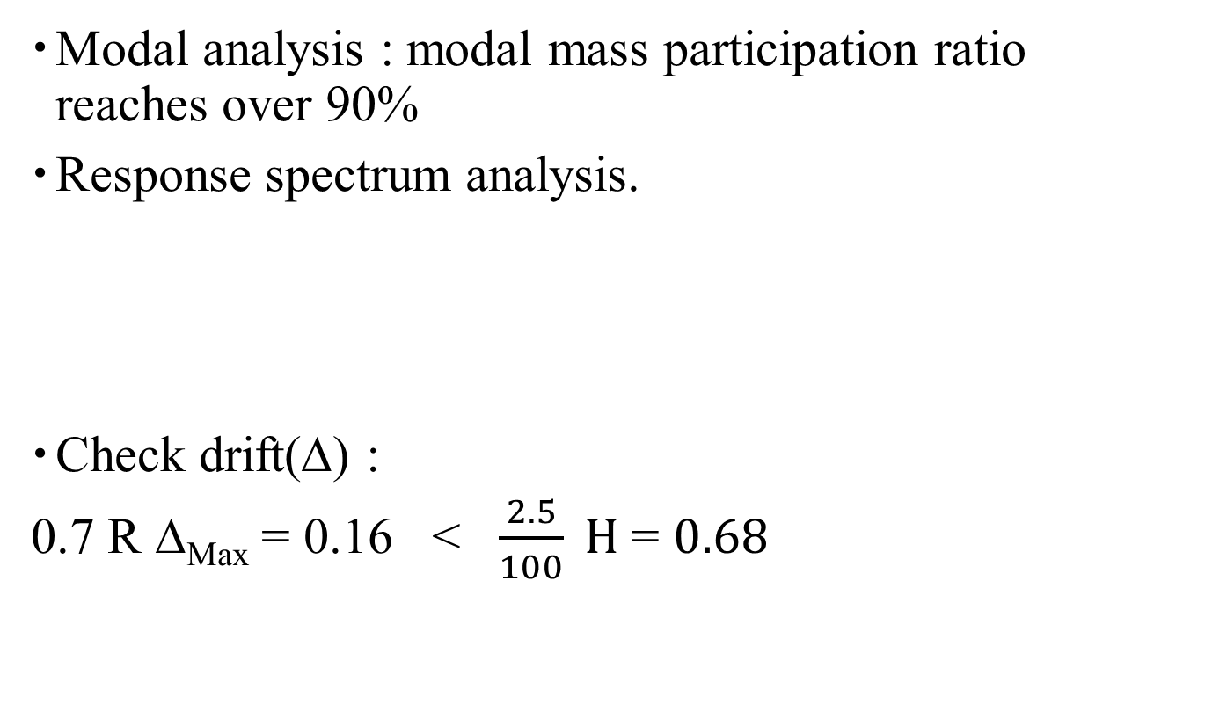
Response spectrum analysis RSA
Modal analysis : modal mass participation ratio reaches over 90%
Response spectrum analysis.
Check drift(∆) :
0.7 R ∆_{Max} = 0.16 < $\frac{2.5}{100} H$= $0.68$
Direction | V_{eq} (KN) | V_{Resp} (KN) | (I*g/R) | Scaled factor (KN)
X | 3732 | 2916 | 1.7836 | 2.2869
Y | 3732 | 3035 | 0.5945 | 2.192

Slide 34
Design For Gravity and Lateral Forces
Design of :
  Footings
  Tie beams
  Slabs
  Stairs
  Ramp
  Beams
  Shear walls
  Basement wall

Slide 35
Design of Footings
There are four types of footings:
  wall footing
  isolated footing
  combined
  mat foundation
  Bearing capacity of soil = 300 KN/m² .

Slide 36
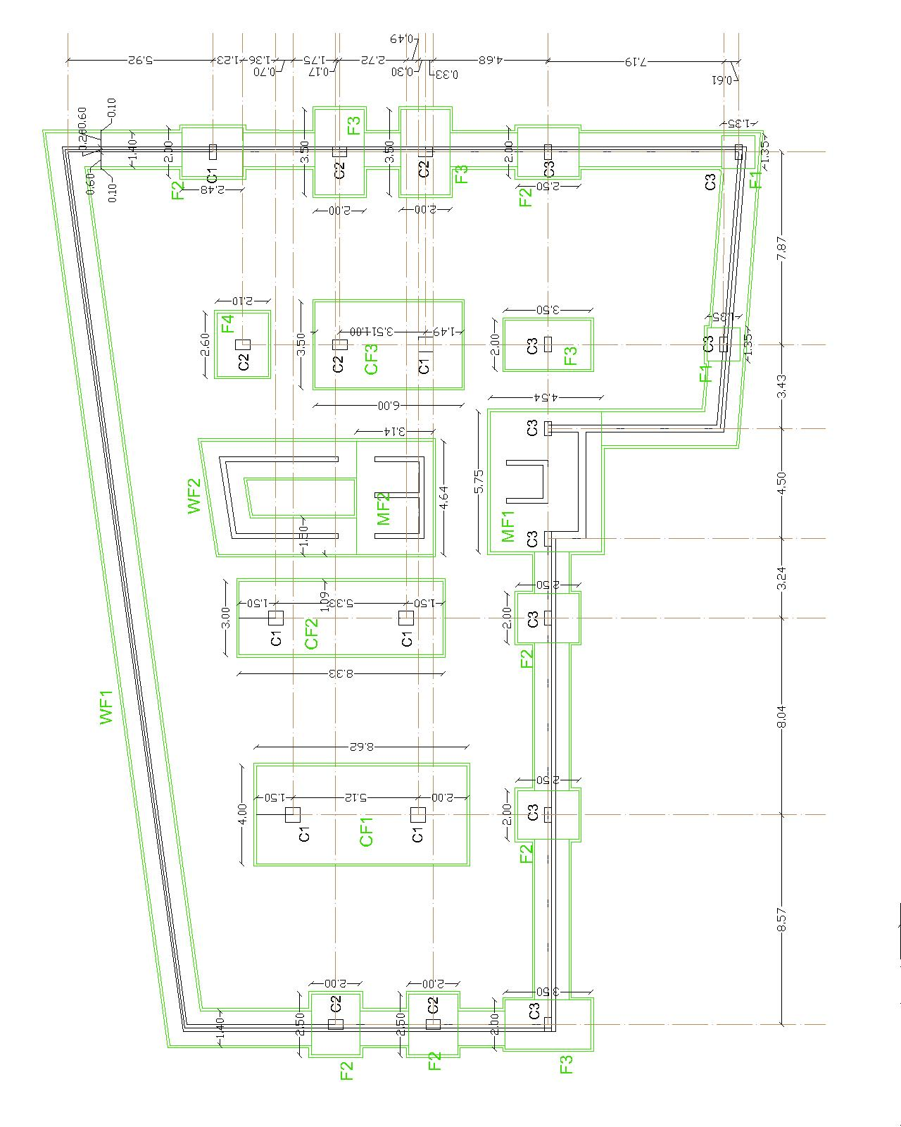

Slide 37
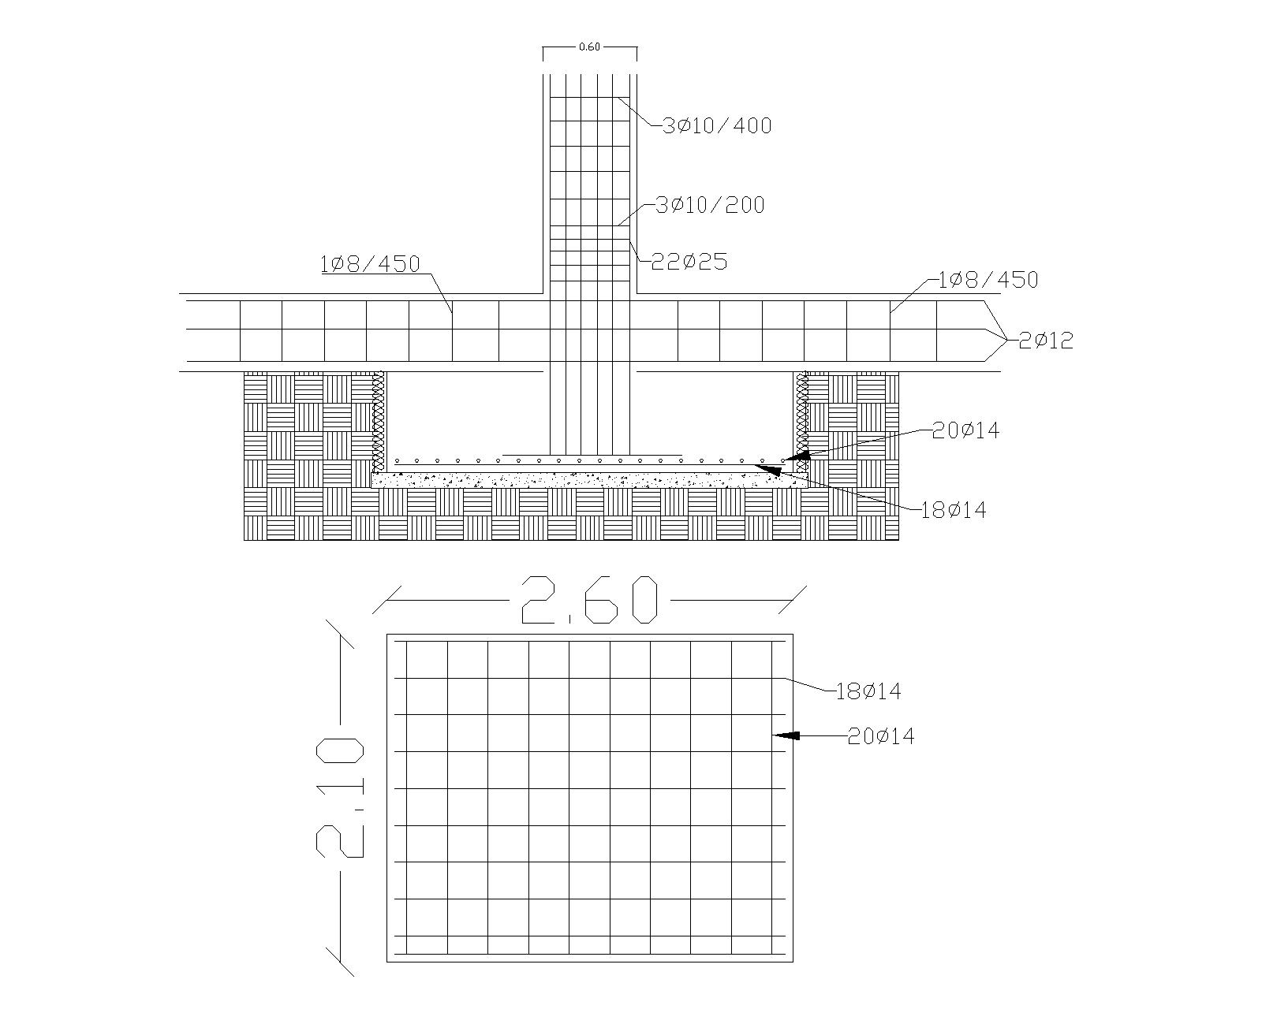
Single footing design

Slide 38
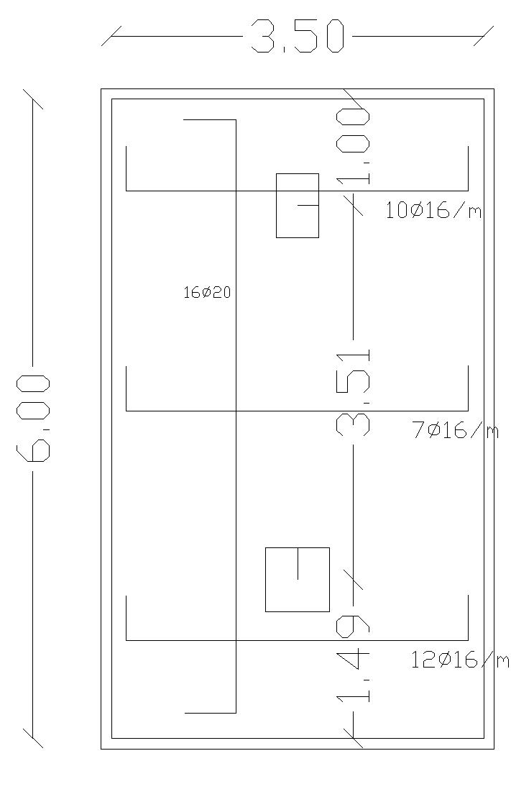
Combined footing design

Slide 39
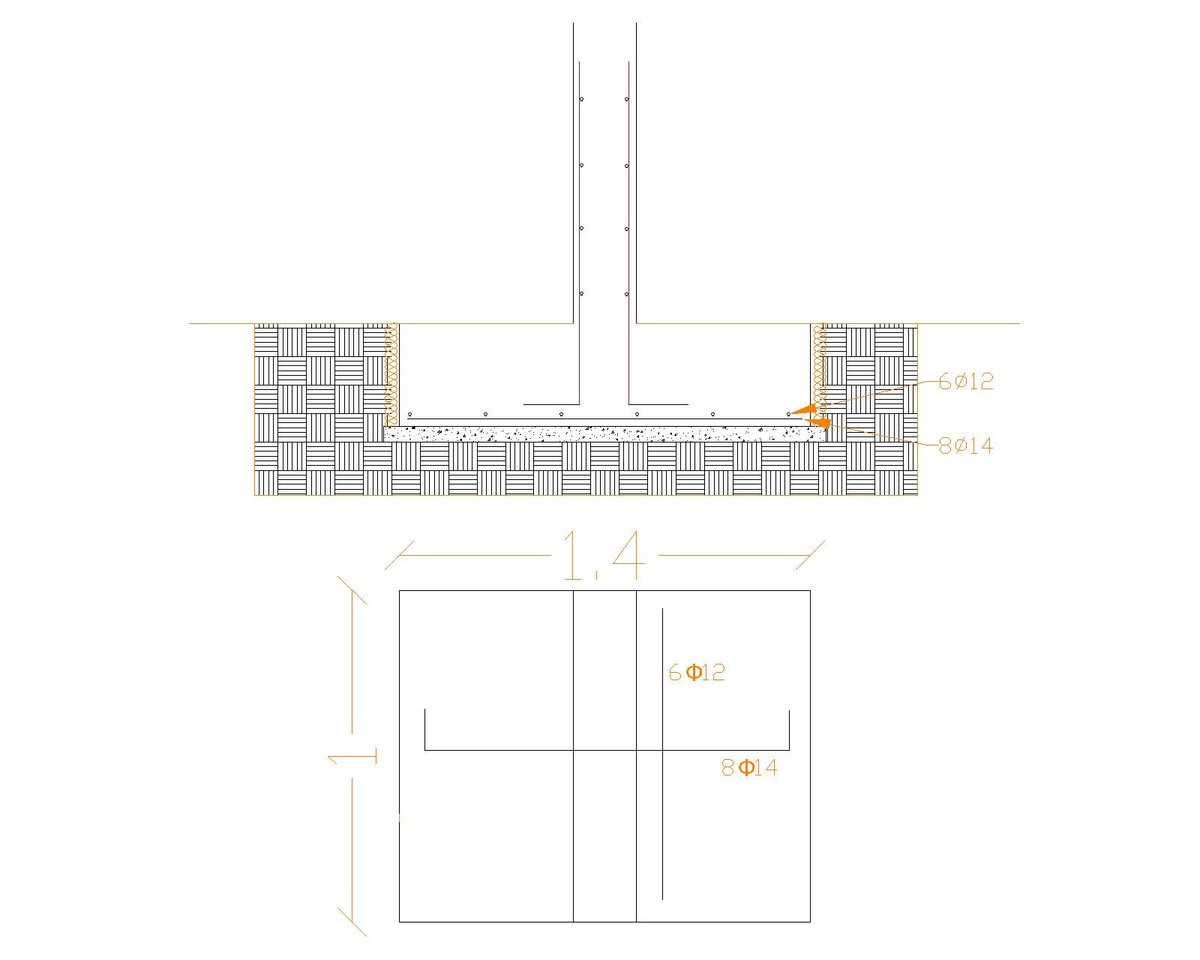
Wall footing design

Slide 40
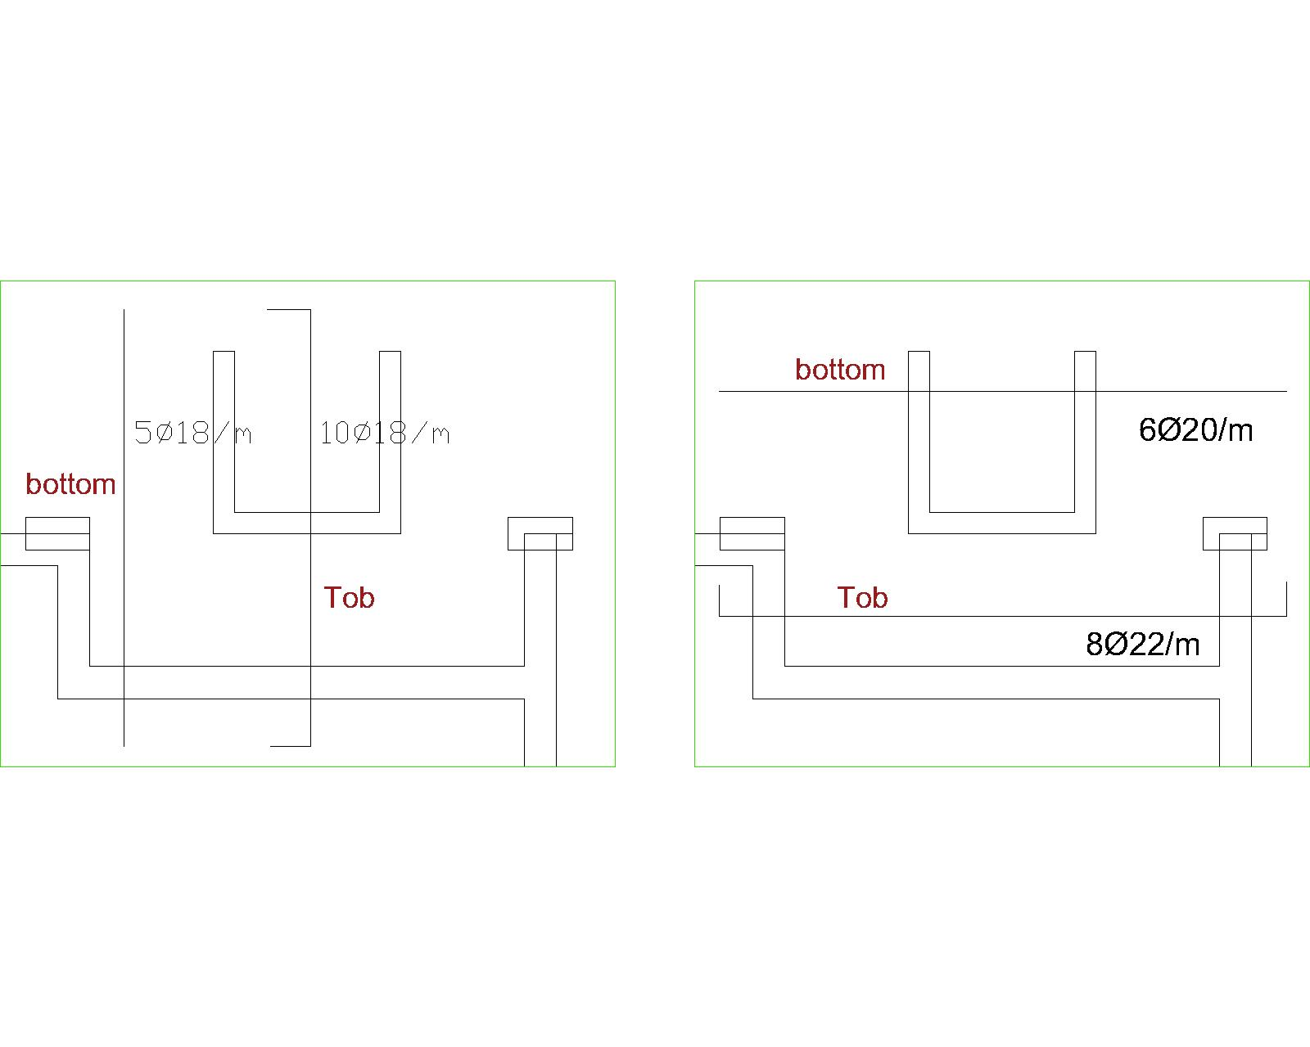
Mat foundation design

Slide 41

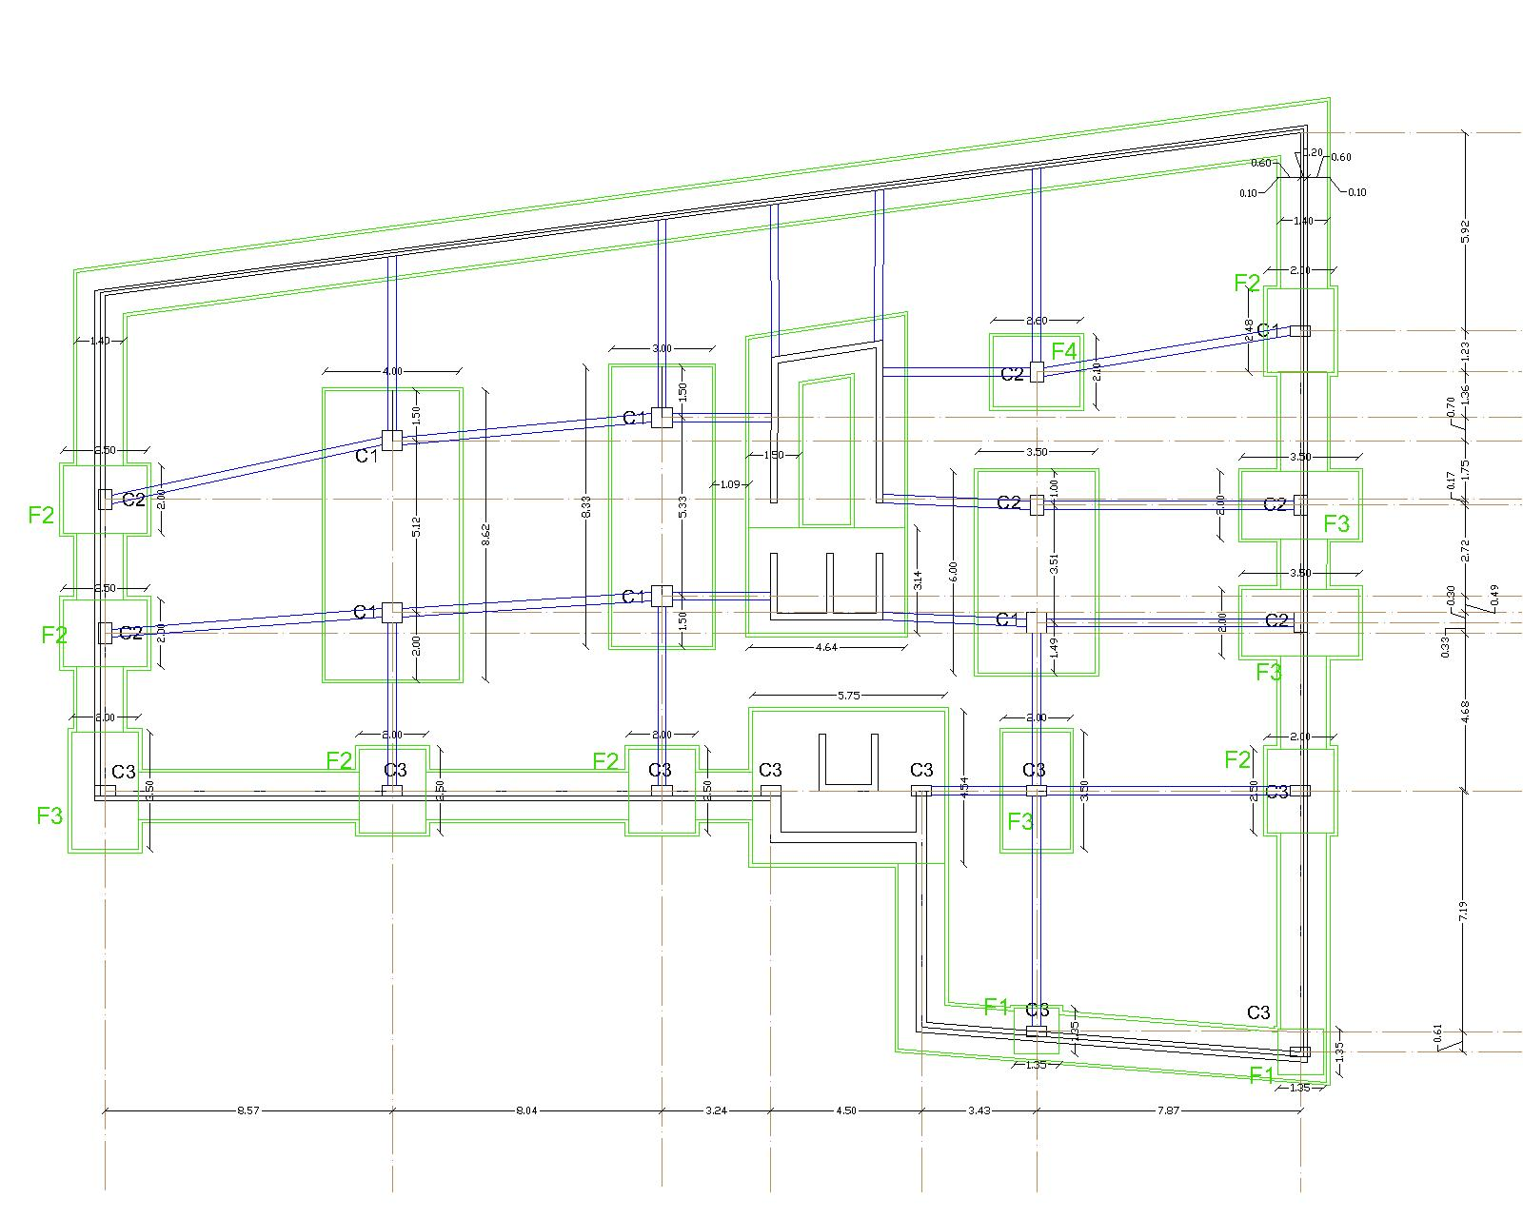

Slide 42
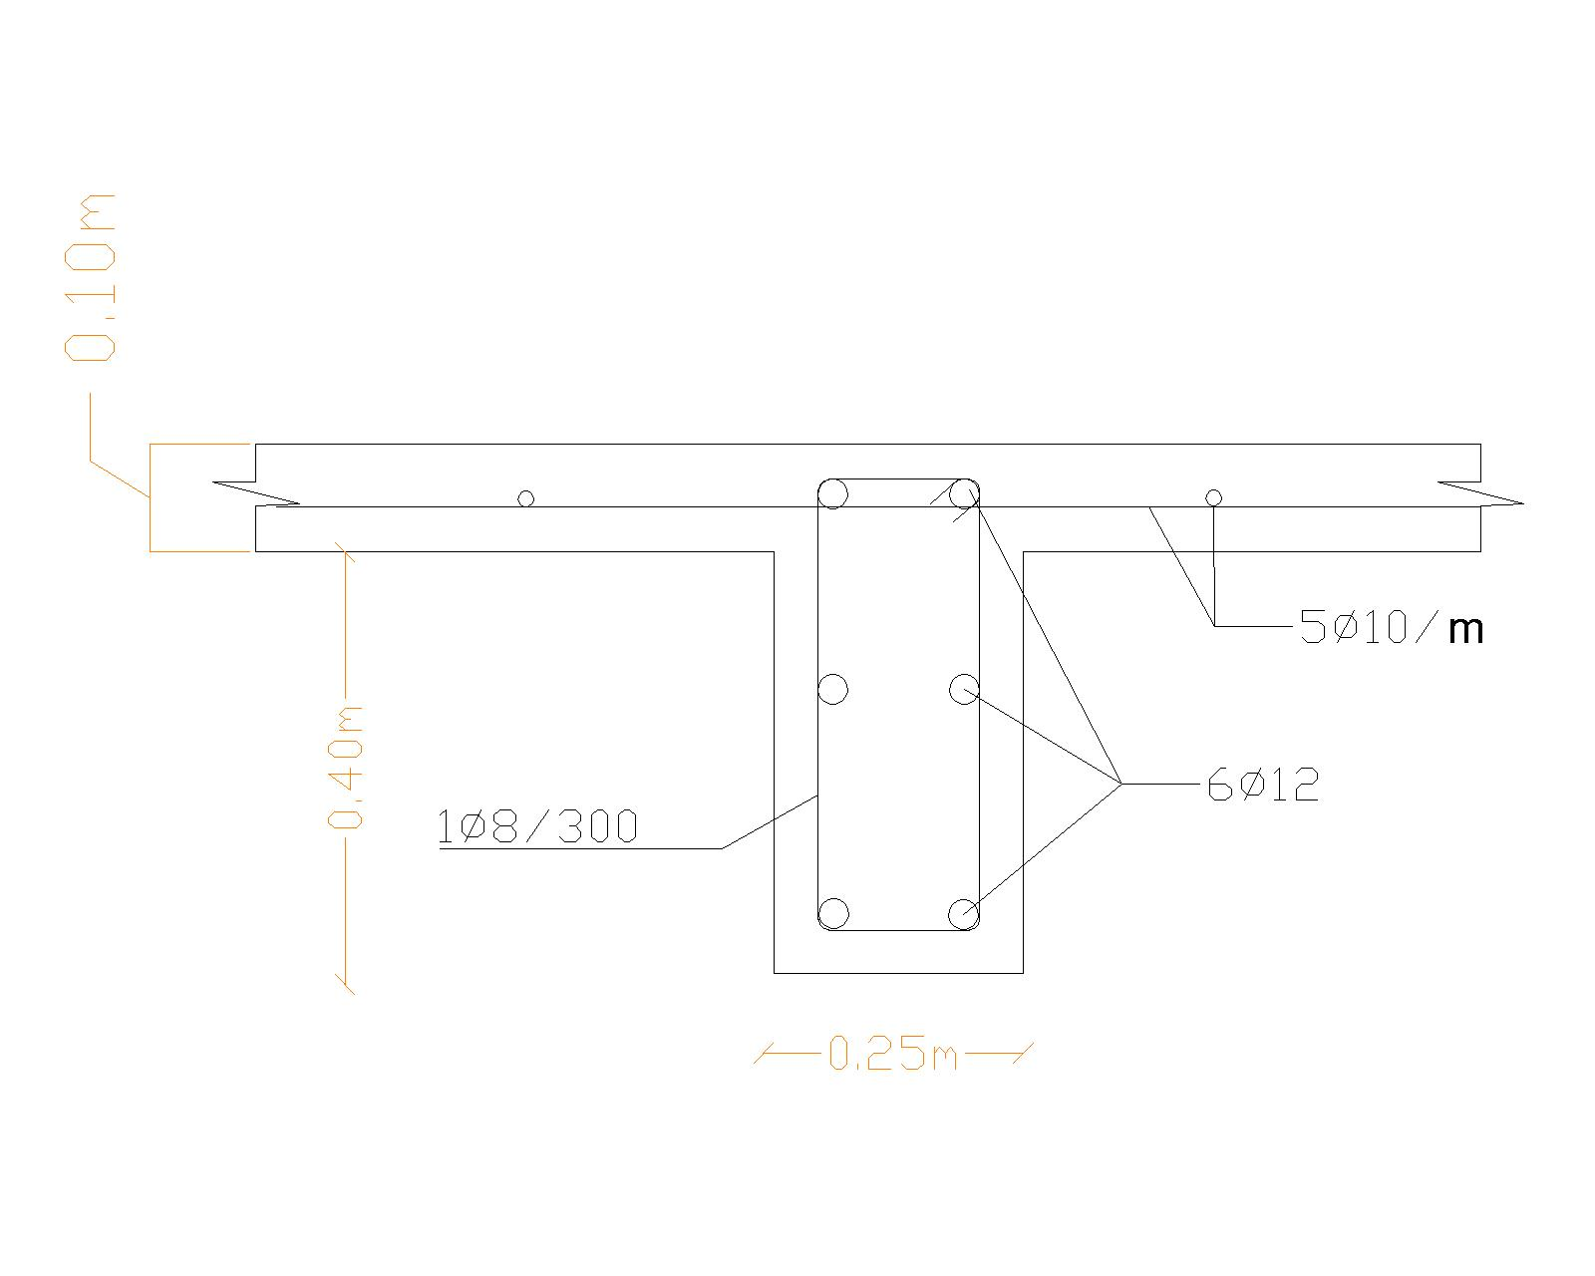

Slide 43
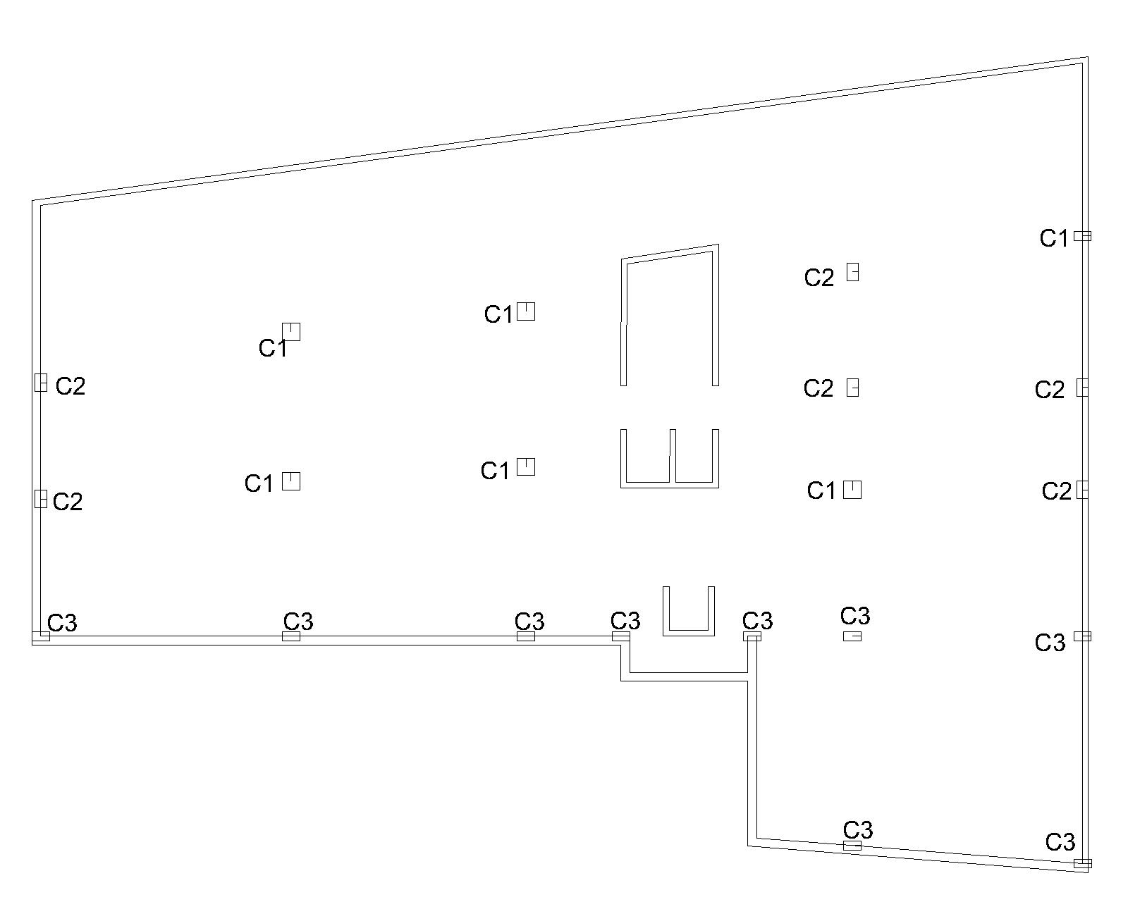
Design of columns

Slide 44
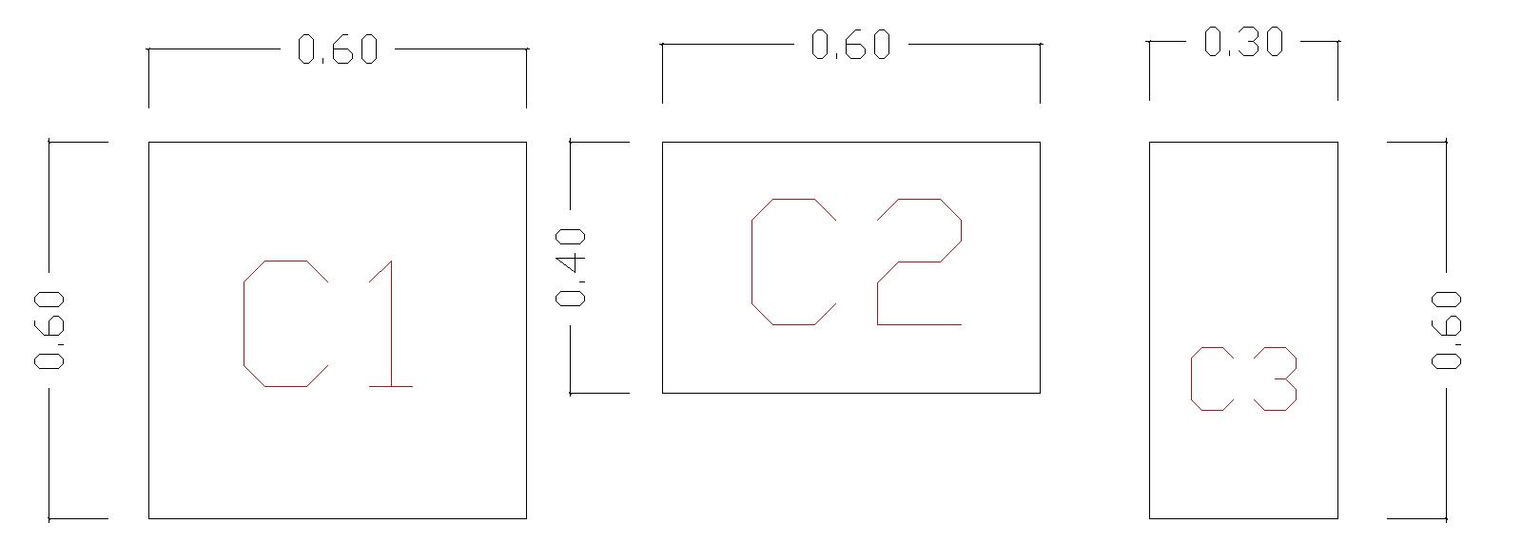
Column Dimension

Slide 45
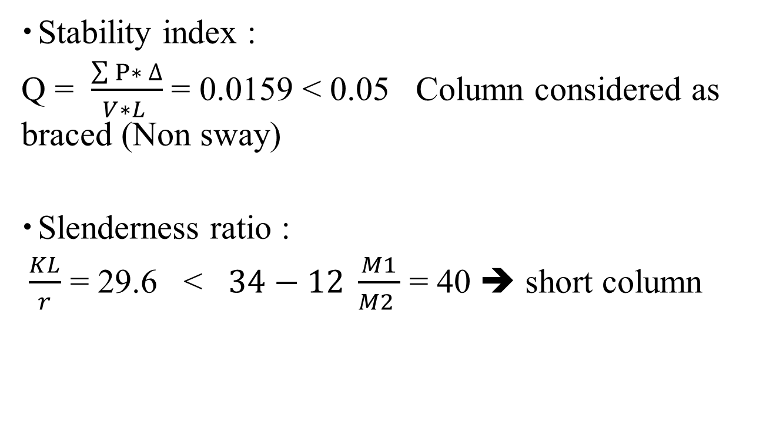
Checks
Stability index :
Q = $\frac{\sum{P∗ ∆}}{V∗L }$ = 0.0159 < 0.05 Column considered as braced (Non sway)
Slenderness ratio :
$\frac{KL}{r}$ = 29.6 < $34−12 \frac{M1}{M2 }$ = 40 ➔ short column

Slide 46
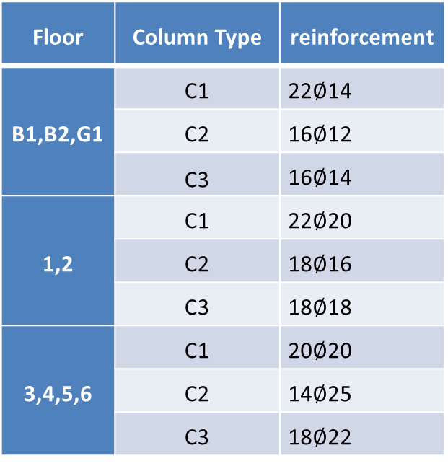
Summary of steel reinforcement of Column
Floor | Column Type | reinforcement
B1,B2,G1 | C1 | 22$∅$14
 | C2 | 16$∅$12
 | C3 | 16$∅$14
1,2 | C1 | 22$∅$20
 | C2 | 18$∅$16
 | C3 | 18$∅$18
3,4,5,6 | C1 | 20$∅$20
 | C2 | 14$∅$25
 | C3 | 18$∅$22

Slide 47
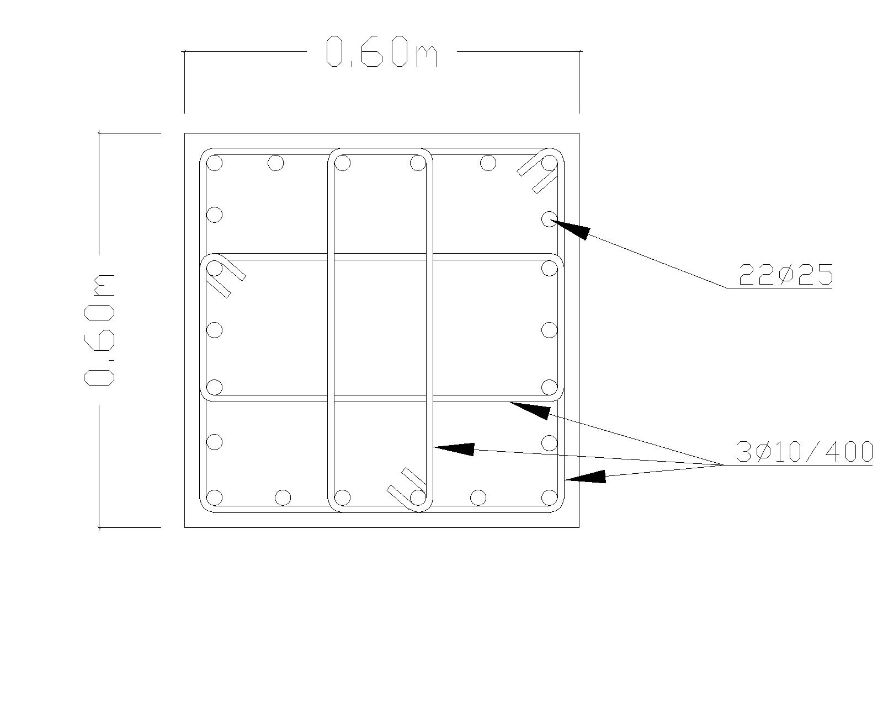
Column C1 in floor B1,B2,GF

Slide 48
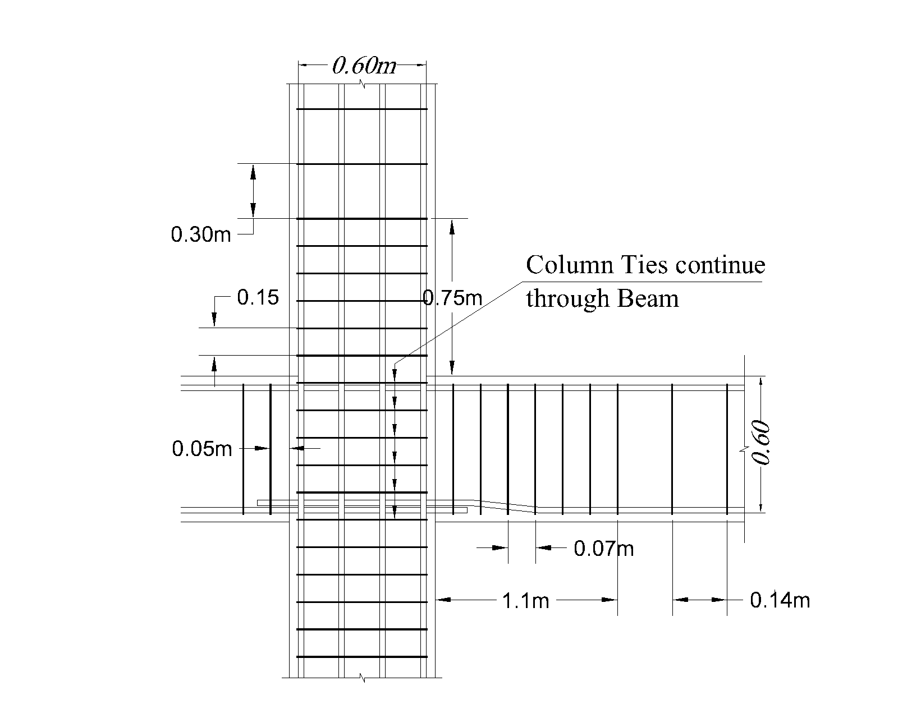

Slide 49
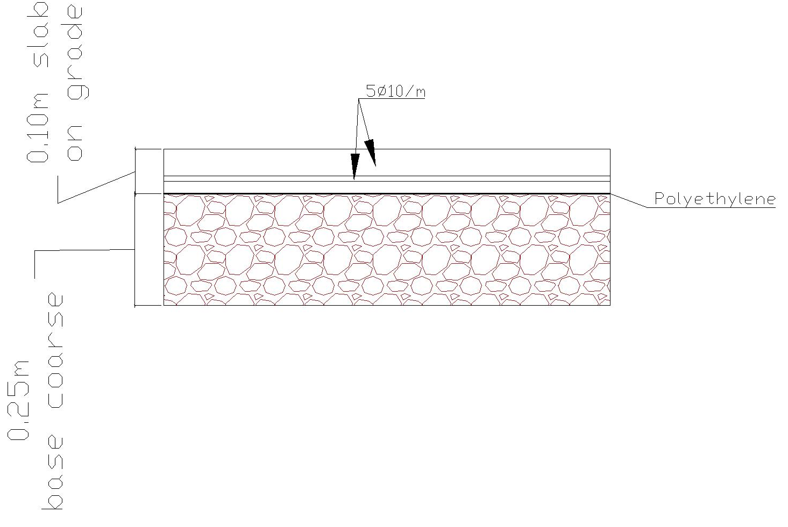
Design of Slabs
Basement 2 floor (slab on grade)

Slide 50
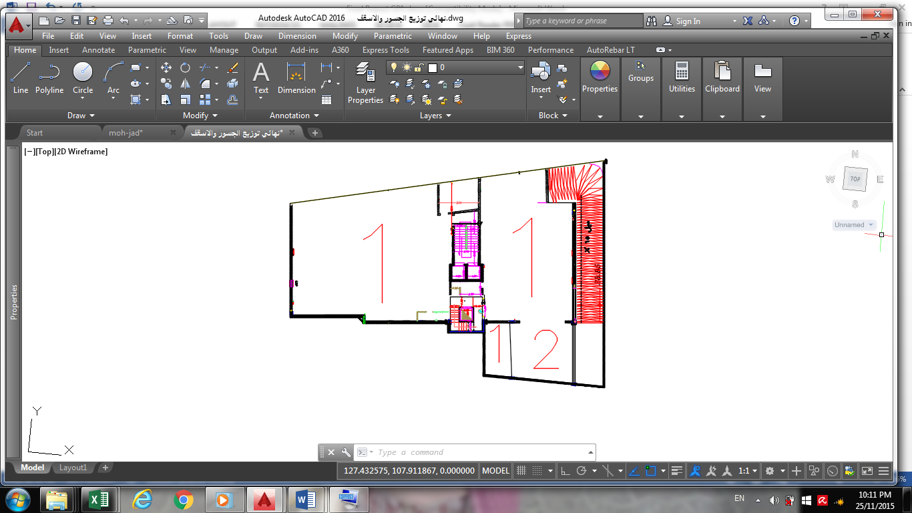
Design of Slabs
Basement 1 Slab

Slide 51
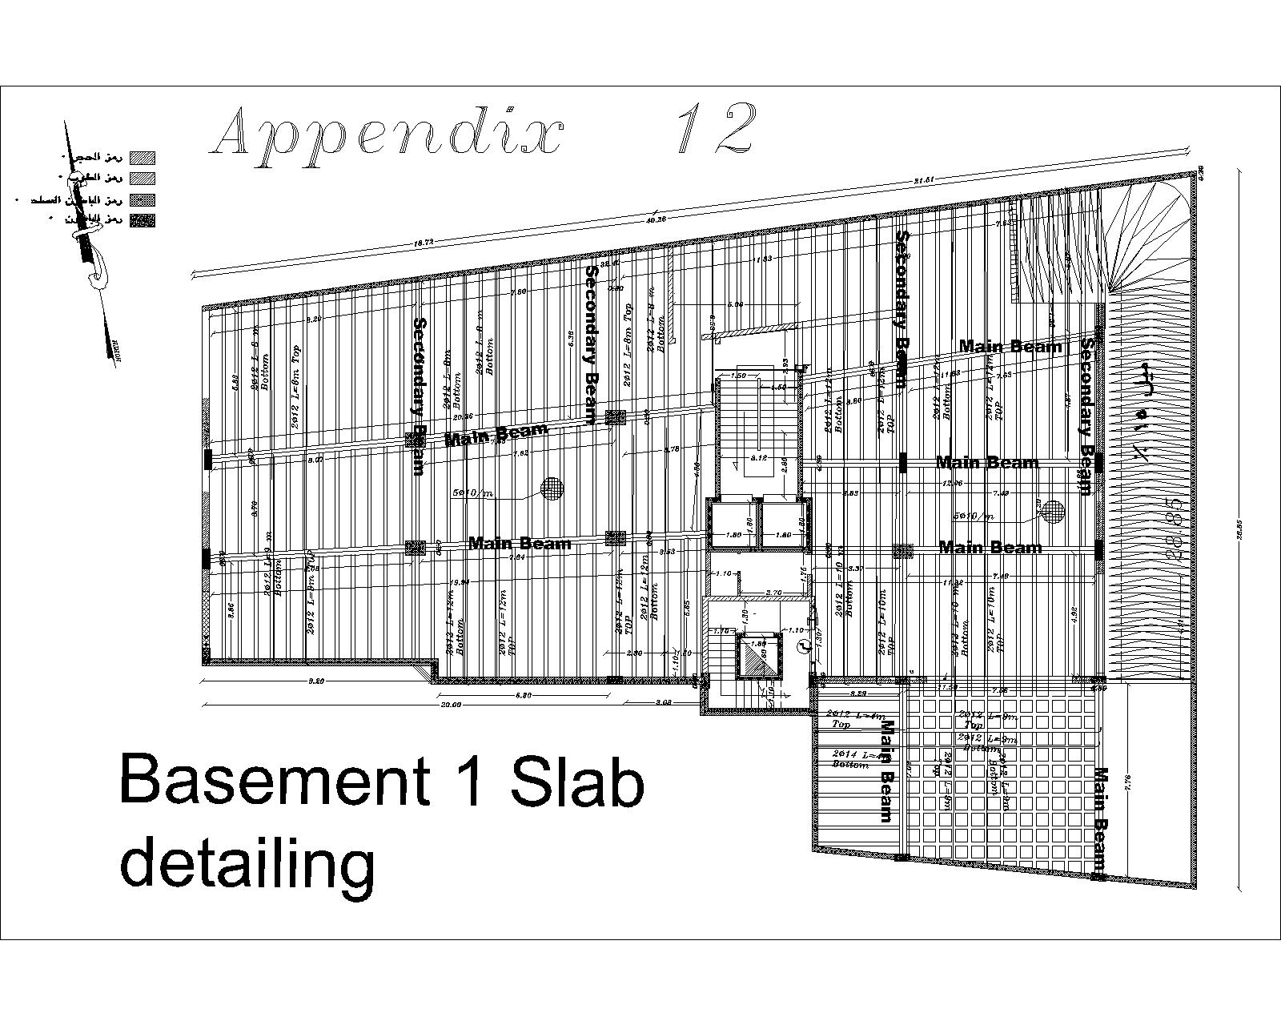

Slide 52
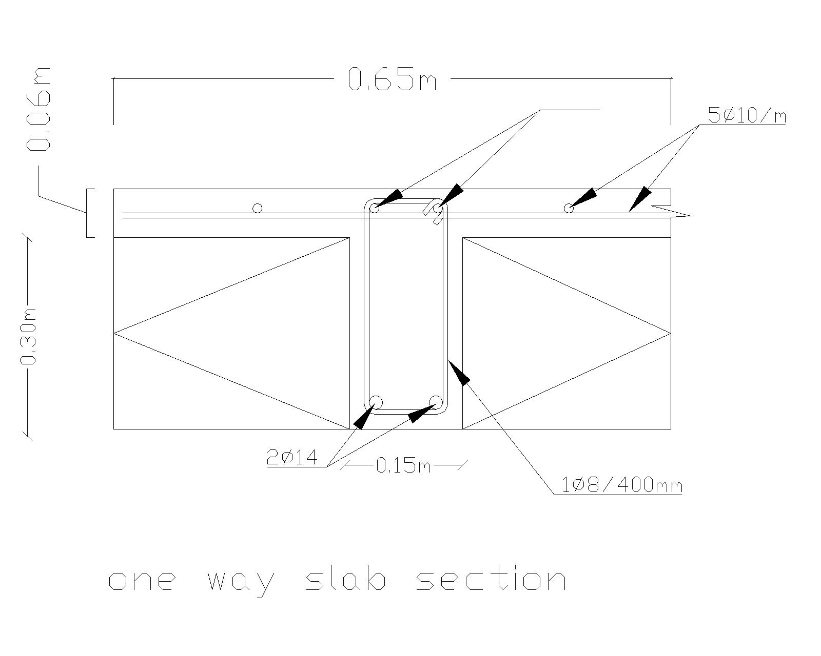

Slide 53
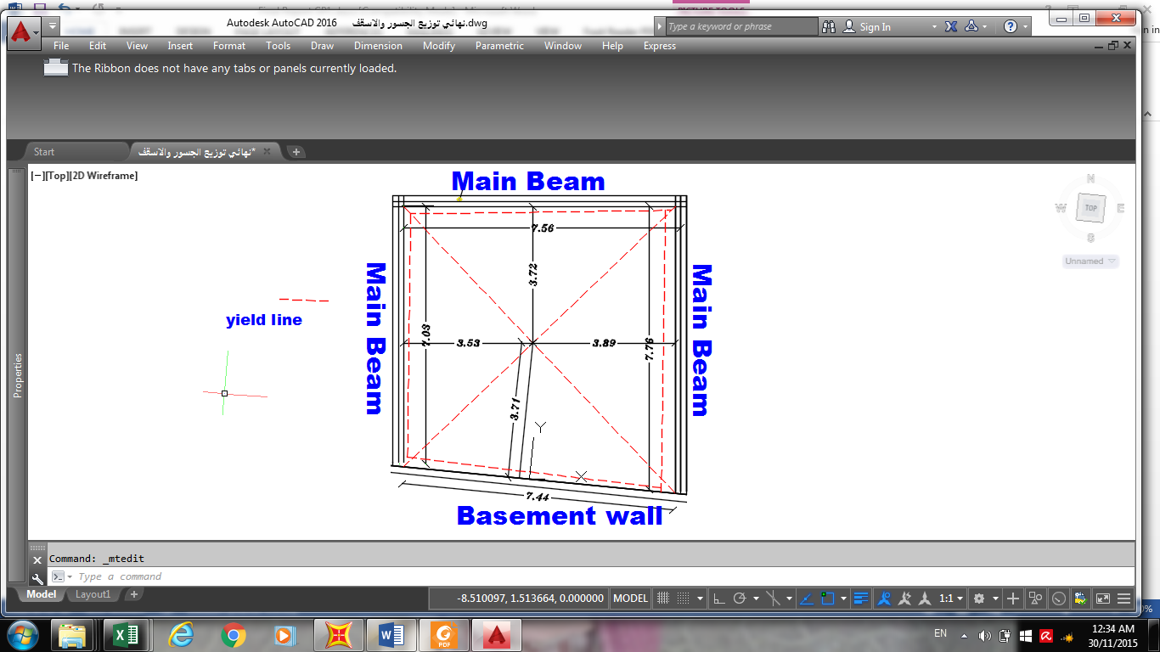
Two way ribbed slab property

Slide 54
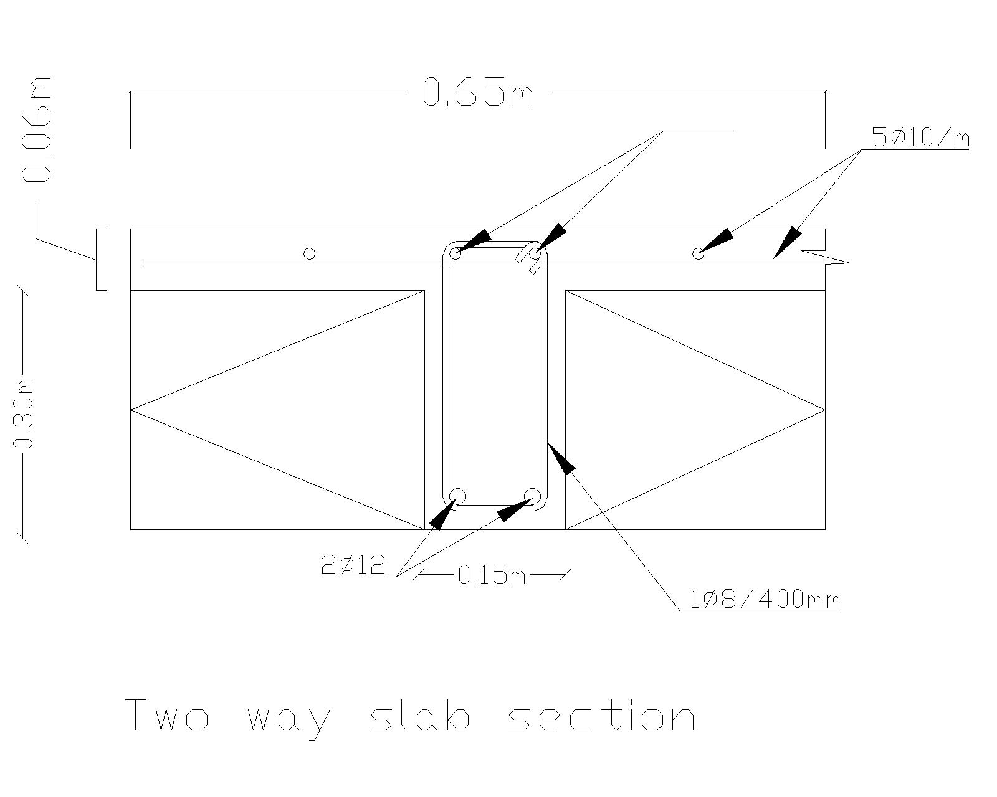

Slide 55
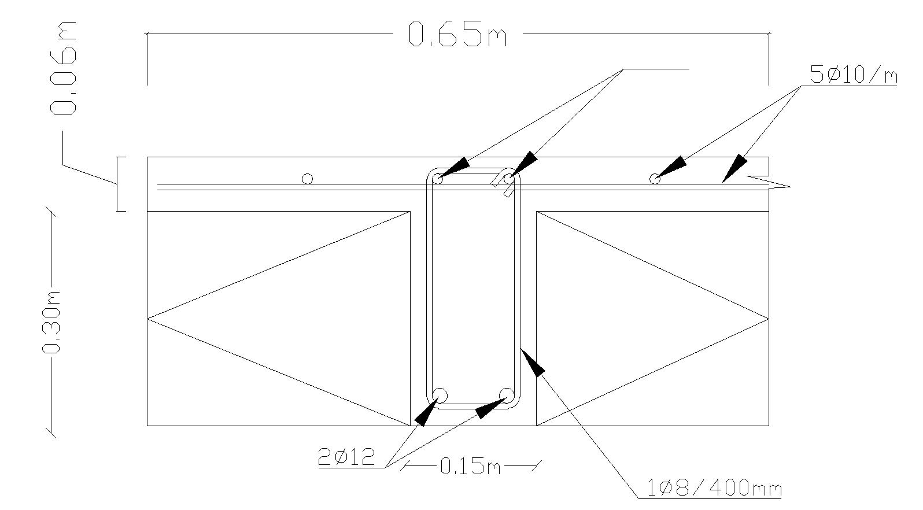
One way ribbed slab

Slide 56
Design of stairs
Stair dimensions
  Going = 30 cm
  Riser = 15 cm
  Floor height = 3.5 m
  No. of goings = 10
  No. of risers = 9
  Length of Flight =3.06 m
  landing thickness = 20 cm
  the thickness of flights = 15 cm

Slide 57
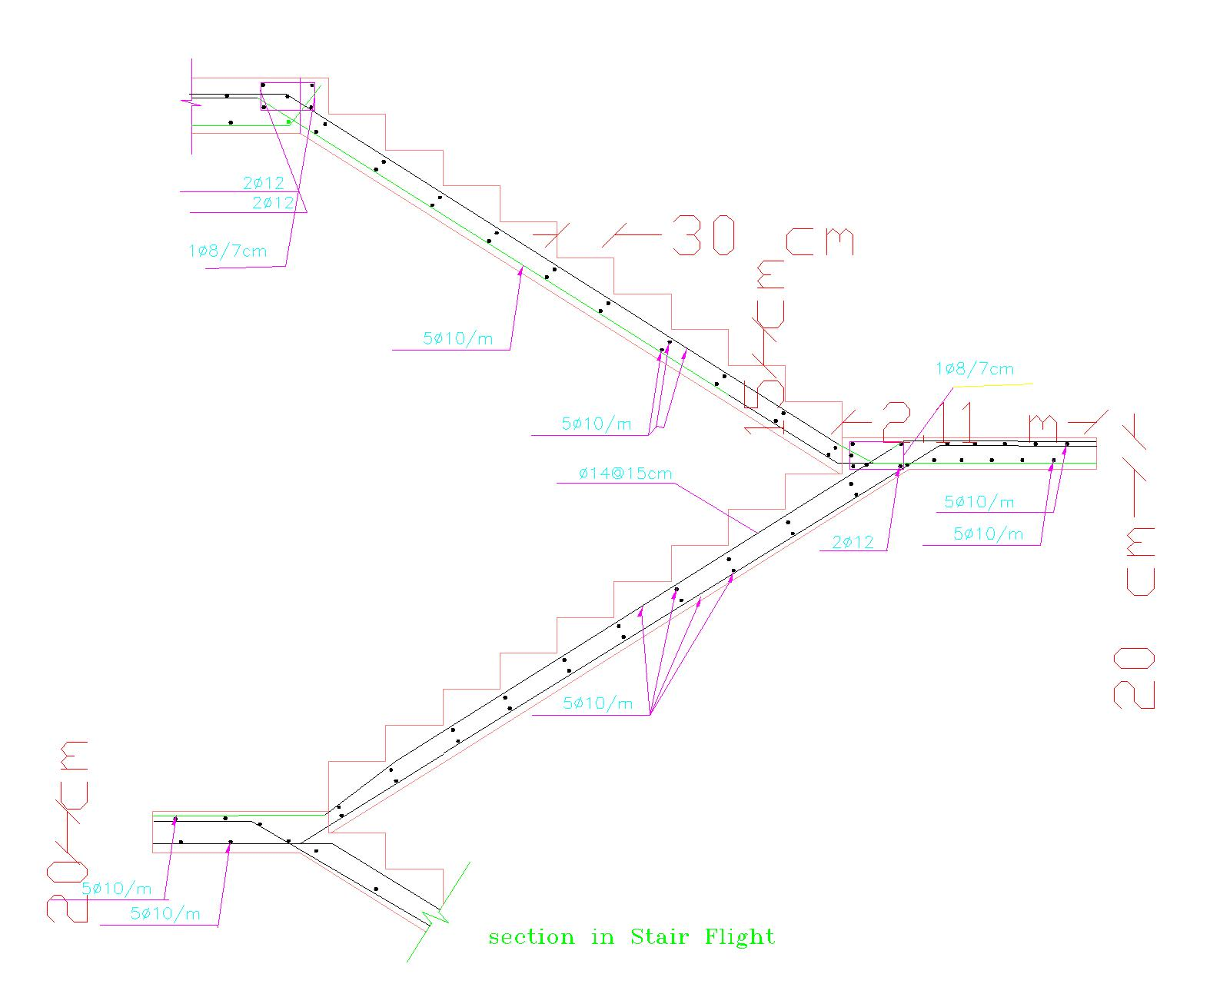

Slide 58
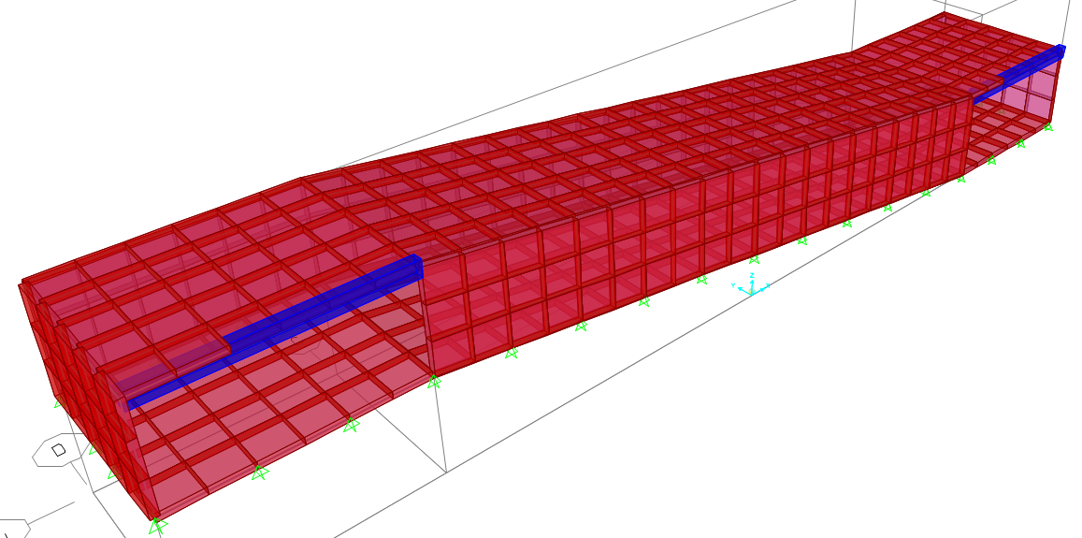
Design of ramp

Slide 59
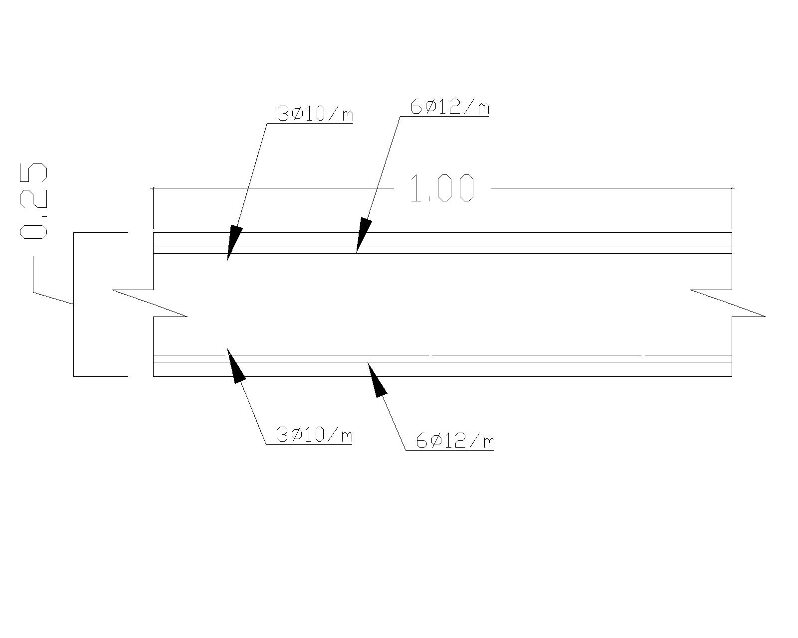

Slide 60
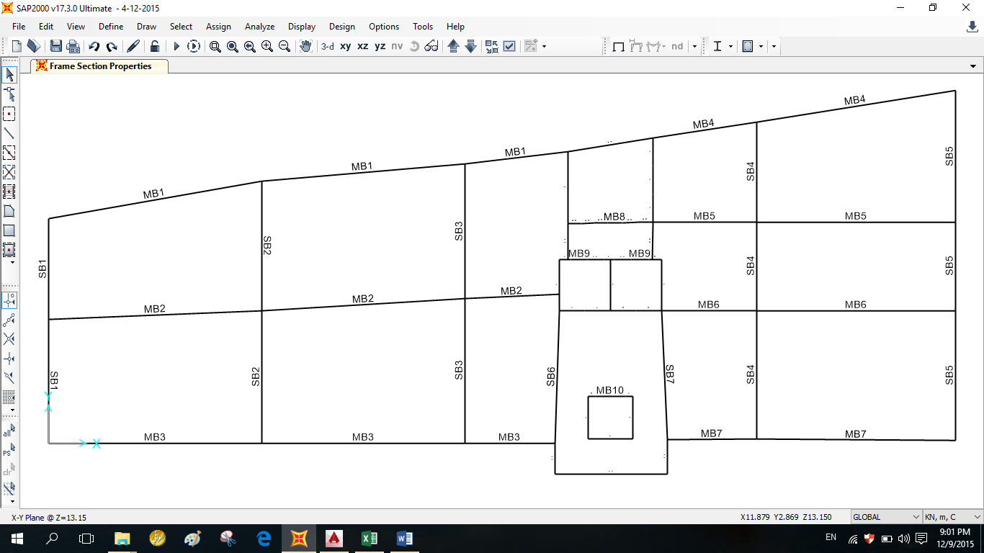
Design of beams

Slide 61
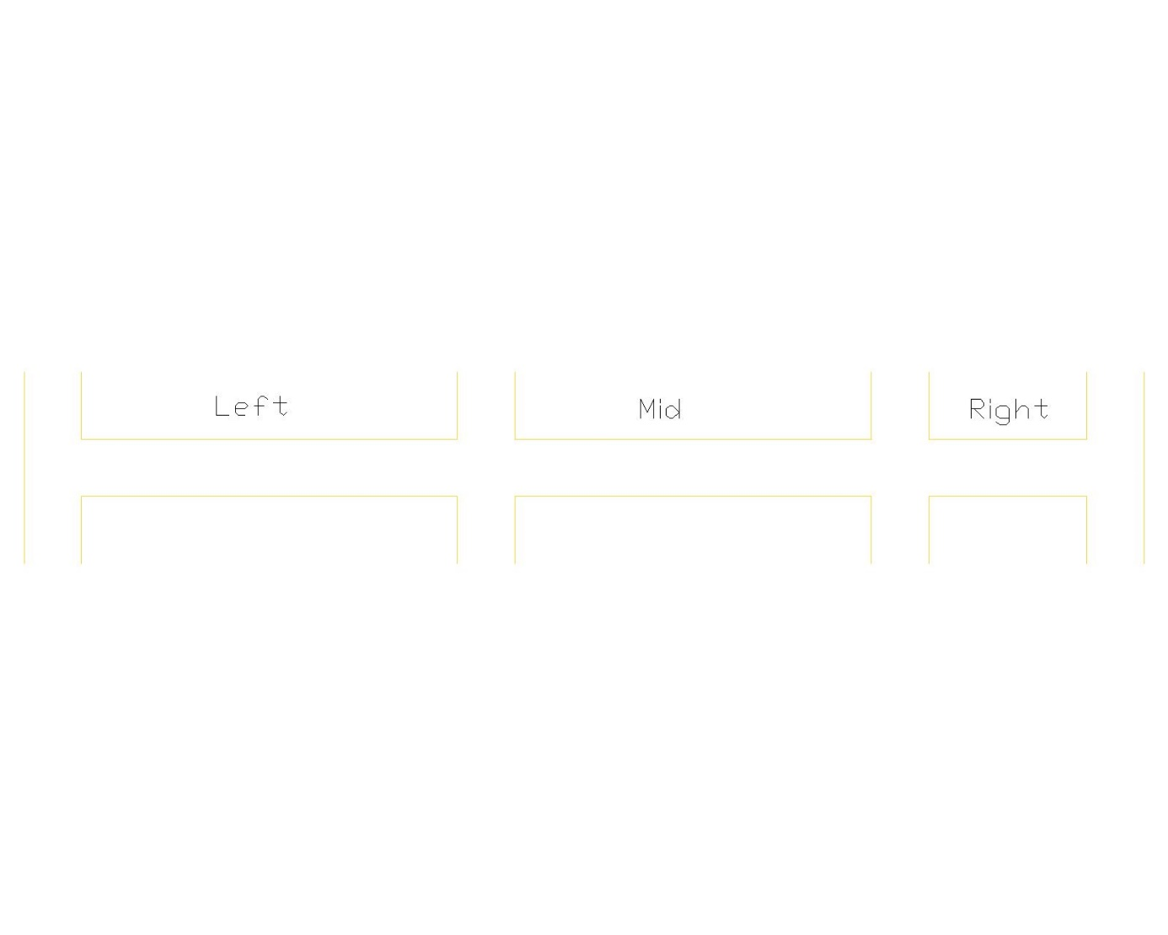
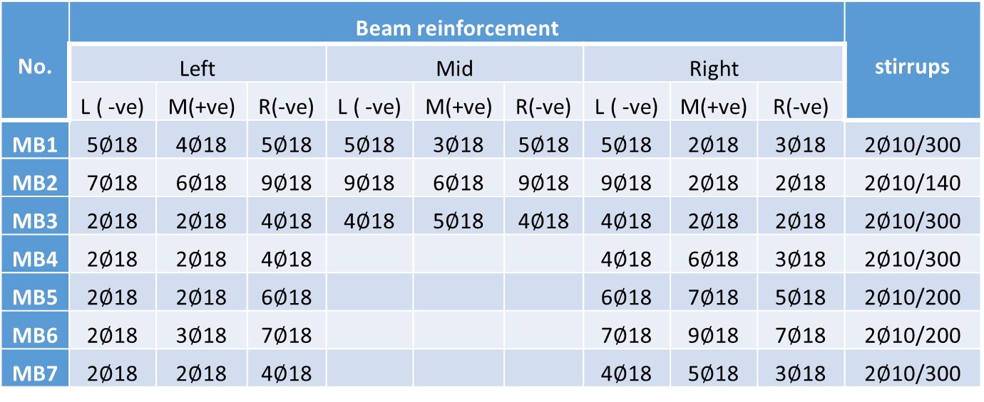
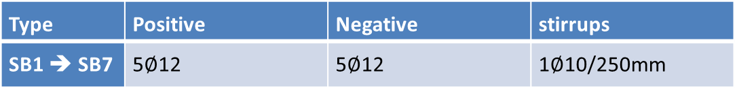
No. | Beam reinforcement |  |  |  |  |  |  |  |  | stirrups
 | Left |  |  | Mid |  |  | Right
 | L ( -ve) | M(+ve) | R(-ve) | L ( -ve) | M(+ve) | R(-ve) | L ( -ve) | M(+ve) | R(-ve)
MB1 | 5$∅$18 | 4$∅$18 | 5$∅$18 | 5$∅$18 | 3$∅$18 | 5$∅$18 | 5$∅$18 | 2$∅$18 | 3$∅$18 | 2$∅$10/300
MB2 | 7$∅$18 | 6$∅$18 | 9$∅$18 | 9$∅$18 | 6$∅$18 | 9$∅$18 | 9$∅$18 | 2$∅$18 | 2$∅$18 | 2$∅$10/140
MB3 | 2$∅$18 | 2$∅$18 | 4$∅$18 | 4$∅$18 | 5$∅$18 | 4$∅$18 | 4$∅$18 | 2$∅$18 | 2$∅$18 | 2$∅$10/300
MB4 | 2$∅$18 | 2$∅$18 | 4$∅$18 |  |  |  | 4$∅$18 | 6$∅$18 | 3$∅$18 | 2$∅$10/300
MB5 | 2$∅$18 | 2$∅$18 | 6$∅$18 |  |  |  | 6$∅$18 | 7$∅$18 | 5$∅$18 | 2$∅$10/200
MB6 | 2$∅$18 | 3$∅$18 | 7$∅$18 |  |  |  | 7$∅$18 | 9$∅$18 | 7$∅$18 | 2$∅$10/200
MB7 | 2$∅$18 | 2$∅$18 | 4$∅$18 |  |  |  | 4$∅$18 | 5$∅$18 | 3$∅$18 | 2$∅$10/300
Type | Positive | Negative | stirrups
SB1 ➔ SB7 | 5$∅$12 | 5$∅$12 | 1$∅$10/250mm

Slide 62
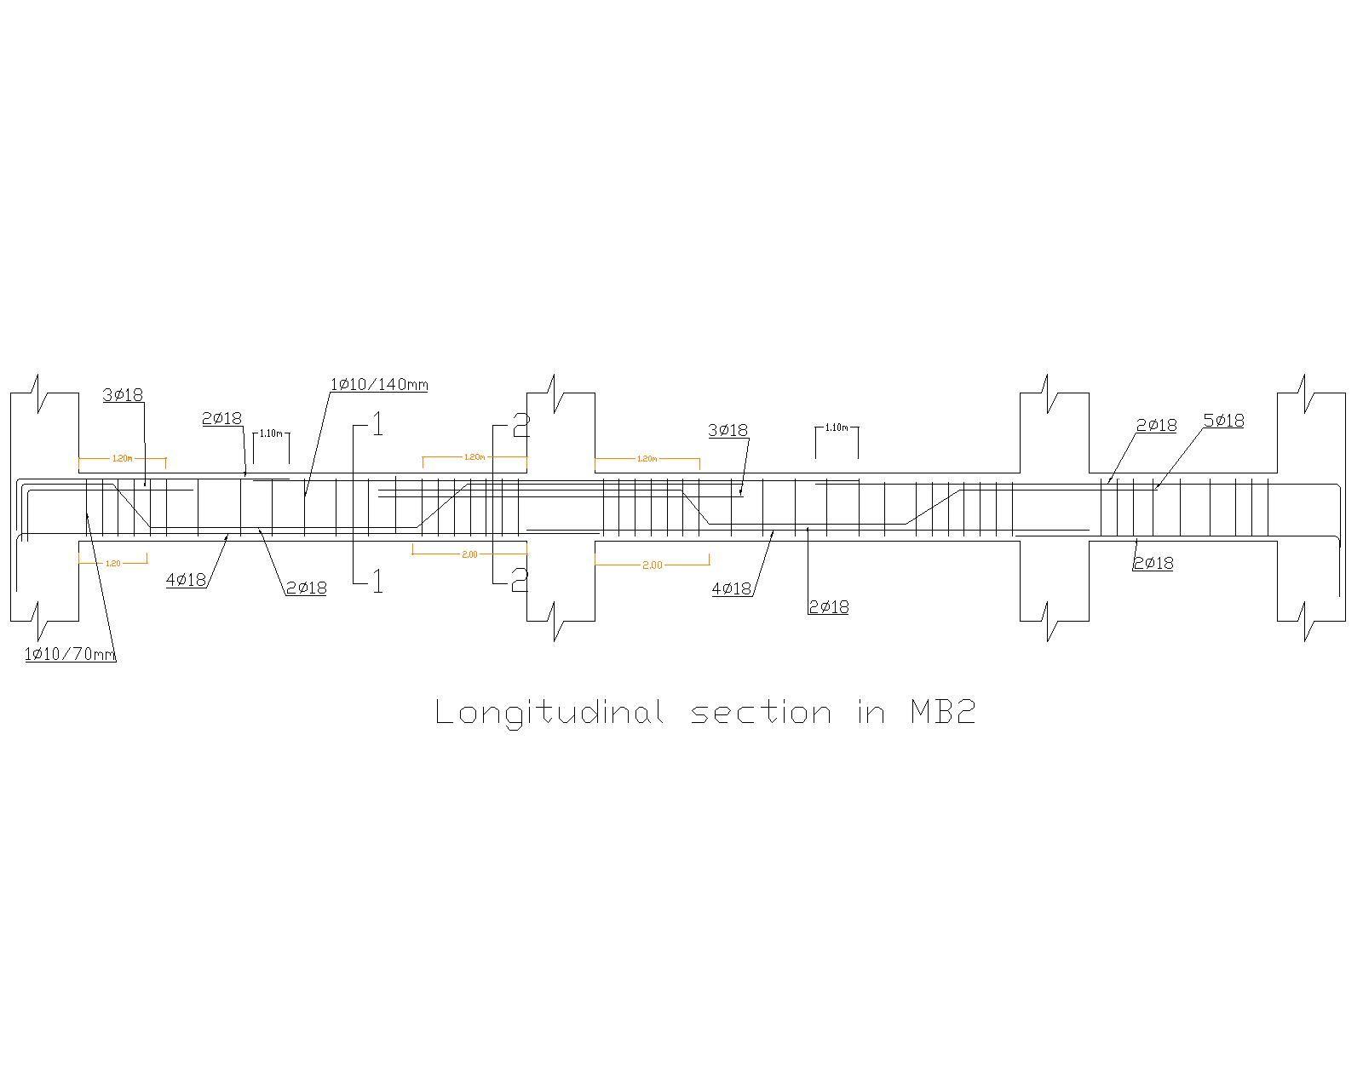

Slide 63
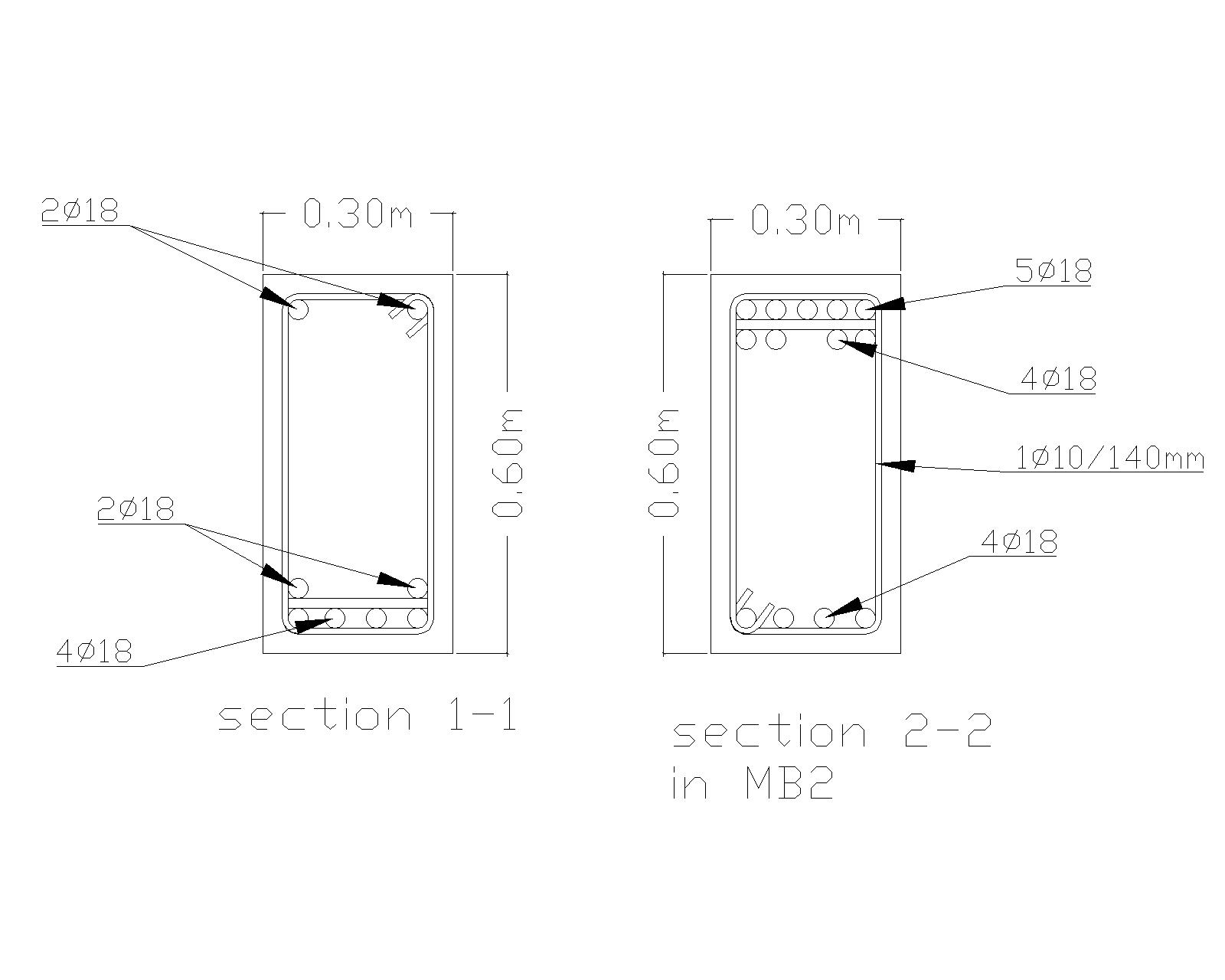

Slide 64
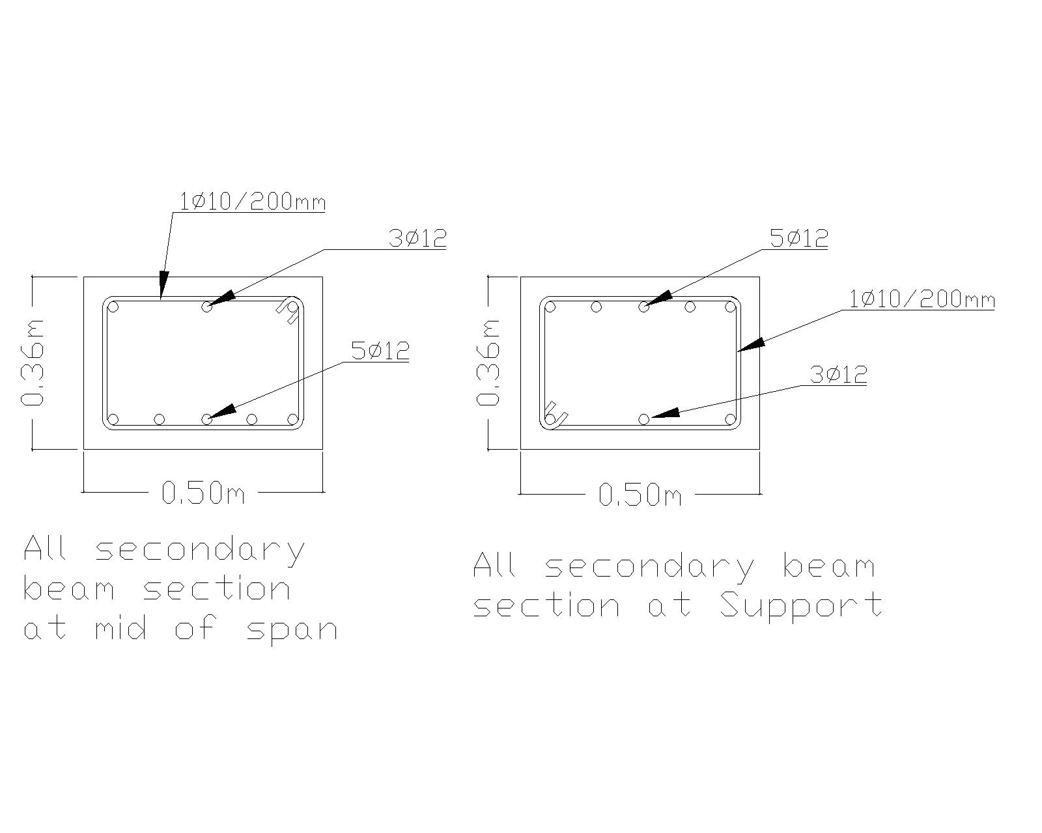

Slide 65
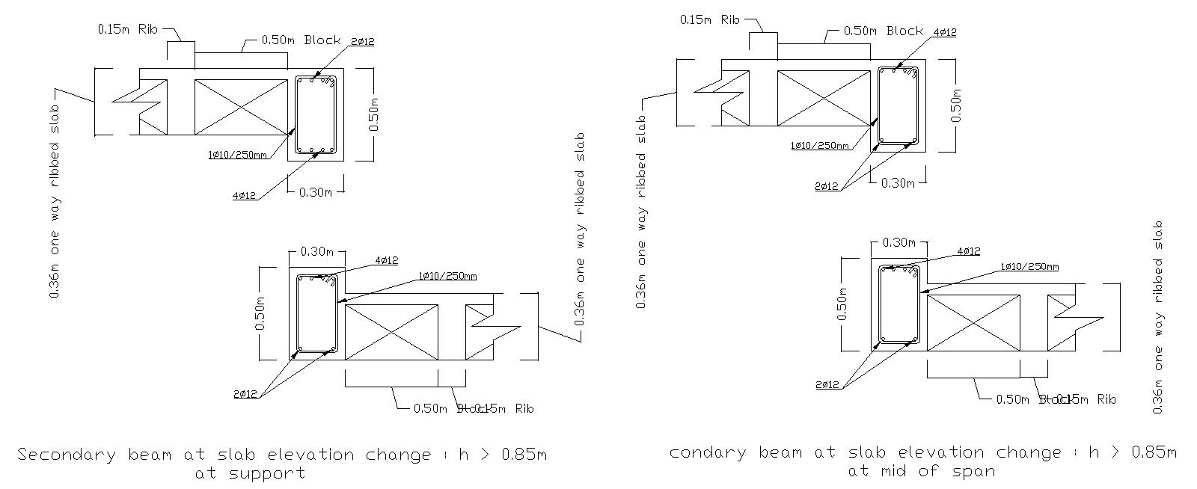
Secondary beam at slab elevation change

Slide 66
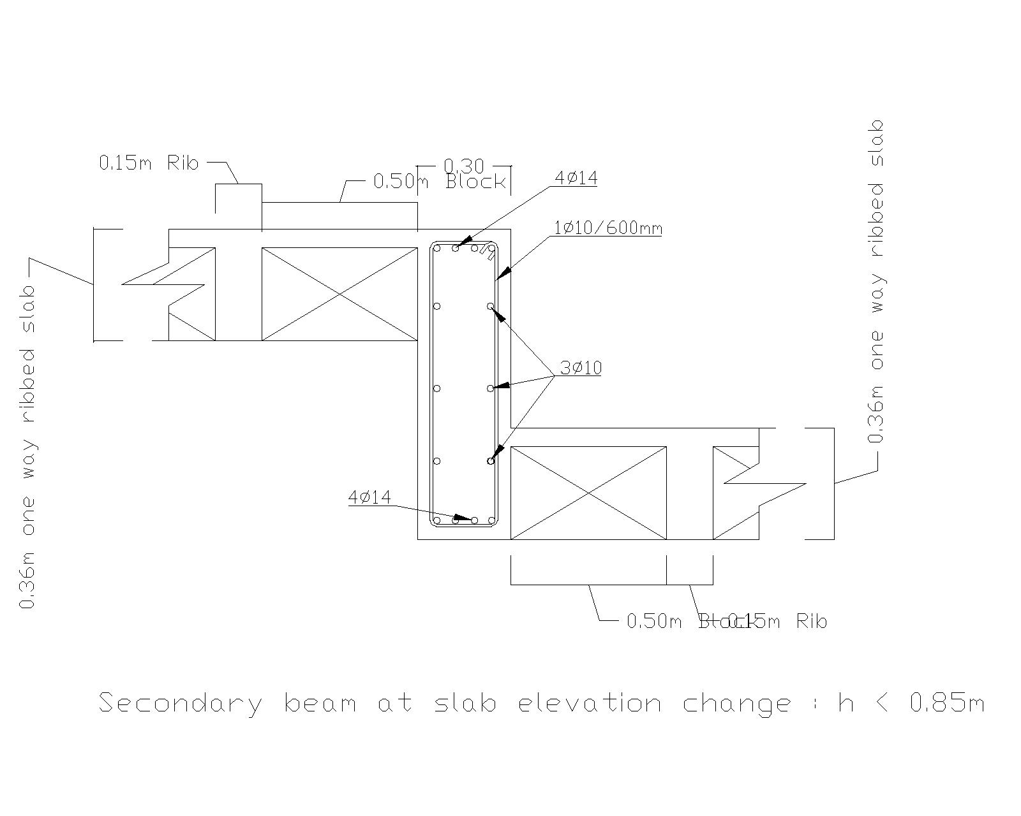

Slide 67
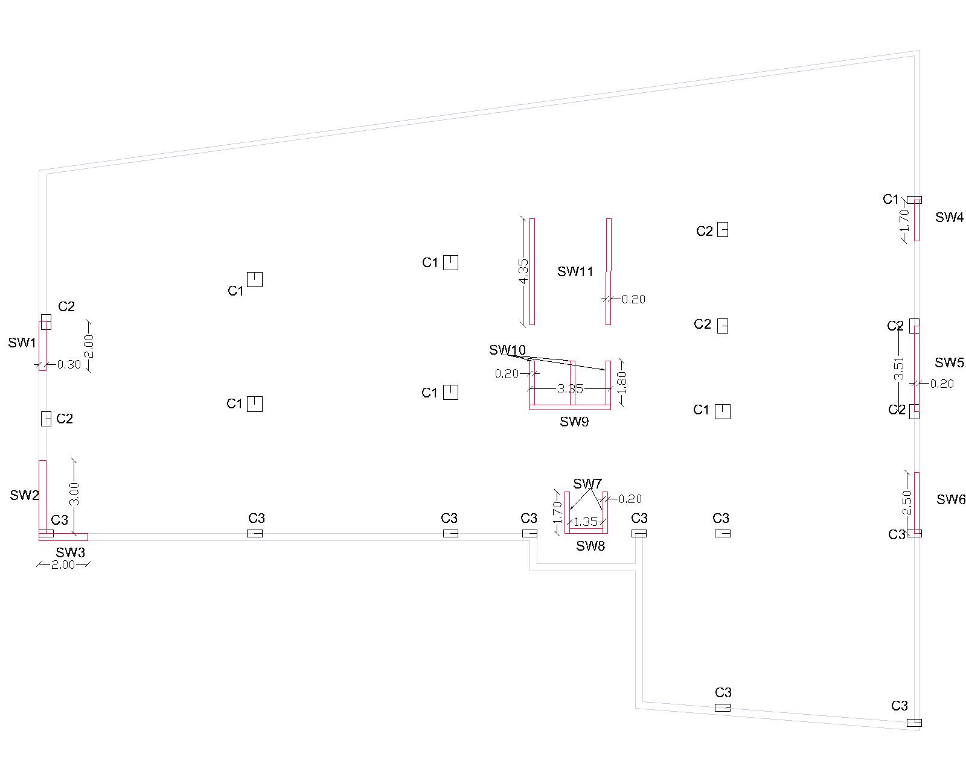
Design of shear wall

Slide 68
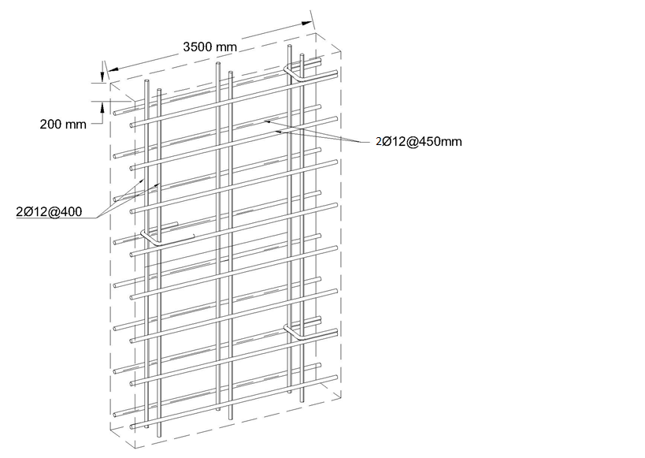
Shear wall reinforcement and dimension

Slide 69
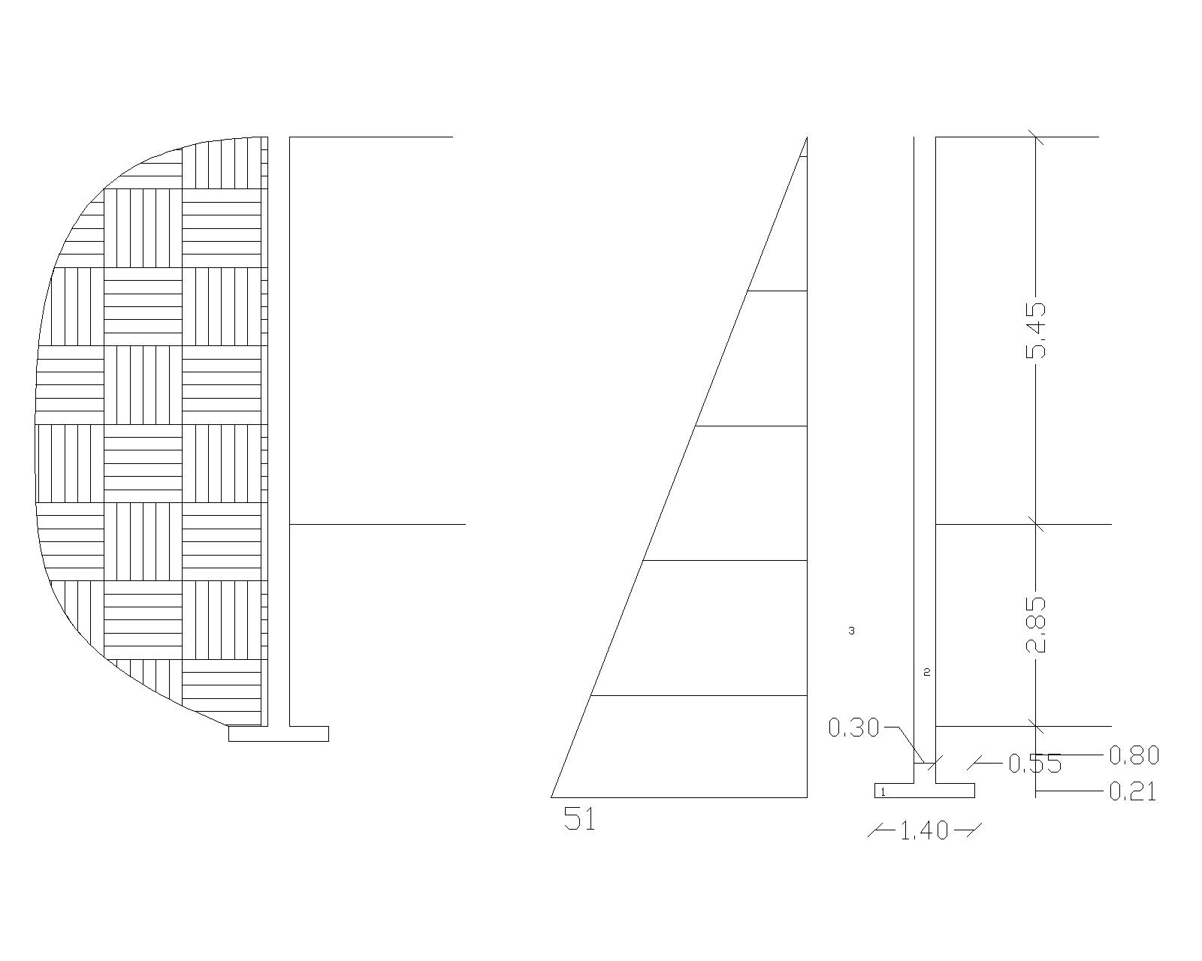
Design of basement wall

Slide 70
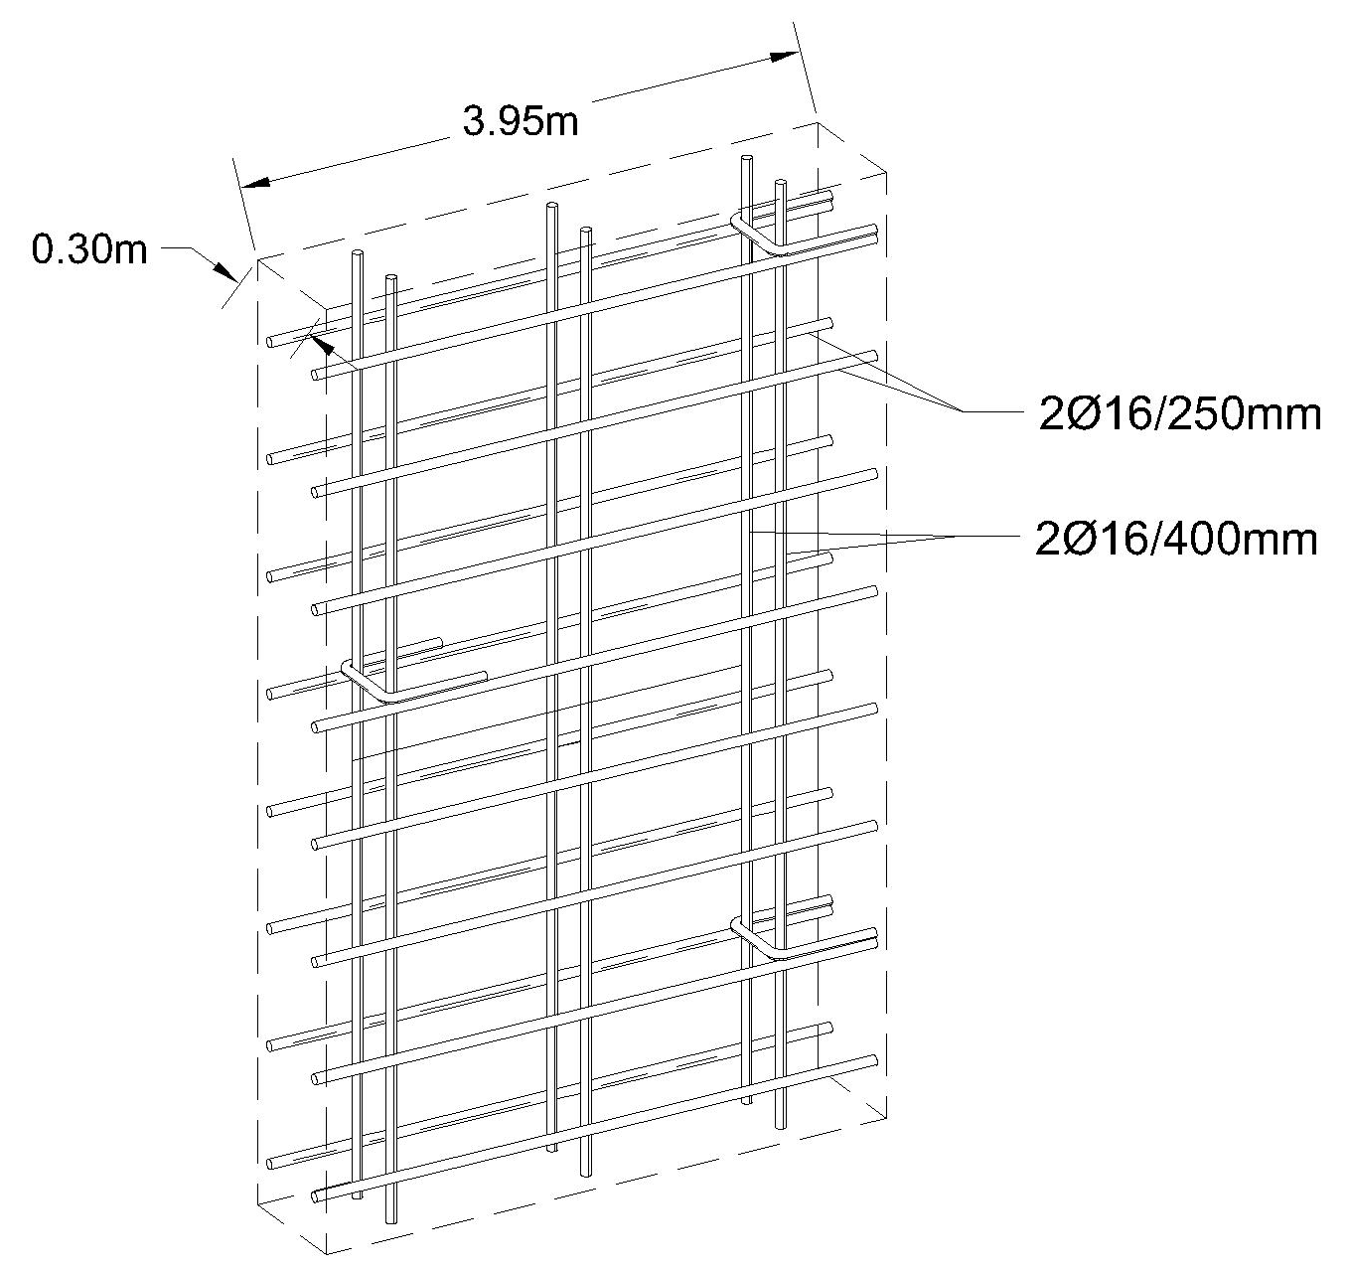
basement reinforcement and dimension

Slide 71


