Slide 1
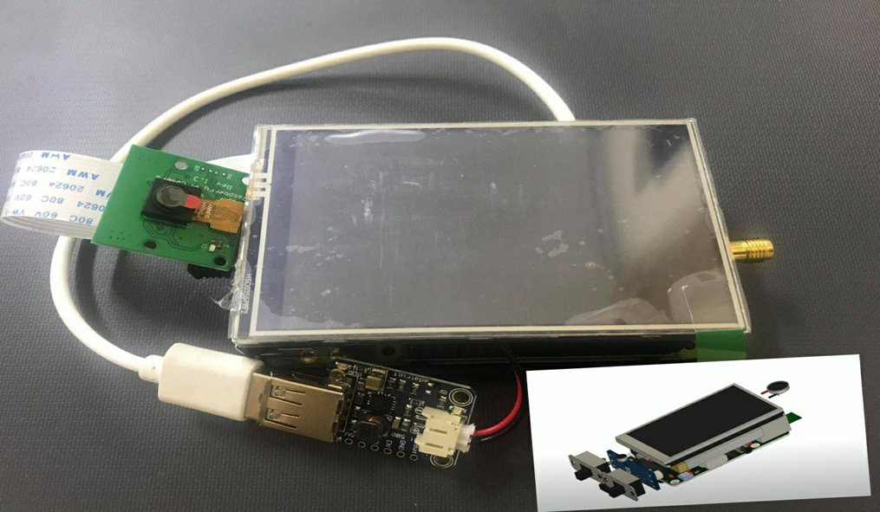
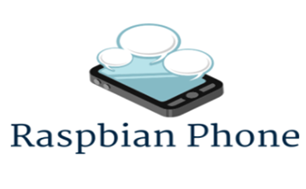
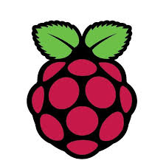
Raspberry Pi Phone Based Dedicated Applications

Tasbeeh Hamadneh
Amon Bani Jaber
Anagheem Hammad
Dr. Saed Tarabia


Slide 2
Problem Definition
The smartphone has become the primary thing in life.
Given the effect of the lack of awareness and culture among most people on the use of applications that are made with the mobile phone.
The suffering of people from the high prices of these phones.
We conducted a research to make a suitable mobile phone for these to solve these problems using making a mobile phone with a cheap Raspberry.
Downloading the programs most used by people And their awareness of how to use for fear that there are applications that the person does not realize how dangerous it is to use them.

Slide 3
Objectives &Alternative Solution
Our project aims primarily to provide a simple and affordable low-cost mobile phone.
Alternative:
We can use to connect to another phone using Raspberry and its related functions, and is appropriate for the applications they use.

Slide 4
Introduction
Engineering specialization is the most in our live?
We were multidisciplinary, including Telecommunication Engineering, Electricity, Electronics, Computer and Information Technology, we are all talking about the impact of specialization in life. And programming languages such as Python and Java.
However, it was different from the appearance of the electronic piece called “Raspberry Pi”, a term that dissolved the boundaries between control science, electronics, electricity, operating systems, programming, communications and even the management of servers and all disciplines of information technology.

Slide 5
Introduction
Because of this simple piece, we have merged together with one amazing document to change the world view of electrical and electronic devices and even the world of computers simultaneously.
We will learn about this wonderful electronic masterpiece called Raspberry Pi, learn how it appeared to the world, how it affected it, what its possibilities, what we can do with it and Why are there 3 million of monthly searches on Google for that word “Raspberry Pi”.

Slide 6
Why “Raspberry Pi”?
Raspberry Pi is not an Arduino nor BegaleBone because it is a small, powerful, permeable, cheap, flexible, customizable, fully programmable and fast computer board, including the installation of a complete operating system for use as a personal computer.
The Raspberry Pi is a low cost, credit-card sized computer that plugs into a computer monitor or TV, and uses a standard keyboard and mouse.
It is a capable little device that enables people of all ages to explore computing, and to learn how to program in languages like Scratch and Python.
It’s capable of doing everything you’d expect a desktop computer to do, from browsing the internet and playing high-definition video, to making spreadsheets, word-processing, and playing games.
The Raspberry Pi has the ability to interact with the outside world, and has been used in a wide array of digital maker projects.

Slide 7
Raspbian Operating System
Raspbian is the official operating system of the Raspberry Pi and it is based on one of the original Linux distributions Debian.
There are several versions of Raspbian including Raspbian Buster and Raspbian Stretch, Raspbian uses PIXEL, Lightweight as its main desktop environment.
It is composed of a modified LXDE desktop environment and the Openbox stacking window manager with a new theme and few other changes.

Slide 8
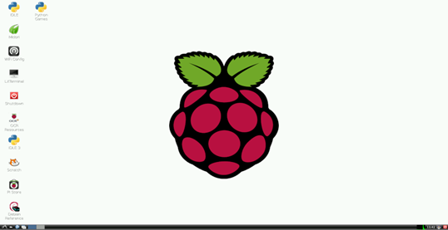
Raspbian Interface

Slide 9
Why we using Raspbian?
Raspbian is one of the longest-running Linux distributions and concentrates on stability, high compatibility, and excellent performance even on modest hardware making it a great partner for the Raspberry Pi.
And adds custom tools and software to make using the Raspberry Pi as easy as possible.
also it does have enough resources to run LXDE and a handful of applications and provide the Epiphany web browser and a few other desktop programs.
This is what we make it suitable for this project.

Slide 10
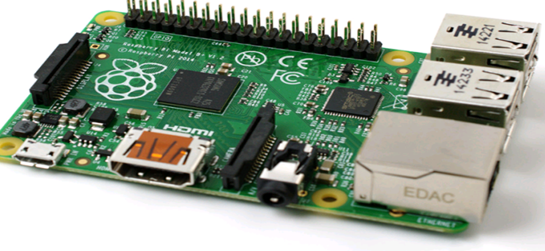
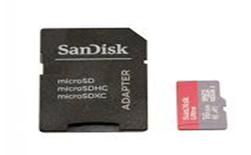
Hardware Components
Raspberry Pi3 model B+:
SanDisk (SD card):
fits the work in this project in terms of memory capacity in this type compared to other types where the memory capacity up to 512 MB and also contains a network port Ethernet which gives us the possibility of connecting to the Internet
holds the operating system and all the files on the raspberry pi, tand we use it with 64GB size

Slide 11
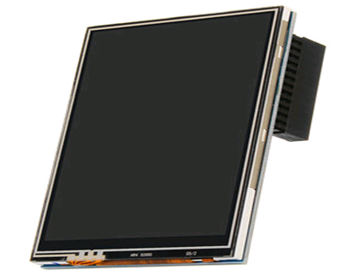
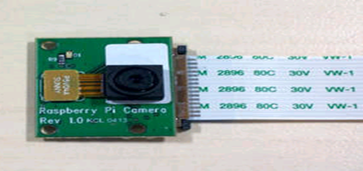
Hardware Components
PITFT Touchscreen
The Raspberry Pi Camera Model
TFT touchscreen and we use it as 3.5 inches .
the hardware resolution it is 480x320 also this touchscreen .
provide 125MHz High-Speed SPI signal transmission.
with the 50Hz refresh rate Raspberry Pi.
allow to Watch videos with multi format like MP4 and Play video games.
take photos by touching up to 17 camera modes .
ability to record still images or video to project.
it designed to connect to the Camera Serial Interface (CSI) of the Raspberry Pi.
weighs just 3 grams it draws considerably less power, so it doesn’t strain the Raspberry Pi’s power supply

Slide 12
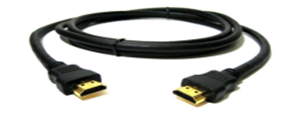
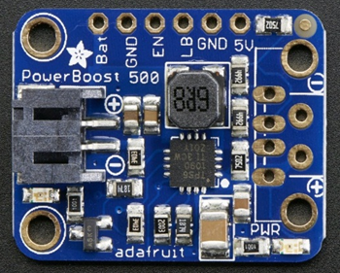
Hardware Components
HDMI cable
DC-DC Converter
cable to connect the raspberry pi with TFT touch screen
Is the perfect power supply for project This little DC/DC boost converter module.
can run from 1.8V batteries or higher, and convert that voltage to 5.2V DC for running your 5V .
has 2A internal switch, synchronous conversion, excellent efficiency, and 700KHz high-frequency operation.

Slide 13
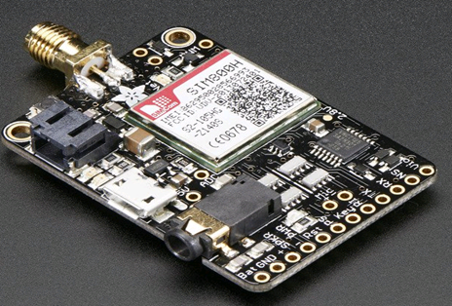
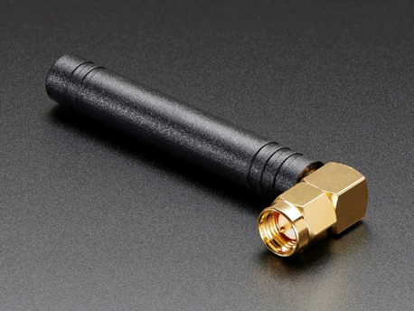
Hardware Components
Adafruit FONA(GSM) Module
Right-angle Mini GSM/Cellular Quad-Band Antenna
It's breadboard Introducing Adafruit's FONA MiniGSM.
lets we add voice, text, SMS and data in little package.
At the heart is a GSM cellular module (we use the latest SIM800) the size of a postage stamp, we can run it with 2.8V to 5V logic.
send and receive voice calls using headset or an external 8Ω speaker.
This 2.4"/61mm long antenna has 2dBi of gain and 50Ω impedance. considered as the main communications module, because allow us to send standard AT commands to it to make calls, hang up, send texts, data etc ......

Slide 14
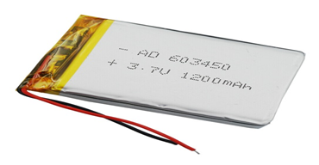
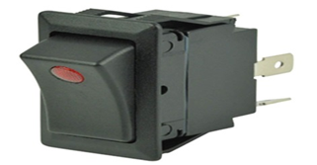
Hardware Components
Lipoly Battery
Small Electrical Switch
light and powerful.
The output ranges from 4.2V when completely charged to 3.7V
this battery has a capacity of 1200mAh for a total of about 4.5 Wh
connect it with the battery and with antenna in order to hook up the electricity

Slide 15
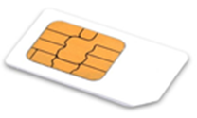
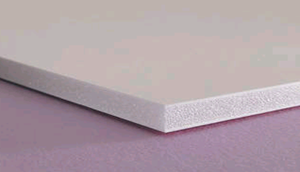
Hardware Components
SIM Card
Foam Board
allow the GSM module to associate with local GSM network
This board separating the GSM module from the Raspberry Pi.
we must ensure to no electrical connections between them and we will use it as the same size of raspberry pi

Slide 16
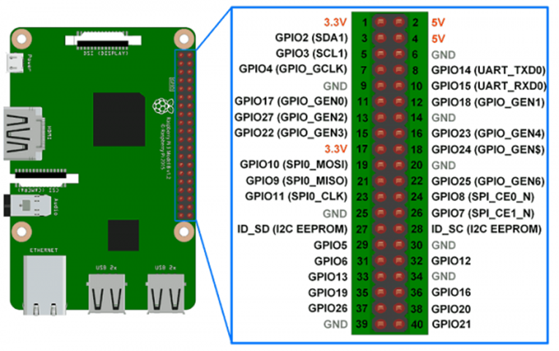
Software Components
we present the use of Raspberry Pi in electronic control projects through the general points that are used as input or output (GPIO), so that the Raspberry Pi becomes an advanced alternative to microcontrollers and shown in the picture:

Slide 17
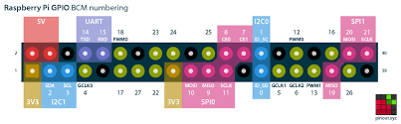
Control Exist GPIO
GPIO is abbreviated to General-Purpose Input /Output.
The Raspberry has an electrical connection point ( pins) called GPIO.
Some are used for electronic control (output), some are for sensors(input).
some are for power supply, some are for communication protocols between different components and electronic devices.

Slide 18
Programming Supported by Raspberry
It works with Linux.
which means that it has full support for most of the programming languages that Linux supports, such as Pascal, Ruby, Perl, Python, Java, C#, C++, C(Mono)………etc.
All of these languages we can use to make any kind of applications, whether desktop applications, servers, or even applications to control electronic ports (GPIO).
we found software libraries that can be added to any of these languages to transform into a tool to control GPIO easily.
we chose the Python language because it is supported in an excellent way and the most famous languages in controlling these ports (GPIO).

Slide 19
Python Program
In our project, we will use python language to make our project functional.
Python code is written in English, providing the Pi with commands in a manner that is quick to learn and easy to follow.
It works on all operating systems and different versions of Windows, Linux and its derivatives, Unix and its derivatives, mobile phone systems such as Android, Symbian.
The presence of most of the additional libraries with it, including libraries included with the language and the other can be downloaded such as the Bluetooth library.
Dealing with the following databases Oracle, Sybase, PostGres, mSOL, Persistence. Python ability to control electronic ports GPIO.

Slide 20
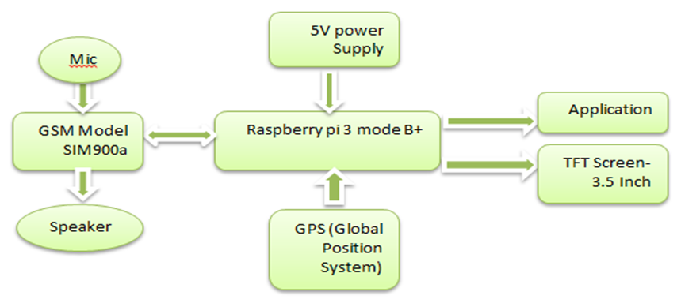
Proposal System
the operating mode of the mobile phone is connected to the nearest station or communication tower to request the service from it.
In order to connect and send messages, I must use the card and GSM.
for voice calls using the loudspeaker and microphone, the call is successfully made by simply calling the station or the nearest communication tower on the card.
we use the downloaded applications on Phone by pressing the application terminals.

Slide 21
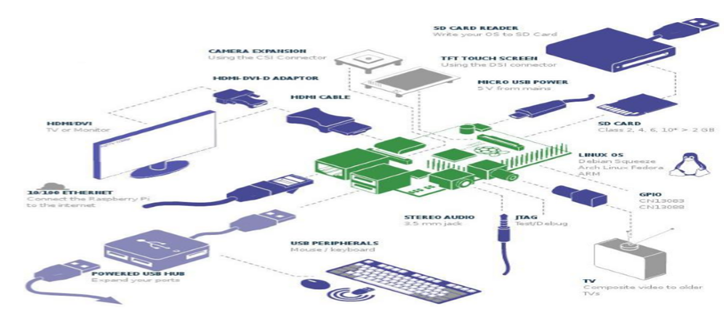
Methodology

Slide 22
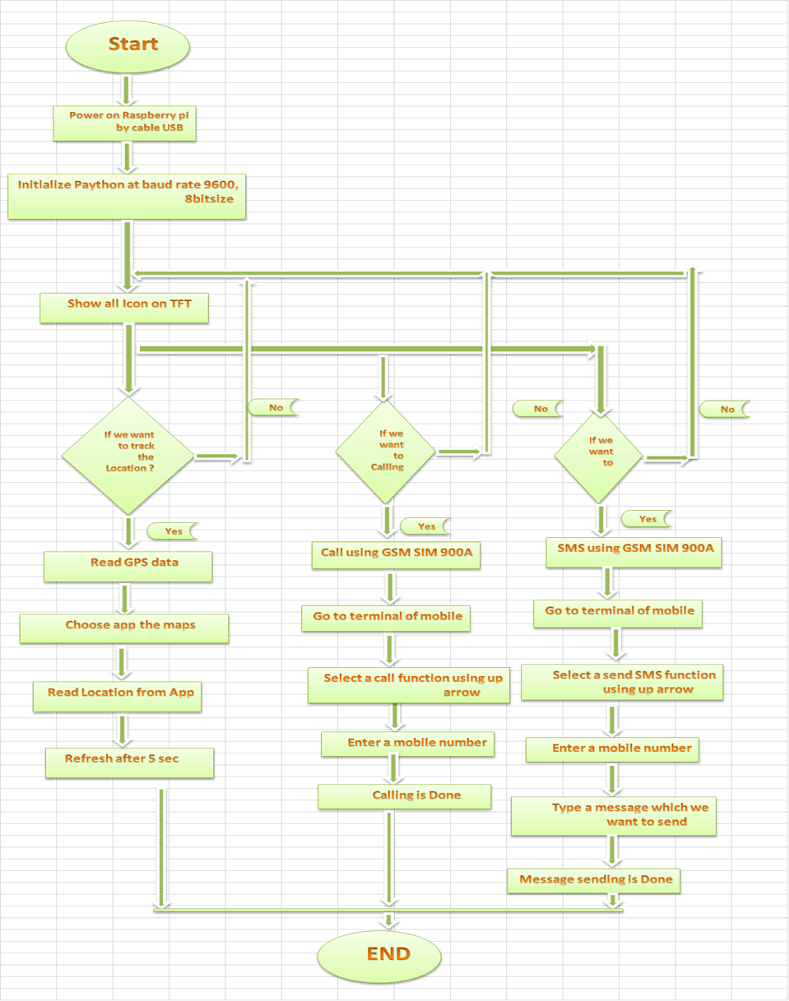
Methodology
*Flow Chart*

Slide 23
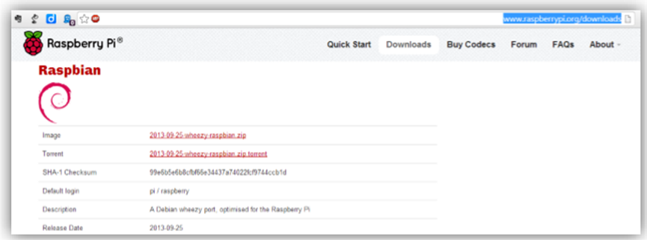

Methodology
*Electronic Design*
Raspbian Operating Systems
Wheezy Raspbia.img

Slide 24
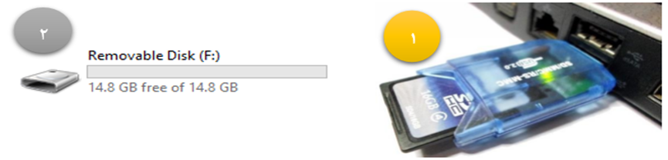
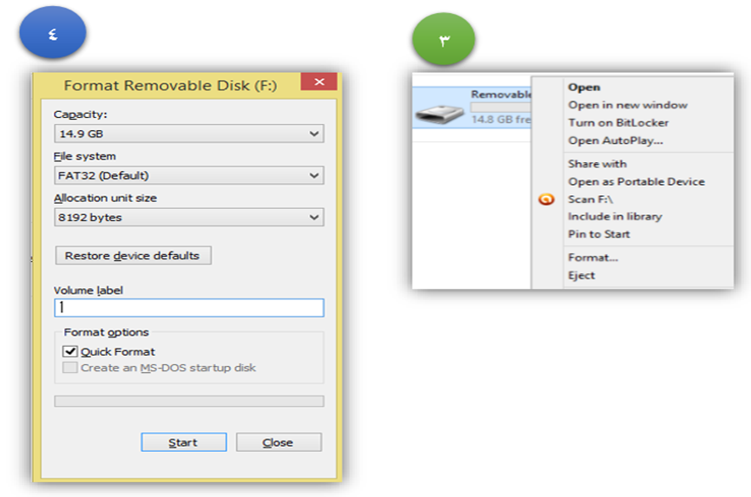
Methodology
*Electronic Design*
Memory Card with Letter F
Format Removable Disk

Slide 25
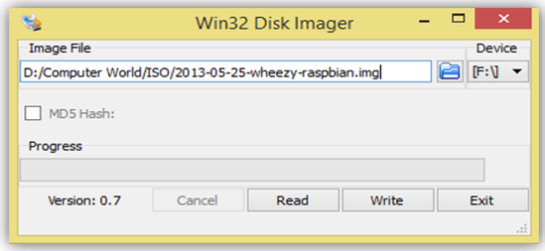
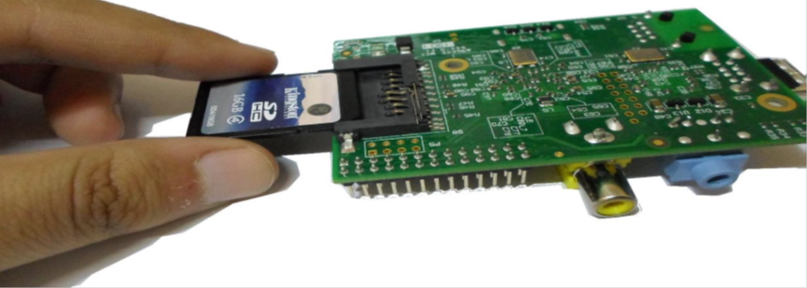
Methodology
*Electronic Design*
Image Writing on SD Card
Memory Card in the Raspberry Pi Panel

Slide 26
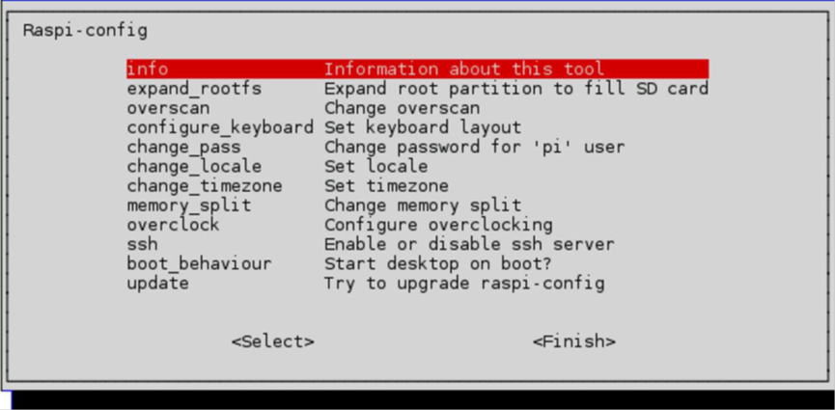

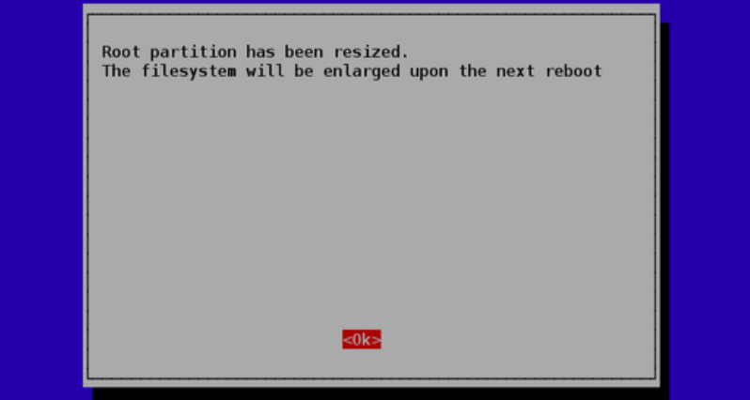
Methodology
*Electronic Design*
Raspberry-Config Info
Raspberry-Config. Root Partition

Slide 27
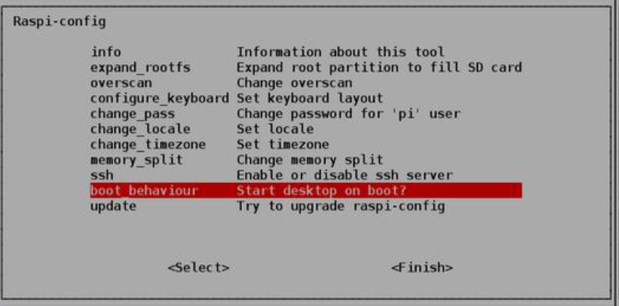
Methodology
*Electronic Design*
Raspberry config Boot_Behaviour

Slide 28
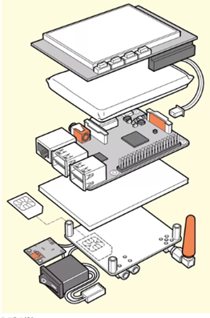
Methodology
*Mechanical Design*
using a special program called Autodesk Fusion360 which is a program specializing in mechanical designs.
which is design, manufacture and engineering using a three-dimensional computer that integrates multiple functions across a cloud-based platform.
it is smart manufacturing software that combines production planning, job tracking and machine monitoring.
providing real-time visibility, and instant access to my production data.

Slide 29
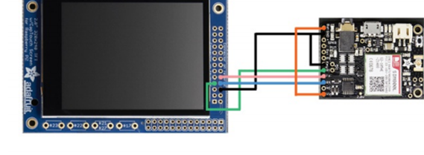
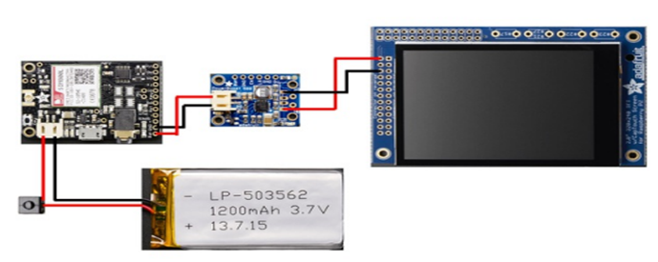
Methodology
*Electrical Design*
we deal with the connection of electronic parts with each other.
how to take into account the amount of current and voltage inside and outside on these parts so that we do not fall into the wrong path during networking.

Slide 30
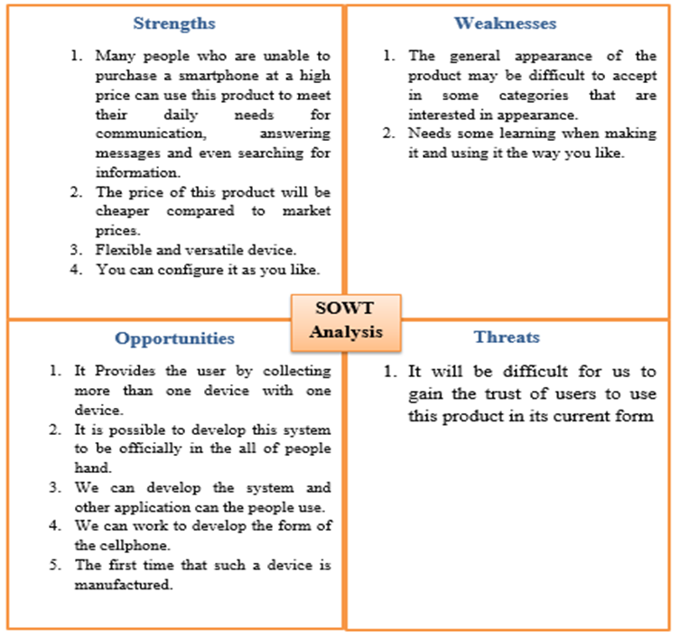
SWAT Analysis

Slide 31
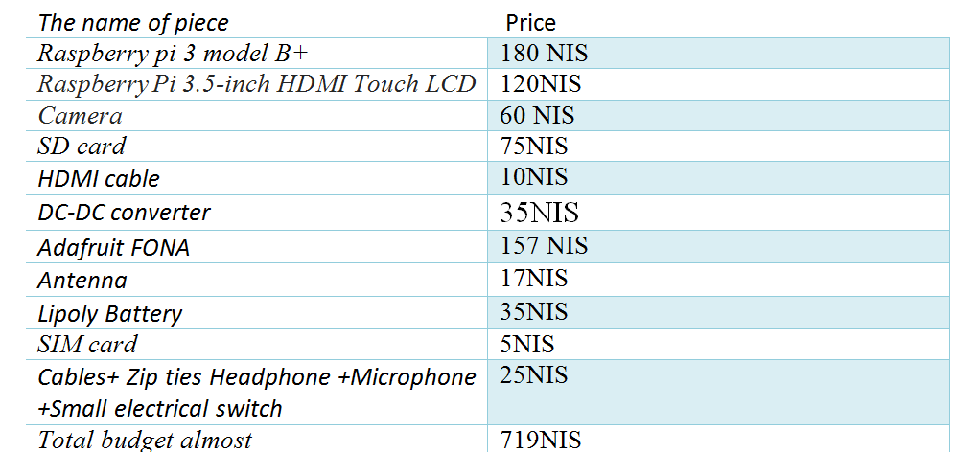
Budget Estimation
. These prices are according to the local market.

Slide 32
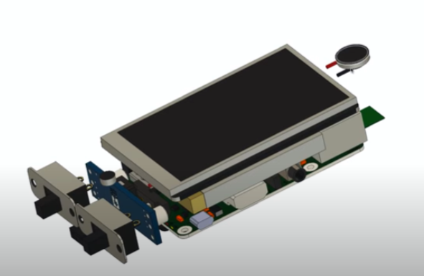
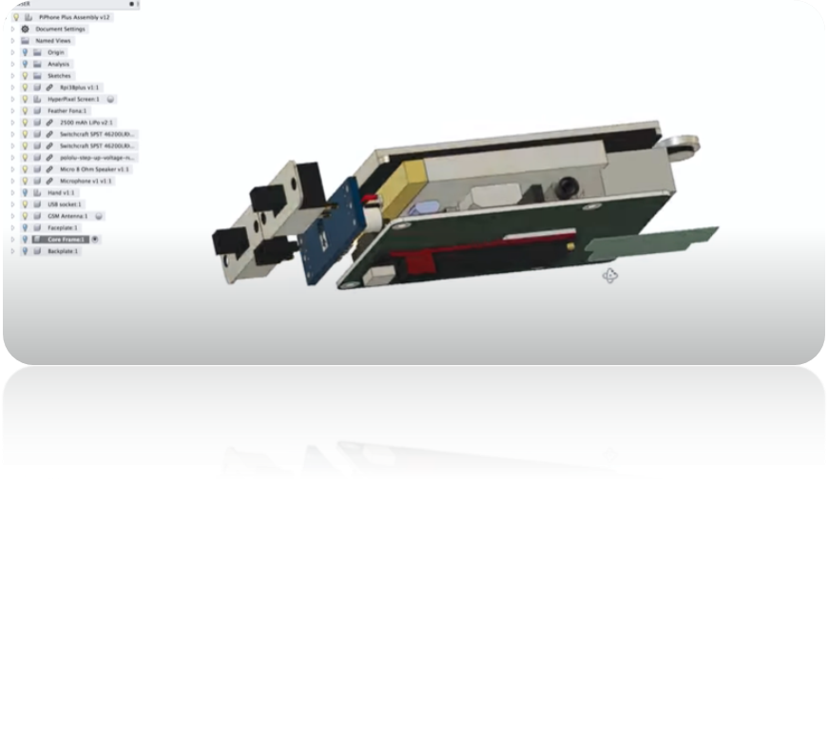
Modeling The Project as Design
Autodesk Fusion 360 is a 3D computer design, manufacture and engineering program that integrates multiple functions across a cloud-based platform. Use it for anything from product design to construction project. We drew the idea on it and turned it into detailed drawings :
Modulation Modle1
Modulation Model2

Slide 33
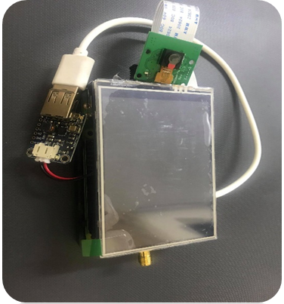
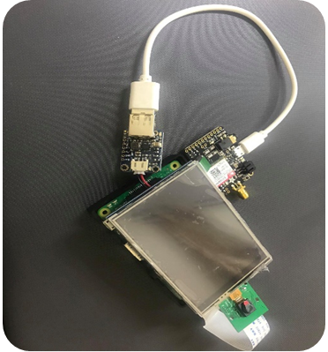
Modeling The Project as a Hardware
The final design of the hardware shown in the pecturs was supposed to appear on the interface as a result of the previous questionnaire. The most used people for applications were Facebook and YouTube, but due to the circumstances that occurred the spread of Corona disease we could not accomplish these things.
The Final Design of the Hardware

Slide 34
Conclusion
Recently, smart phones are becoming increasingly popular and the number there of has increased greatly in the past few years.
smart phones become basic need for all life field's such as educational and industrial field.
the idea of this project give efficient cell phone because in that all features and function of laptops easily available.
this is possible only when we used raspberry pi without need to carry the laptop or other high priced smart phone.

Slide 35
Recommendations
In the future, we will create a complete system consisting of hardware and software components, to made a cellphone using raspberry pi 3B+.
in which calling, messaging is possible, where communication and messages are made, no matter what important features are available on the laptop or computer in our system.
download applications that suit the uses of people.
Notes:
من ناحية التعليم والتعلم والالعاب والعمل والاعمال البيتية والتطوير كما يشاء

Slide 36









