Slide 1
Seismic Design of Fatima Al Zahra Mosque
Supervisor Name :
Dr. Mahmoud Dweikat
By: Banan Majid Damrah
Refat Mustafa Dameh
Mohammad Eyad Hamad

Slide 2
Outline
Introduction.
Preliminary Design.
Modeling and Design.
Dynamic Analysis for Seismic Loading.
Seismic Design Checks.
Special Structural Elements.

Slide 3
Introduction
Project Description.
Codes and Specifications.
Materials.
Loading.

Slide 4
Introduction
Abstract
Fatima Al Zahra mosque is an old prominent landmark in Qaffen-Tulkarm City where engineering offices do not design for seismic loads.
This mosque, consists of a ground floor and a first floor with a total area of 476m² (238m² for each).
For seismic design UBC 97 code will be used. The difference between the gravity design and seismic design will be shown in Details.

Slide 5
Introduction
Project Description
Floor | Area (m²) | Height(m)
Ground | 238 | 4.2
First | 238 | 4.2

Slide 6
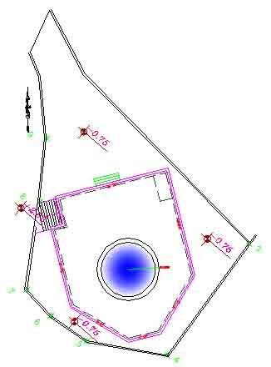
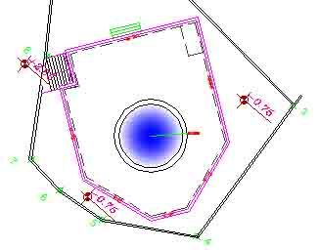

Preliminary Design
Alterations and Constrains
$$→$$

Slide 7
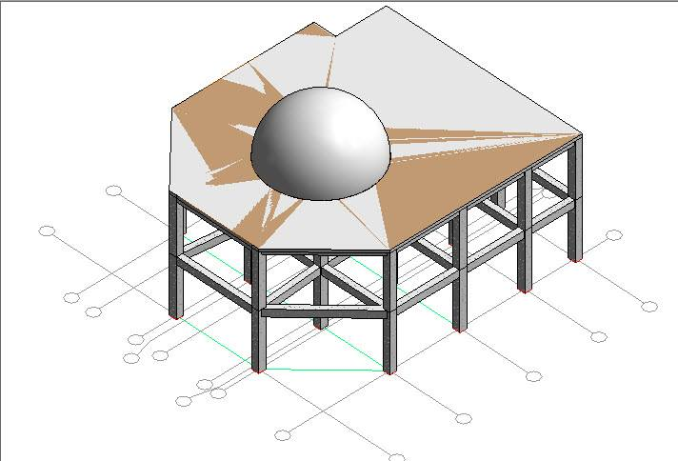
Introduction
Project Description

Slide 8
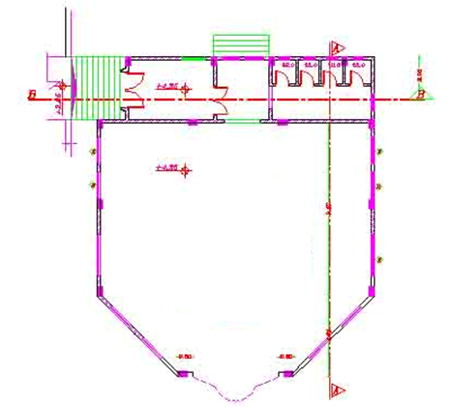
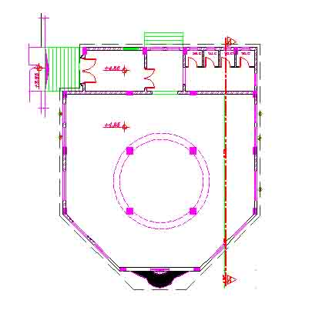
Introduction
Project Description
Ground Floor
First Floor

Slide 9

Introduction
Soil Properties
The soil in the site area is rock soil with a bearing capacity 400

Slide 10
Introduction
Codes and Specifications
ACI318 : American concrete institute.
UBC97 : Uniform Building Code.
ASCE : American Society of Civil Engineers.
ASTM : American Society for Testing and Materials.

Slide 11
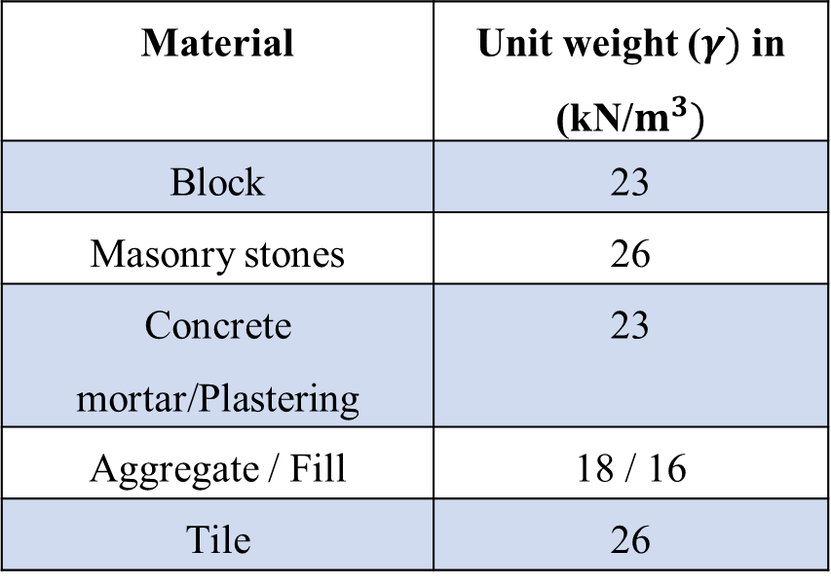
Introduction
Martials
Structural material:
Non-Structural material.
Material | Unit weight (𝜸) in (kN/$m^{3})$
Block | 23
Masonry stones | 26
Concrete mortar/Plastering | 23
Aggregate / Fill | 18 / 16
Tile | 26
Material | strength
Concrete , (f’c) | 28 MPa
Steel , (Fy) | 420 MPa

Slide 12
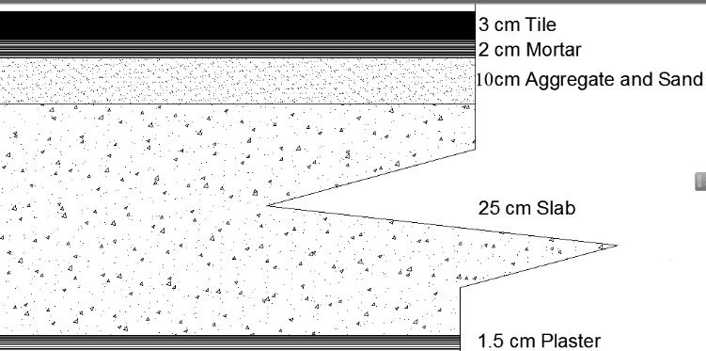
Introduction
Loading
Dead Load : consists of the own weight of the structural elements such as slabs, beams, columns, footings and shear walls.
Superimposed dead load : consists of the weight of all non-structural elements such as the weight of tiles, weight of fill under the tiles, mortar, partitions .

Slide 13
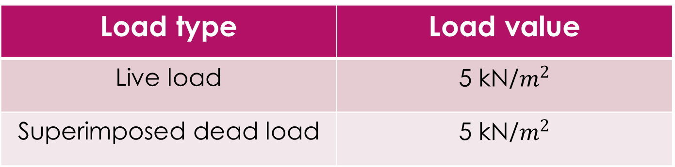
Introduction
Loading
Load type | Load value
Live load | 5 kN/$m^{2}$
Superimposed dead load | 5 kN/$m^{2}$

Slide 14
Preliminary Design

Slide 15
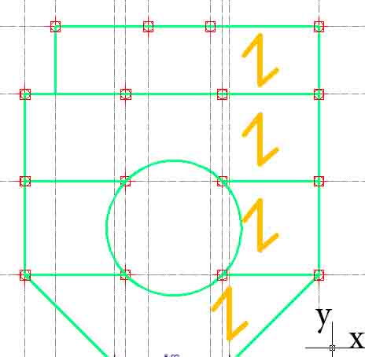
Preliminary Design
Design Alternatives
In this project we use One way solid slab
Case of loading.

Slide 16
Static Design
Structural Element | Dimension (cm)
Solid Slab thickness | 20
Column | 50*50
Beam | 50*40

Slide 17
Modeling and Design

Slide 18
Outline
First Floor Modeling.
Complete model.
Analysis and Design.

Slide 19
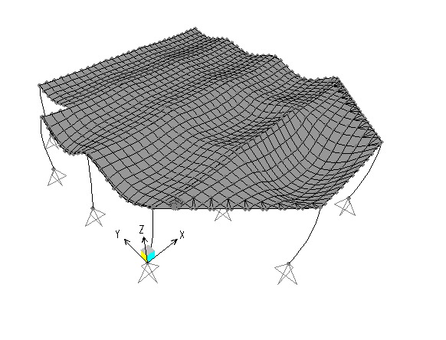
Modeling and Design
First Floor modeling
Compatibility check:

Slide 20

Modeling and Design
First Floor modeling
Equilibrium check:
Total dead load = 1869.574 kN.
Total live load = 1189.524 kN.
Total SID load = 1189.524 kN.

Slide 21
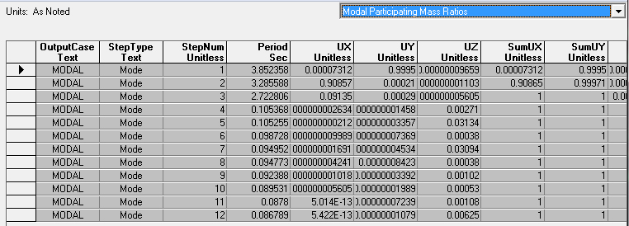
Model Mass Participation Ratio

Slide 22
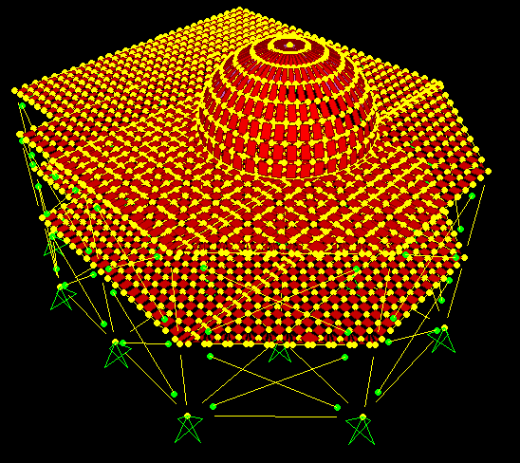
Modeling and Design
Complete structure modeling

Slide 23
Modifiers for slab, beams and columns
Modeling and Design
Slab modifiers
 | m11 | m22 | m12 | Torsional constant | Axial
Slab | 0.035 | 0.35 | 0.035 | 0.01 | 1
Beams and Columns modifiers
 | M about 3 axis | M about 2 axis | Torsional constant | Axial
Main Beams | 0.35 | 0.35 | 0.35 | 1
Secondary Beams | 1 | 1 | 1 | 1
Columns | 0.7 | 0.7 | 0.7 | 1

Slide 24
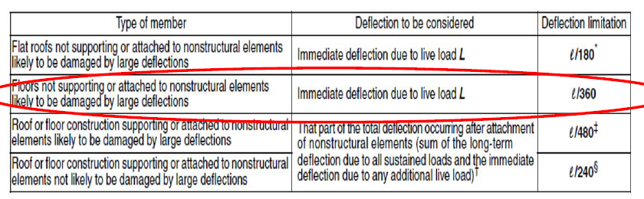
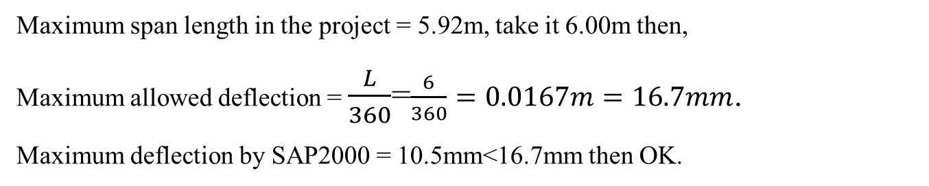
Maximum deflection by ACI
Modeling and Design
Maximum span length in the project = 5.92m, take it 6.00m then,
Maximum allowed deflection = $\frac{L}{360}$=$\frac{6}{360}=0.0167m=16.7mm$.
Maximum deflection by SAP2000 = 10.5mm<16.7mm then OK.

Slide 25
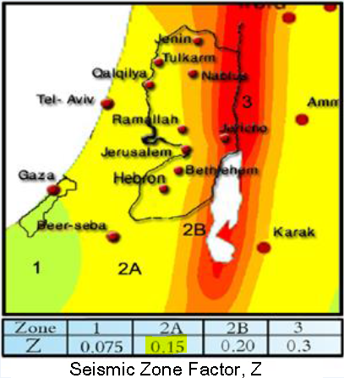
Dynamic Analysis for Seismic Loading
Main factors according to UBC 97 code
Z= seismic zone factor, for Tulkarm city (Zone 2A); Z= 0.15
I= importance factor. From Table 16K (UBC 97), for occupancies used for Mosque I= 1.25 .
R= numerical coefficient representative of the inherent over strength and global ductility capacity of lateral - force- resisting systems, then in this project (frame structural system provided by braced frames) use R= 5.5 .

Slide 26
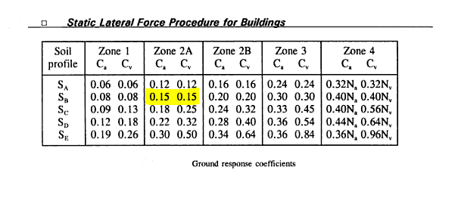
Ground response coefficients, Ca & Cv
Dynamic Analysis for Seismic Loading
Soil is rock so soil profile type SB from Table16-J (UBC 97)
Ca= acceleration seismic coefficient, from Table 16-Q (UBC 97)Ca=0.15
Cv= velocity seismic coefficient, from Table 16-R (UBC 97)Cv=0.15

Slide 27
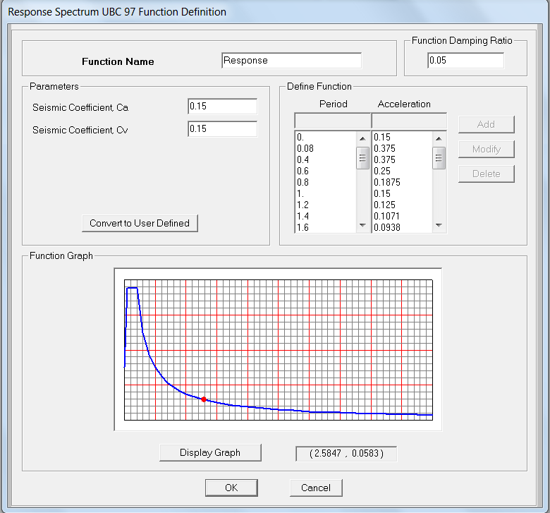
Response Spectrum

Slide 28
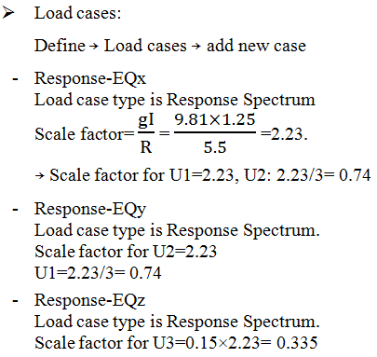
Response Spectrum

Slide 29
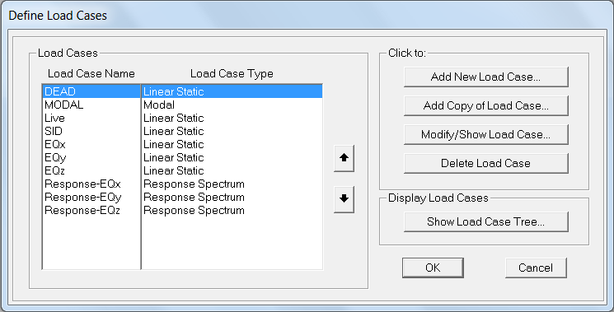
Response Spectrum

Slide 30
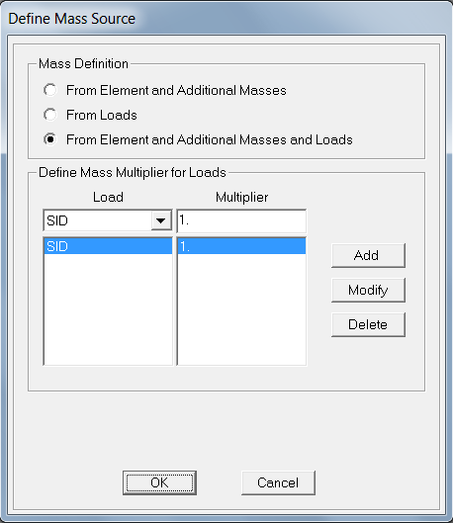
Total Base Shear Check
Define Mass source

Slide 31
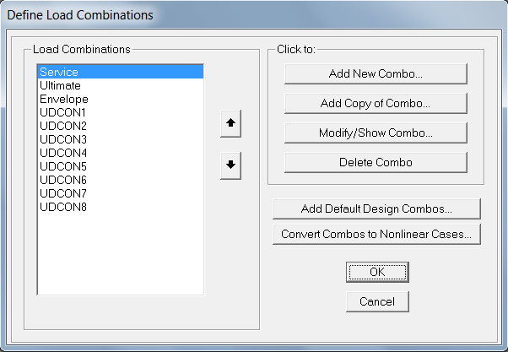
Response Spectrum

Slide 32
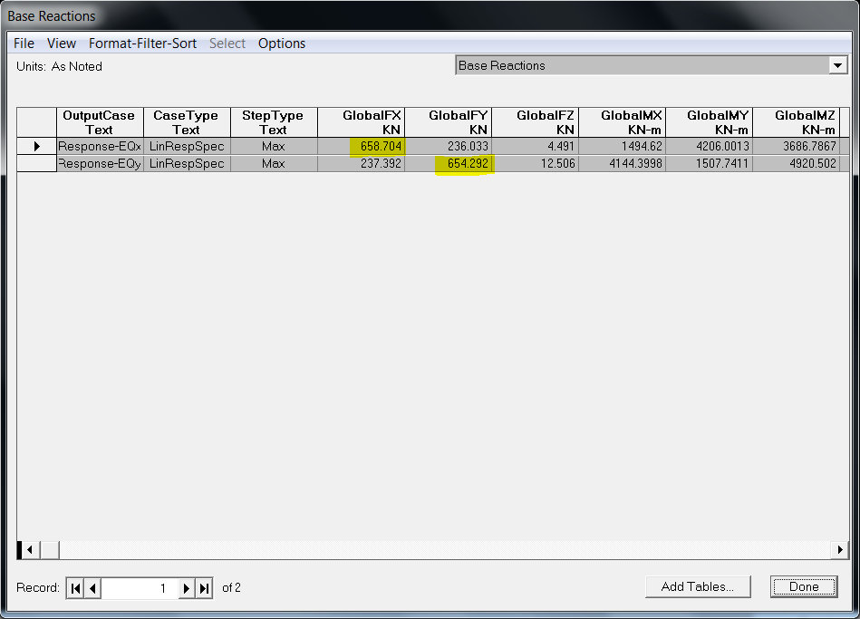
Total Base Shear Check
Total Base Shear in X & Y directions

Slide 33



Total Base Shear Check
Equivalent Static Method

Slide 34
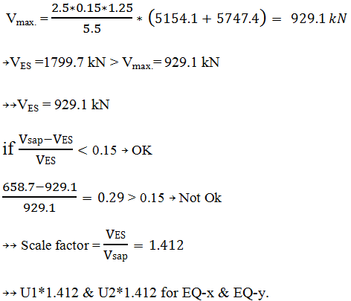
Total Base Shear Check
Equivalent Static Method

Slide 35
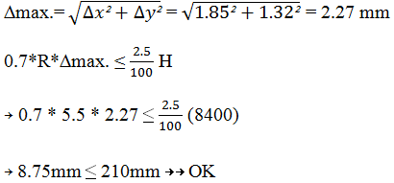
Lateral Drift Check

Slide 36
Design &Checks
• 1- Slab design.
• 2- Beams design.
• 3- Columns design.

Slide 37
Design &Checks
Slab Design
• One way solid slab.
• Check shear capacity.
• Dimensions are the same.
• Find max positive and negative moment.
• Find ρ.
• Find As and compare with minimum As.
• Choose a suitable reinforcement & check for spacing.

Slide 38
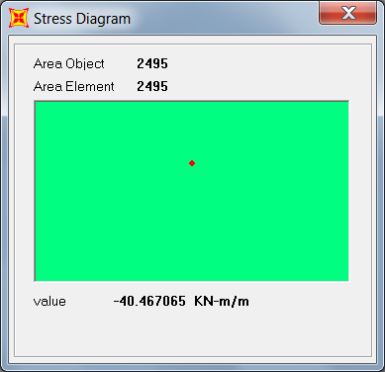
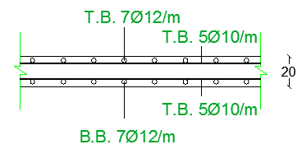
Design Checks
Slab Design
From SAP we find the maximum moment on the slab=40.47kN.m
Typical cross section in slab

Slide 39
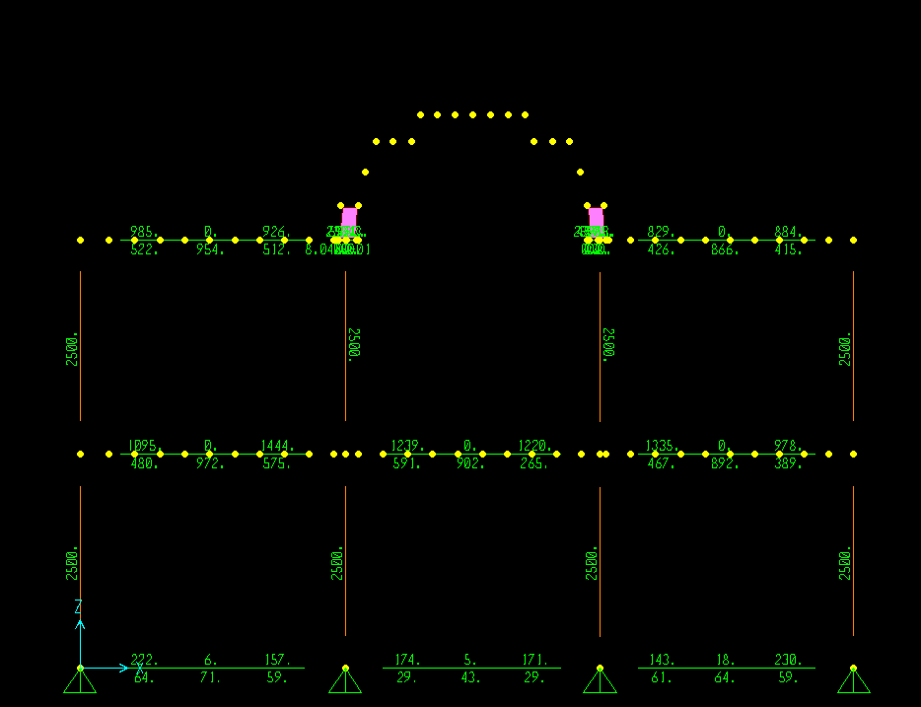
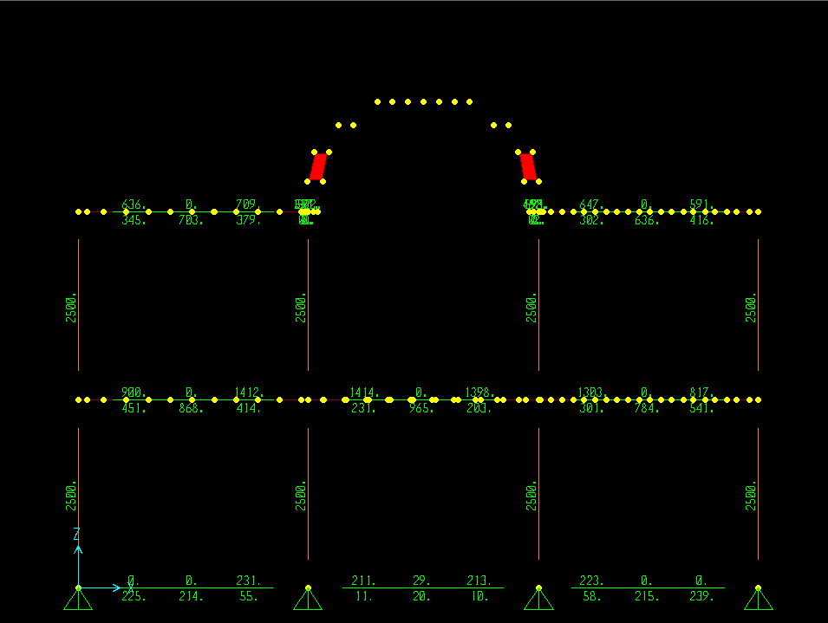
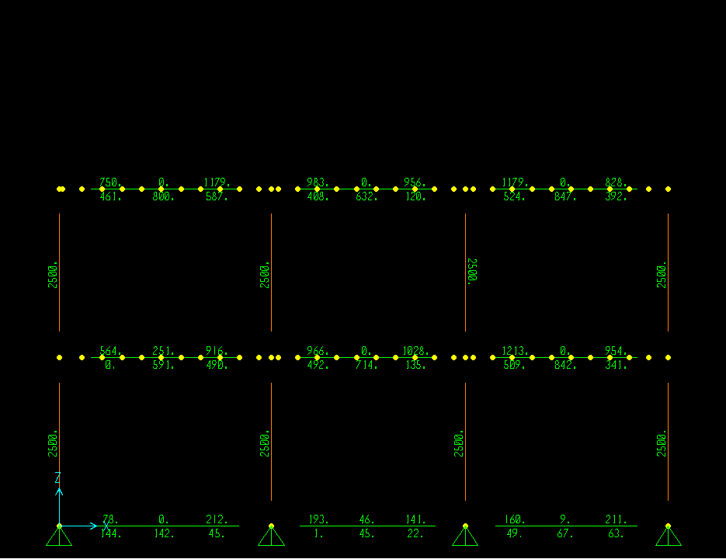
Design Checks
Beam Design
After making design all of the beams are gives green color that’s indicate there is no error as shown in the figures below.

Slide 40
Design Checks
Beam Design
• Design for Bending moment
• Take moment from SAP
• Find 𝜌
• Check for 𝜌 min
• Find area of steel
• Design for Shear
• Take Vu from SAP
• Find Vc and check for need of steel
• Check spacing

Slide 41
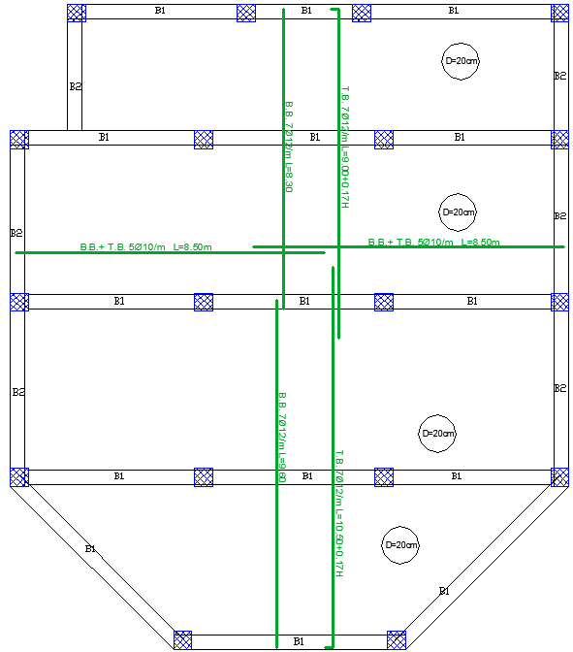
Design Checks
Beam Design

Slide 42
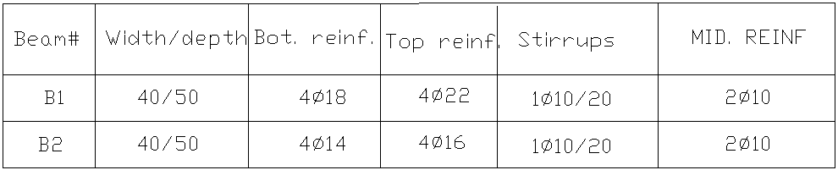
Design Checks
Beam Design
SAP Result

Slide 43
Design Checks
Column Design
• Check SWAY–NON SWAY
• Check SLENDERNESS
• Check SAP results using interaction diagrams
• Find As and suitable reinforcement

Slide 44
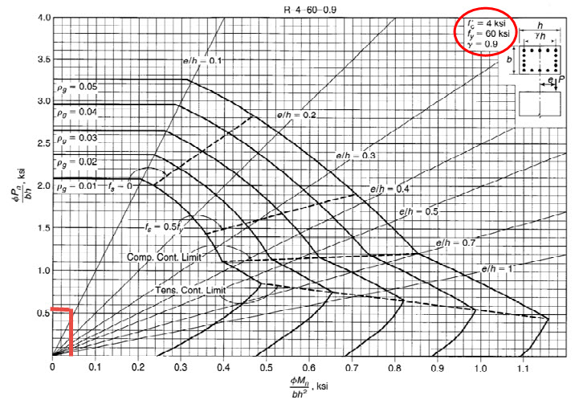
Design Checks
Column Design
• Interaction Diagram

Slide 45
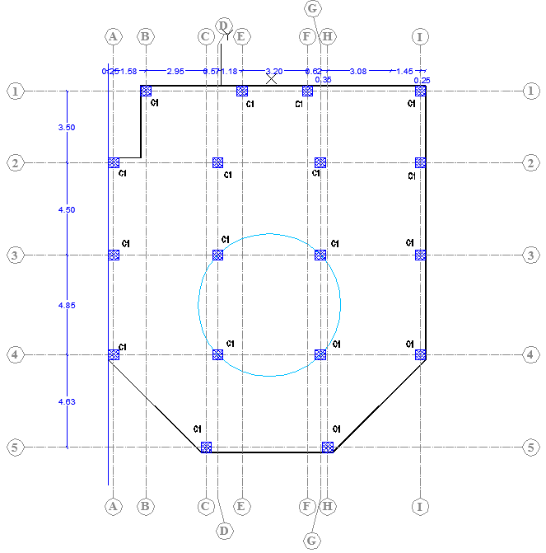
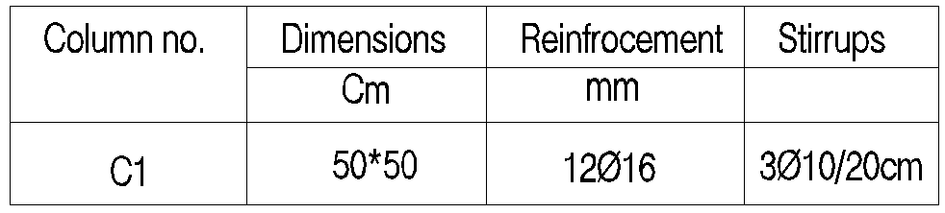
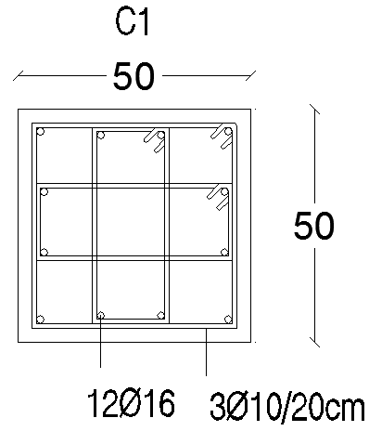
Design Checks
Column Design

Slide 46
Special Structural Elements
1- Footing Design.
2- Stairway Design.
3- The Dome Design.

Slide 47

Special Structural Elements
Footing Design
• Specify the suitable type of footing.
• Take P_{service} from SAP then determine the dimensions of footing.( )
• Take P_{ultimate} from SAP then calculate the thickness of the footing based on punching shear and wide beam shear.
• Find Moment and As.

Slide 48
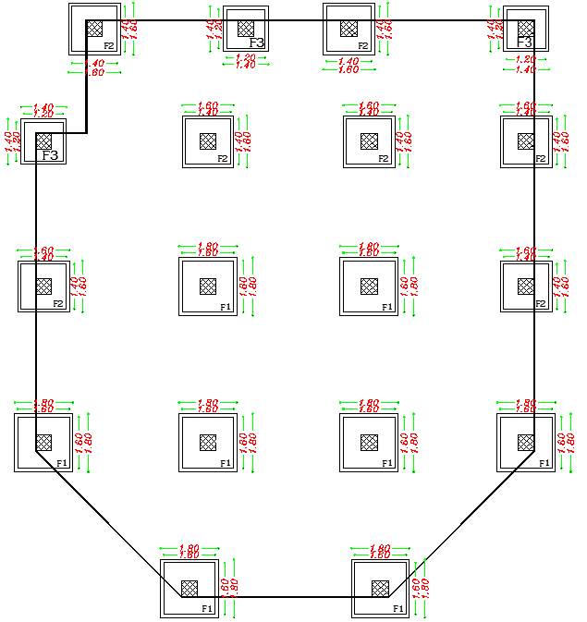
Special Structural Elements
Footing Design
• The type of footings is square single footing and we have three type of dimensions:
1- Footing F1: 1.6x1.6 m
2- Footing F2: 1.4x1.4 m
2- Footing F3: 1.2x1.2 m

Slide 49
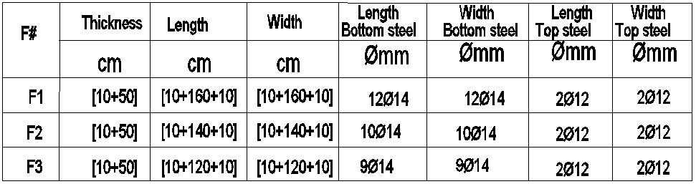
Special Structural Elements
Footing Design

Slide 50
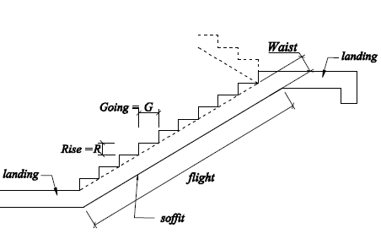
Special Structural Elements
Stairway Design
• Stairway was designed as simply supported.
• Stairway dimensions:
-Going = 0.30 m
-Riser = 0.17 m
-Floor height = 1.60 m
• Stairway loading=20 kN/m².

Slide 51
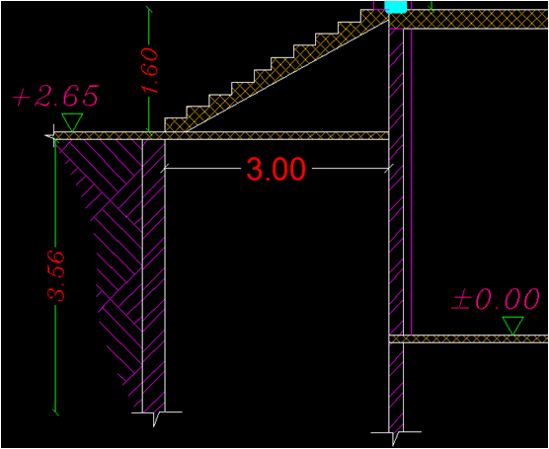
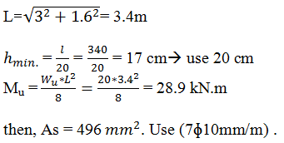
Special Structural Elements
Stairway Design
• Stairway reinforcement:

Slide 52
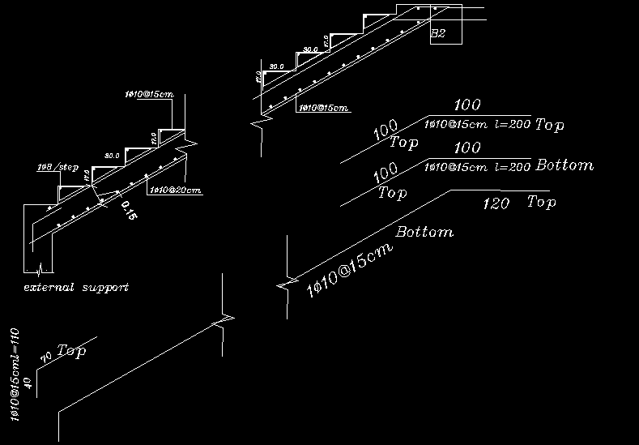
Special Structural Elements
Stairway Design
• Stairway reinforcement:

Slide 53
Special Structural Elements
The Dome Design
• Take the meridian internal force as compression & tension from SAP (F₁₁or Nɸ).
• Take the hoop internal force as compression & tension from SAP (F₂₂or Nθ).
• Check thickness of the dome from compression force for F₁₁ & F₂₂.
• Find As from tension force for F₁₁ & F₂₂.

Slide 54
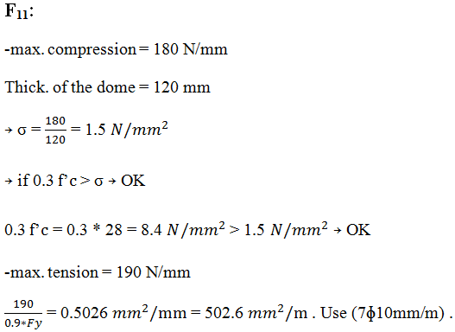
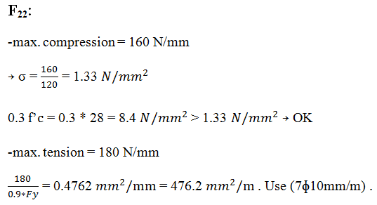
Special Structural Elements
The Dome Design

Slide 55
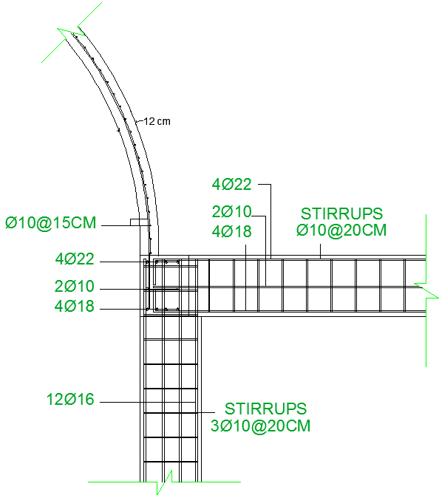
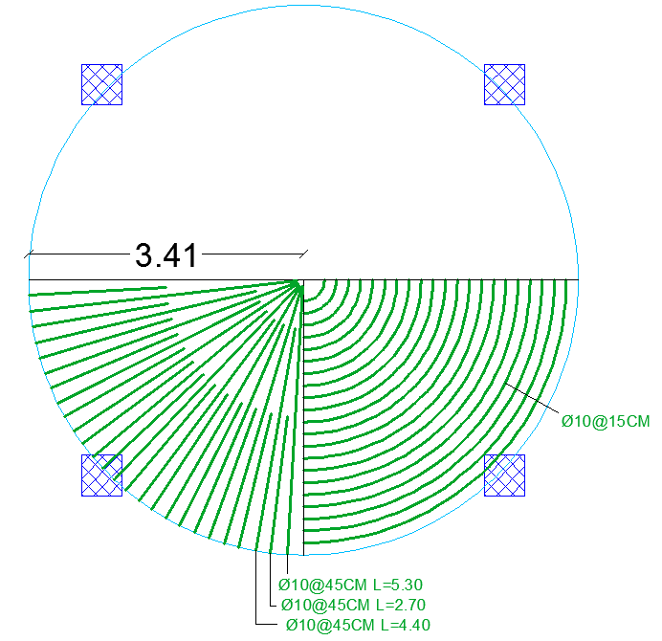
Special Structural Elements
The Dome Design

Slide 56
Discussion and Conclusion
Discussion ☺
Thank You

