Slide 1
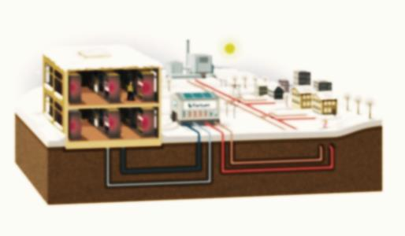
An-Najah National University
Faculty of Engineering
Mechanical Engineering Department
District Heating Network
Prepared by:
Mahmoud Salem
Mahmoud Ghanem
Basem Daghlas
Mohammad Daragmeh
Supervisor:
Eng. Luqman Hirzallah

Slide 2
Contents :
Introduction
Benefit of DH
System Components
Literature Review in Palestine
Module
Network design
Calculations
Recommendations

Slide 3
Introduction :
Definition
District Heating Network : is a system for distributing heat generated in a centralized location for residential and commercial for heating and production of domestic hot water.
District heating replaces individual boilers it uses less energy costs and make cities more organized places.

Slide 4
Benefit of DH:
Organize the heat production
Reduce the risk and maintenance
Easy to use and control

Slide 5
Components :
The System consist of
Boiler
Pipe Network isolated
Pumps
Heat Exchanger for each building
Valve and accessories

Slide 6
: Boiler
We select model REX7- REX 30 and Rex 450 for the center Boiler.
We select vertical centrifugal pump with 6 bar and mass flow 20 l/s
: Pumps
: Pipes
We select stainless steel pipe with Insulation u= 0.136-0.41 w/m.c

Slide 7
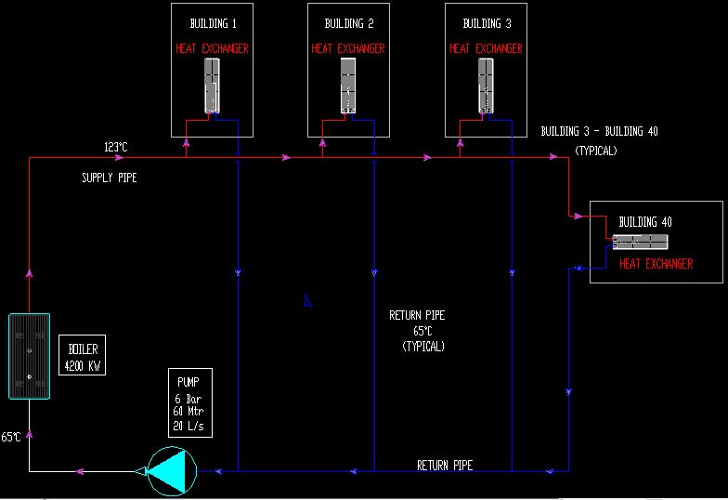

Slide 8
Motivation
This project will be the first in Palestine
It has not been implemented yet in Palestine even though there is need for such a project.
Prices of electricity and gas are high

Slide 9
Model :
Representation of reality
It is required to perform the calculation
In DH networks the following assumption :
One dimensional geometry
Junctions between components occurs in points

Slide 10
Network design
Topological representation
  we use graph theory to determine nodes and branch's
Physical representation
  we use fluid dynamic equations and thermal equation

Slide 11
Topological representation
A graph is a representation of a set of connected objects.
This representation is based on two concepts: the node and the branch
Nodes are used to describe a section at which two or more components are connected. the nodes of fluid network usually correspond to junctions
A branch is a line that is bounded by two nodes

Slide 12

Physical representation
  Momentum equation
      $\left(P_{i}−P_{i−1}\right)= − {ΔP}_{FRICT}−{ΔP}_{LOCAL}−{ΔP}_{PUMP}$
      $\left(P_{i−1}−P_{i}\right)={ R}_{j}{ G}_{j}−{ΔP}_{PUMP, j }$
  Continuity equation
    A. G+Gex = 0
    ${ A}^{T }.P$= $ΔP$
  Energy equation

Slide 13
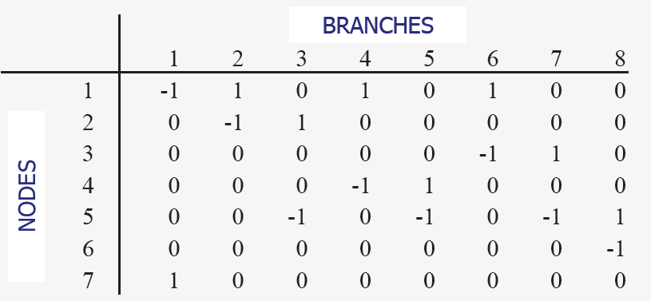
Incidence matrix
The interconnection between the nodes and branches is expresses by the incidence matrix

Slide 14
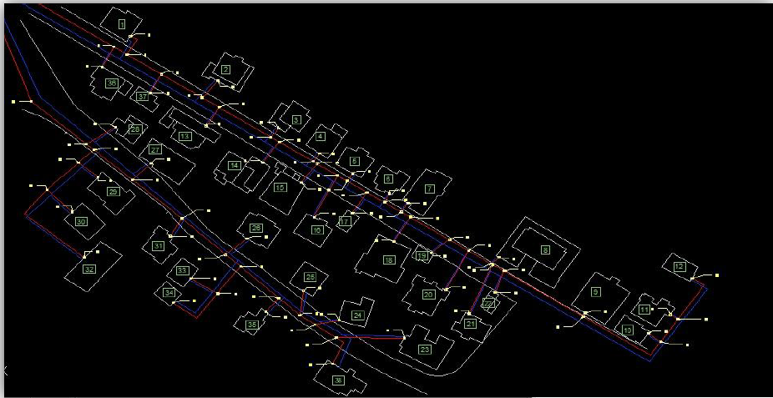
Calculations :
We have assumed heating loud is 120w per area and we have 38 building as shown in fig

Slide 15
Mass flow rate

Slide 16
Temperature

Slide 17
Pressure loss

Slide 18
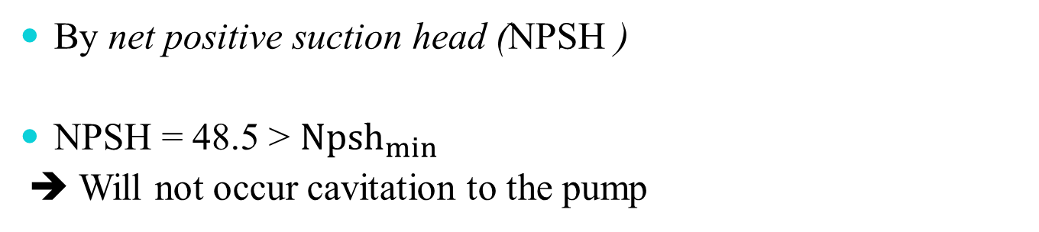
Compressed fluid check
From compressed thermodynamics table flow the pressure found 5 bar at 120°C ,so using a pump greater than 5 bar to take over friction to be fluid compressed liquid .
Pump Cavitation check
By net positive suction head (NPSH )
NPSH = 48.5 > ${Npsh}_{min}$
➔ Will not occur cavitation to the pump

Slide 19
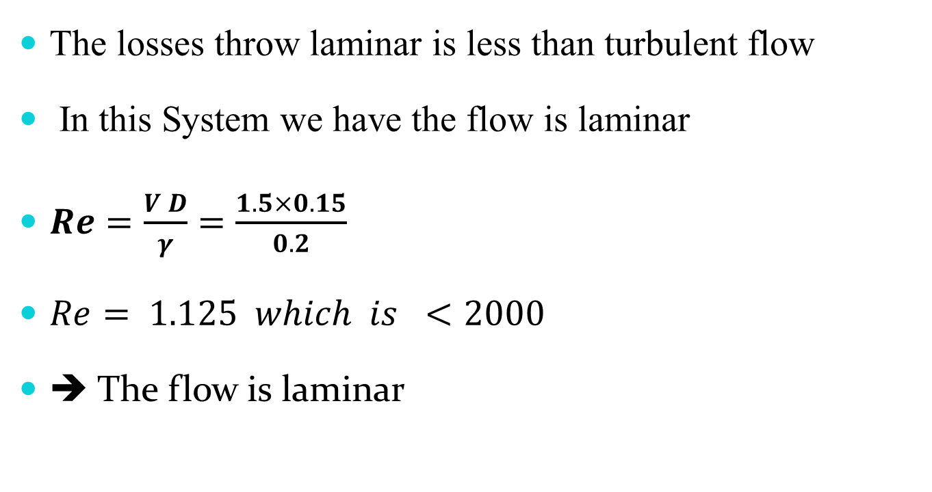
Laminar or turbulent flow in pipes
The losses throw laminar is less than turbulent flow
In this System we have the flow is laminar
$Re=\frac{V D}{γ}=\frac{1.5×0.15}{0.2}$
$Re= 1.125 which is <2000$
➔ The flow is laminar

Slide 20
Comparison between traditional and central district heating systems

Slide 21
Conclusion:
This system in our country is not feasible due to the high cost of oil derivatives.
This system can be applied in our country only through the converting waste to energy furnace or utilizing gas located on Gaza Strip.

Slide 22
Thank you for listening
Questions ?

