Slide 1

An-Najah National University
Faculty of Engineering & Information Technology
Civil Engineering Department
Graduation Project II
Structural Analysis and Design of Illar Basic Girls' school
Prepared by:
Tahleel Ghanem Dunya Abbas
Ayah Abudura Mira Alkayyal
Supervisor : Dr. Munther Diab
2020-2021

Slide 2
Outline:
Project Description
Structural System Design and Analysis .
Modeling and Checks
Design of structural elements

Slide 3
Project Description

Slide 4
Project Description :
This project is Analysis and Design of Illar Basic Girls' school .
The building consists of seven floors, and located on three different levels. The building contains two basement floors and five above the ground .
This building includes classrooms, laboratories and meeting rooms and the fourth floor is stage.

Slide 5
Area and height floor
Floor | Height (m) | Area (m2)
The second basement | 3.64 | 274.15
The first basement | 3.64 | 346.68
The ground floor | 3.64 | 609.77
The first floor | 3.64 | 609.77
The second floor | 3.64 | 609.77
The third floor | 3.64 | 609.77
The fourth floor | 3.64 | 678.17

Slide 6
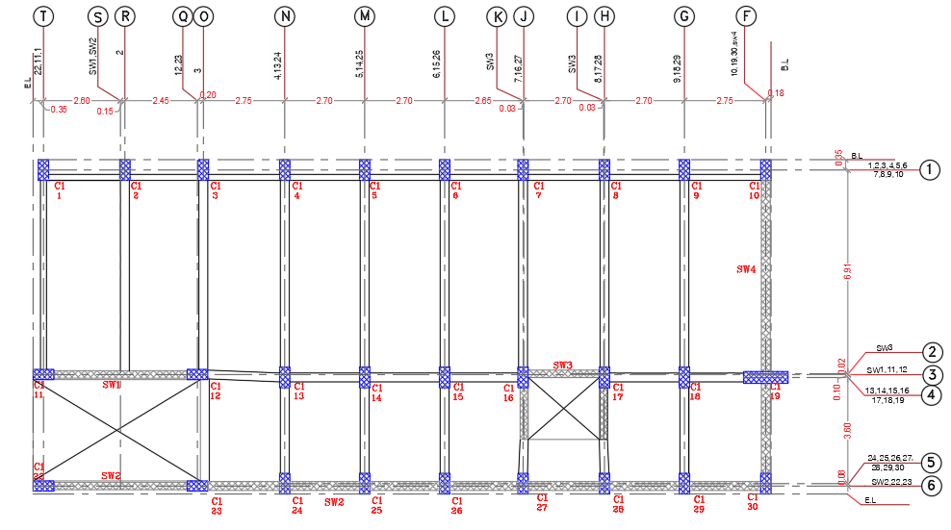
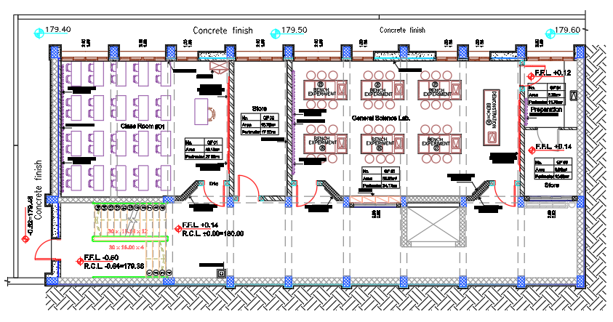
Architectural Plans:
For second basement

Slide 7
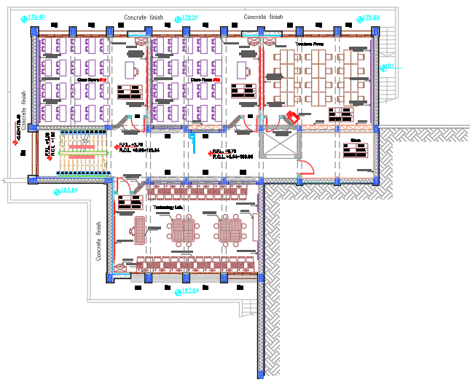
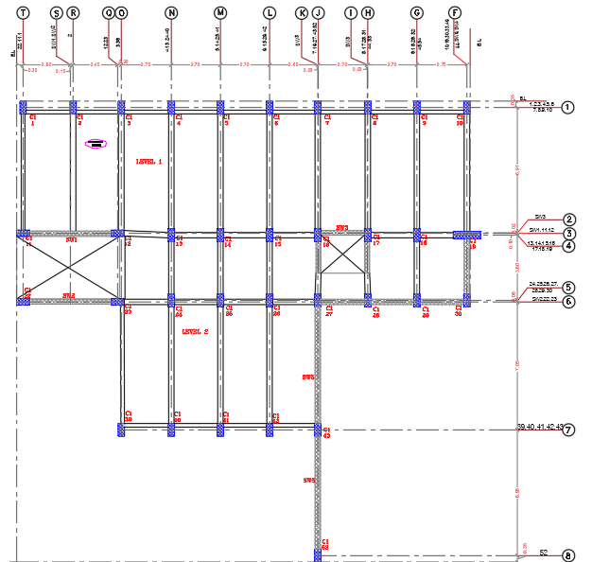
Architectural Plans:
For first basement

Slide 8
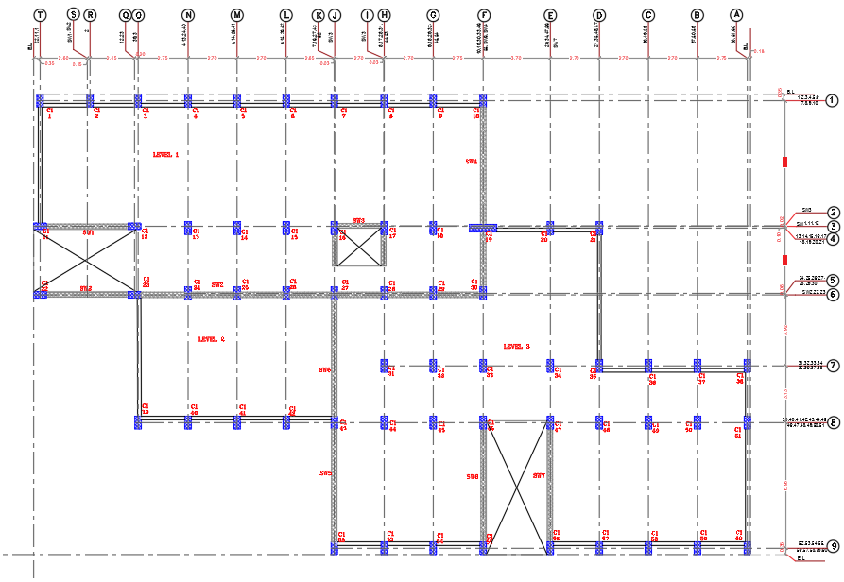
Architectural Plans:
For Ground floor

Slide 9
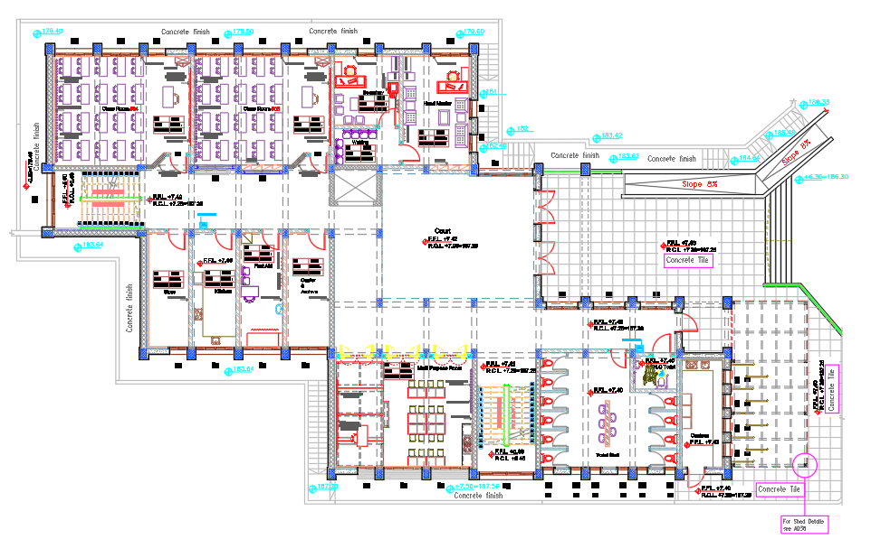
Architectural Plans:
For Ground floor

Slide 10
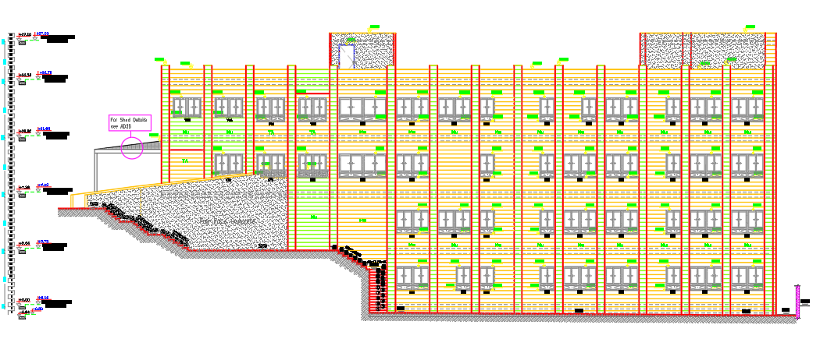
Architectural north elevation :

Slide 11
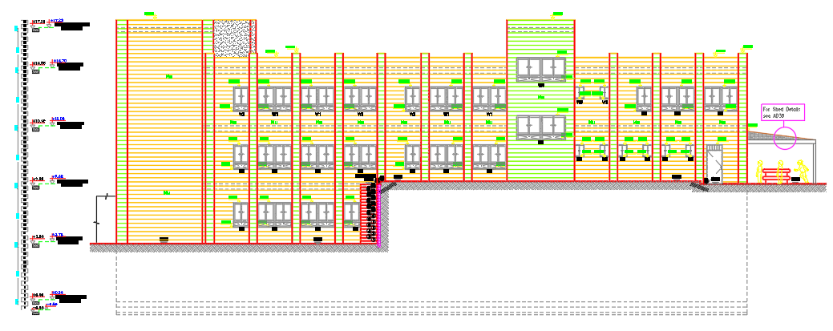
Architectural south elevation :

Slide 12
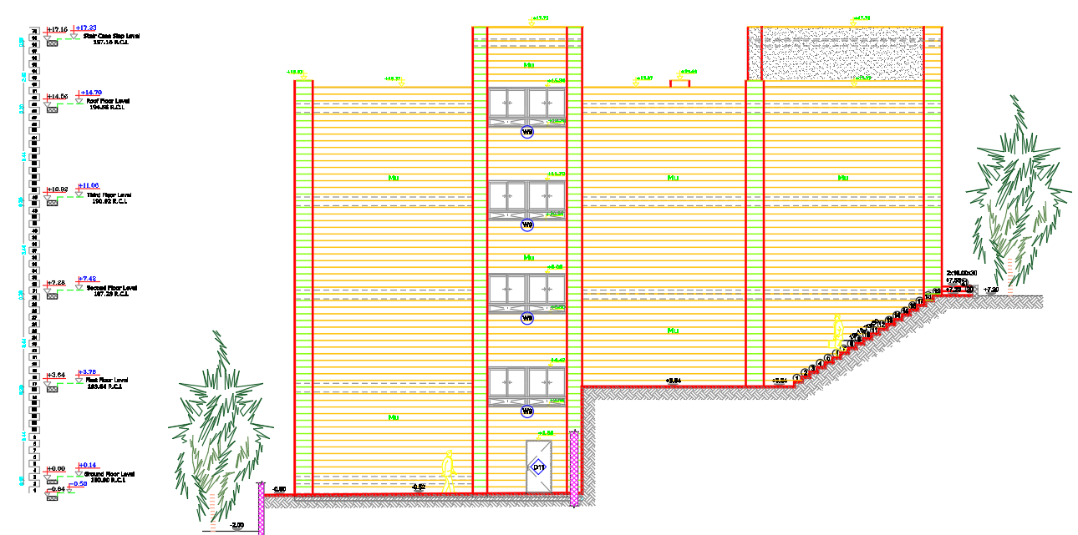
Architectural west elevation :

Slide 13
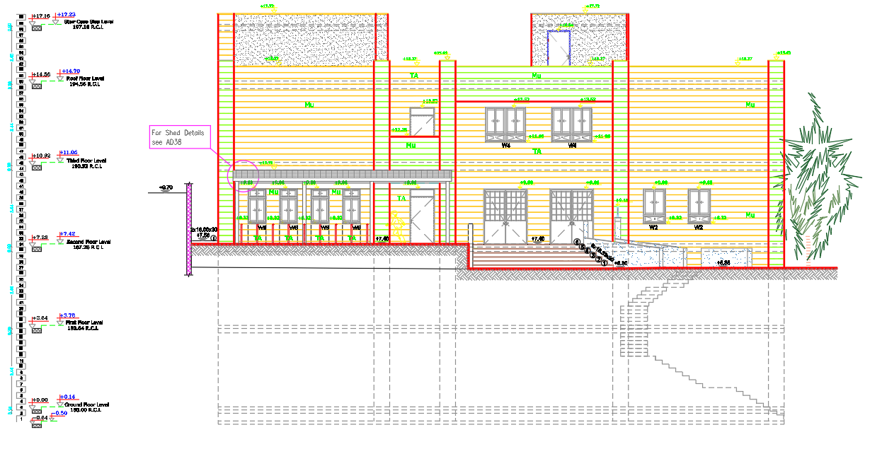
Architectural east elevation :

Slide 14
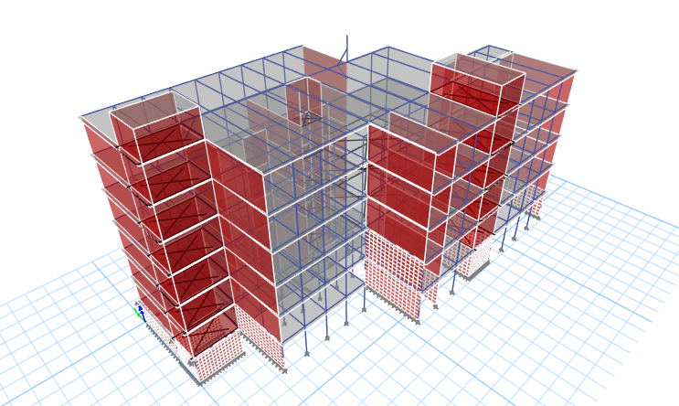
3D Model

Slide 15
  Codes and standards:
American Society of Civil Engineer (ASCE 7-16): For Live load & lateral combination values
American Society for Testing and Materials (ASTM): For materials
American Concrete Institute (ACI 318-14): For design
INTERNATIONAL BUILDING CODE (IBC-2012)

Slide 16
Software :
ETABS 18.0.2.
AUTOCAD 2017.

Slide 17
Types of Loads
There are two type of load on structural :
Gravitational loads such as live, dead and superimposed dead loads.
Lateral loads such as wind, earthquakes, and soil pressure.
gravity loads:
Dead Load :
Known as static loads, are those that remain relatively constant over time such as the weight of a building’s structural elements like beams, walls, and structural flooring components.

Slide 18
Live Load :
Can know it as Loads that change over time. Typical live loads may include; People, furniture, or other movable objects.
Occupancy or use | Uniform Live Load (kN∕m²)
Classrooms | 2.00KN/m²
First-floor corridors | 4.79 KN/m²
Stairs and exit ways | 5.00 KN/m²
Training Rooms | 5.00KN/m²
Offices | 3.00KN/m²
Lab and Library | 3.00KN/m²
Use the value of live load = 5 KN/m2 for all stories. Use the value of live load in book story = 5 KN/m.

Slide 19
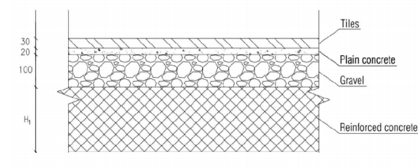
Superimposed dead load :
The weight of all construction materials incorporated into the building, including walls, floors, roofs, partitions, finishes .
superimposed dead load for layers of floors :
Total SID in slab = 3.65 KN/m² take it 4KN/m² (for all room except bath room)
Total SID in slab = 5.65 KN/m² take it 6KN/m² .(for bath room)

Slide 20
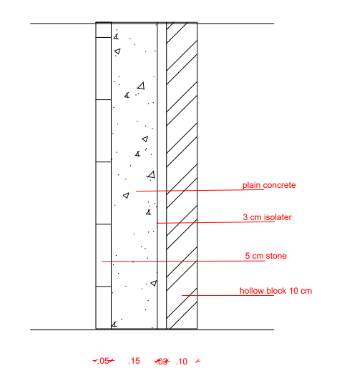
superimposed dead load for partitions :
Wall1 weight (Hollow blocks 10cm + 3cm isolator +15cm concrete +5cm stone) =
= 1.94+0.03*0.5+.15*23+.05*27= 6.785 KN/ m²
= 6.785 *3.44 (height) = 23.3 (KN/m) use 30 KN/m

Slide 21

Lateral Load:

Slide 22
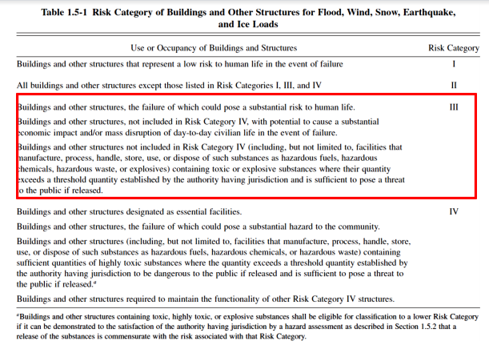
        Risk category of building

Slide 23
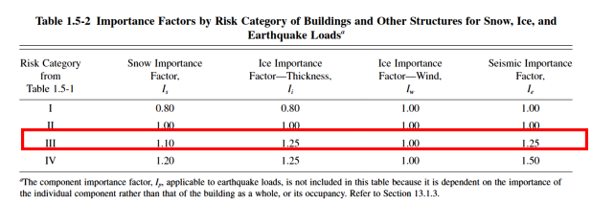
        Importance Factor, Ie

Slide 24
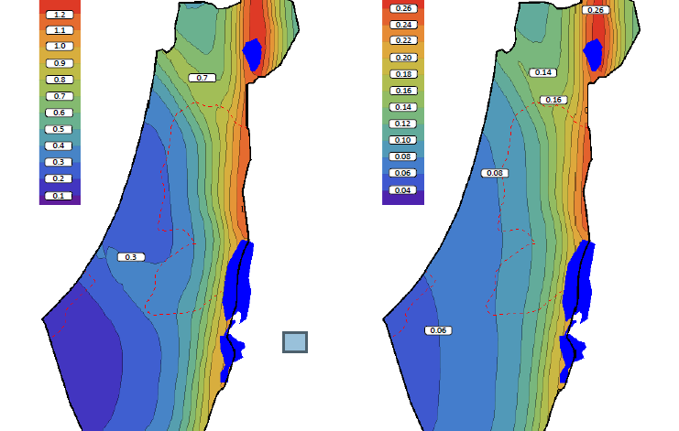
        Seismic zone factor (z)
Ss = 0.4
S1 = 0.1

Slide 25
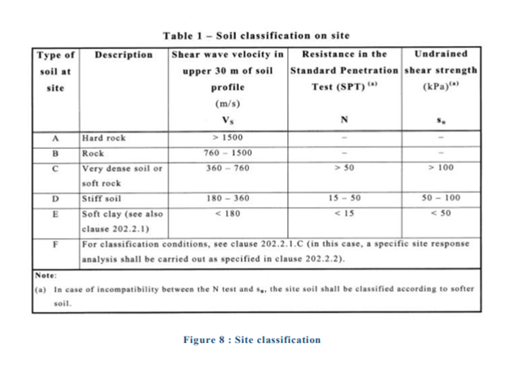
        Site classification
Bearing capacity of the soil is 278 kN/m²
The type of soil as site is C.

Slide 26
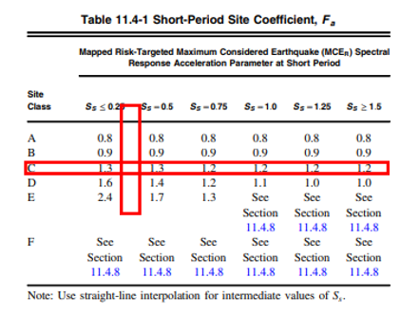
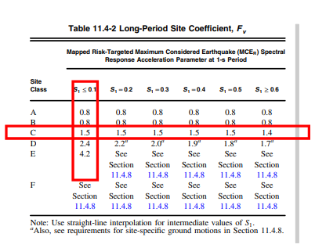
        Determination of response accelerations SMS & SM1
Short-Period site coefficient - Fa (at 0.2 s-period) = 1.3
Long-Period site coefficient - Fv (at 0.1 s-period) = 1.5
𝑆𝑀s = 𝐹𝑎 × 𝑆𝑠
= 1.3× 0.4
= 0.52
𝑆𝑀1 = 𝐹𝑣 × 𝑆1
= 1.5× 0.1
= 0.15

Slide 27
        Calculate the design spectral accelerations S_{DS} & S_{D1}
For 2% probability of exceedance of return period 50 years.
SDS = 2/ 3 SMS
= 2/ 3 × 0.52
= 0.3467
SD1 = 2 /3 SM1
= 2/ 3 × 0.15
= 0.1

Slide 28
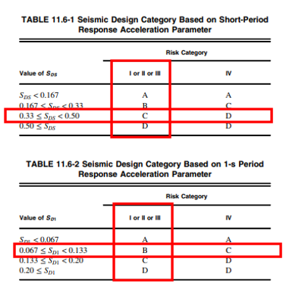
        Seismic Design Category
As the value of 𝑆𝐷𝑆 = 0.3467 is less than 0.5 and the value of 𝑆𝐷1 = 0.1 less than 0.2, then the seismic design category is C.
From the results above, the seismic design category is C

Slide 29
Load Combinations
1. Ultimate Load Combinations
For gravity load : Ultimate Load Combination
1.4D+1.4SD
1.2 D +1.2SID+ 1.6 L
-For earthquake load : Ultimate Load Combination
1.32D + L + Sex
1.32D + L + Sey
0.78 D + Sex
0.78 D + Sey
=sum of Service Load

Slide 30
Load Combinations
2. Service Load Combinations
For gravity load : Service Load Combination
D
D+L

Slide 31
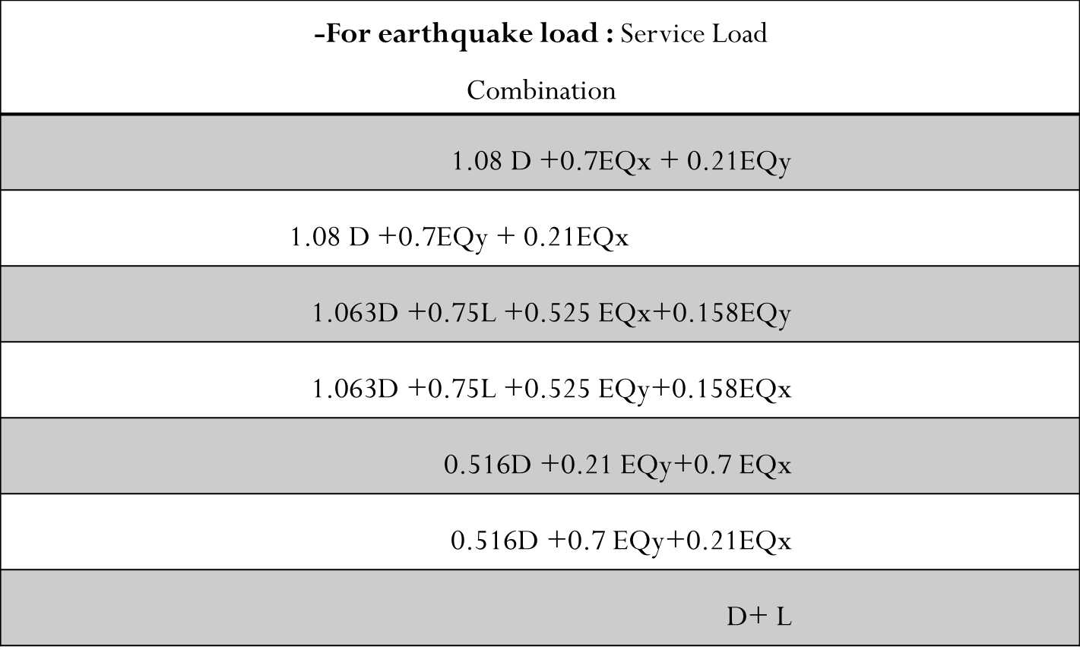

Slide 32
Structural System Design and Analysis

Slide 33
Structural Element:
Slab System
Beams System
Columns System
Shear wall System

Slide 34
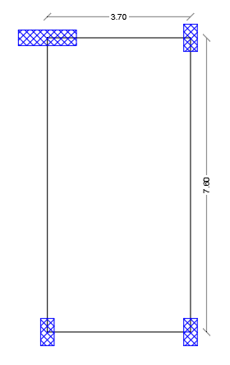

Preliminary Design :
Slab Thickness :
The ratio of the longer to the shorter side (Lx/Ly) of the slab greater than two so it’s preferable to design the slab as one way slab.
For critical panel :

Slide 35
Slab thickness for one way slabs are design according to ACI code :
type | Simply supported | One end continues | two end continues | cantilever
Solid one way slab | L/20 | L/24 | L/28 | L/10
Beam and one way ribbed | L/16 | L/18.5 | L/21 | L/8
One way solid:
h=L/28=3.46/28=0.12 m take it 0.15 solid in X
One way solid: ( for stage )
h min =Ln/28 =3.1/28 =0.11 m Use h =0.12 m

Slide 36
Beams Dimensions :
Beams have been designed according to the ACI code
Beam | Depth (mm) | Width (mm)
B1 | 600 | 300
B2 | 600 | 200
B3 | 900 | 400
B4 | 1500 | 400

Slide 37
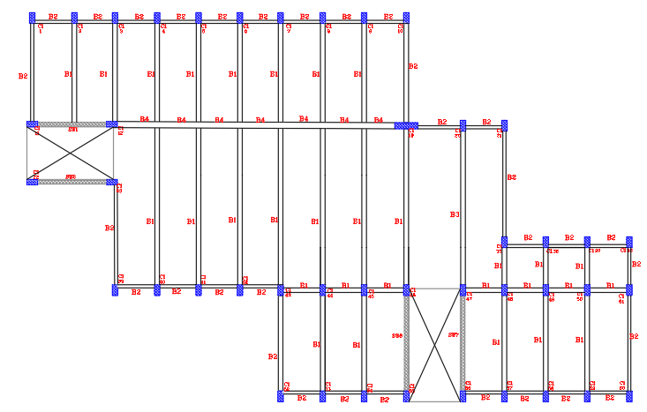
Beams Dimensions :
Beam Layout

Slide 38
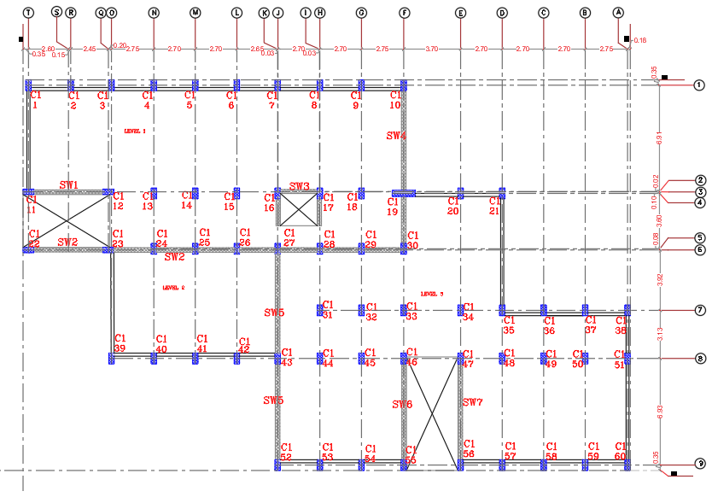
Column Dimensions :
Column | Width(mm) | Depth(mm)
Interior column | 350 | 700
Edge column 1 | 350 | 700
Edge column 2 | 400 | 1500
Corner column | 350 | 700

Slide 39
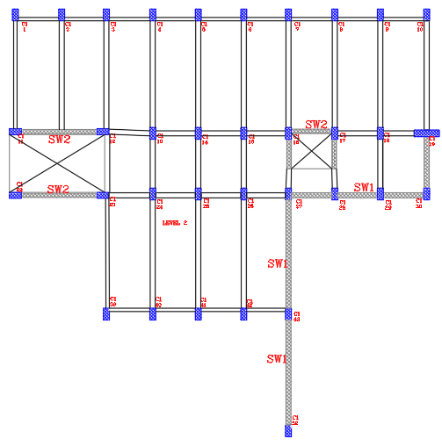
Wall Thickness :
Wall | Depth (mm)
SW1 | 300
SW2 | 250

Slide 40
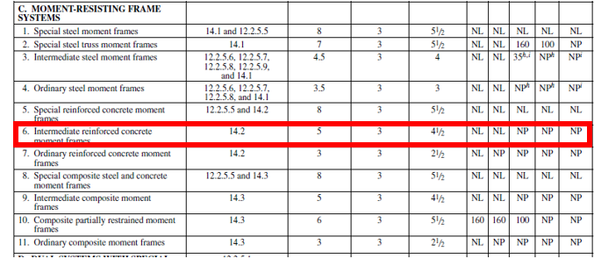
  Type of structural system
For this system,
( R ) = 5,
( Ωo )=3
( Cd ) = 4.5 .

Slide 41
Modeling and Checks

Slide 43
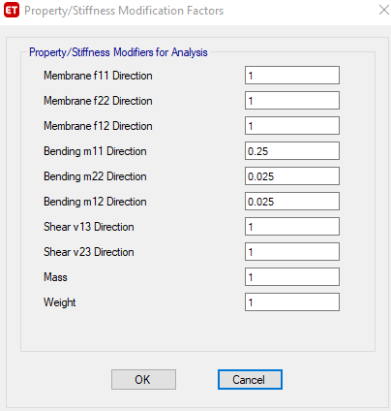
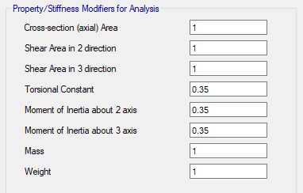
Modifiers
For slab
For beam

Slide 44
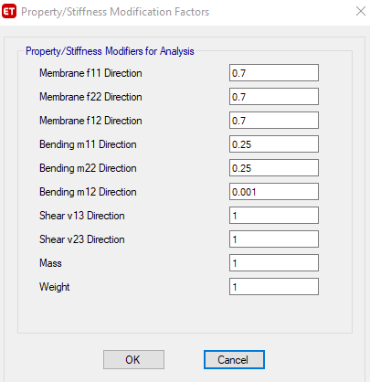
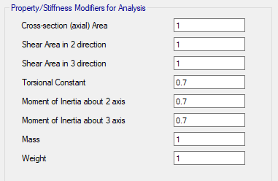
Modifiers
For column
For wall

Slide 45
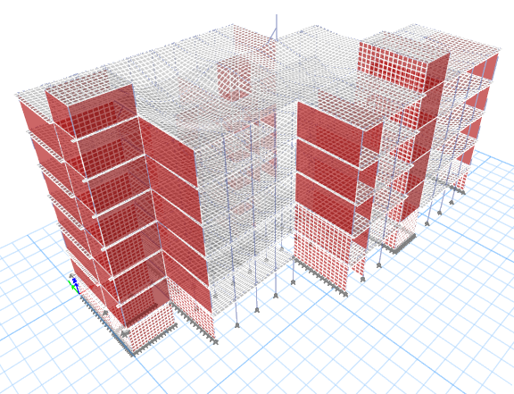
Structural Model Verification
Compatibility Check

Slide 46
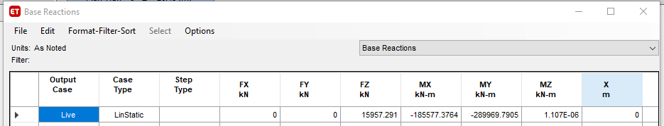
Structural Model Verification
    Equilibrium Check
    Total live load from hand calculation = 15957.40 KN
    Total live load from ETABS :
%Error=0.00%

Slide 47
Internal Forces Check
From live load :
Error < 10 OK
 | Hand calculation | From ETABS
Slab | 8.55 | 8.36
Beam | 67.62 | 68.195
Column | 305.20 | 305.64
 | Slab | Beam | Column
Error | 2.2 | 0.80 % | 0.1 %

Slide 48
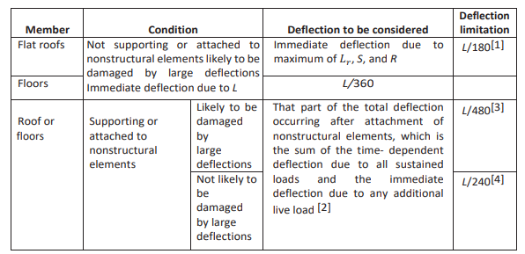
Deflection Check
Allowable long term Deflection
Long term Deflection = 2D+2SID+1.25L
Long term Deflection=(11.67+ 20.25)/2 -23.88=7.92
Allowable Deflection = L/240=3700/240 = 15.42 mm> 7.92 mm

Slide 49
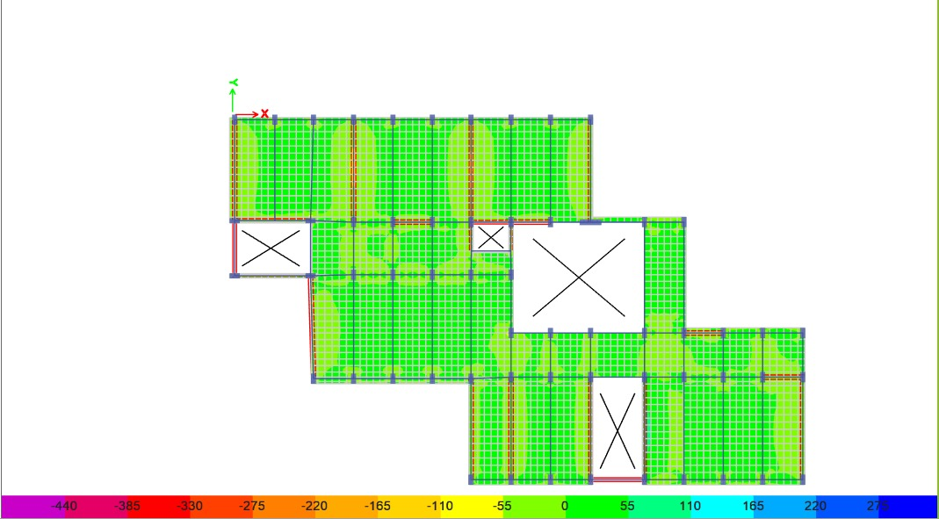
Shear Check for Slab
∅𝑉𝑐 = ∅ 1/ 6 𝜆√𝑓𝑐 ′ 𝑏𝑤𝑑 = 0.75 × 1/ 6 × √24 × 1000 × 120 ×1.1= 80 KN
Vu < ∅𝑉𝑐 OK

Slide 50
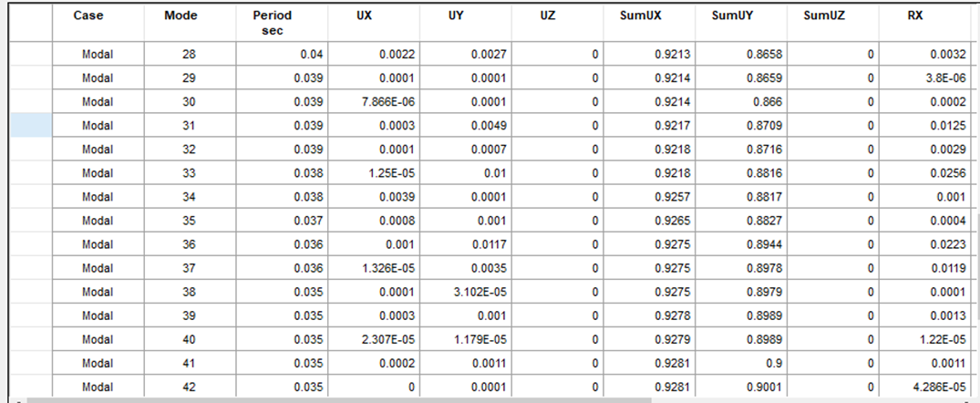
    Modal mass participation ratio
From the table above, it obvious that the summation of modes are more than 0.9, which is mean that most masses of the structure move in these modes ( the main motion are in X and Y direction ) .

Slide 51
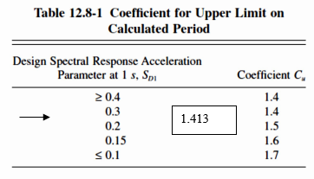
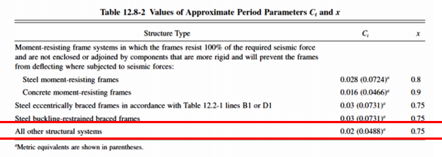
Period calculations
The project case is all other structural systems with Ct =0.0488 and X =0.75
Ta = Ct*hnx=0.0488×25.48^{.75} = 0.553439 sec.
T= Cu Ta = 0.783 sec
Fundamental period for the structure = 0.382 sec which is less than 0.783 sec.

Slide 52
Base shear
      hand calculation using ELF method
The value of C_{s} =0.1115
W = Dead load + Superimposed load
= 83269.25Kn.
V _{Manual} = Cs×W
= 0.1115×83269.25
= 9284.521 Kn.

Slide 53
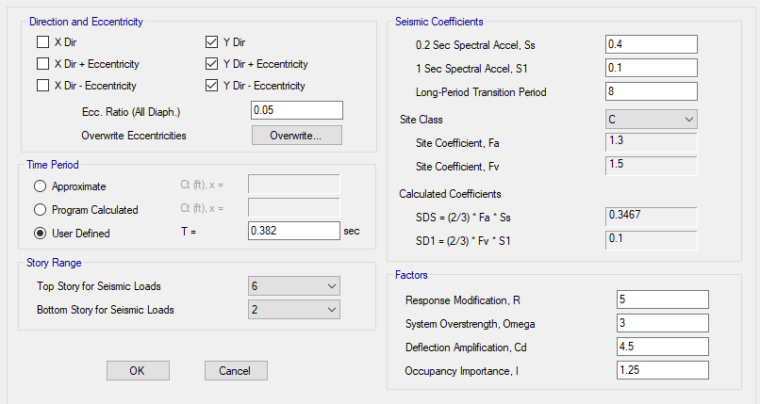
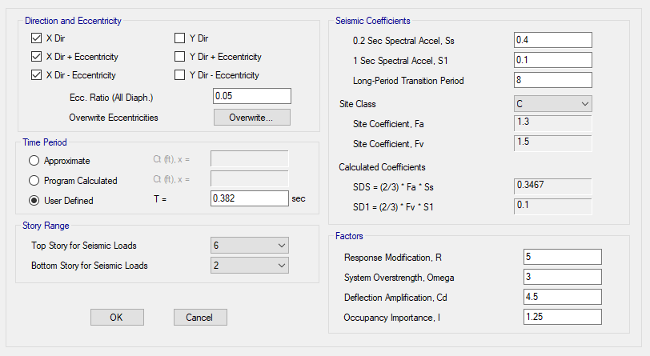
Definition of ELF in ETABS

Slide 54
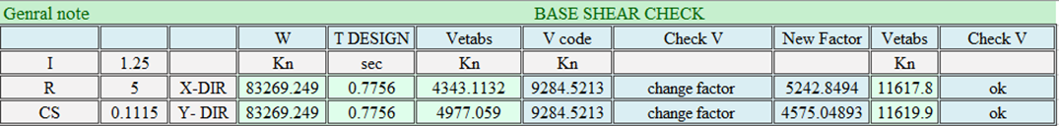

ETABS calculation
For response spectrum in X – direction :
Scale factor =$\frac{g}{R}$*$\frac{Base shear in x \left(ELF\right)}{Base shear \left(response\right)}$ *1000
=$\frac{9.81∗1.25}{5}$*$\frac{9284.521}{4343.1132}$ *1000 = 5,242.8
For response spectrum in Y – direction :
Scale factor =$\frac{g}{R}$*$\frac{Base shear in y \left(ELF\right)}{Base shear \left(response\right)}$ *1000
=$\frac{9.81∗1.25}{5}$*$\frac{9284.521}{4977.09}$ *1000 = 4575.04893

Slide 55
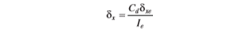
    Drift Check
Allowable story drift ( Δa) ≤ 0.02h_{x}
All values of drift are less than the allowable drift.
    Torsional irregularity check
Structure transverse ratio should not exceeds 1.4
So according to all ratios, there is no torsional irregularity or extreme torsional irregularity in Y-Direction & X-Direction.

Slide 56
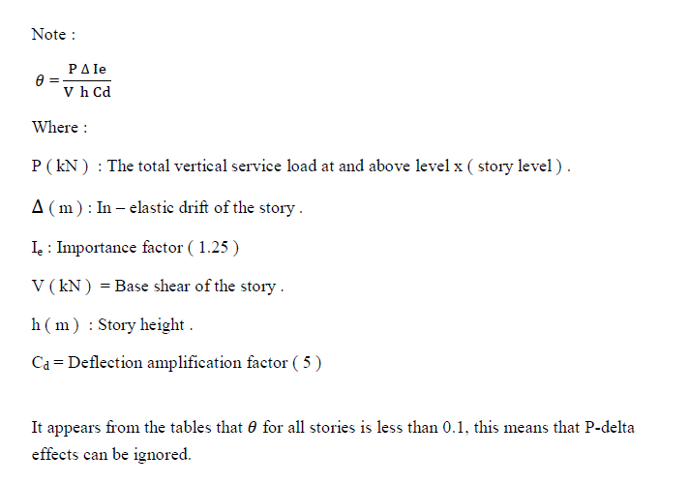
    P – delta check
P- delta effects on story shears and moments, the resulting member forces and moment, and the story drifts induced by these effects can be ignored if the stability coefficient ( 𝜃 ) is equal or less than 0.1
So according to all ratios less than 0.1, there is no P-delta effects in Y-Direction & X-Direction

Slide 57
Design of structural elements

Slide 58
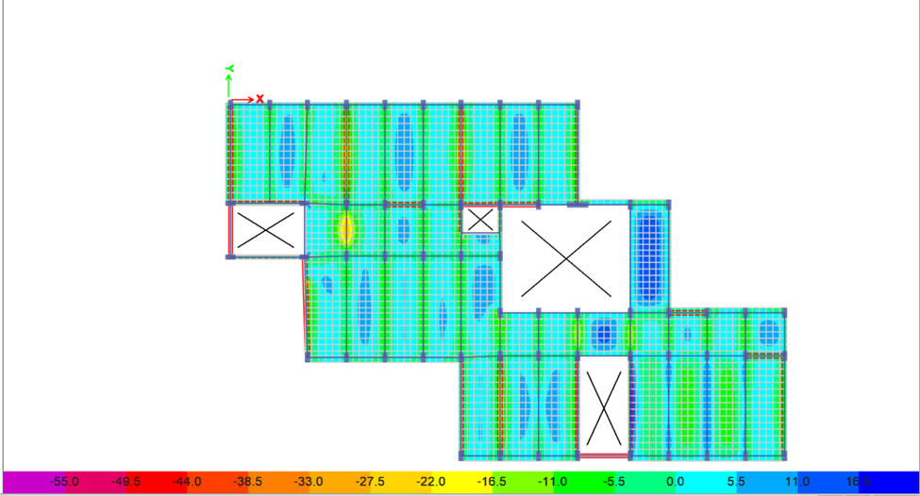
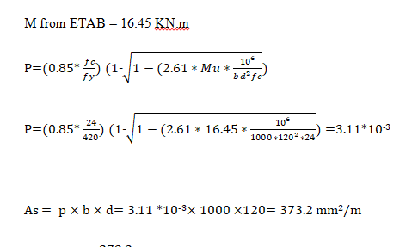


Slab Design
Design for flexure:
Slab shrinkage steel

Slide 59
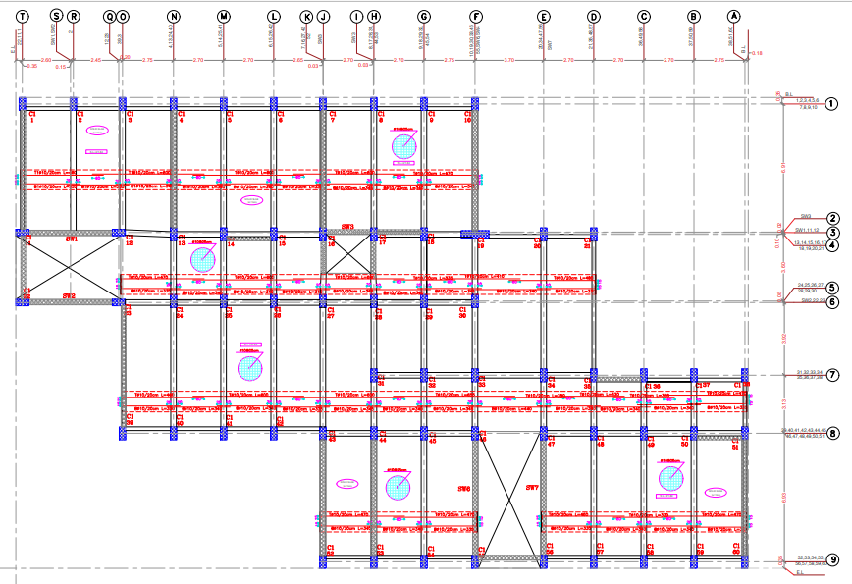
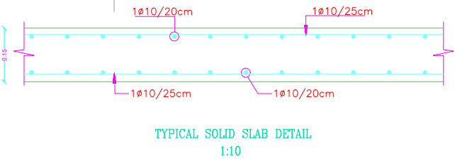
Slab Design
Design for flexure:

Slide 60
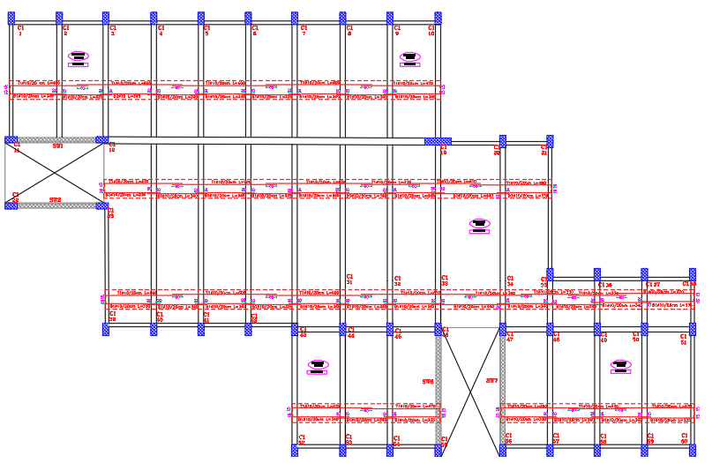
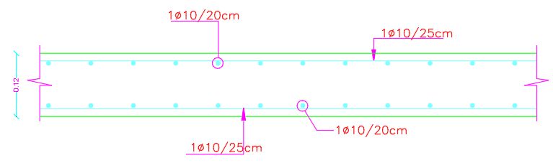
Slab Design
Design for flexure:

Slide 61
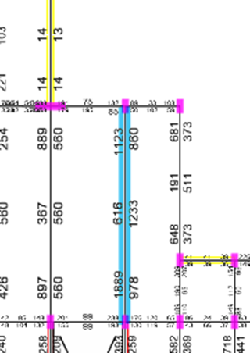

Beam Design
Sample Calculation for one beams: Beam (30X90)
Flexural Reinforcement

Slide 62


Beam Design
Sample Calculation for one beams: Beam (30X90)
Shear Reinforcement for Beam

Slide 63

Beam Design

Slide 64


Column Design

Slide 65


Column Design

Slide 66


Column Design
Cross section for Column 700 X 350

Slide 67

  Footing design

Slide 68

  Footing design

Slide 69


  Footing design

Slide 70

  Footing design

Slide 71


  Footing design

Slide 72

  Shear wall design

Slide 73



  Shear wall design

Slide 74
Thanks
For
Listening

