Slide 1

Ras Al-Abd
Production line
Samaa Yasin & Tala Yaseen
Supervised by Dr.Mahmoud Assad

Slide 2
Overview
Today, we'll talk about Ras El Abed, a popular Palestinian winter sweet. It combines biscuits, cream, and chocolate, and is loved by many, especially during the cold season.
2
2

Slide 3
Introduction
Project Stages
Hardware Components
Challenges & Solution
Future improvement
Conclusion
2
3

Slide 4
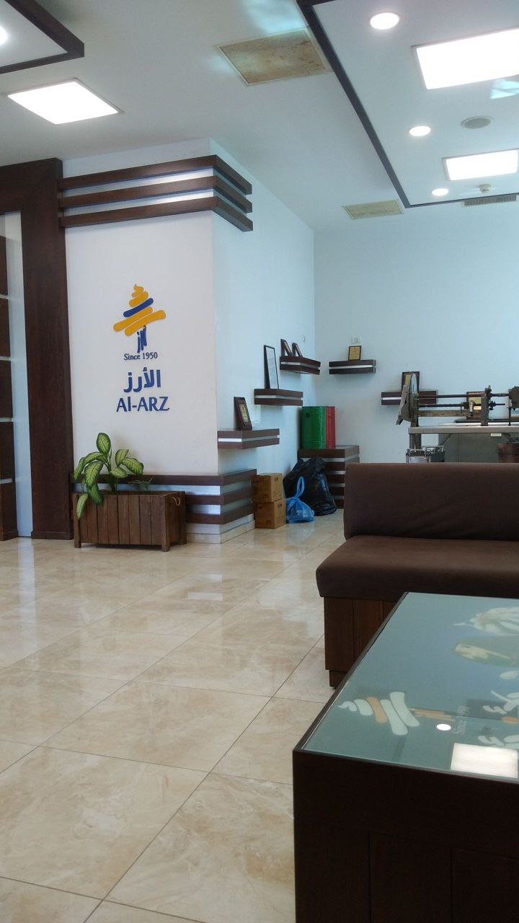
How We Start ?
4

Slide 5
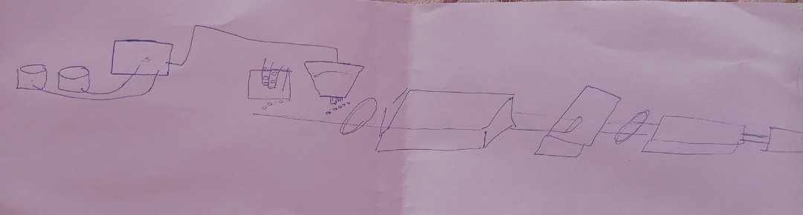
Simple project diagram

Slide 6
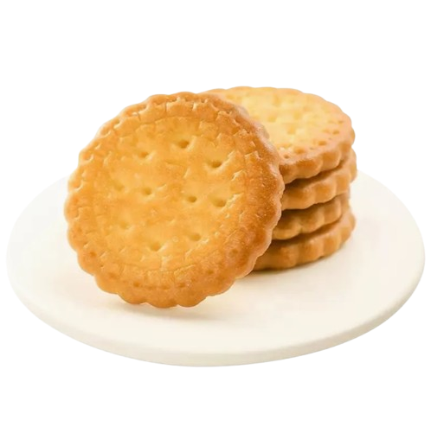
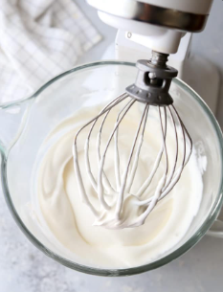
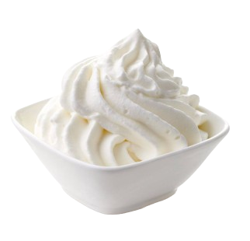

Project Stages
Placing the Biscuit
Mixing
Pouring the Cream
Melting and Pouring the Chocolate
5

Slide 7
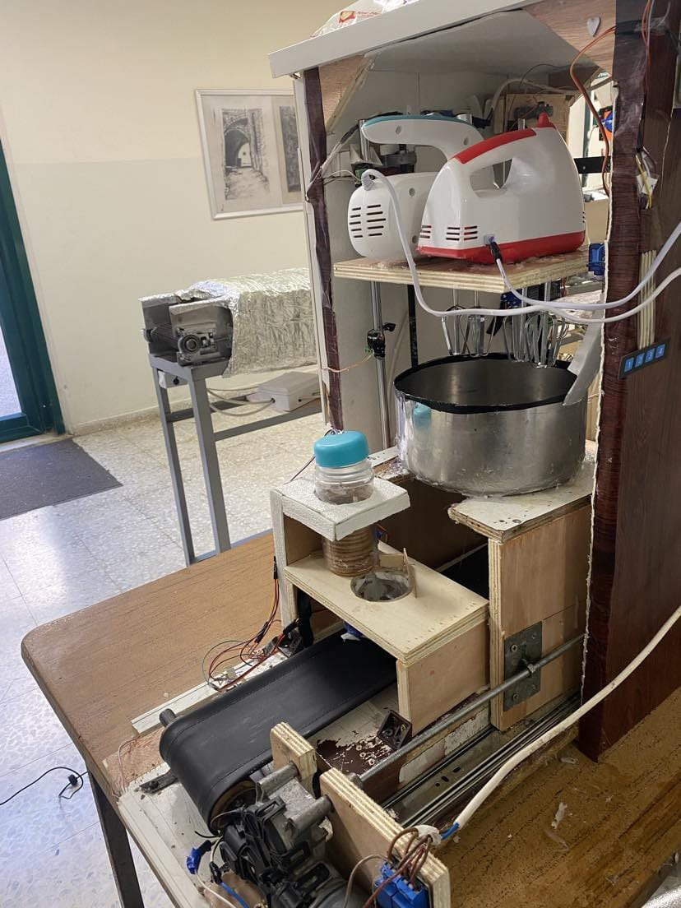
Hardware Components
6

Slide 8

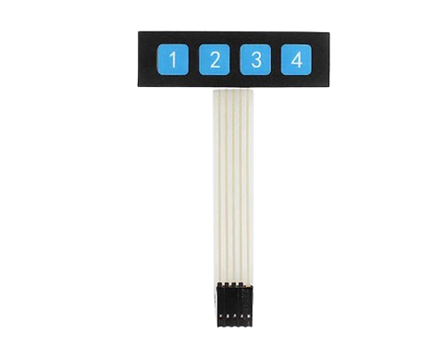
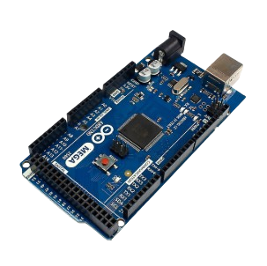
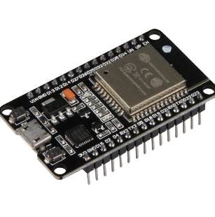
Hardware Components
7

Slide 9
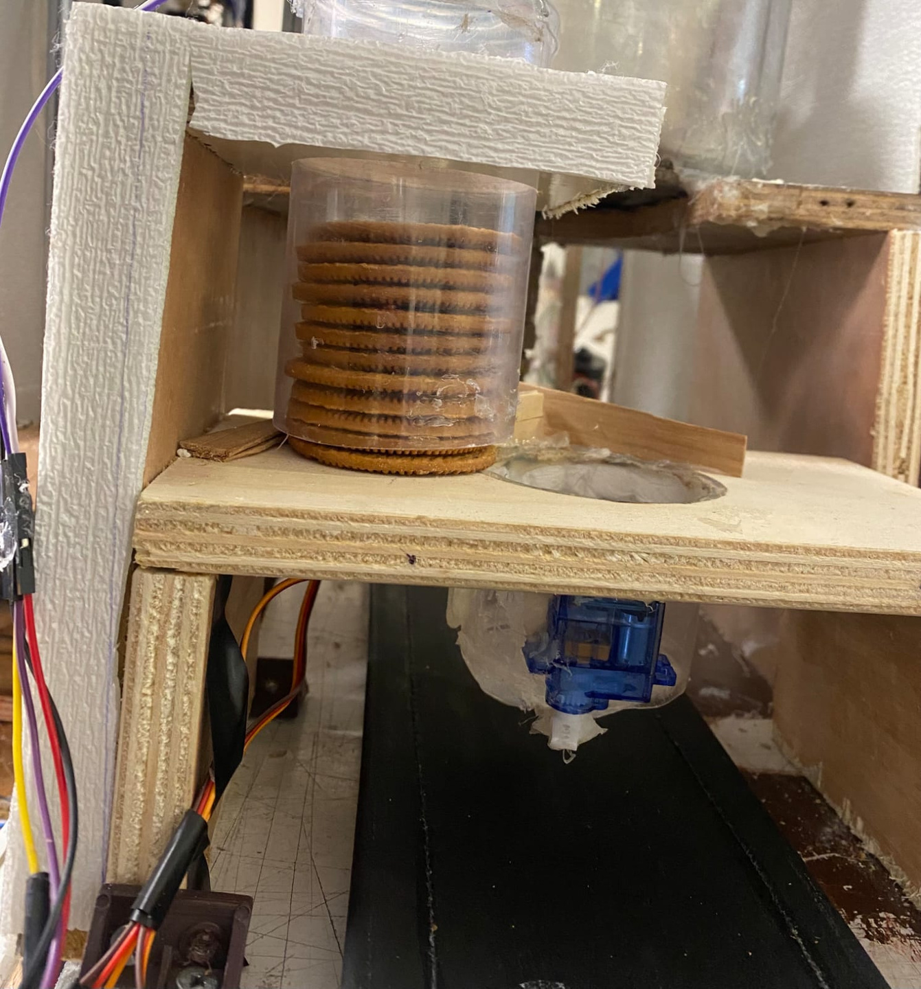
Placing the Biscuit
8

Slide 10

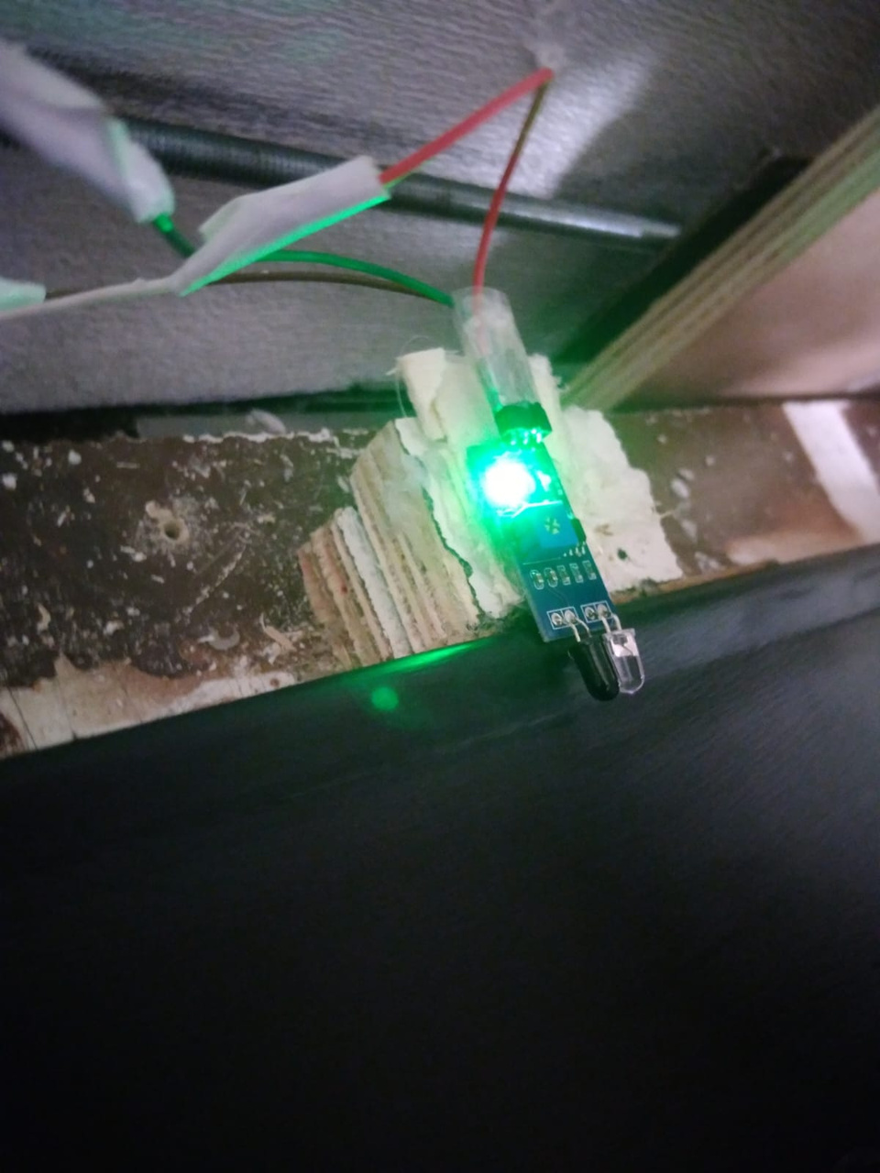
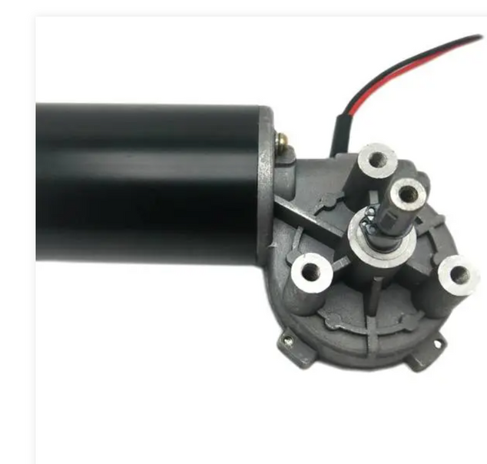
Hardware Components

Slide 11
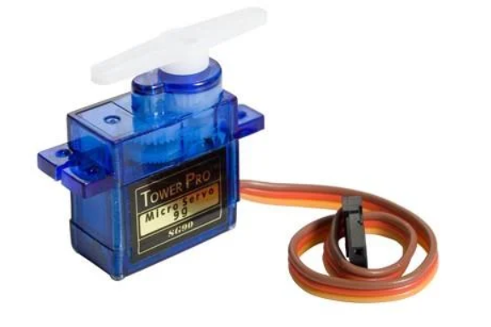
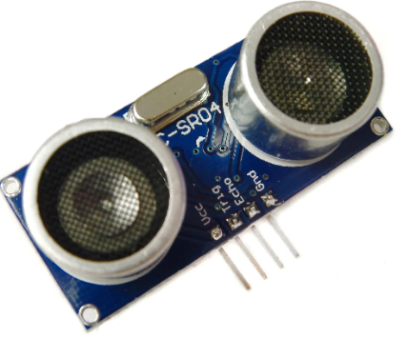
Hardware Components
9

Slide 12
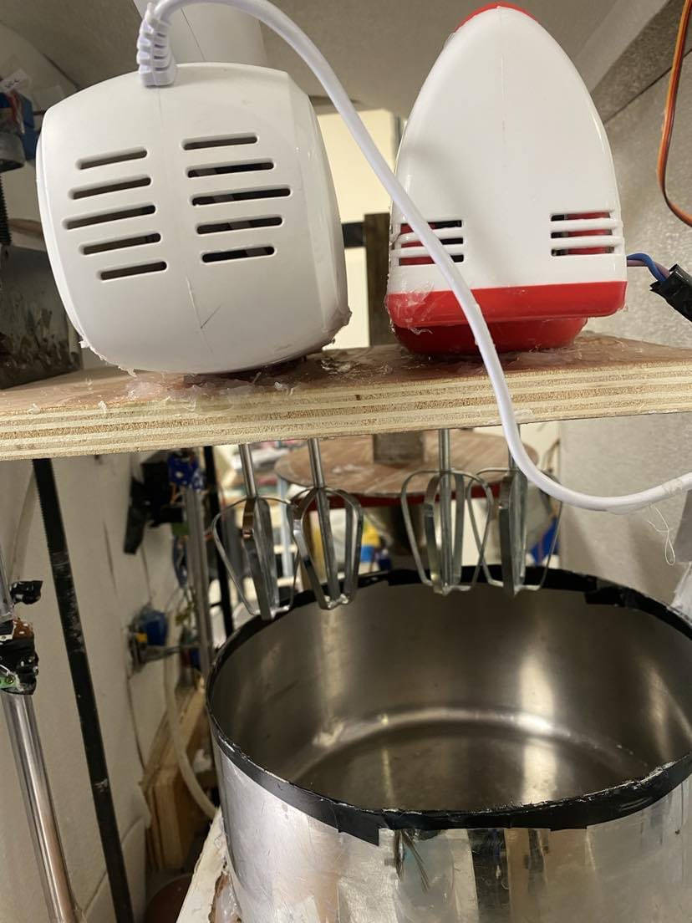
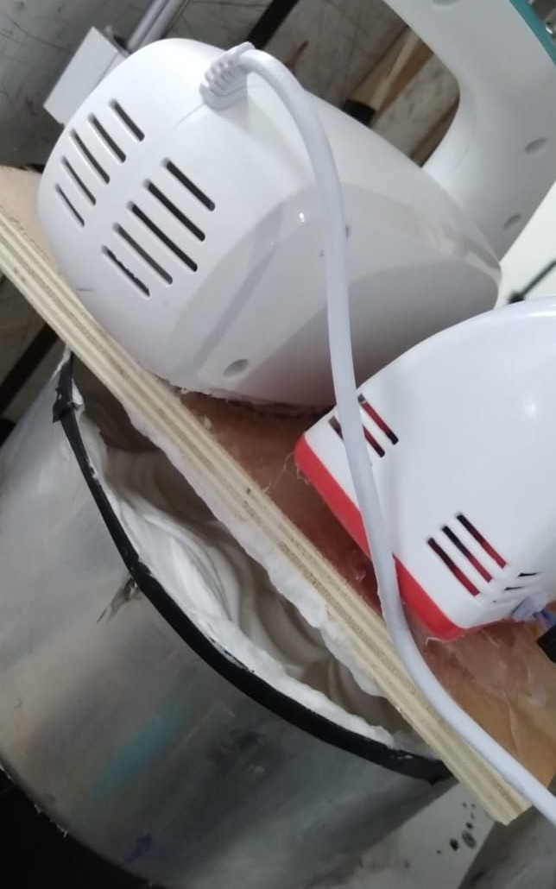

Mixing cream
10

Slide 13
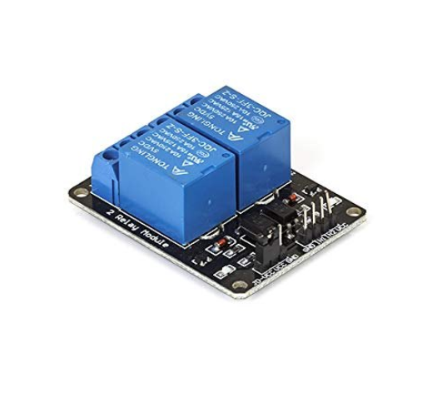
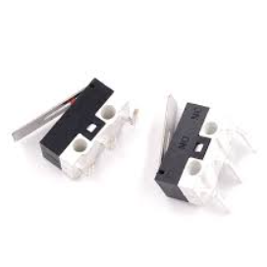
Hardware Components
11

Slide 14
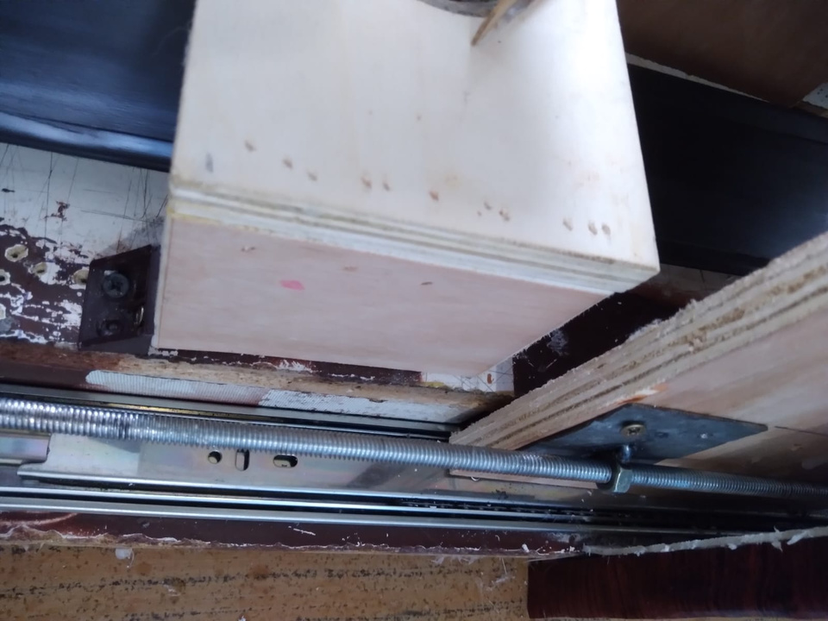
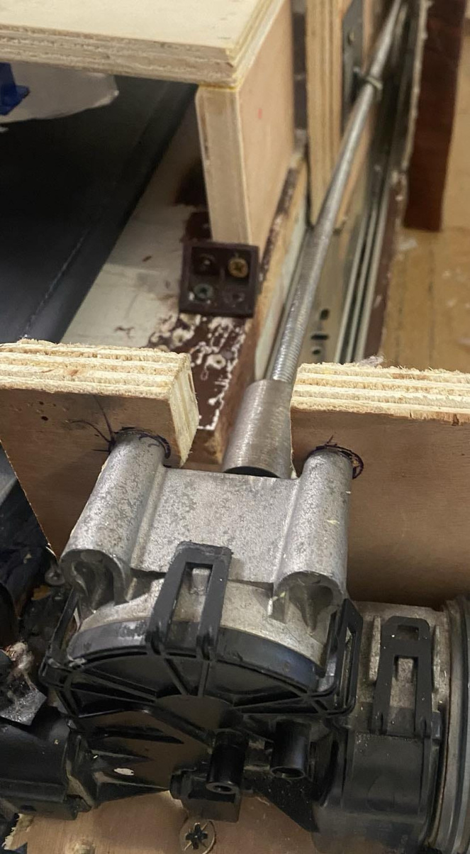

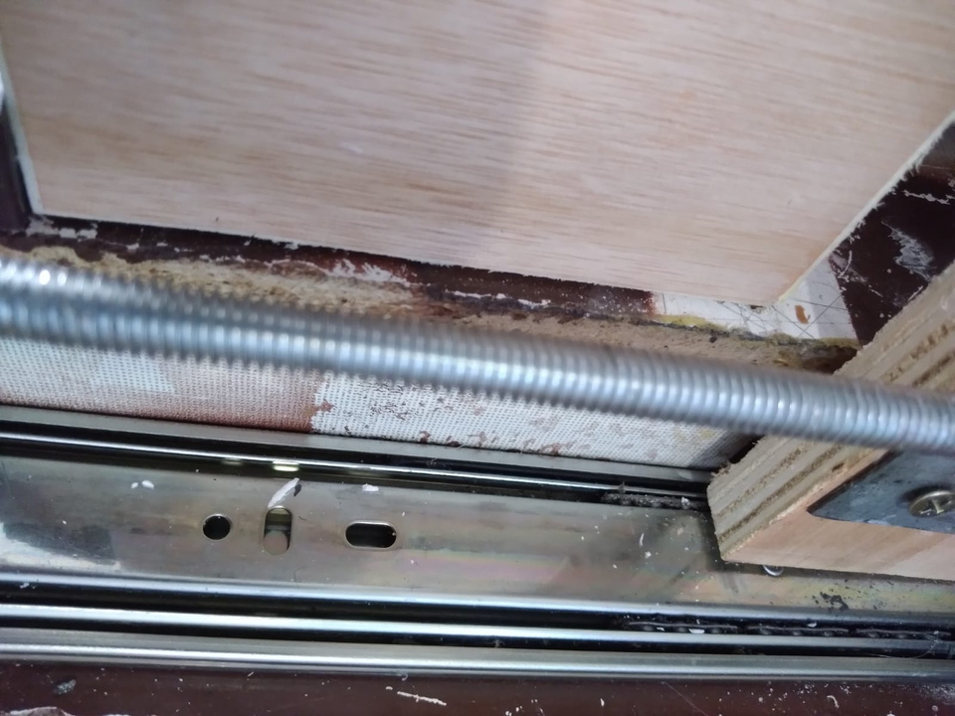
Hardware Components

Slide 15
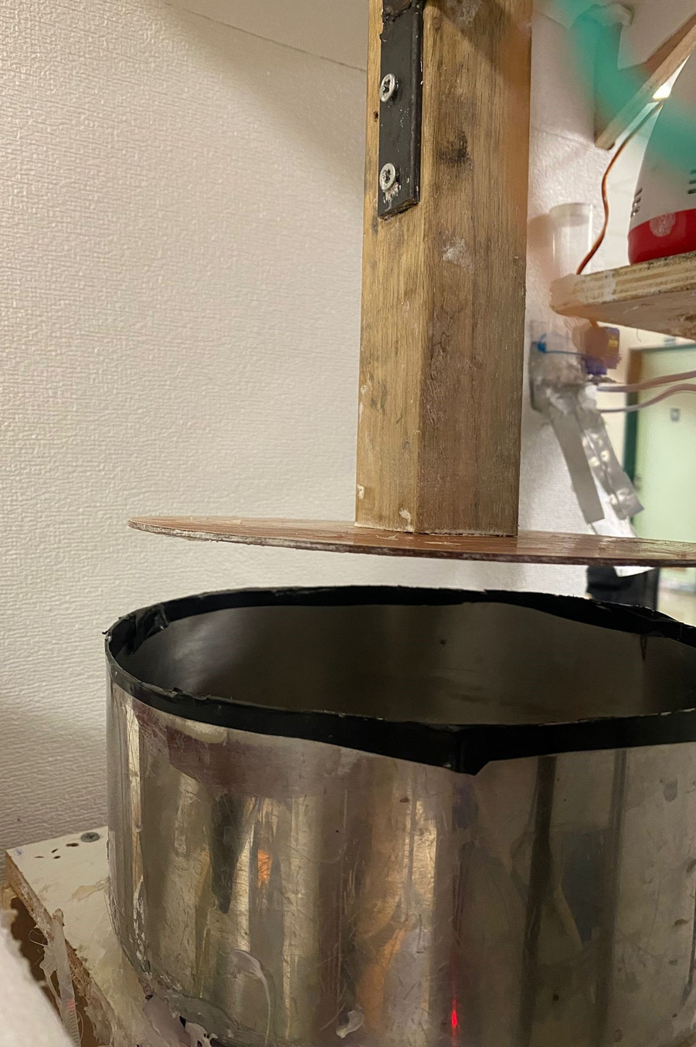
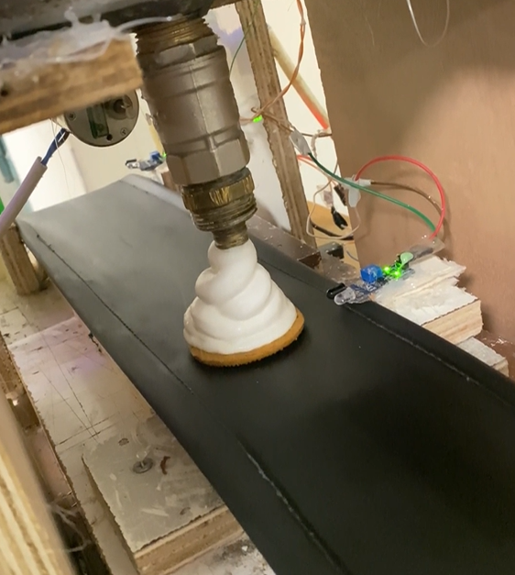
Pouring the Cream
12

Slide 16

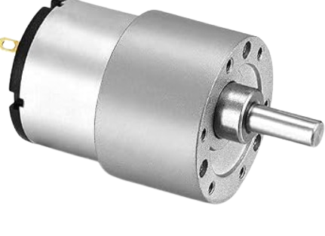
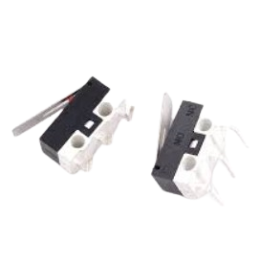

Hardware Components
13

Slide 17
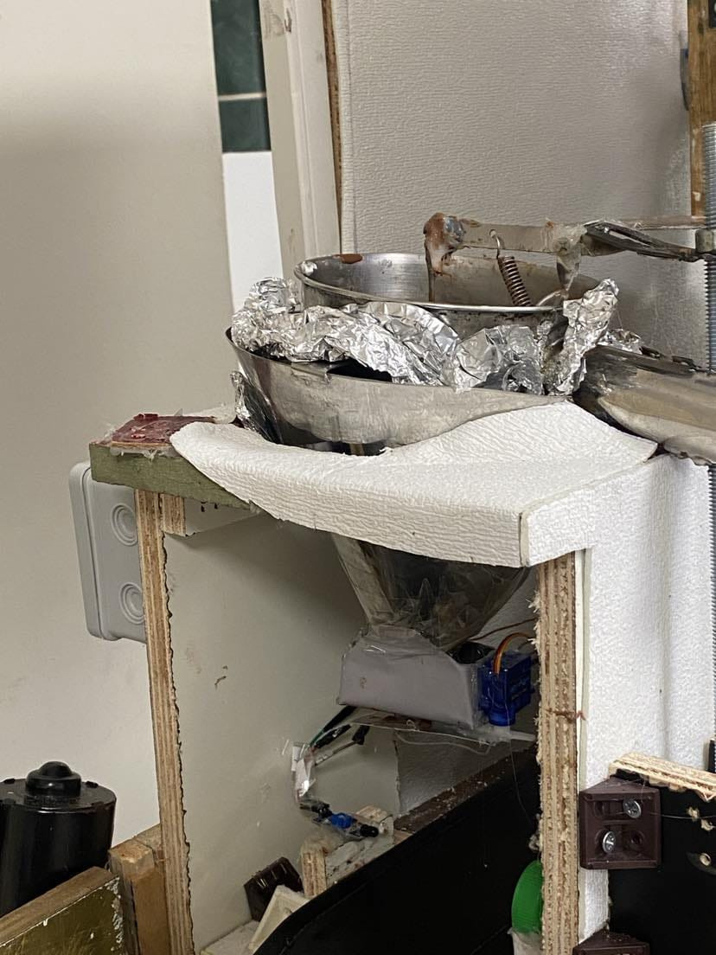
Melting and Pouring the Chocolate
14

Slide 18
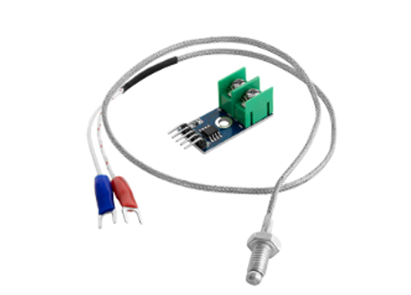
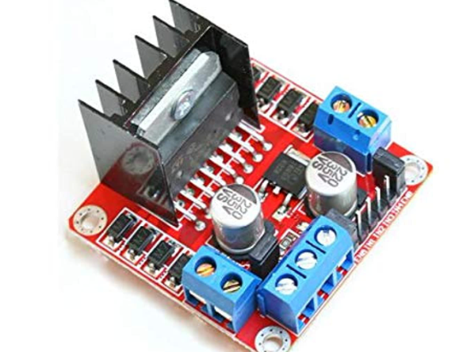
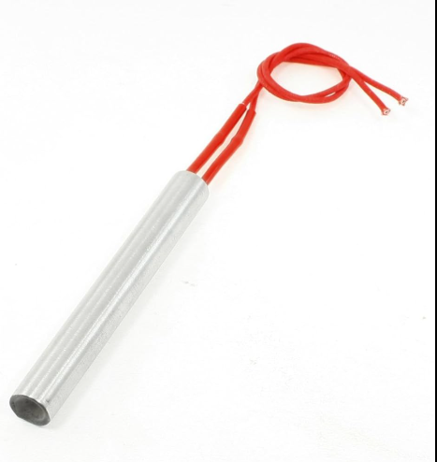

Hardware Components
15

Slide 19
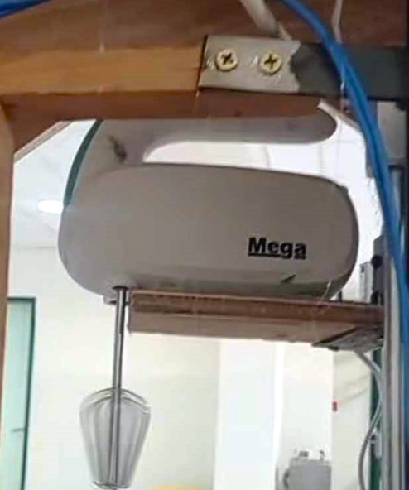

Challenges & Solution
Inconsistent mixing
19

Slide 20
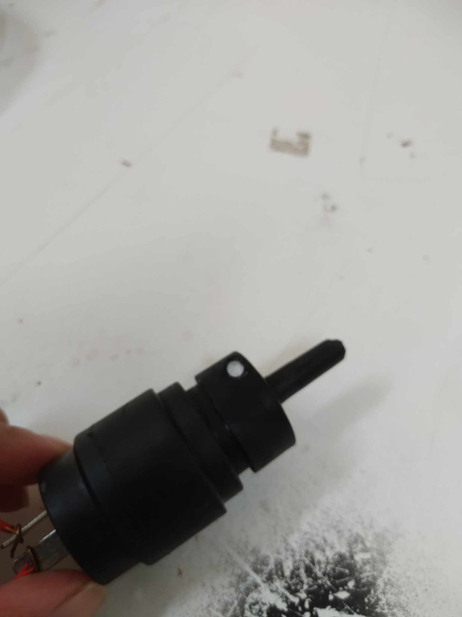
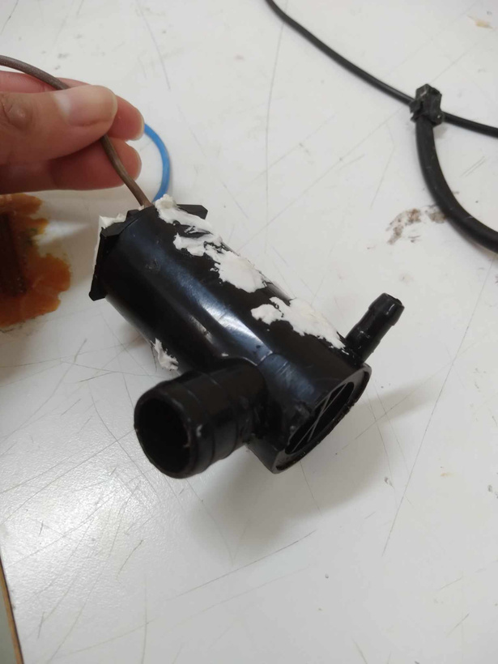
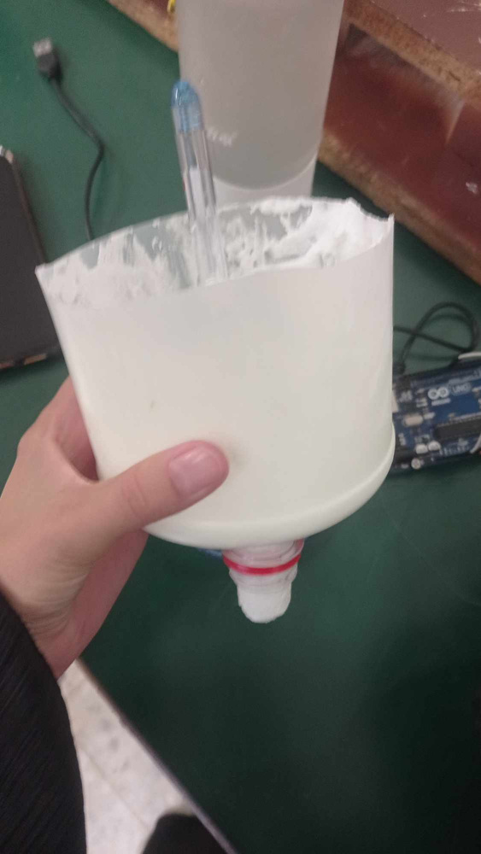
Challenges & Solution
Cream pumping problem
16

Slide 21
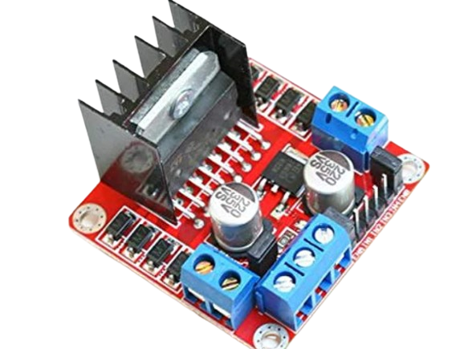


Challenges & Solution
Replace with
Cream pouring problem
18

Slide 22
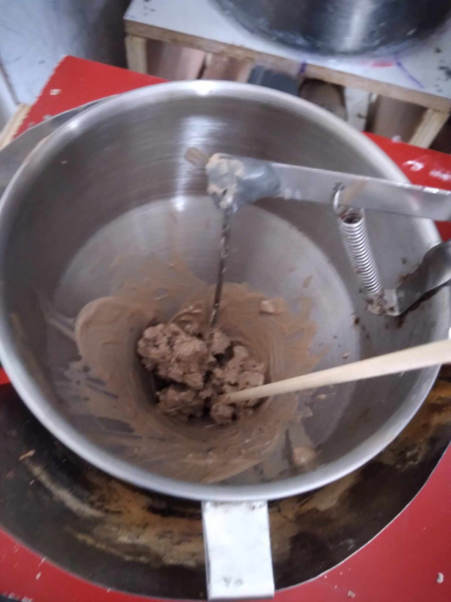
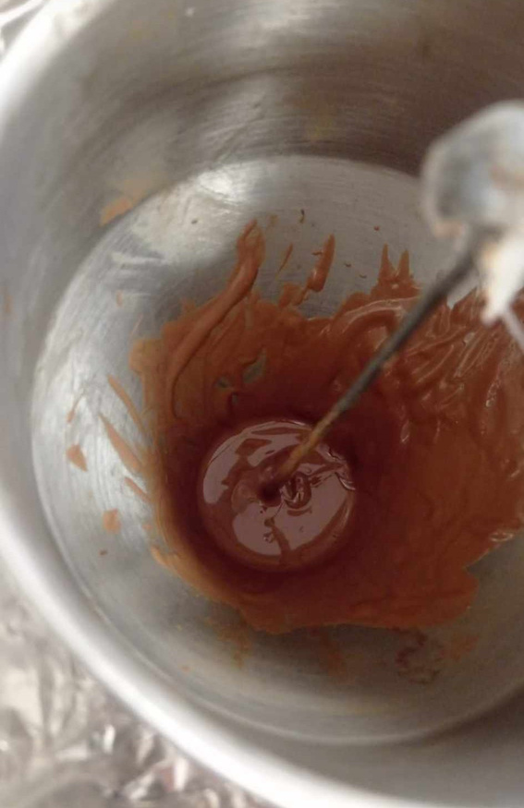
Challenges & Solution
Chocolate melting problem
17

Slide 23

Hygienic Design Improvements
Production Speed Optimization
Use AI to detect
Future improvements
Improvement of the Chocolate Pouring Process
Packaging and Cooling Stage Improvement
Customization & Scalability
20

Slide 24
Thank you
for listening!

