Slide 1
Design of A Sewer Network For Tell Village
(Sewer collection network)
Prepared By :
Ibraheem Emad Ramdan
Majd Omar
Mohammad Abdul-Salam Hosain
Submitted to :
Dr. Abdul-Fattah Al-Mallah

Slide 2
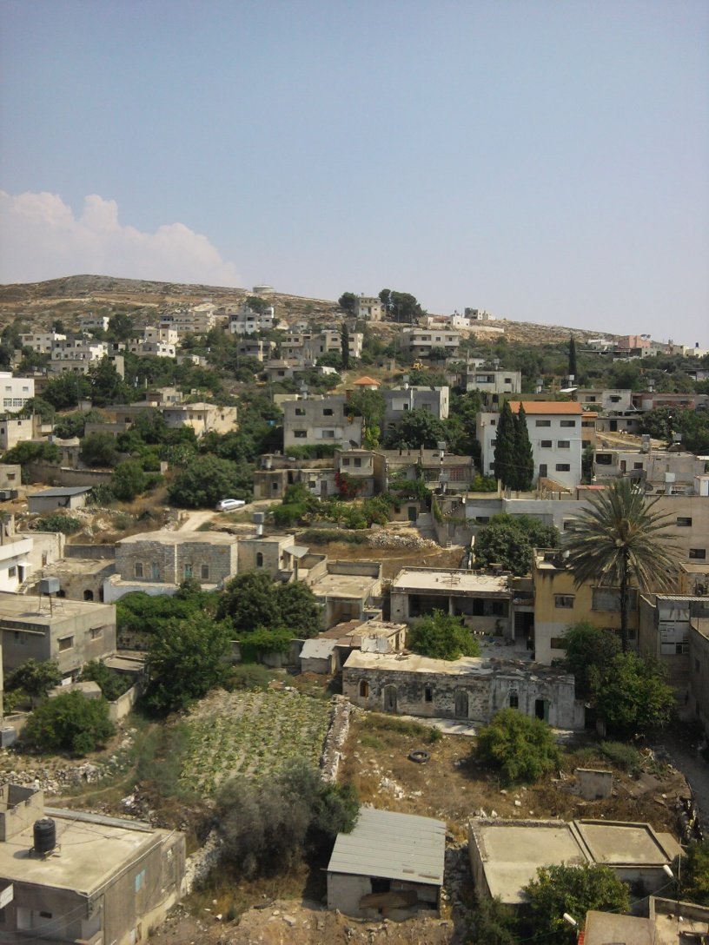
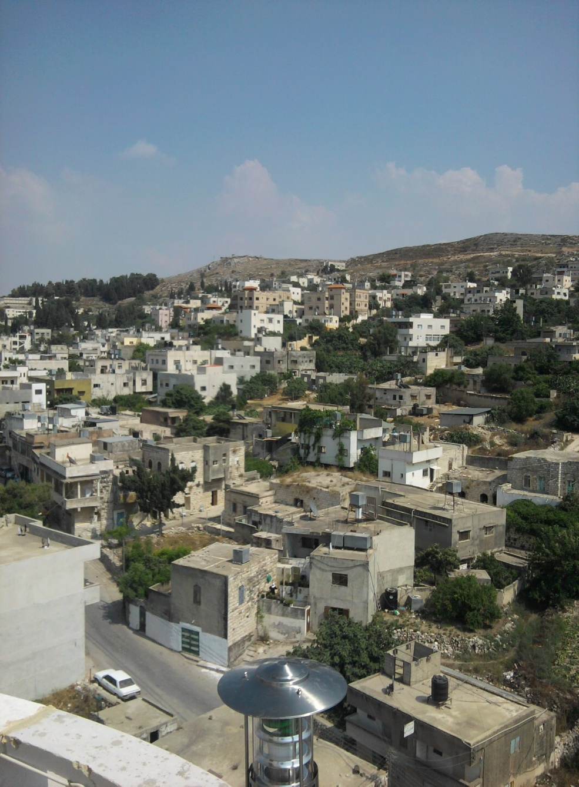
Tell Village

Slide 3
Outline
Objectives and significance of the project,
Study area,
Methodology,
Modeling, and design,
Results, Conclusions, And,
Recommendations.

Slide 4
Objectives
The main objectives of this project are:
To hydraulically design a wastewater collection system for Tell Village Area using SewarCAD program.
To estimate the potential cost of this network.

Slide 5
Significance of the work

Slide 6
Approach
To design Sewer Collection Network.
Use SewerCAD software to design the network.

Slide 7
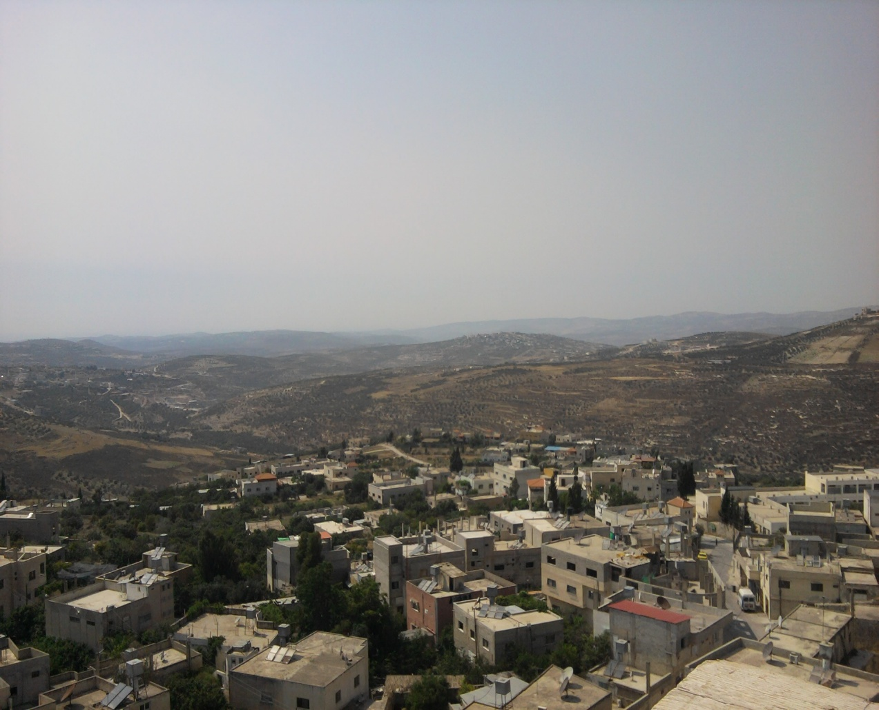
Study area
Tell village.

Slide 8
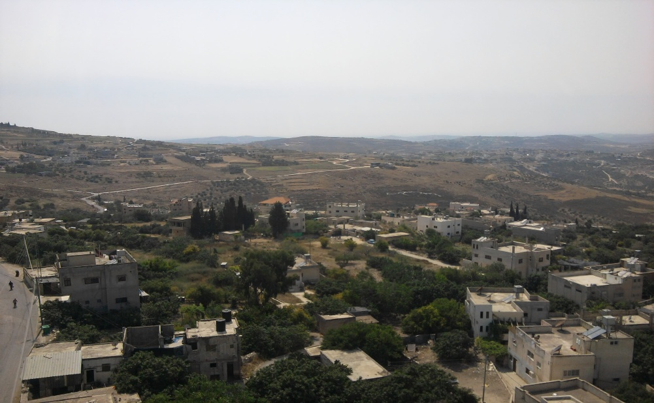
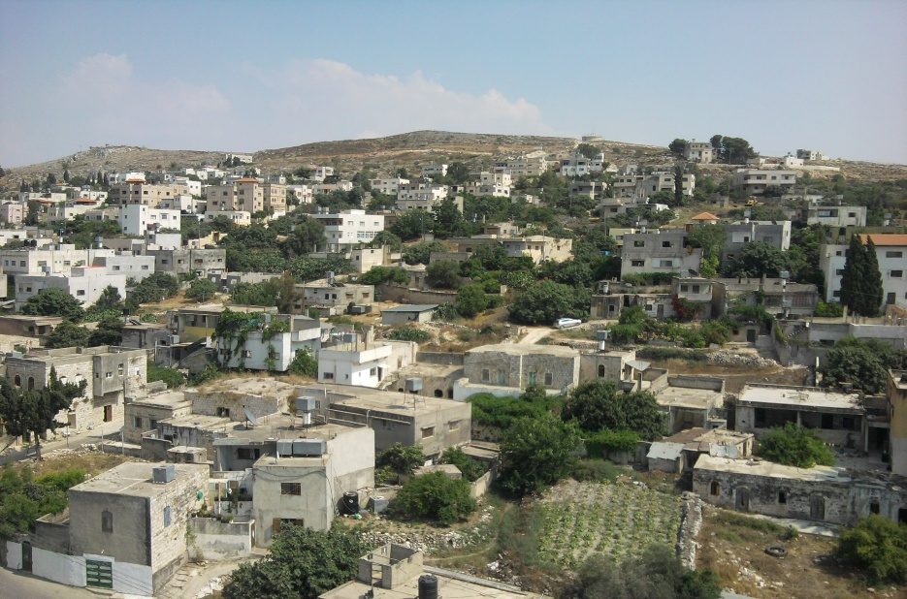
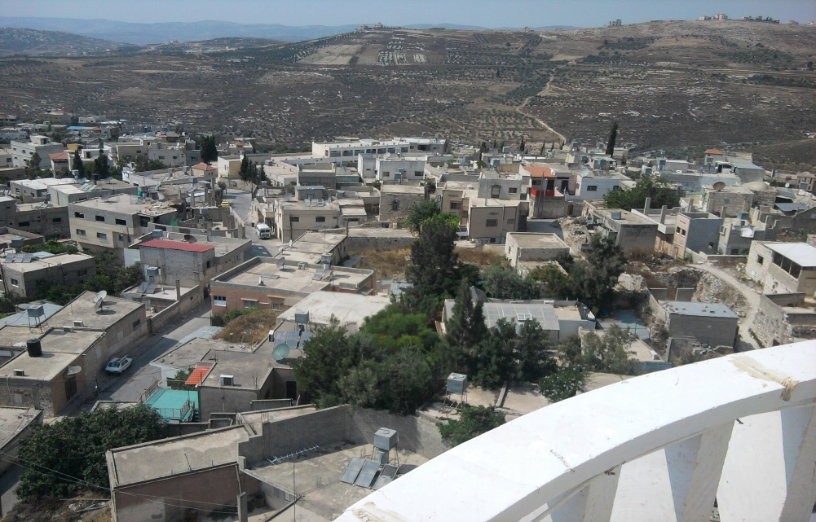
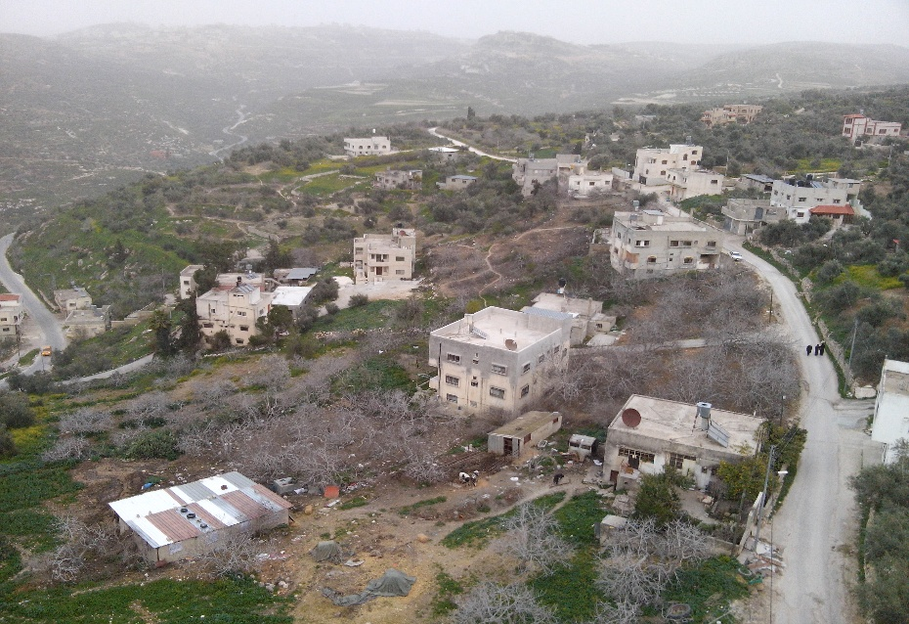
Location

Slide 9

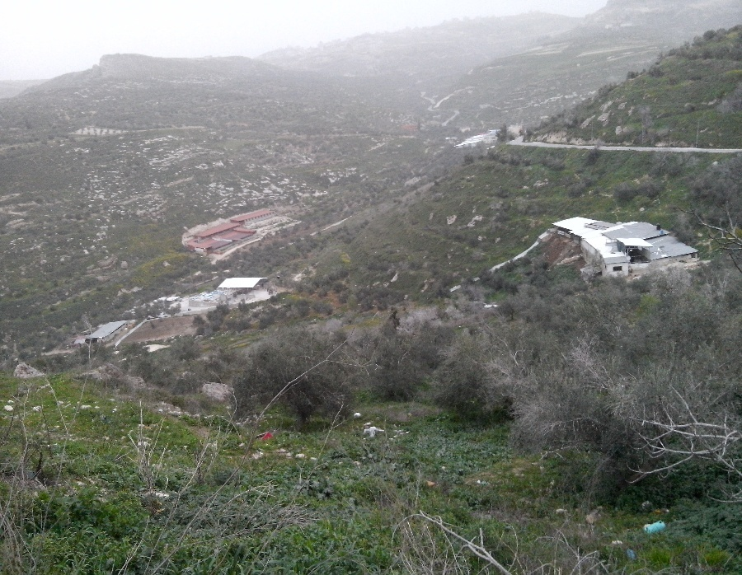
Topography
Maximum elevation = 750m.
Average elevation = 615m.
Minimum elevation = 442 m.

Slide 10
Area and land use
Total Area = 18018 donums.
Residential area = 1100 donums.
Pastures land = 1000 donums.
Agricultural land = 14000 donums.
Barren land = 2000 donums.

Slide 11
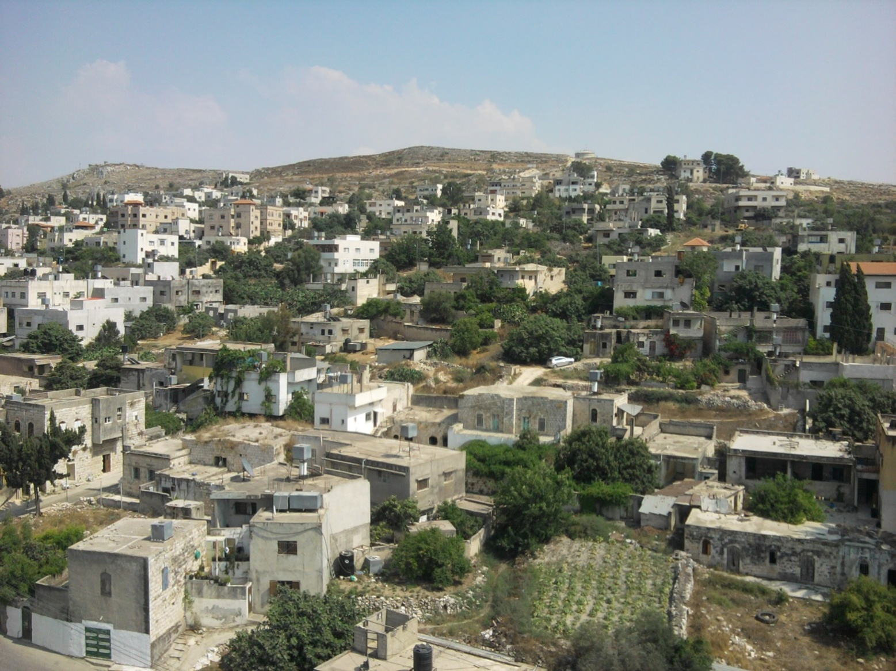
water resources

Slide 12
Sewage Sources
Domestic Wastewater
Industrial Wastewater
Storm water
Infiltration
Feedlots

Slide 13
Other things
Population.
Animal Wealth.
Climate.
Social-Economic Situation

Slide 14
Methodology
Data Collection
Training on SewerCAD Software.
Data analysis
Selection of the study area
Designing by SewerCAD program.
Giving results and recommendations.

Slide 15
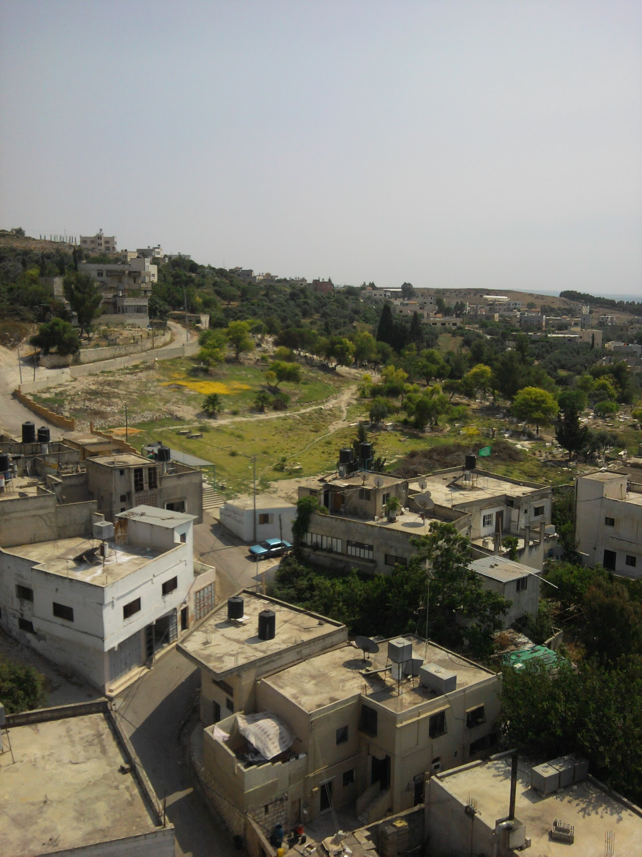
Selection of the study area

Slide 16
Data collection
Contour map.
Road network.
Structural plan.
Boundary of study area.
Outfall location.
Population number.
Demand.

Slide 17
Data analysis
Preparation of data.
Population forecasting.
Demand Forecasting.

Slide 18
Training on SewerCAD software.
Design of Tell Village sewage network using SewarCAD program

Slide 19
sewer Collection network
Sewer Systems
Sewerage Elements

Slide 20
Related hydraulic concepts
Distance between manholes.
A General procedure for design flow rates quantification.
The Energy Principles used.
The Energy Equation.
Friction Loss Methods.

Slide 21
SewerCAD Program
Population Calculations
Loading Calculations

Slide 22
design the Network
Collecting information
Constructing the network
Input data
Design Criteria
  Running the model
The Results

Slide 23
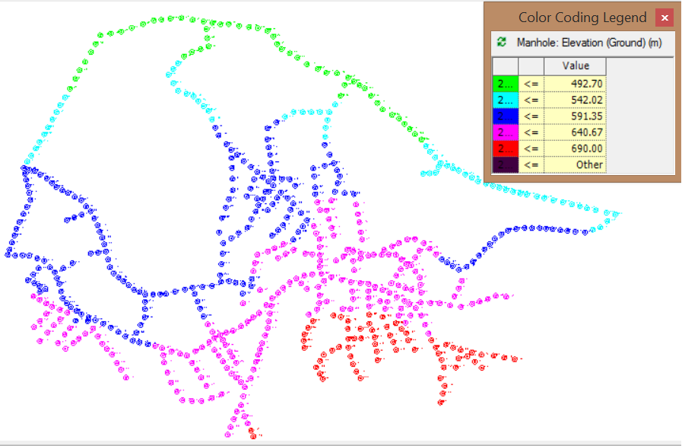
Layout the network
Layout of Manholes

Slide 24
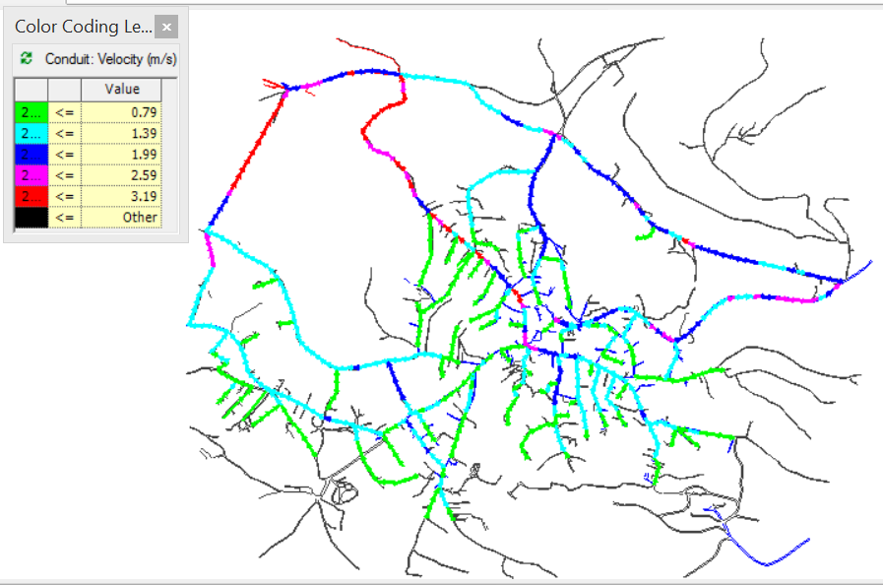
Layout the network
Layout of Conduits

Slide 25
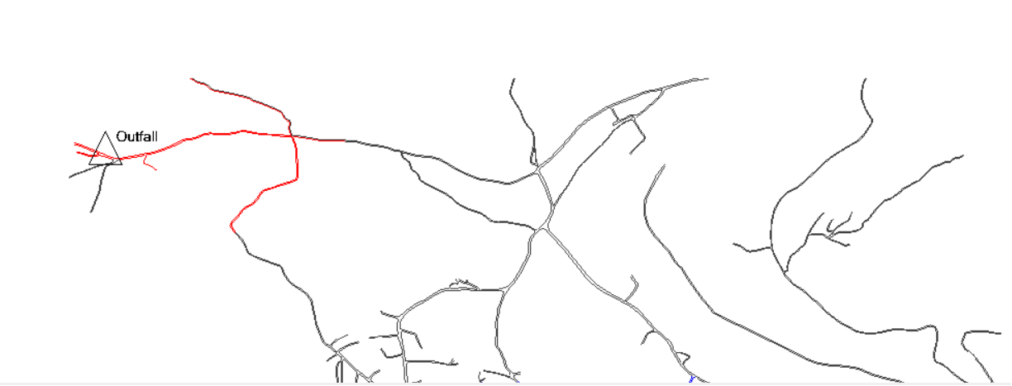
Layout the network
Layout of Outfall

Slide 26
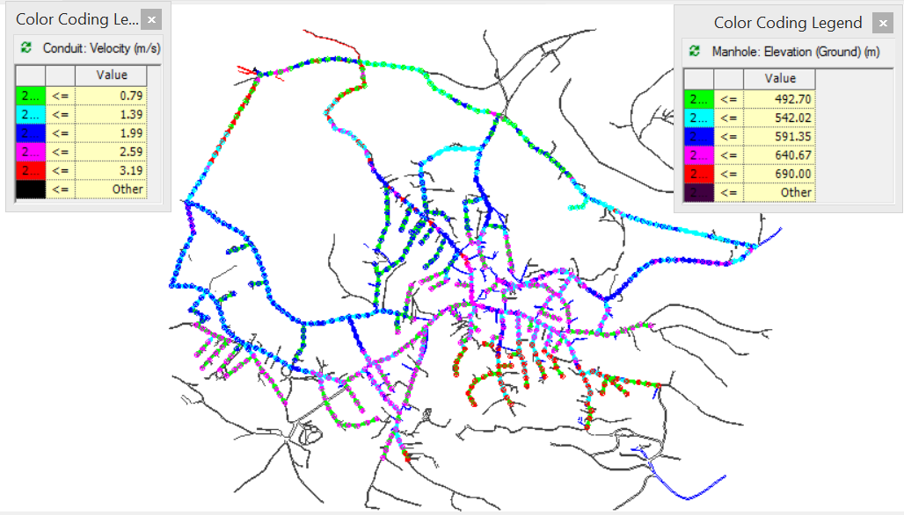
Layout the network

Slide 27
Quantities and Costs
Summary for Bills of Quantities
No. of Bill | Name of Bill | Cost of Bill (U.S.$)
1 | SUPPLY OF U-P.V.C PIPES | 404,282.0
2 | EXCAVATION AND PIPE LAYING | 445,475.6
3 | SEWER MANHOLES | 170,700.0
4 | MISCELLANEOUS FOR THE SEWAGE NETWORK | 7,400.0
Total cost of project |  | 1,027,857.6 $

Slide 28
Conclusion
we recommend constructing a sewer network because the people will be very pleased and most of their problems will be removed.
All constraints are achieved and there are no any problems in the model, and all the results are in the ranges as specifications and criteria.
The cost of the network is very common for this type of projects over this area which is equal to 1,027,857.6 $ (U.S. dollar).

Slide 29
Thank You

