Slide 1
Optimal
Media Selection Tool
Prepared By
Aseel Qaimari Mohammad Antari
Sally Khammash Shireen Sinnokrot
Supervised By
Dr. Mohammad Othman

Slide 2
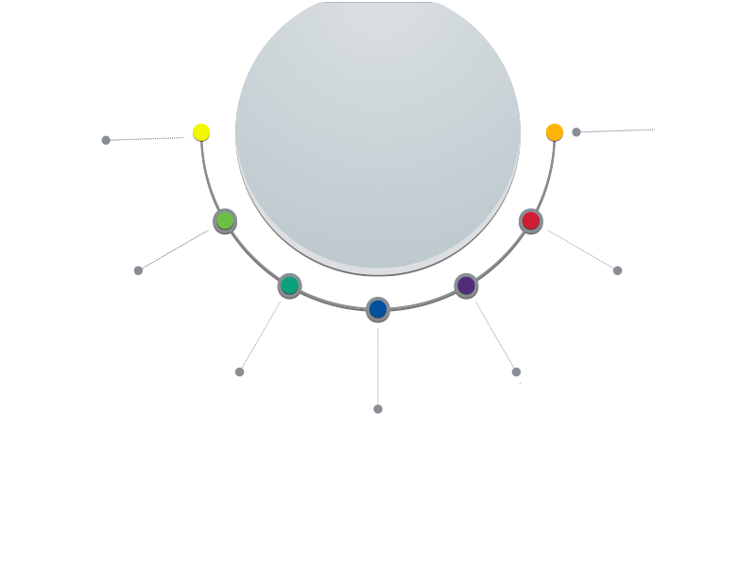
Outlines
  Overview
Conclusion
Problem
statement
Case study
Methodology
and
data analysis
Objectives
Literature
review

Slide 3



Overview
Optimal media selection Tool
This project states an integral part of optimum advertising decision making and presents a media planning model that determines the optimal media mix with an objective of maximizing the overall reach and frequency dedicated to consumers through the potential market being categorized into a number of segments based upon a linear integer mathematical.

Slide 4

Problem Statement
Generally it is not enough for any business in industry to have only high services and quality products sold at attractive prices to generate sales and profits, but the benefits of products have to be communicated to and reached by the maximum number of customers and this goal can be only accomplished through the world of Advertising.

Slide 5




Improving effective marketing of a product
Maximizing advertising reach
Maximizing the return on investment of advertising
Tool Development
Objectives

Slide 6
Project constraints
Time
Interruptions
Limited experience in modeling
Limited knowledge in the programming methods and languages
Filling in the questionnaires
Obtaining some data from companies during interview

Slide 7
Scope of the Work
Advertisements are targeted to the overall market with mass advertising as well as the segments with segment specific advertising.

Slide 8




Media planning model that assists a firm in determining the optimal media mix for product advertise in segmented market
Media mix decision model for advertising .
Media planning and optimization models

Slide 9
Methodology

Slide 10

Methodology
Problem analysis.

Slide 11
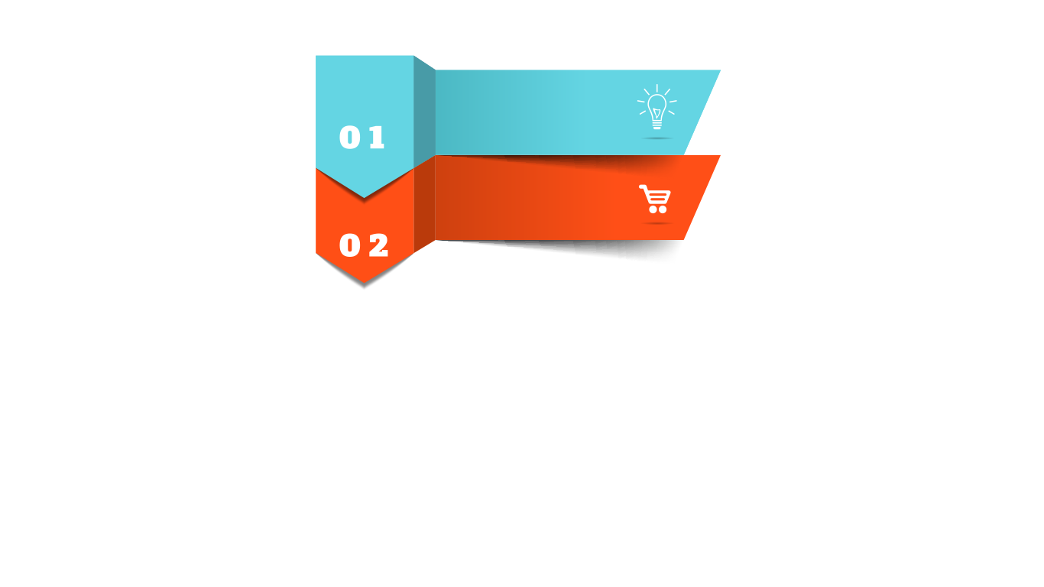
Methodology
Problem analysis.
Research methodology

Slide 12
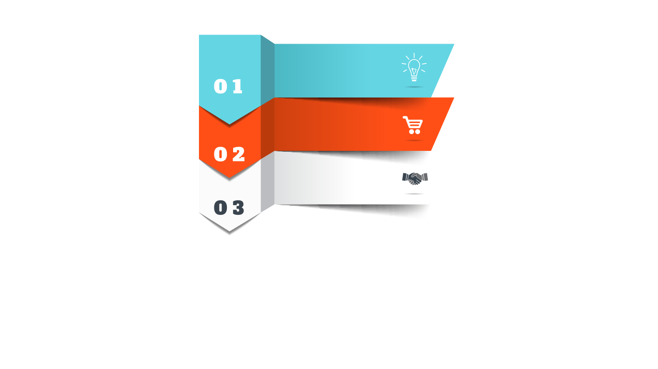
Methodology
Problem analysis.
Research methodology
Model development, design and testing

Slide 13
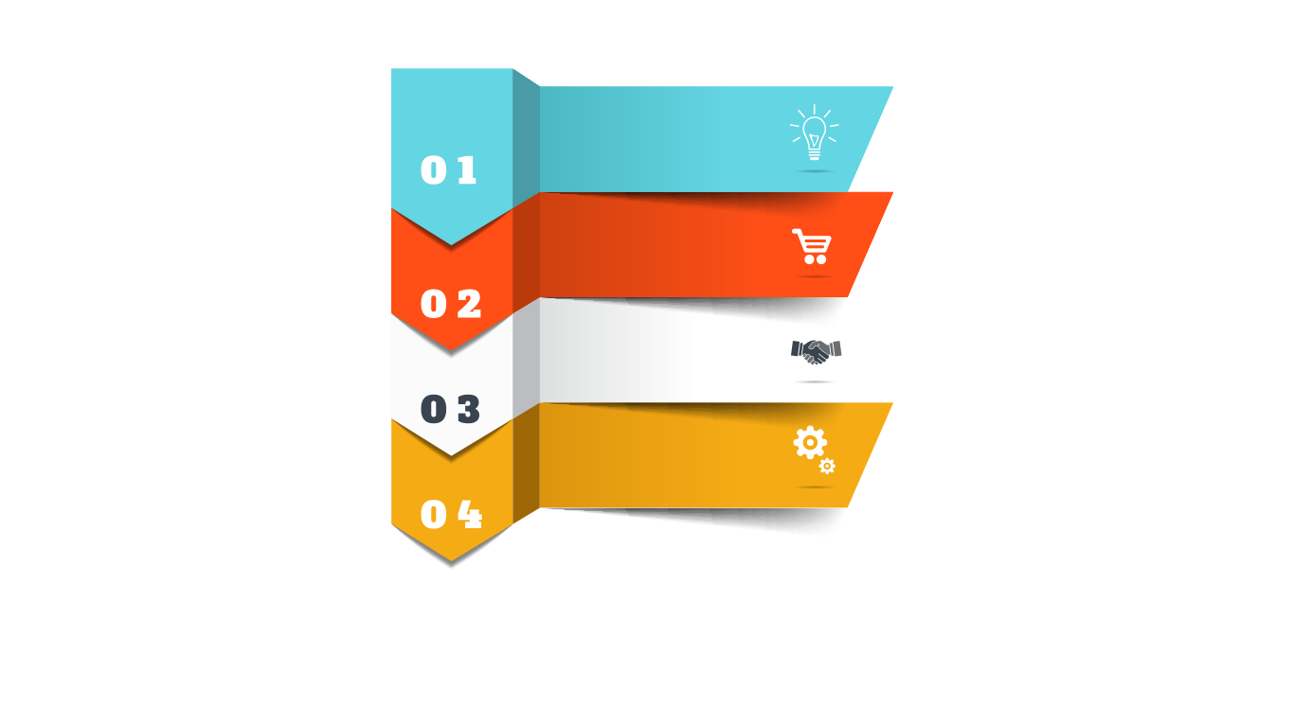
Methodology
Problem analysis.
Research methodology
Model development, design and testing
Data analysis and results

Slide 14

Methodology
Problem analysis.
Research methodology
Model development, design and testing
Data analysis and results
Applying case study

Slide 15
Problem analysis.
The main approach in our project is to study the media marketing plan’s elements that can be analyzed, selected and evaluated based on :
Cost
Reach
Accessibility
Effectiveness

Slide 16

Research Design
Research Instrument
Data Collection
Procedures
Sampling Method
Research Methodology

Slide 17
Sampling Method

Slide 18
Model development , design and testing
Assumptions
1- The market studied is stable.
2- The model is applied to a no-risky-environments.
3- The given results of the model are used for a short term period due to multiple changes that affects the given results.

Slide 19
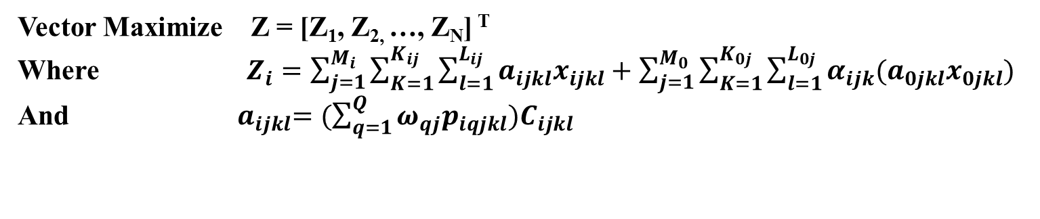
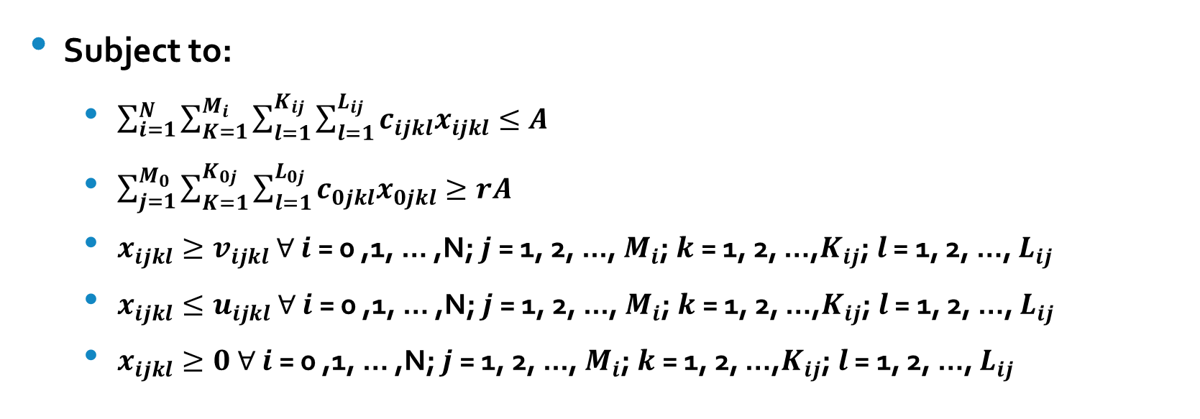
Model development , design and testing
Vector Maximize Z = [Z₁, Z_{2,} …, Z_{N}] ^{T}
Where $Z_{i}=\sum_{j=1}^{M_{i}}{\sum_{K=1}^{K_{ij}}{\sum_{l=1}^{L_{ij}}{a_{ijkl}x_{ijkl}+\sum_{j=1}^{M_{0}}{\sum_{K=1}^{K_{0j}}{\sum_{l=1}^{L_{0j}}{α_{ijk}(a_{0jkl}x_{0jkl})}}}}}}$
And ${ a}_{ijkl}=(\sum_{q=1}^{Q}{ω_{qj}p_{iqjkl})C_{ijkl}}$
Subject to:
  $\sum_{i=1}^{N}{\sum_{K=1}^{M_{i}}{\sum_{l=1}^{K_{ij}}{\sum_{l=1}^{L_{ij}}{c_{ijkl}x_{ijkl}≤A}}}}$
  $\sum_{j=1}^{M_{0}}{\sum_{K=1}^{K_{0j}}{\sum_{l=1}^{L_{0j}}{c_{0jkl}x_{0jkl}≥rA}}}$
  $x_{ijkl}≥v_{ijkl}$ $∀$ $i$ = 0 ,1, … ,N; $j$ = 1, 2, ..., $M_{i}$; $k$ = 1, 2, …,$K_{ij}$; $l$ = 1, 2, …, $L_{ij}$
  $x_{ijkl}≤u_{ijkl}$ $∀$ $i$ = 0 ,1, … ,N; $j$ = 1, 2, ..., $M_{i}$; $k$ = 1, 2, …,$K_{ij}$; $l$ = 1, 2, …, $L_{ij}$
  $x_{ijkl}≥0$ $∀$ $i$ = 0 ,1, … ,N; $j$ = 1, 2, ..., $M_{i}$; $k$ = 1, 2, …,$K_{ij}$; $l$ = 1, 2, …, $L_{ij}$

Slide 20
Lingo Code
This research uses Lindo Systems’ Lingo 16.0 for solving this model.
LINGO is a simple tool for utilizing the power of linear and nonlinear optimization to formulate large problems concisely, solve them, and analyze the solution.
LINGO provides a completely integrated package that includes a powerful language for expressing optimization models, a full featured environment for building and editing problems, and a set of fast built-in solvers.

Slide 21
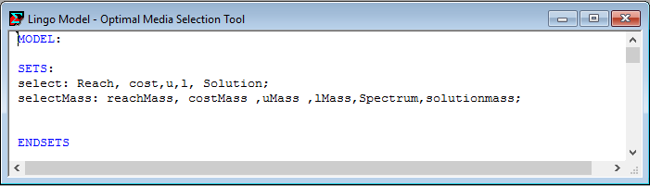
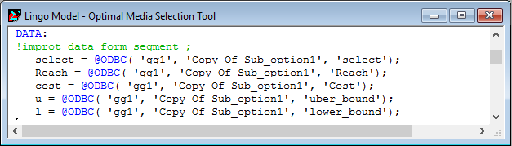
Lingo Code
LINGO Sets
Data import

Slide 22
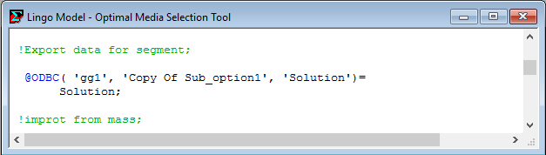
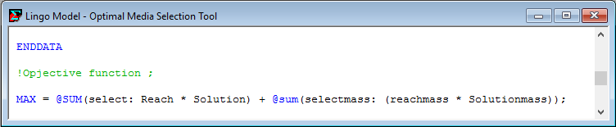
Lingo Code
data export
Objective function

Slide 23
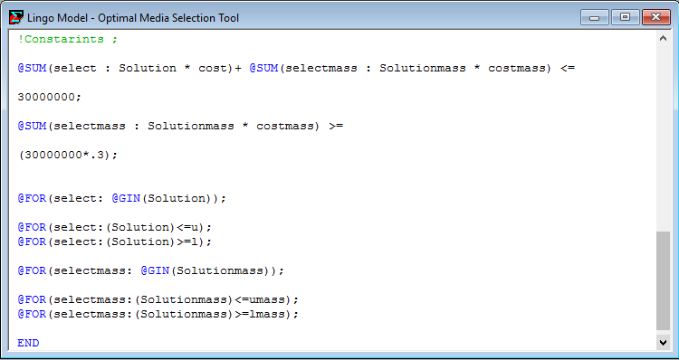
Lingo Code
Constraints

Slide 24
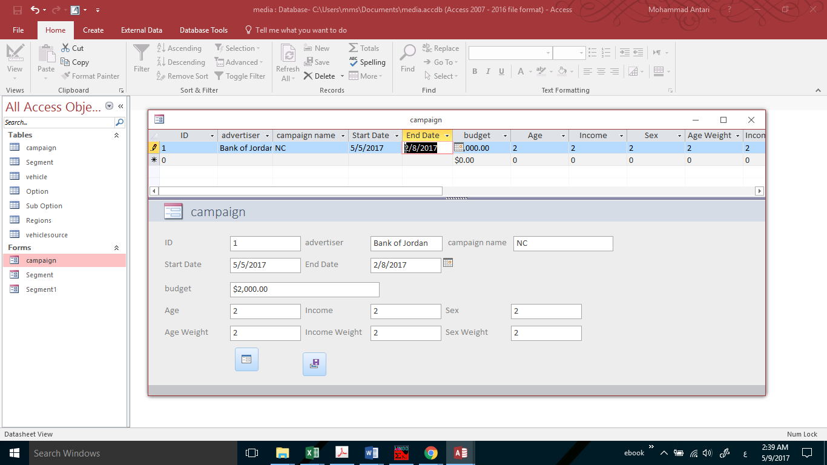
Interface Design
Microsoft Access is a database management system
The interface was designed to have clear information and to be used simply and easily.

Slide 25
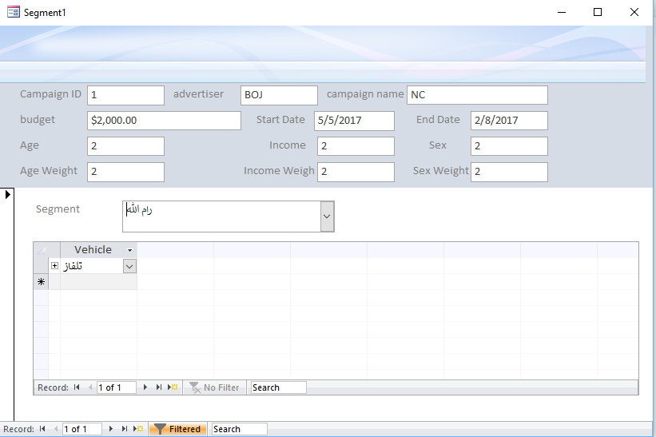
Interface Design
SEGMENTS WINDOW

Slide 26
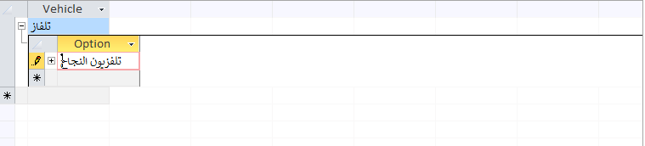
Interface Design
Option

Slide 27
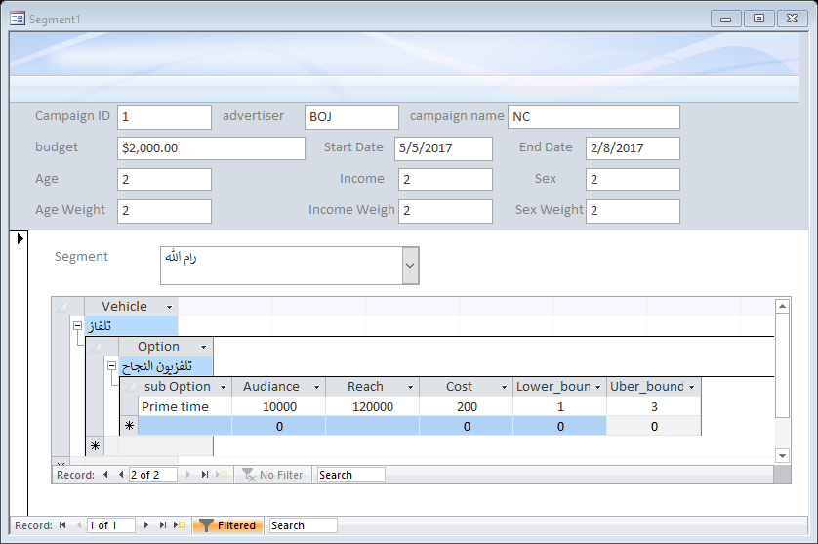
Interface Design
Sub option and other constants

Slide 28
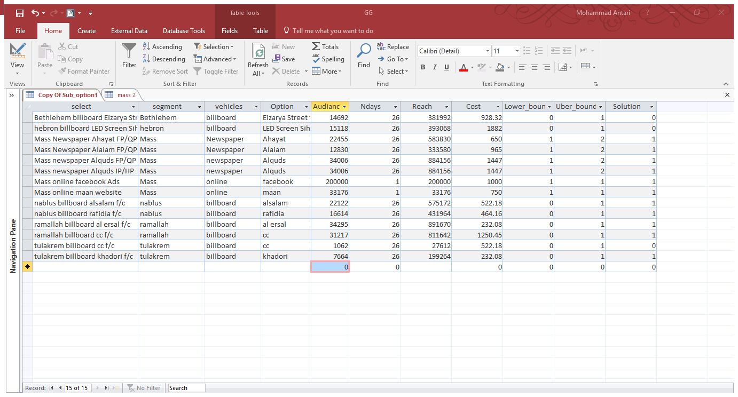
Interface Design

Slide 29
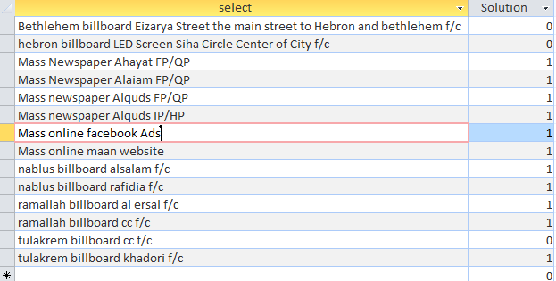
Interface Design
result table

Slide 30
Data analysis and result
Demographic characteristics
GENDER analysis
Age analysis
Educational level
Monthly Income

Slide 31
Data analysis and result
Frequencies and percentages for general media questions

Slide 32
Data analysis and result
FREQUENCIES AND PERCENTAGES FOR THE RADIO SECTION

Slide 33
Data analysis and result
most preferable Radio Stations

Slide 34
Data analysis and result
most preferable Radio Stations

Slide 35
Data analysis and result
most preferable Radio Stations

Slide 36
Data analysis and result

Slide 37
Data analysis and result

Slide 38
Data analysis and result

Slide 39
Data analysis and result

Slide 40
Data analysis and result

Slide 41
Data analysis and result

Slide 42

Case Study
In general, it is planned, based on past experience, popularity and the number of audiences, to advertise in three main mass newspapers (Al-Quds newspaper, Al-Ayyam newspaper and Al-Hayat newspaper), two mass radio stations (AJYAL and Raya FM), four regional radio stations (Nisaa,24 FM, Bethlehem 2000 and Tareeq Al-Mahaba) and eight different and regional billboards

Slide 43
Case Study
Audience membership
Segment/ Newspaper | Al-Aiam | Al-Hayat | al-Quds
Nablus | 2652 | 4642 | 7030
Tulkarem | 1262 | 2209 | 3346
Ramallah | 2437 | 4265 | 6458
Hebron | 3968 | 5695 | 10167
Bethlehem | 1511 | 2644 | 4005
Segment/Radio | Raya FM | Ajyal | 24 FM | Nisaa | Tareeq al-Mahaba | Bethlehem 2000
Tulkarem | 3861 | 1930 | 2204 | - | - | -
Nablus | 6222 | 3062 | 3930 | - | 2271 | -
Ramallah | 8707 | 2423 | 3257 | 6242 | - | 6733
Bethlehem | 4787 | 5885 | - | - | - | 9268
Hebron | 3577 | 5074 | - | - | - | 9087
Segmented Billboards | Audience membership
Bethlehem billboard Eizarya Street the main street to Hebron and bethlehem f/c | 9692
hebron billboard LED Screen Siha Circle Center of City f/c | 10118
nablus billboard alsalam f/c | 16122
nablus billboard rafidia f/c | 14614
ramallah billboard al ersal f/c | 20295
ramallah billboard cc f/c | 21217
tulakrem billboard cc f/c | 3062
tulakrem billboard khadori f/c | 5664
 | Audience membership
Mass online maan website | 10176
Mass online Facebook Ads | 15000

Slide 44
Case Study
Uber and lower bounds
The marketing administrator decide that the number of Ads in all newspapers, billboard and online must be equal one
 | Ajyal/West Bank | Raya FM/West Bank | 24fm/West Bank | Nisaa FM/Ramallah | Bethlehem 2000/Bethlehem City | Tareeq Al Mahaba/Nablus
Bounds | (2,12) | (2,10) | (2,7) | (2,12) | (2,10) | (2,10)

Slide 45
Case Study
percentage Profile Matrix

Slide 46
Case Study
select | Audience Number | Reach | Cost | Solution | Total Reach | price | Bank displacement | Bank Reach | Bank Cost
Bethlehem billboard Eizarya Street f/c | 9692 | 9692 | 928.32 | 1 | 9692 | 928.32 | 1 | 9692 | 928.32
hebron billboard LED Screen Siha Circle f/c | 10118 | 10118 | 1882 | 1 | 10118 | 1882 | 1 | 10118 | 1882
Newspaper Ahayat FP/QP | 15455 | 15455 | 650 | 1 | 15455 | 650 | 1 | 15455 | 650
Newspaper Alaiam FP/QP | 7830 | 7830 | 965 | 1 | 7830 | 965 | 1 | 7830 | 965
newspaper Al-Quds FP/QP | 22006 | 22006 | 1447 | 1 | 22006 | 1447 | 1 | 22006 | 1447
newspaper Al-Quds IP/HP | 22006 | 22006 | 1447 | 1 | 22006 | 1447 | 1 | 22006 | 1447
online Facebook Ads | 15000 | 15000 | 1000 | 1 | 15000 | 1000 | 1 | 15000 | 1000
online maan website | 10176 | 10176 | 750 | 1 | 10176 | 750 | 1 | 10176 | 750
nablus billboard alsalam f/c | 16122 | 16122 | 522.18 | 1 | 16122 | 522.18 | 1 | 16122 | 522.18
nablus billboard rafidia f/c | 14614 | 14614 | 464.16 | 1 | 14614 | 464.16 | 1 | 14614 | 464.16
ramallah billboard al ersal f/c | 20295 | 20295 | 232.08 | 1 | 20295 | 232.08 | 1 | 20295 | 232.08
ramallah billboard cc f/c | 21217 | 21217 | 1250.5 | 1 | 21217 | 1250.45 | 1 | 21217 | 1250.45
tulakrem billboard cc f/c | 3062 | 3062 | 522.18 | 1 | 3062 | 522.18 | 1 | 3062 | 522.18
tulakrem billboard khadori f/c | 5664 | 5664 | 232.08 | 1 | 5664 | 232.08 | 1 | 5664 | 232.08
radio 24 pt | 9391 | 9391 | 2.97 | 7 | 65737 | 20.79 | 7 | 65737 | 20.79
radio ajial pt | 18374 | 18374 | 10.61 | 10 | 183740 | 106.1 | 12 | 220488 | 127.32
radio Bethlehem 2000 pt | 25088 | 25088 | 2.83 | 10 | 250880 | 28.3 | 7 | 175616 | 19.81
radio raya pt | 27154 | 27154 | 4.96 | 10 | 271540 | 49.6 | 10 | 271540 | 49.6
nablus radio Tareq almahaba PT | 2271 | 2271 | 2.83 | 2 | 4542 | 5.66 | 7 | 15897 | 19.81
ramallah radio nisaa pt | 6242 | 6242 | 3.54 | 12 | 74904 | 42.48 | 5 | 31210 | 17.7
Total |  |  |  |  | 1044600 | 12545.38 |  | 973745 | 12547.5

Slide 47
Conclusion
An optimization model that combines the two previously mentioned points is formulated to determine the media mix for a product advertised in a segmented market using both segment and mass advertising strategies is obtained.
This optimization model was improved and validated to be applicable through a real life case

Slide 48
Thank You !
Any Questions?

