Slide 1


An–Najah National University
Design of Low cost Treatment Plant and Reuse system for Anin Village
Prepared By: Mohammad Foqha
Taqreer Assaf
Supervisor: Dr. Hafez Shaheen
2013

Slide 2
Presentation Outline
Project 1 :
Introduction
Project objectives
Methodology
Study Area.
Data Collection and Analysis

Slide 3
Presentation Outline
Project 2 :
Selection of treatment process.
Anin Plant Design.
Conclusion.
Recommendation.

Slide 4


Slide 5
Introduction
There is an increase in water demand and there is a shortage in water supply in Anin.
WWTP and reuse for irrigation are the main alternatives to lesson the problem and prevents further groundwater and springs pollution.
A separate project is prepared for the design of the Wastewater collection system.

Slide 6


Slide 7
Project objectives
Review the water and wastewater sanitation system in Anin.
Conceptual design of the wastewater treatment plant, which will treat "domestic wastewater" to the standards for reuse in agriculture.
Address the reuse potential of the treated wastewater in agriculture.

Slide 8


Slide 9
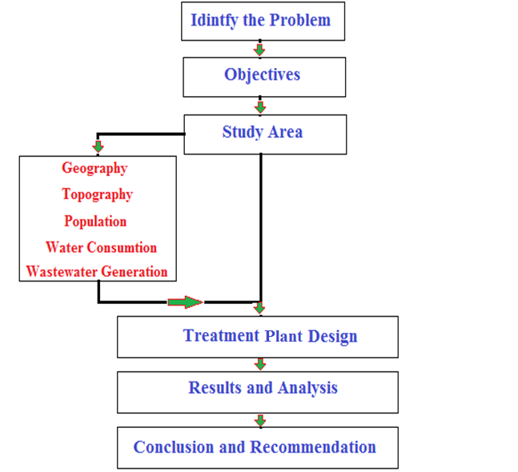
The following Figure shows the methodology that is applied in the study.

Slide 10


Slide 11
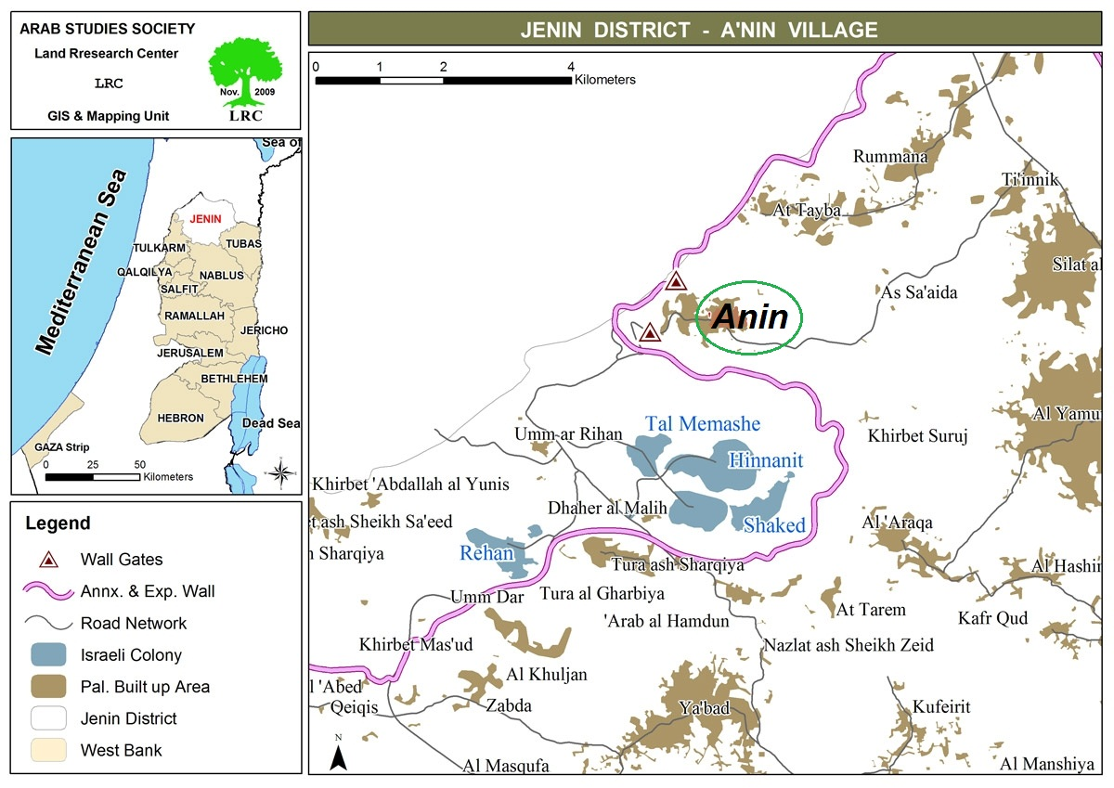

Slide 12


Slide 13
Design Figures
The average annual growth rate is 2.89%.
Design year is 2040.
P2040 = 9450 capita.
Water daily consumption = 130l/c

Slide 14
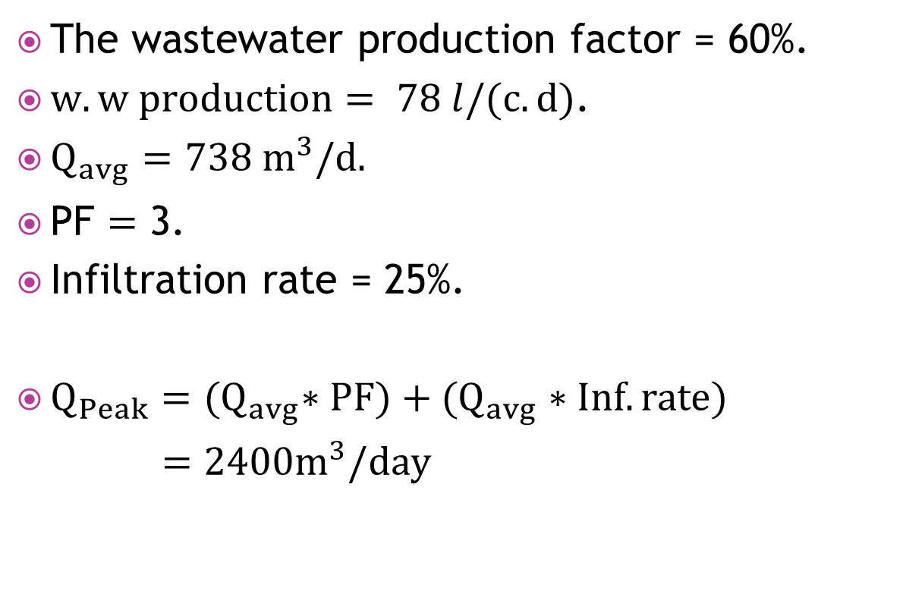
Wastewater Flow and Design Loads
The wastewater production factor = 60%.
$w.w production= 78 l/(c.d)$.
$Q_{avg}=738 m^{3}/d.$
PF $=$ 3.
Infiltration rate = 25%.
$Q_{Peak}={(Q}_{avg}∗PF)+(Q_{avg}∗Inf. rate)$
$=2400m^{3}/day$

Slide 15
Characteristics of Wastewater for the village of Anin
SS produced = 70 g/c.d
BOD produced = 50 g/c.d

Slide 16
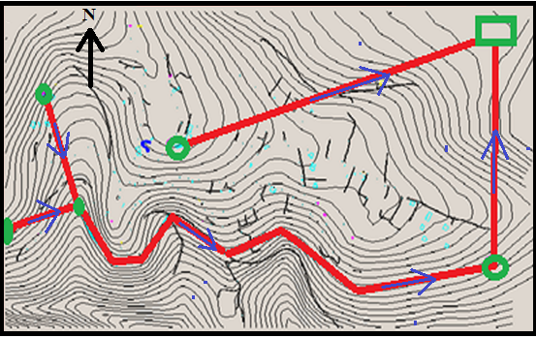
Location of the plant

Slide 17
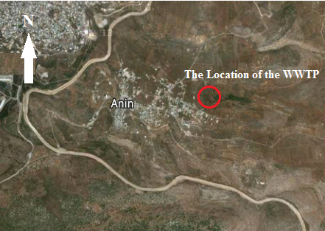

Slide 18
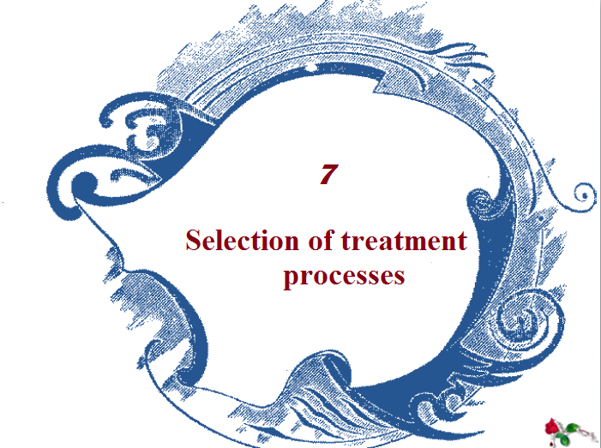

Slide 19
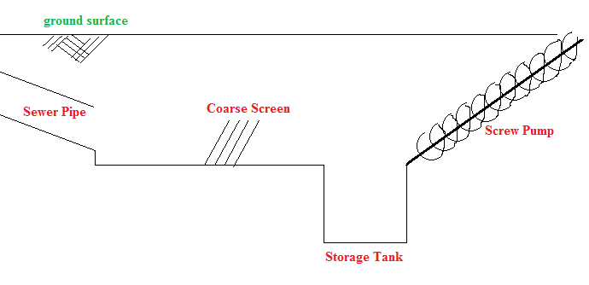
Treatment Process
Preliminary Tre. Proc.

Slide 20
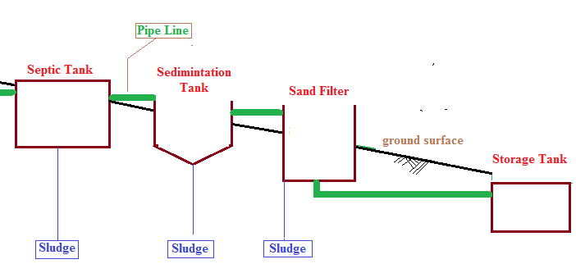
Secon.

Slide 21
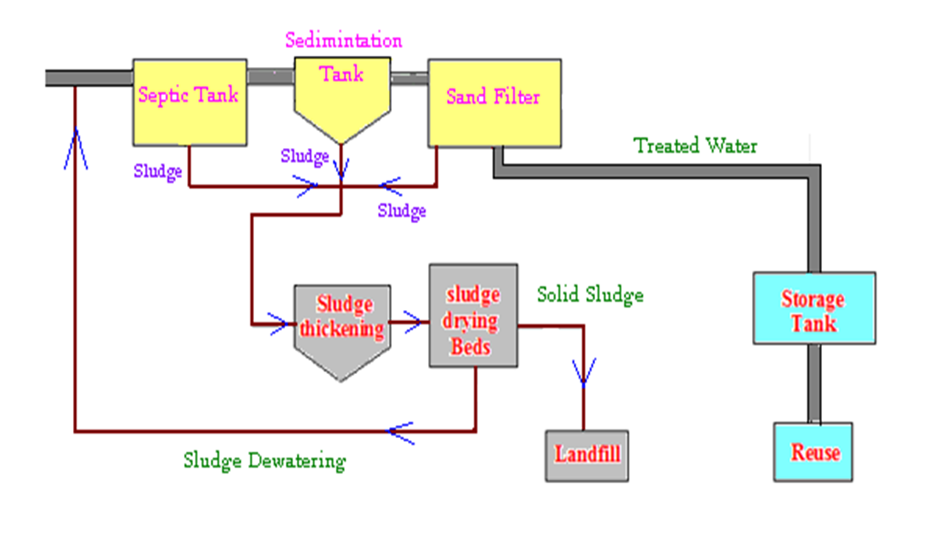
Sludge Management

Slide 22


Slide 23
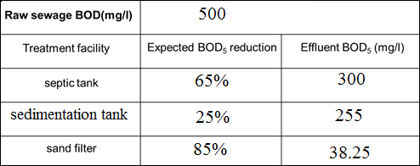
Plant design was chosen to meet this figure:

Slide 24
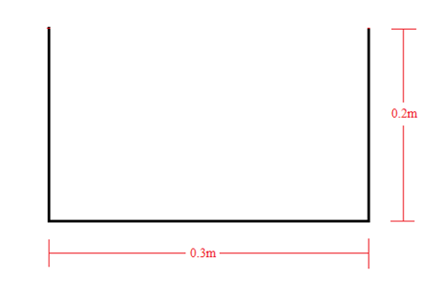
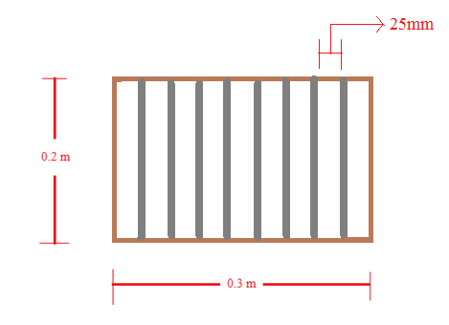
Channel Design:
No. of screen bars = 8 bars

Slide 25
Septic tank volume = 27mX9mX1.5m
Sedimentation tank volume = 10m * 2m * 1.6m
Sand filter design : 3.5mX3.0mX1.7m
  Design gravity thickener
  Diameter of sludge thickener=5 m
  Total depth of thickener= 4.5 m

Slide 26


Slide 27
The hilly topography of Anin village helps to design the gravitational system, so the wastewater reaches the WWTP by gravity.
A law cost treatment plant have been considered to treat wastewater in Anin according to the Palestinian specification to get effluent water used in agricultural and irrigation.
There is potential for reuse.

Slide 28
It is recommended to establish WWTP to treat wastewater as to be used in agriculture.
Environmental consideration :
Protect the environment and wildlife.
Reduce the pollution of groundwater and springs

Slide 29
Economical consideration:
New water resource will be available.
The resulted sludge could be used as fertilizers.
Need to look for funding source to fund the project.
Public awareness program to ware people to use the treated water in irrigation.

Slide 30

THANKS FOR LISTENING

