Slide 1

NNU - COMPUTER ENGINEERING GRADUATION PROJECT 2
SynLab
PROJECT PRESENTATION
By: Adel Qadi, Ghassan Qasrawi.
Supervisors: Dr. Raed Qadi, Dr. Manar Qamhieh

Slide 2
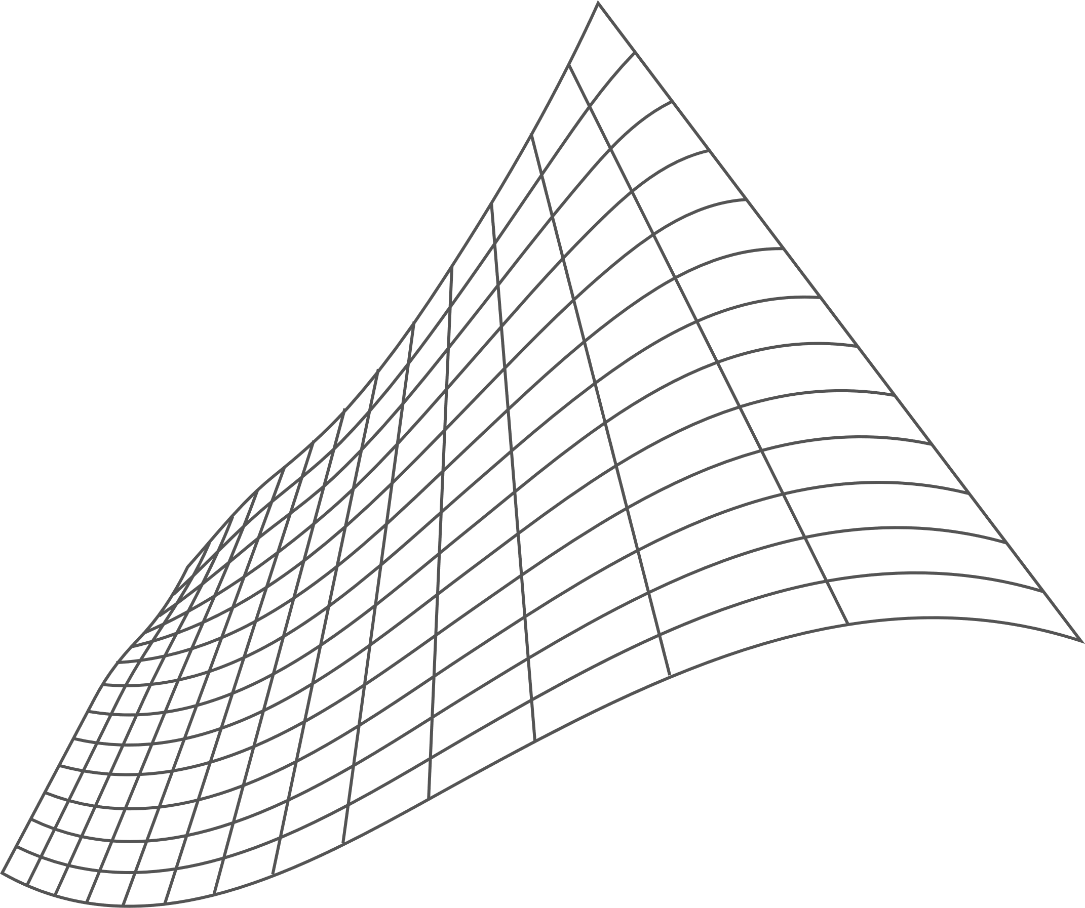

SYNLAB
PROJECT OVERVIEW
SynLab is a modular IoT-based electronics laboratory
Integrates multiple lab instruments into one system
Instruments communicate wirelessly
Controlled via display + mobile application
Designed for education, experimentation, and accessibility

Slide 3
SYNLAB
BULKY AND EXPENSIVE STANDALONE INSTRUMENTS
01
PROBLEM STATEMENT
02
NO INTERCONNECTIVITY BETWEEN DEVICES
Traditional lab equipment can be further improved to solve the many issues users suffer from. using SynLab these can be tackled simultainously
03
LIMITED REMOTE ACCESS
LACK OF SMART, UNIFIED, SCALABLE LAB ENVIRONMENTS
04

Slide 4
SYNLAB
PROJECT OBJECTIVES
01
02
03
04
05
DESIGN A SMART MODULAR ELECTRONIC LAB
INTEGRATE PARTS:
ENABLE REAL-TIME MONITORING AND CONTROL
IMPLEMENT IOT COMMUNICATION
IMPROVE LEARNING EXPERIENCE FOR STUDENTS
IC Tester
Oscilloscope
Function Generator
PIC Programmer
AC/DC Monitoring

Slide 5
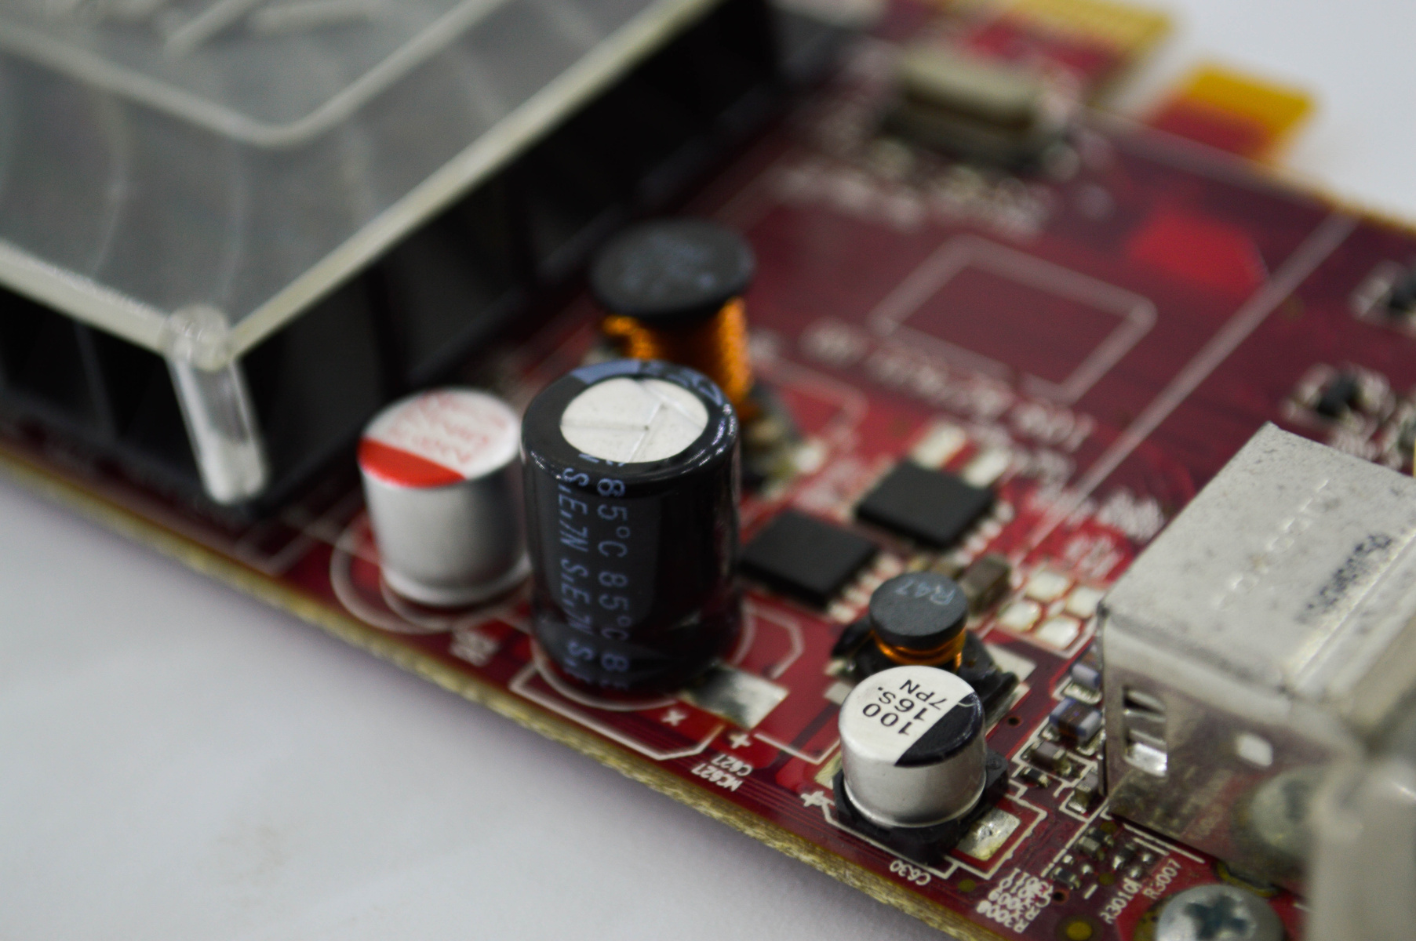
SYNLAB
SYSTEM CONCEPT
01
MODULAR SYSTEM: EACH INSTRUMENT IS INDEPENDENT
02
ALL MODULES CONNECTED VIA IOT (WI-FI)
CENTRALIZED CONTROL THROUGH
03
Nextion Display
Mobile Application
04
SCALABLE AND EXPANDABLE DESIGN

Slide 6
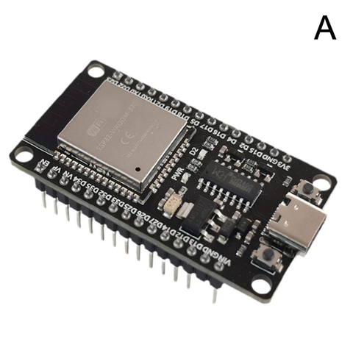
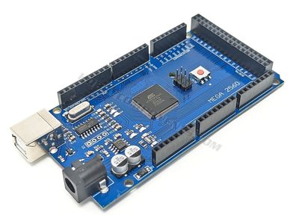
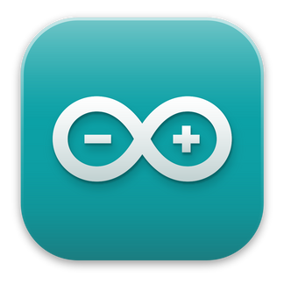




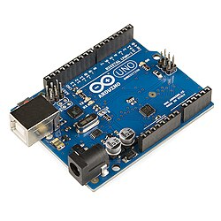
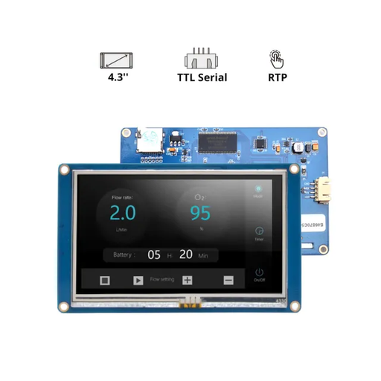
SYNLAB
TECHNOLOGIES USED
Microcontrollers
Communication
Software
Arduino IDE
C++
Wifi
ESP32
Arduino MEGA
HMI
MQTT
Protocol
Arduino UNO

Slide 7
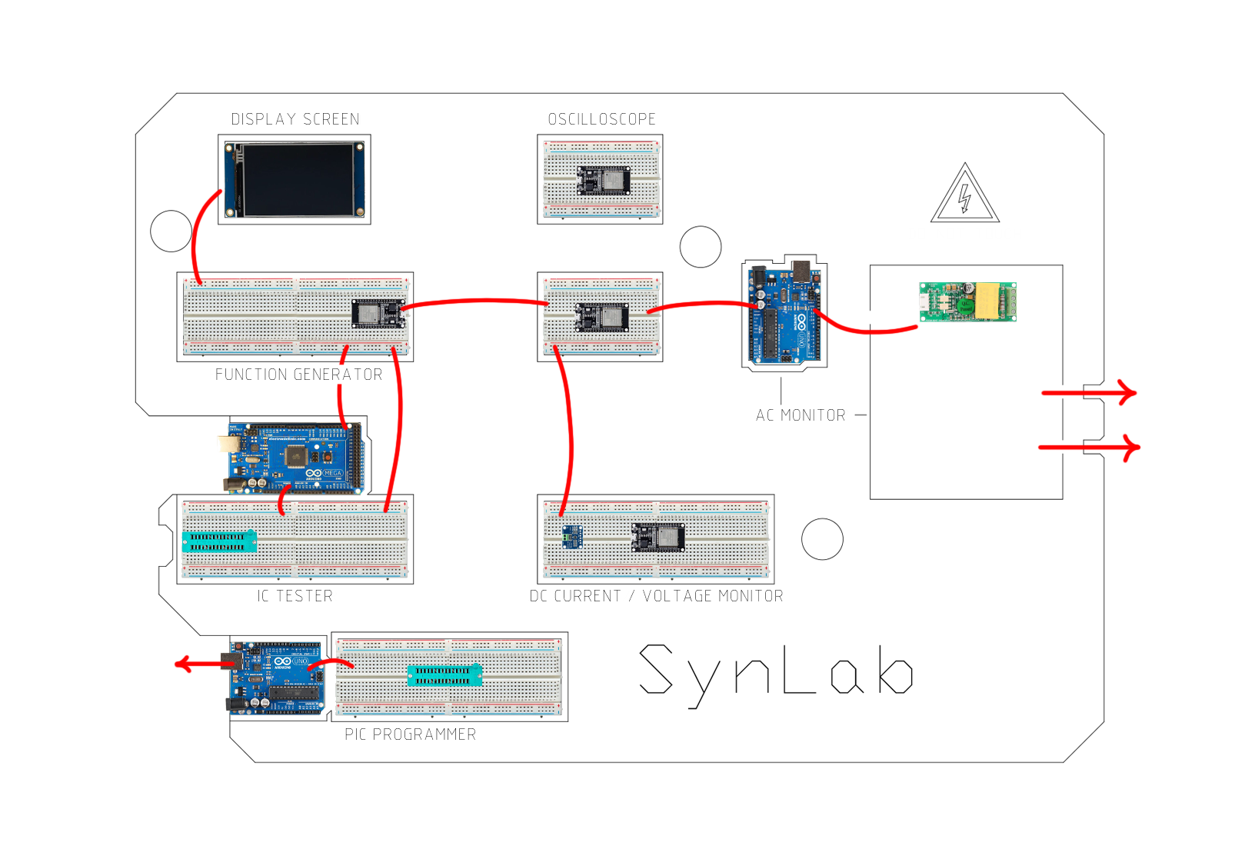
SYNLAB
MAIN SYSTEM MODULES
3
1
FUNCTION GENERATOR
IC TESTER
OSCILLOSCOPE
PIC PROGRAMMER
AC MONITOR
DC MONITOR
5
2
6
4

Slide 8
SYNLAB
PAGE 03
FUNCTION GENERATOR MODULE
Generates Sine, Square, Triangle waveforms
Based on ESP32 DAC & PWM
Adjustable frequency and amplitude
Integrated with Nextion touchscreen
Wave parameters are controlled in real time through the system interface.
ESP32
AMP
KEY ADVANTAGE:
DAC /PWM
Low-cost waveform generation suitable for education and prototyping.
OUTPUT
02

Slide 9
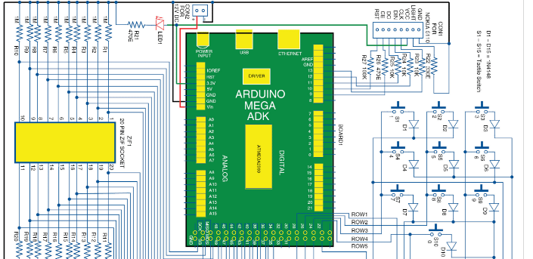
SYNLAB
PAGE 04
IC TESTER MODULE
Supports 74xx (TTL) and 40xx (CMOS) IC families
Uses Arduino Mega 2560
ZIF socket for safe IC insertion
Communicates with system via serial
Designed to quickly verify logic IC functionality without external equipment.
OPERATING MODES
Auto Mode: IC detected automatically
Manual Mode: User selects IC type
Detailed Mode: Shows test process step-by-step
02

Slide 10
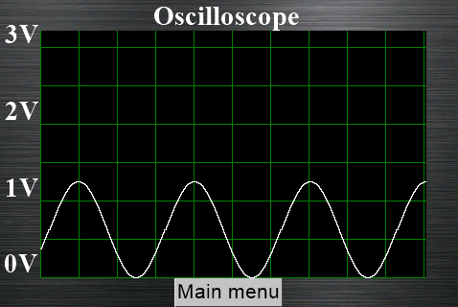
SYNLAB
PAGE 05
OSCILLOSCOPE MODULE
ESP32-based digital oscilloscope module
Real-time analog signal acquisition
Wireless data transmission between nodes
Designed for educational and prototyping use
Optimized for educational use and low-frequency electronic experiments.
Uses ESP32 ADC1 (GPIO33)
12-bit resolution (0–4095)
11 dB attenuation for wider input range
256 samples per frame
Target sampling rate: 20 kHz
Captured frame is down-sampled to 15 points
Values scaled from 12-bit → 8-bit (0–255)
Data sent wirelessly using ESP-NOW
ESP32 operates in Wi-Fi station mode
Packets sent to a paired receiver ESP32 via ESP-NOW
02

Slide 11
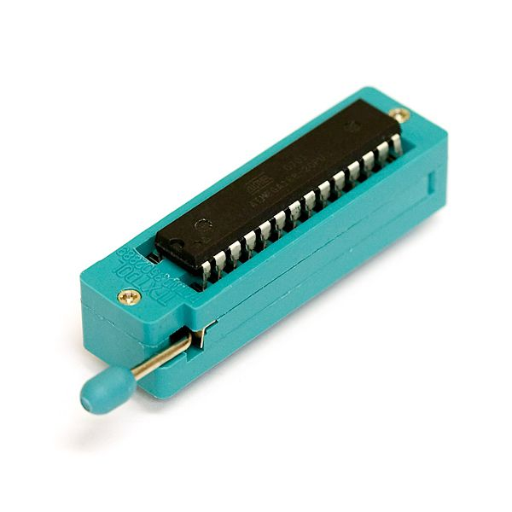
SYNLAB
PIC 18F4XXX PROGRAMMER MODULE
PAGE 06
Arduino Uno is used as a custom programmer to communicate directly with the PIC microcontroller using low-voltage ICSP.
Programming is done by manually driving the PIC’s programming pins:
Eliminates the need for separate programming hardware.
PGC – Programming Clock
PGD – Programming Data
PGM – Programming Mode Enable
MCLR – Reset / Programming Control
Operations:
Program : programs a hex file into the PIC Flash memory
Erase : erases the flash memory of the device
Read: reads a single line of flash memory
Dump: reads the entire Flash memory
02

Slide 12
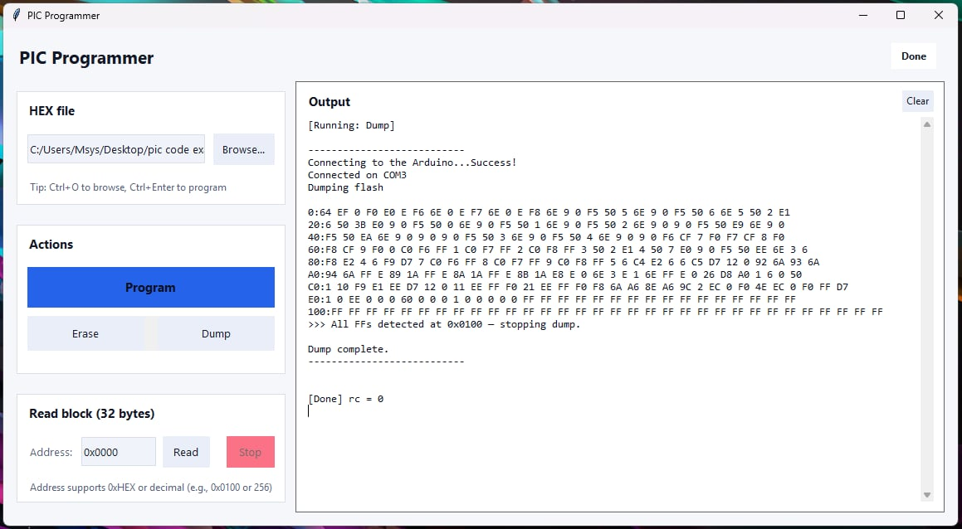

Slide 13
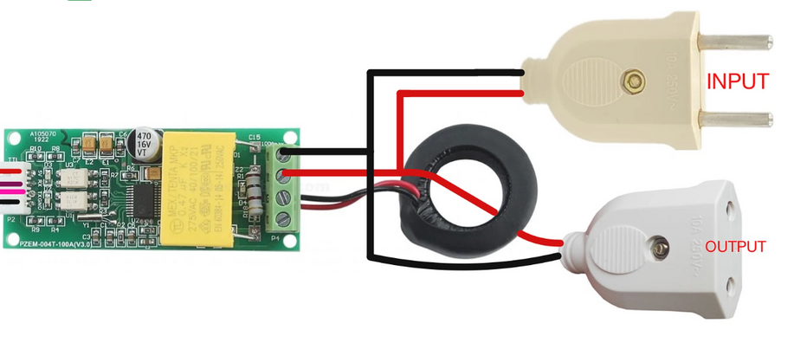
SYNLAB
PAGE 08
AC MONITOR MODULE
AC Power Monitor (PZEM-004T)
Measures AC :
Operates on 220 V mains
Arduino Uno reads data from the PZEM via UART
Data is sent to an ESP32, then transmitted using ESP-NOW.
Allows safe observation of AC electrical behavior without direct exposure.
VOLTAGE
CURRENT
POWER
FREQUENCY
POWER FACTOR
02

Slide 14
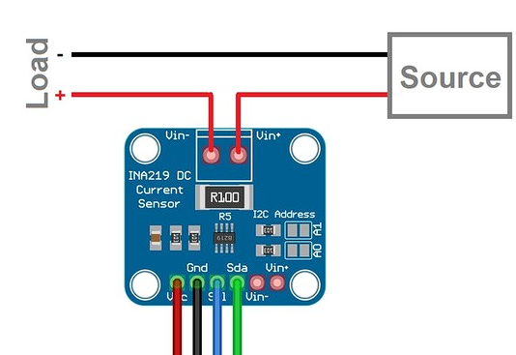
SYNLAB
PAGE 09
Uses an INA219 sensor to measure:
ESP32 directly reads measured values and transmits them wirelessly through ESP-NOW
A second ESP32 receives the data and displays it on the TFT screen
DC MONITOR MODULE
DC voltage
Current
Power
02

Slide 15
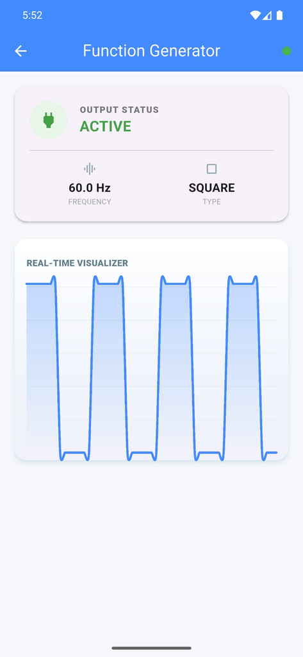
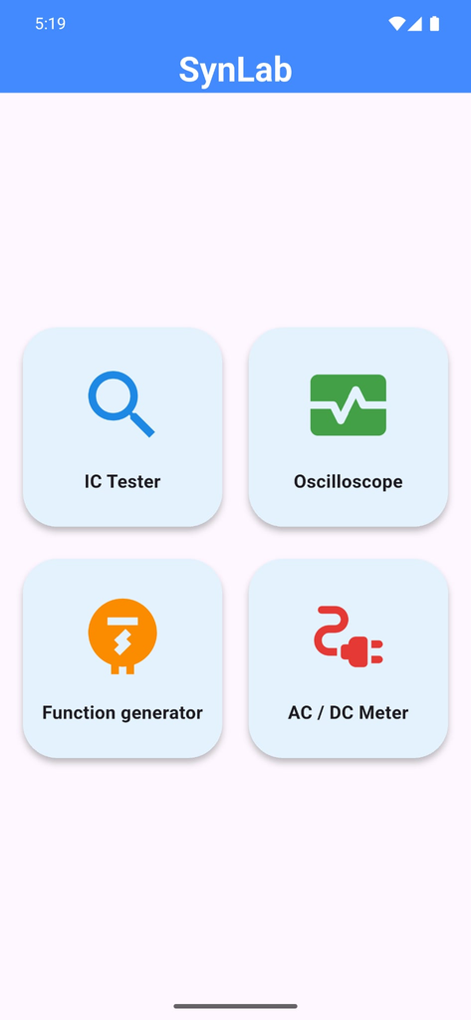
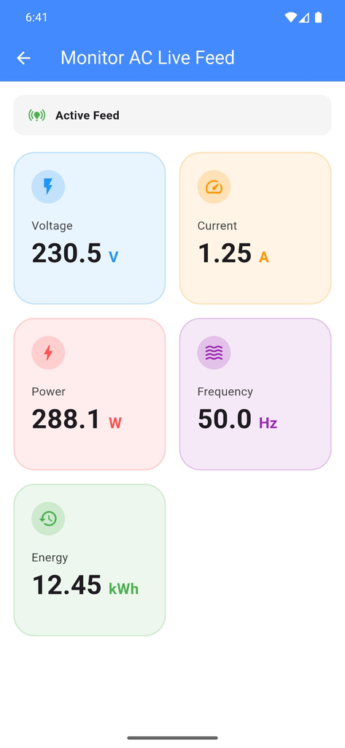
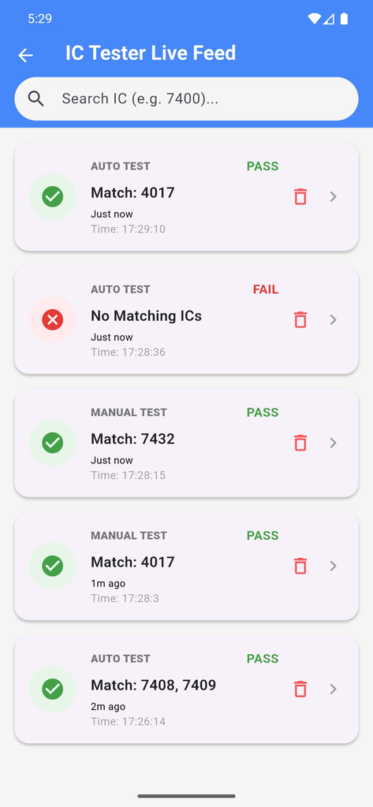
SYNLAB
MOBILE APPLICATION
Built using Flutter
Real-time system monitoring
Module control and data logging
Simple and clean interface

Slide 16
SYNLAB
PAGE 07
DISCUSSION
Compared to traditional labs, SynLab provides better coordination and usability.
SYSTEM PERFORMANCE
EDUCATIONAL IMPACT
ALL MODULES OPERATED INDEPENDENTLY AND COLLECTIVELY WITHOUT CONFLICTS
STABLE IOT COMMUNICATION BETWEEN ESP32 NODES
REAL-TIME DATA VISUALIZATION ACROSS INTERFACES
SMOOTH SYNCHRONIZATION BETWEEN HARDWARE AND SOFTWARE
REDUCED SETUP TIME FOR EXPERIMENTS
EASIER UNDERSTANDING OF RELATIONSHIPS BETWEEN INSTRUMENTS
INCREASED STUDENT ENGAGEMENT THROUGH INTERACTION
SUPPORTS HANDS-ON AND EXPLORATORY LEARNING

Slide 17
PAGE 09
LIMITATIONS
Limited measurement precision due to the use of microcontroller internal ADCs/DACs and low-cost sensors, which do not match commercial lab accuracy.
Breadboard-based hardware may introduce noise, loose connections, and reduced long-term reliability.
ESP32 processing and load constraints when handling real-time sampling, wireless communication, and user interface updates simultaneously.
Dependence on wireless communication (ESP-NOW / MQTT), which may be affected by interference or network congestion.
High-voltage AC measurements require enclosed and controlled operation for safety reasons.

Slide 18
SYNLAB
PAGE 07
FUTURE WORK
Replace breadboards with custom PCBs
Improve signal conditioning and filtering
Increase sampling rates and accuracy
Add more lab instruments
Cloud-based experiment logging

Slide 19
SYNLAB
PAGE 10
THANK YOU FOR YOUR ATTENTION
By: Adel Qadi, Ghassan Qasrawi.
Supervisors: Dr. Raed Qadi, Dr. Manar Qamhieh

