Slide 1

Holy Land Juices
Students:
Israa Odeh
Raghad Sabri
Supervisor: Dr. Raed Qadi

Slide 2

Outline
Introduction
Building Process
Mechanism of Action
Constraints
Live Demo
Questions

Slide 3
Introduction
Manual methods for the beverage industry are time-consuming,
error-prone, and inadequate for meeting demand.
Beverage companies like Coca-Cola/Cappy rely on automation
for efficient, precise production.
The juice production process is aimed to be automated for the
Holy Land Juices project.
This is achieved by utilizing a range of components including
Arduino boards, sensors, motors, and pneumatic pistons.

Slide 4
Building Process
Creating the overall design of the project.
Constructing the project hardware structure.
Implementing the Code.
Testing the project.

Slide 5
Mechanism of Action
Bottle size detection stage
Filling stage
Capping stage
Classification stage

Slide 6
Constraints
Interference problems related to the IR sensors.
Inaccurate Dimensions of 3D-Printed Components.
Designing the Wooden Structure for the Project.
Cost and time Management.

Slide 7
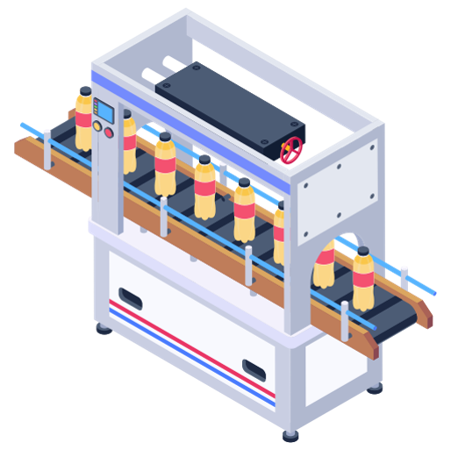
Live Demo …

Slide 8
Does anyone have any questions?

Slide 9
Thank you for listening!

