Slide 1
Rehabilitation of Al-Seka Road
Prepared by :
Faisal Ghanem
Farah Shaheen
Ibraheem Alawneh
Submitted to :
Dr.Khaled Al-Sahili

Slide 2
Introduction
This project is a part of the MP of Jenin municipality.
Al-Seka road will reduce the congestion in city center.
The project enhance traffic movement and safety condition in study area.

Slide 3
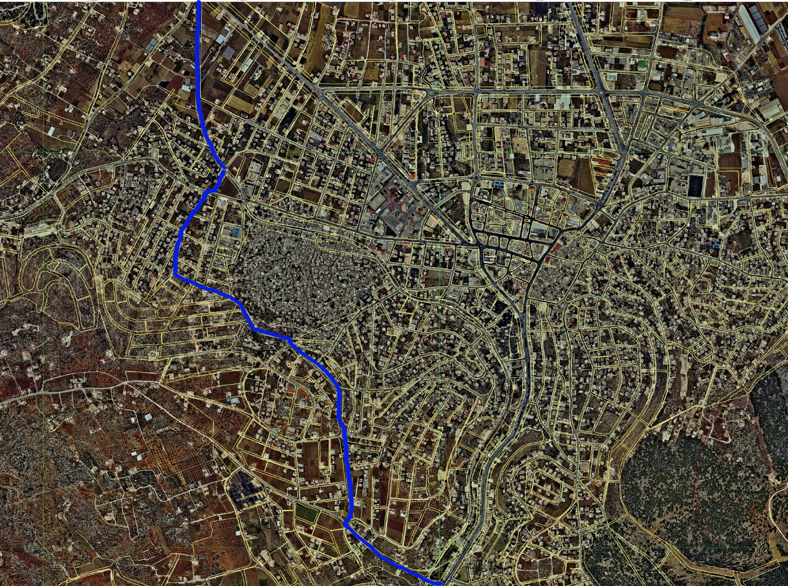
Study Area
Notes:
The highway starting from yousef asfor roundabout, passes through Jenin Camp and end in Haifa street. This street is served residential , industrial, and commercial area.

Slide 4
Importance of The Project
Safety
Serve the Traffic Efficiently
Accessibility
Mobility
Notes:
Many reasons led construct a new highway, with the aim to provide higher speed and more safety.
This road will provide considerable mobility as traffic don’t need to enter the towns and villages.
. The highway is designed to serve the traffic more efficientely, like connection with Arab American University, and will serve the fertile agricultural areas, and the quarries of Qabatya. Finally this new highway is expected to induce and carry increasing commercial and industrial traffic in future.

Slide 5
Objective
After making the necessary studies and determining the design
criteria, based on AASGHTO (2011), and Palestinian standards the following will be done:
1) Geometric Design
-Set three alternative of the route and select the best alignment .
-Design the horizontal alignment
-Design the vertical alignment
-Design the cross section elements
-Intersection design
2) Pavement Design
3) marking an signing
4) Traffic Signals
-

Slide 6
Methodology
Data collection and studies
Traffic studies
Design criteria
Preliminary design
Geometric design

Slide 7
Yousef Asfor
PH=1:15-2:15
PHF=0.94
DHV=2168
PHV=2036
Abu-Hija
PH=1:00-2:00
PHF=0.9
PHV=176
DHV=196
Borqine
PH=7:30-8:30
PHF=0.91
PHV=521
DHV=572

Slide 8
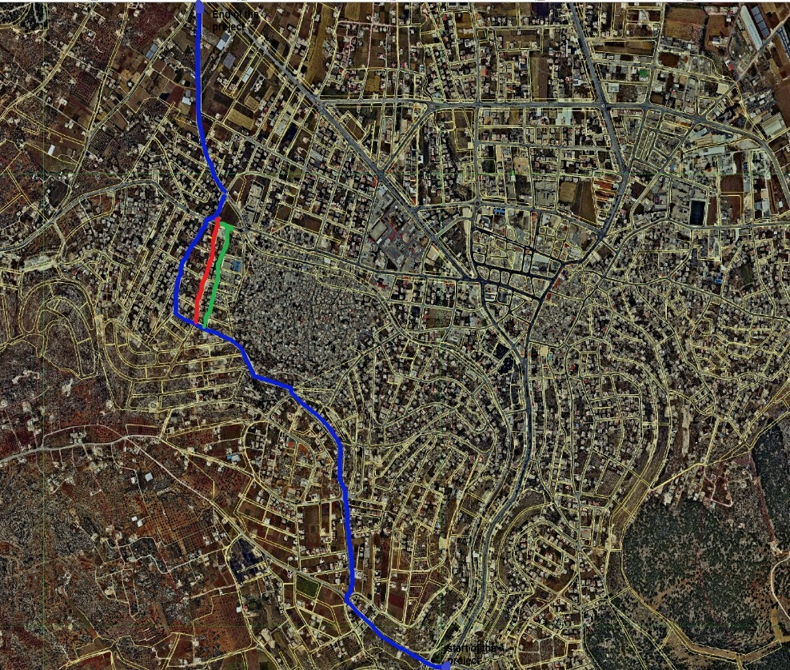
The Best Alignment
We set three alternative and then choose the best one .
Selection Based on :
1- Master plan
2- Ability to extend
the street up to MP
width limit

Slide 9
Design Speed
The highway is divided into 7 zones depending on the
design speed
From station 0+000 to station 2+280 V= 40 Kph
From station 2+280 to station 2+340 V= 20 Kph
From station 2+340 to station 2+720 V= 40 Kph
From station 2+720 to station 2+810 V= 20 Kph
From station 2+810 to station 2+900 V= 40 Kph
From station 2+900 to station 2+940 V= 20Kph
From station 2+940 to station 3+874 V= 40Kph
Notes:
For the Rural Arterial Highway and based on the mountainous terrain the design speed ranges from 70 to 90 km/h

Slide 10
Cross Section Elements
- 2 lanes with 5.1 m width for each
- Sidewalk 1.5m width for each
- Raised median with 3 m width
- Cross slope is 2% for traveled lanes
- Daylight for cut 2:1 and for fill 3:1
Notes:
The cross section elements are designed based on AASHTO recommendation

Slide 11
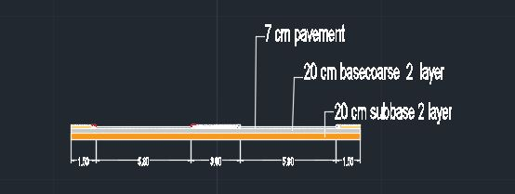
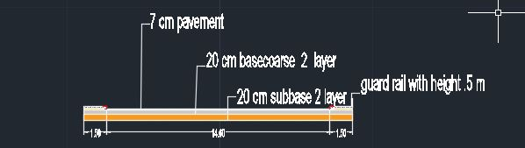
Typical Assemblies That Used in The Highway

Slide 12
Pavement Design
The factors considered in AASHTO procedure for the design of flexible pavement are:
1) Pavement performance
2) Traffic
3) Roadbed Soil (subgrade material)
4) Material of construction
5) Environmental
6) Drainage
7) Reliability

Slide 13
The Traffic Counts, ESAL factors, and Design EASL
 | TRUCK | BUS | PASSENGER
%DHV | 0.12 | 0.1 | 0.78
DHV | 87 | 87 | 87
K | 0.1 | 0.1 | 0.1
AADT | 870 | 870 | 870
LD | 0.5 | 0.5 | 0.5
GRN | 29.7 | 29.7 | 29.7
TF | 0.73 | 0.21 | 0.0004
ESAL | 0.413*10⁶ | 0.099*10⁶ | 0.001*10⁶
ESAL TOTAL | 0.514*10⁶

Slide 14
Reliability | S₀ | ΔPSI | Total ESAL
95% | 0.45 | 2 | 5.14 * 10^5

Slide 15
Calculation and results
Layer | CBR | Mr | ai | mi | SN | D(cm)
Asphalt | - | 45000 | 0.45 | - | 2 | 8
Basecourse | 80 | 24800 | 0.14 | 1 | 2.4 | 30
Subbase | 40 | 14000 | 0.13 | 1 | 4.3 | 40
Subgrade | 2.2 | 3300 | - | - | - | -

Slide 16
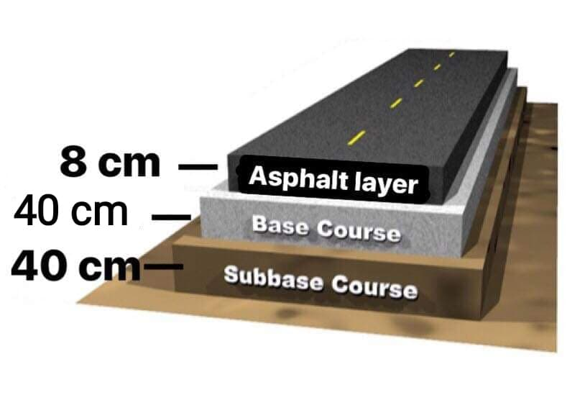
Recommended Layers Depth

Slide 17
Intersection Design
The main factors that affected the design of intersection are :
- Angle of the turn (90, 45)
-Turning speed ( > 20 Km/h)
-Design vehicle (WB-15)
-Traffic volume ( 87 Veh/h)
Notes:
-

Slide 18
Design of Jabreat Roundabout
The criteria that used in design of Jabreat Roundabout are :
Speed at intersection = 20 Kph.
Radius = 18m

Slide 19
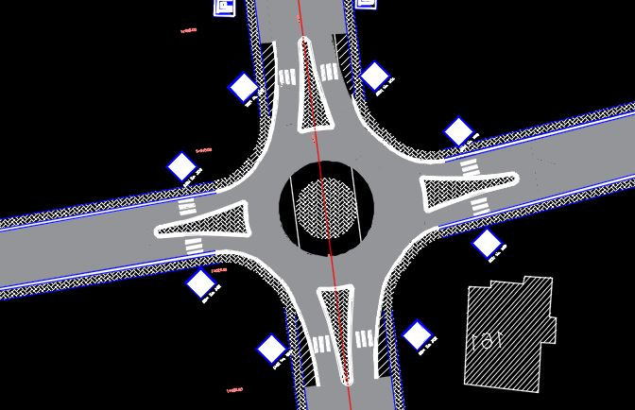
Jabreat Roundabout

Slide 20
Design of Abu Al-Hija Intersection
The criteria that used in design of Abu Al-Hija intersection are:
Speed at intersection = 20 Kph .
Radius = 18m but for constructed building it reduce to 10 m.

Slide 21
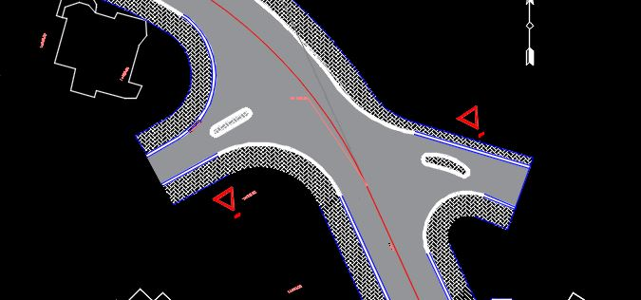
Abu Al-Hija intersection

Slide 22
Design of Borqine intersection
The criteria that used in design of Borqine intersection are
Speed at intersection = 20 Kph .
Radius = 18m

Slide 23
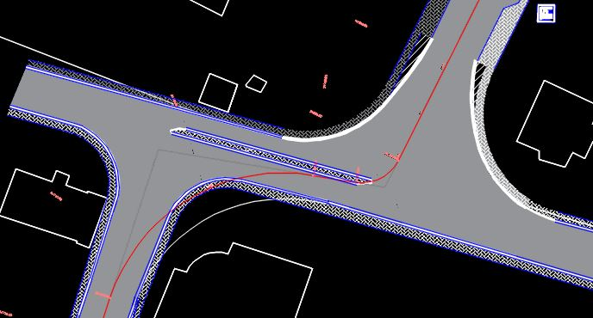
Borqine Intersection

Slide 24
Yousef Asfor Intersection
we suggest changing the roundabout to a signalized intersection based on geometry of the intersection.
This intersection is satisfied the peak hour warrant.
Traffic signals will reduce the conflict points.

Slide 25
Bill of Quantities
Name | Unit | Length | Width | Area | Addition Amount | Number | Price | Total Price
Pavement | m² | 3,110 | 12 | 36,076 | 4,930 | 1 | 36 | 1,476,216
Pavement | m² | 750 | 15 | 10,950 | 6,205 | 1 | 36 | 617,580
Sidewalk Bricks | m² | 3,860 | 2 | 5,790 | 1,275 | 2 | 70 | 989,100
Median Bricks | m² | 750 | 3 | 2,250 | 0 | 1 | 70 | 157,500
Median Curb | m | 750 | 0 | 0 | 0 | 2 | 50 | 75,000
Basecourse | m² | 3,860 | 18 | 67,936 | 7,480 | 2 | 18 | 2,714,976
Subbase | m² | 3,860 | 18 | 67,936 | 7,480 | 2 | 15 | 2,262,480
Marking | m | 3,110 | 0 | 0 | 425 | 3 | 18 | 190,890
Marking | m | 750 | 0 | 0 | 425 | 4 | 18 | 84,600
Guard Rail | m | 600 | 0 | 0 | 0 | 1 | 300 | 180,000
Cat Eyes | unit | 3,110 | 0 | 0 | 71 | 518 | 25 | 14,729
Cat Eyes | unit | 750 | 0 | 0 | 0 | 125 | 25 | 3,125
Traffic Signal | unit | 0 | 0 | 0 | 0 | 1 | 80,000 | 80,000
Sidewalk Curb | m | 3,860 | 0 | 0 | 1,175 | 2 | 50 | 503,500
Traffic Sign | unit | 0 | 0 | 0 | 0 | 50 | 450 | 22,500
Cut | m³ | 0 | 0 | 0 | 0 | 171,790 | 15 | 2,576,848
Fill | m³ | 0 | 0 | 0 | 0 | 20,280 | 15 | 304,200
Total cost (NIS) 12,253,244

Slide 26
Conclusion
The construction of the Al-Seka road will help in reducing the congestion in the CBD area of Jenin.
Hard topography and narrow width of right of way will cause difficulty to meet all the design requirements for the highway.
It is necessary to put guard rails at edges of some segments of the road due to high side slopes.

Slide 27
Recommendations
We hope to start the new design as soon as possible to enhance the transportation system in the study area.

Slide 28


