Slide 1

An- Najah National University
Faculty of Engineering
Electrical Engineering Department
Graduating project 2
The Technical and economic impact of solar system (500kw) on Network (Anabta as a case study )
Supervisor:
Dr. Imad Break
Prepared By:
Tahseen Salameh
Mohammad Nassar

Slide 2
Outlines
Introduction.
Data about Anabta network.
Technical impact .
Economical impact .
Conclusion.

Slide 3
Introduction
Our project is to make a load flow study and analysis for Anabta Electrical Network using ETAP software to explain the technical and economical impacts for network after we put the solar system on the network which we designed it in the graduation project (1) to solve shortage of supply problem .

Slide 4
Data about Anabta network
Anabta electrical network is provided by North Electricity Distribution Company (NEDCO ) at 33 KV.
One Connection points with maximum demand 3.5 MW .
Overhead cable used ACSR (95mm2 &50 mm2)
The network has:
- 53 BUS
- 18 Distribution transformer
- 18 loads (residential, industrial, commercial).

Slide 5
Technical Impact Results
Original network ( study 1)
In these part of project we will make a load flow analysis for the network in the reality. We consider the electrical supplie as swing generator.

Slide 6
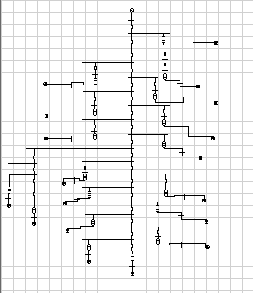
Technical Impact Results
Original network (study 1 )

Slide 7
Technical Impact Results
The network after putting capasitors (study 2)
In these part of project we will make a load flow analysis after putting capasitors on the network, the value of the capasitors 300 kvar , 500kvar and 500kvar .

Slide 8
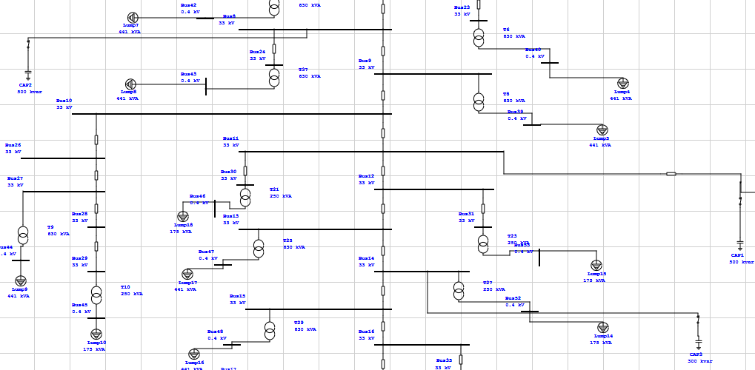
Load flow analysis and Results
The network after putting capasitors (study 2)

Slide 9
Technical impact Results
Buses Voltage
Bus number | Nominal voltage(KV) | Actual voltage Orginal networks (KV) | ( Actual voltage After putting capasitors (KV)
Bus 37 | 0.4 | 0.392 | 0.394
Bus 38 | 0.4 | 0.390 | 0.399
Bus 40 | 0.4 | 0.391 | 0.396
Bus 41 | 0.4 | 0.395 | 0.399
Bus 42 | 0.4 | 0.392 | 0.397
Bus 43 | 0.4 | 0.390 | 0.382
Bus 39 | 0.4 | 0.391 | 0.397
Bus 19 | 33 | 33 | 33
Bus 20 | 33 | 32.983 | 32.983
Bus 22 | 33 | 32.934 | 32.934
Bus 23 | 33 | 32.953 | 32.953
Bus 24 | 33 | 32.932 | 32.932
Bus 9 | 33 | 32.9 | 32.9

Slide 10
Techincal Impact Results
Summary
The network after capasitors |  |  |  | Orginal networks |  |  |  | Loads in seasons
losses | Apparent losses (MW) | P.F | Total demand (MW) | losses | Apparent losses (MW) | P.F | Total demand (MW)
0.005107 | 0.028 | 93.4% | 5.482 | 0.00619 | 0.013 | 85.04% | 5.487 | Max s day
0.00465 | 0.023 | 94.15% | 4.923 | 0.00202 | 0.010 | 85.04% | 4.927 | Max s night
0.004317 | 0.018 | 95.10% | 4.387 | 0.0018 | 0.008 | 85.04% | 4.377 | Min s day
0.00466 | 0.023 | 94.15% | 4.923 | 0.00202 | 0.010 | 85.04% | 4.927 | Max w day
0.00510 | 0.028 | 93.34% | 5.482 | 0.002375 | 0.013 | 85.04% | 5.473 | Max w night
0.00304 | 0.010 | 97.54% | 3.285 | 0.00152 | 0.005 | 85.04% | 3.282 | Min w day
0.00255 | 0.007 | 98.84% | 2.737 | 0.00152 | 0.005 | 85.04% | 3.282 | Min w night
0.00255 | 0.007 | 98.84% | 2.737 | 0.001096 | 0.008 | 85.04% | 2.735 | Spring

Slide 11
NOTES
It is noticeable after putting capacitors on the network to improve the Power factor . The Power Factor has gained more than 92 % and the losses increase .

Slide 12
Technical Impact Results
In these part of project we will make a load flow analysis after putting capacitors on the network, the value of the capacitors 300 kvar , 500kvar and 500kvar , And putting the PV system .
The network after putting capacitor's and putting solar system (study 3)

Slide 13
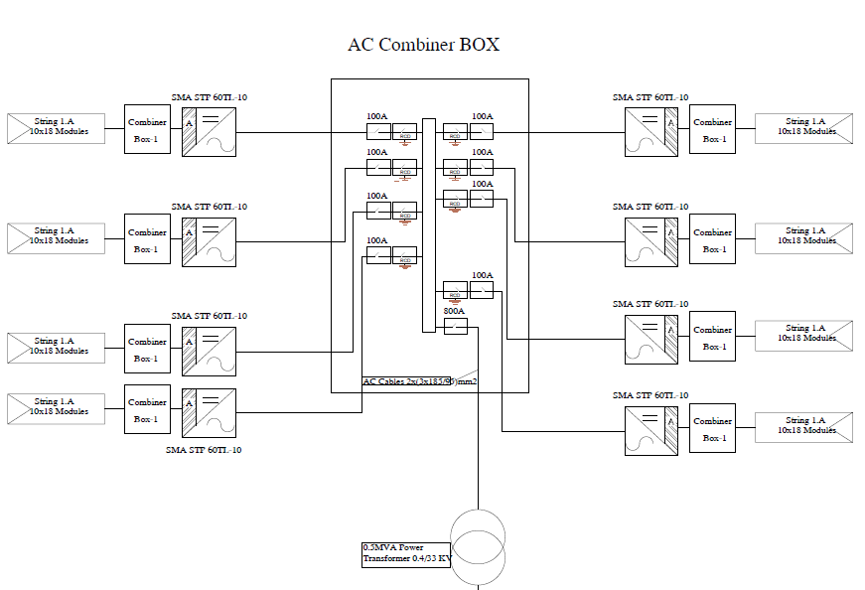
Technical Impact Results

Slide 14
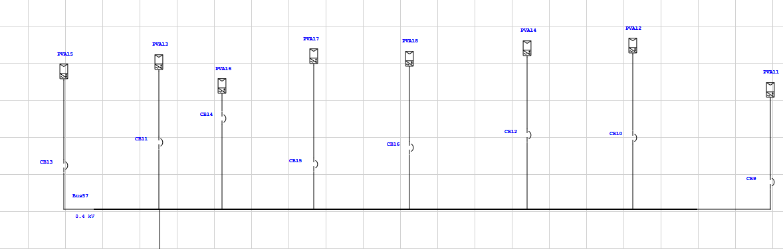
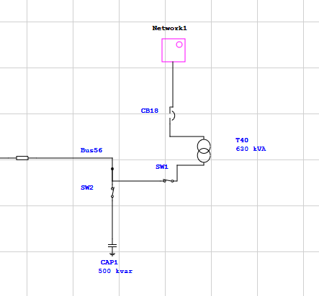
Technical Impact Results

Slide 15
Technical Impact Results
Summery
The network after capasitors and after the solar system |  |  |  | Orginal networks |  |  |  | Loads in seasons
losses | Apparent losses (MW) | P.F | Total demand (MW) | losses | Apparent losses (MW) | P.F | Total demand (MW)
0.004562 | 0.025 | 92.55% | 5.480 | 0.00619 | 0.013 | 85.04% | 5.487 | Max s day
0.00465 | 0.023 | 94.15% | 4.923 | 0.00202 | 0.010 | 85.04% | 4.927 | Max s night
0.00365 | 0.016 | 94.64% | 4.381 | 0.0018 | 0.008 | 85.04% | 4.377 | Min s day
0.00425 | 0.021 | 93.87% | 4.931 | 0.00202 | 0.010 | 85.04% | 4.927 | Max w day
0.00510 | 0.028 | 93.34% | 5.482 | 0.002375 | 0.013 | 85.04% | 5.473 | Max w night
0.00304 | 0.010 | 97.54% | 3.285 | 0.00152 | 0.005 | 85.04% | 3.282 | Min w day
0.00255 | 0.007 | 98.84% | 2.737 | 0.00152 | 0.005 | 85.04% | 3.282 | Min w night
0.00219 | 0.006 | 98.93% | 2.737 | 0.001096 | 0.008 | 85.04% | 2.735 | Spring

Slide 16
Notes
It is noted that after the development of the solar system, the Power Factor in all cases in the day are reduced and also reduced losses compared to the situation that was before the system.

Slide 17
Economical Impact Results
The economic analysis that is used is based on the use of the life cycle cost and the cost annuity (NIS/kWh) as in off-grid system except in grid tie system there is no need for batteries and charge controller in the initial cost. The life cycle cost of grid tie system equal to the initial cost of PV system plus present worth of maintenance and operation minus present worth of salvage value.

Slide 18
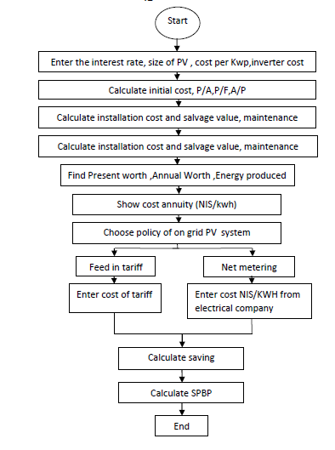
Economical Impact Results

Slide 19
Economical Impact Results
Step 1: Fixed Cost=PV array cost + inverter cost
In this project we use the:
1- Pv array cost = we have 1440 module, for 1 module 120 $
PV cost = 1440 *120 = 172,800 $
2- Inverter cost = we have 8 inverter, for 1 inverter 5362 $
Inverter cost = 8 *5362 = 42,896 $
Fixed Cost= 172,800 + 42, 896 = 215,696 $

Slide 20
Economical Impact Result
Step 2: The initial cost of Grid tie PV system =fixed cost + installation cost
Installation cost is approximately 0.1 of the Fixed cost for on grid
PV systems.
The initial cost of Grid tie PV system = 215,696 + ( 0.1 * 215,696 ) = 237265.6 $
Step 3: E is the total yearly kWh produced from the grid tie PV
E = output power of PV system × PSH x365(day).
E= 500 kw * 5.5 * 0.175 * 365 = 1003750 kwh

Slide 21
Economical Impact Result
Step 4 : The life cycle cost of grid tie system
The life cycle cost of grid tie system= fixed cost + installation cost + Operation and maintenance * (P / A, i,n) – salvage value *(P / F, i ,n).
The interest rate is about 10%.
The lifecycle of the system components will be considered as 20 years for PV, Inverter.
Operation and maintenance = 0.02 *237265.6 = 4745.312 $
salvage value = 0.15 * 237265.6 = 35589.84 $
(P / A, 10%, 20)= 8.51
(P / F, 10%, 20) = 0.148
LCC= 237265.6 + 4745.312 *8.51 - 35589.84 * 0.148 = 272380.9 $

Slide 22
Economical Impact Result
Step 5 : Annual worth AW
AW = PW (A / P, i , n)
(A / P, 10% , 20)= 0.11
AW= 272380.9* 0.11 = 29961.8$
Step 6 : The unit cost of energy
Unit cost= Aw/ E is the total yearly kWh
Unit cost = 29961.89 / 1003750= 0.1155 $/Kwh
Step 7 : Annual saving money
Annual saving money = Energy generated from PV system*Cost of energy
Annual saving money = 1003750 * 0.32 = 321200NIS

Slide 23
Economical Impact Result
Step 7: simple payback period
S.P.B.P = investment / saving
Investment = fixed cost + installation cost + Operation and maintenance * (P / A, i,n) = 277648.2 $
S.P.B.P = 277648.2 /(321200/3.6) = 3 years and 6 months

Slide 24
Conclusion
In our project we draw the one line diagram for Anabta network and analysis it by using ETAP16.0.0 the software program show us problems of these network , like the high losses and the decrease of PF of swing bus which case high penalties and this is because of problems in cables and lines, or from the old transformers that leads to reduced efficiency, and the over load problem , In this project we studied the technical and economic impact of the solar system on electrical networks using the ETAP program where we took the town of Anabta as a case study .

