Slide 1


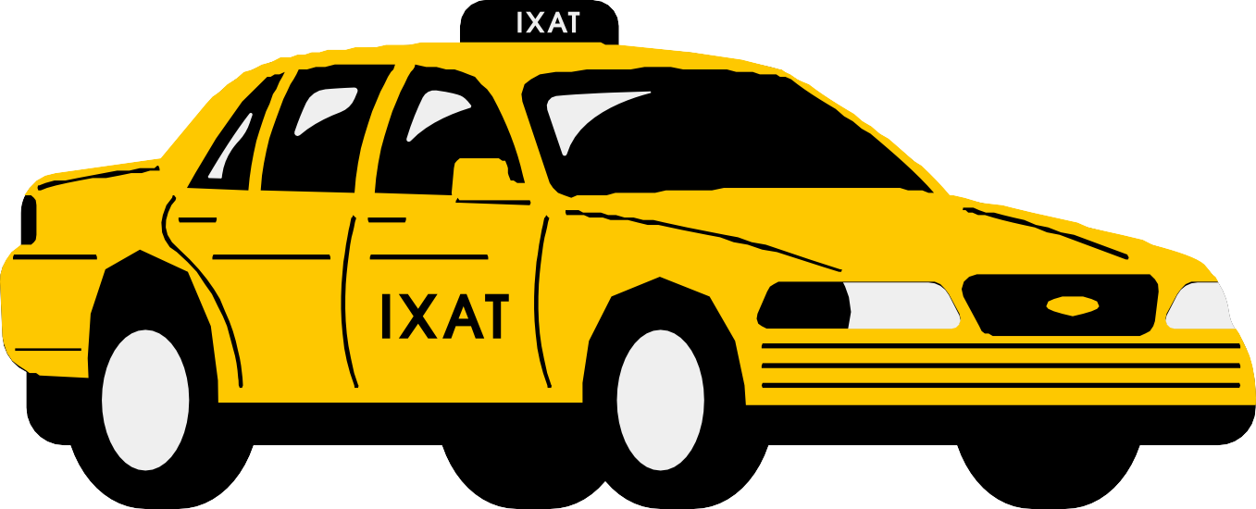
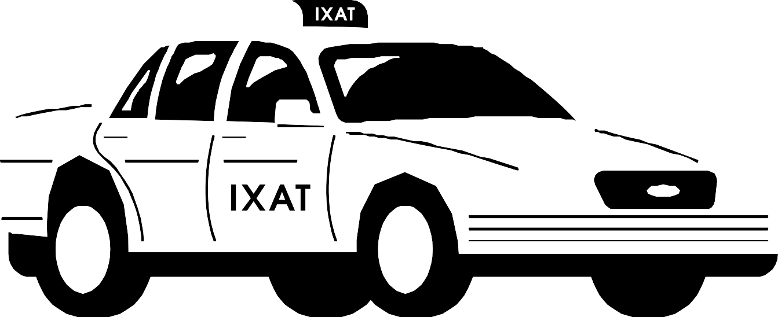
WASSILNI
B Y A D A M A B D A L H A F I Z
&
A M R O S O U S

Slide 2



CONTENTS
01
Introduction
02
Objectives
03
Tools
04 Features
05
Future Work

Slide 3

INTRODUCTION
Wassilni is a modern public transportation booking system designed to improve urban mobility.
01
This application seeks to address key
challenges in public transportation, providing solutions that benefit both drivers and riders alike.
02

Slide 4


PROBLEMS
Challenges in Public Transportation
L a c k o f a D e d i c a t e d P u b l i c T r a n s p o r t B o o k i n g A p p
A
U n p r e d i c t a b l e W a i t i n g T i m e s
No real-time updates on bus availability.
B
L a c k o f R i d e r F e e d b a c k & R a t i n g s
No structured system for driver performance evaluation.
C
Riders must go to the garage to book a bus
even if the bus route passes near his location
D

Slide 5

OBJECTIVES
01
Live Tracking & Travel Optimization
02
Real-Time Car Availability & Booking
03
Live Tracking & Travel Optimization
04
Fair Queue & No-Show Updates

Slide 6


TOOLS
Reactjs &
MongoDB
Express
NodeJS
Python
Native

Slide 7
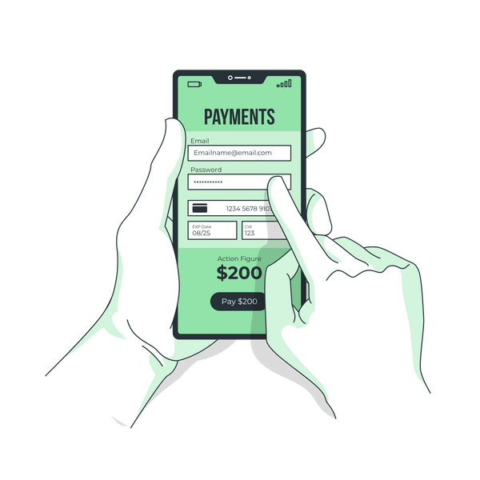
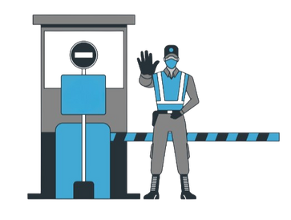

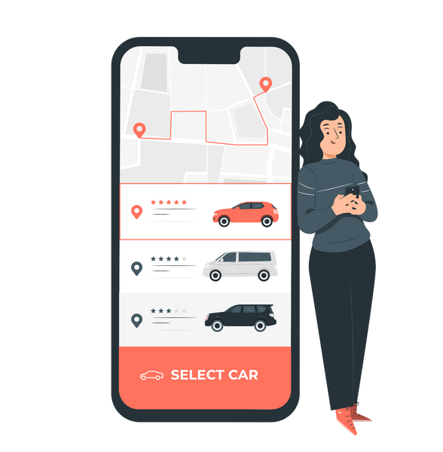
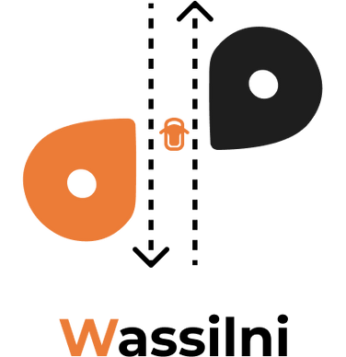

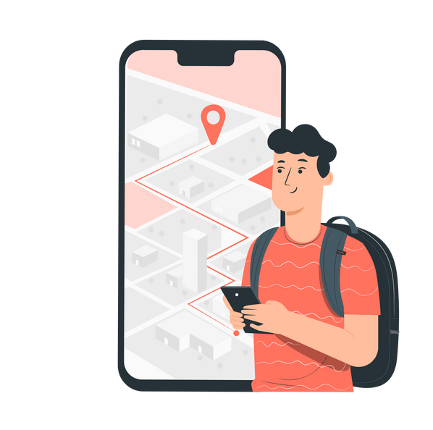
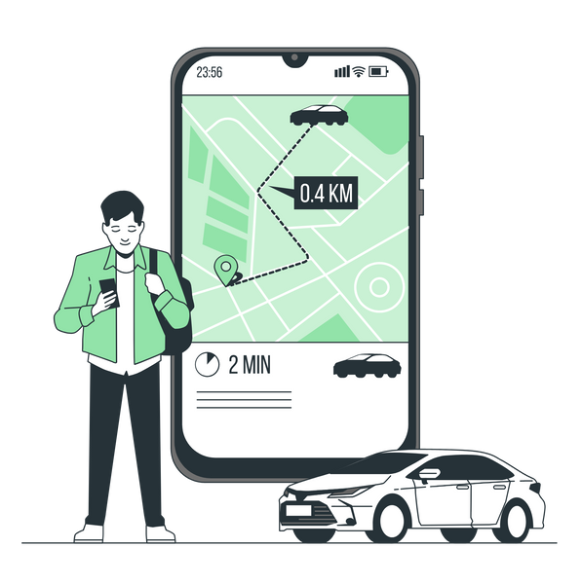
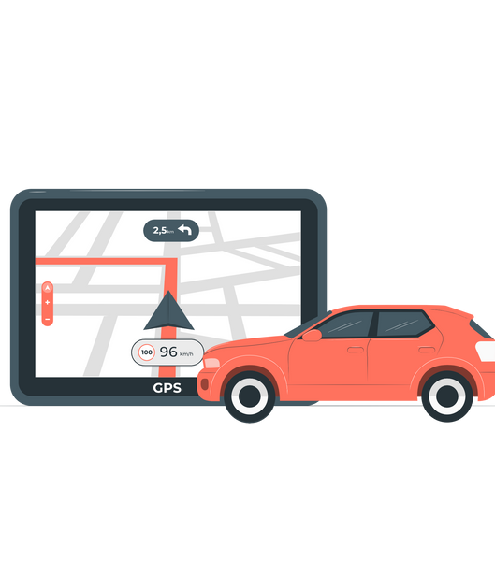
FEATURES
Payment
CheckPoints
Notification
Booking
Chat
Plans
Routes
Track

Slide 8


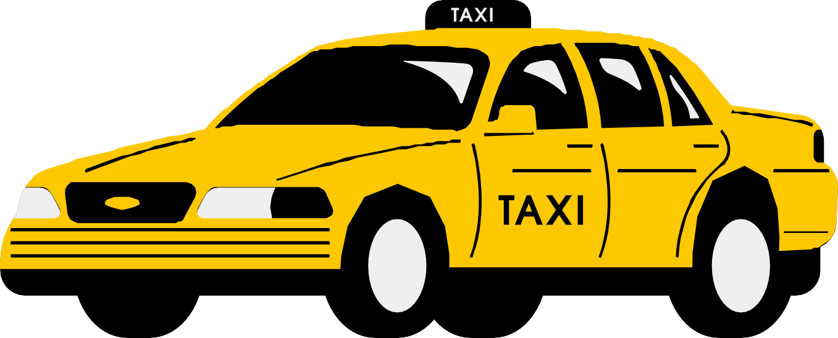

FUTURE WORK
01
Improved Checkpoint Updates:
02
Predictive Analytics:

Slide 9
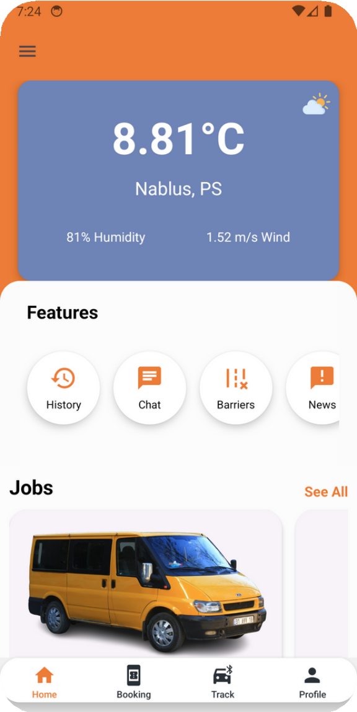
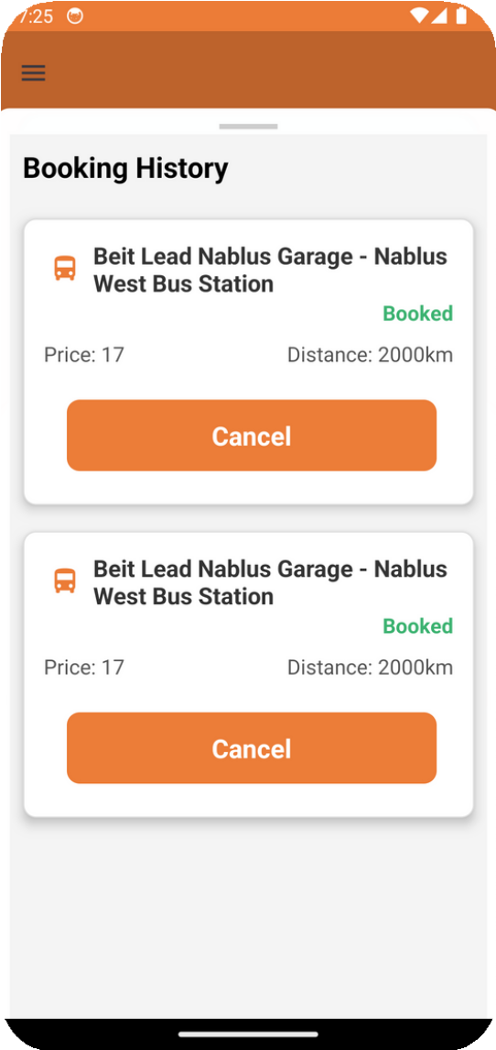
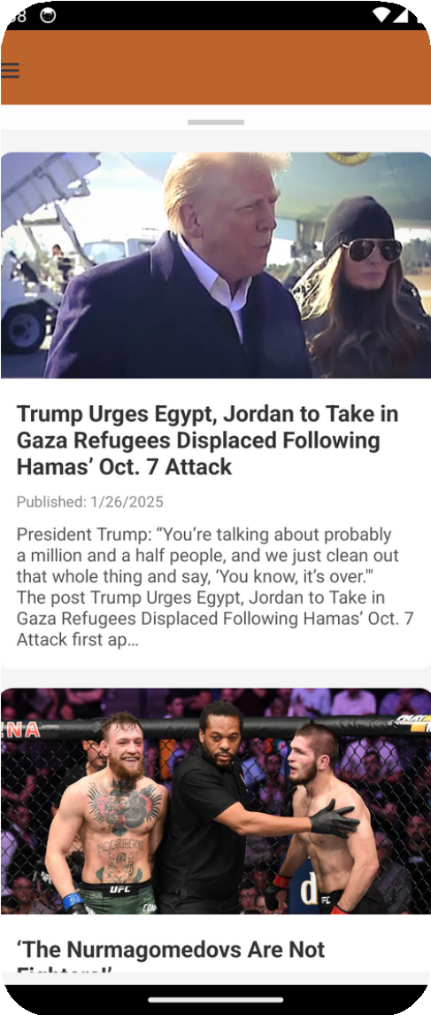
HOME RIDER
Home Screen
Booking History
News

Slide 10
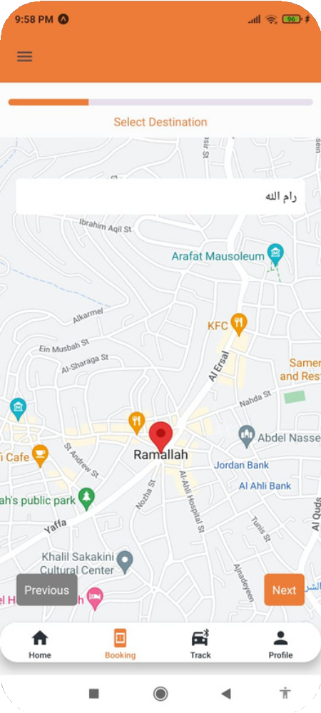
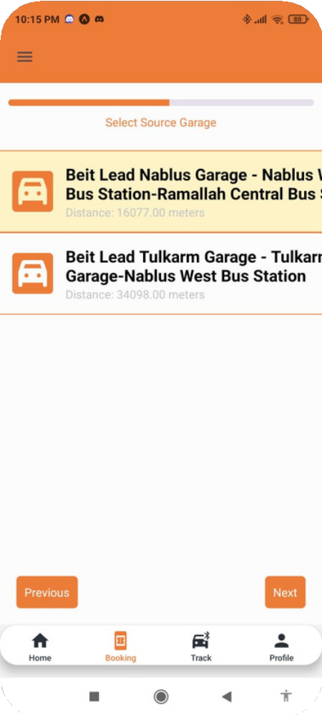
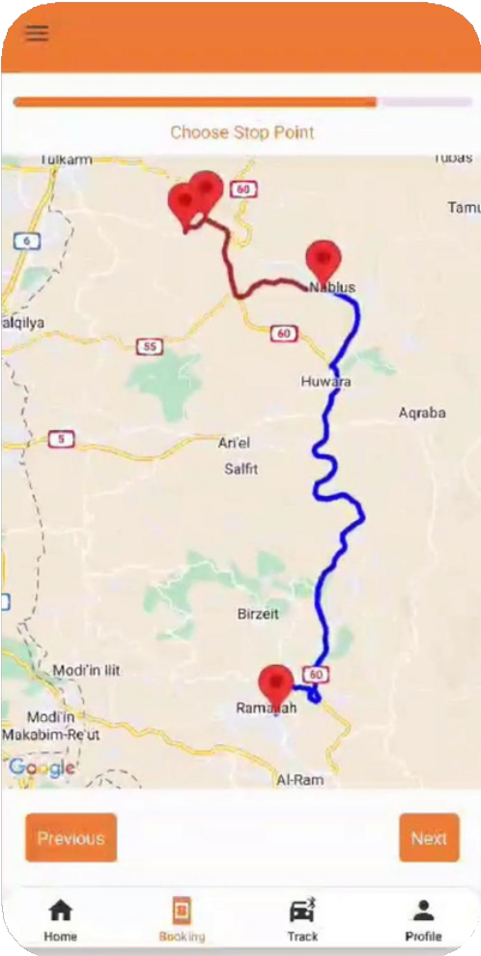
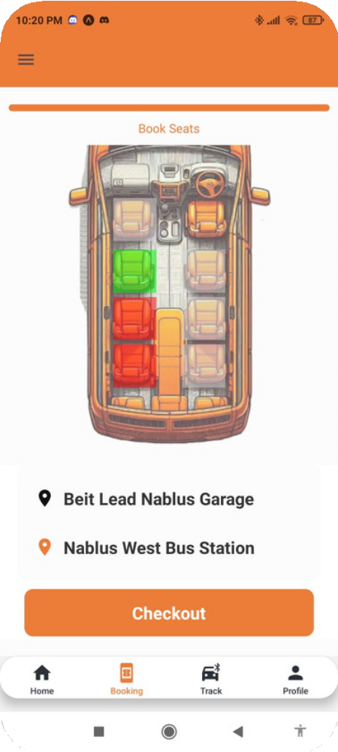
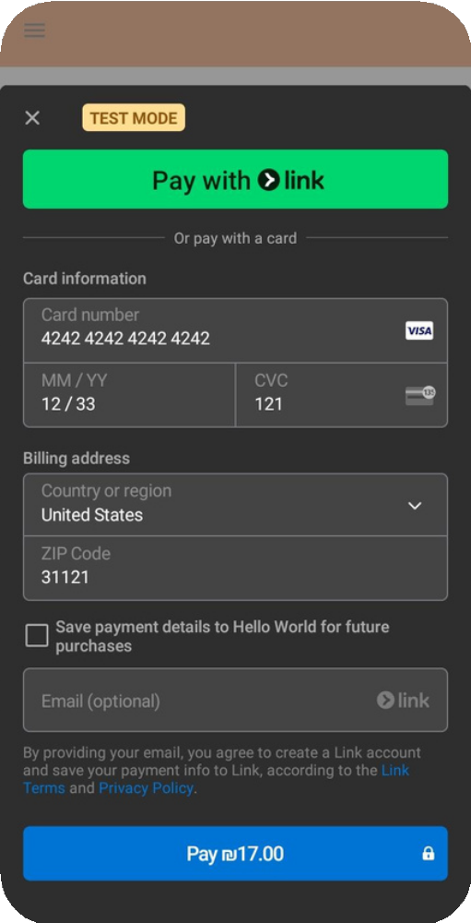
BOOKING PROCESS
01
02
03
04
05

Slide 11
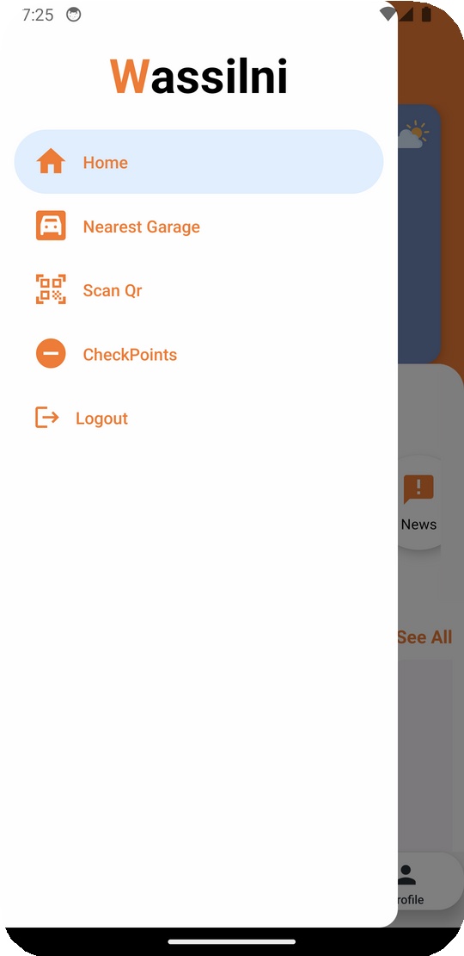
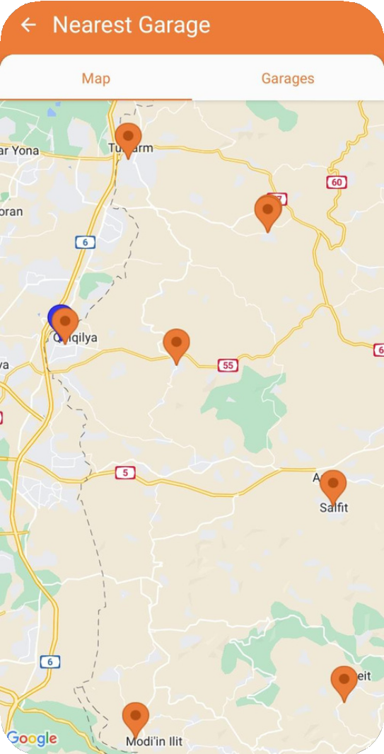
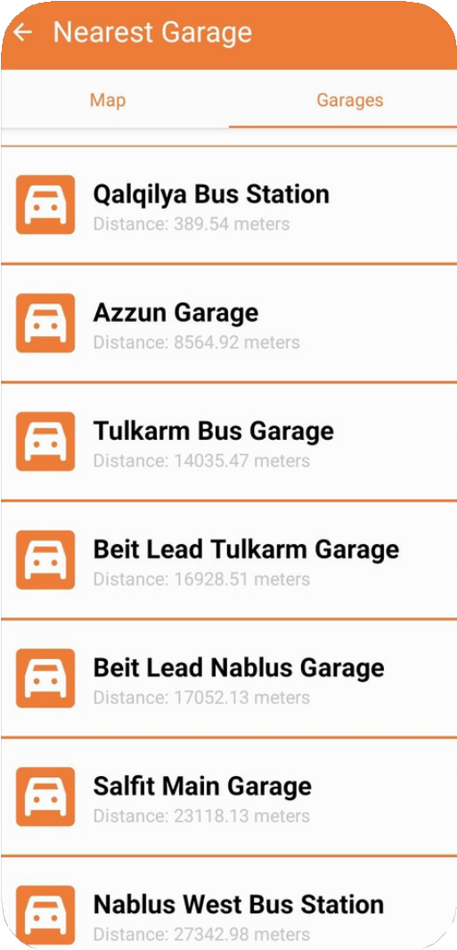
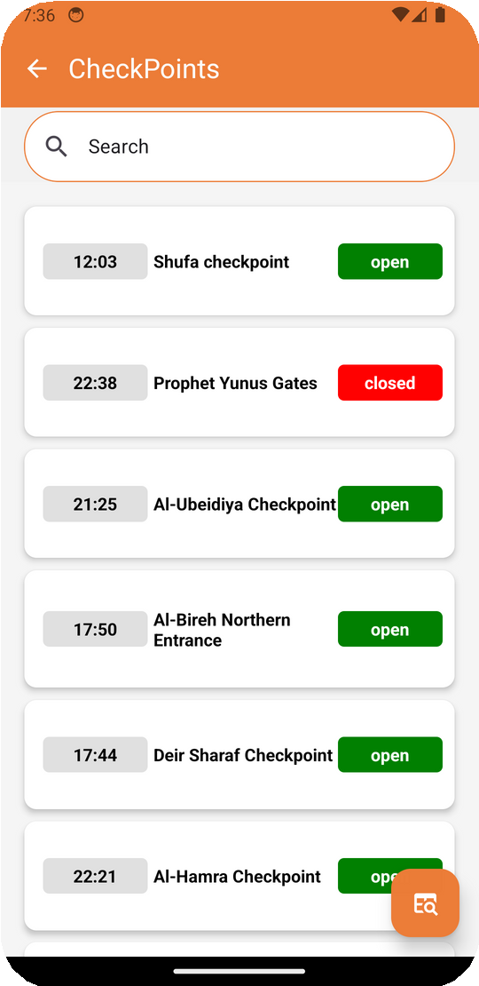
DRAWER CONTENT
Drawer
Nearest Garages Map Nearest Garages List
Checkpoints List

Slide 12
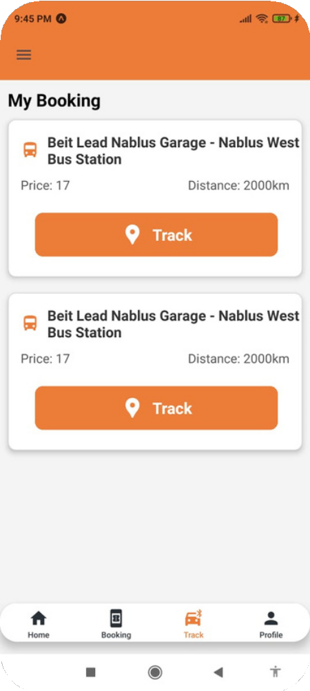
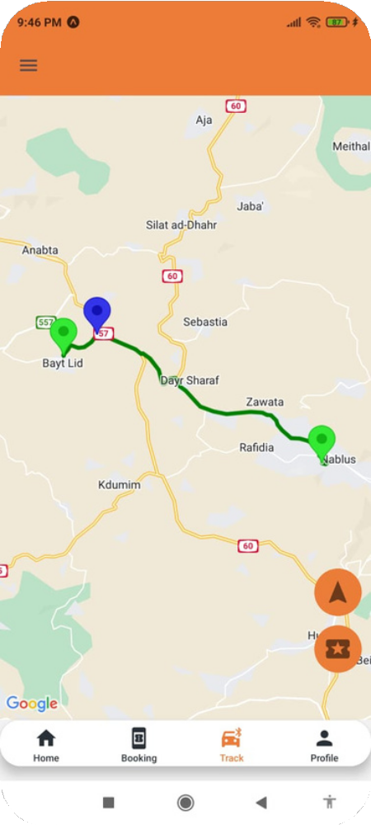
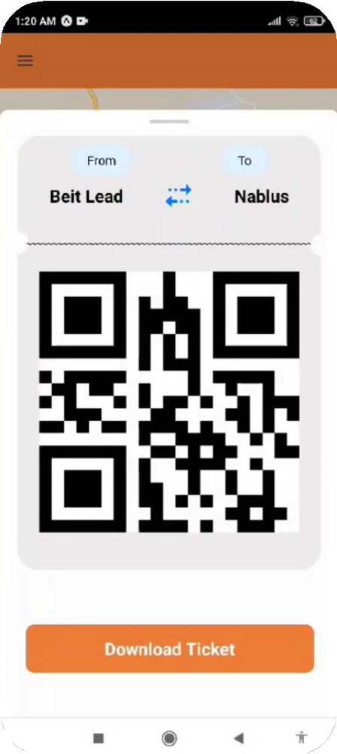
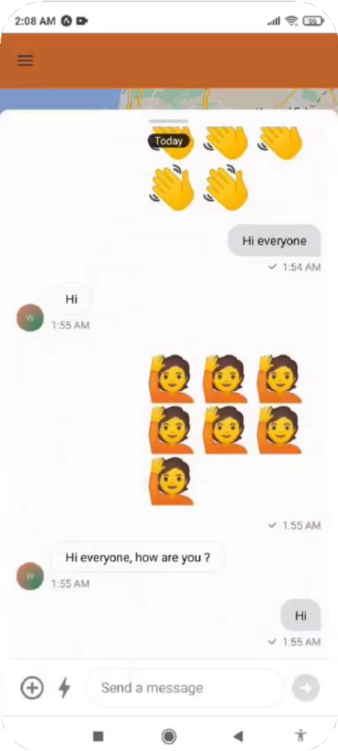
TRACK PROCESS
Tracking List
Tracking Map
Ticket
Chat travel

Slide 13
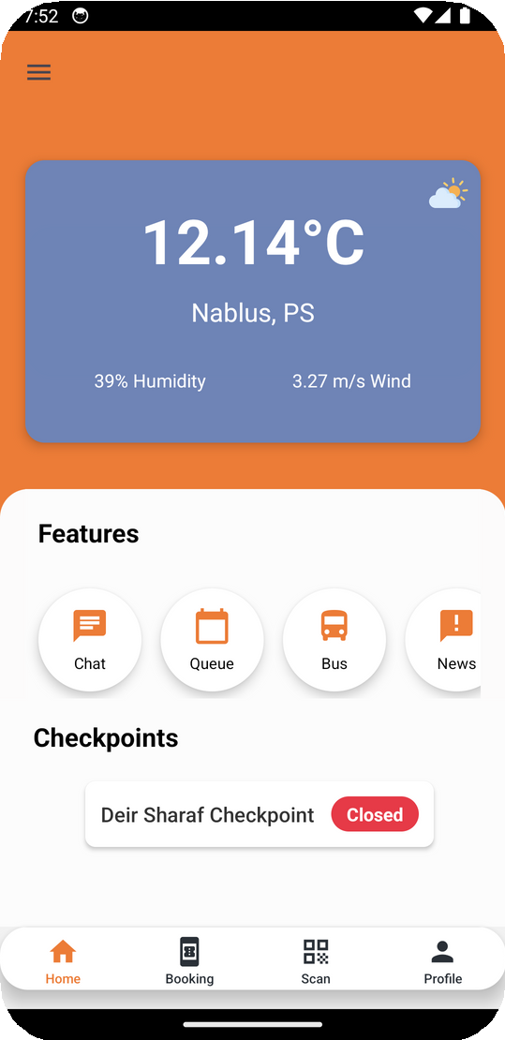
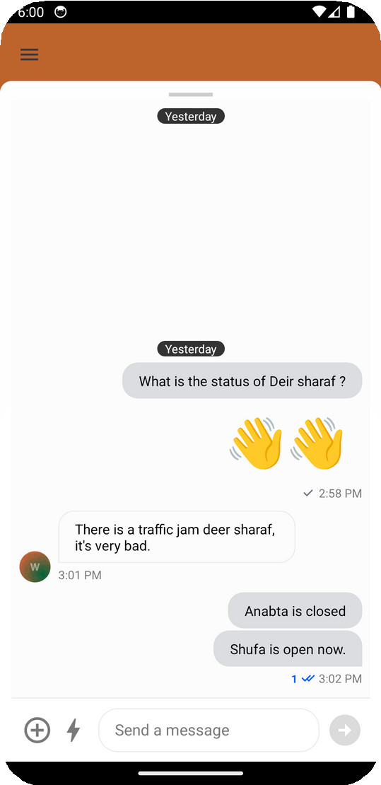
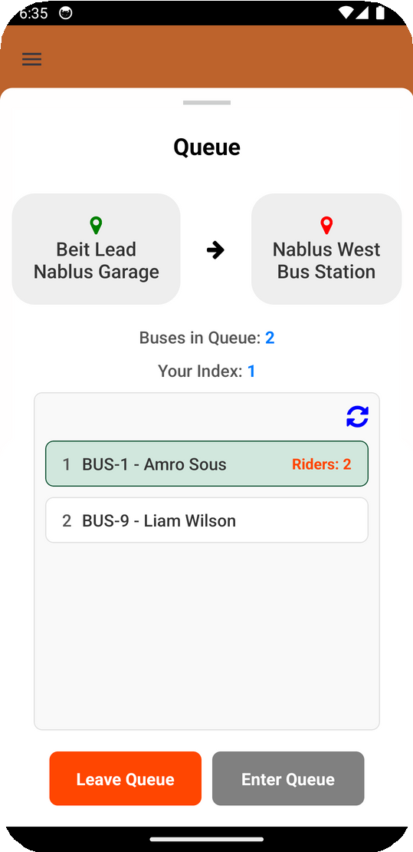
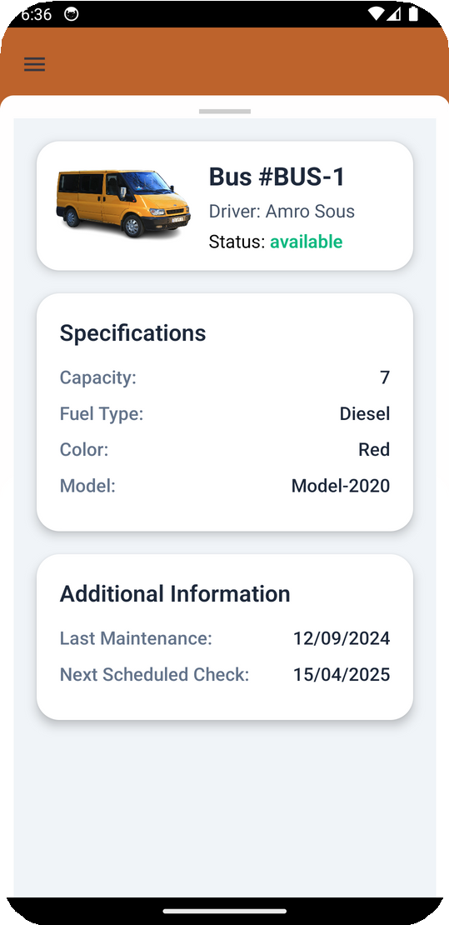
HOME DRIVER
Driver Home
Chat Driver Route
Queue Drivers Garage
Bus info

Slide 14
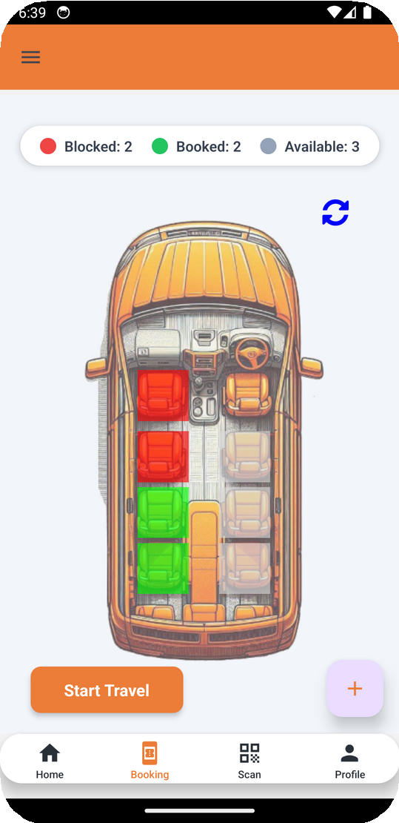
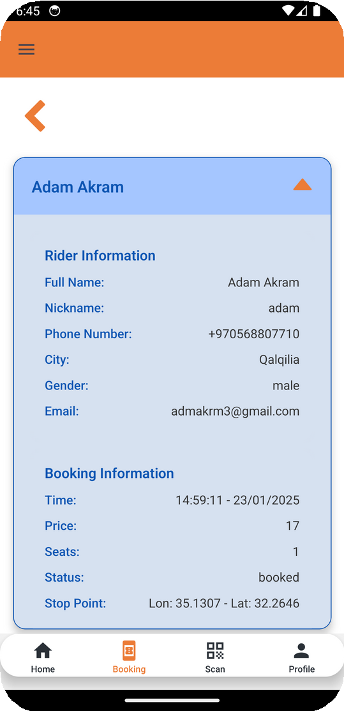
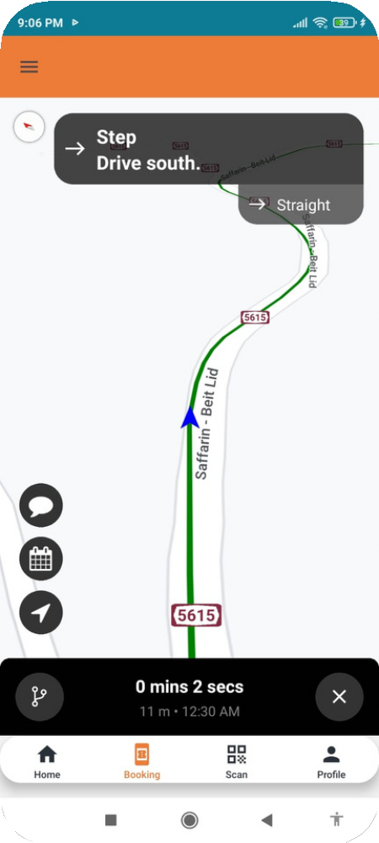
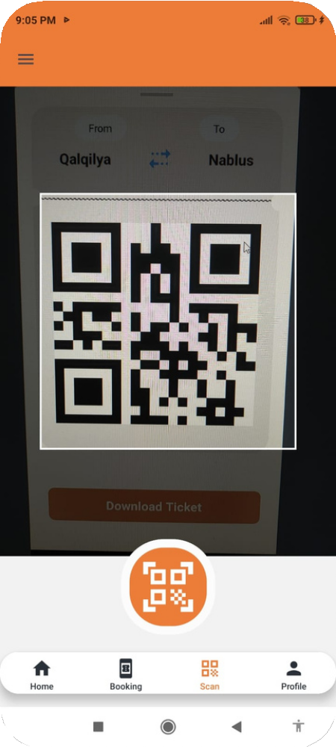
TRAVEL PROCESS
Booking Status
Riders Booked
Live Map Track
Scan QR

Slide 15

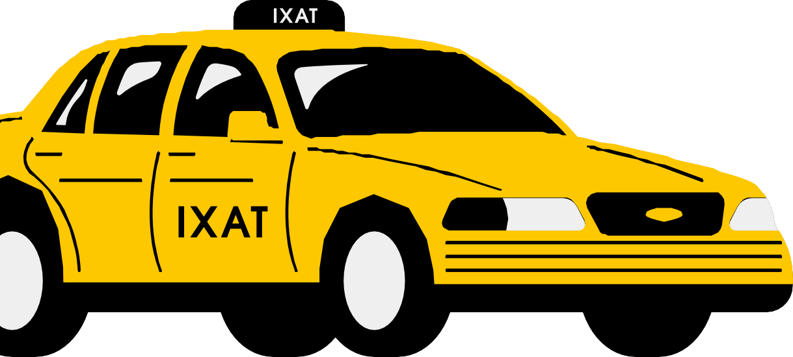
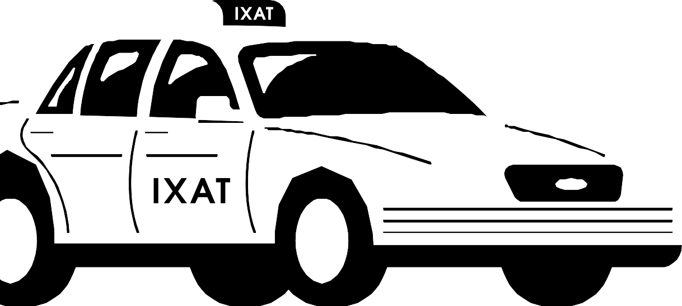
THANK YOU

