Slide 1

An-Najah National University
Engineering Faculty
Civil Engineering Department
Graduation Project II Presentation
Kinetic Analysis and Design for High Strength Municipal Wastewater
Prepared By: Ahmad Bitar
Ahmad Domaidi
Osama Khader
Under the Supervision of:
Abdel Fattah Hasan, Ph.D.
23/5/2012

Slide 2
Part A

Slide 3
Outline
Objectives
Background
Methodology
Experiment Setup
Running the Experiment
Experiment Results
Data Analysis and Design

Slide 4
Objectives
Ultimate Goal:
A healthy environment for people and ecology.
The main objectives for this project are:
To determine the BOD, COD and SS contents of Nablus’ WW.
To determine the Kinetic Parameters of high strength Municipal WW (here for Nablus–West).
To optimize the Aeration Tank of Nablus-West WWTP.
To determine the effect of industrial WW on the strength and quality of the influent WW.

Slide 5
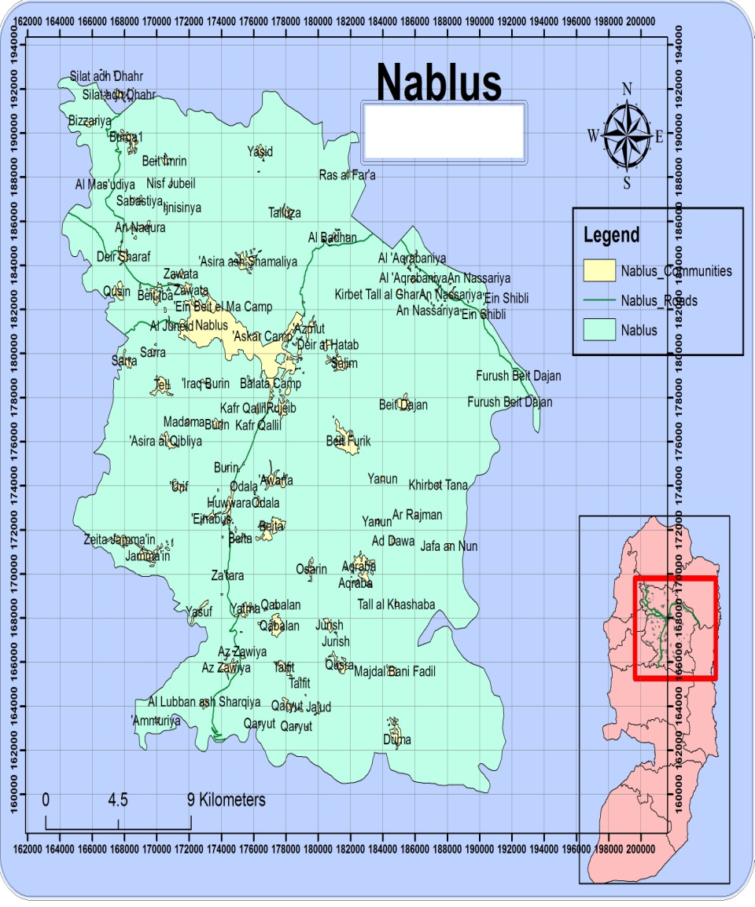
Background
Nablus is one of
the major cities in
North of the West
Bank.
Our main concern
will be the west of
Nablus area.

Slide 6
Background
Nablus’ produced wastewater used to be discharged into Wadi Zimar to the West & Wadi Badan to the East.
Nablus-West will be the first WWTP to directly serve the western area of Nablus.
Nablus WWTP is under construction.
Original design was done by Lahmeyer, Dr. Beitelsmann and Hijjawi.

Slide 7
Background
For the design, two methods stand out:
1) Mass Loads Design.
2) Kinetic Constants Design.
These are used for the design of the secondary treatment process.

Slide 8
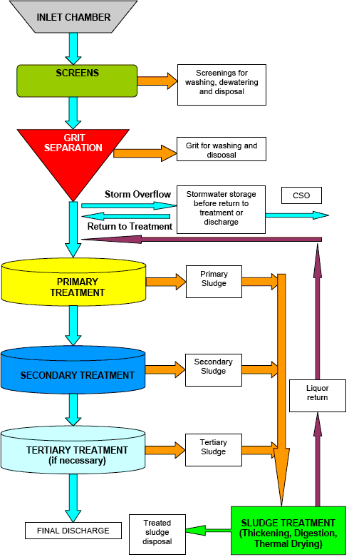

Background
Preliminary treatment
Thickening
Typically biological
treatment

Slide 9

Background
For the Mass Loads design, the following table was developed through experience which is used for the design process:
$Hydarulic Retention Time \left(HRT\right)=\frac{Volume∗24}{Flow Rate}$
$BOD Load=\frac{Flow Rate∗BOD Concentration}{Volume}$= F/M * MLSS
$Sludge Age= \frac{MLSS ∗Volume}{Wasteage Sludge}$
AS-Process | BOD Loading (g BOD/m³.d) | MLSS (mg/L) | F/M Ratio (g BOD/g MLSS.d) | Sludge Age (d) | Aeration Period (hr) | Return Sludge Rate (%) | BOD Removal Efficiency (%)
Conventional | 320-640 | 1,000-3,000 | 0.2-0.5 | 5-15 | 4-7.5 | 2-40 | 80-90
Step Aeration | 640-960 | 1,500-3,500 | 0.2-0.5 | 5-15 | 4-7 | 30-50 | 80-90
Extended Aeration | 160-320 | 2,000-8,000 | 0.05-0.2 | >20 | 20-30 | 50-100 | 85-95

Slide 10
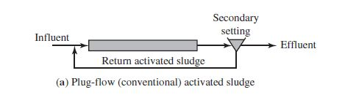
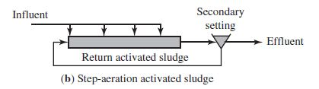
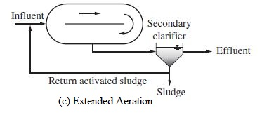
Background

Slide 11
Background
As for the Kinetic Constants design, it was developed since it more closely represents the actual kinetic behavior of the microorganisms.
Kinetic Constants give a more conservative design for the aeration tank in the activated sludge treatment system design.

Slide 12
Background
In short, Kinetic Constants depend on the type of bacteria as well as the concentration of BOD in the wastewater.
The effect of industry (main producer of COD), which has a significant presence in Nablus, should be considered as well.

Slide 13
Background
The four Kinetic Parameters that need to be determined for the design are:
Y= growth yield, in mg VSS/mg BOD (or mg COD).
k_{d}= microbial decay coefficient, in d⁻¹.
K_{s}= saturation constant, in mg/L of BOD (or COD).
k= maximum rate of substrate utilization per unit mass of biomass, in d⁻¹.

Slide 14
Background
The following table shows the range of these constants for the USA.
Notice that that WW in the USA has a BOD value of about 150 mg/L while this value in Nablus might reach up to 1000 mg/L, so the kinetic constants for Nablus should be completely different.
Constant | Units | Range
Y | mg VSS/mg BOD | 0.4 – 0.8
Y | mg VSS/mg COD | 0.3 – 0.4
k_{d} | d⁻¹ | 0.04 – 0.08
K_{s} | mg/L of BOD | 25 – 100
K_{s} | mg/L of COD | 25 – 100
k | d⁻¹ | 4 - 8

Slide 15

Background
We are caught between two minds, should we design based on the Kinetic Constants or the Mass Loads?

Slide 16
Methodology
Design Period was set for 30 years.
The Population and Hydraulic Loads were determined through two approaches:

Slide 17
Methodology
Approach (I):
Population, assuming a 2.22% growth rate, will be 449,722 in 2042.
Design Population will be: 450,000.
Assuming a 100 L/c.d water consumption rate, the following values will be used for design:
Water Consumption Per Day (m³) | 45,000
Equivalent Flow from Industry Per Day (m³) | 10,000
Estimated Infiltration Per Day (m³) | 5,000
Total Design Flow Per Day (m³) | 60,000

Slide 18
Methodology
Approach (II):
Taking the values for the population and hydraulic loads from the estimations of the original design team (Lahmeyer, Dr. Beitelsmann and Hijjawi) the following table was created:
 | Stage 1 (2020) | First Extension | Final Extension (2035)
Population Equivalents | 150,000 | 225,000 | 300,000
Average Flow (m³/d) | 14,860 | 19,707 | 27,377
Peak Flow (m³/d) | 19,037 | 24,607 | 34,239

Slide 19
Methodology
The four Kinetic Parameters that need to be determined for the design are:
Y= growth yield, in mg VSS/mg BOD (or mg COD).
k_{d}= microbial decay coefficient, in d⁻¹.
K_{s}= saturation constant, in mg/L of BOD (or COD).
k= maximum rate of substrate utilization per unit mass of biomass, in d⁻¹.

Slide 20
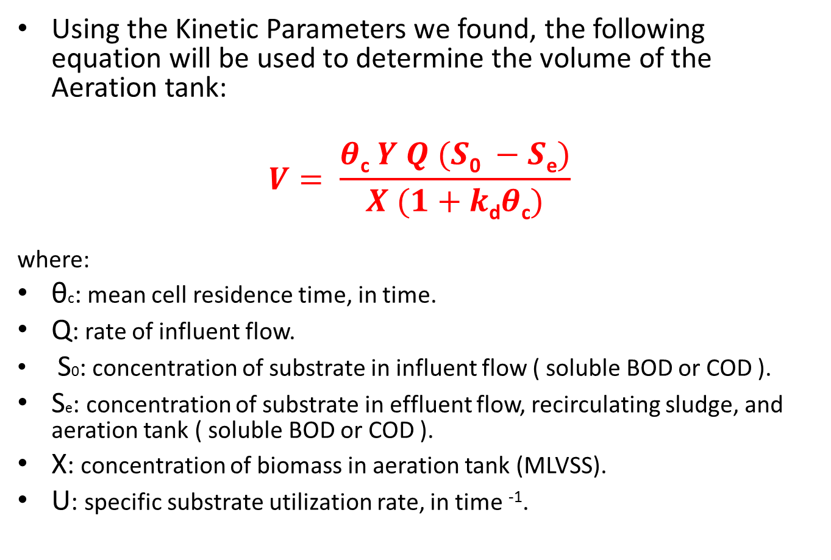
Methodology
Using the Kinetic Parameters we found, the following equation will be used to determine the volume of the Aeration tank:
$$V= \frac{θ\text{c} Y Q (S\text{0} −S\text{e})}{X (1+k\text{d}θ\text{c})}$$
where:
θc: mean cell residence time, in time.
Q: rate of influent flow.
S0: concentration of substrate in influent flow ( soluble BOD or COD ).
Se: concentration of substrate in effluent flow, recirculating sludge, and aeration tank ( soluble BOD or COD ).
X: concentration of biomass in aeration tank (MLVSS).
U: specific substrate utilization rate, in time ⁻¹.

Slide 21
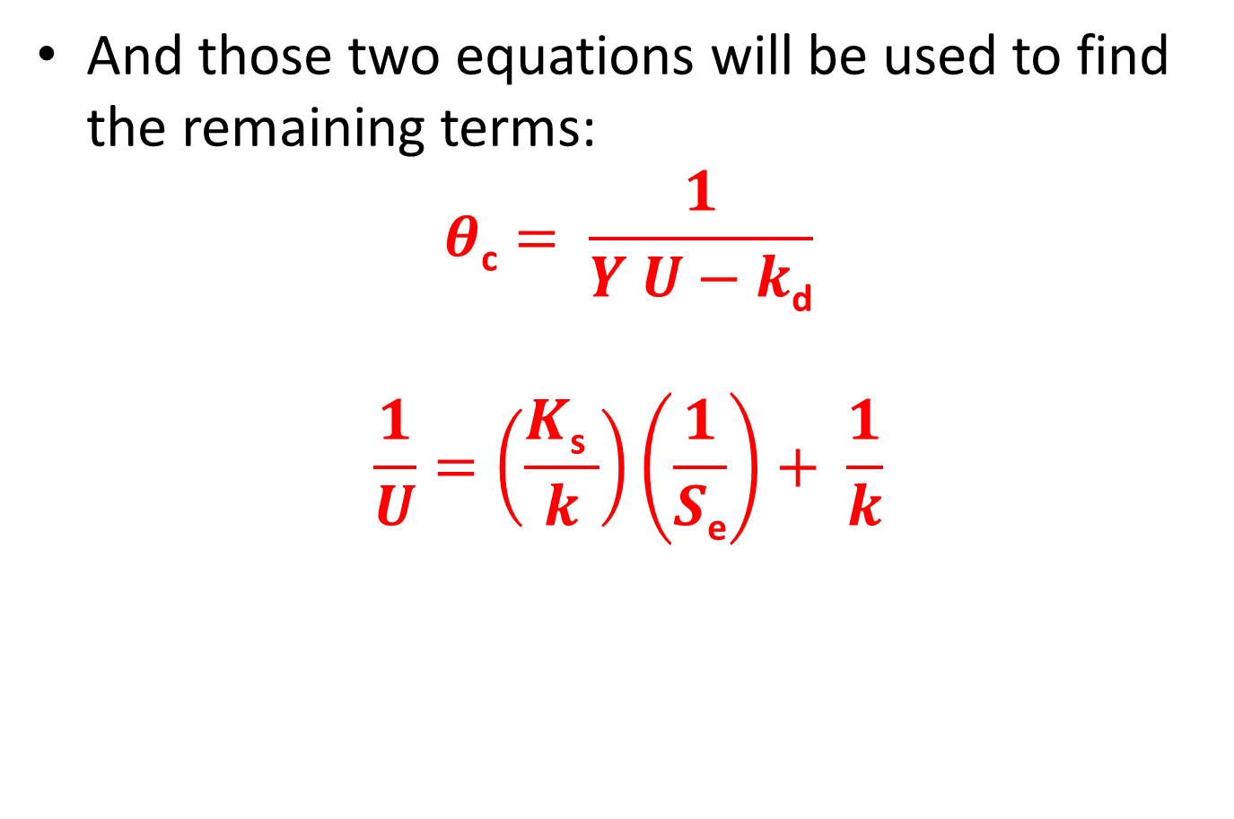
Methodology
And those two equations will be used to find the remaining terms:
$$θ\text{c}= \frac{1}{Y U−k\text{d}}$$
$$\frac{1}{U}=\left(\frac{K\text{s} }{k}\right)\left(\frac{1}{S\text{e}}\right)+ \frac{1}{k}$$

Slide 22
Methodology
From the two following curves, the Kinetic Constants can be determined:

Slide 23
Methodology
1/k (day)

Slide 24
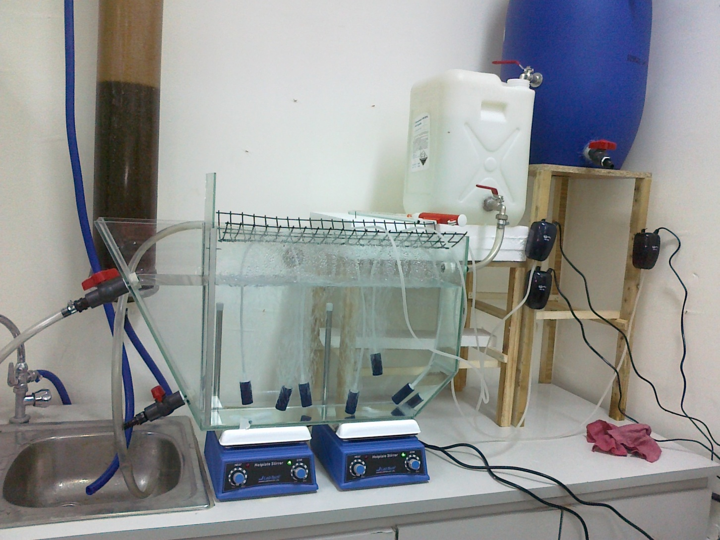
Experimental Setup
Primary Sedimentation Tank
Buffer Tank
Aeration Tank
Aerators

Slide 25
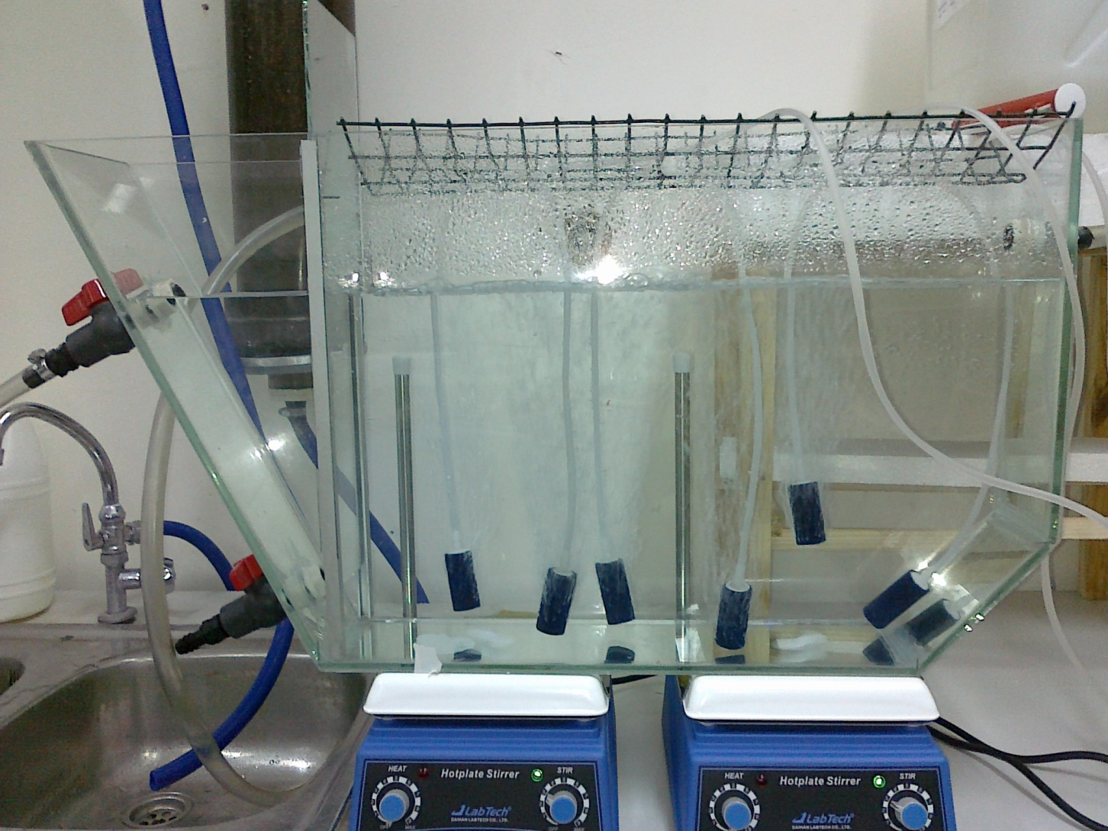
Experimental Setup
Aeration Tank
Inflow
Outflow
Air Diffusers
Sludge Removal
Magnetic Stirrers

Slide 26
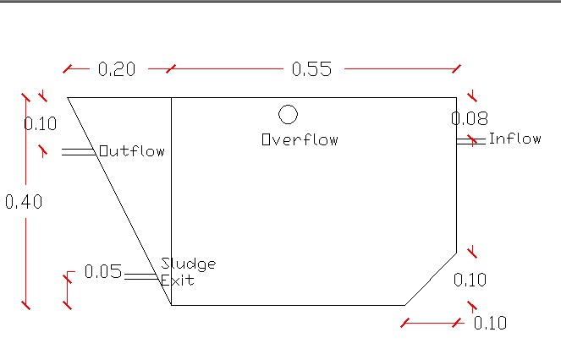
Experimental Setup
Dimensions of the Aeration Tank:

Slide 27
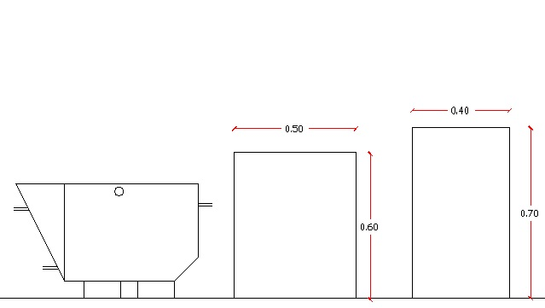
Experimental Setup

Slide 28
Experimental Setup
The system was checked to make sure it provides complete mixing and it has no “dead zones”, and provides complete drainage for the whole system.

Slide 29
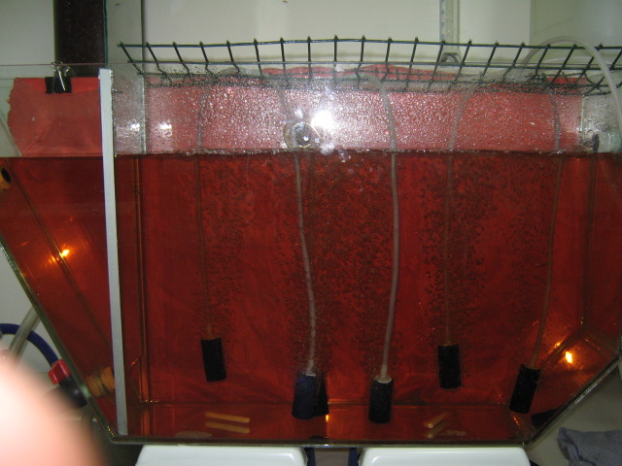
Experimental Setup

Slide 30
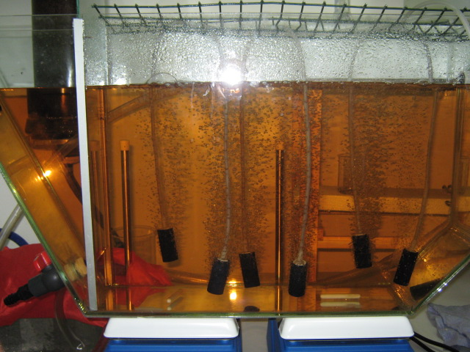
Experimental Setup

Slide 31
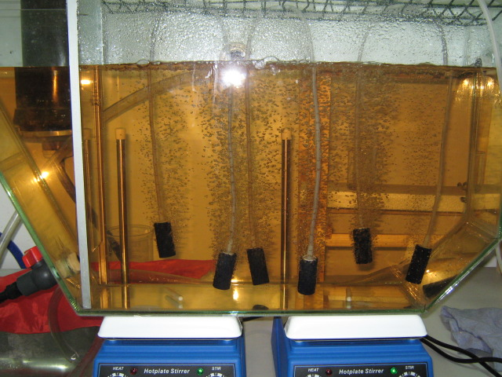
Experimental Setup

Slide 32
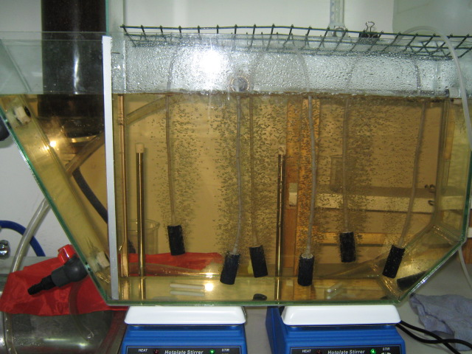
Experimental Setup

Slide 33
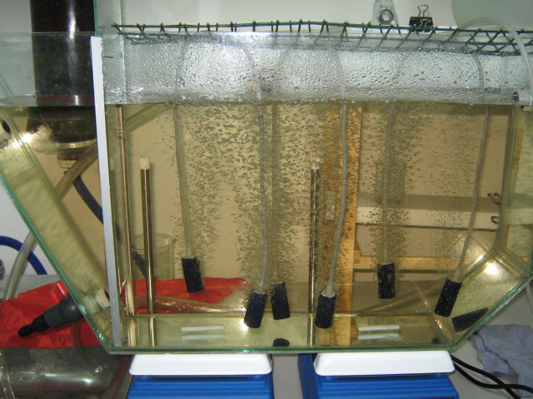
Experimental Setup

Slide 34
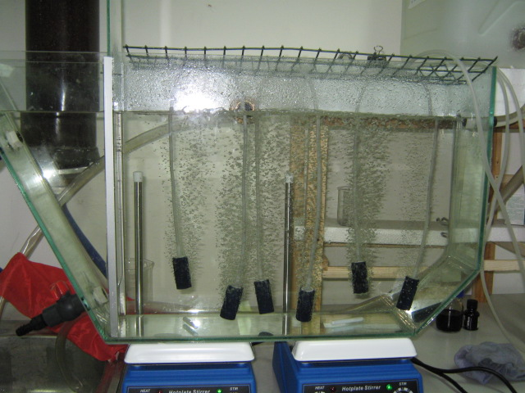
Experimental Setup

Slide 35
Running the Experiment
Samples were taken on a daily basis, during the period from Mar, 19th to April, 12th.
Those samples were used to feed the previously illustrated system to make sure that a continuous flow of 3-8 L/h was maintained.

Slide 36
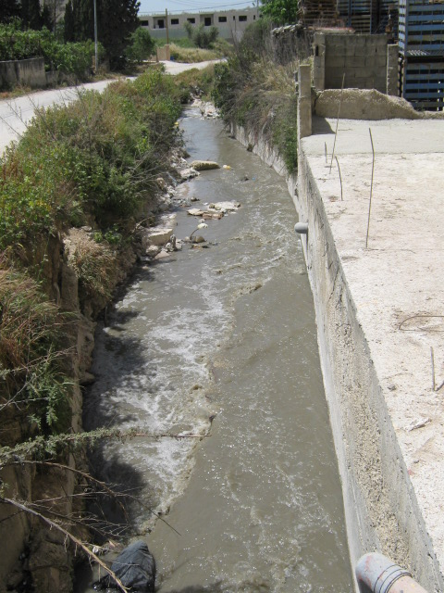
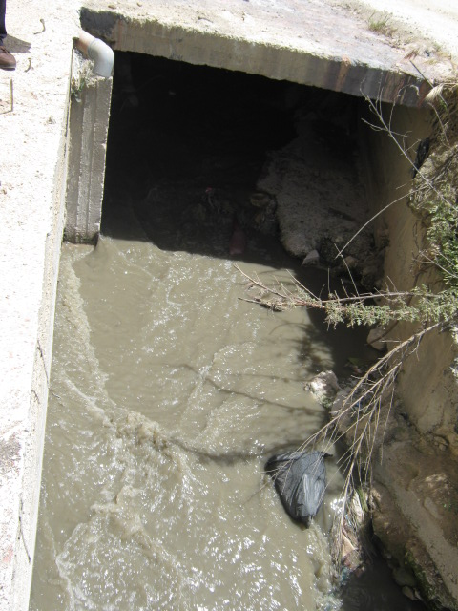
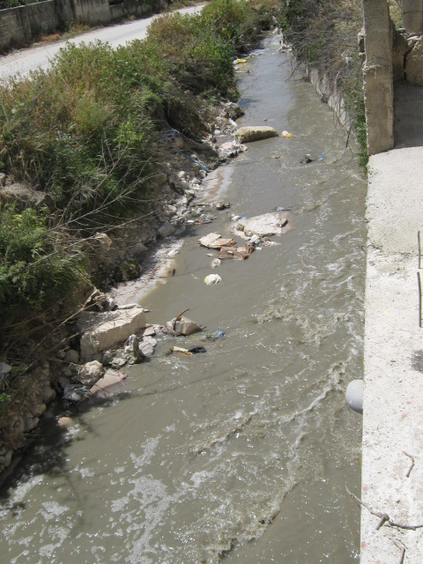
Sampling Location
About 500 m to the west of Shaghoor Swimming Resort.

Slide 37
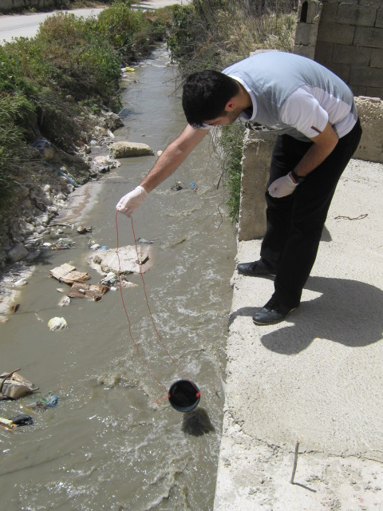
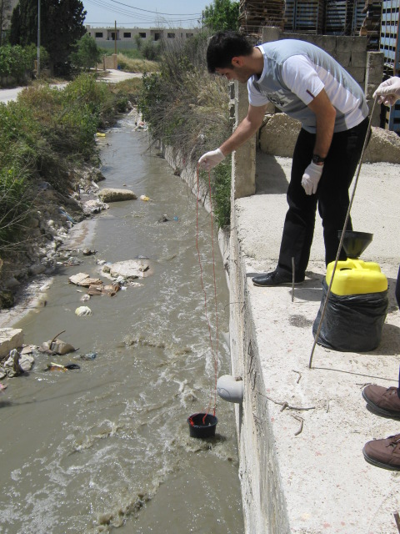
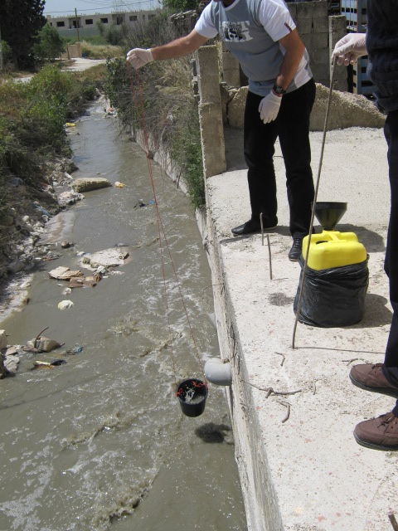
Collecting the Samples
About 100 L were collected daily.

Slide 38
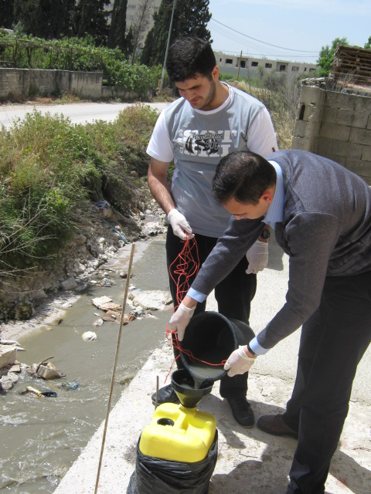
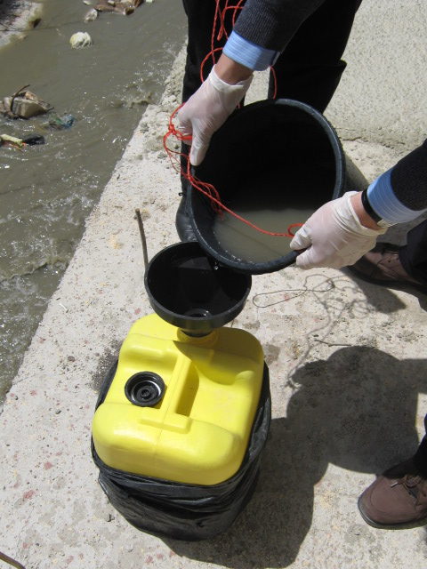
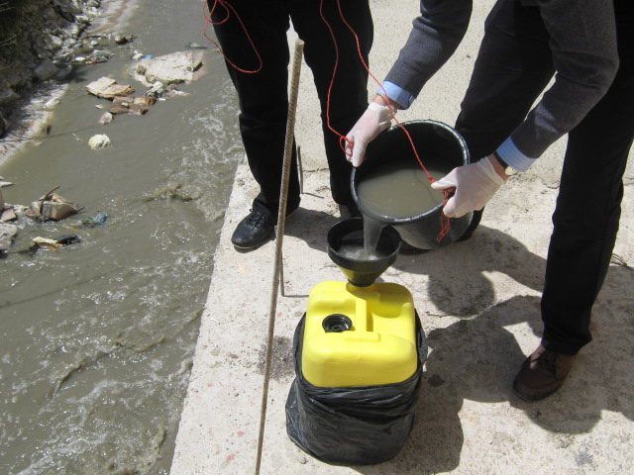
Collecting the Samples

Slide 39
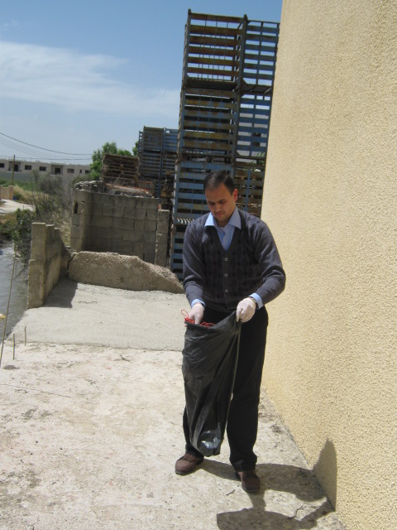
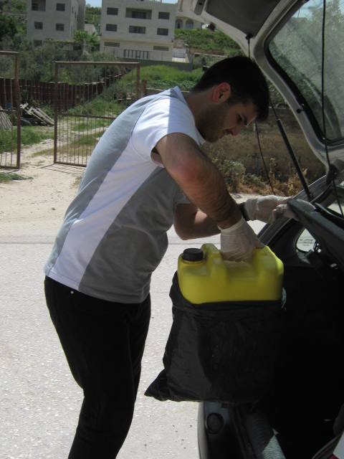
Packing

Slide 40
Collecting Samples from the System
The following day, samples from the inflow and outflow were taken to determine their COD content.
Samples from three places in the AT were taken the following day as well to find the Avg. SS content
Samples were poured into the PST. After settling, they were discharged into the rest of the system.

Slide 41
Experiment Results
DO values:
Measurements for the DO were carried out daily. The following graph shows the obtained values:

Slide 42
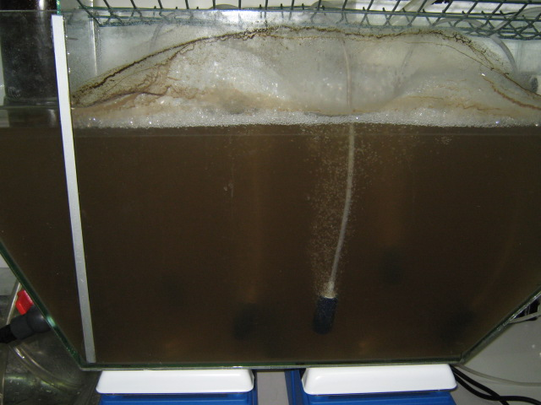
Experiment Results
Avg. Value for Design:
4000 ppm

Slide 43
Experiment Results
Avg. Inflow COD concentration:
682 ppm

Slide 44
Experiment Results

Slide 45
Experiment Results
BOD:
Using a conversion factor of 0.7 the value used for design for the inflow BOD will be equal to:
0.7*680= 480 ppm

Slide 46
Experiment Results
Final Results for Design
Parameter | Concentration (ppm)
Suspended Solids | 4000
Inflow BOD | 480
Outflow BOD | 20
Outflow SS | 30

Slide 47
Finding the Kinetic Constants
After Properly organizing and interpreting the results, the following two graphs were obtained:

Slide 48
Experiment Results
From the graphs, the following results were obtained:
* COD: *BOD(using a conversion factor of 0.7):
Y | 0.18 mg VSS/mg COD
K_{s} | 940 mg COD/L
k | 2.56 d⁻¹
k_{d} | 0 d⁻¹
Y | 0.26 mg VSS/mg BOD
K_{s} | 660 mg BOD/L
k | 2.56 d⁻¹
k_{d} | 0 d⁻¹

Slide 49
Design Based on Mass Loads
The following table shows the limitations for this type of design:
Process |  | BOD Load (g/m³.d) | Aeration Period (h) | Maximum Inflow BOD (ppm)
Conventional | Lower Limit | 320 | 4 | 53
 | Upper Limit | 640 | 7.5 | 200
Step Aeration | Lower Limit | 640 | 4 | 107
 | Upper Limit | 960 | 7 | 280
Extended | Lower Limit | 160 | 20 | 133
 | Upper Limit | 320 | 30 | 400

Slide 50
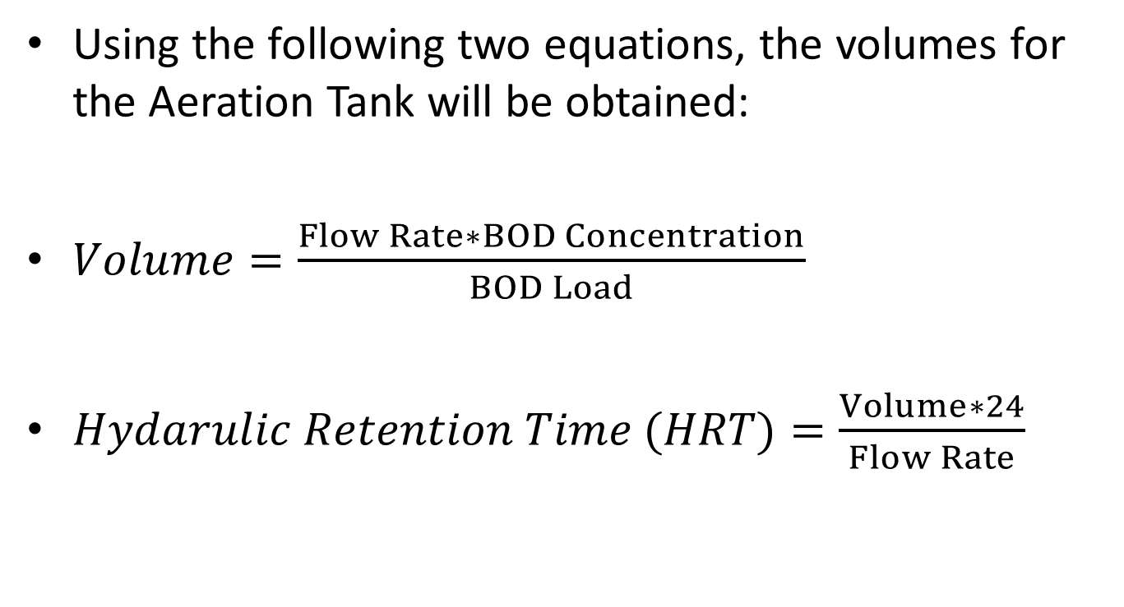
Design Based on Mass Loads
Using the following two equations, the volumes for the Aeration Tank will be obtained:
$Volume=\frac{Flow Rate∗BOD Concentration}{BOD Load}$
$Hydarulic Retention Time (HRT)=\frac{Volume∗24}{Flow Rate}$

Slide 51
Design Based on Mass Loads
Approach (I):
Process |  | BOD Load (g/m³.d) | Volume (m³) | HRT (h)
Conventional | Lower Limit | 320 | 90,000 | 36
 | Upper Limit | 640 | 45,000 | 18
 | Average | 480 | 60,000 | 24
Step Aeration | Lower Limit | 640 | 45,000 | 18
 | Upper Limit | 960 | 30,000 | 12
 | Average | 800 | 36,000 | 14.4
Extended | Lower Limit | 160 | 180,000 | 72
 | Upper Limit | 320 | 90,000 | 36
 | Average | 240 | 120,000 | 48
HRT values don’t apply

Slide 52
Design Based on Mass Loads
Approach (II):
Stage I
Process |  | BOD Load (g/m3.d) | Volume (m3) | HRT (h)
Conventional | Lower Limit | 320 | 28,555.5 | 11
 | Upper Limit | 640 | 14,277.8 | 6
 | Average | 480 | 19,037 | 8
Step Aeration | Lower Limit | 640 | 14,277.8 | 6
 | Upper Limit | 960 | 9,518.5 | 4
 | Average | 800 | 11,422.2 | 5
Extended | Lower Limit | 160 | 57,111 | 23
 | Upper Limit | 320 | 28,555.5 | 11
 | Average | 240 | 38,074 | 15

Slide 53
Design Based on Mass Loads
Approach (II):
Extension I
Process |  | BOD Load (g/m3.d) | Volume (m3) | HRT (h)
Conventional | Lower Limit | 320 | 36,910.5 | 15
 | Upper Limit | 640 | 18,455.3 | 7
 | Average | 480 | 24,607 | 10
Step Aeration | Lower Limit | 640 | 18,455.3 | 7
 | Upper Limit | 960 | 12,303.5 | 5
 | Average | 800 | 14,764.2 | 6
Extended | Lower Limit | 160 | 73,821 | 30
 | Upper Limit | 320 | 36,910.5 | 15
 | Average | 240 | 49,214 | 20

Slide 54
Design Based on Mass Loads
Approach (II):
Extension II
Process |  | BOD Load (g/m3.d) | Volume (m3) | HRT (h)
Conventional | Lower Limit | 320 | 51,358.5 | 21
 | Upper Limit | 640 | 25,679.3 | 10
 | Average | 480 | 34,239 | 14
Step Aeration | Lower Limit | 640 | 25,679.3 | 10
 | Upper Limit | 960 | 17,119.5 | 7
 | Average | 800 | 20,543.4 | 8
Extended | Lower Limit | 160 | 102,717 | 41
 | Upper Limit | 320 | 51,358.5 | 21
 | Average | 240 | 68,478 | 27

Slide 55
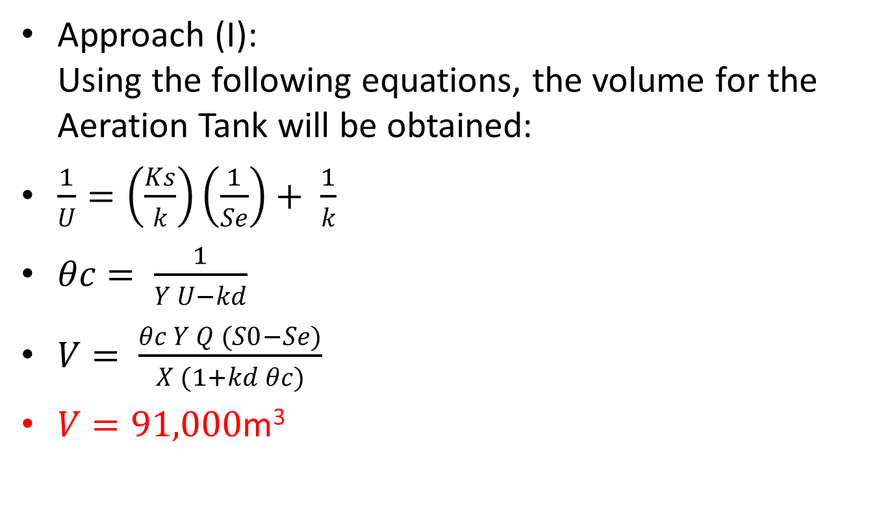
Design Based on Kinetic Constants
Approach (I):
Using the following equations, the volume for the Aeration Tank will be obtained:
$\frac{1}{U}=\left(\frac{Ks}{k}\right)\left(\frac{1}{Se}\right)+ \frac{1}{k}$
$θc= \frac{1}{Y U−kd}$
$V= \frac{θc Y Q (S0−Se)}{X (1+kd θc)}$
$V=91,000\text{m}\text{3}$
Y | 0.26 mg VSS/mg BOD
K_{s} | 660 mg BOD/L
k | 2.56 d⁻¹
k_{d} | 0 d⁻¹

Slide 56
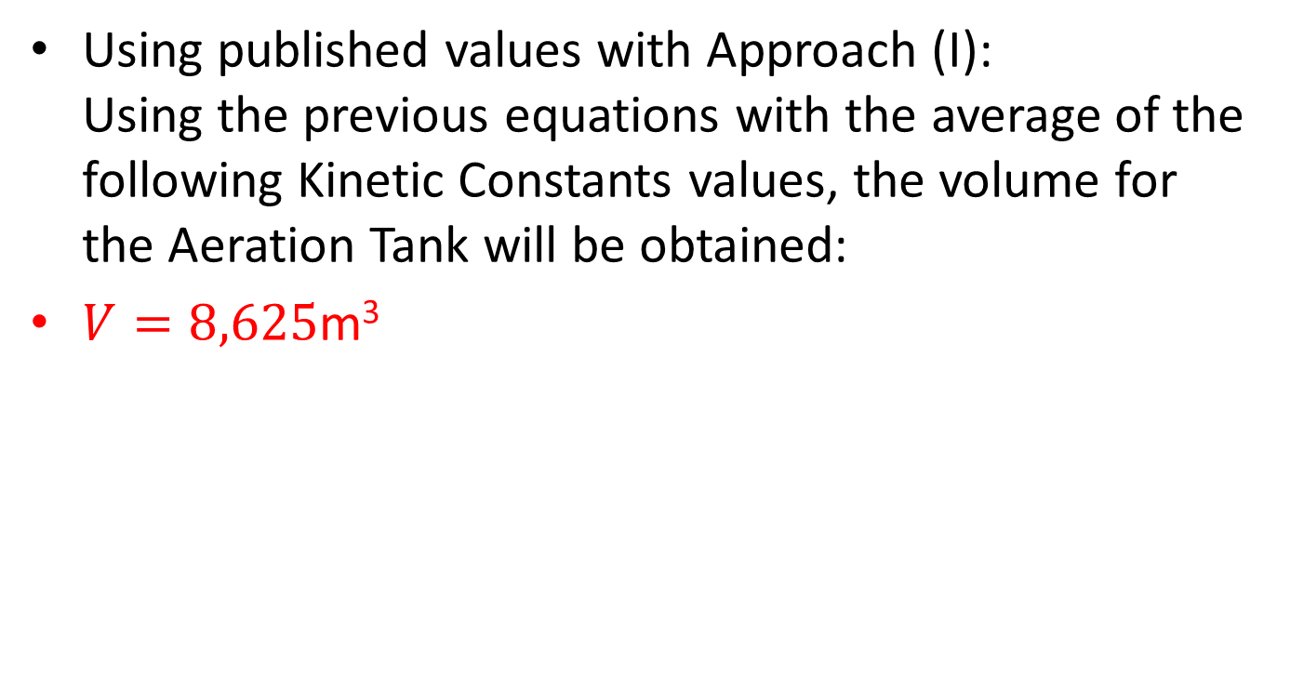
Design Based on Kinetic Constants
Using published values with Approach (I):
Using the previous equations with the average of the following Kinetic Constants values, the volume for the Aeration Tank will be obtained:
$V=8,625\text{m}\text{3}$
Constant | Units | Range
Y | mg VSS/mg BOD | 0.4 – 0.8
k_{d} | d⁻¹ | 0.04 – 0.08
K_{s} | mg/L of BOD | 25 – 100
k | d⁻¹ | 4 - 8

Slide 57
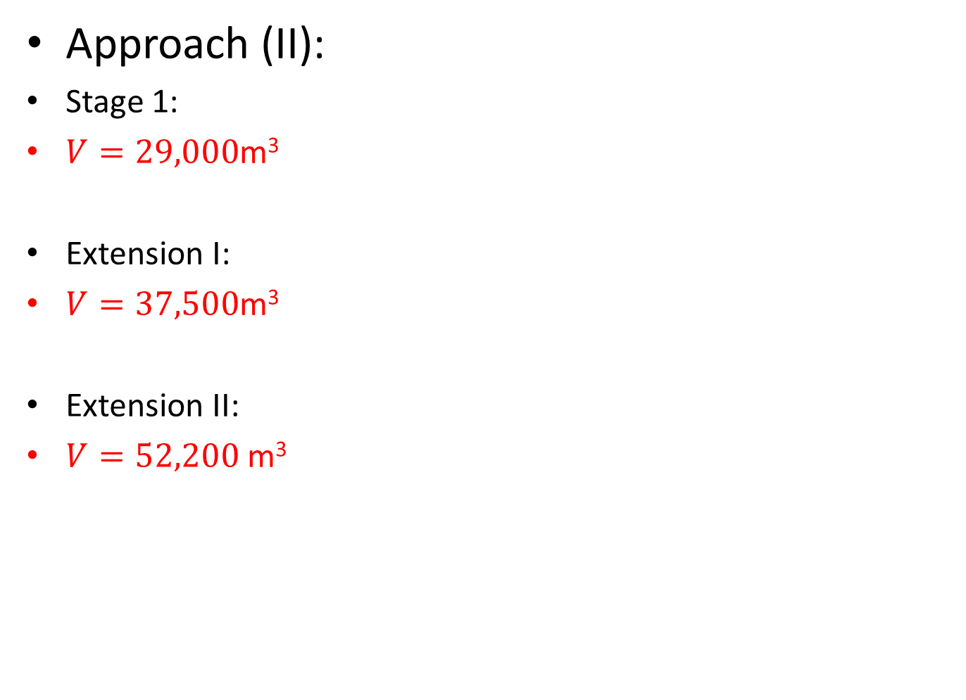
Design Based on Kinetic Constants
Approach (II):
Stage 1:
$V=29,000\text{m}\text{3}$
Extension I:
$V=37,500\text{m}\text{3}$
Extension II:
$V=52,200 \text{m}\text{3}$

Slide 58
Steady Modeling Program
Several runs were carried out using Steady Modeling Program.
Steady is a program for WWTP modeling.
It was created by Professors Luis Aburto-Garnica and Gerald E. Speitel Jr. of the Civil Engineering Department at the University of Texas (Austin).

Slide 59
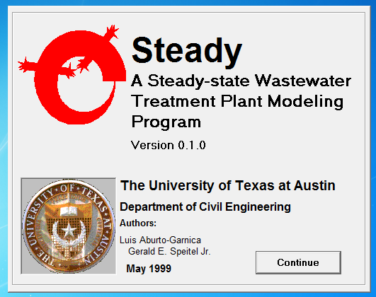
Steady Modeling Program

Slide 60
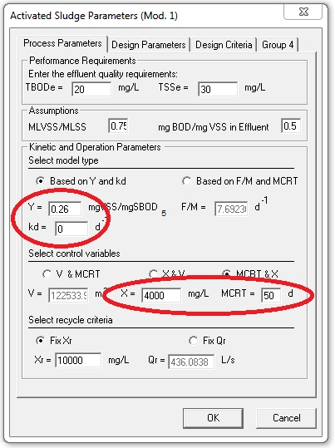
Steady Modeling Program
We inserted the Kinetic Parameters which we have gotten from our work to the steady program.
We compared the variations of the volume for aeration tank with two parameters ( X, MCRT).

Slide 61
Steady Modeling Program

Slide 62
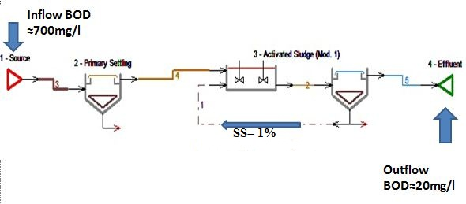
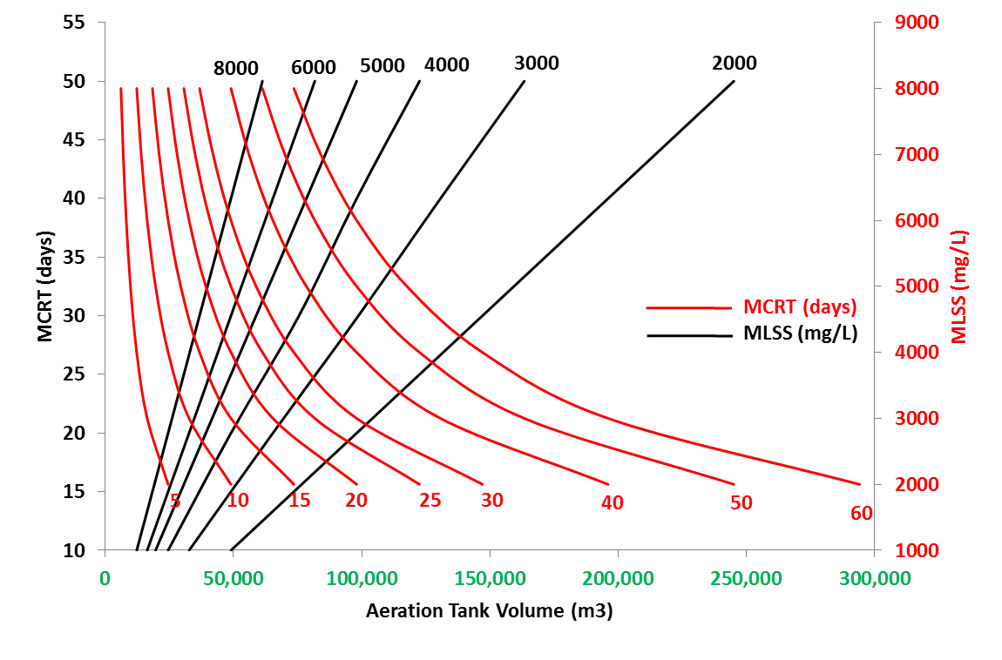
Q= 2500 m³/h
DESIGN CHART FOR AT OF NABLUS WEST

Slide 63
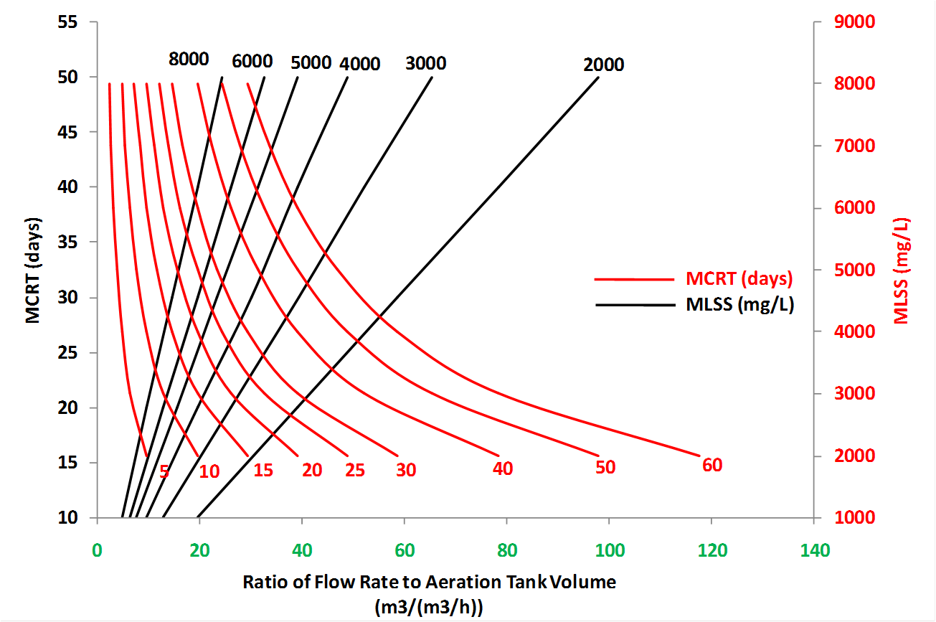
Q= 1 m³/h
GENERAL DESIGN CHART FOR AT OF HIGH STRENGHT MUNICIPAL WW

Slide 64
Part B

Slide 65
Industrial Wastewater in Nablus City

Slide 66
sub objective:
Determine the amounts of industrial wastewater for a sample of factories .
WHY?
Industrial wastewater usually is low flow compare to domestic wastewater flow but contains high contamination(BOD,COD,SS).

Slide 67
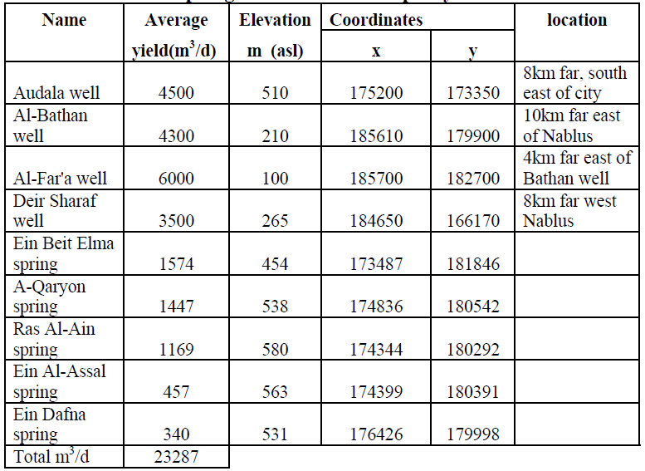
Water resources in Nablus:

Slide 68
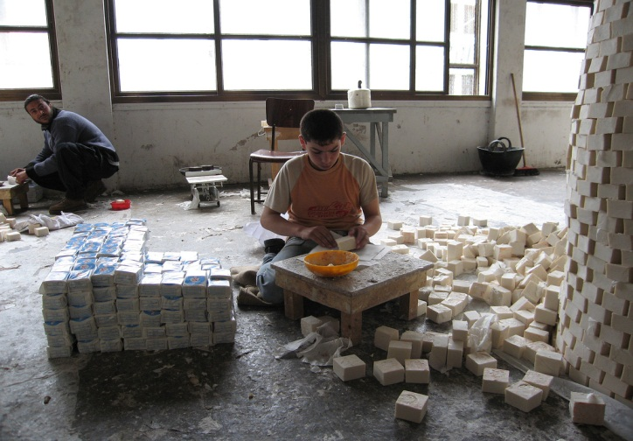
Traditional Industries
Soap Industry:

Slide 69
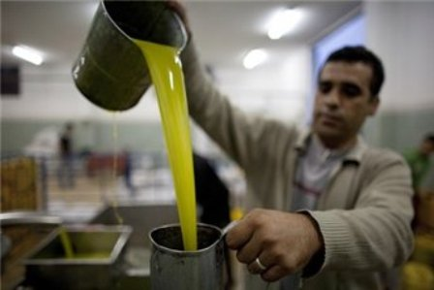
Vegetable oil:

Slide 70
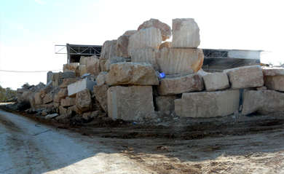
Stone Crushing:

Slide 71
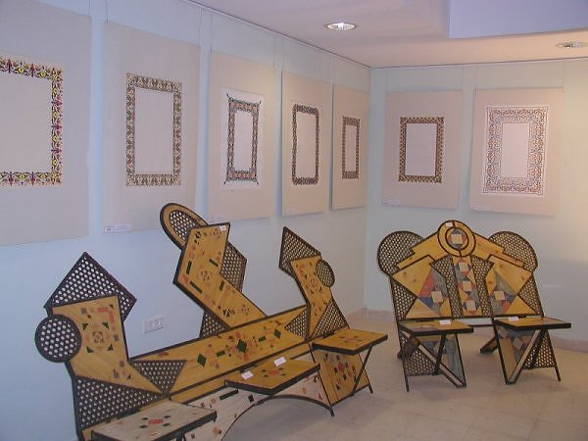
Furniture Industry:

Slide 72
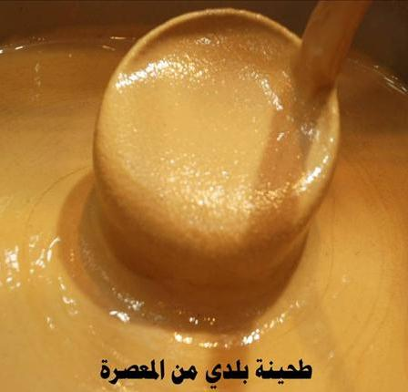
The Tuhineh:

Slide 73

sweet industries:

Slide 74

Methodology

Slide 75
Methodology
Collecting data

Slide 76
Data collection
From municipality of Nablus and chamber of commerce and industry we get:
Main industries
Water consumption for each one

Slide 77
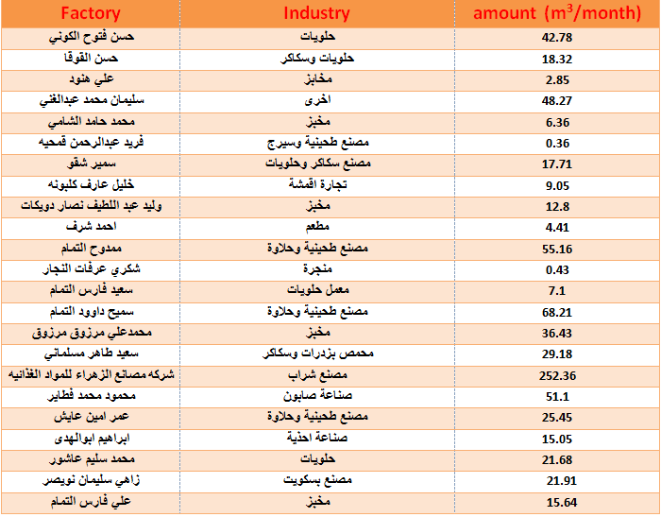

Slide 78
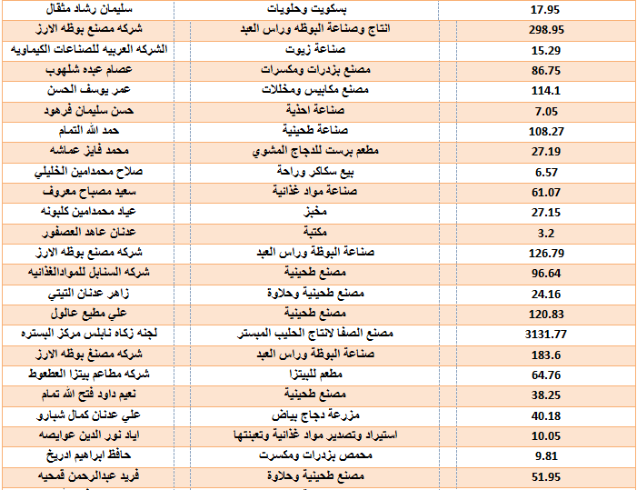

Slide 79
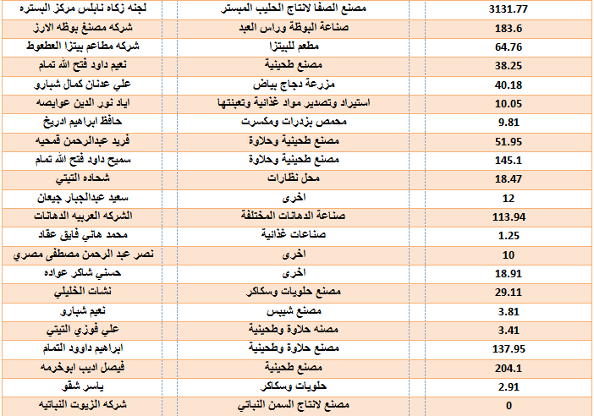

Slide 80
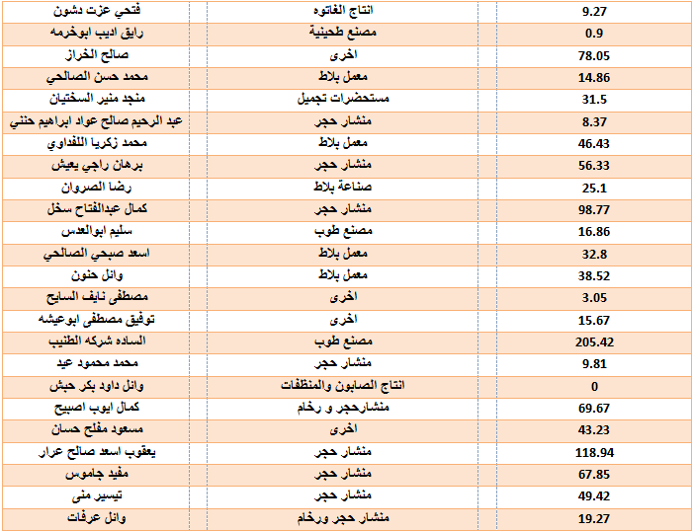

Slide 81
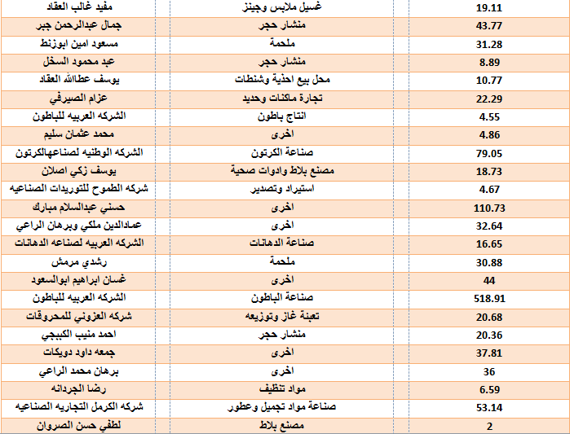

Slide 82


Slide 83

Methodology
Collecting data
Analyzing data

Slide 84
Data analysis
By assuming the consumed water = wastewater
Classify the industries into sub categories
Summing up all water consumption for each category

Slide 85
Results of data analysis
Industry | Quantity (m³/month)
Constructions, Queries | 2500
Tahenah, Halawah | 1100
Sweets | 1100
Food | 4000
Chemicals | 550
Leather, Glass, Plastic, Textile | 370
Service Industries | 580
Other | 650
From this results we can see that the largest amount of waste water comes from the ( food industries ) high BOD and
( stone crushing ) high SS.

Slide 86
Methodology
Collecting data
Analyzing data
Final
results

Slide 87
BOD, COD, SS, P, N in Wastewater :
Industry | Quantity (m³/month) | BOD | COD | SS | N | P
Constructions, Queries | 2500
Tahenah, Halawah | 1100
Sweets | 1100
Food | 4000
Chemicals | 550
Leather, Glass, Plastic, Textile | 370
Service Industries | 580
Other | 650

Slide 88
Nablus city
west
east
domestic
industrial
domestic
industrial
BOD: 55 g/c.d
COD: 75 g/c.d
SS: 80 g/c.d
N: 50 g/c.d
P: 2 g/c.d
Work for another group
TO WWTP

Slide 89
Benefits
Political: treating wastewater using Nablus-West WWTP will deprive the Israelis of the revenues they generate through treating Palestinian WW.
Economical: building and running the WWTP will provide job opportunities on the medium and long term for local workforce.

Slide 90
Benefits
Social: through building the sewer line that reaches the plant to the west of the city, the unsavory sight of flowing WW would be eliminated.
It will be replaced by the view of treated WW flowing in the wadi after the WWTP instead.
Health: many pathogens that originate from WW would not be exposed anymore, resulting in better health for residents of the nearby area.

Slide 91
Benefits
Environmental:
1) Providing water for irrigation purposes in the nearby agricultural areas.
2) Using excess water for groundwater recharge.
3) Dried sludge can be used for fertilizing.

Slide 92


