Slide 1
Assessment of AL-QUDS OPEN University
(Quantity Survey and Cost Estimate)
Prepared by : Abdel Majeed Abu Hamda
Osama Abu Joub
Yazan Shraim
Under supervision of: Eng. Reema Nassar

Slide 2
Title and Content Layout with List
What is project management
What is project management system
Estimator meting
Project life cycle
Quantity survey
Delivery system
Contracts
Project introduction

Slide 3
Title and Content Layout with List
What is BIM ?
Benefits of BIM ?
Difference between BIM and CAD
Industry Foundation Classes
Clash Detection
Time and Cost Estimation
Visualization
Case Study
Final Project

Slide 4
What is Project Management ?
The main key words have been to recognize :
Goals
Process
Decisions
Planning
Monitoring

Slide 5
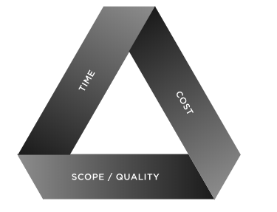
What is Project Management System ?

Slide 6
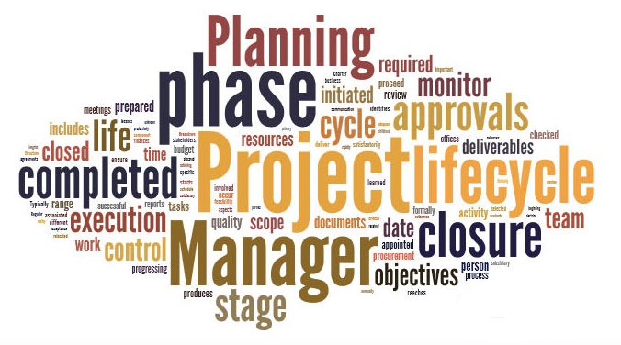
Project life Cycle
The basic faces of scheduling are :
Planning
Scheduling
Monitoring

Slide 7
What is BIM ?
"A digital representation of the physical and functional characteristics of a building displayed as a 3D model, with the added capability to integrate a whole array of design and construction data related to cost, schedule, materials, assembly, maintenance, energy use, and more". (Chuck Eastman, 2008)
Building Information Modeling

Slide 8
Benefits of BIM
Accurate Modeling.
saving Time & Cost .
Navigation.
Accurate Quantity Survey .

Slide 9
Methodology
Work break down structure.
Quantity survey using Revit software
Time schedule using Primavera software
Assessment the project using BIM

Slide 10

Quantity Survey

Slide 11
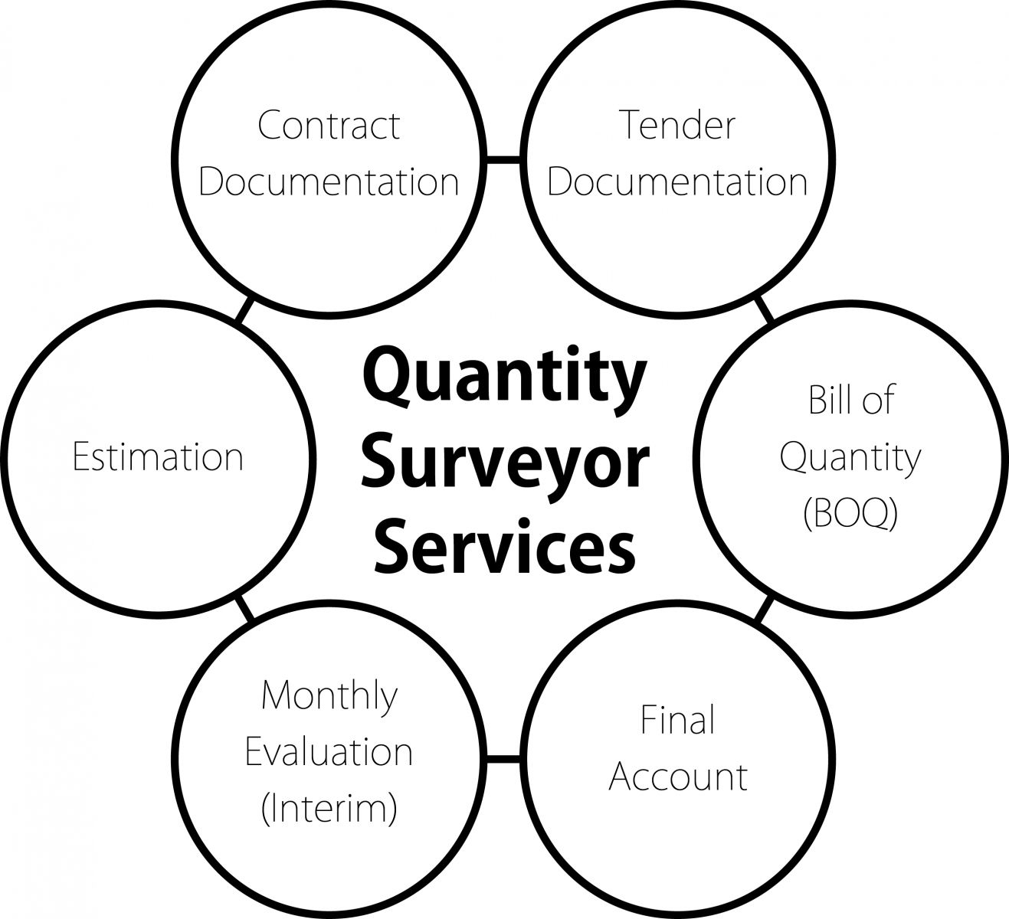
Quantity Survey
Importance of quantity survey

Slide 12
Quantity Survey
Data required for the preparation of an estimate or quantity survey
Drawings
Specifications
Rates

Slide 13
Delivery System
Design-Bid-Build
Design-Build
Integrated Project

Slide 14

Contracts
Types of Contracts
Lump Sum Contract
Unit Price Contract
Cost-Plus Contract

Slide 15
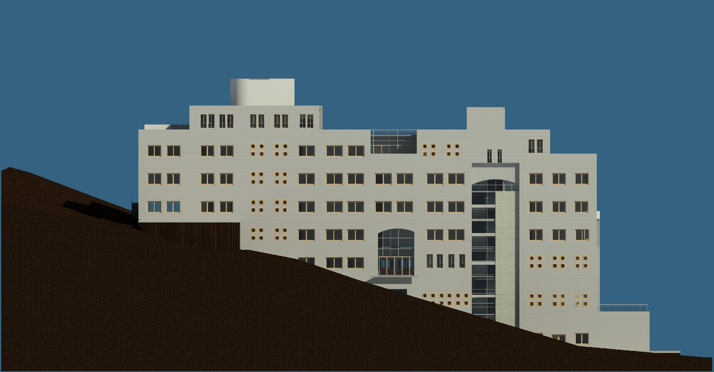
Project Introduction
Project delivery system :
Design-Bid-Build
Project contract :
Unit price

Slide 16

Quantities Surveying Using Revit Software

Slide 17
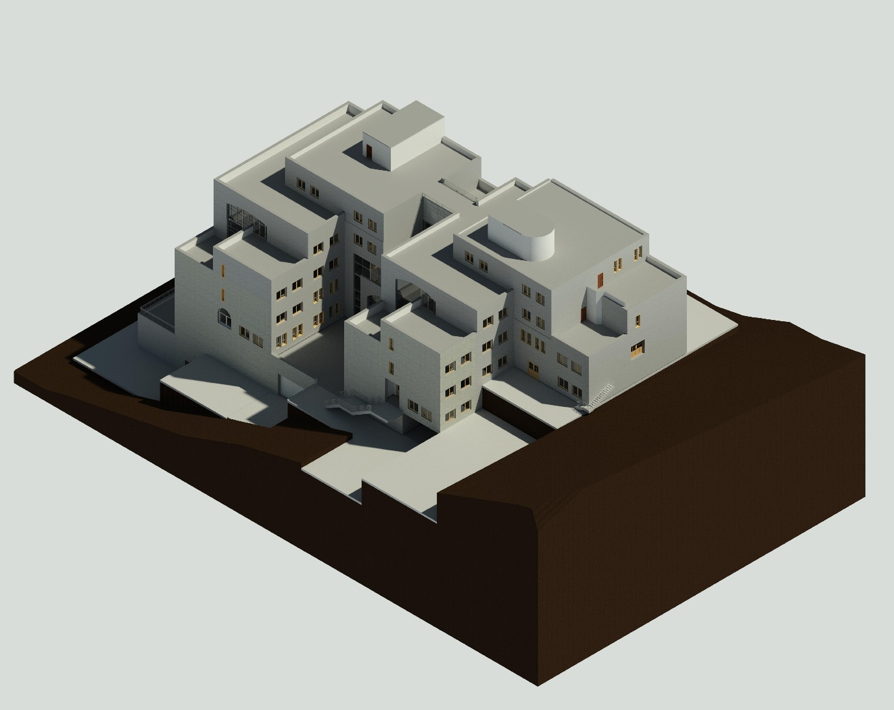
Architectural Model
Architectural elements are the unique details and component parts that, together, form the architectural style of buildings

Slide 18

Levels

Slide 19
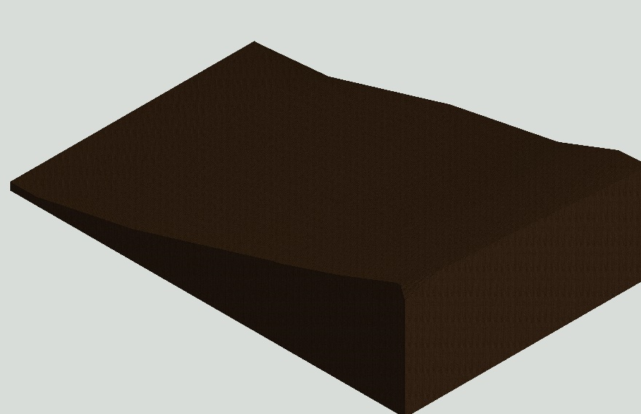
Site Modeling

Slide 20
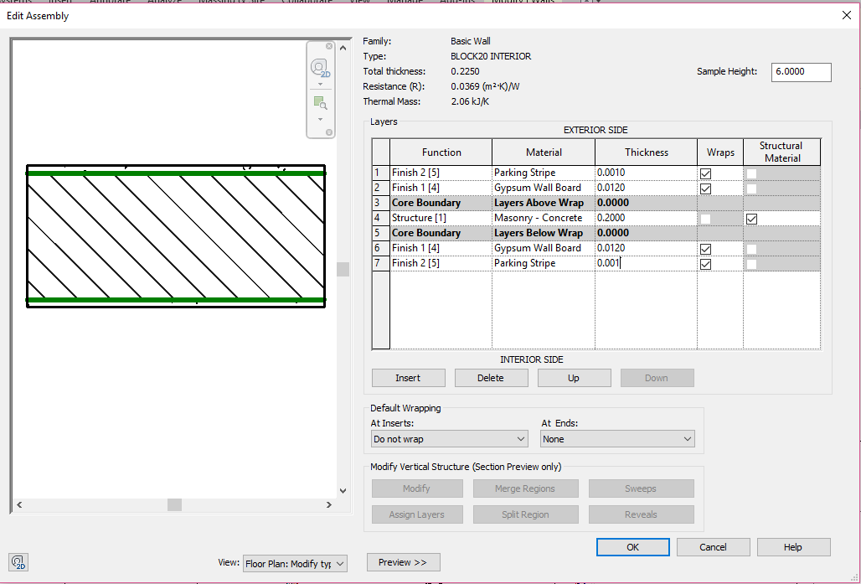
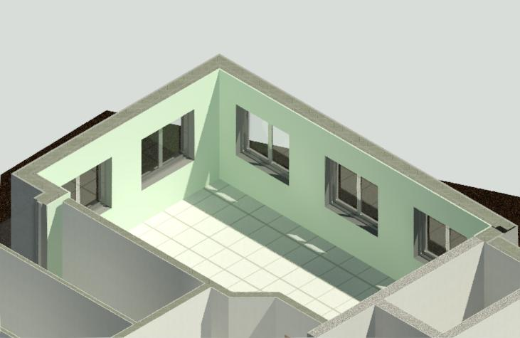
Walls
Interior Walls

Slide 21
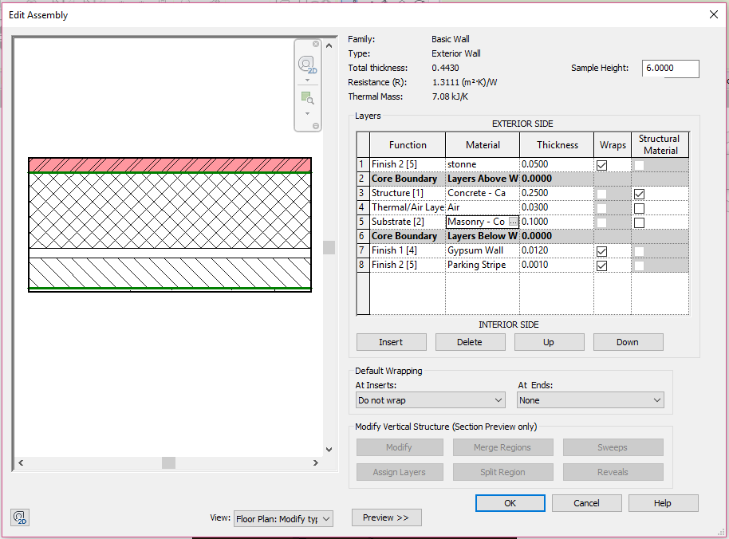
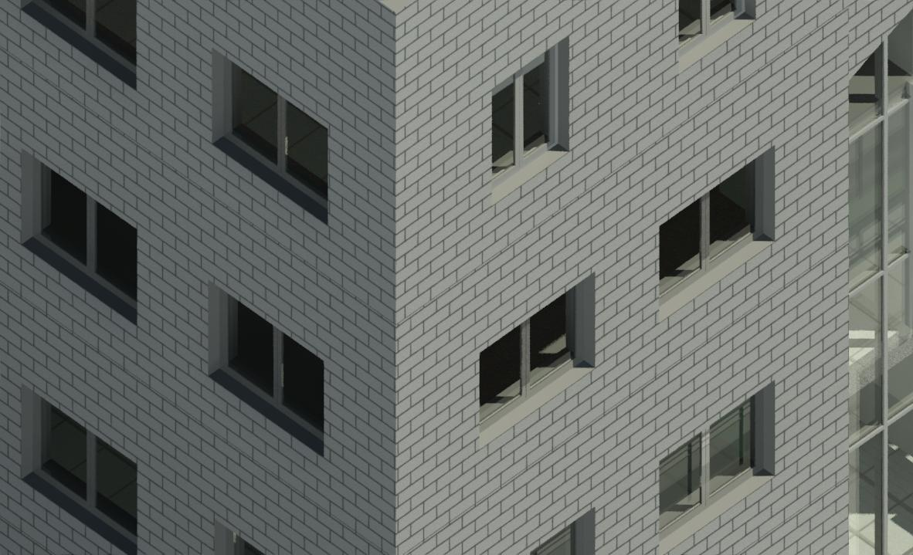
Walls
Exterior Walls

Slide 22
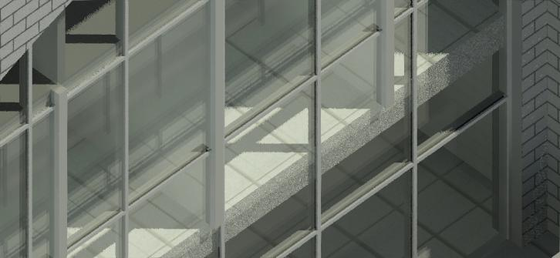
Curtain walls

Slide 23
Result
Exterior Walls |  |  | Interior Walls
Stone A (m²) | 3001 |  | Block 10cm (NO.) | 53467
Stone B (m²) | 754 |  | Block 20cm (NO.) | 30941
Concrete (m³) | 938.75 |  | Mortar (m³) | 100.63
Islulation (m²) | 3755 |  | Plaster (m²) | 12188
Block 10cm (NO.) | 12108 |  | Paint (m²) | 12188
Mortar (m³) | 52.35
Plaster (m²) | 3755
Paint (m²) | 3755

Slide 24
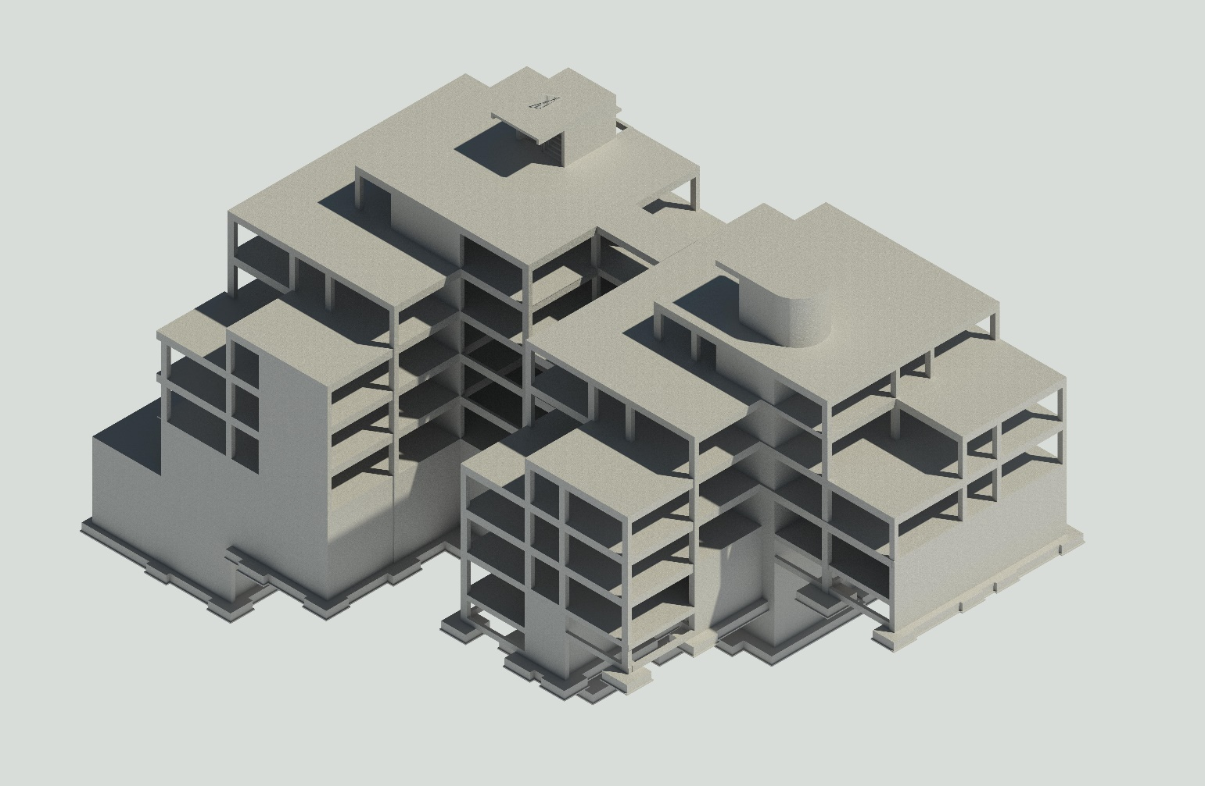
Structural Model

Slide 25
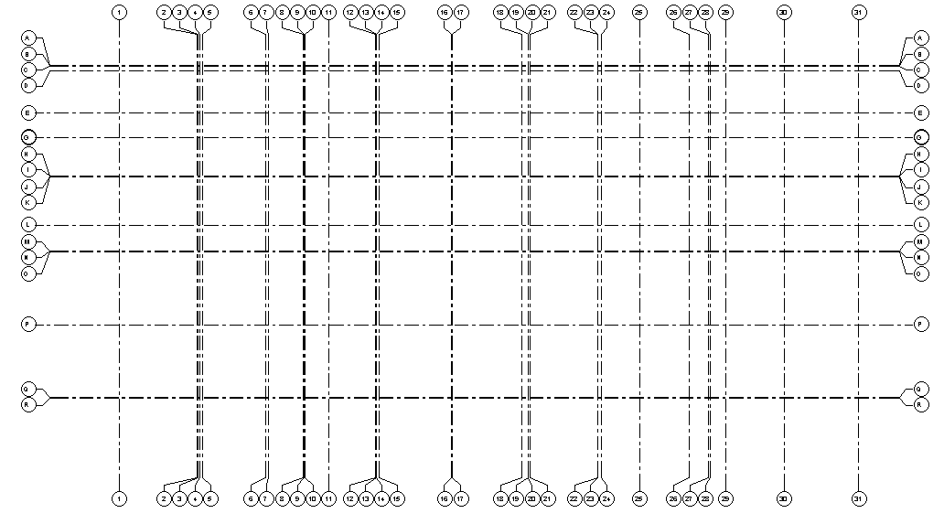
Grid System

Slide 26
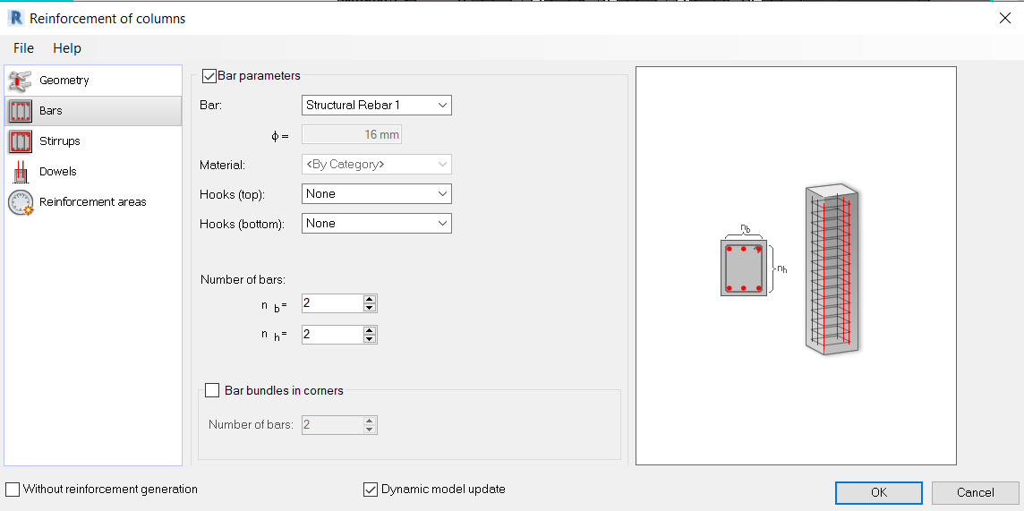
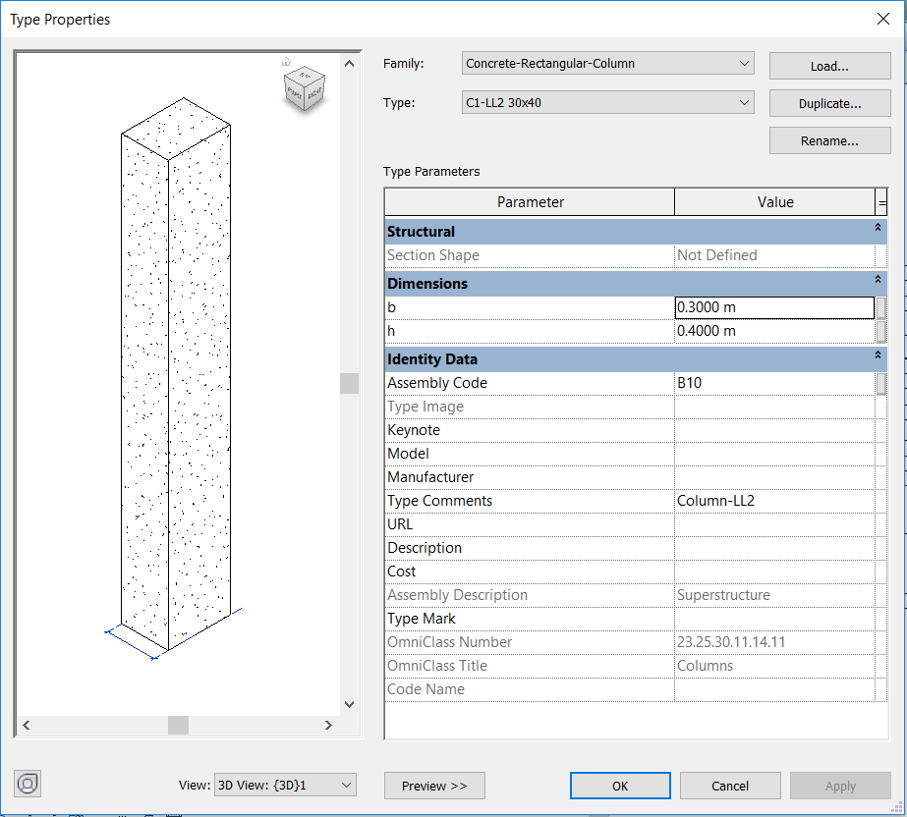
Columns

Slide 27
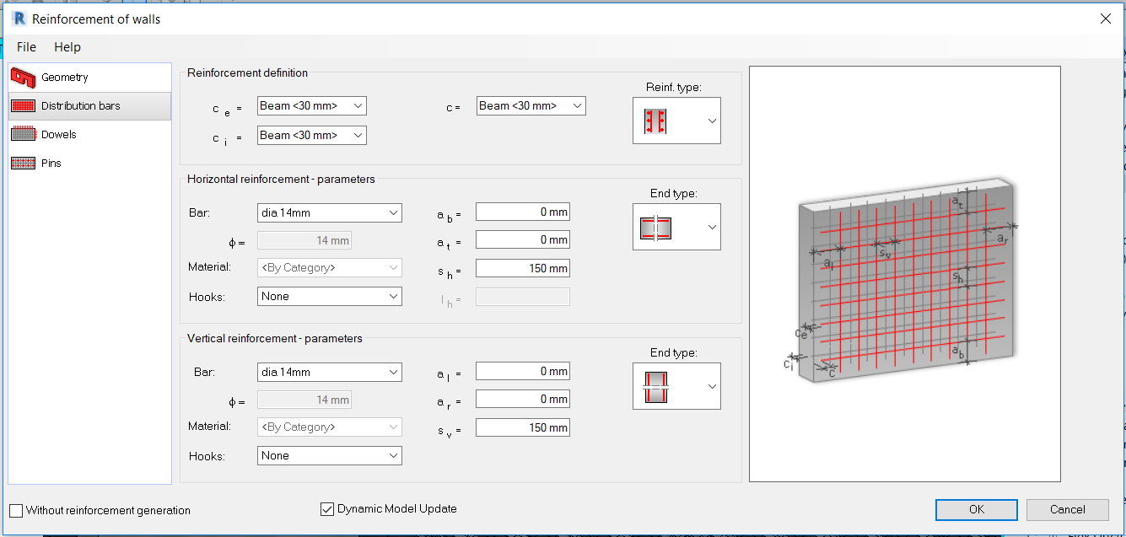
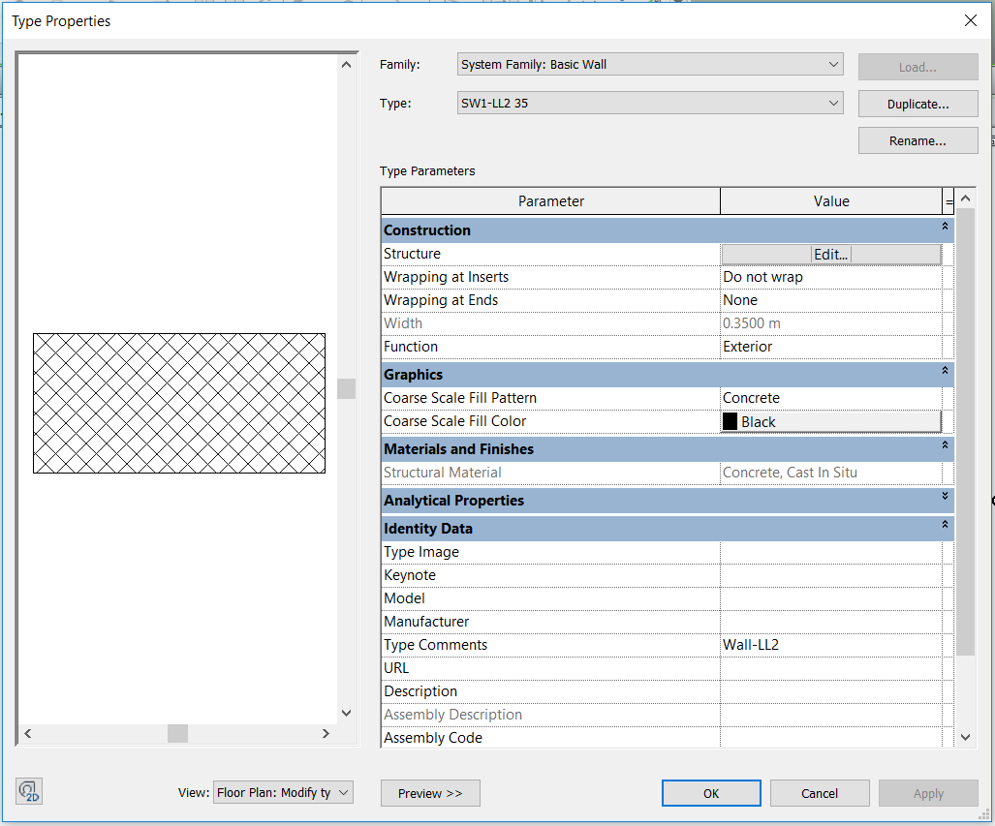
Shear walls

Slide 28
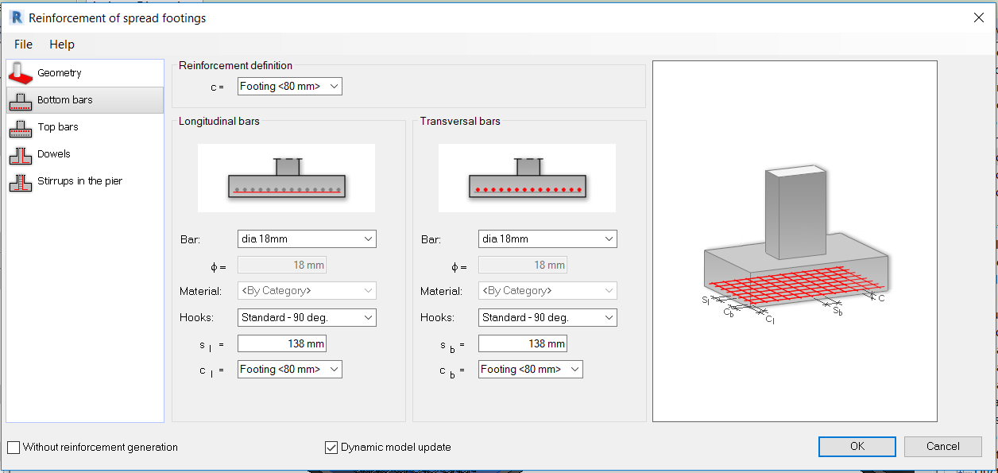
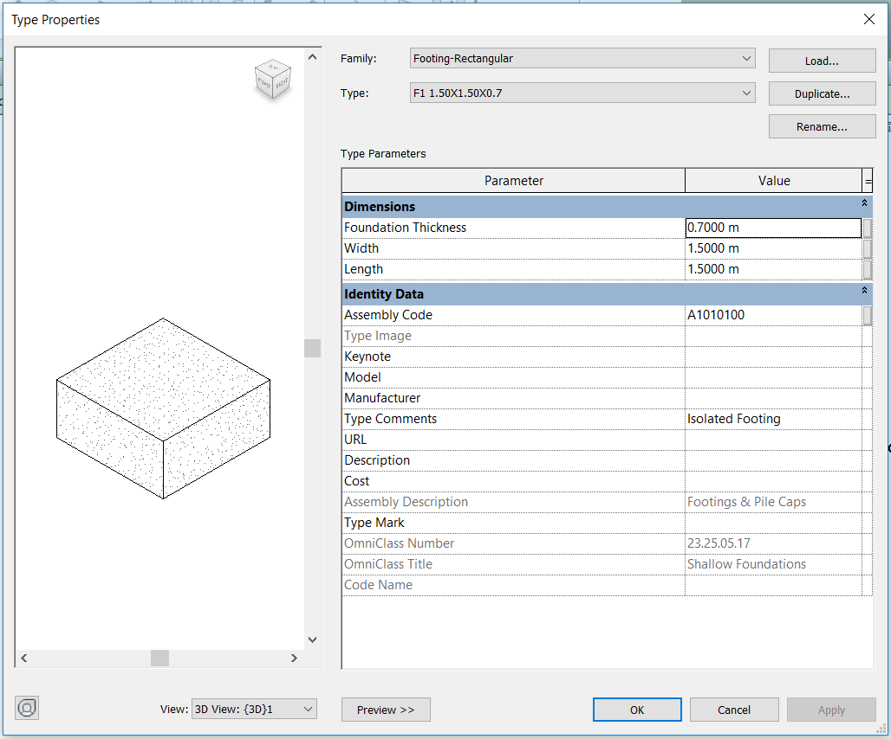
Footings

Slide 29
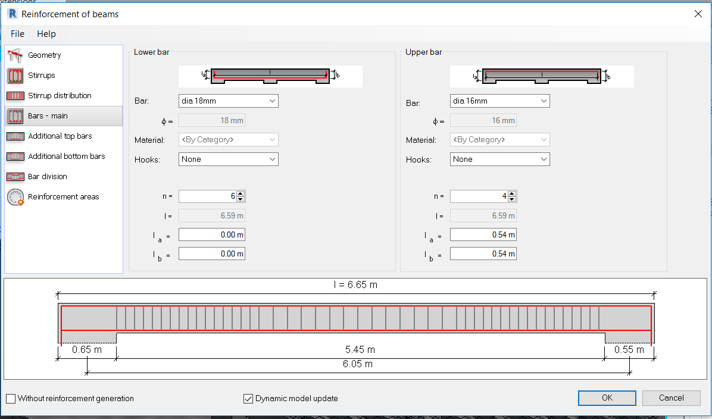
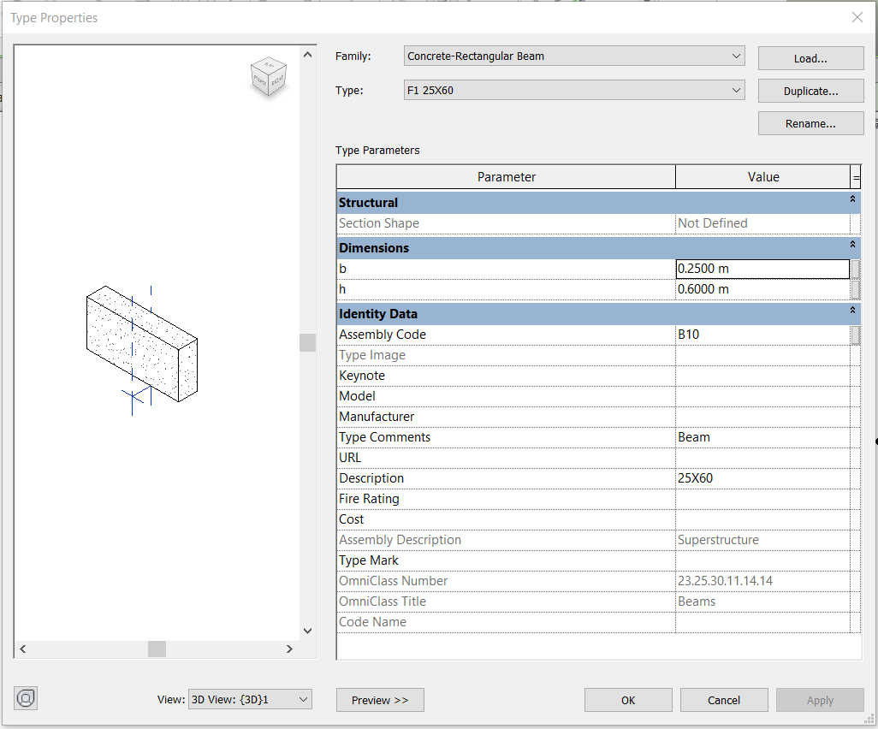
Beams

Slide 30
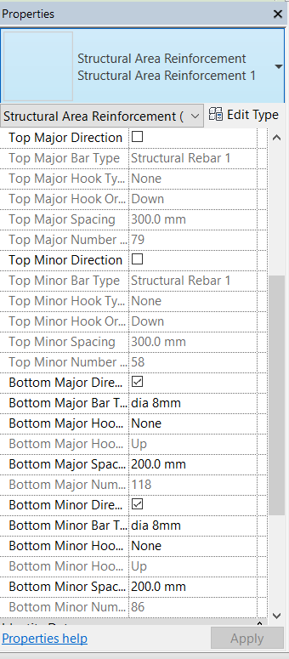
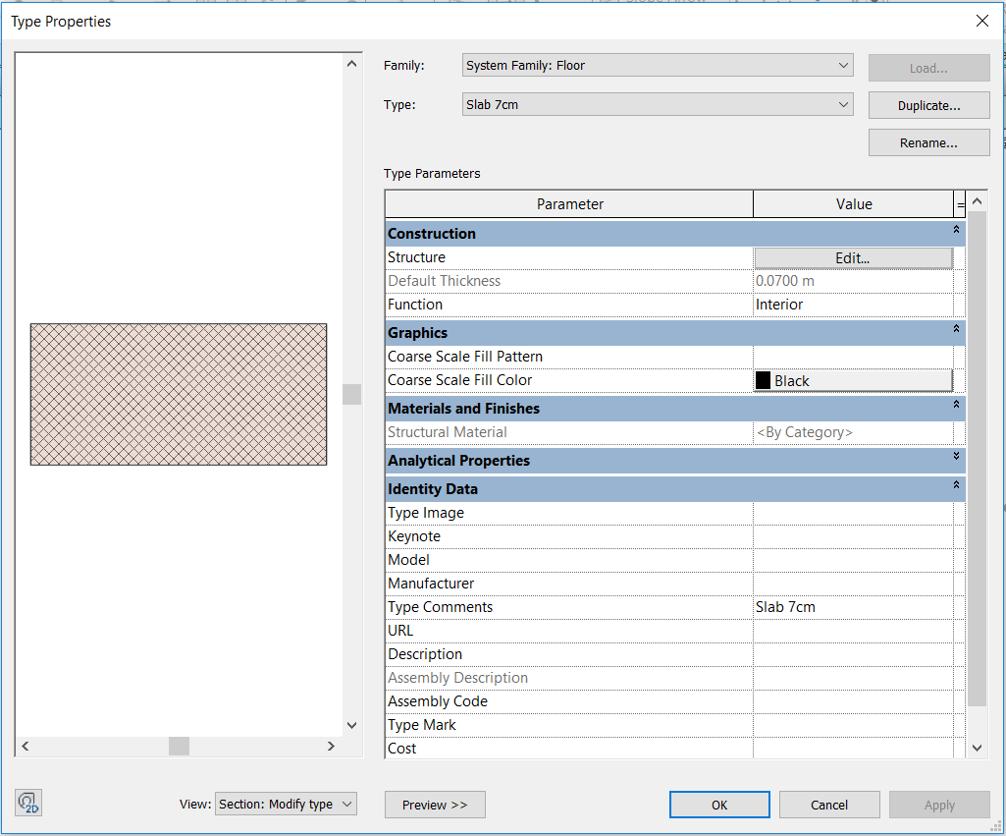
Slabs

Slide 31
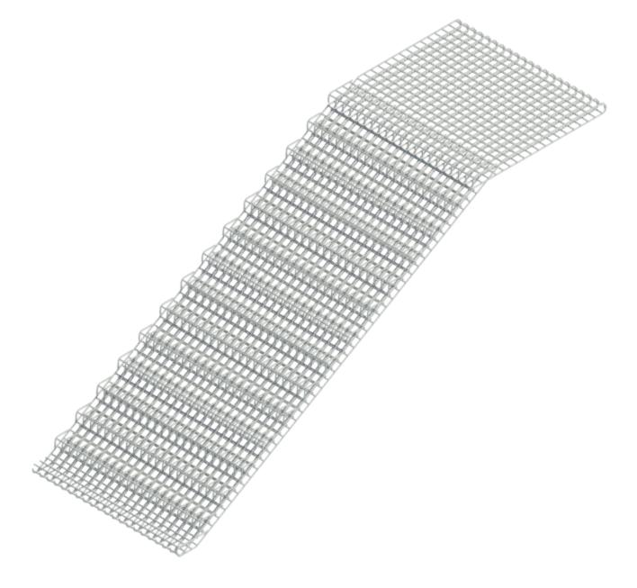
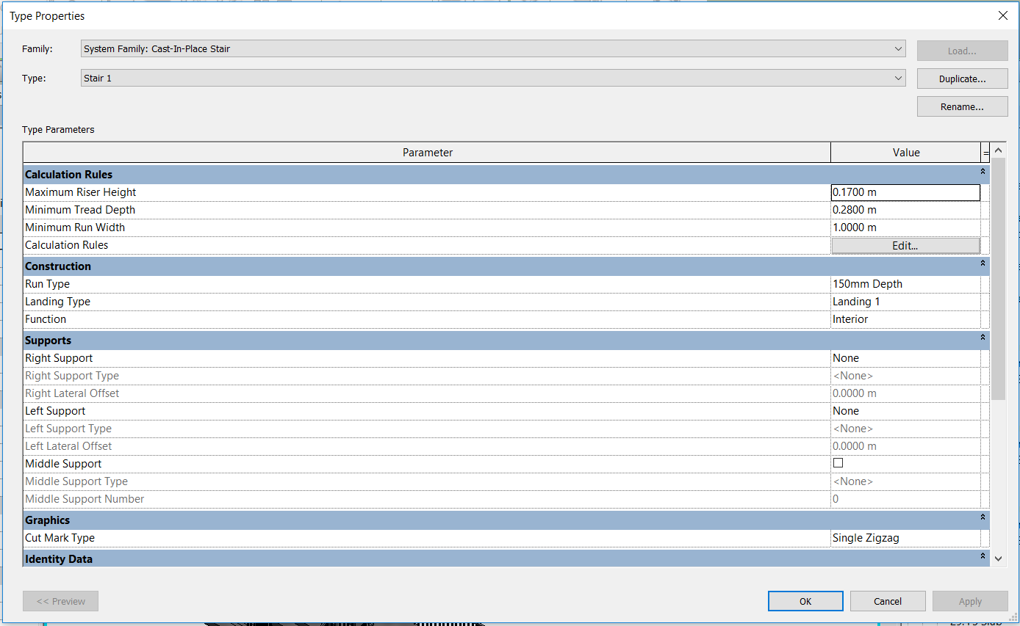
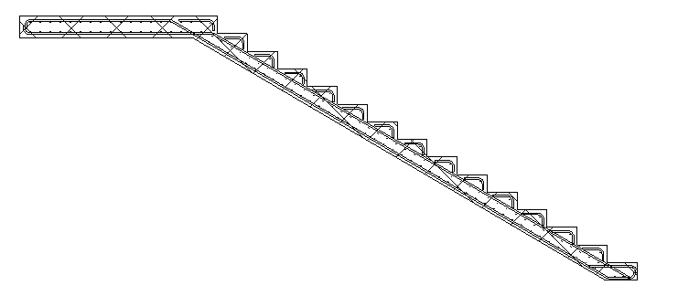
Stairs

Slide 32
Result
 | Concrete (m³) | Reinforcement (Ton) | Blocks (NO.)
Plain Concrete | 89.75 | 0
Isolated Footings | 416 | 31.079
Wall Footings | 152.85 | 10.816
Column Necks | 32.93 | 9.778
Wal Necks | 157.31 | 18.535
Tie Beams | 100.44 | 28.532
Slab on Ground | 250.01 | 8.763
Columns | 244.15 | 61.978
Walls | 719.03 | 79.313
Stairs | 70.47 | 12.853
Beams | 361.88 | 94.526
Slabs | 1101.62 | 192.26 | 39225

Slide 33

Time Schedule Using Primavera Software

Slide 34
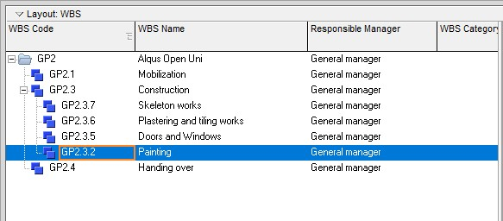
Work Breakdown Structure (WBS)

Slide 35
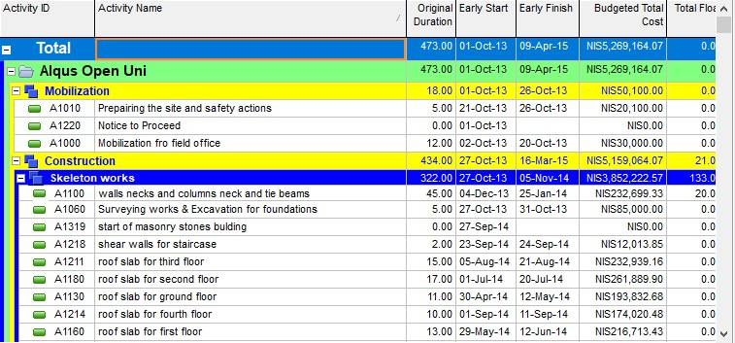
Activities

Slide 36
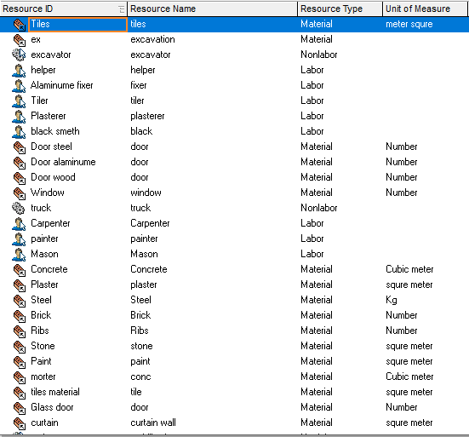
Resources

Slide 37
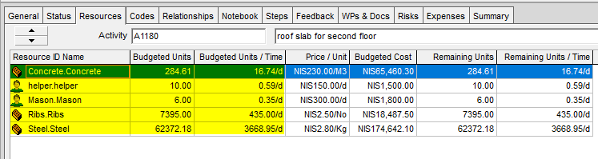
Productivity Rate

Slide 38
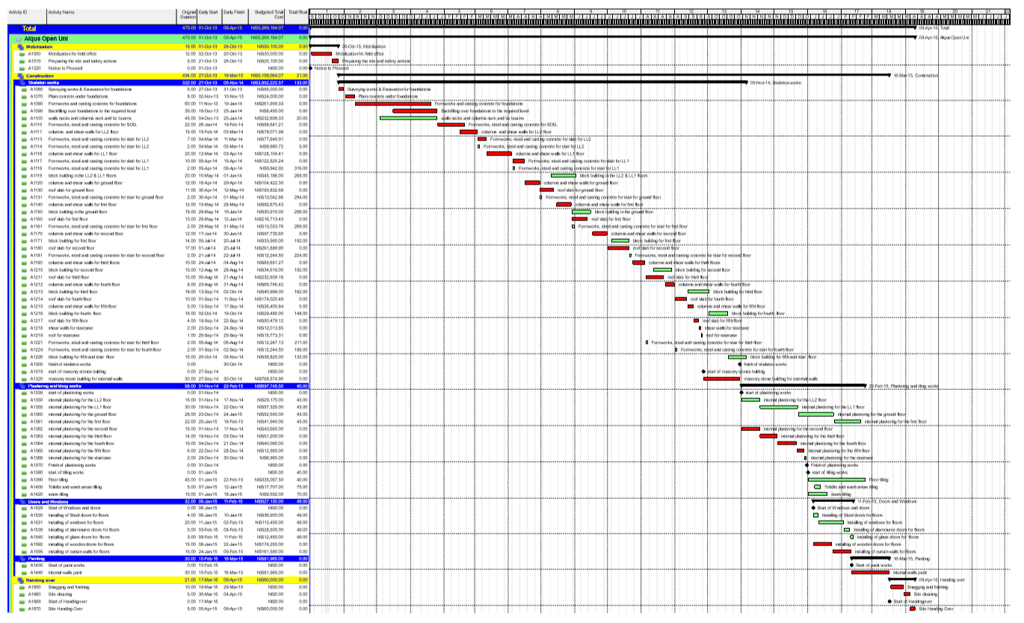
Time Schedule

Slide 39
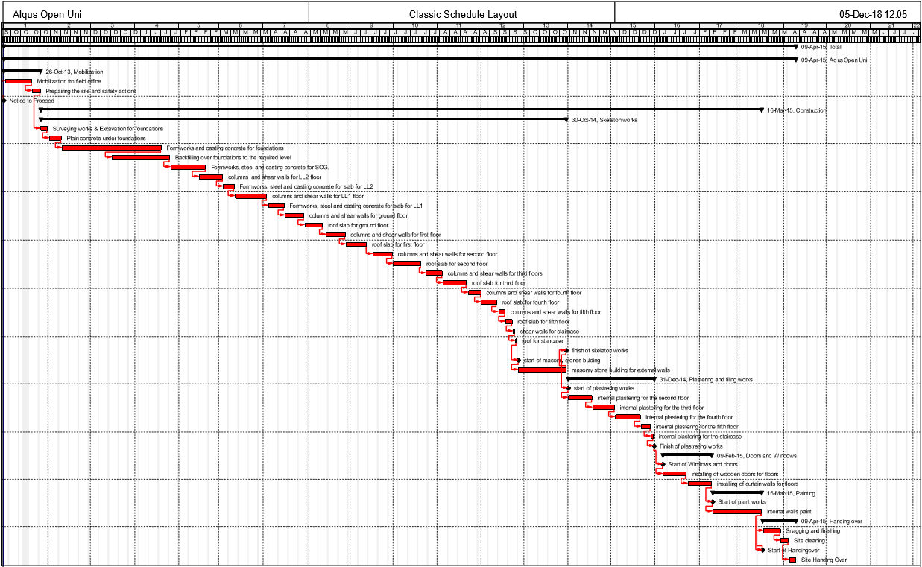
Critical Path

Slide 40
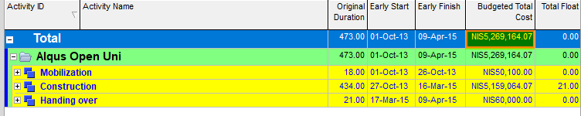
Summary
 | Concrete(m³) | Reinforcement(Kg) | Stone(m²) | Plaster(m²) | Paint(m²) | Brick(NO)
LL2 | 204.97 | 34383.36 | 266.5 | 1398.5 | 1398.5 | 4604.5
LL1 | 334.09 | 55794.20 | 548 | 2806 | 2806 | 12892
GF | 359.79 | 71561.75 | 417.5 | 2567.5 | 2567.5 | 14780
F1 | 362.94 | 74767.83 | 459 | 2037 | 2037 | 13705
F2 | 436.84 | 88066.48 | 479 | 2123 | 2123 | 14134
F3 | 372.56 | 75435.81 | 726 | 2500 | 2500 | 17074
F4 | 290.98 | 58134.82 | 631 | 1943 | 1943 | 14065
F5 | 102.41 | 17785.88 | 228 | 568 | 568 | 1136
Sum | 2464.58 | 475930.12 | 3755.00 | 15943.00 | 15943.00 | 92390.50
After contacting with contractors who implement the structure, the total price was 1800000 $ during 22 months.

Slide 41


