Slide 1

An-Najah National University
Department of Mechanical and Mechatronics Engineering
Design and Control of Multi-Purpose Robot
By: Asem Malayshi Supervisor: Dr. Bashir Nouri
Presentation for Graduation project of :
Design and Control of Multi-Purpose Robot
Submitted in partial Fulfilment Of The Requirements For The Degree Of B.Sc. In Mechatronics Engineering.
By: Asem Malayshi Supervisor: Dr. Bashir Nouri

Slide 2
An-Najah National University
Department of Mechanical and Mechatronics Engineering
Design and Control of Multi-Purpose Robot
By: Asem Malayshi Supervisor: Dr. Bashir Nouri
Contents
Introduction
General purpose industrial robot
Mechanical aspect
-manipulator
-workspace
-mechanics of actuation
Electrical aspect
-stepper motor
-motor drivers
Control aspect
-Arduino controller
-frame attachment and parameters
Conclusion and future work

Slide 3
An-Najah National University
Department of Mechanical and Mechatronics Engineering
Design and Control of Multi-Purpose Robot
By: Asem Malayshi Supervisor: Dr. Bashir Nouri
Introduction
Robots are electro-mechanical machines guided by a computer.
they are consider as good example of mechatronics systems.
They are mechanically moved, the need electricity to be powered, and they are controlled and programmed to do tasks.

Slide 4
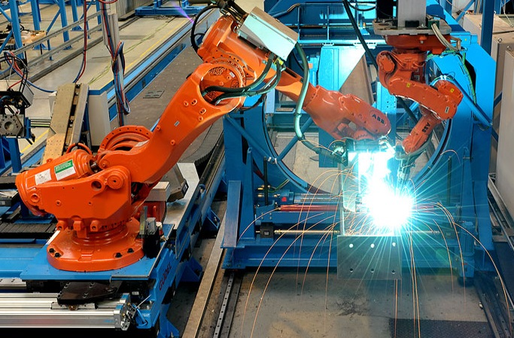
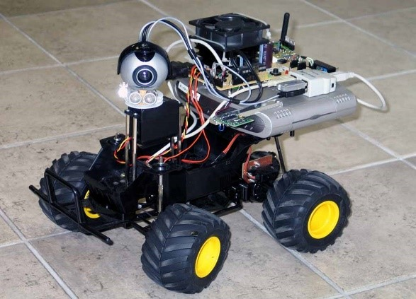
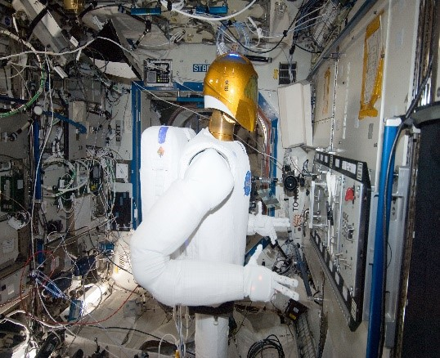
An-Najah National University
Department of Mechanical and Mechatronics Engineering
Design and Control of Multi-Purpose Robot
By: Asem Malayshi Supervisor: Dr. Bashir Nouri
General-Purpose Industrial Robot

Slide 5
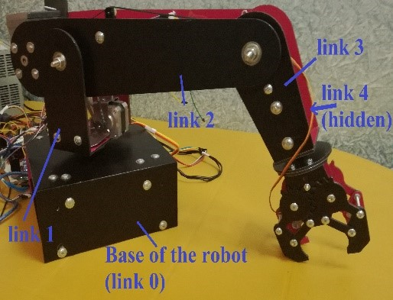
An-Najah National University
Department of Mechanical and Mechatronics Engineering
Design and Control of Multi-Purpose Robot
By: Asem Malayshi Supervisor: Dr. Bashir Nouri
Mechanical Aspect
Manipulator
Set of links connected in series.
They are the hardware of the robot.`
This project consists of four links and four degrees of freedom.
Links and DOF are to be shown while it is working.

Slide 6
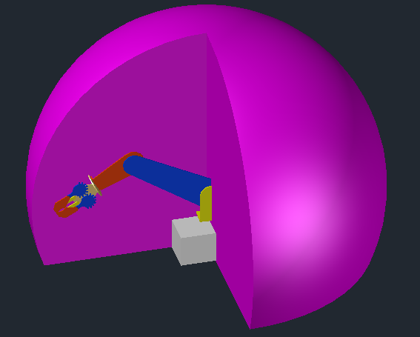
An-Najah National University
Department of Mechanical and Mechatronics Engineering
Design and Control of Multi-Purpose Robot
By: Asem Malayshi Supervisor: Dr. Bashir Nouri
Mechanical Aspect
Workspace
defined as the set of points that the robot can reach.
Project’s robot workspace is a sphere where its center is the
second joint.
The sphere has a diameter of 100 cm from the center point.

Slide 7
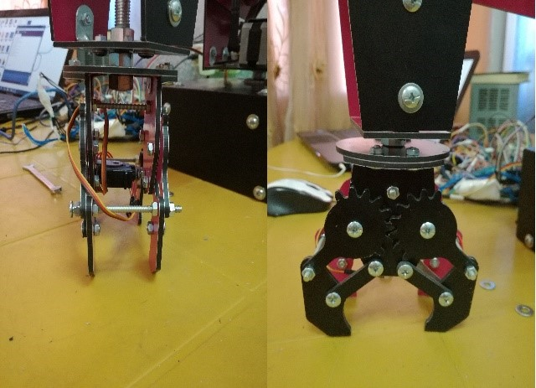
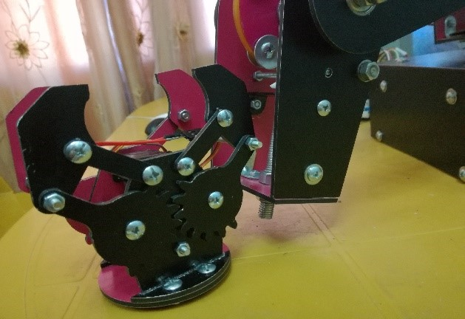
An-Najah National University
Department of Mechanical and Mechatronics Engineering
Design and Control of Multi-Purpose Robot
By: Asem Malayshi Supervisor: Dr. Bashir Nouri
Mechanical Aspect
Changeable End Effector

Slide 8
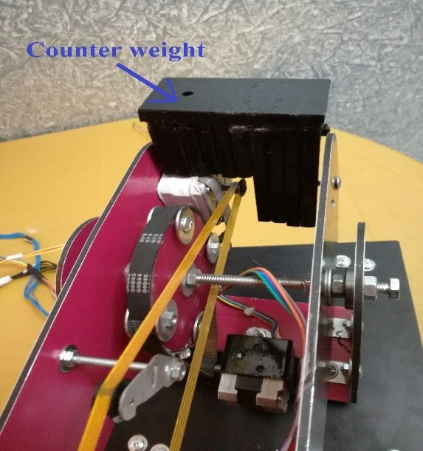
An-Najah National University
Department of Mechanical and Mechatronics Engineering
Design and Control of Multi-Purpose Robot
By: Asem Malayshi Supervisor: Dr. Bashir Nouri
Mechanical Aspect
Counter Weight
A counter weight had to be installed at the second link.
It balances the load at the second link.
It helps second stepper moving the second, third,
and forth link as well as the load.

Slide 9
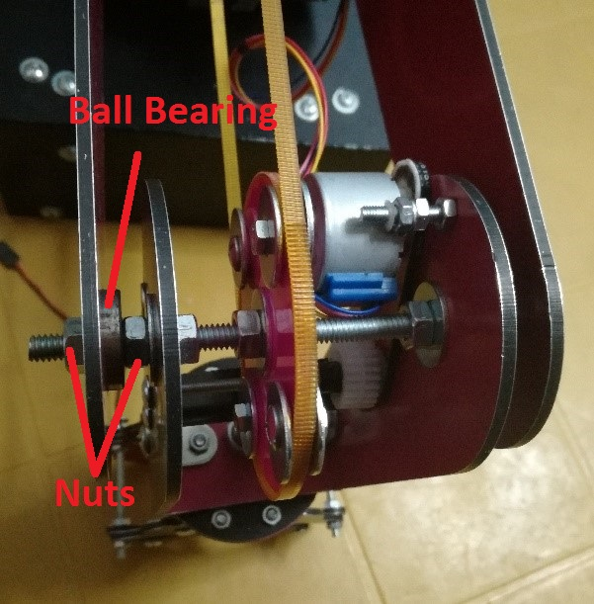
An-Najah National University
Department of Mechanical and Mechatronics Engineering
Design and Control of Multi-Purpose Robot
By: Asem Malayshi Supervisor: Dr. Bashir Nouri
Mechanical Aspect
Joint Description
Consists of two ball bearings that their outer race is fixed
with the previous link.
Their inner race is fixed with the next link using a screw
When the gear moves, it moves the screw and the next
link while the previous link is still at its position.

Slide 10
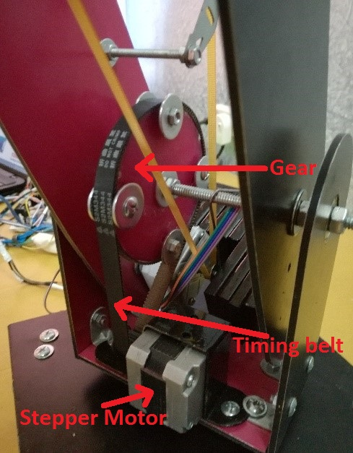
An-Najah National University
Department of Mechanical and Mechatronics Engineering
Design and Control of Multi-Purpose Robot
By: Asem Malayshi Supervisor: Dr. Bashir Nouri
Mechanical Aspect
Mechanism of Actuation
A motor is mounted with a specific link and moves a timing belt.
The timing belt is connected to the motor coupling and a gear .
The gear is mechanically mounted with the next link .

Slide 11
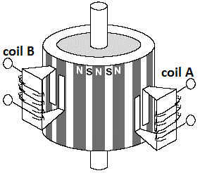
An-Najah National University
Department of Mechanical and Mechatronics Engineering
Design and Control of Multi-Purpose Robot
By: Asem Malayshi Supervisor: Dr. Bashir Nouri
Electrical Aspect
Stepper Motor Actuator
Consists of a permanent magnet cylinder with different poles.
When electricity is applied to a coil, it directs the motor shaft
to a specific position
A specific pulse from the controller could move the motor to
either clockwise or CCW direction.

Slide 12
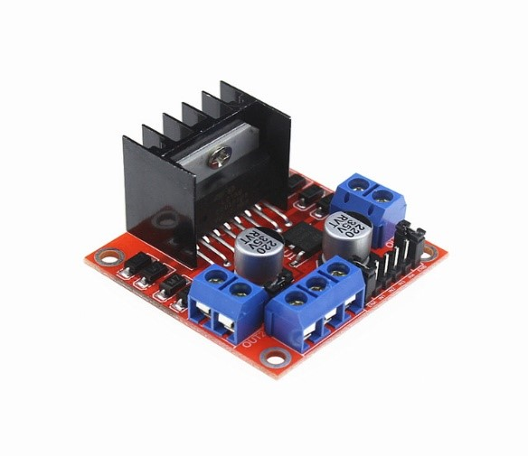
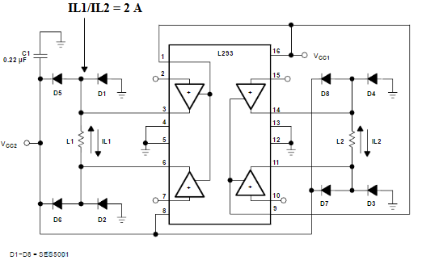
An-Najah National University
Department of Mechanical and Mechatronics Engineering
Design and Control of Multi-Purpose Robot
By: Asem Malayshi Supervisor: Dr. Bashir Nouri
Electrical Aspect
Motor Drivers (L293N)
Provides an interface between
the high voltage of the motor
and the low voltage of the
controller.

Slide 13
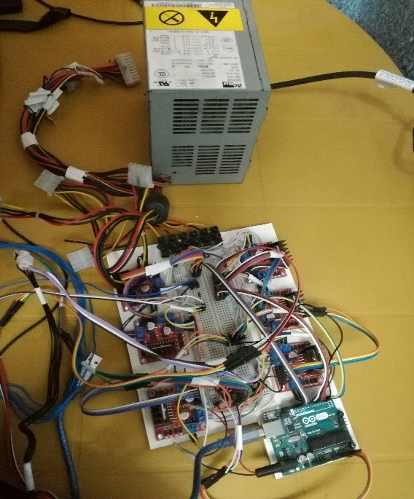
An-Najah National University
Department of Mechanical and Mechatronics Engineering
Design and Control of Multi-Purpose Robot
By: Asem Malayshi Supervisor: Dr. Bashir Nouri

Slide 14
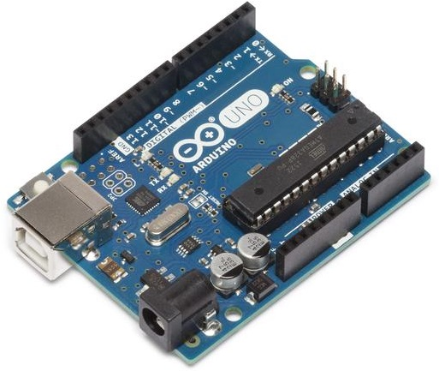
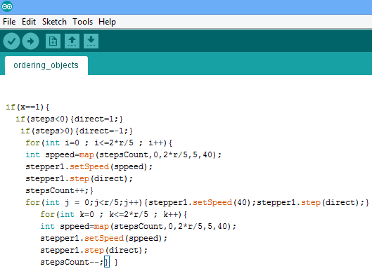
An-Najah National University
Department of Mechanical and Mechatronics Engineering
Design and Control of Multi-Purpose Robot
By: Asem Malayshi Supervisor: Dr. Bashir Nouri
Control Aspect
Arduino UNO Microcontroller and Arduino IDE programming language

Slide 15
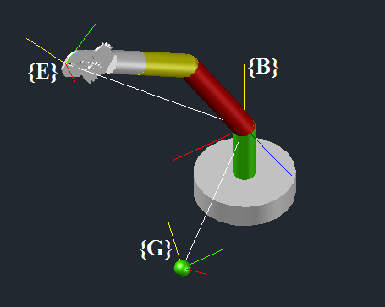
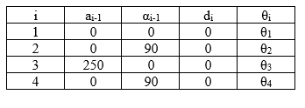
An-Najah National University
Department of Mechanical and Mechatronics Engineering
Design and Control of Multi-Purpose Robot
By: Asem Malayshi Supervisor: Dr. Bashir Nouri
Control Aspect
Frame Attachment and Link Parameters

Slide 16
An-Najah National University
Department of Mechanical and Mechatronics Engineering
Design and Control of Multi-Purpose Robot
By: Asem Malayshi Supervisor: Dr. Bashir Nouri

Slide 17
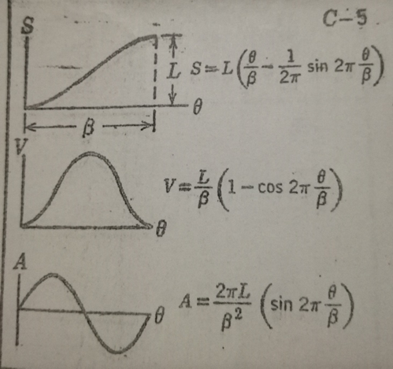
An-Najah National University
Department of Mechanical and Mechatronics Engineering
Design and Control of Multi-Purpose Robot
By: Asem Malayshi Supervisor: Dr. Bashir Nouri
Control Aspect
Smooth Speed Curve
A smooth curve of motion has to be chosen, because ON-OFF
signals do not work.
ON-OFF signals will generate high vibrations to the mechanism.

Slide 18
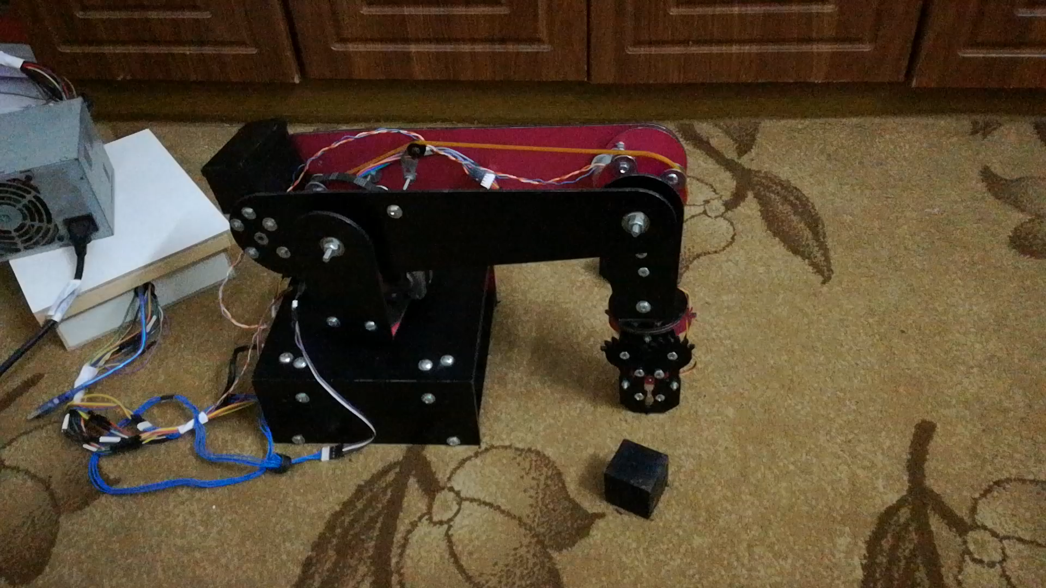
An-Najah National University
Department of Mechanical and Mechatronics Engineering
Design and Control of Multi-Purpose Robot
By: Asem Malayshi Supervisor: Dr. Bashir Nouri
Conclusion
Showing a video of the robot while it is ordering objects :

Slide 19
An-Najah National University
Department of Mechanical and Mechatronics Engineering
Design and Control of Multi-Purpose Robot
By: Asem Malayshi Supervisor: Dr. Bashir Nouri
Future work
There are many methods of developing the project.
On one hand, designing other types of end effectors such as a writing end effector.
On the other, providing the robot with sensor elements such as vision cameras.

Slide 20
An-Najah National University
Department of Mechanical and Mechatronics Engineering
Design and Control of Multi-Purpose Robot
By: Asem Malayshi Supervisor: Dr. Bashir Nouri
Thanks and Appreciation

