Slide 1

E-Commerce
Crown Store
Jehad Abdalhaq
Abdullah Jawabreh
Supervised by Dr. Ruba Aways

Slide 2



About Crown Store:
Seamless Online Shopping
Convenient Home Delivery
Personalized Style & Pricing
Easily browse and purchase the latest men's clothing collections from anywhere.
Enjoy the convenience of having your purchases delivered right to your doorstep.
Find your perfect style with customized options and transparent pricing.

Slide 3



Problem & Solution
Problem | Solution
Decline in sales due to an ineffective product display. | We have made online ordering easy by clearly and attractively displaying the product.
Lack of transparency in pricing and ordering | Simplify the ordering process and clarify prices and discounts.
No customization options for customers. | Added flexibility to personalize orders
Managing inventory and ordering products was manual | A smart digital system for ordering products and managing inventory
Sales were recorded manually using paper and pen. | ➤ Fully automate sales electronically.
➤ Declining sales due to ineffective product display.
➤ We have made online ordering easy by clearly and attractively displaying the product.
➤ Lack of transparency in pricing and demand mechanisms.
➤ A clear pricing system and an easy and straightforward ordering mechanism.
➤ Lack of customization options for customers.
➤ Provide customization options such as color and size.
➤ Managing inventory and ordering products was manual and slow, causing delays and errors.
➤ A smart digital system to order products and manage inventory easily and quickly from within the site.
➤ Sales were recorded manually using paper and pen.
➤ Fully automate sales electronically.

Slide 4



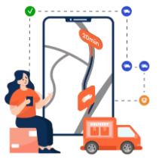








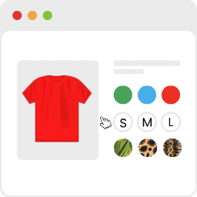
Used Technologies & Tools :
Litespeed Cashe
WooCommerce
Elementor
Orders Tracking
Google Analytics & Exact Metrics
MailPoet
WP 2FA – Two-factor authentication for WordPress
reCAPTCHA
Stock manager
Tawk.To Live Chat
Variation Swatches
Return Refund & Exchange

Slide 5
Website Features:
✔️ High security
✔️ Dynamic user interfaces
✔️ Customization
✔️ Multiple payment methods
✔️ Choose a pickup and delivery date
✔️ Order tracking
✔️ Stock Manager
✔️ AI Chat
✔️ Refund and Exchange system
✔️ Send & Receive Quotes
✔️ Mailpoet
✔️ Reports

Slide 6
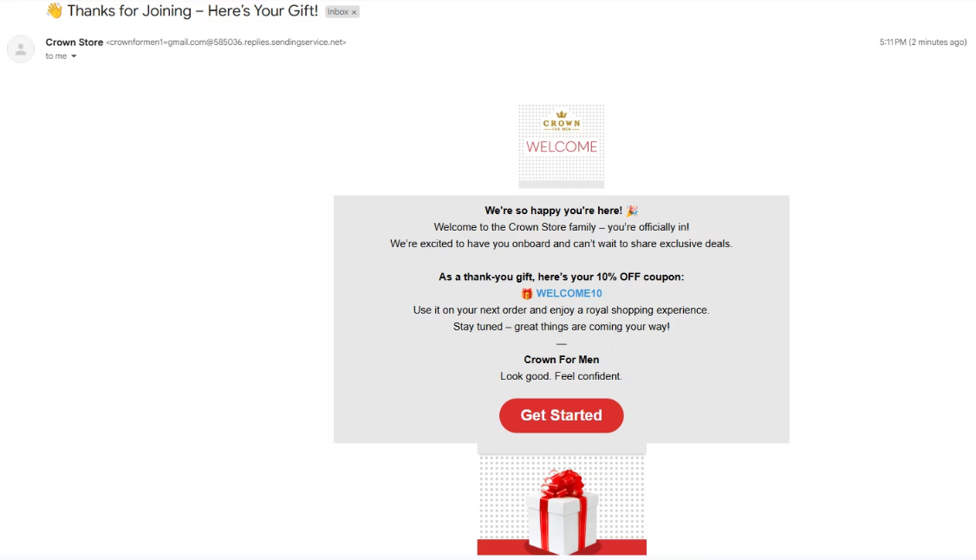
MailPoet
📩 When a customer registers on the website, an automatic welcome email is sent to their inbox thanking them for registering. The email also includes a 10% off coupon for their first purchase to encourage engagement and loyalty.
🔑 Coupon code: WELCOME10.

Slide 7
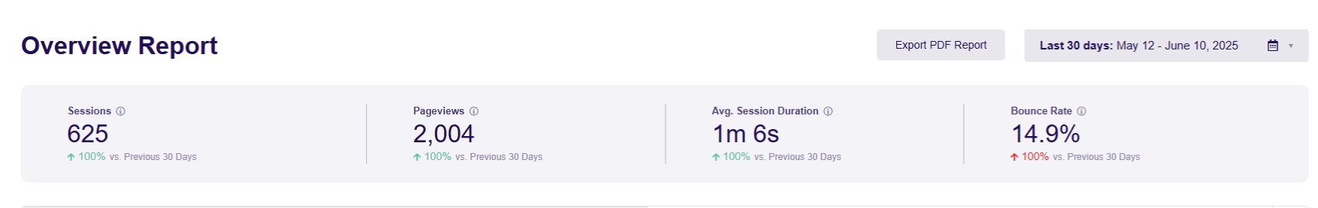
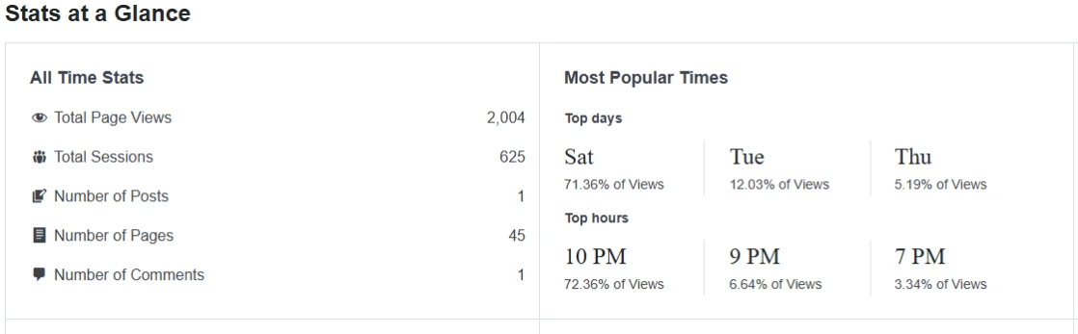
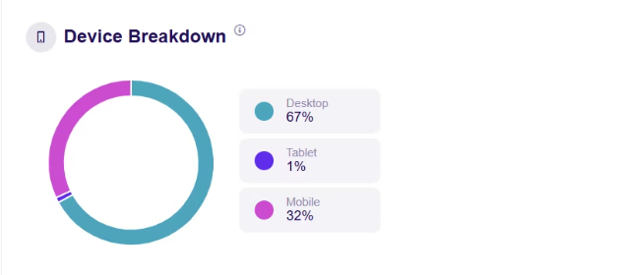
ExacitMetrics

Slide 8
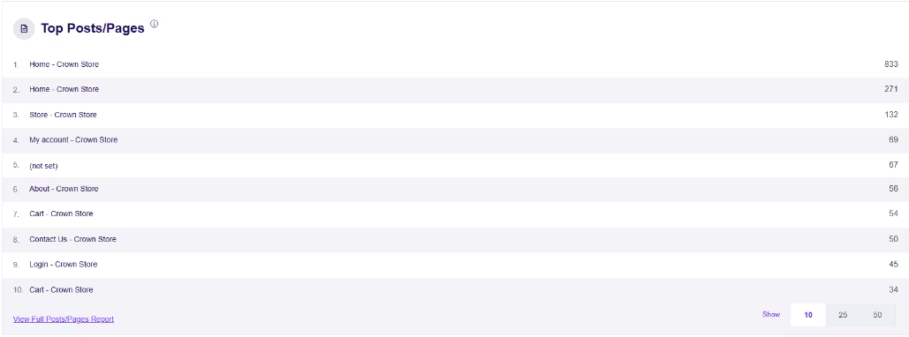
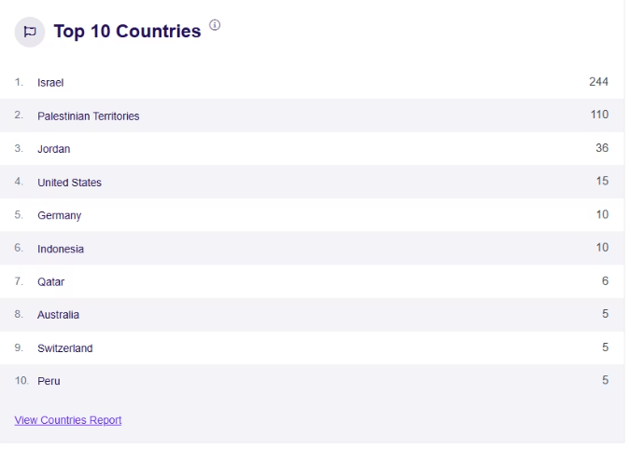

Slide 9
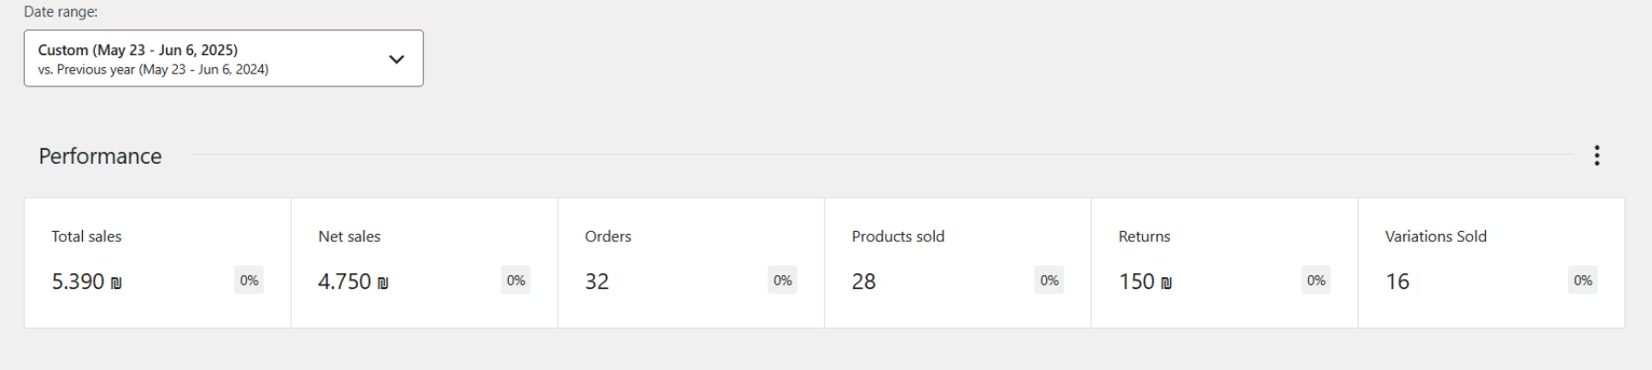
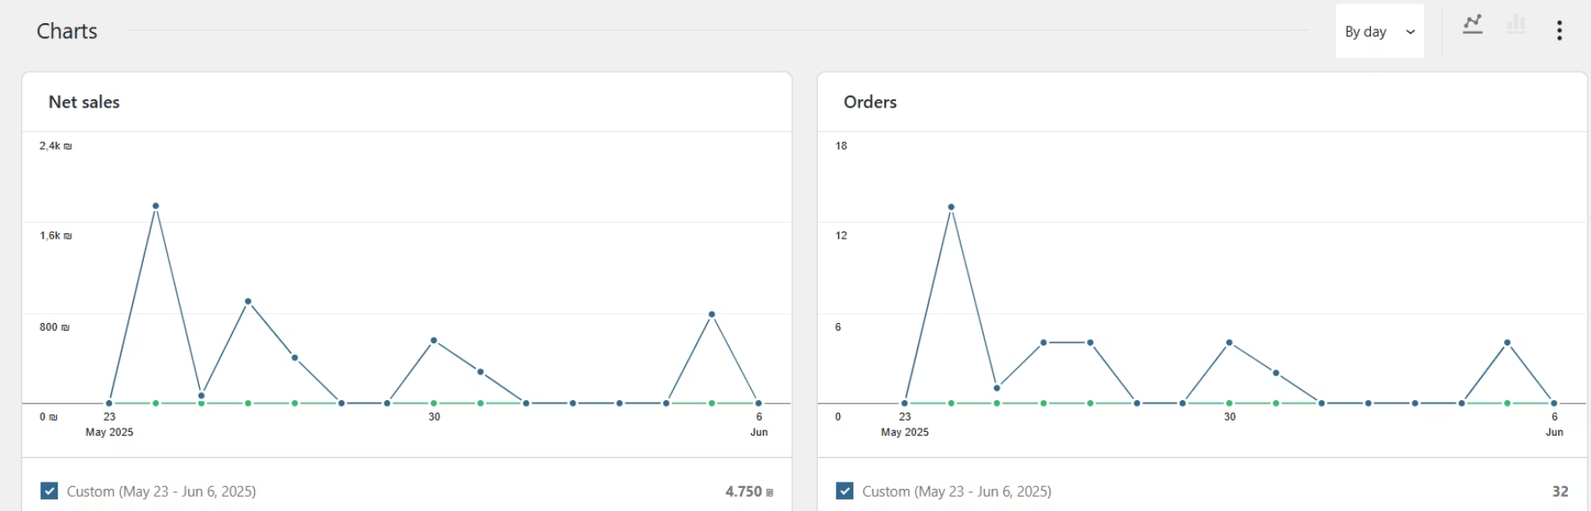
Reports
Reports that include net and gross sales, best-selling products, inventory status, and customer data help optimize store performance by understanding market needs, improving inventory management, and facilitating effective strategic decision-making.

Slide 10
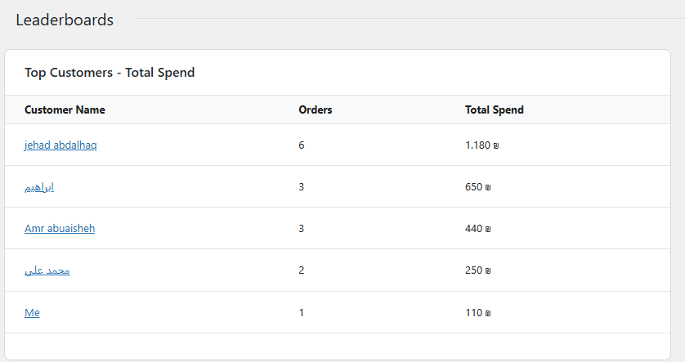
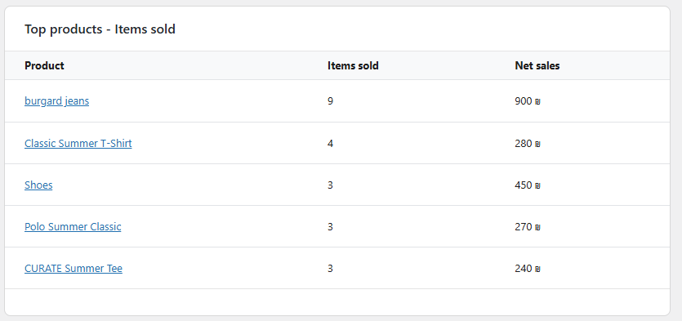
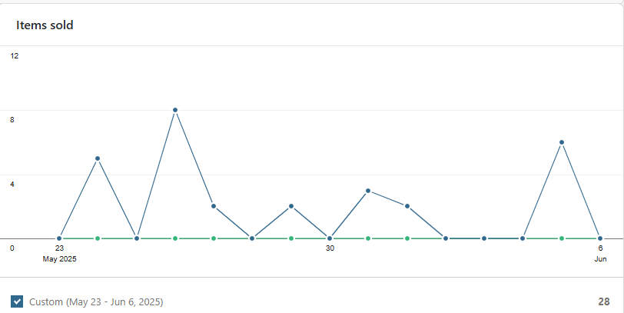
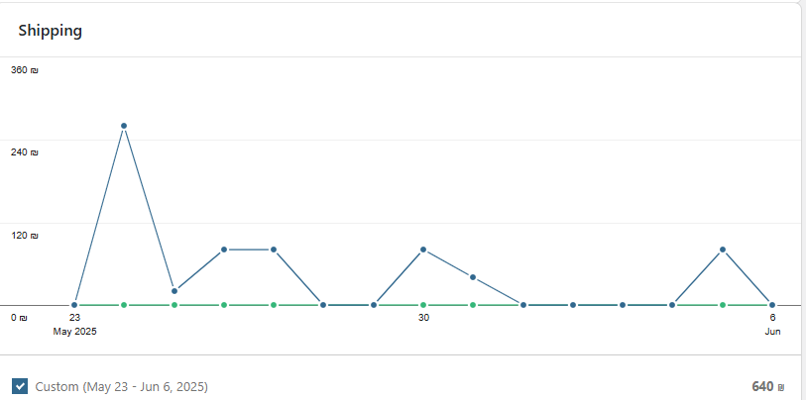

Slide 11
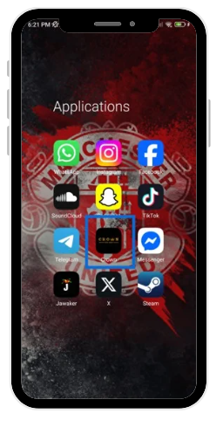
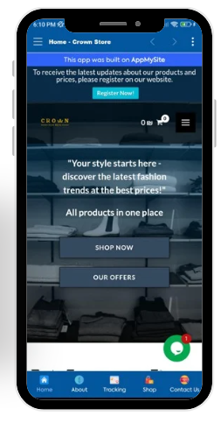
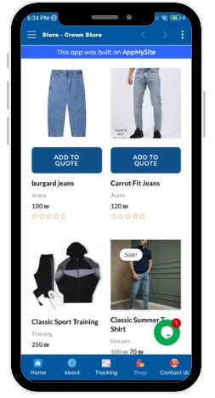
Crown Application

Slide 12

Future Plans
➤ Launch iOS Mobile App the Android app is already developed next step is launching the iOS version to reach more users.
➤ Create a Custom Clothing Page with 3D Visualization.
➤ Optimize quotations by linking them to real-time inventory.
➤ Send SMS messages to customers to confirm orders, ensuring clarity and convenience.
➤ Developing the mobile app for both App Store and Play Store availability.

