Slide 1
Angel
Prepared by:
Eman Qaqa
Dunia Saffarini

Slide 2
Outline
What is Angel?
Motivation
How does it work?
Technical choices.
Constraints.
Future work

Slide 3
What is Angel?
Angel is a robot that helps nurses and hospital employees to deliver the appropriate diet to the appropriate patient.

Slide 4
Motivation
• Save time and efforts.
• Sensitive duties for hospital employees.
•Delivering the appropriate diet to the appropriate patient.
•No errors while delivering the diets.

Slide 5
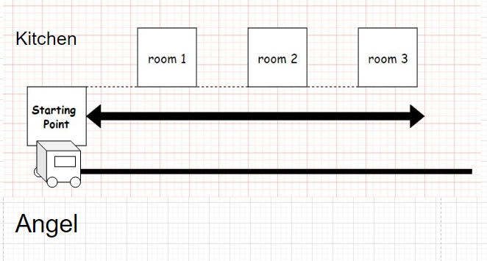
How does it work?
Our Angel starts the movement from a starting point Which is the kitchen in the hospital.

Slide 6
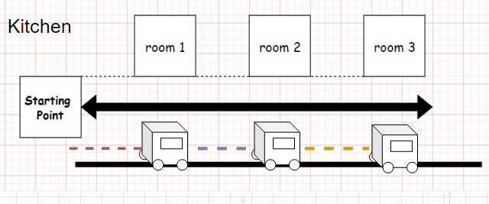
2) It will start the movement after putting the diets or the medicine in the turntable part of our robot

Slide 7
3) It will follow a speciﬁc black line and deliver the appropriate diet to the appropriate room and determine the rooms by distance

Slide 8
The distance between the rooms will be the same, our robot can deliver up to 3 rooms right now

Slide 9
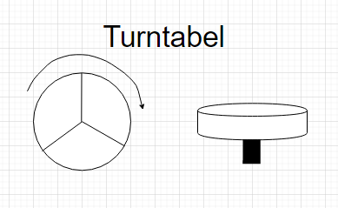
4) In front of each room the turntable inside the robot will turn until match the right room & the right dish

Slide 10
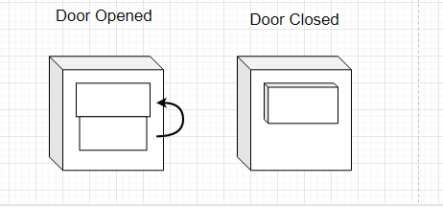
5) The door will open after specific delay which is enough to take the dish the door will close

Slide 11
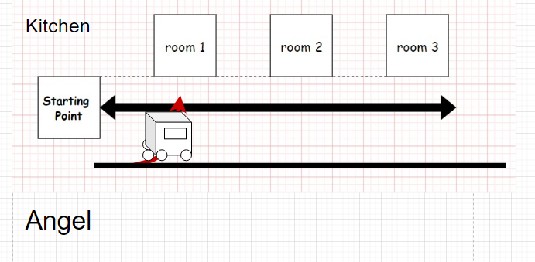
6) if there are line to inside the room which need to turn right or left Our Angel can turn based on IR Sensors

Slide 12
Technical choices
1- Moving the wheels:
DC motor
Dual H-Bridge driver
IR sensors
2- The Turntable Disk:
Stepper motor
IR sensors
3- The door: Servo motor
4- Controller: Arduino Mega

Slide 13
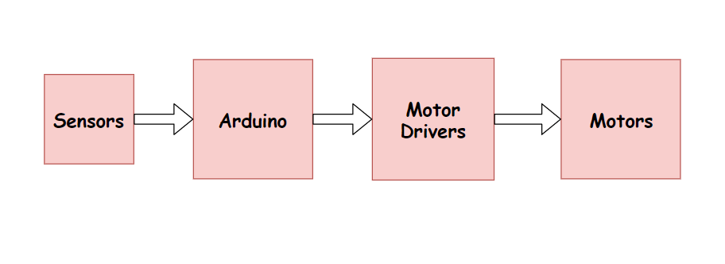
The Movement part
Line Following Process:

Slide 14
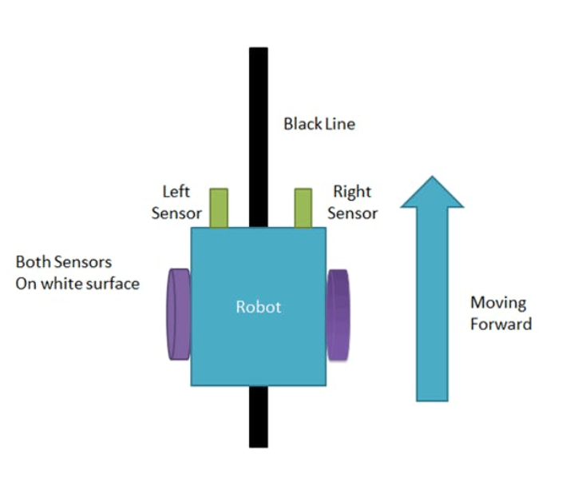
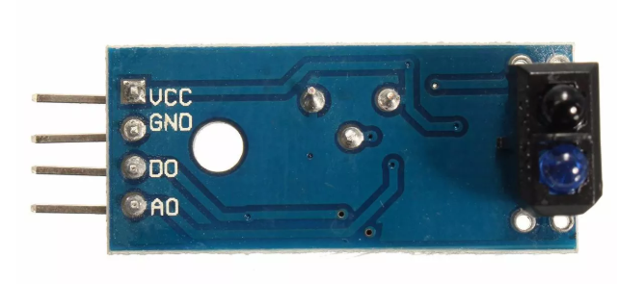
The Movement part
1-Line Following process(Cont.)
We used 2 IR sensor module
1- IR transmitter and IR receiver.
2- white surface is a reflected surface but the black not.

Slide 15
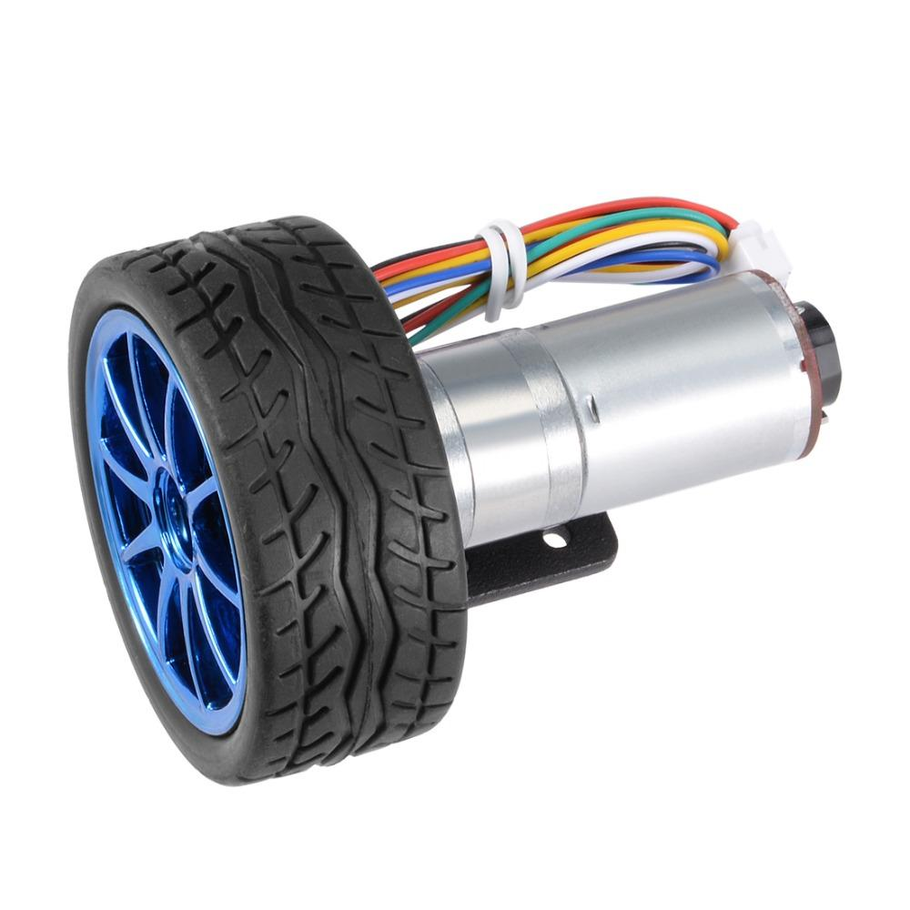
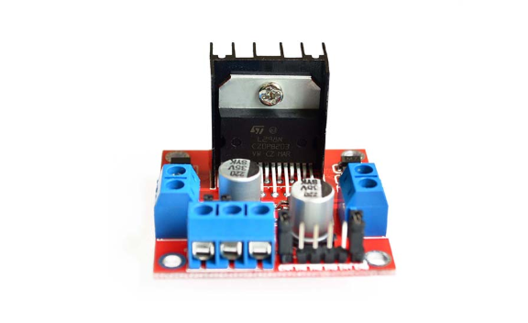
The Movement part
2- 4 DC motors to move the wheels of the Robot.
3- L298n Dual H-Bridge Driver:
interface between arduino and motors.
control 2 motors independently in both directions.

Slide 16
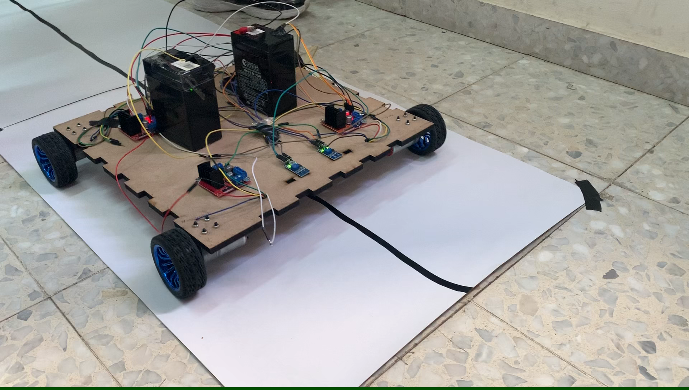

Slide 17
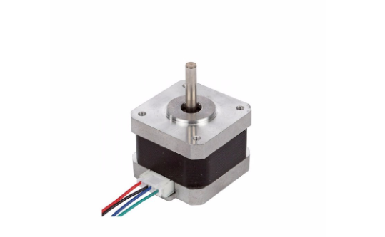
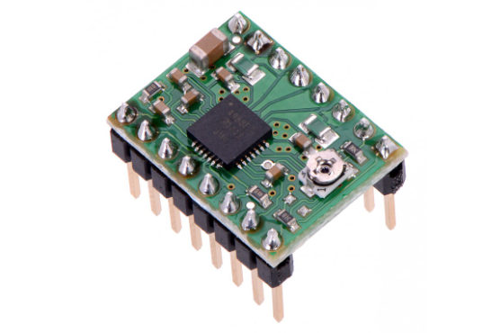
The Turntable Part
1- Stepper motor.
To achieve a precise motion control to the turntable part.
2- A4988 stepper motor driver.
Control rotation of Stepper motor by using 2 pins.
3- 3 IR sensors.

Slide 18
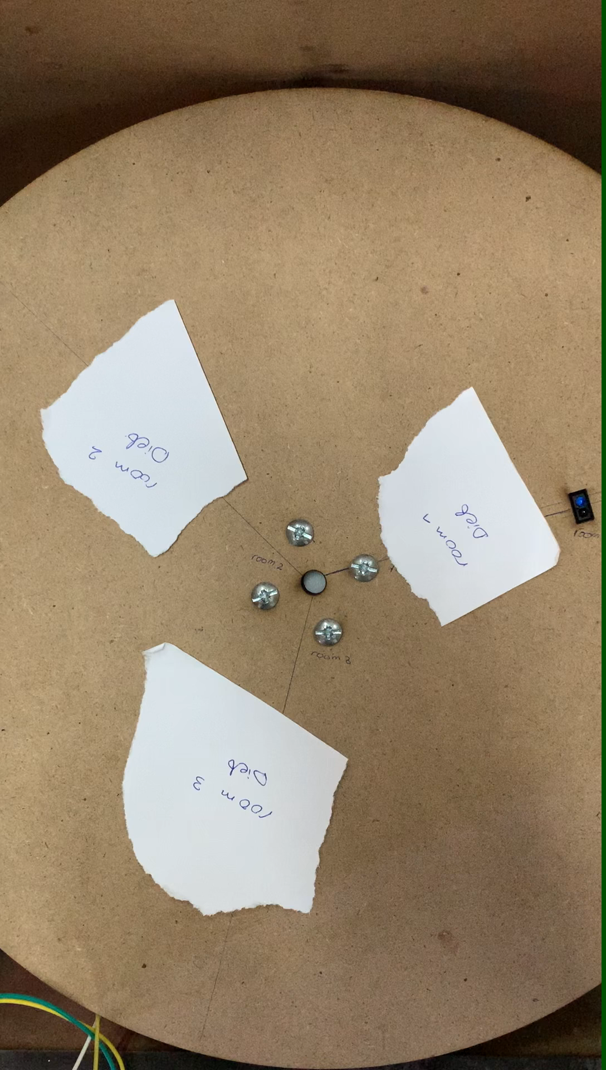

Slide 19
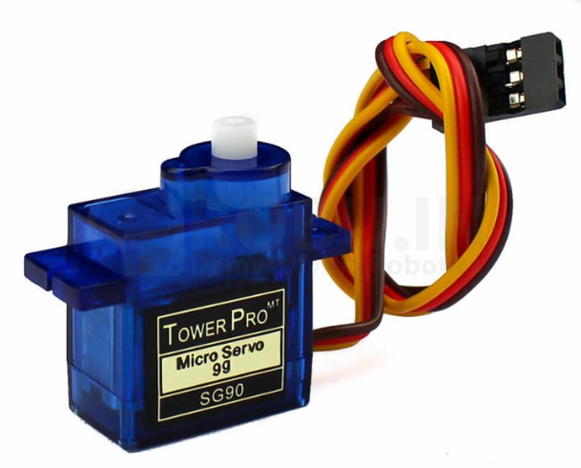
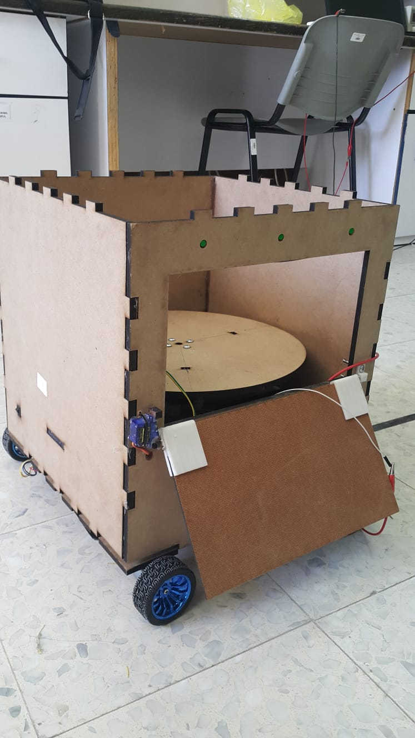
The Door
1- Servo motor .
push and rotate an object with a specific angle.
open the door: rotate it by -180 degree
close door : rotate by 180 degree

Slide 20
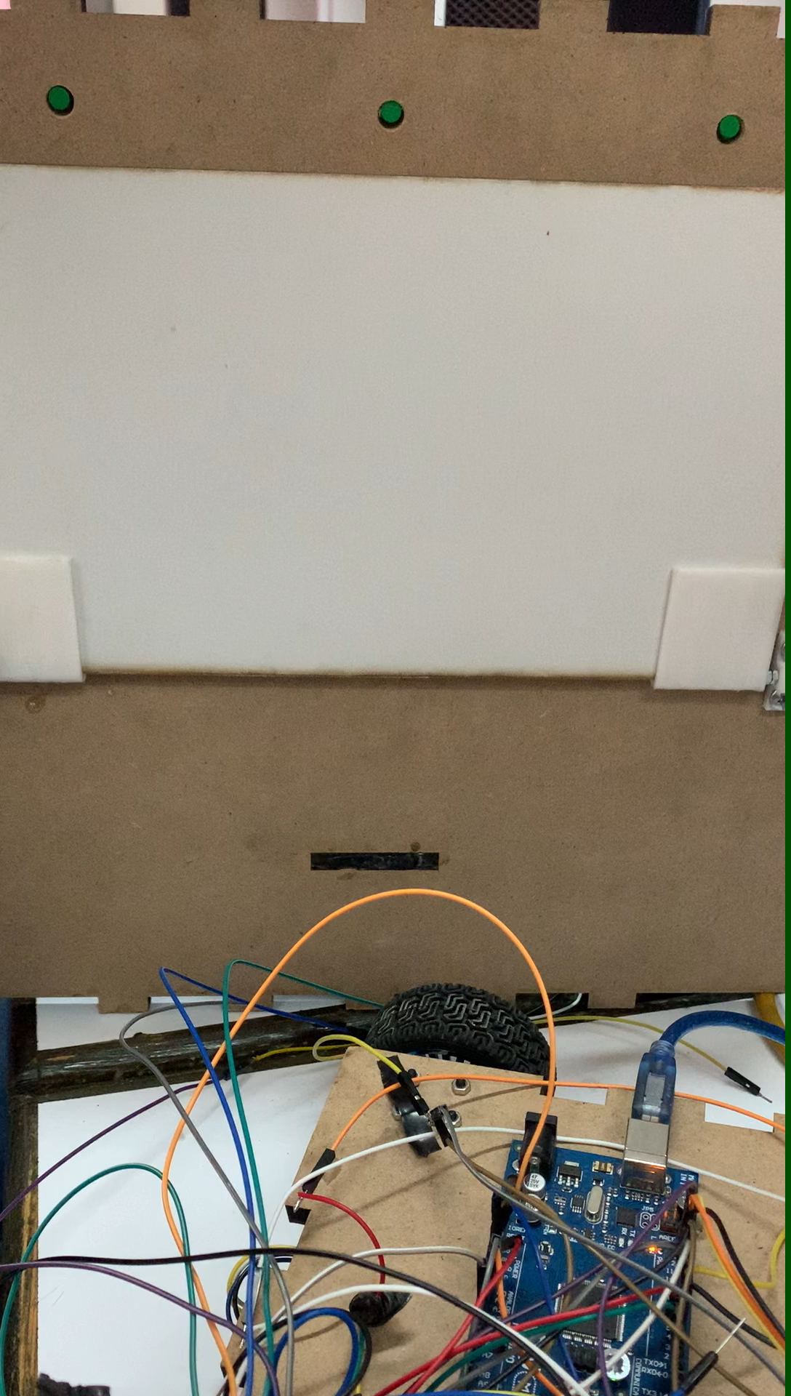

Slide 21
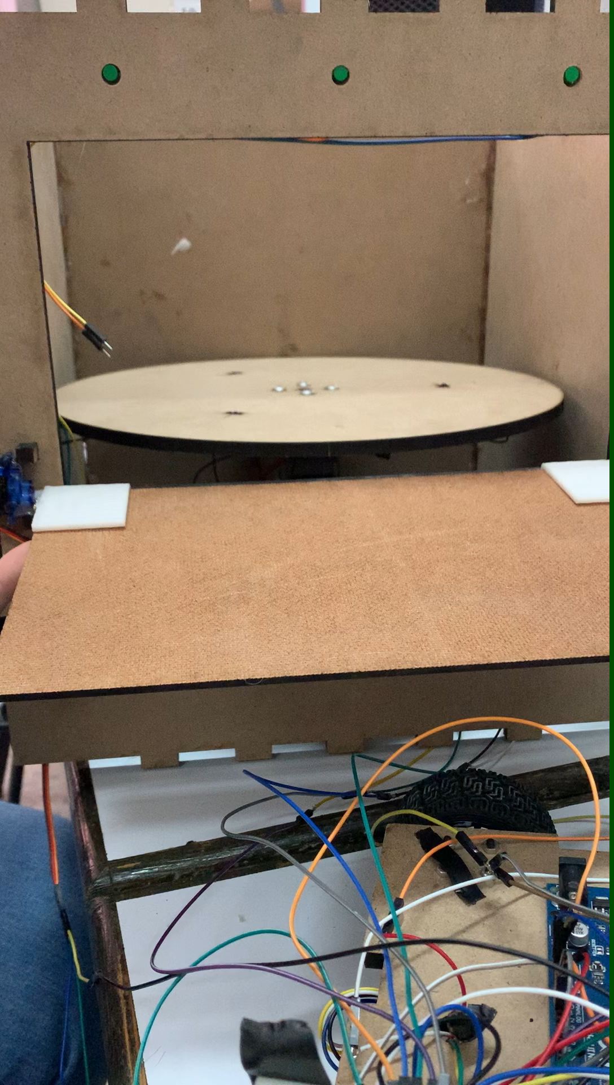

Slide 22
Constrains
1- IR sensors can’t detect the right color that because it only detects it by a speciﬁc distance.
2-The motors and the wheels always need to tied them up.
3- Fraction of stepper motor with the turntable part.

Slide 23
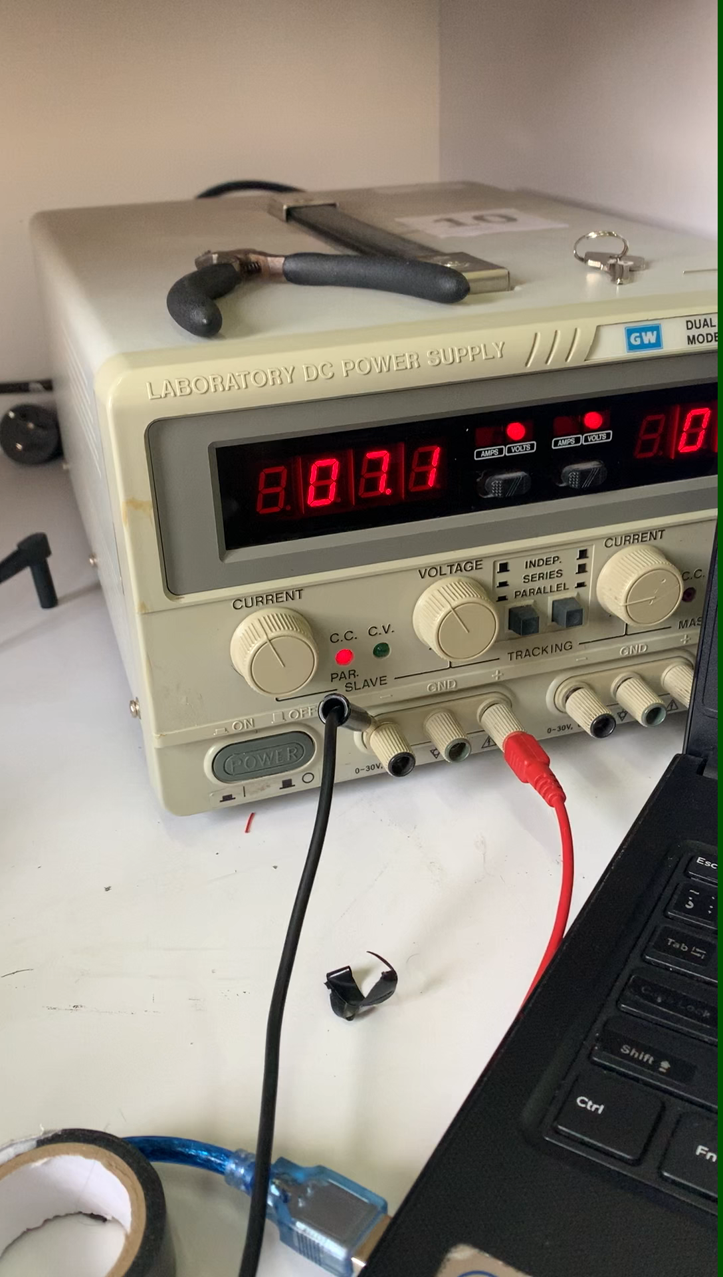

Slide 24
Conclusion and future work
1- Adding more rooms to be serviced
2- Controlling the movement and the process by a mobile app.
3- Involve image processing system to detect the rooms automatically.
4- Involve AI to detect the shortest Path to deliver the food.

