Slide 1

Design and Optimization of a Hybrid Solar/Diesel Energy System Using HOMER Software
Done By:
Abdullah Ammar
Hamza Aker
Hussam Ezzat
Supervised by:
Dr. Adel Juaidi
Graduation Project 2, May.2025

Slide 2
index
Introduction
Methodology
Results
Objectives
Case Study
Literature Review

Slide 3

Introduction
Global energy crisis
Importance of renewable energy
hybrid energy systems

Slide 4
Energy Situation in Palestine
Need for sustainable energy solutions
Challenges in energy supply
Potential of solar energy
Political instability, deficient infrastructures, and large energy import dependency [11].
PSH between 5.4 and 6 (kWh/m²/ day) and nearly 3000 sunshine hours annually [12].
Of all the electricity consumed in the West Bank, 97.2% is imported [12].

Slide 5
Objectives
To analyze and optimize a hybrid SPV/DG system
To evaluate the economic feasibility of the hybrid system
To assess environmental benefits and CO₂ emissions
To demonstrate the potential of HES in supporting energy independence in conflict-affected regions.
To use HOMER software for system simulation and optimization

Slide 6
Literature Review
Reference | Country | Year | Methodology | Main Findings
[69] | Palestine | 2025 | HOMER | The hybrid system brings down electricity costs to 0.285 USD/kWh thus producing USD 44,698 worth of profit while achieving a 22% decrease in energy payments during a 7.58-year payback period [69]. The system reaches an 88.6% renewable power share while cutting down 8.262 annual tons of CO₂ [69].
[70] | Nigeria | 2025 | HOMER | The hybrid system generates earnings by achieving positive return on investment together with four-year capital recovery [70]. The implementation provides a reliable power supply system through the combination of wind power with solar energy and diesel engines and storage batteries [70].
[71] | India | 2025 | HOMER | The hybrid system equipped with LI batteries achieved the lowest net present cost which amounted to 1.64 million USD [71].
[73] | Indonesia | 2025 | HOMER | The study demonstrated that a hybrid renewable energy system can be a reliable and cost-effective solution for rural electrification [73].

Slide 7
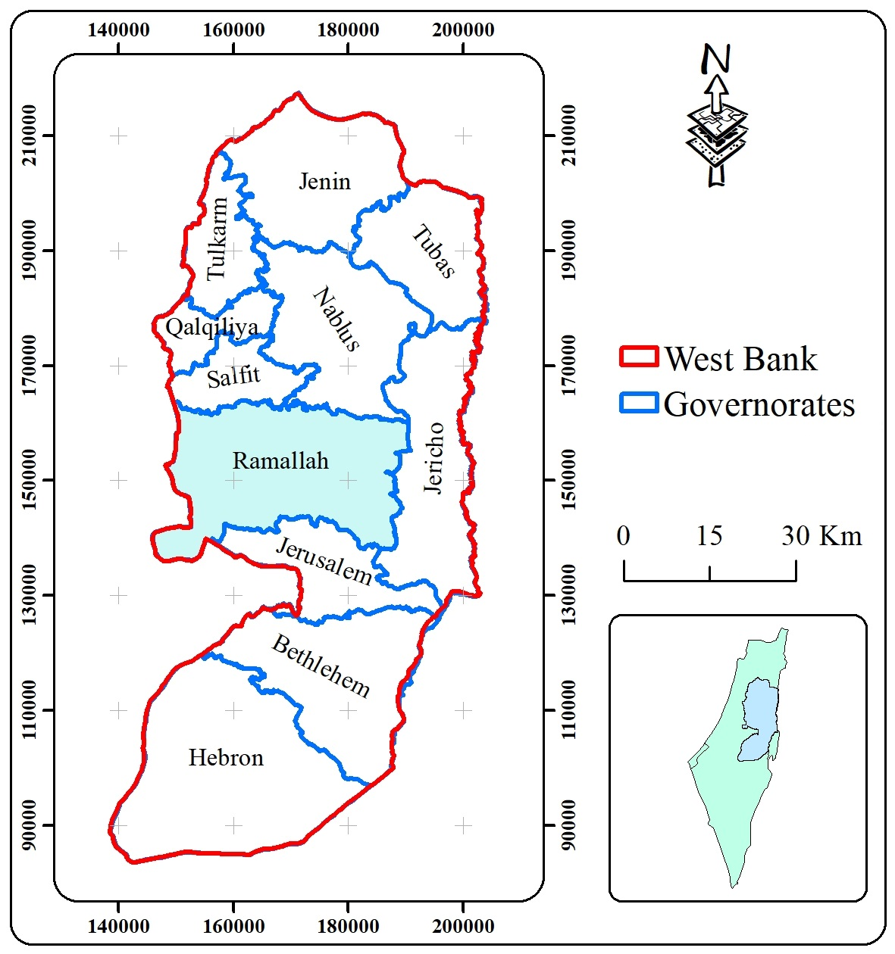
Case Study: Ramallah
Central part of the West Bank
Standard Mediterranean climate [61]

Slide 8
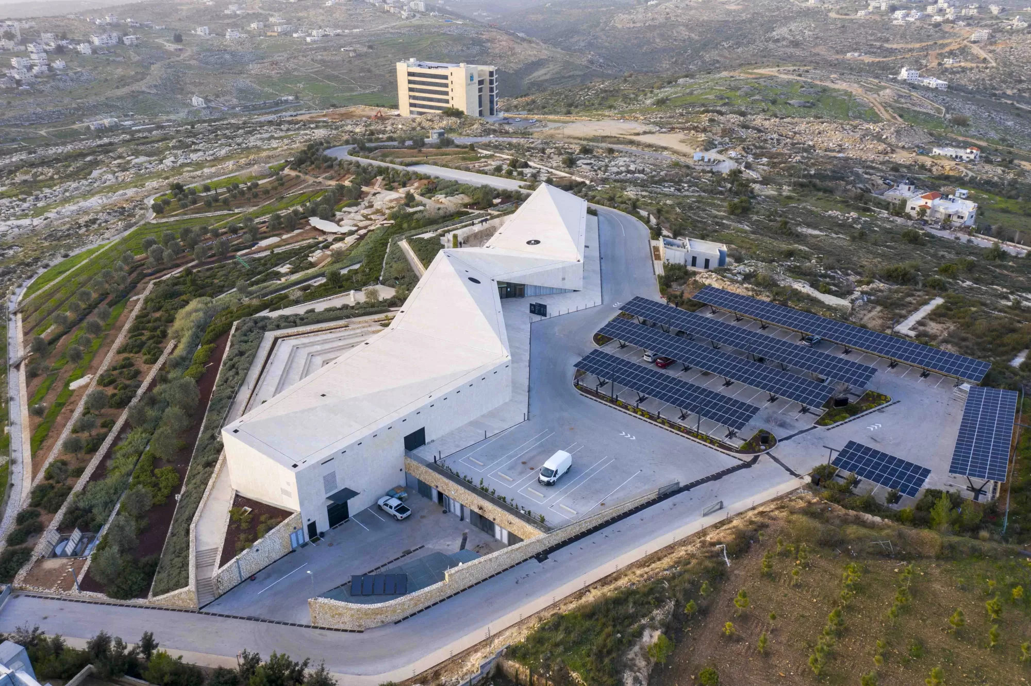
Case Study: Palestinian Museum
Electricity consumption of nearly 35,831 KWh/month or 430 MWh annually
First green building in Palestine following the LEED rating system
The museum has an existing 230 kW solar PV system already installed.

Slide 9
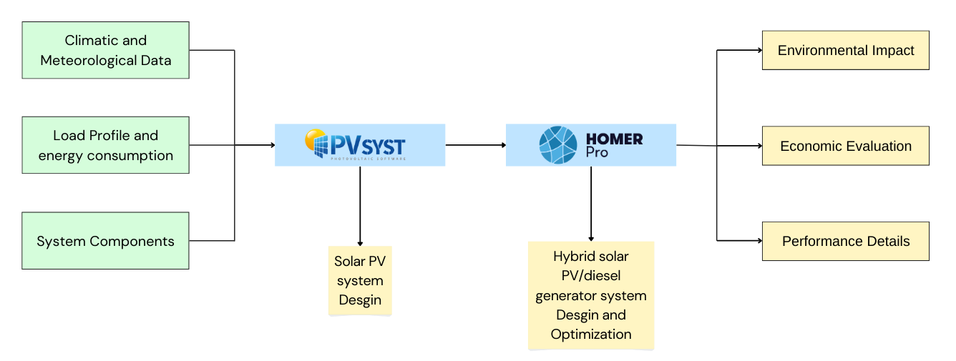
Methodology Overview
Added Value

Slide 10
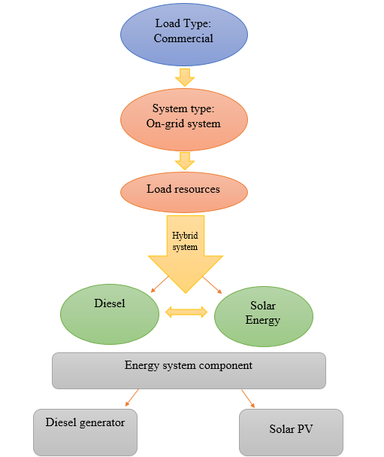
System Configuration

Slide 11
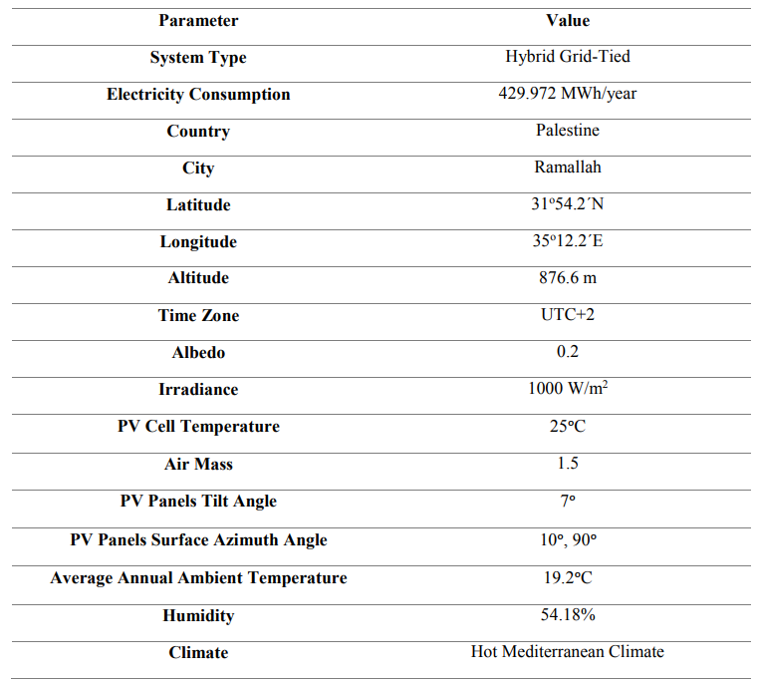
Design Criteria

Slide 12
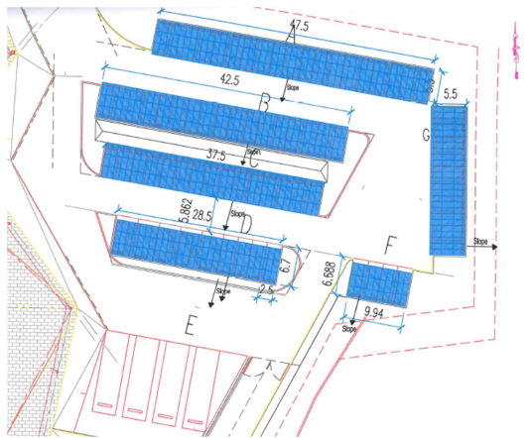
PV System Summary
2 Orientations (Tilt/Azimuth)
PV Panels (Seraphim)
Inverters (SMA)
No. of modules 576
No. of inverters 5
$$7° /10°$$
$$7° /90°$$
7° /10°
7° /90°
Total PV power at STC = 230 kWp
Module area = 1172 m²
Peak power = 400 Wp
Total inverter power = 220 kWac

Slide 13
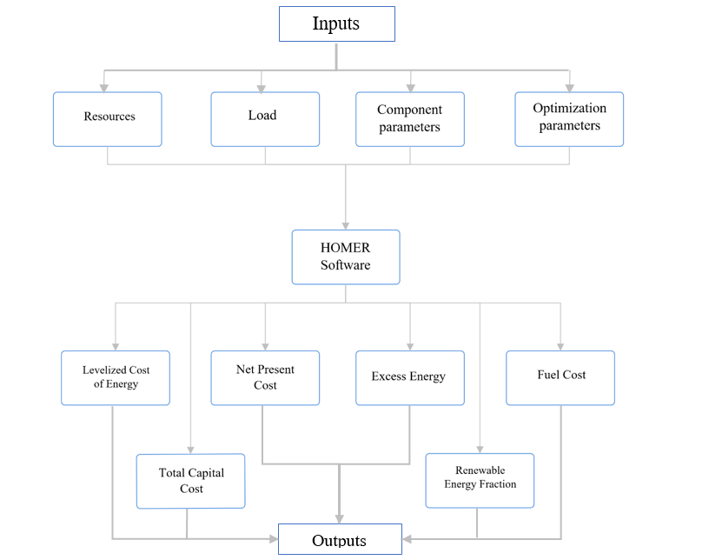
Modeling & Simulation

Slide 14
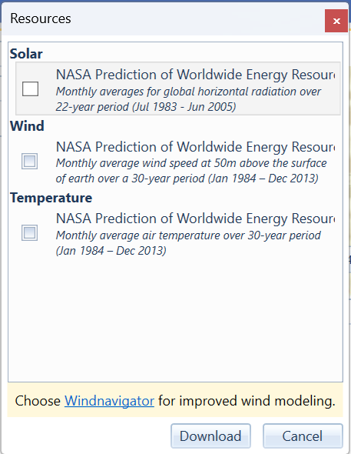
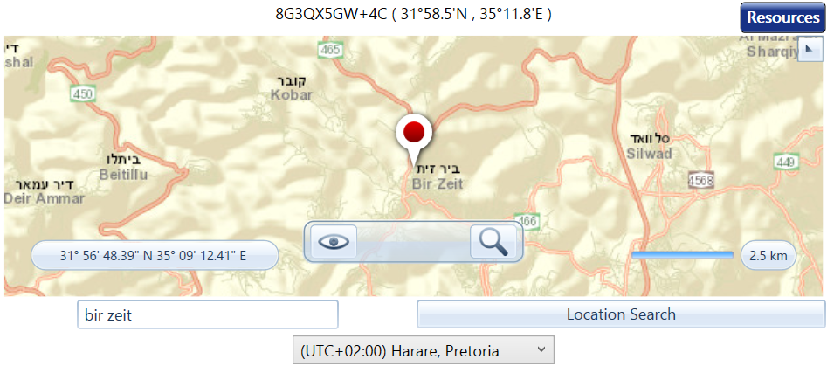
Modeling & Simulation

Slide 15
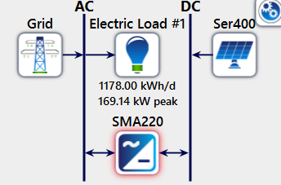
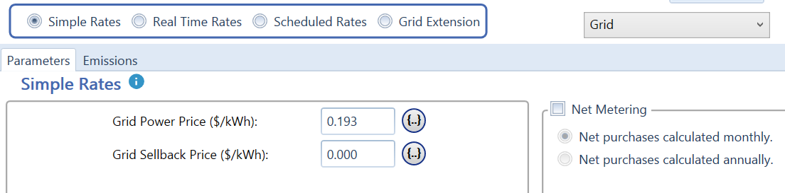
Modeling & Simulation
PV/Grid Schematic
Grid Input

Slide 16
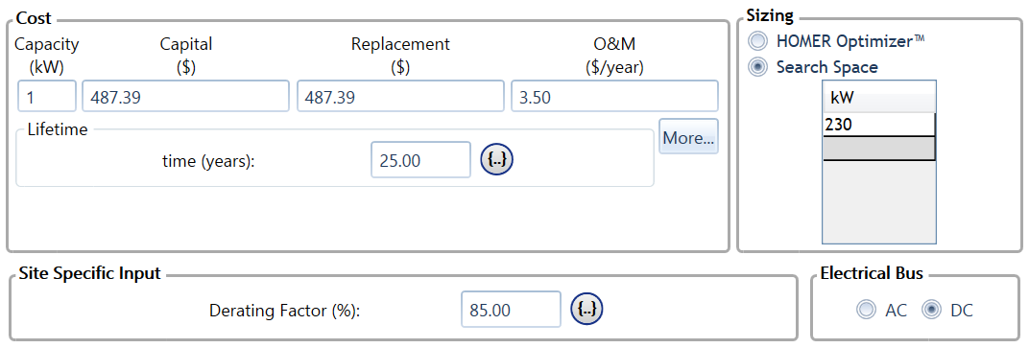
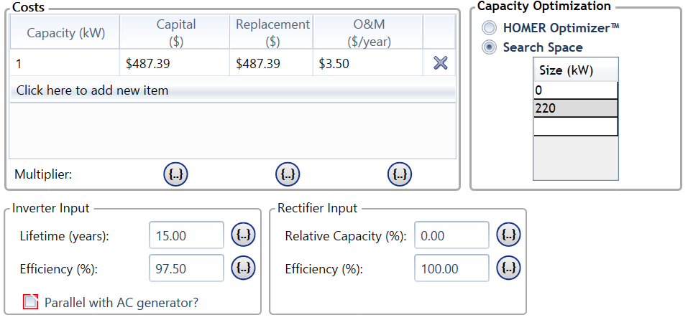
Modeling & Simulation
PV Input
Inverter Input

Slide 17
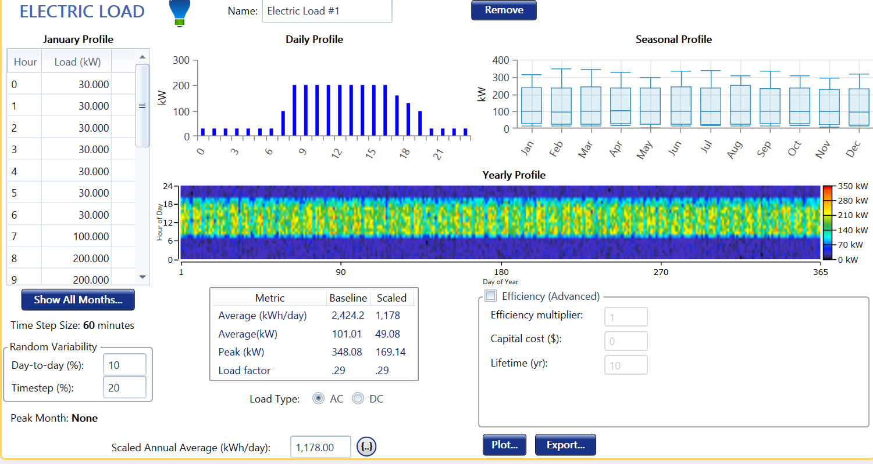
Modeling & Simulation

Slide 18
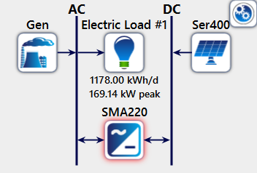
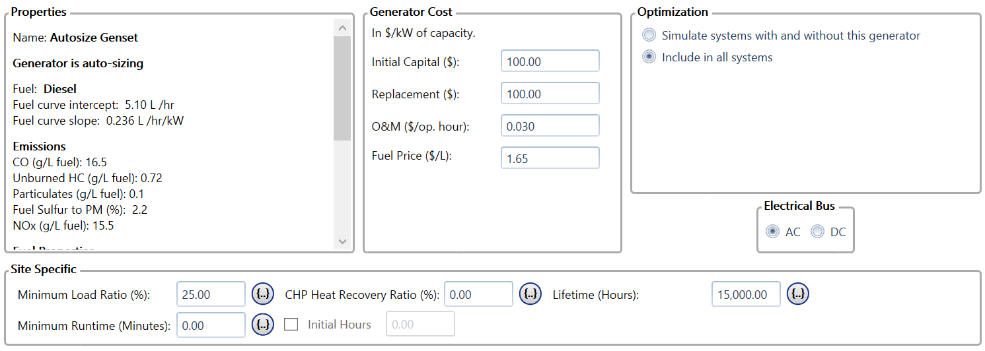
Modeling & Simulation
PV/Autosized DG Schematic
DG Input

Slide 19
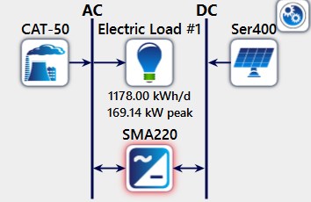
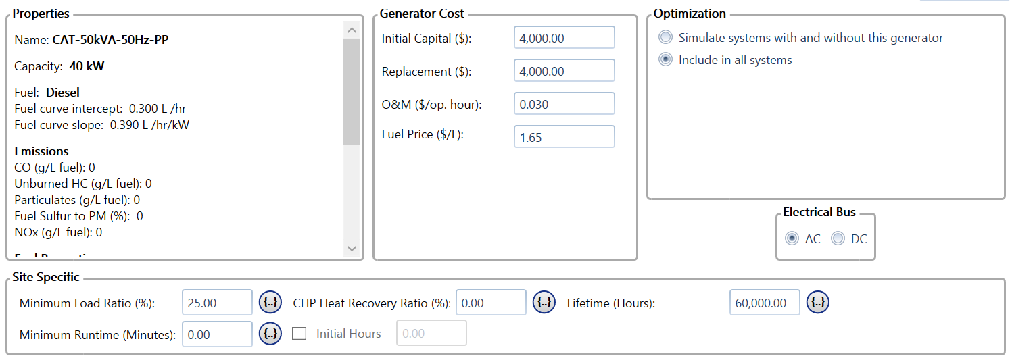
Modeling & Simulation
PV/40kW DG Schematic
DG Input

Slide 20
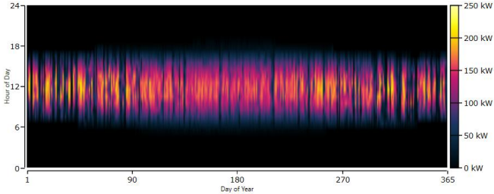
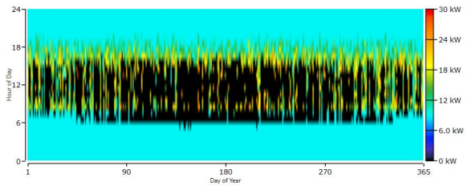
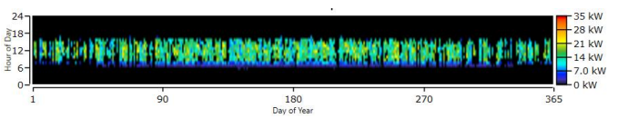
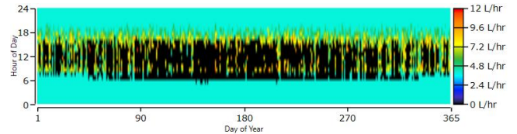
Results
PV power output
Inverter output
Generator power output
Fuel consumption

Slide 21
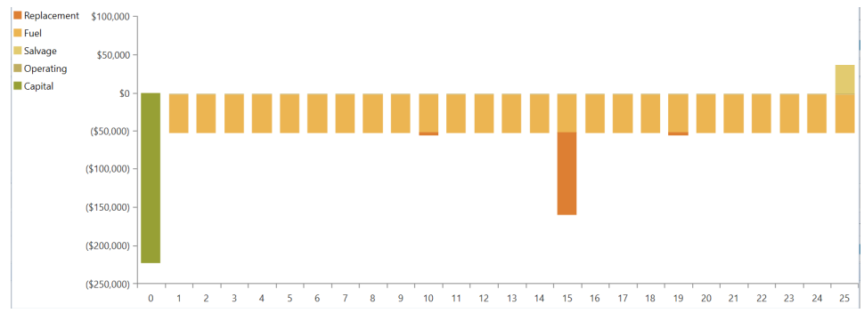
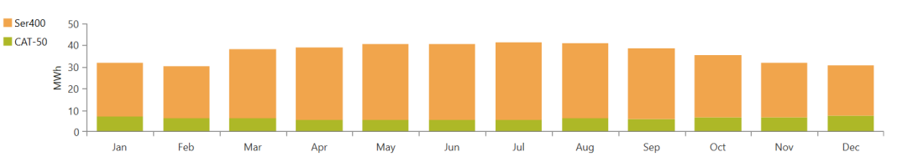
Cash flow
Monthly electric production

Slide 22
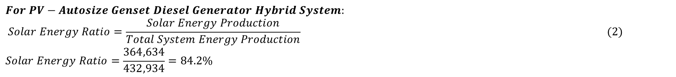
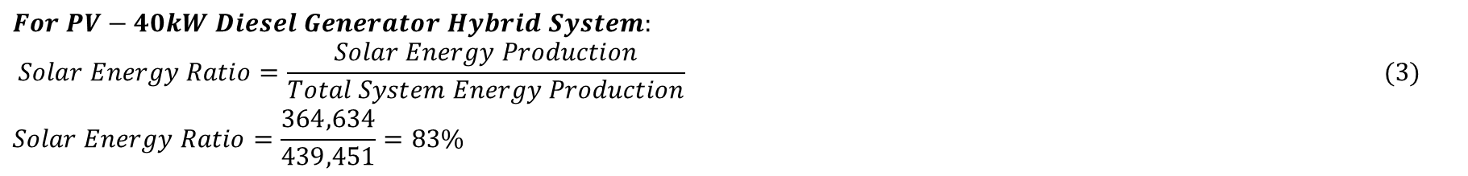
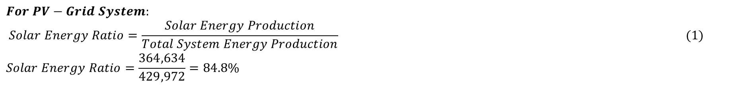
Equations used:
$$For PV−Grid System:$$
$$Solar Energy Ratio=\frac{Solar Energy Production}{Total System Energy Production} (1)$$
$$Solar Energy Ratio=\frac{364,634}{429,972}=84.8\%$$
$$For PV−Autosize Genset Diesel Generator Hybrid System:$$
$$Solar Energy Ratio=\frac{Solar Energy Production}{Total System Energy Production} (2)$$
$$Solar Energy Ratio=\frac{364,634}{432,934}=84.2\%$$
$$For PV−40kW Diesel Generator Hybrid System:$$
$$Solar Energy Ratio=\frac{Solar Energy Production}{Total System Energy Production} (3)$$
$$Solar Energy Ratio=\frac{364,634}{439,451}=83\%$$

Slide 23
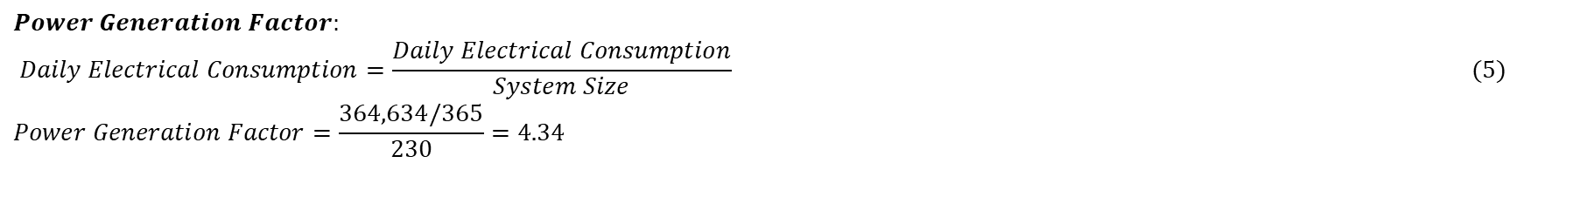
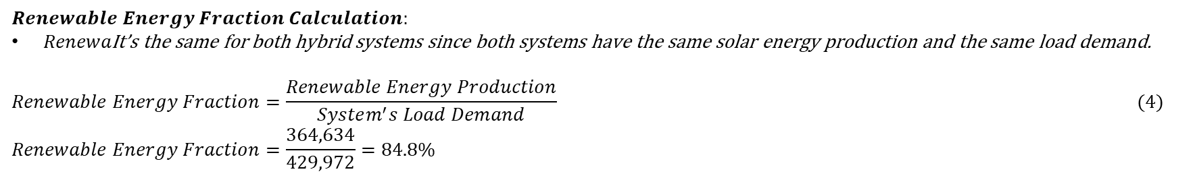
$$Renewable Energy Fraction Calculation:$$
$Renewa\text{It}\text{’}\text{s} \text{the} \text{same} \text{for} \text{both} \text{hybrid} \text{systems} \text{since} \text{both} \text{systems} \text{have} \text{the} \text{same} \text{solar} \text{energy} \text{production} \text{and} \text{the} \text{same} \text{load} \text{demand}\text{.}$
$$Renewable Energy Fraction=\frac{Renewable Energy Production}{System^{′}s Load Demand} (4)$$
$$Renewable Energy Fraction=\frac{364,634}{429,972}=84.8\%$$
$$Power Generation Factor:$$
$$Daily Electrical Consumption=\frac{Daily Electrical Consumption}{System Size} (5)$$
$$Power Generation Factor=\frac{364,634/365}{230}=4.34$$

Slide 24
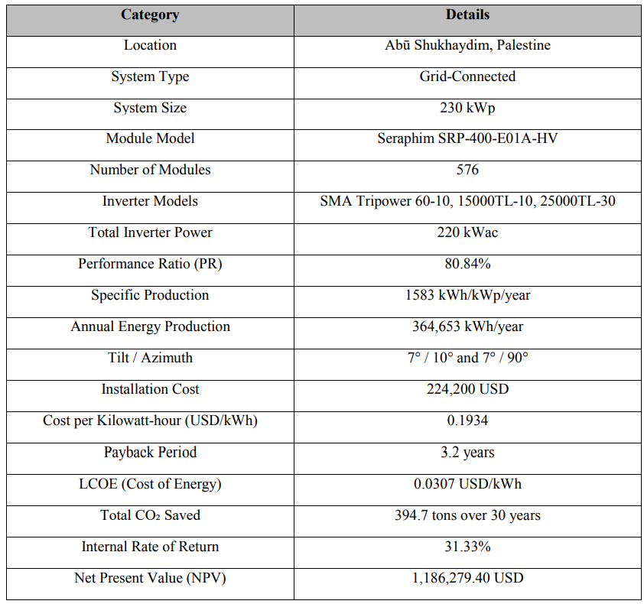
Main PVsyst Results

Slide 25
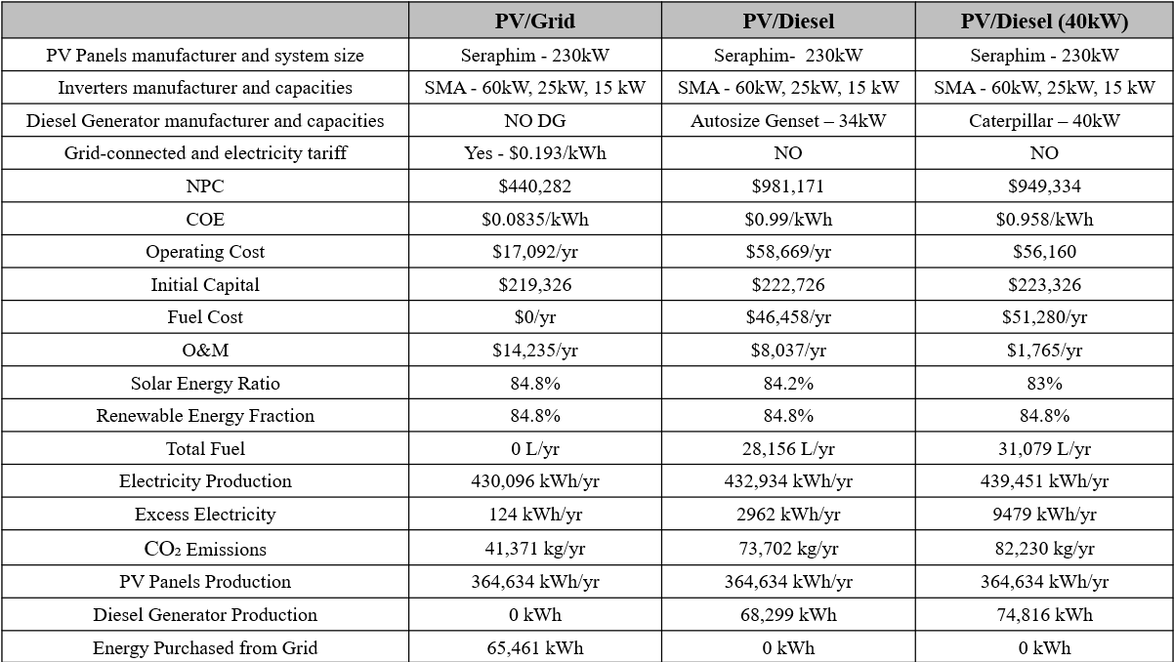
Main HOMER Results

Slide 26
References
[11] Juaidi, Adel, et al. “An Overview of Renewable Energy Potential in Palestine.” Renewable and Sustainable Energy Reviews, vol. 65, Nov. 2016, pp. 943–960, https://doi.org/10.1016/j.rser.2016.07.052. Accessed 20 Oct. 2020.
[12] Abboushi, Nour, and Husain Alsamamra. “Achievements and Barriers of Renewable Energy in Palestine: Highlighting Oslo Agreement as a Barrier for Exploiting RE Resources.” Renewable Energy, vol. 177, Nov. 2021, pp. 369–386, https://doi.org/10.1016/j.renene.2021.05.114. Accessed 13 Dec. 2021.
[23] Ismail, M, et al. “DESIGN of a PV/DIESEL STAND ALONE HYBRID SYSTEM for a REMOTE COMMUNITY in PALESTINE.” Journal of Asian Scientific Research, vol. 2, no. 11, pp. 599–606. Accessed 23 Nov. 2024.
[33] Hrayshat, Eyad S. “Techno-Economic Analysis of Autonomous Hybrid Photovoltaic-Diesel-Battery System.” Energy for Sustainable Development, vol. 13, no. 3, Sept. 2009, pp. 143–150, https://doi.org/10.1016/j.esd.2009.07.003. Accessed 6 Dec. 2024.
[57] Salameh, Tareq, et al. “Techno-Economical Optimization of an Integrated Stand-Alone Hybrid Solar PV Tracking and Diesel Generator Power System in Khorfakkan, United Arab Emirates.” Energy, vol. 190, Jan. 2020, p. 116475, https://doi.org/10.1016/j.energy.2019.116475. Accessed 6 Dec. 2024.
[60] Salau, Ayodeji Olalekan, et al. “Design, Modeling, and Simulation of a PV/Diesel/Battery Hybrid Energy System for an Off-Grid Hospital in Ethiopia.” E-Prime - Advances in Electrical Engineering, Electronics and Energy, vol. 8, 18 May 2024, p. 100607, https://doi.org/10.1016/j.prime.2024.100607. Accessed 6 Dec. 2024.
[61] Weatherandclimate.com. (2015b). Ramallah, West Bank, PS Climate Zone, Monthly Averages, Historical Weather Data. [online] Available at: https://weatherandclimate.com/palestine/west-bank/ramallah [Accessed 25 Dec. 2024].

Slide 27
acknowledgement

Slide 28
THANK YOU
Hope you enjoyed

Slide 29
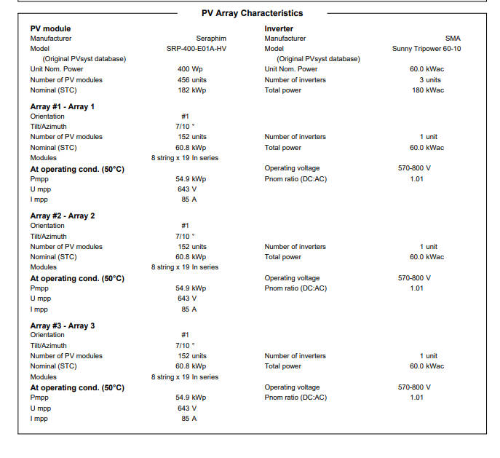
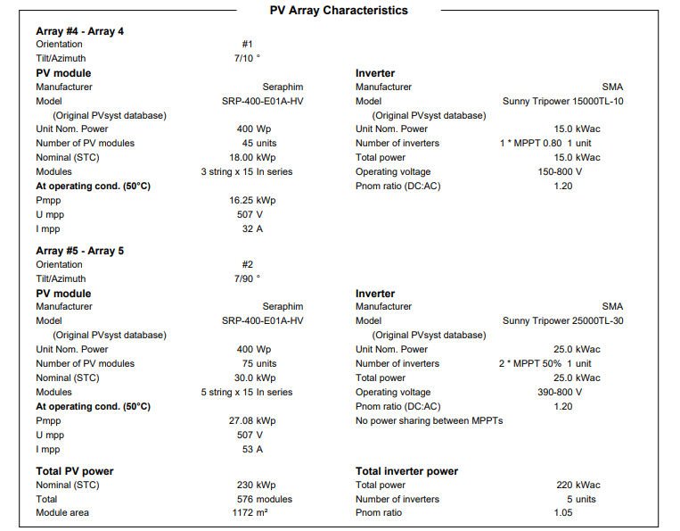

Slide 30
Why was PVsyst used, what does it add?
PVsyst was used in the study to perform detailed simulations and analysis upon the installed PV system at the museum. It provides in-depth insights into electricity production, system losses, performance ratio, payback period, and emissions. These results will be used as a reference when we work on HOMER, and the hybrid system’s results from HOMER will be compared with the current energy system results from PVsyst.

Slide 31
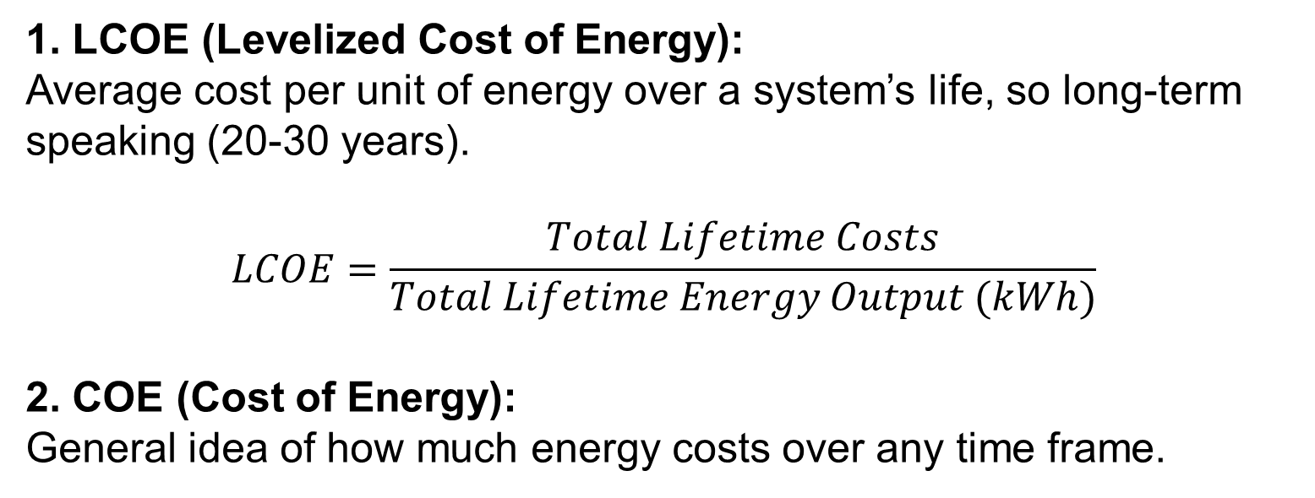
What is the difference between the LCOE and COE?
1. LCOE (Levelized Cost of Energy):
Average cost per unit of energy over a system’s life, so long-term speaking (20-30 years).
$$LCOE=\frac{Total Lifetime Costs}{Total Lifetime Energy Output (kWh)}$$
2. COE (Cost of Energy):
General idea of how much energy costs over any time frame.

Slide 32
What is the difference between the efficiency and performance ratio?
Efficiency
Measures: The ability of the solar panel to convert sunlight into electricity.
Depends on: Panel technology, temperature, angle, and irradiance.
Typical Range: 15–23% for commercial solar panels
Performance Ratio
Measures: The overall performance of the entire PV system, including losses from Inverters, Wiring, Temperature effects, Shading, Dust, or soiling.
Typical Range: 70–90%

Slide 33
Why wasn’t a battery storage system used?
Economic Justification
Reliable Generator Support
Lower system complexity
Grid Availability (not a rural area)

Slide 34
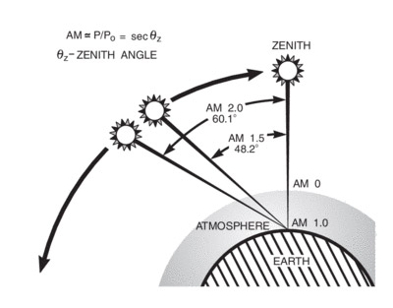
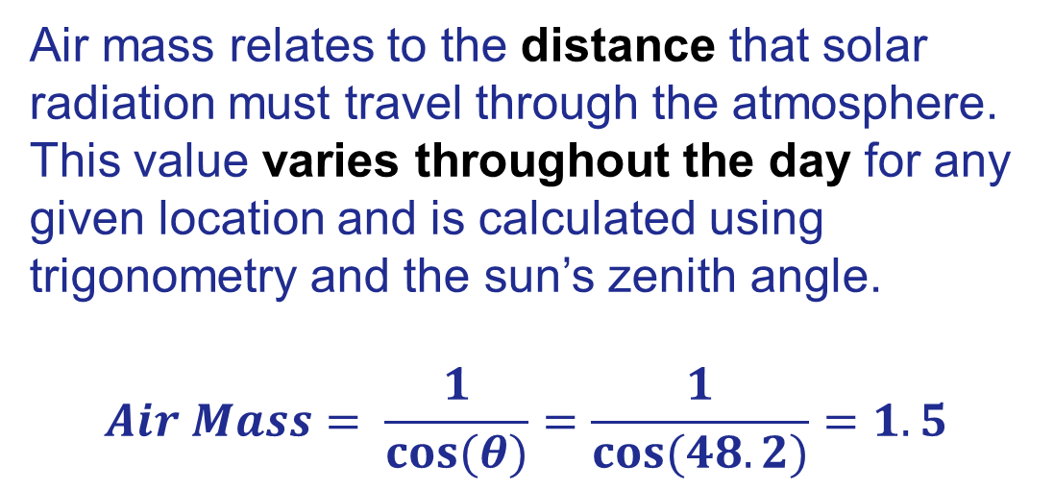
What does Air Mass mean or indicate?
Air mass relates to the distance that solar radiation must travel through the atmosphere. This value varies throughout the day for any given location and is calculated using trigonometry and the sun’s zenith angle.
$$Air Mass= \frac{1}{cos⁡(θ)}=\frac{1}{cos⁡(48.2)}=1.5$$

Slide 35
How much does 1 kWh give you in kW of electricity?
kW (kilowatt) = Power (rate of energy use or generation)
kWh (kilowatt-hour) = Energy (amount of electricity used or produced over time)
kWh = kW × hours

