Slide 1

Structural Analysis and Redesign The Building Of Scientific Center
An-Najah National University
Faculty of Engineering
Civil Engineering Department
Prepared by:
1.Ayman Abo Baker.
2.Baraa Bani Hasan.
3.Mohammad Omar.
Supervised by: Dr.Mahmoud Dweikat

Slide 2
Out Line :
Project description.
Preliminary Design.
Project Modeling.
Model Checks.
3D Dynamic Evaluation.
Conclusion.

Slide 3

Picture of the project

Slide 4
Project description
The project addresses is the analysis and redesign of the building of scientific center located in Nablus with total area 5720 m².
And it consists of six floors with roof Staircase as shown in the following table:

Slide 5
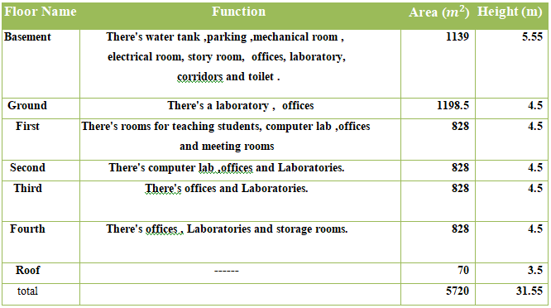

Slide 6
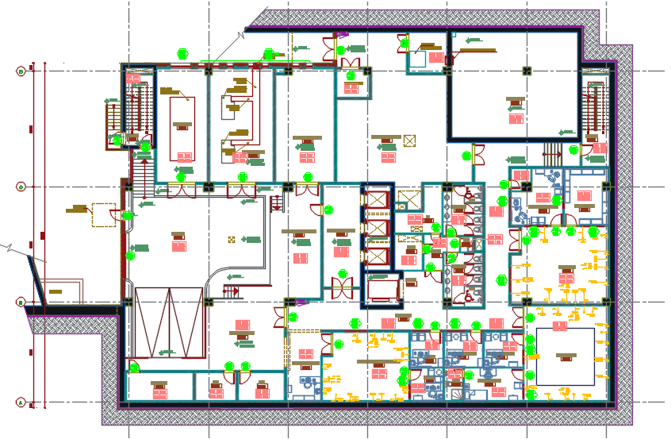
Architectural Description:
Architectural plan for basement floor

Slide 7
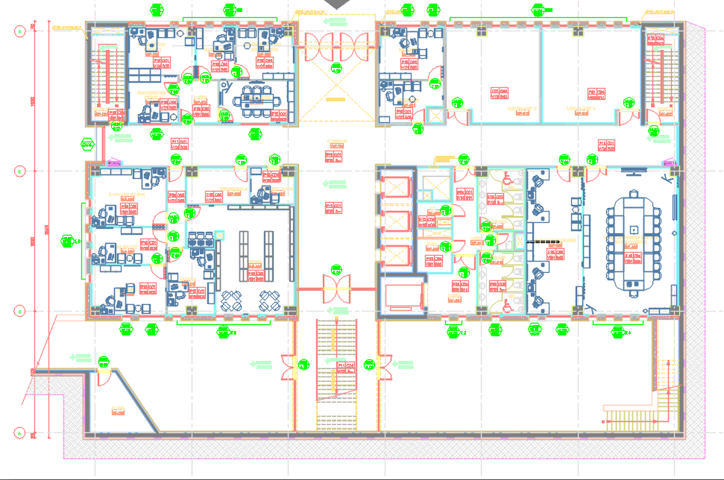
Architectural plan for ground floor

Slide 8
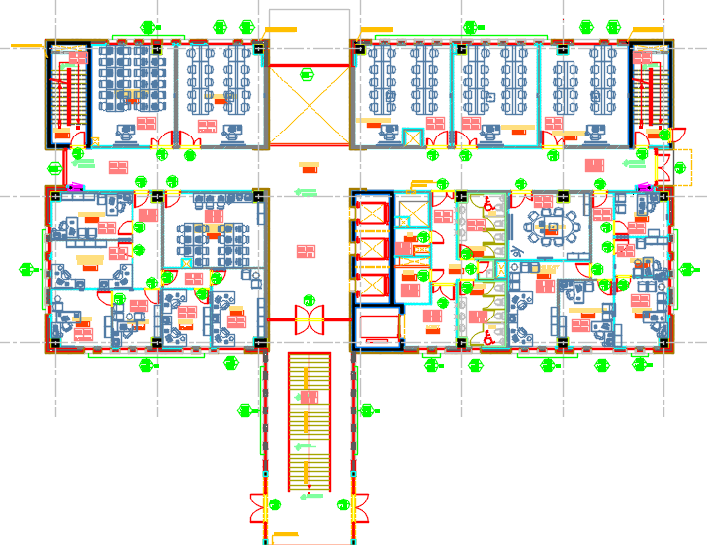
Architectural plan for first floor

Slide 9
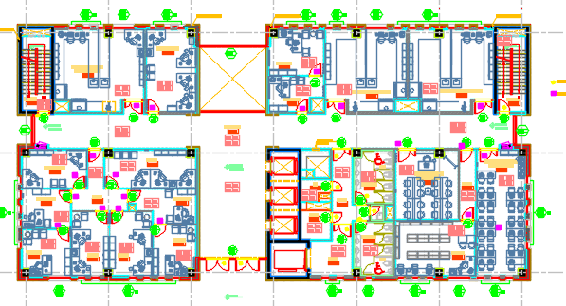
Architectural plan for second floor

Slide 10
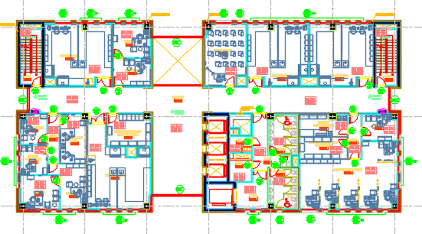
Architectural plan for third floor

Slide 11
Architectural plan for fourth floor

Slide 12
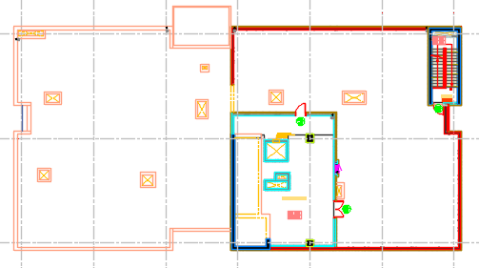
Architectural plan for sixth floor

Slide 13
Structural description
The building consists of one blocks designed as two way soiled slab system.
The materials used in this project are :(Structural Materials)
1-Concrete with f ̀c= 28Mpa , f ̀c= 35Mpa
2-steel with F_{y} = 420Mpa.
Soil properties:
The bearing capacity of the soil in the region is estimated to be 3Kg/cm2 .

Slide 14
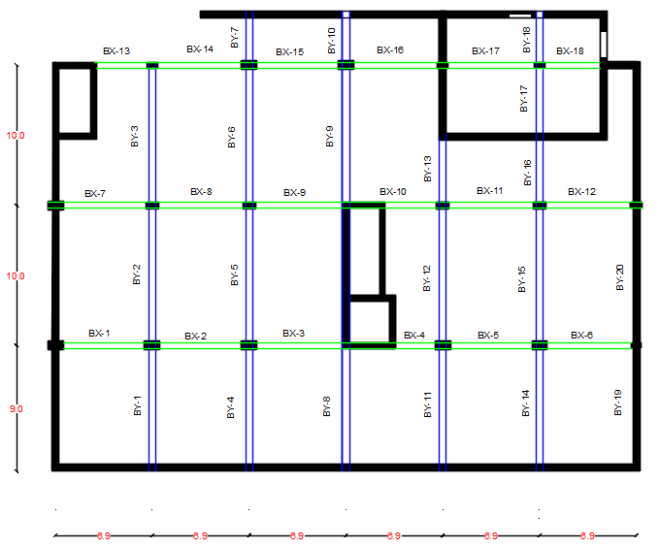
Structural plan:

Slide 15
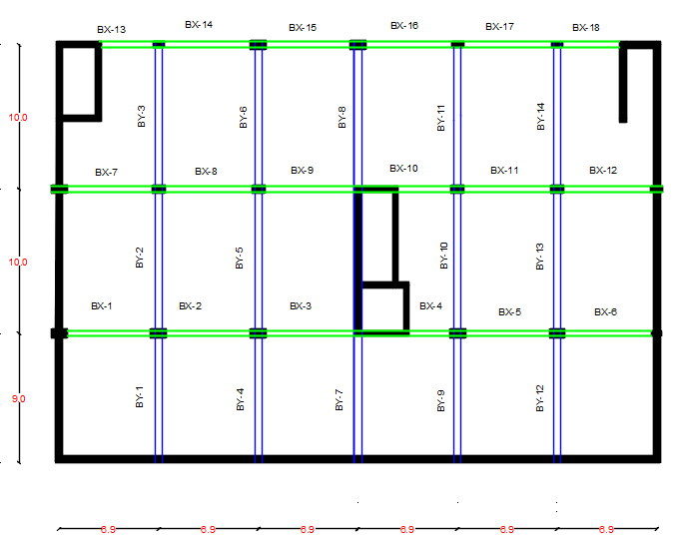

Slide 16
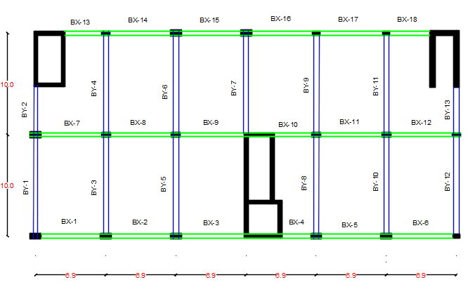

Slide 17
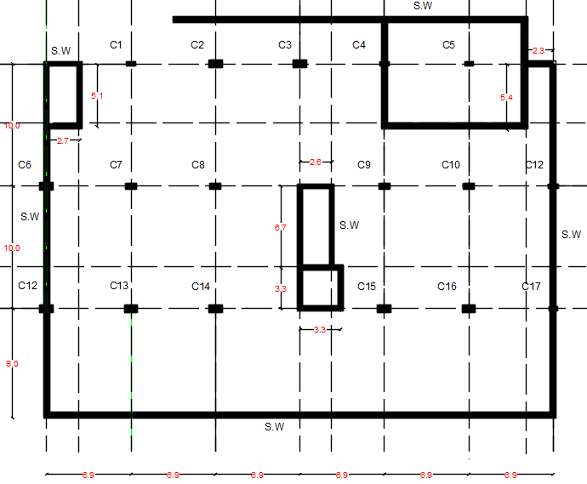

Slide 18
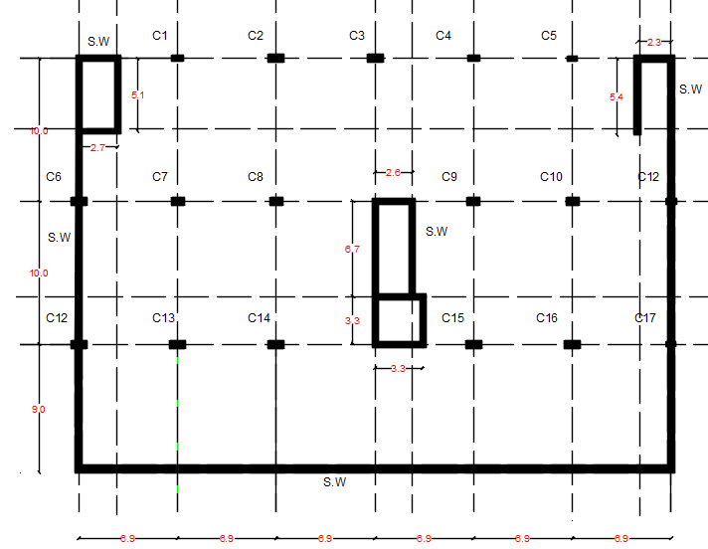

Slide 19
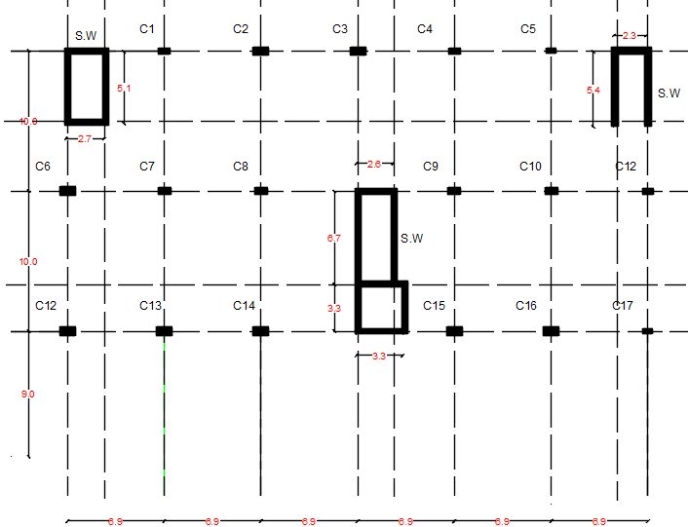

Slide 20
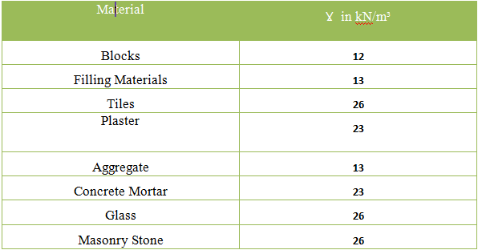
Non-Structural Materials:

Slide 21
Design Codes and Specification:
• ACI Committee 318 (2011 )“Building Code Requirements for Structural Concrete (ACI
318M-11)” American concrete institute, Michigan.
• ASCE Committee(2010), “American Society of Civil Engineers, Minimum Design Loads
for Buildings and Other Structures” American Society of Civil Engineers, Virginia
20191,.
• Nilson, Arther H., David Darwin, Charles W. Dolan.” Design of concrete structures.
Fourteenth edition”. New York: McGraw-Hills Companies, Inc., 2010.
• A.E. Cardenas, J. M Hanson, W.G. corley, and E. Hongnested .(1973). “Design
Provision for shear walls”.
• CSI (1997).”SAP 2000 integrated finite elements analysis and design of structure
• Murat Saaticiogl, Design of Slender Columns”Jordanian Code( 2012)
• UBC Committee , “The Uniform Building Code (UBC)-Volume 2 ” International Council
of Building Officials, California ,1997.

Slide 22
“Design
Provision for shear walls”.
• CSI (1997).”SAP 2000 integrated finite elements analysis and design of structure
• Murat Saaticiogl, Design of Slender Columns”Jordanian Code( 2012)
• UBC Committee , “The Uniform Building Code (UBC)-Volume 2 ” International Council
of Building Officials, California ,1997.
• IBC Committee, “the International Building Code. “ The International Code Council
(ICC), California, 2009.
• https://theconstructor.org/structural-engg/strengthening-of-founda􀆟ons/1945/, last access
13/5/2017.
• ACI Commi􀆩ee 440 (2008), "Guide for the Design and Constructionof Externally Bonded FRP
Systems for Strengthening Concrete Structures (ACI 440, 2R-08)",American concrete institute, Michigan.

Slide 23
Method of analysis and design:
The analysis and design of the project are carried out using finite element (FE) using SAP2000, and manual calculations are conducted in parallel and on selected elements to check the validity of the result obtained from SAP2000 models.

Slide 24
Load Types and Its Calculations:
Gravity Loads:
1. Dead Loads:
The dead loads of each structure are calculated by the multiplying volume of each section with the unit weight.

Slide 25

2. Live Loads:
Live Load Values for Each Function in the Structure By ASCE-2010:
Use maximum value of live load 4.8 KN/m²

Slide 26
3- Super imposed load:
This type of load come from the weight of all non-structural material like filler material, tiles, partitions, plaster:
Superimposed Dead Load Material in the Slab

Slide 27
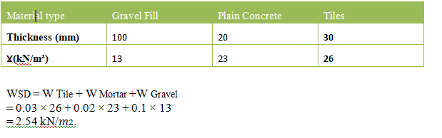
Calculate the super imposed dead load:
1- Superimposed Dead Load by Material in the Slab:

Slide 28
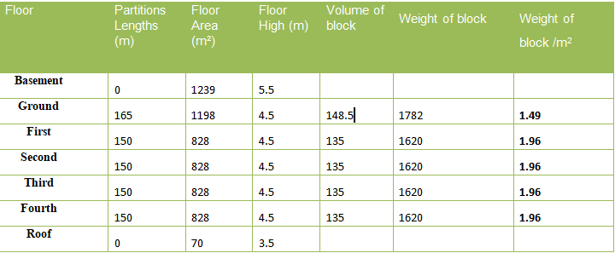
2- Superimposed Dead Load by partition:
We considered The width of partition = .2 m
we took the large number to be in safe side if there is any change in future.
WSD = 2.54 + 1.96 = 4.5 kN/𝑚2
Wsd=4.8 kN/m² is used for all stories.

Slide 29
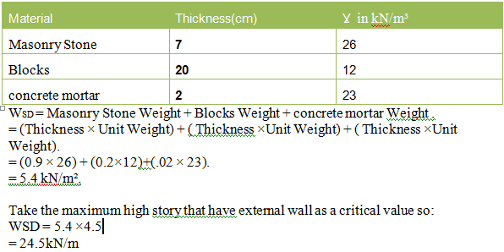
3-External Wall Super Imposed Dead Load:
Thickness and Unit Weight of the Material used in external wall:
Use it 24.5*0.8=20KN/m to consider the windows and other open in wall

Slide 30
4-Snow Loads:
Snow load is the downward force on a building's roof by the weight of accumulated snow :
Ɣ for snow = 3 kN/m³
We consider the thickness of snow = 0.5 m
Ws= 3*.5= 1.5 KN/m2

Slide 31
2- Lateral Loads:
Importance of seismic design in these days

Slide 32
Load Combinations:
According to the "ACI 318-2015, the load factors that are used in the analysis and redesign are:
1-ultimate load combinations:
1.4D
1.2D+1.6L+0.5 S
D+L
1.2D+1L+1.6 S
1. 2D+1.0E+L+0.2S
D+0.7E
D+0.75L+0.75S
0.9D+1.0E
(1.2+0.2SDs)D+Ʊ QE+L+0.2S
(0.9-0.2SDs)D+Ʊ QE+L

Slide 33
2-service load combinations:
D+L
D+S
D+L
D+0.75L+0.75S
D+0.7E
D+0.75L+0.75(0.7E)+0.75S
0.6D+0.7E
:E = ρ Eh + Ev
:ρ = Reliability/Redundancy Factor =1 (because of seismic design category = C )

Slide 34
horizontal earthquake forces in x and y directions:
Structures shall be designed for ground motion producing structural response and seismic forces in any horizontal direction. The code tries to achieve this by adding 30% of the effect in one direction to 100% of the effect in the other direction.
Eh1 = Ex +0.3 Ey
Eh2 =0.3 Ex + Ey

Slide 35
vertical earthquake effect:
Ev = the load effect resulting from the vertical component of the earthquake ground motion and it is equal to an addition of 0.2SDs*D to the dead load effect :
Ev = 0.2 SDs * D
= 0.2*0.334 D
= 0.0668D.

Slide 36
Preliminary Design for Slabs

Slide 37
Take the panel between this for column (C7 . C8 . C13 .c14)
Assume αfm > 2.0, so the minimum slab thickness =23cm
h ≥ 𝑙𝑛×([0.8+(𝑓𝑦/1400)]/36+9𝛽) ≥ 90mm
𝛽 = 𝑙𝑜𝑛𝑔𝑒𝑟 𝑐𝑙𝑒𝑎𝑟 panel/𝑠ℎ𝑜𝑟𝑡𝑒𝑟 𝑐𝑙𝑒𝑎𝑟 panel = (10-.9)/(6.9-.9)=1.52
h = 9.1×[0.8+(420/1400)] /(36+9×1.52) = 0.202 m
So use h = 0.23 m

Slide 38
αf = E𝐼/L 𝑏𝑒𝑎𝑚/ E𝐼/L 𝑠𝑙𝑎𝑏
αfm = 1.23 so
2 > αfm > 0.2
The thickness of slab shall not be less than
H= 𝐿(0.8+𝑓𝑦1400)/(36+5𝛽(αfm−0.2))
H= 9.1(0.8+420/1400)/(36+5∗1.52(1.57−0.2) )=216 mm ≥ 125 mm >>>>>>ok
Use h = 23cm

Slide 39
Preliminary Design for Beams
Width(cm)=l/20 | Depth(cm) | Beam
40 | 55 | =6.9 m Beam (x)
50 | 70 | Beam (y)=10 m

Slide 40
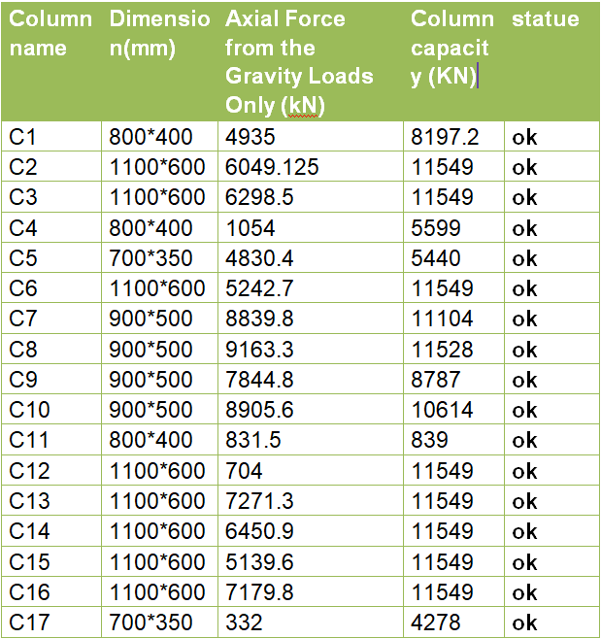
Preliminary Design for Columns

Slide 41
Take C1 in basment story as a sample calculation:
C1 is a rectangular column 800*400 mm as a primary dimensions.
ØPn = Øʎ (0.85fc’ (Ag - As) + As × fy)
Where:
Ø = 0.65
ʎ = 0.8
p=0.05 from SAP200 result
fc’ = 35 Mpa
fy = 420 Mpa
Ag =800*400=320000 𝑚𝑚2
As = 0.05 * Ag = 16000 𝑚𝑚2 (Assume)
ØPn = 0.65 × 0.8 (0.85 × 35 (0.95*320000) + 16000 × 420)
= 8197.2kN > > 4181 kN so it is O.K

Slide 42
Preliminary Design for The shear walls
External = 50cm
Internal= 40cm

Slide 43
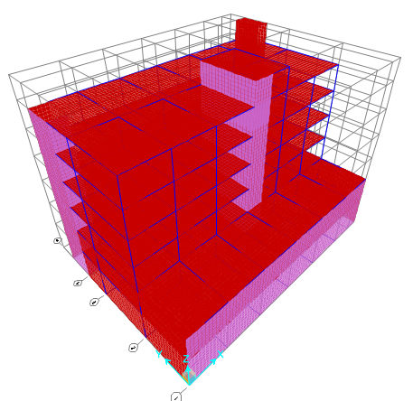
Structural Analysis:

Slide 44
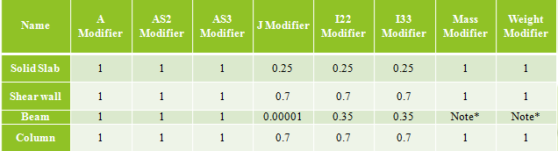
Modifiers and Loads Combinations

Slide 45
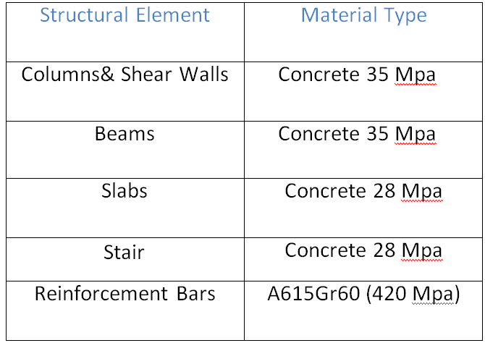

Slide 46
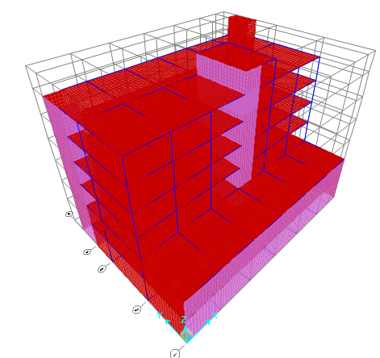
Model Analysis
To ensure that model will behave as one static unit.
1- Compatibility Check

Slide 47
2-Period check:-
By SAP2000 T=0.7 sec
For all buildings, the value T may be approximated from the following formula:
T = Ct (hn)¾
= 0.0488(31.55)¾=0.65
0.7<1.4(0,65) it’s ok!

Slide 48
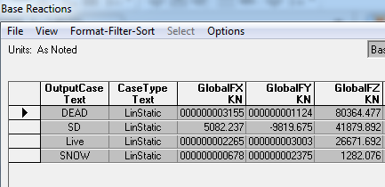
3-Equilibrium Checks:
To insure that model is satisfied the Newton law for statics and equilibrium objects.
By hand:
For Live Load:
LL=4.8KN/m2 & total area=5558m2
Reaction = LL*total area
=5558*4.8=26671KN
Error=266679-26671/26672 *100% = 0.03% <5%
Its ok!

Slide 49
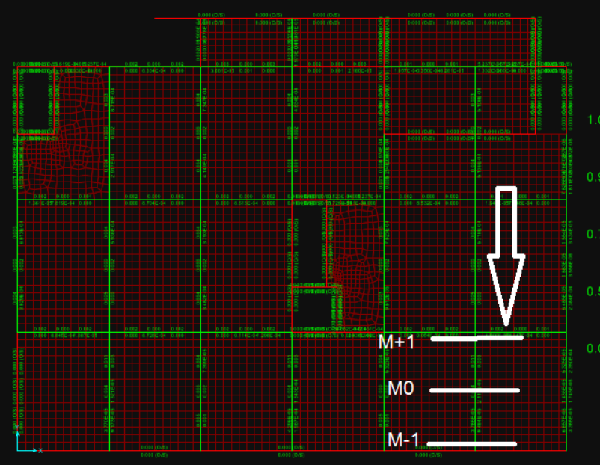
4- Stress strain Checks
To insure that the loads will be distributed in an expected way in both slabs and beams.
M-1=24KN.m
M0=18KN.m
M+1=507KN.m
Mav= (24+507)/2 + 18 = 284KN.m
By hand:
Mav = 4.8*8.7^2 *6.9/8313KN.m
Error=9.3% <10%

Slide 50
For column C7
Reaction from SD by SAP2000=internal compression force =1959KN
By hand:
Reaction = #of floor*tributary area*LL
=6*(10*6.9)*4.8=1987KN
Error=1.4% its ok!

Slide 51
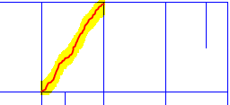
5- Deflection Checks:
From long term combination load(2D+2SD+1.3L)
For the critical slab (6.9*10) :
Deflection=0.048-0.25(0.0067+0.0073+0.010+0.0099)
=0.039=3.9cm
Allowable deflection = L/240
L=(6.9^2+10^2)^0.5=12.15m
=12.15/240=0.05m=5cm>3.9
Its ok!

Slide 52
EARTHQUAKE LOADS
The magnitude earthquake load depends up the mass of the structure, the stiffness of the structural system and the acceleration of the surface of the earth. It can be seen that the application of these two types of loads is very different.

Slide 53
Dynamic Analysis
Why do we design for lateral loads?
The lateral loads will tend to create additional stresses .
The lateral loads could affect the overall stability of the building .
The the seismic design is more and more become obligated by law.

Slide 54
The method of analysis
Static analysis:
Static (Equivalent lateral force method).
Dynamic analysis:
Modal response spectral analysis.
Time history analysis.

Slide 55
Response Equations
Base shear (V) = Cs x W
Cs= SDs*I/R
Csmax= SD1*I/T*R

Slide 56
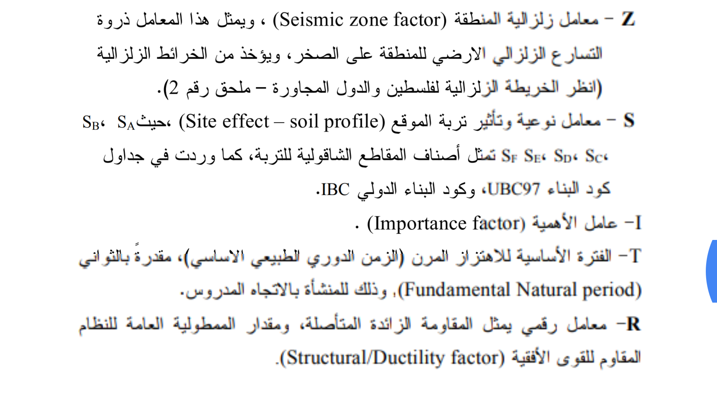
IBC Factors

Slide 57
Dynamic Evaluation
determinig period by method A
T = (Ct) (hn) ^ ^{(3/4)}
T= (0.0488) (31.55) ^0.75 = 0.65 sec.
Ct =0.0853 for steel moment-resisting frames.
Ct =0.0731 for reinforced concrete moment-resisting frames and eccentrically braced frames.
Ct =0.0488 for all other buildings.
This value must be more than 1.4 Tsap
In X-dir : (1.4)(T_{method A})=0.91> 0.71 Sec … OK
In Y-dir :(1.4)(T_{method A})=0.91 > 0.4Sec … OK
The structure is stiff enough.

Slide 58
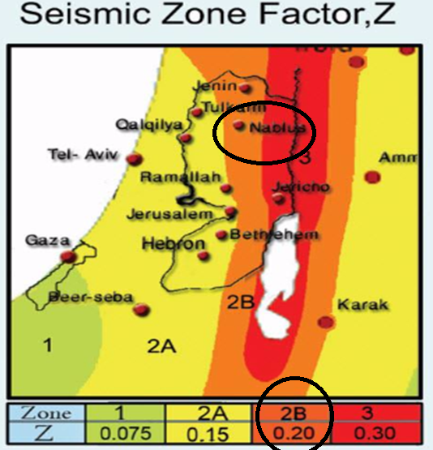
Seismic zone factor (Z)
POE = 10% : once each 500 yrs.
Depends on: energy and depth .
Z=Rock acc.
g
Nablus( zone 2B)
Z=.2

Slide 59
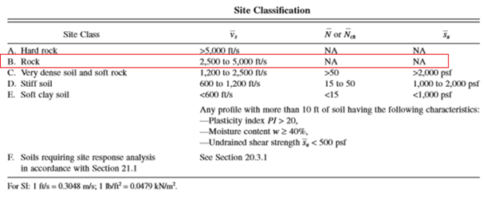
Site Classification:
Rough estimate or shear wave velocity or soil experiments.

Slide 60
Site coefficient
Ss: The mapped spectral accelerations for short periods
Ss=2.5*Z =0.5
S1: The mapped spectral accelerations for 1-second periods
S1=1.25*Z=0.25

Slide 61
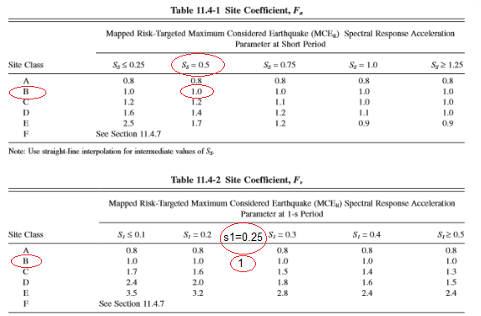
Site coefficient

Slide 62
Fa :Site coefficient for Ss Fa=1
Fv: Site coefficient S1 Fv=1
SDs = 2/3 *Fa*Ss = 0.334
SD1 =2/3 *Fv*S1 = 0.167

Slide 63
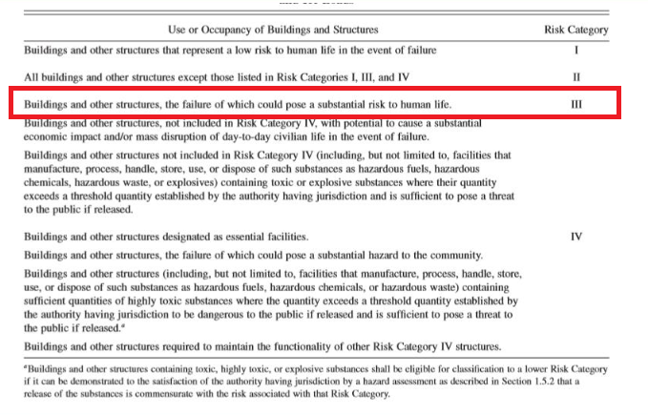
Importance Factor
Risk category : III

Slide 64
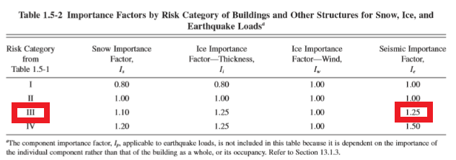
Importance Factor

Slide 65
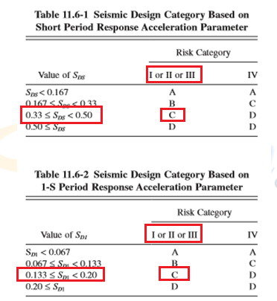
Seismic design ctegory
From SDs(.334) , SD1(.167) and risk category (III)
Category is C For both

Slide 66
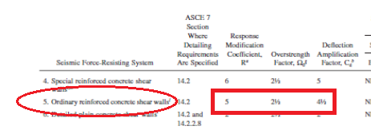
Respons modification factor (R)
Because Ordinary reinforced concrete is used:
R=5
Omega =2.5

Slide 67
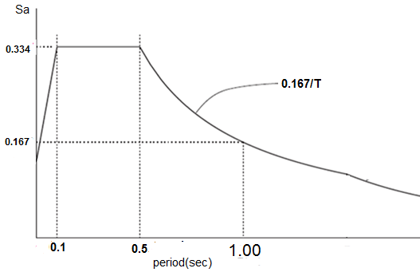
Response spectrum curve

Slide 68
Base shear (V):
In X-direction:
Cs = (SDs*I/R) = 0.334*1.25/5= 0.0835
Csmax= SD1*I/T*R = 0.167*1.25/5*0.7= 0.059
Cs > Cs max .
Base shear (V-x) = Csmax * W = 0.059 *126356 = 7455KN
In Y-direction:
Cs max = = 0.105 > Cs then
Base shear (V) = (SDs*I/R) W = 0.0835 *126356 = 10550KN

Slide 69
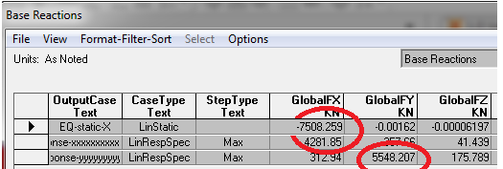
Equivalent Static shear check:-
V-x by hand = 7455KN
V-x by SAP2000 = 7508 KN
Error = 0.05% < 5% so it's ok.

Slide 70
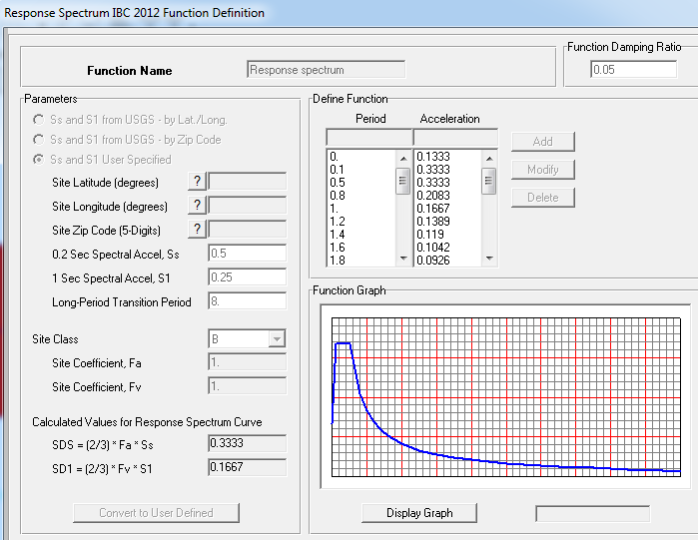
Figure 6.11: Definition of Response Spectrum Function

Slide 71
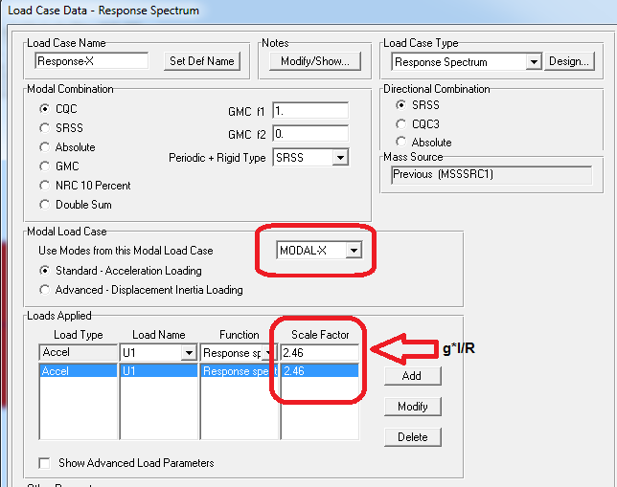
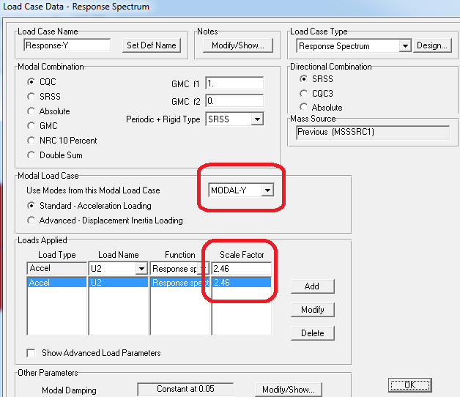

Slide 72
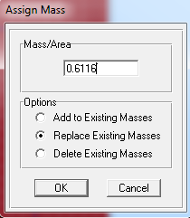
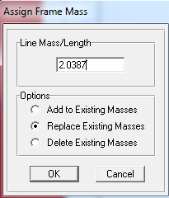

Slide 73
Initial base shear
**Shear check:-
According IBC2015 Code
V by SAP2000 > 0.85 V by hand
Not ok!

Slide 74
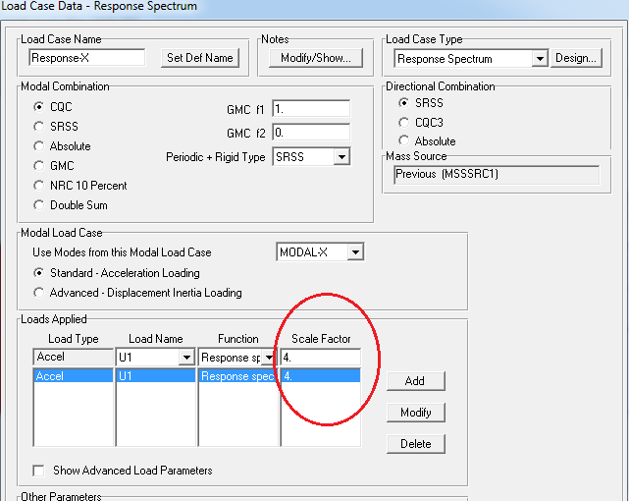
Modified scale factor

Slide 75
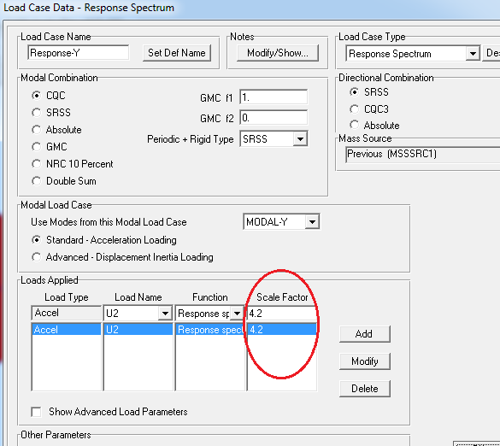

Slide 76
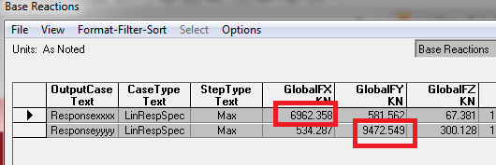
Final base reaction
V new > 0.85 V by hand so its ok

Slide 77
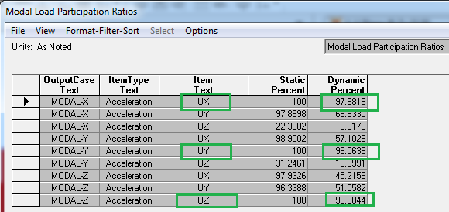
Modes and Torsion Check

Slide 78
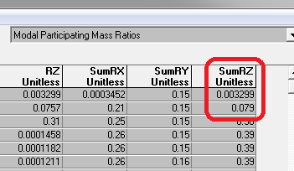
The torsion mode is not in the two first modes.
,and the percent of torsion in the first and second mode is less than (10%).

Slide 79
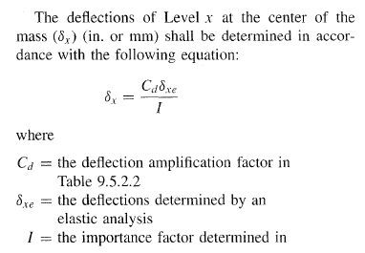
Drift check:-

Slide 80
--- | ᶋxe | Cd | Height (m) | ᶋx(m) | Allowable (m)
Story 1 | 0.0001 | 4.5 | 5.55 | 0.00036 | 0.0832
Story 2 | 0.0002 | 4.5 | 4.5 | 0.00072 | 0.0675
Story 3 | 0.0021 | 4.5 | 4.5 | 0.00756 | 0.0675
Story 4 | 0.0027 | 4.5 | 4.5 | 0.00972 | 0.0675
Story 5 | 0.0031 | 4.5 | 4.5 | 0.01116 | 0.0675
Story 6 | 0.003 | 4.5 | 4.5 | 0.01116 | 0.0675
Table 4.11:Inelastic Response Displacement in X

Slide 81
--- | ᶋxe | Cd | Height (m) | ᶋx(m) | Allowable (m)
Story 1 | 0.0003 | 4.5 | 5.55 | 0.00108 | 0.0832
Story 2 | 0.0006 | 4.5 | 4.5 | 0.00216 | 0.0675
Story 3 | 0.001 | 4.5 | 4.5 | 0.0036 | 0.0675
Story 4 | 0.0013 | 4.5 | 4.5 | 0.00468 | 0.0675
Story 5 | 0.0016 | 4.5 | 4.5 | 0.00576 | 0.0675
Story 6 | 0.0013 | 4.5 | 4.5 | 0.00468 | 0.0675
Table 6.1: Inelastic Response Displacement in Y
As we can see from the upper calculations the inelastic
Response displacement is ok and less than the maximum limit.

Slide 82
Design
After build the 3D model using SAP2000 and make the checks, then we can make the design process and preparing the detailing sheets for all members. In project one we will show the design for one beam, column and one slab because of the analysis process exclude the lateral forces, where after take over the lateral forces, changes in the models maybe occurs. The full design will be ready in project two.

Slide 83
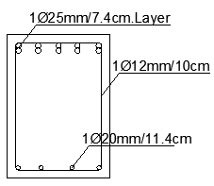
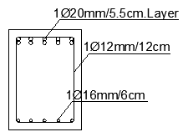
Design
Beam design
Beam Y6 detailing
Beam X7 detailing

Slide 84
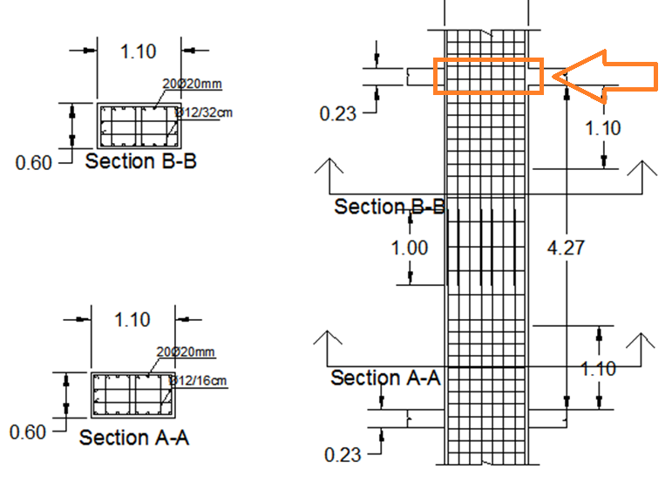
Column design (C16)

Slide 85
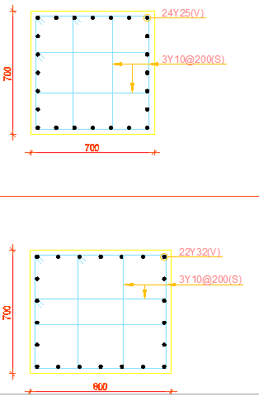
Column C16 before redesign
Ro = 2.4%
80cm*70cm
Ro = 3.16%
80cm*70cm

Slide 86

Column C16 after redesign
Ro = 1%
110cm*60cm

Slide 87

Slab Design
For Axial and moment

Slide 88


Slide 89

Shear wall design
(Before)

Slide 90

Shear wall design
After

Slide 91
  Proportion the wall such that V_{x} ≤ φV_{c}.
  Design for V_{y} in a way similar to beams.
  Design for M_{y} can be carried out by assuming two equal areas of steel on both faces of the wall working as a couple (one is in tension and the other is in compression).
  Design for P and M_{x} in a way similar to columns.

Slide 92


Slide 93

Stair design

Slide 94

Stair beam design

Slide 95

Footing design
Footing type (Single)
Area footing <70% total area

Slide 96


Slide 97


Slide 98

Footing plan

Slide 99
conclusion
As a result of this project, we found out that the solid slab with drop beam system was the best system for this structure .
We learned many things from this project:
- Knowledge about SAP2000 program.

Slide 100
To be prepared for the real life work.
We are proud about our work. Also, our engineering sense has increased about numbers and quantities.
We hope for all who will open our report to benefit from our project.

