Slide 1
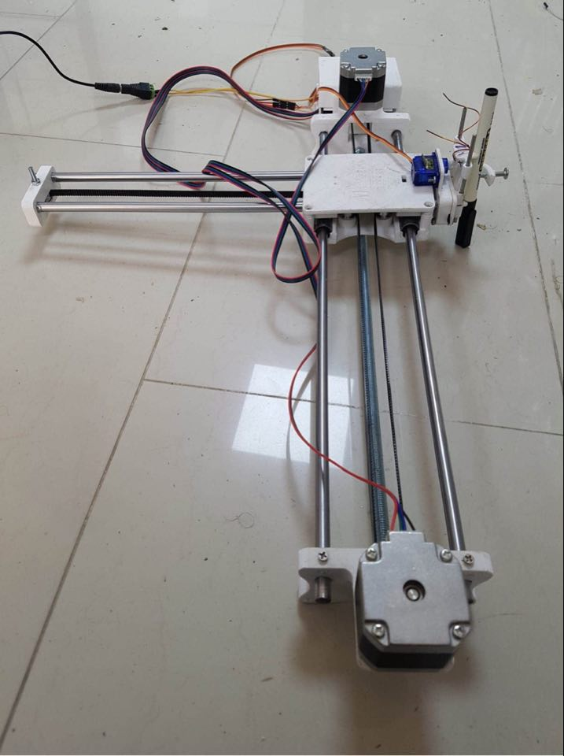
AxiDraw
Prepared By :
Tasneem Sawalha
Yasmeen Mohammad
Supervisors:
Dr.Sufyan Samarah
Dr.Luai Malhis

Slide 2
Outline
Introduction.
Main Features
Tools
Constraints.
Future Work
Demo

Slide 3
Introduction
Statement of the problem
Project objectives

Slide 4
Main Features
Draw many pictures and writings.
Also, Draw all geometric shapes, curves, lines, and many others

Slide 5
Tools
3D printed items
Nema 17(17hs4401)
A4988 Stepper Motor Driver
Rods
Lm8uu
GT2 Pulley 16 teeth
2000mm GT2 belt
CNC / 3D Printer shield
Servo sg90
Arduino uno

Slide 6
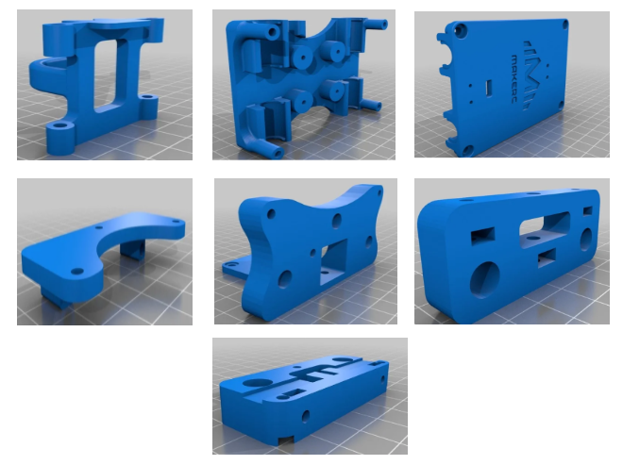
3D printed items

Slide 7
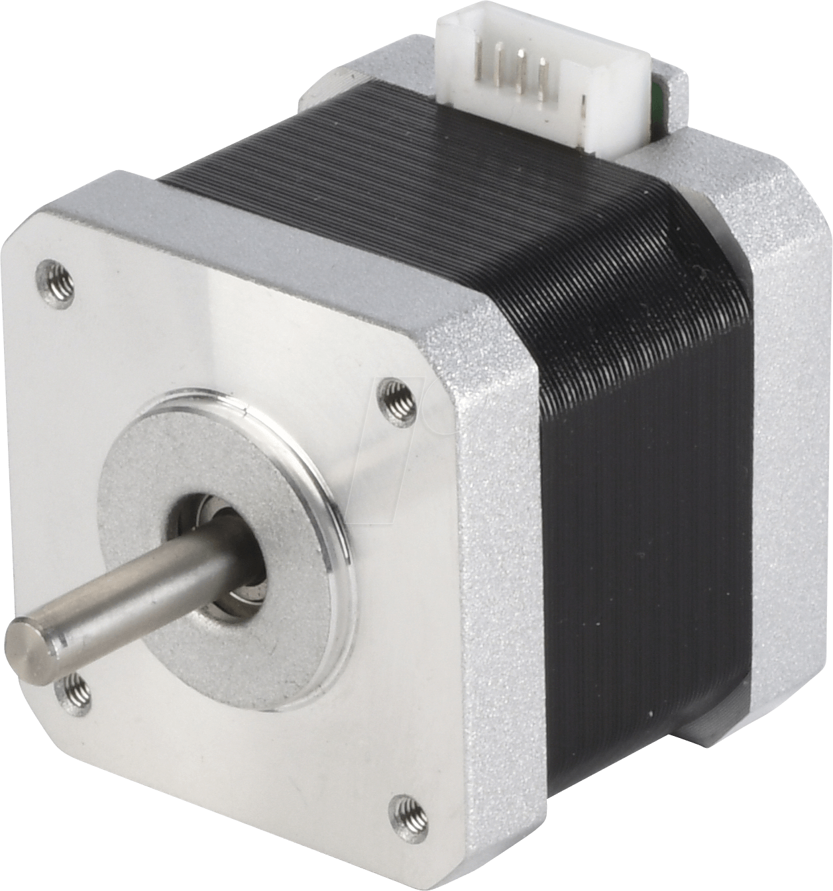
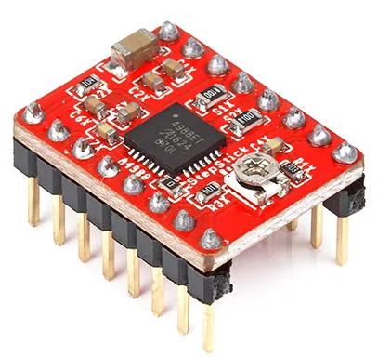
Nema 17(17hs4401)
A4988 Stepper
Motor Driver

Slide 8
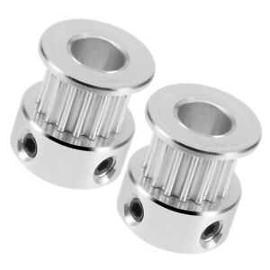
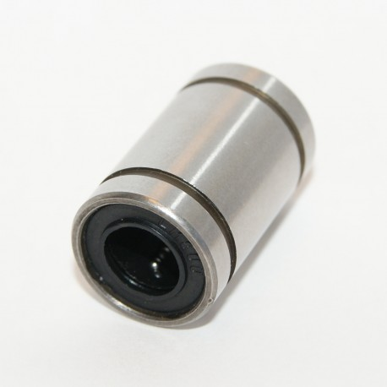
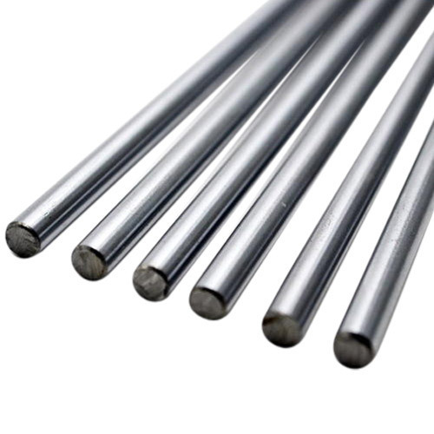
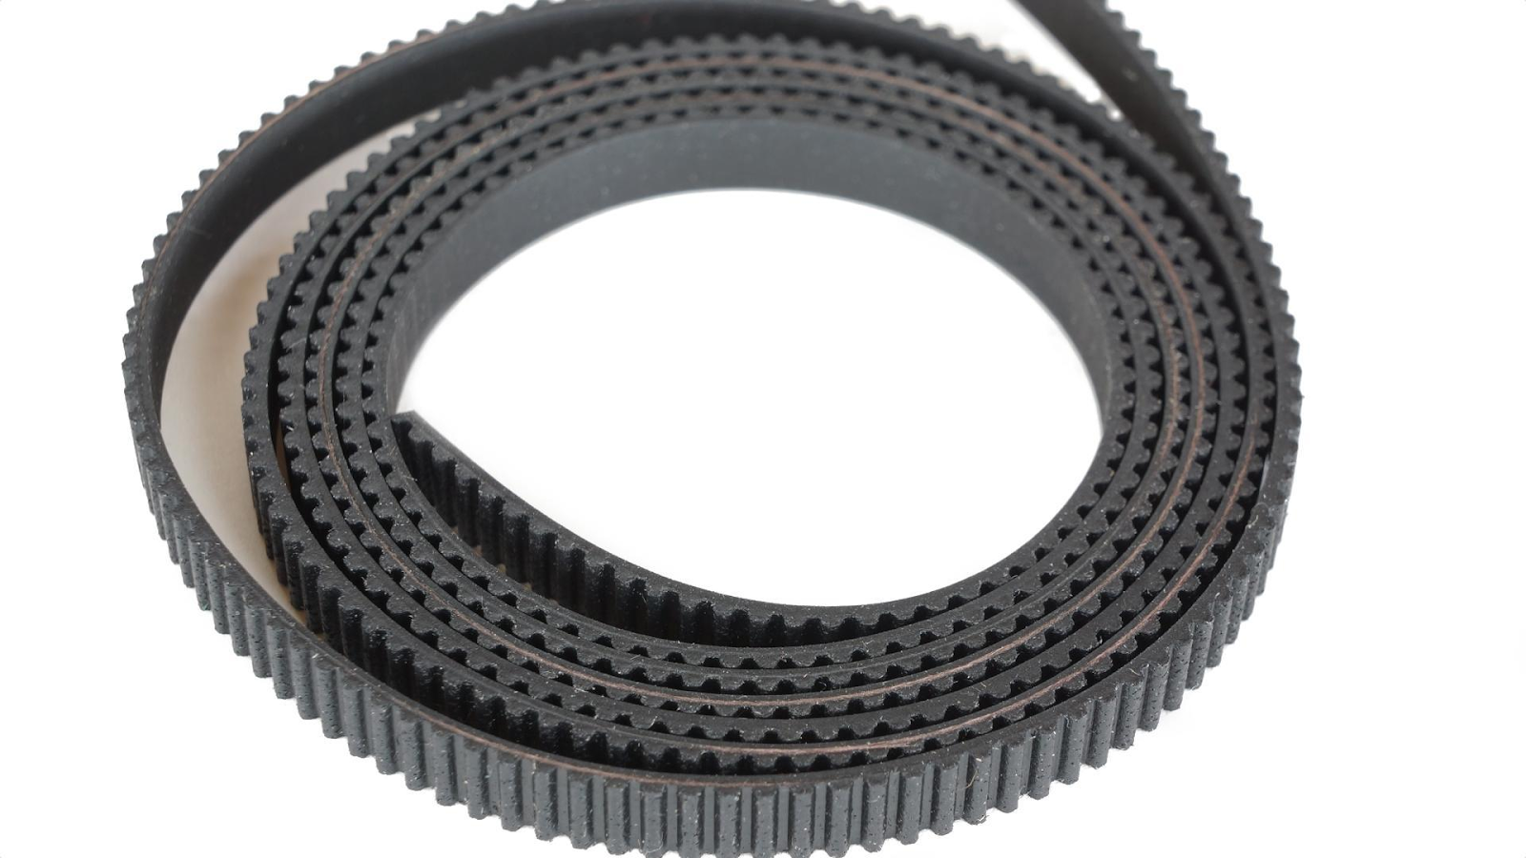
rods
Lm8uu
2000mm GT2 belt
GT2 Pulley 16 teeth

Slide 9
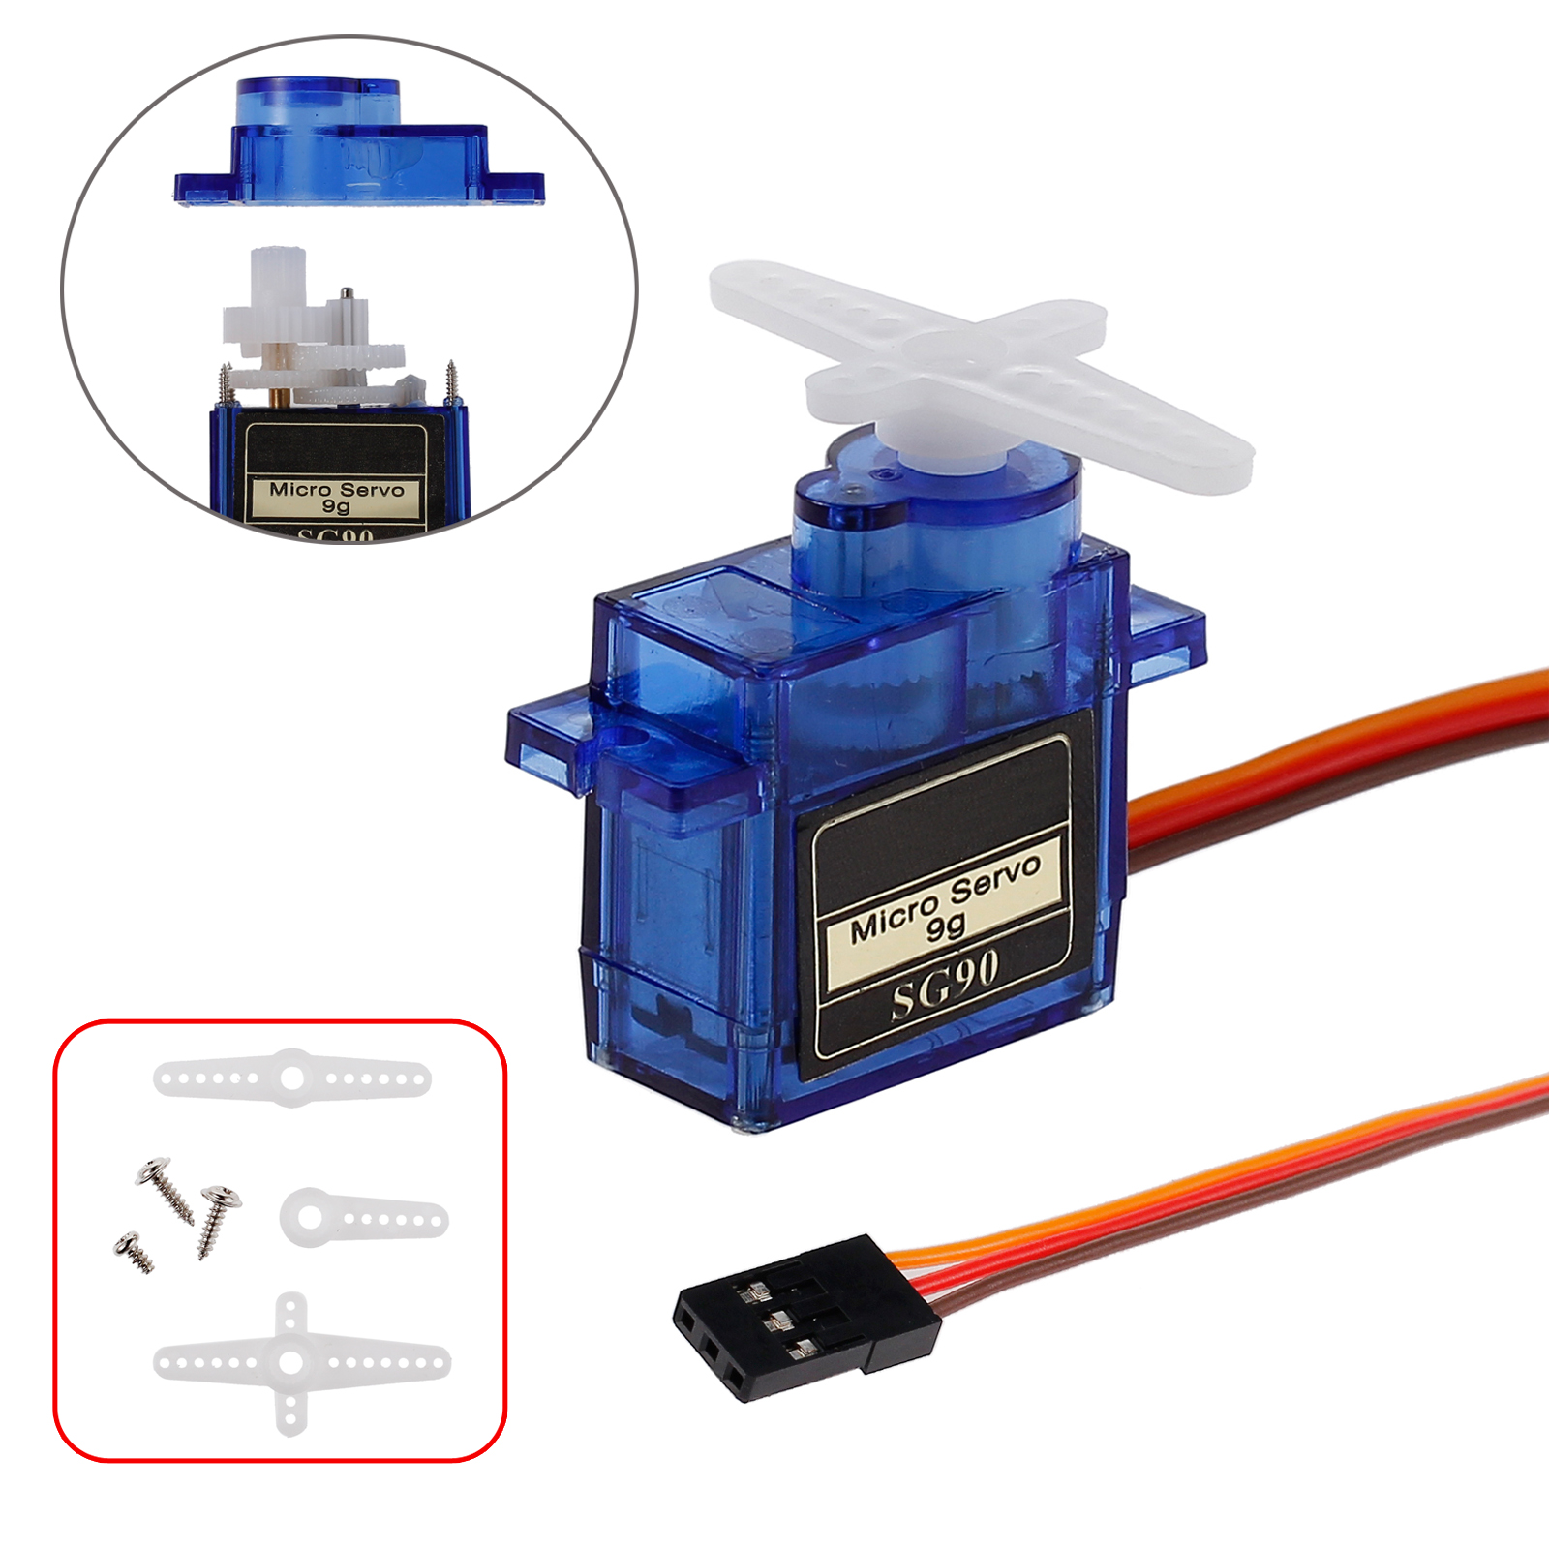
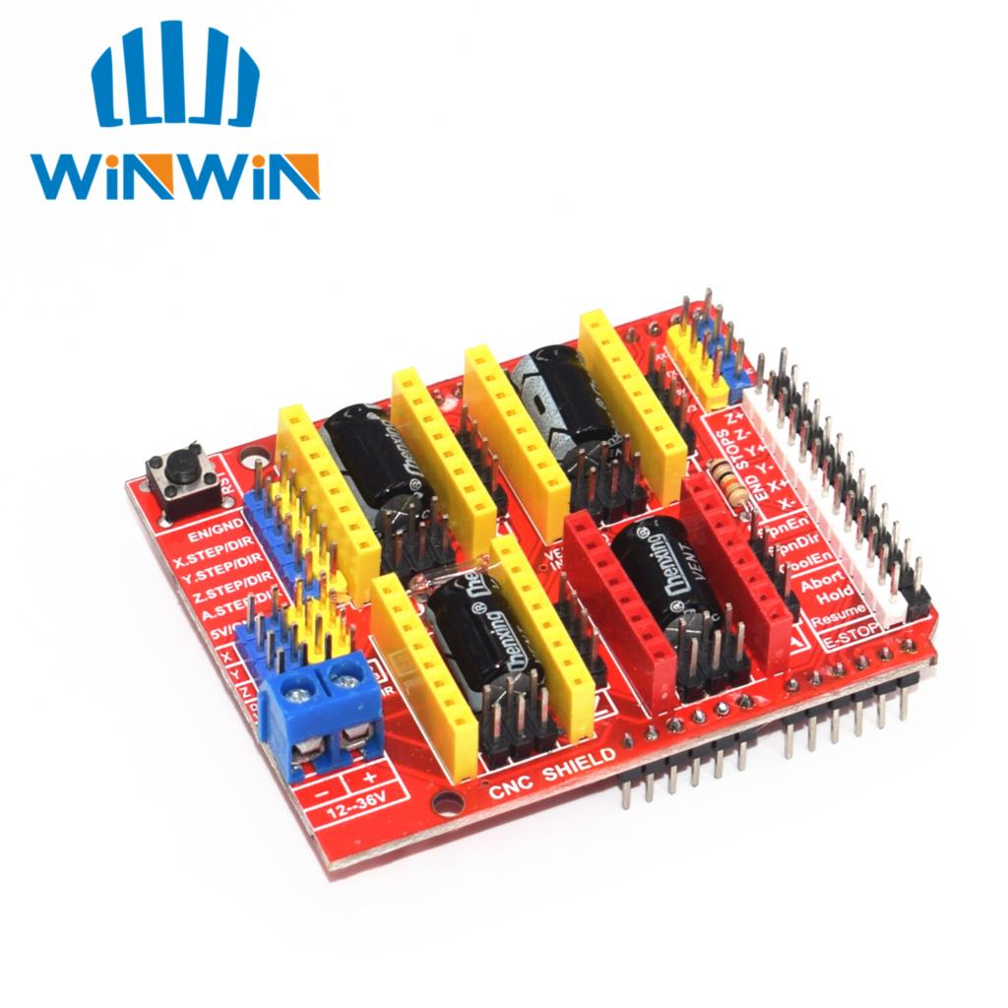
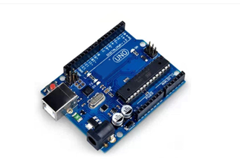
CNC / 3D Printer shield v3 engraving machine A4988 driver
Servo sg90
Arduino uno:

Slide 10
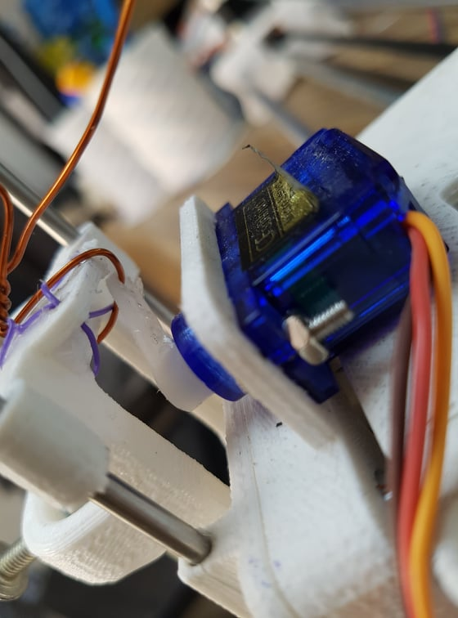
Constraints
Time
The rise up of the pen
slipping the pen

Slide 11
Future Work
we may add the feature of drawing on objects other than paper , such as drawing on cups

Slide 12
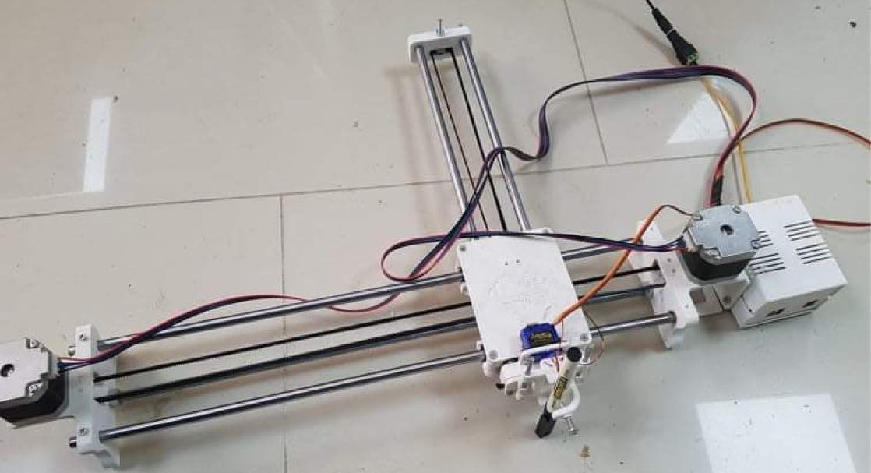
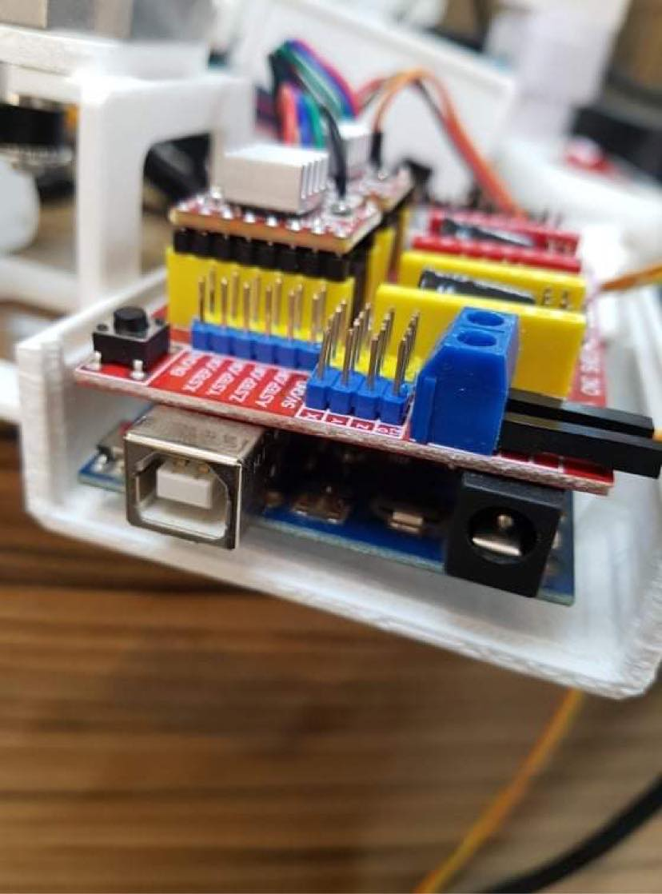
Project structure:
Mechanical part:

Slide 13
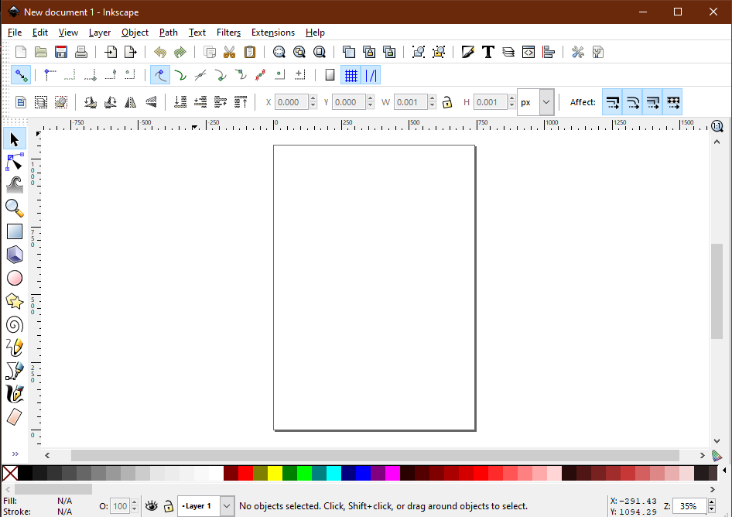
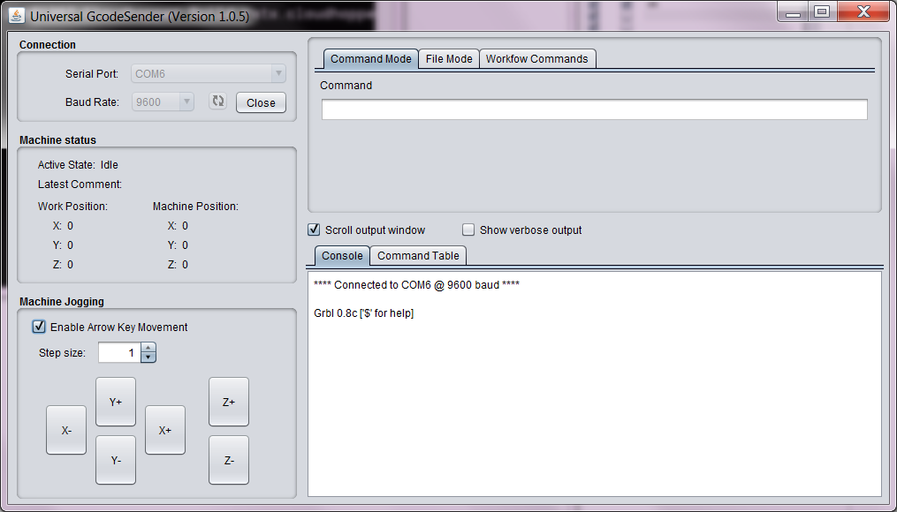
Project structure:
Software part:

Slide 14
Demo

Slide 15
Thank You

