Slide 1

An-Najah National University.
Faculty Of Engineering and Information Technology.
Electrical Engineering Department.
Smart Energy Metering and Control System.
Prepared by:
Enad Shafie (11642800).
Ameer Joudeh (11821760).
Izz Aldeen Shahbari (11924825).
Supervised by:
Dr. Haneen Al Ott.

Slide 2
  Summary of senior project I
In the previous senior project, we discussed the smart meter’s internal components, and the function of each component.
We also highlighted the numerous functions of the smart electricity meter, and the advantages it has over traditional electricity meters.
Moreover, the communication aspect was briefly discussed.

Slide 3
Introduction to senior project II
In this project, we will introduce the software responsible for management, control, and remote reading and writing of smart electricity meters.
We will also discuss in detail, the method of PLC communication, in addition to, international and local standards/configurations of smart electricity meters, and display a live mini module consisting of a single-phase smart meter, a data concentrator unit, and a load.
The mini module that we will show, has been set up for a month prior to the discussion of this report, in order for us to collect useful data.

Slide 4
Features, advantages, international and local standards
Protections:
Over-voltage Protection: local 260V, international 110%V.
Under-voltage Protection: local 180V, international 85%V.
Over load protection: local 32A.
  Tampering detection
  Bidirectional measurement
  Emergency credit
  Accurate bills
control of your home energy use

Slide 5
Hardware components.
Smart Meter.
Data concentrator unit (DCU).
Contactor .
customer interface unit (CIU).
Load.
Cables.
MDM

Slide 6
PLC communication.
  Basic Principles:
  - Carrier Signal Injection
  - Frequency Bands
  Types of PLC
- Narrowband PLC:
* Operates in the lower frequency range (3-500 kHz) .
* Has a longer range but lower data rates.
  - Broadband PLC:
  * Operates in the higher frequency range (1.8-250 MHz).
  * Offers higher data rates but has a shorter range.

Slide 7
Advantages
1. Utilizes Existing Infrastructure:
Reduces the need for new cabling and infrastructure investment.
Easy to implement in buildings and areas with extensive power line networks.
2. Cost-Effective:
Leverages the existing power line infrastructure, minimizing additional costs.
Simplifies network deployment and maintenance.
3. Wide Coverage:
Power lines reach almost every location where electricity is available.
Suitable for both urban and rural areas.

Slide 8
Meter Data Management System (MDMS)
  Vending and Management.
  Remote connect/disconnect.
  Map.
  Meter reading:
- Instantaneous supply voltage.
- Instantaneous load .
- Power factor.
- Relay status.
- Current credit .

Slide 9
- Total import active energy.
- Total export active energy.
    Alerts:
- Terminal cover removed
- Strong DC field detected
- Replaced battery
- Invalid clock
- Reverse current
- Over Power
- Overvoltage
undervoltage.
Load profile .

Slide 10
Recommendations
Map
CT numerator
CT denominator
Counter of power failure

Slide 11
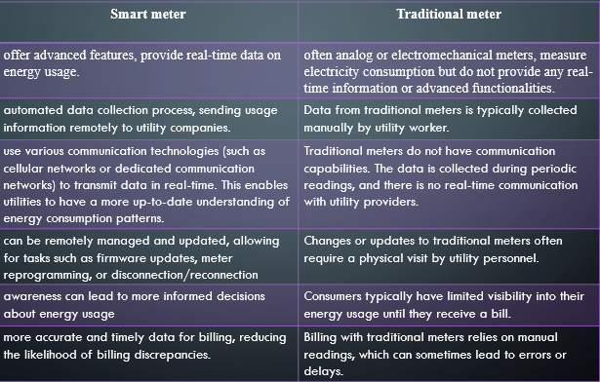
Comparison between smart meters and traditional meters.

Slide 12
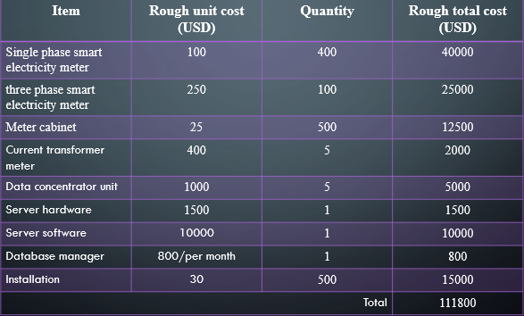
Cost
A part of this project and the previous one, a rough estimate of the cost of the smart metering system, for a utility with 500 customers, and it was found to be as per the table below:

Slide 13
Conclusion
Smart electricity meters offer significant advantages over traditional meters, improving the experience for both consumers and utility providers. They provide accurate billing through real-time data, eliminating the need for estimates and reducing billing disputes. Consumers benefit from enhanced control over their energy usage, with the ability to monitor consumption in real-time and utilize cost-saving opportunities like time-of-use billing.
In conclusion, smart electricity meters represent a major advancement in energy management, delivering accuracy, convenience, cost savings, and sustainability. They are an essential upgrade for modernizing electricity consumption and billing processes.

