Slide 1

An-Najah National University
Faculty of Engineering
Graduation Project
Bearing Capacity of soil
(Comparison between Field and Lab Tests)
1- Ameed Hamarsheh
2- Amjad Al-Hasan
3- Mohmmed Sbaih.
Spring 2016

Slide 2
General Definition
The project Represent a measurement of bearing capacity of soil, and after that make a soil treatment recommendation for the soil depending on results, the field test available on our country is plate bearing test and the lab test performing to calculate the shear strength parameter (c,φ).

Slide 3
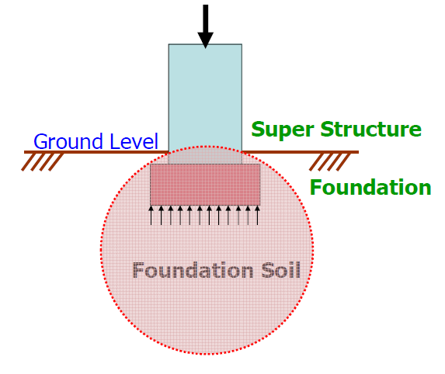
Bearing Capacity of soil
It’s the potential of soil to hold the forces from super structure without undergoing shear failure or excessive settlement.

Slide 4
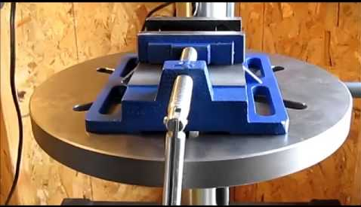
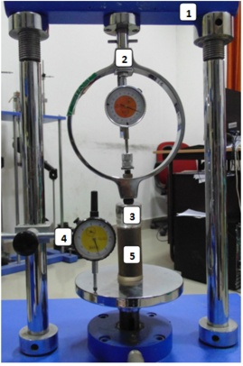
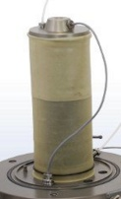
Lab Tests
Unconfined Compression Test

Slide 5
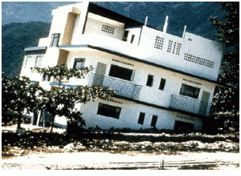

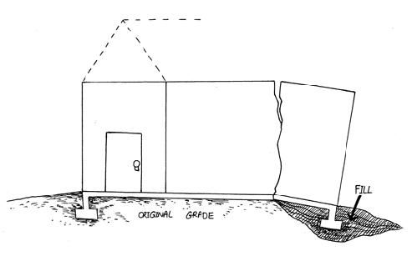
Why Bearing capacity of soil

Slide 6
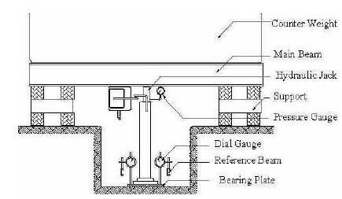
Plate Bearing Test
Characteristics of plate
The plates that are used for tests in the field are usually made of steel and are 25 mm thick and 150 mm to 762 mm in diameter. Occasionally, square plates that are 305mm× 305mm are also used.

Slide 7
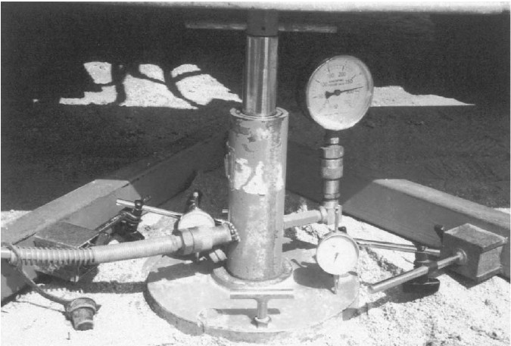
How to measure bearing capacity due to plate bearing test

Slide 8
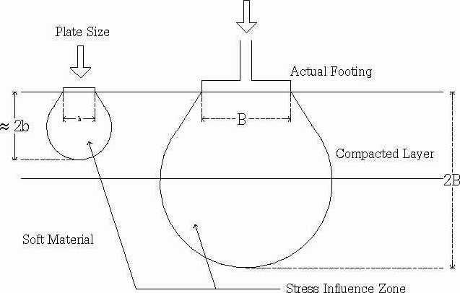
Mechanism of plate bearing

Slide 9
Shear characteristics of soil Parameter (c,φ)
The shear strength of soil is basically made up of the following components:
(i) Frictional component
(ii) Cohesion component

Slide 10
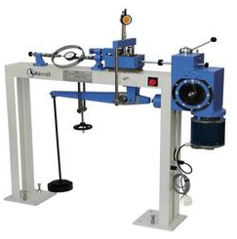
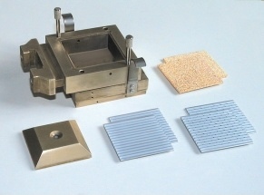
Lab Tests
Direct shear Test

Slide 11
Project Two
In project two of this project, plate bearing test will be performed in site, and the same time samples will be taken from the site to carry laboratory test to compare the results between field and lab.

