Slide 1

Smart Glove For Sign Language
Smart Glove For Sign Language
Presented By:
ENG. AHMED AL-SADEQ
ENG. FAIQ ZEIDAN
Presented By:
ENG. AHMED AL-SADEQ
ENG. FAIQ ZEIDAN

Slide 2

introduction
Breaking Barriers in Sign Language Communication
Approximately there’s 170 million people worldwide have speech impairments that impact clear communication.
Because there’s A lack of universal understanding creates a "silent wall" between users and the general public.
So we create A wearable solution that translates motion into speech in real time.
Our Vision: Creating an affordable, portable bridge for social and educational inclusion.

Slide 3
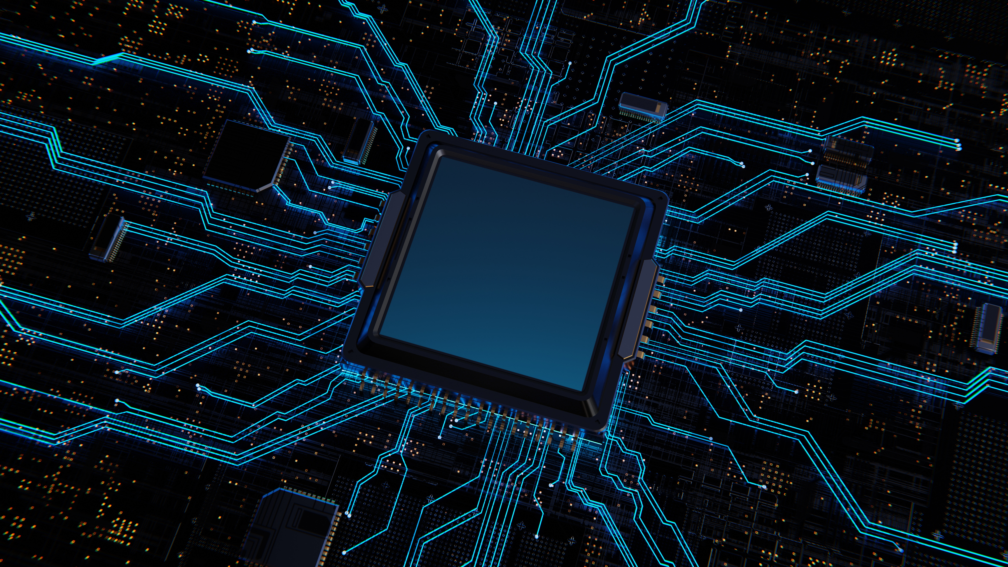
Problem Statement
Communication Barrier: Deaf and mute individuals often face social isolation due to the lack of real-time translation tools.
Vision-Based Limitations: Require fixed cameras, stable lighting, and heavy processing.
The Need: A wearable, self-contained, low-cost translation device.
The Challenge: Reliable acquisition of micro-movements of fingers with low latency.

Slide 4
Objective
Sign language is a primary means of communication for individuals with hearing and speech impairments
communication barriers still exist between sign language users and the general public.
This project presents the design and implementation of an smart glove for real time sign language recognition.
Our project utilizes wearable gloves equipped with flex sensors and inertial measurement units (IMU) to capture raw data from finger bending and hand gestures. The ESP32 microcontroller acts as a data acquisition hub, collecting sensor readings and transmitting them via WIFI to a mobile application. Within the application, the system performs real-time data processing, gesture classification, and linguistic processing including phrase construction to translate hand movements into coherent output.

Slide 5
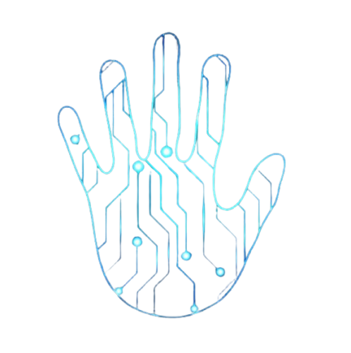
Proposed Solution: The Smart Glove
Core Philosophy: Leveraging physical computing to create an intuitive, portable, and reliable translation tool.
Mechanism:
Captures: Real-time finger articulation and hand orientation.
Processes: Converts physical signs into linguistic text and audio via a dedicated mobile app.
Output: Reconstructs full, grammatically correct sentences using an on-device Local AI engine.

Slide 6
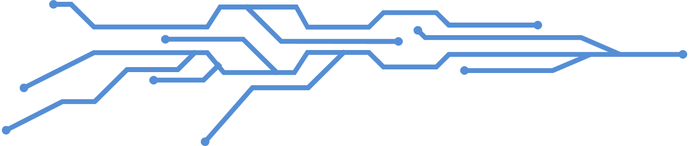
System Architecture & Data Flow
Sensor Hub (ESP32): Functions as the data acquisition layer for real-time, low-latency transmission of flex and IMU sensor data.
Intelligence Layer (Mobile App): Serves as the centralized processing hub that performs:
Gesture Classification: Rule-based linguistic analysis to map and identify sign language tokens.
Linguistic Processing: The Phrase Engine maps tokens into grammatically correct sentences.
Design Rationale: This architecture is optimized for performance, scalability, and ease of future updates, ensuring a seamless user experience on the mobile platform.

Slide 7
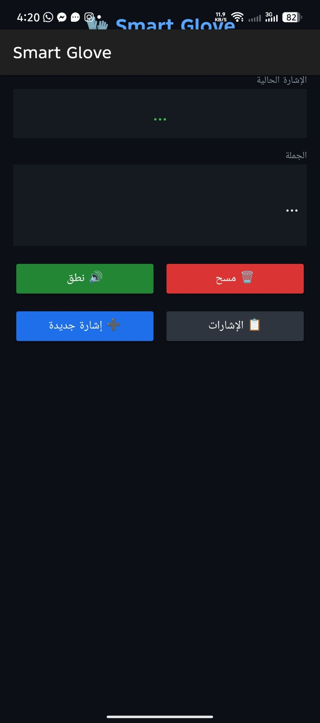
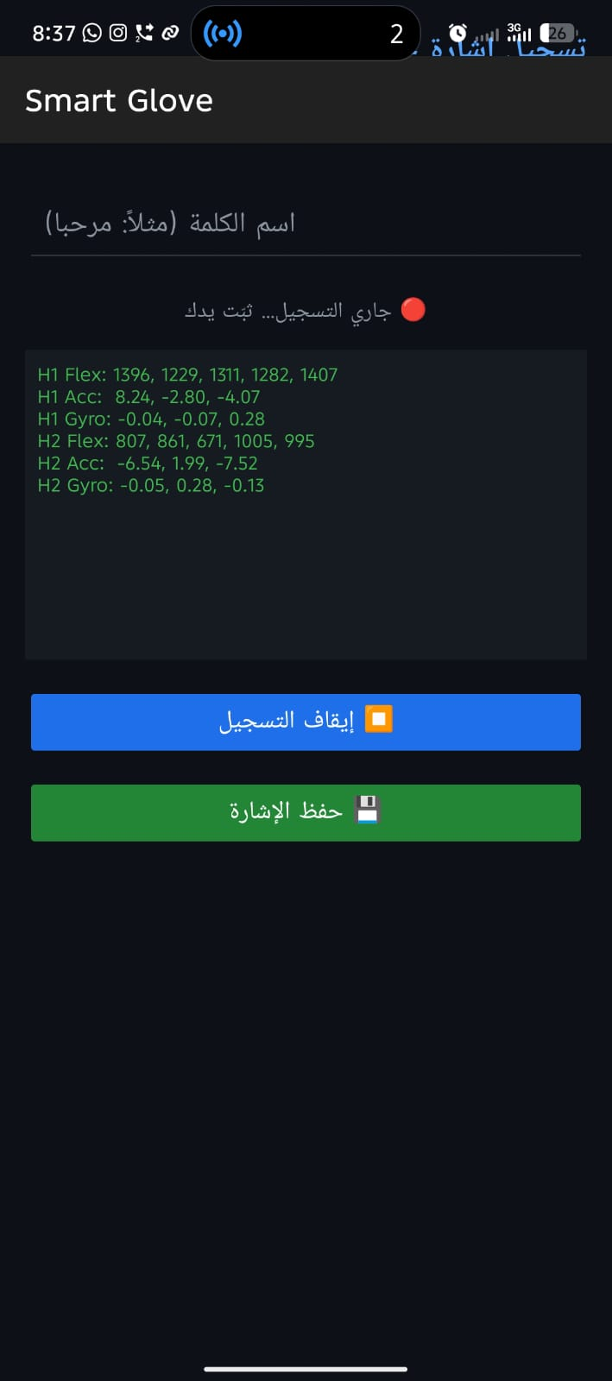
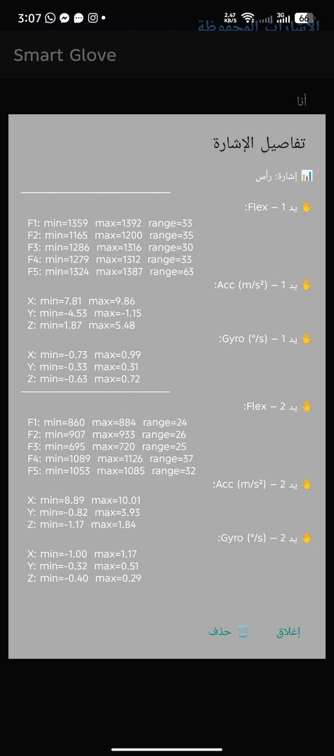
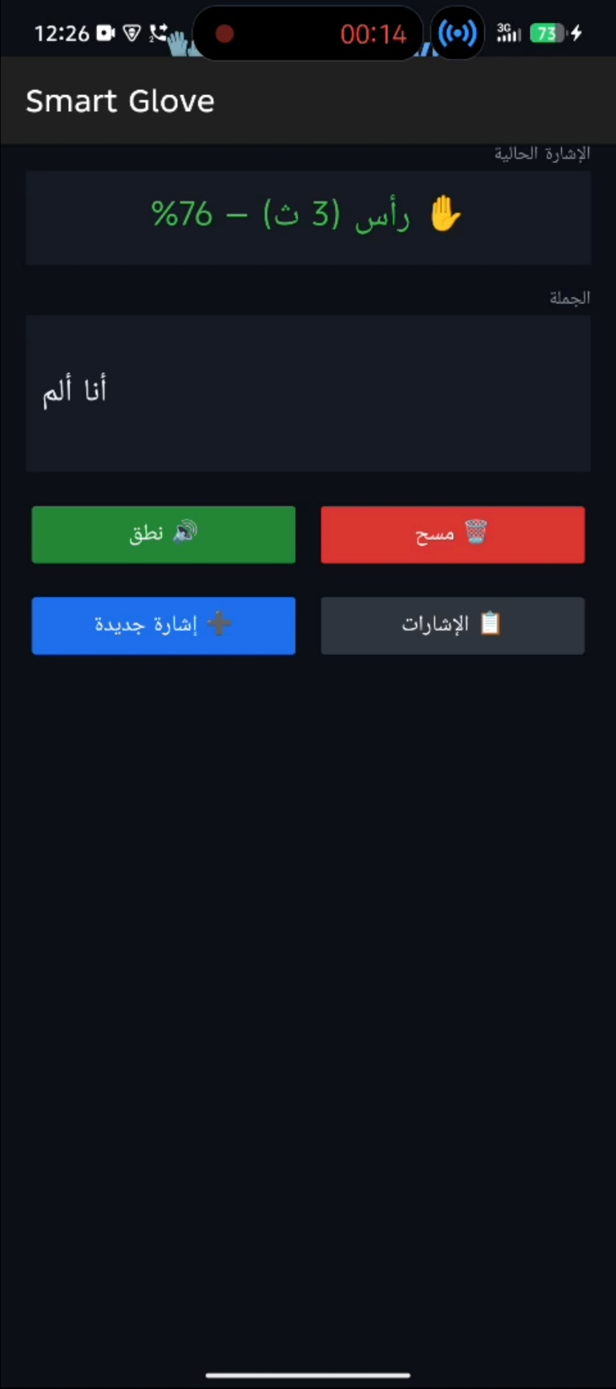
MOBILE APPLICATION

Slide 8
Local AI & Intelligent Linguistic Processing
The Logic Engine (PhraseEngine):
Semantic Reasoning: Acts as the layer that receives gesture-detected keywords and performs linguistic post-processing.
Intelligent Reconstruction: Transforms fragmented signs into meaningful, context-aware sentences by bridging sequence gaps.
Why this is an AI-Integrated System:
Hybrid Architecture: Combines TinyML (for real-time classification) with a Deterministic Reasoning Engine (for semantic refinement).
Local Processing: Operates locally to achieve near-zero latency and ensure maximum data privacy without cloud dependency.
Enhanced Reliability: The engine compensates for classification ambiguities to ensure grammatically correct output.

Slide 9
Flowchart
GLOVES
ESP 32
WIFI
MOBILE APP
AI PROCESSING
TEXT & SPEECH OUTPUT
Detected Keywords
PhraseEngine
Grammatically Correct Sentence

Slide 10


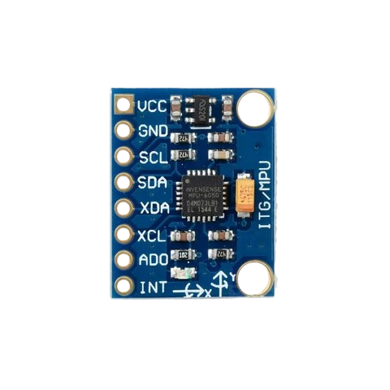
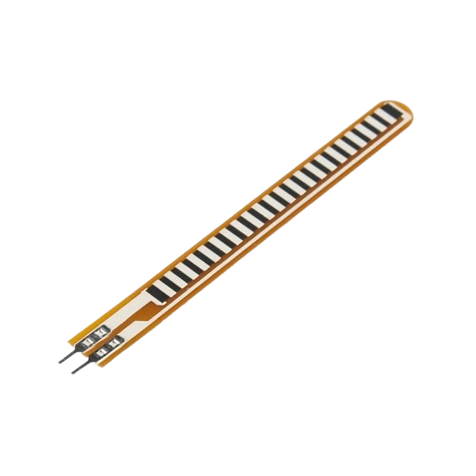
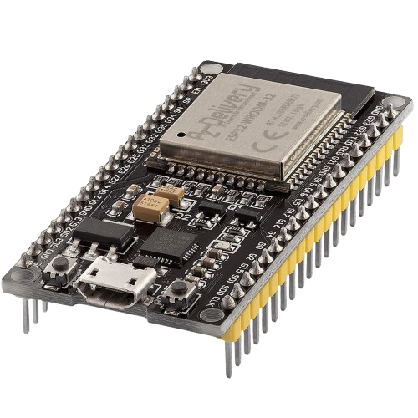
Hardware Architecture & Design
1.
2.
3.
MPU
ESP 32
FLEX SENOSR
Measure fingers displacement
Hand orientation and velocity
Core Processing

Slide 11
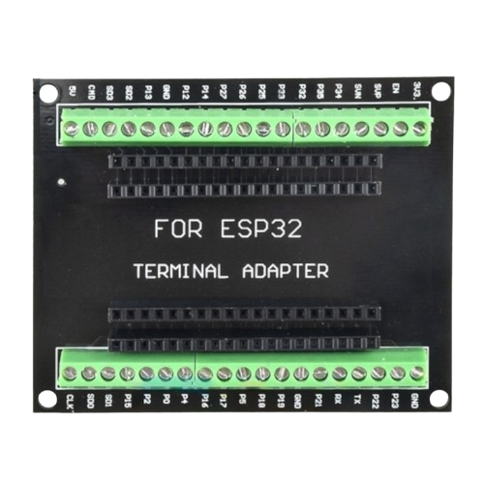
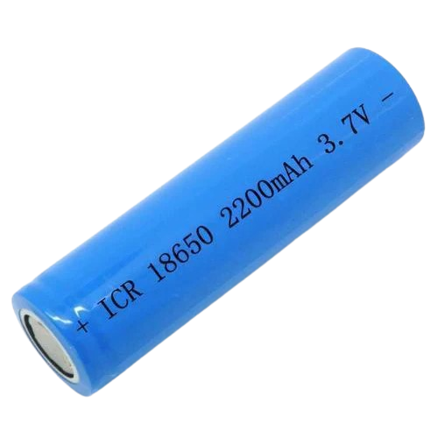
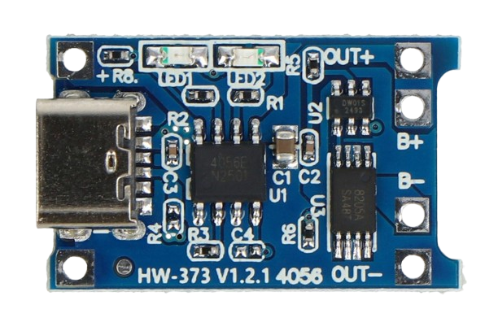
Hardware Architecture & Design
4.
5.
6.
ESP 32 TERMINAL
LI-ION BATTERY
TP4056 Charger

Slide 12
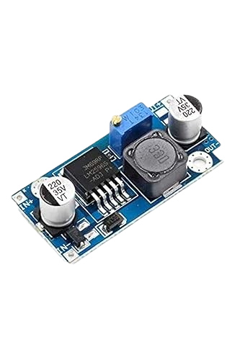
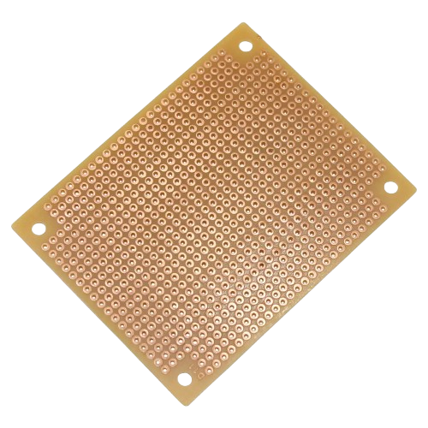
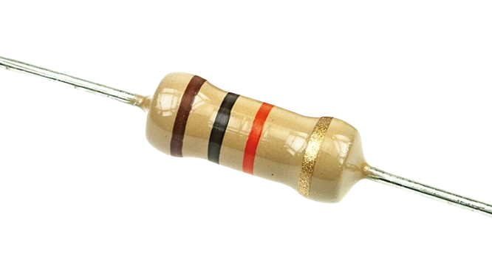
Hardware Architecture & Design
7.
DC-DC
BUCK CONVERTER
8.
9.
PERFBOARD
RESISTORS
for stable 3.3V power.

Slide 13
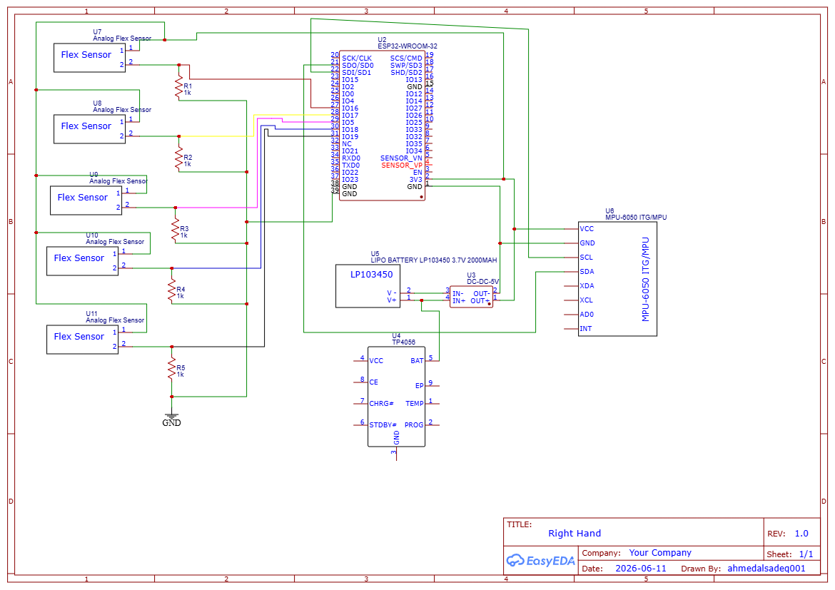
schematic diagram

Slide 14
Software & AI Implementation
1.
ESP32 Firmware
Reads sensors data
Data Preprocessing & Filtering
Sends data via WI-FI
2.
Mobile Application
Receives data.
Normalizes values.
Displays translated words.
Logic Engine: Pattern matching & phrase construction engine.
Live Monitoring: Real-time stream of gesture recognition.

Slide 15
AI Integration
Bridging the Gap: From Raw Gestures to Natural Language
Local AI Engine:
Core Function: Receives recognized gesture keywords to perform advanced linguistic post-processing.
Intelligent Reconstruction: Bridges keyword sequence gaps by analyzing the semantic structure to generate grammatically and contextually correct sentences.
Performance Benefits: Operates entirely locally on the device, ensuring high data privacy and ultra-low latency for real-time translation.
Example:
Input:
أنا
ألم
رأس
Output:
"أنا أعاني من ألم في الرأس"

Slide 16
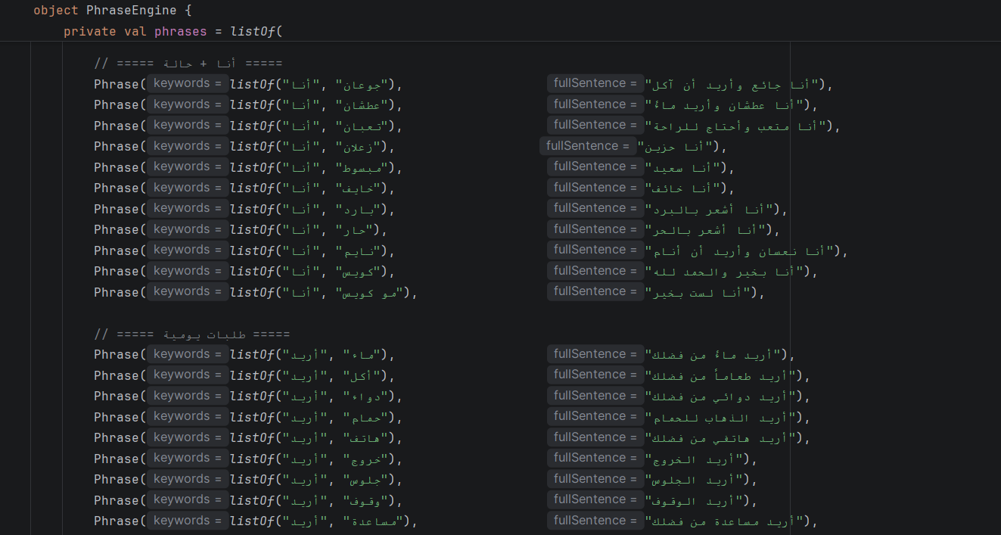
AI Integration

Slide 17
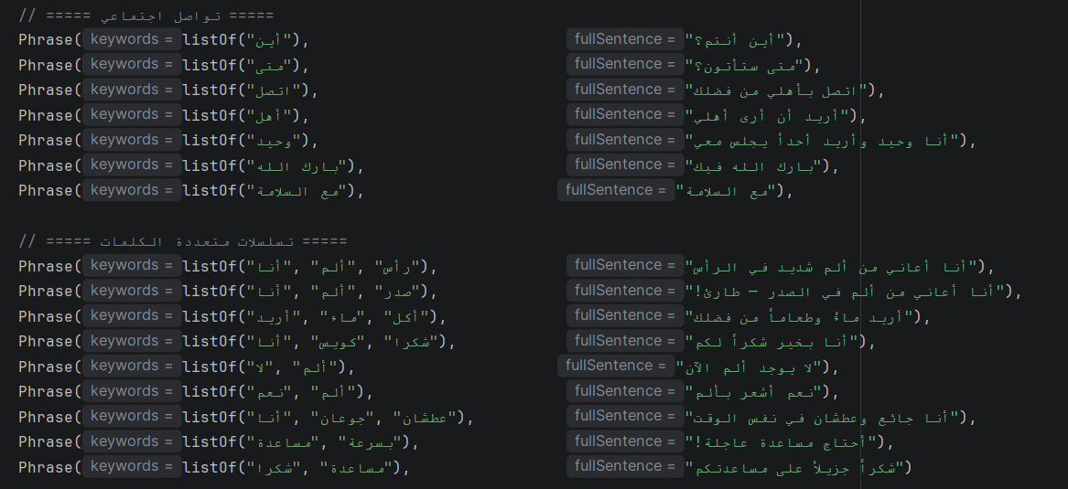
AI Integration

Slide 18
Testing & Results
Performance Results
Metric | Result
Recognition Accuracy | >92%
Response Time | <300 ms
Wi-Fi Stability | High
AI Processing | Near Instant

Slide 19
Videos:

Slide 20

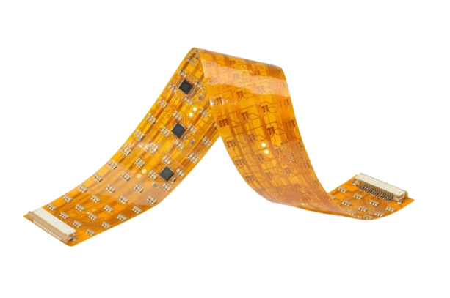
Future Work
Planned Improvements
Flexible Printed Circuit Board (FPCB)
Touchscreen-compatible fingertips
Double-layer fabric design
Larger gesture vocabulary
Enhanced AI models

Slide 21
THANK YOU
As we look to the future, this technology will play a crucial role in shaping a better world for generations to come

