Slide 1



An-Najah National University
Faculty of Engineering & Information Technology
Electrical Engineering Department
Enhancing Grid Stability under Dynamic Loads
Using a Grid-Tied Inverter with Volt/Var Controller
Supervisor Name:
Eng. Omar Tamimi
Presented by:
Ghena Farouq, Tariq Dumaide, Mohammad Qasem, Mohammad Tubileh
${31}^{st}$ January
2025/2026

Slide 2

Simulation using LTspice

Slide 3
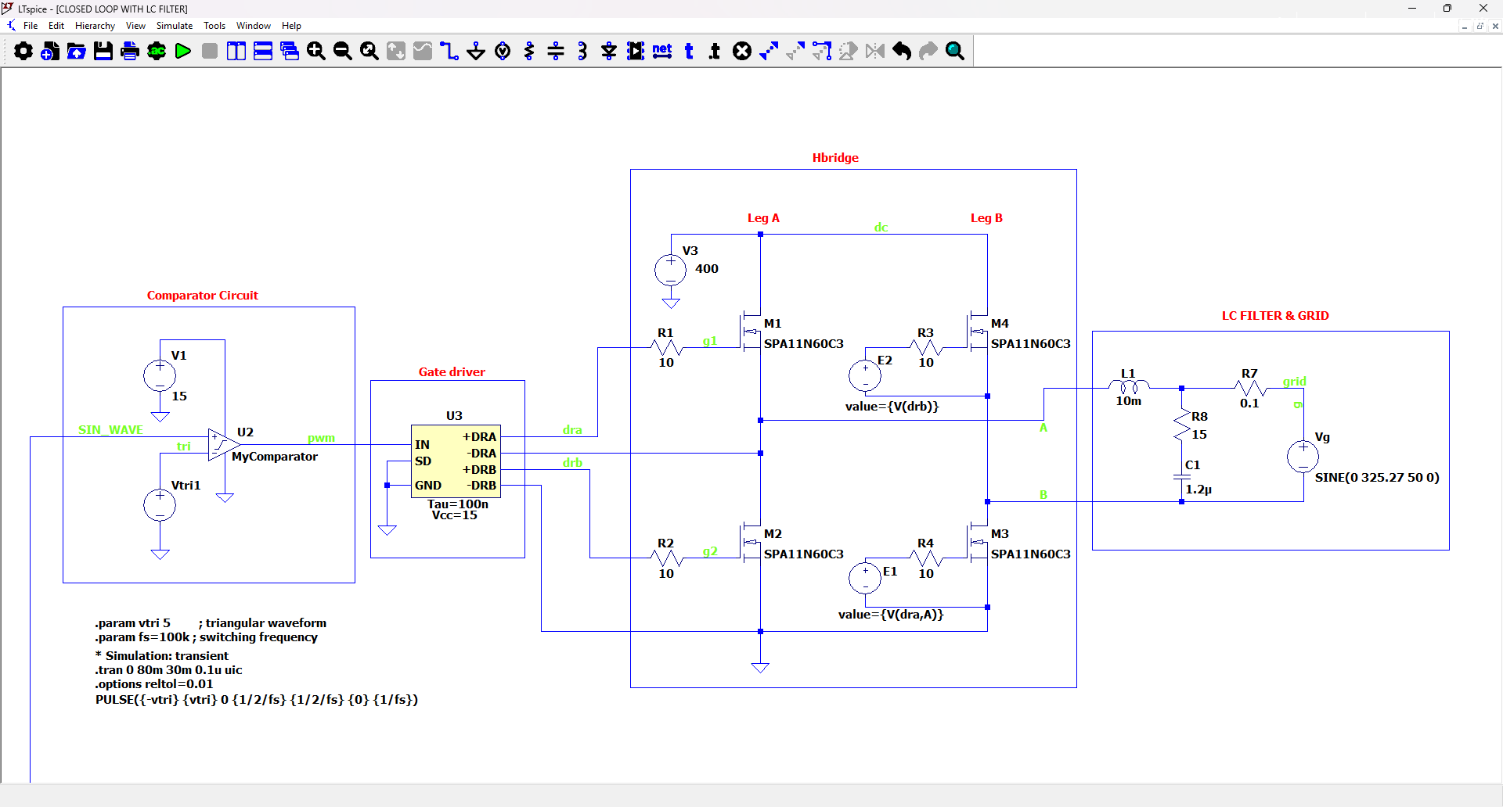
Open Loop Grid Tied Inverter

Slide 4
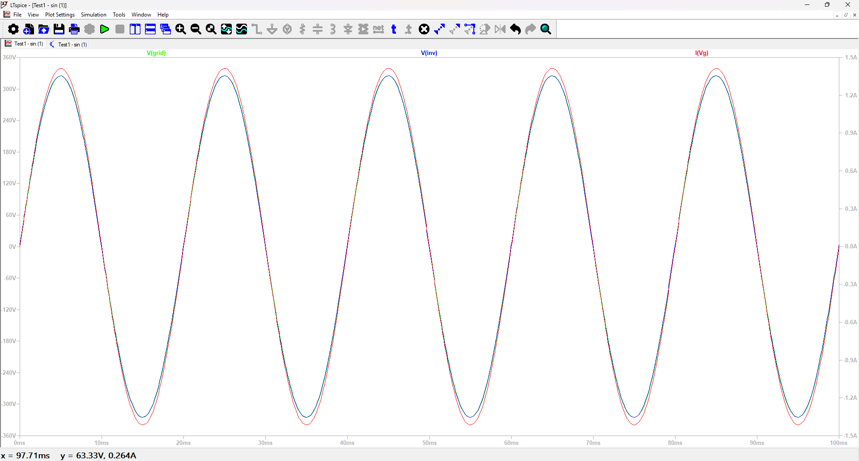
Open Loop GTI – IDEAL Operating Condition
Grid Voltage = 230V RMS
Reference voltage = 230V RMS In Phase
Grid current = 1A RMS

Slide 5
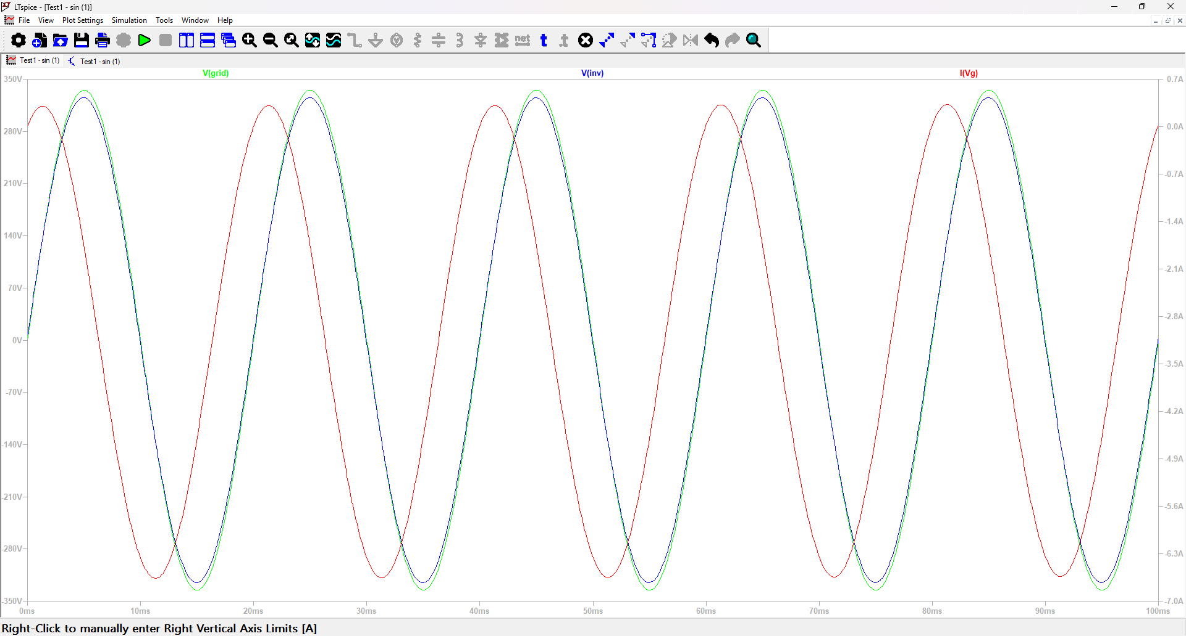
Open Loop GTI – Real Operating Condition
Grid Voltage = 245V RMS Out of Phase
Reference Voltage = 230V RMS Distorted current
Grid Current = Undefined RMS

Slide 6
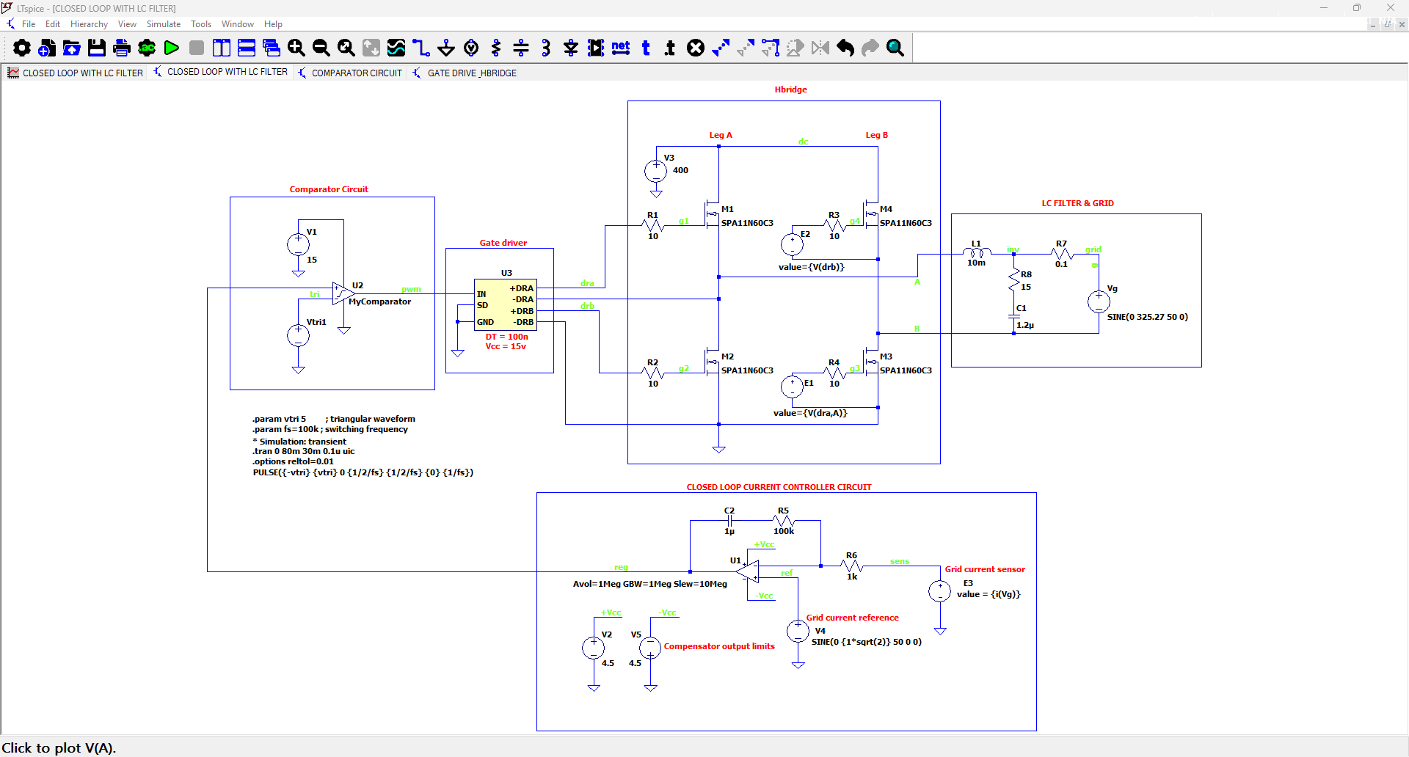
Closed Loop GTI with Current Control Circuit

Slide 7
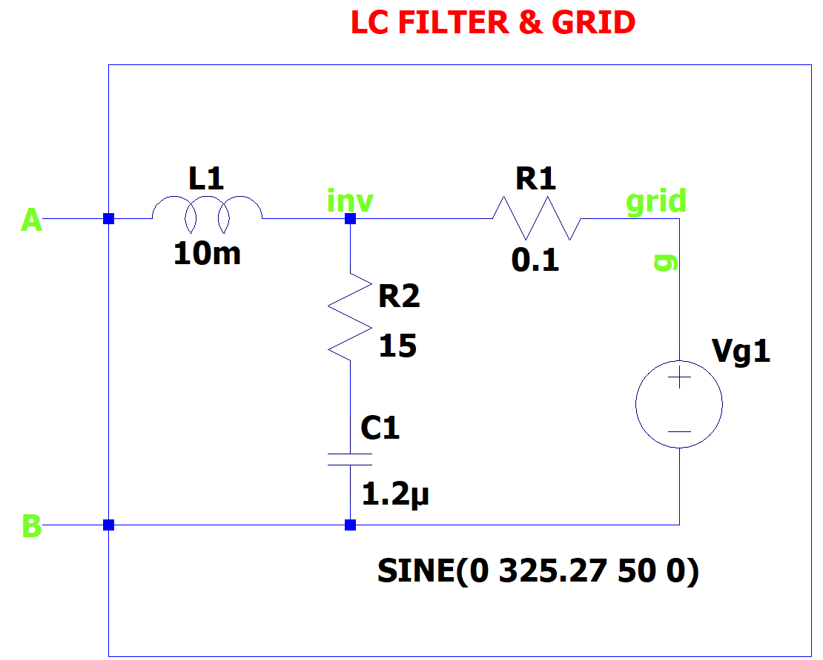
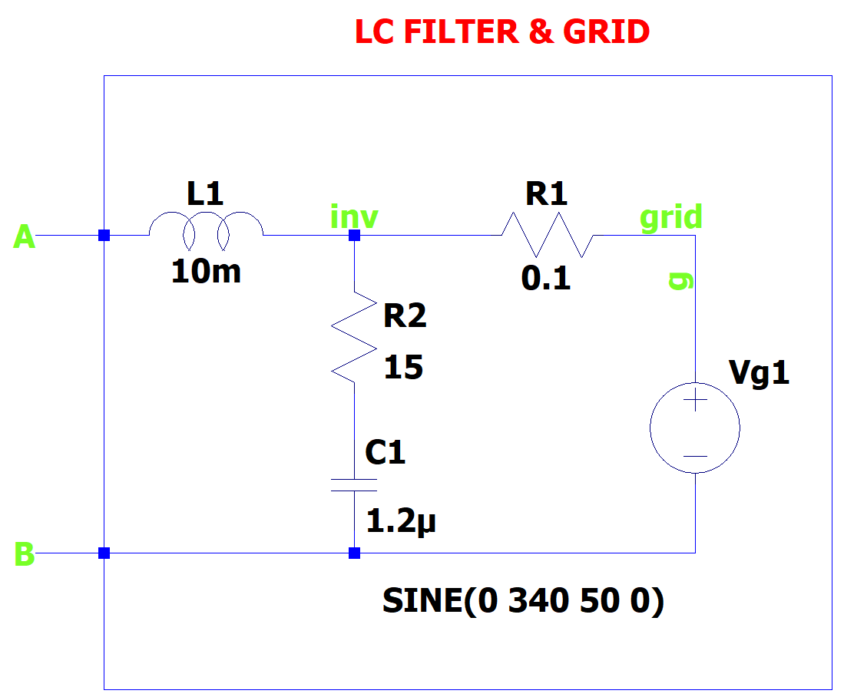
Grid Voltage = 230V RMS
Grid Voltage = 245V RMS

Slide 8
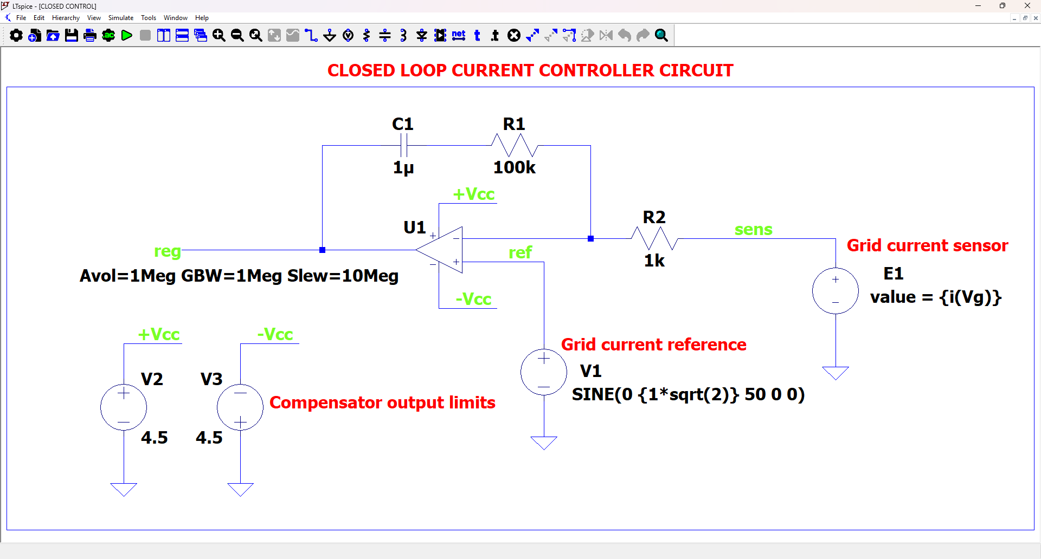

Slide 9
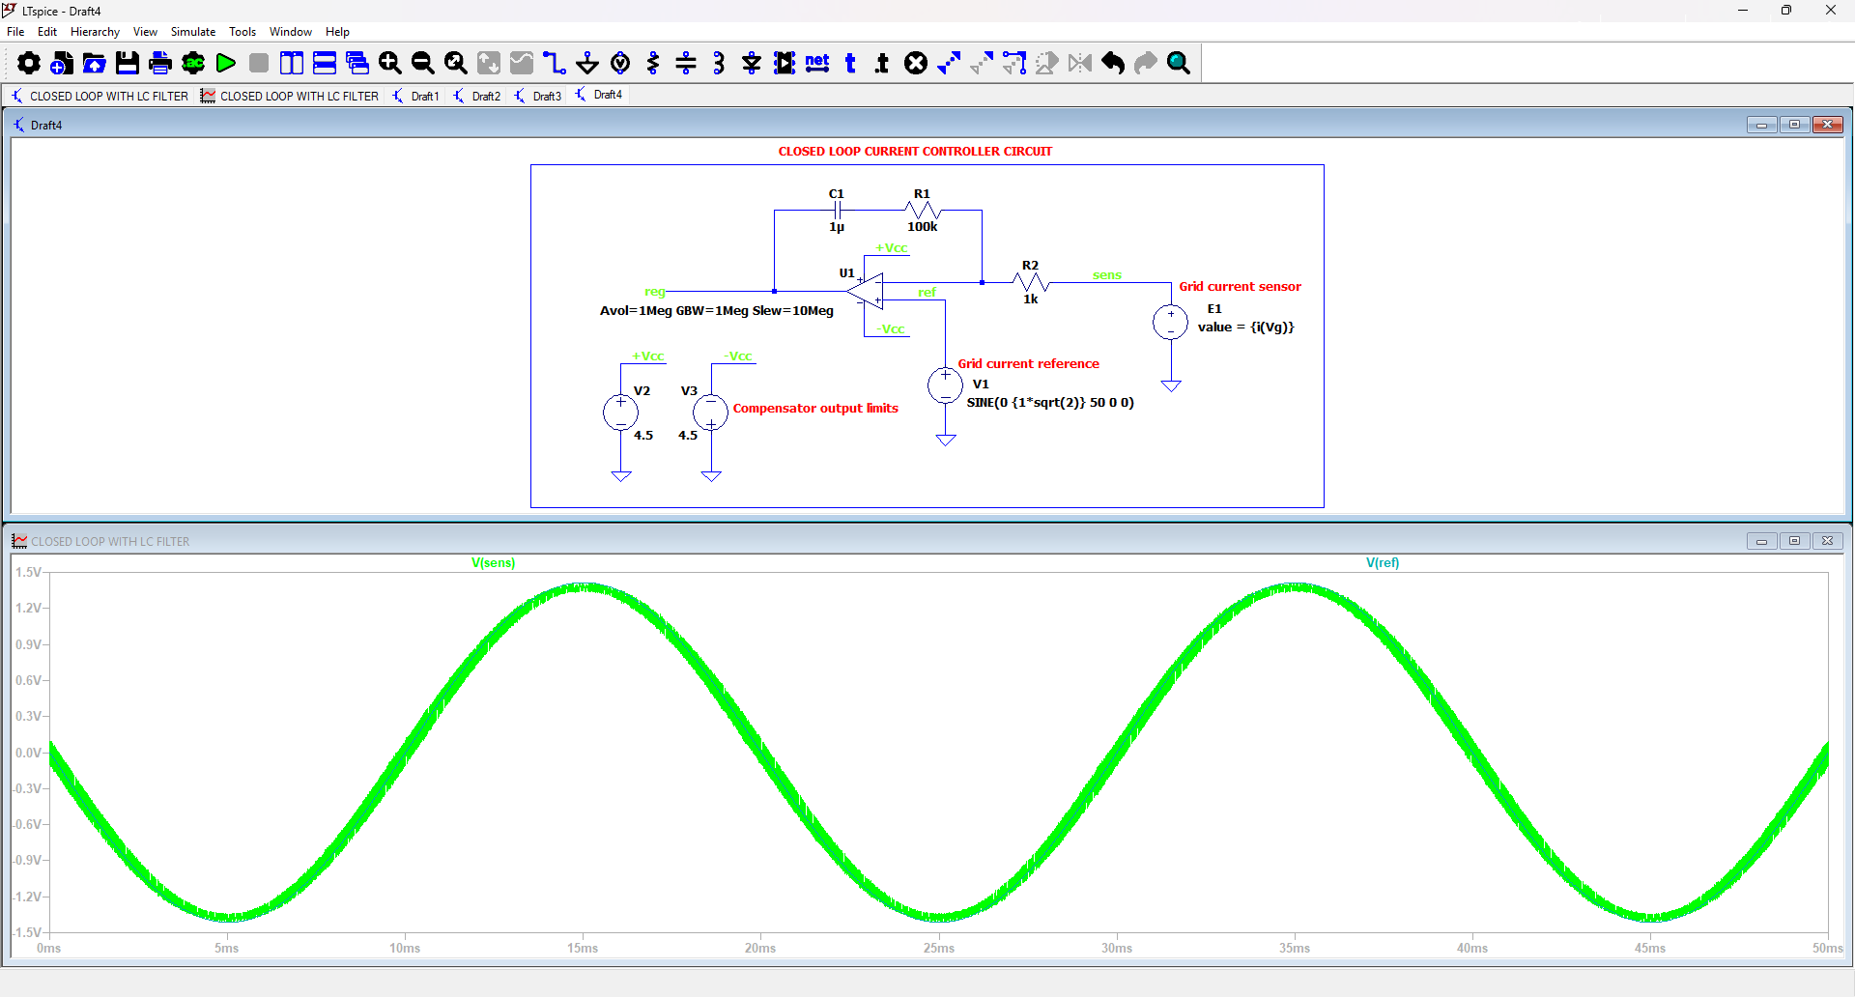


Closed Loop GTI with Current Control Circuit
$e\left(t\right)=current error$
Grid Current Sensor
Grid Current Reference
$i_{grid}\left(t\right)−i_{ref}\left(t\right)=e\left(t\right)$

Slide 10
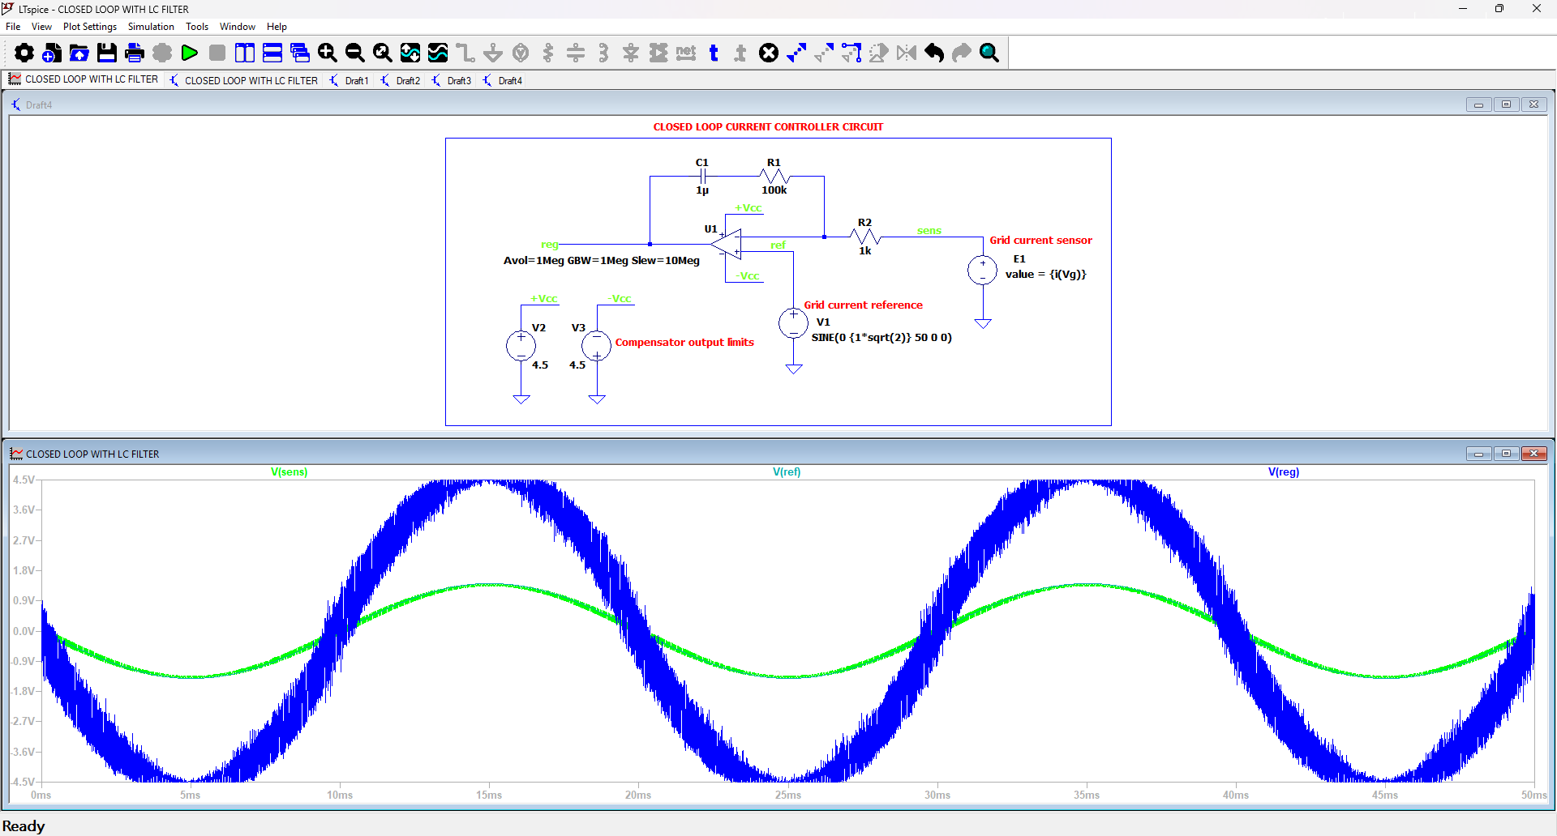
$$u\left(t\right)=K_{p}\left(i_{ref}−i_{grid}\right)+ K_{i}\int{\left(i_{ref}−i_{grid}\right)dt}$$
Grid Current Sensor
Grid Current Reference
Compensator Output Voltage

Slide 11
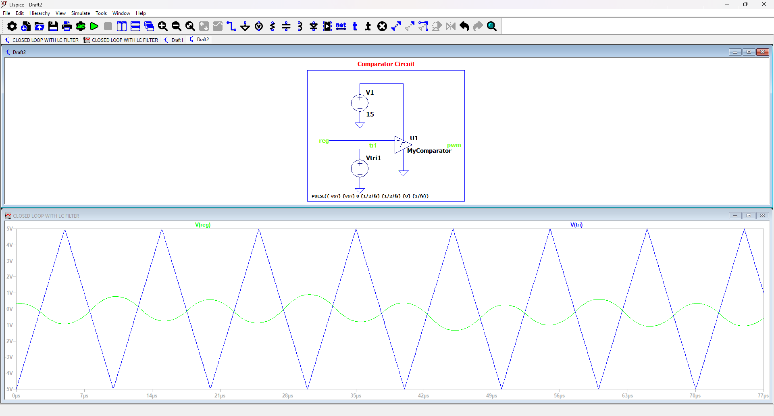
Triangular Voltage (Wave form)
Compensator Output Voltage (Sinusoidal)

Slide 12
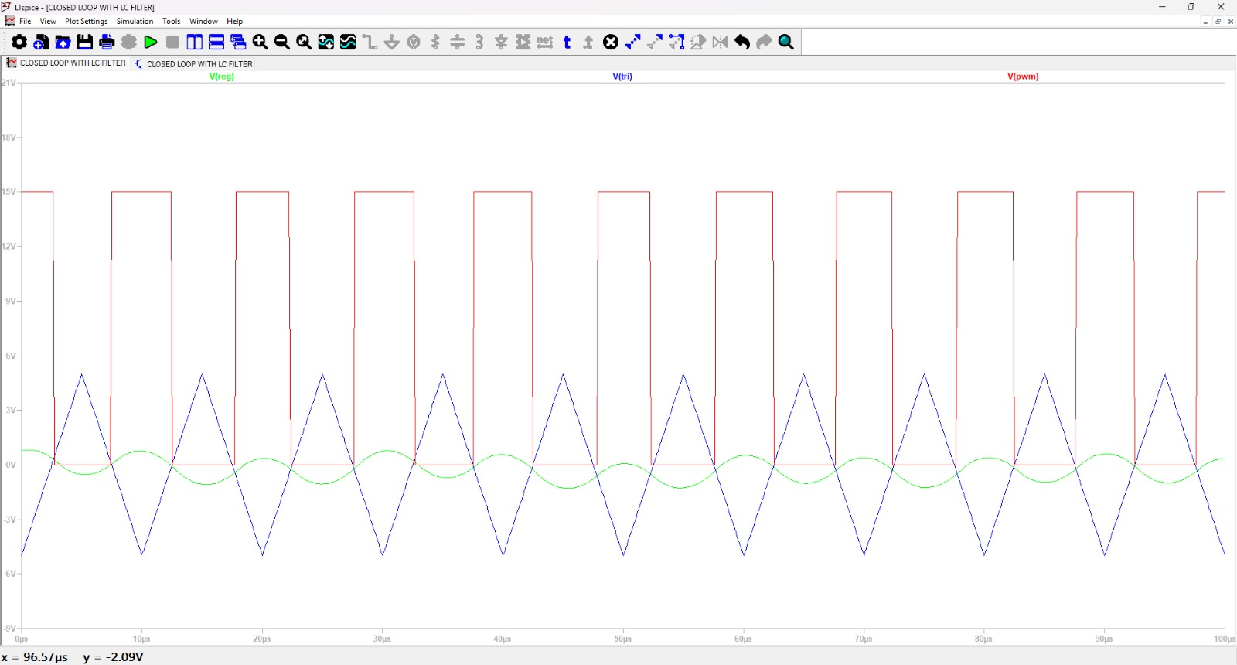

Triangular Voltage (Wave form)
Compensator Output Voltage (Sinusoidal)
PWM
High PWM $→$ Sinusoidal $>$ Triangular
LOW PWM $→$ Sinusoidal $<$ Triangular

Slide 13
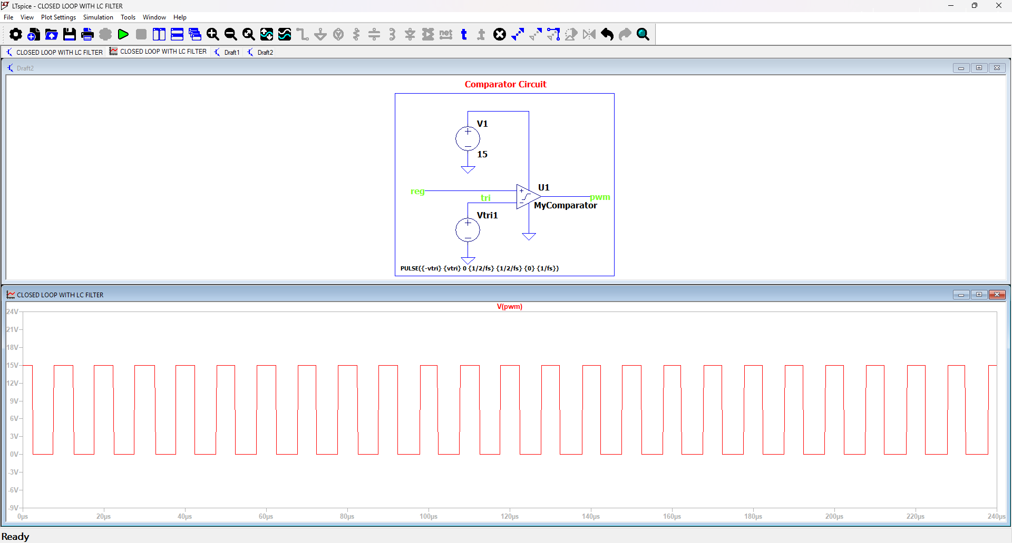
PWM (Wave form)

Slide 14
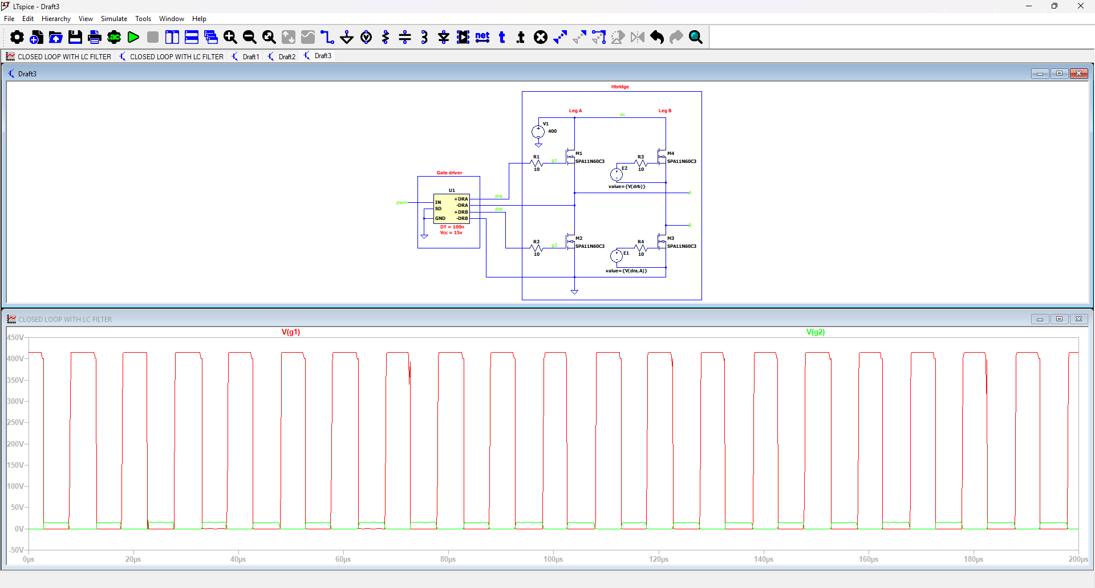

1st Mosfet Gate Voltage
2nd Mosfet Gate Voltage
With dead Time 100ns
$$t_{dead}≥t_{d\left(off\right)}+t_{f}+{∆t}_{driver}+t_{margin}$$

Slide 15
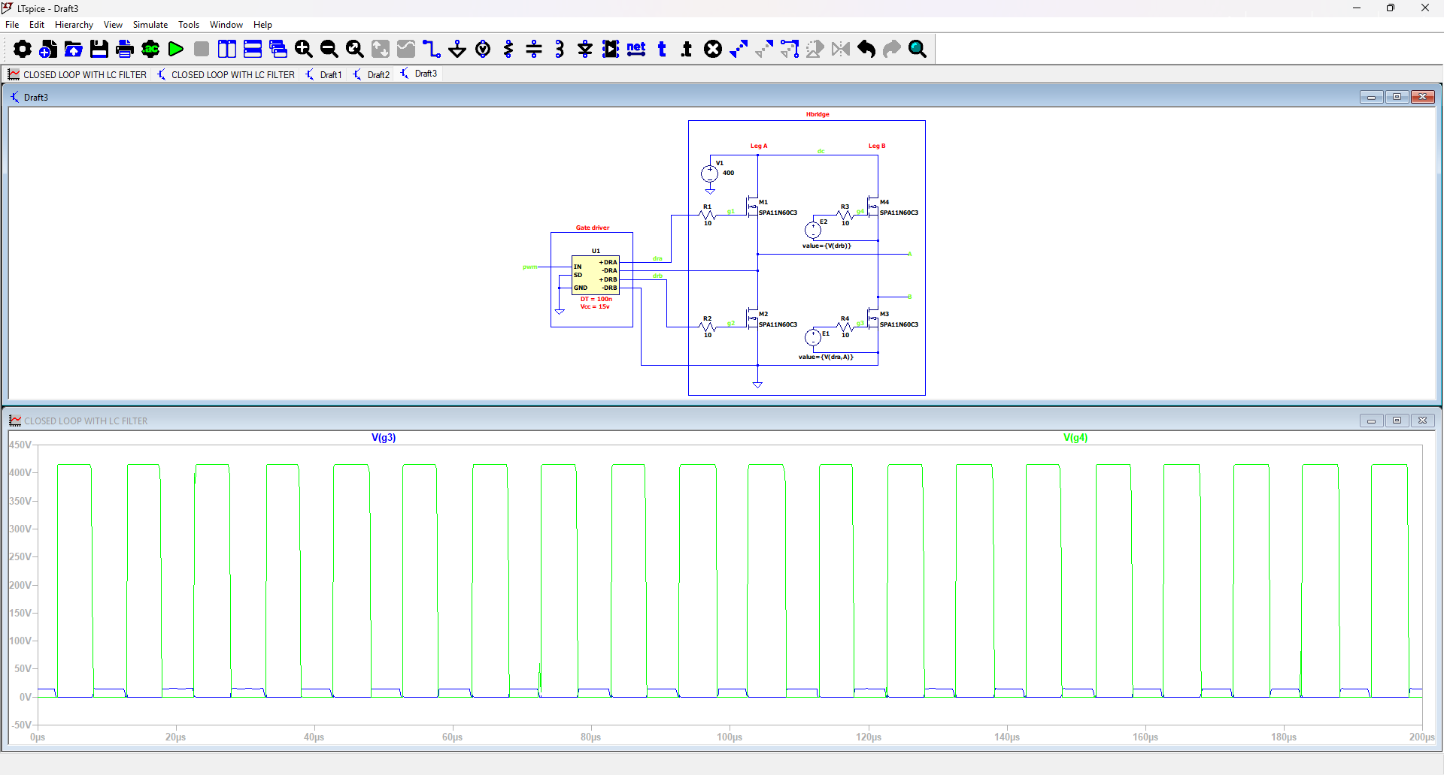
3rd Mosfet Gate Voltage
4th Mosfet Gate Voltage
With dead Time 100ns

Slide 16
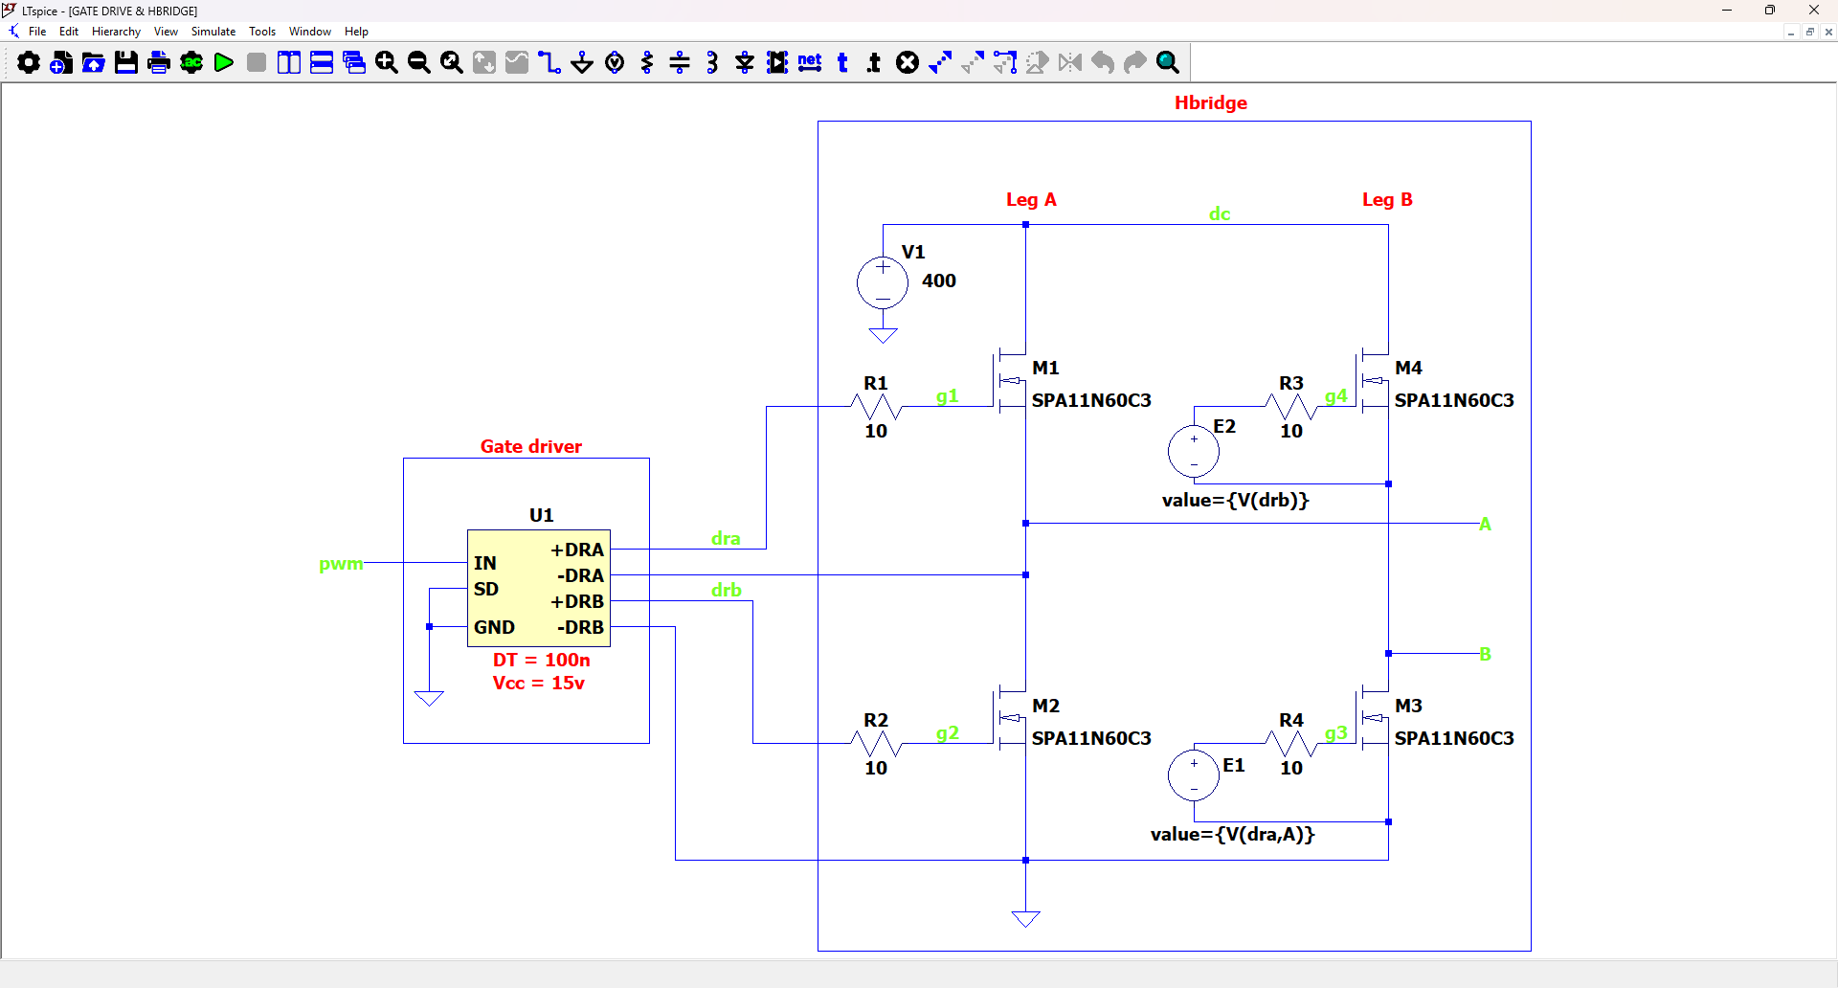
Gate Driver with Full Bridge Inverter

Slide 17
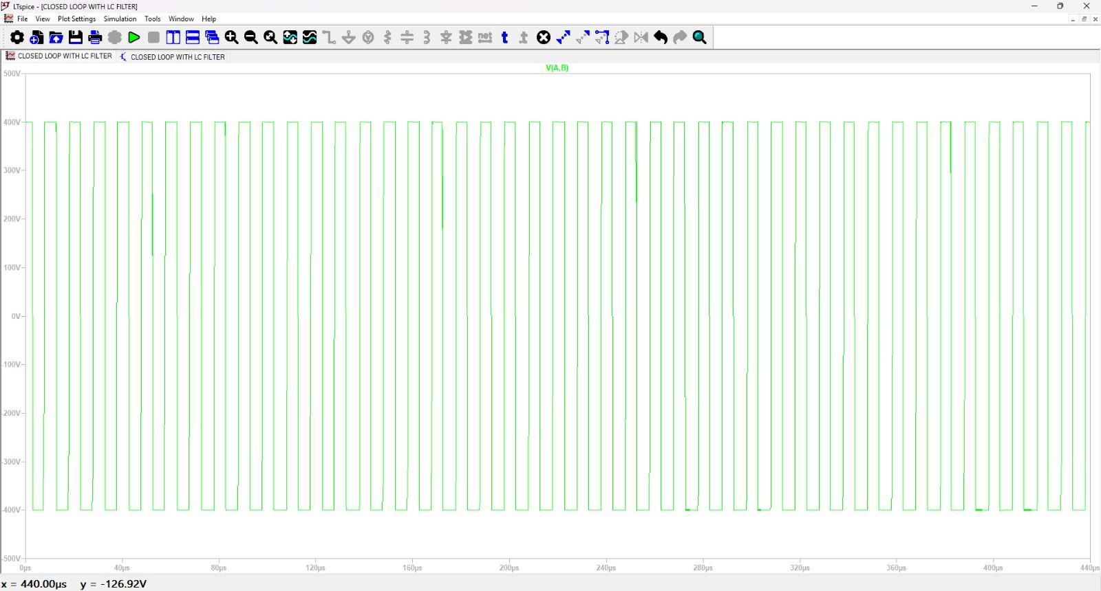
Inverter Output Voltage (-400V to 400V)

Slide 18
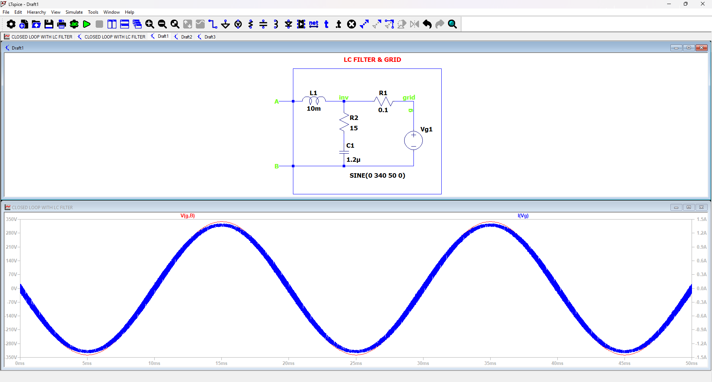
Results of using Closed Loop Current Controller
Grid Current in Phase with Grid Voltage
Exporting Real Power with High Efficiency
System is Stable

Slide 19
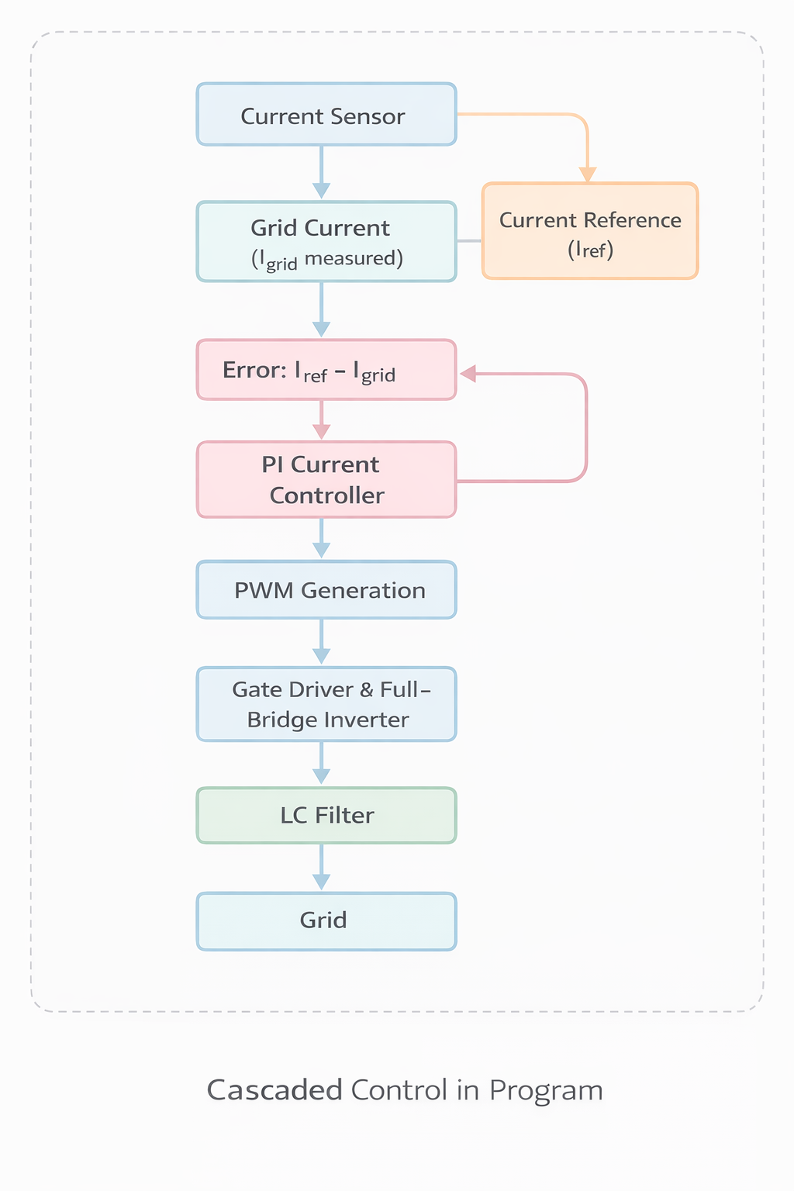
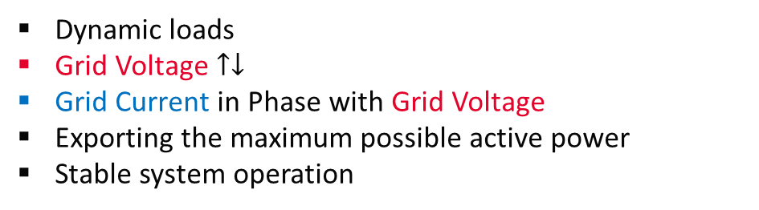
Results of using Closed Loop Current Controller
Dynamic loads
Grid Voltage $↑↓$
Grid Current in Phase with Grid Voltage
Exporting the maximum possible active power
Stable system operation

Slide 20
PCB Layout

Slide 21
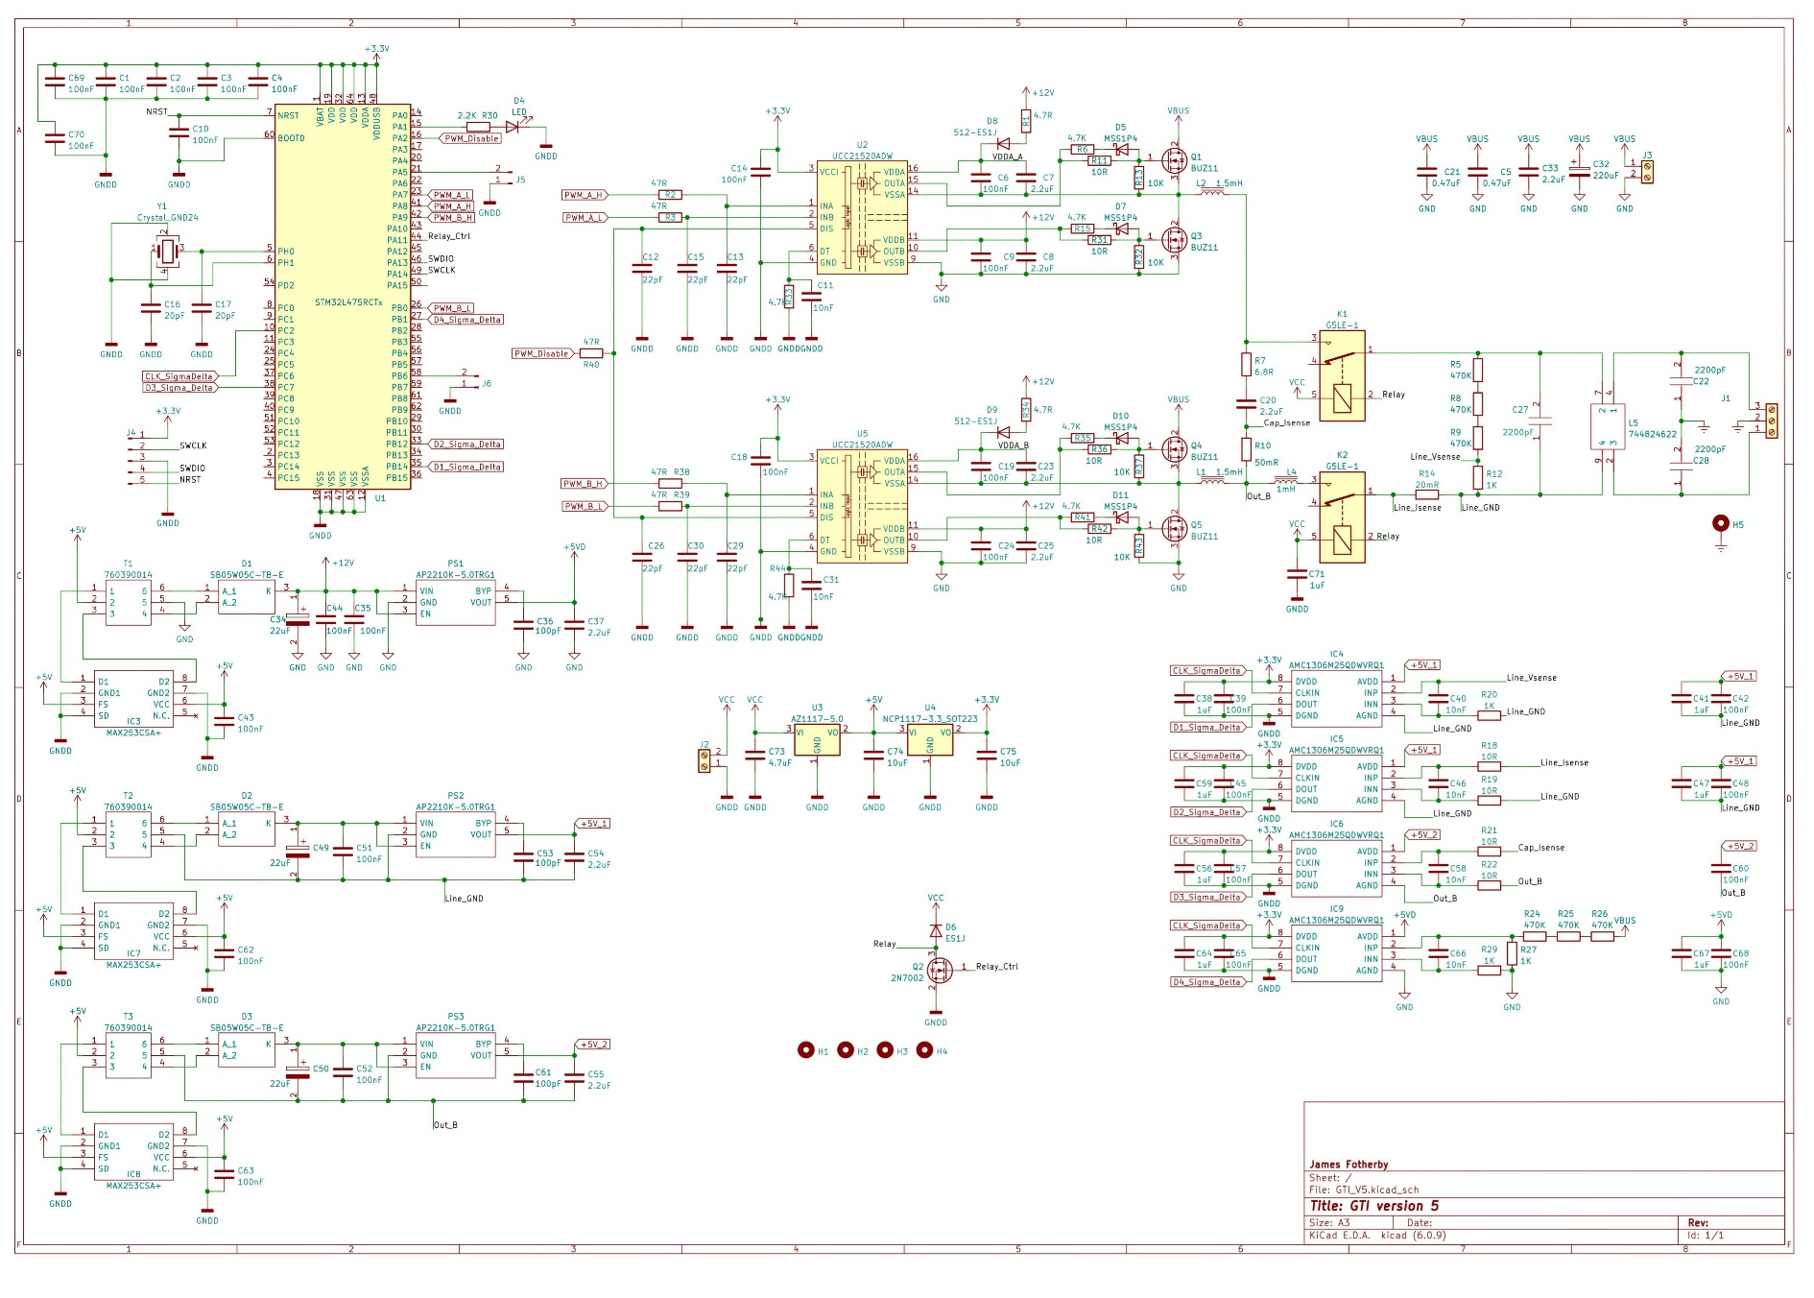
PCB Architecture and Component Selection

Slide 22
PCB Architecture and Component Selection

Slide 23
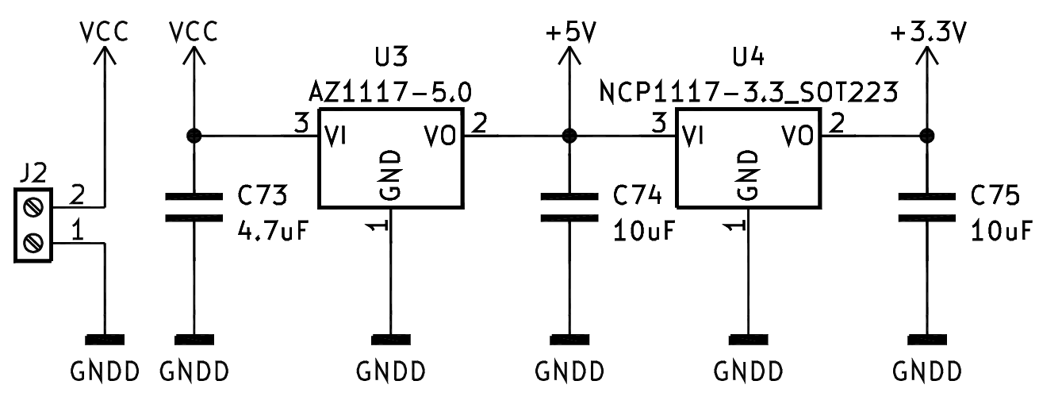
Low-Voltage Regulation

Slide 24
PCB Architecture and Component Selection

Slide 25
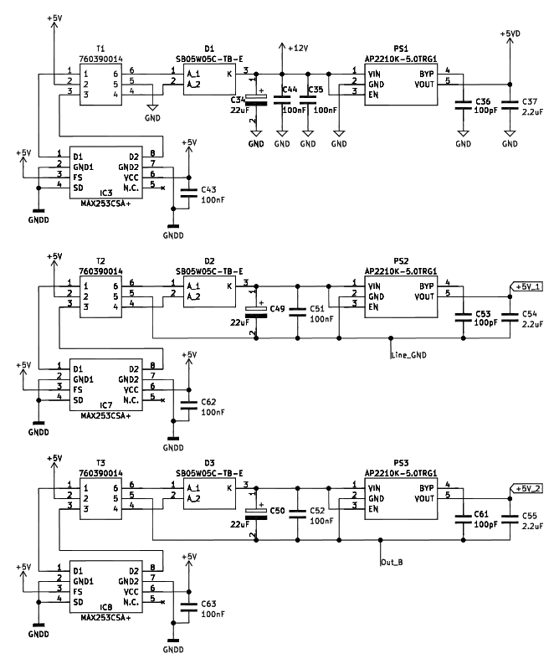
Isolated Auxiliary Power Supply Design

Slide 26
PCB Architecture and Component Selection

Slide 27
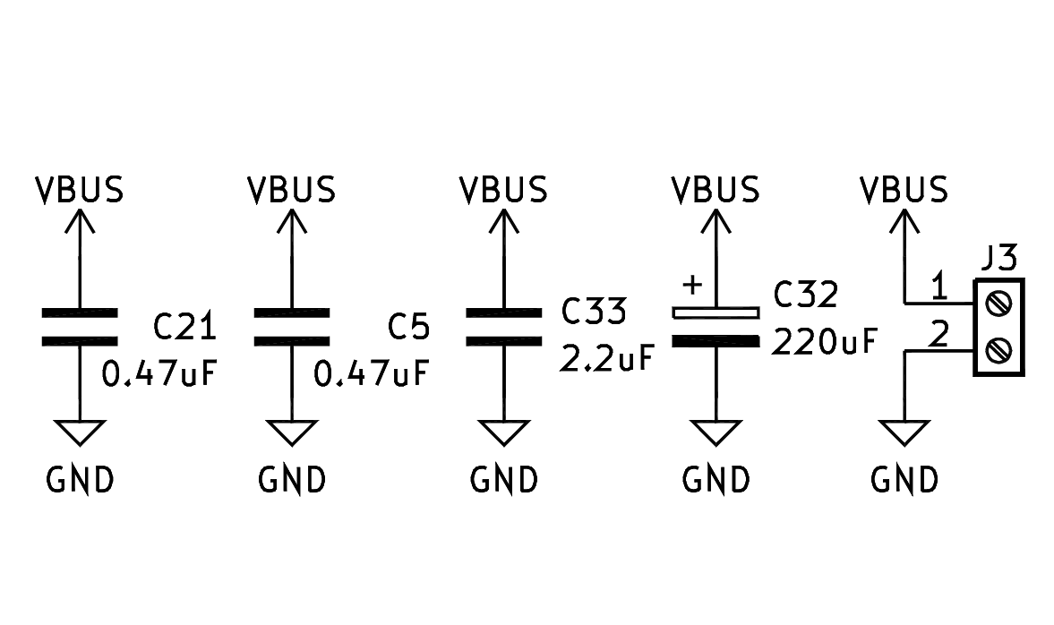
VBUS

Slide 28
PCB Architecture and Component Selection

Slide 29
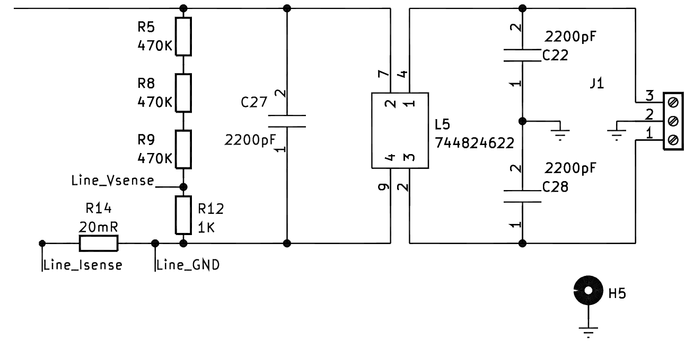
Grid Interface

Slide 30
PCB Architecture and Component Selection

Slide 31
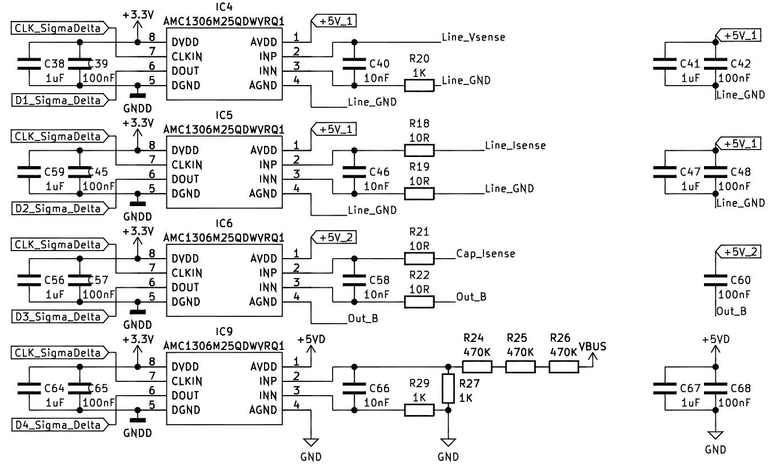
Feed Back

Slide 32
PCB Architecture and Component Selection

Slide 33
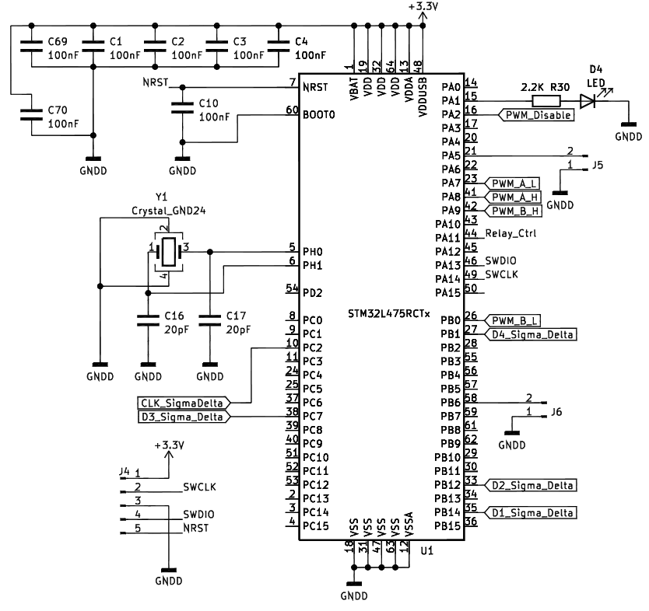
Control Unit based on STM32L475 MCU

Slide 34
PCB Architecture and Component Selection

Slide 35
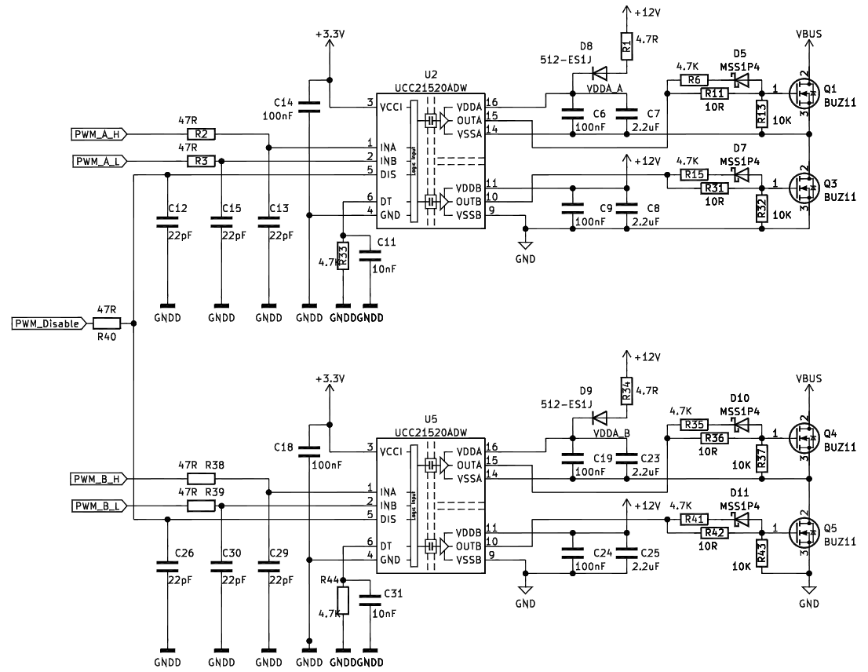
Gate Driver and Full-Bridge Power Stage

Slide 36
PCB Architecture and Component Selection

Slide 37
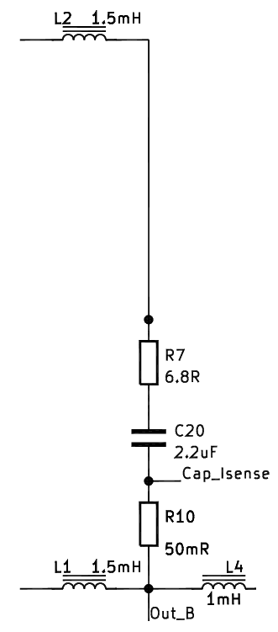
LCL Filter

Slide 38
PCB Architecture and Component Selection

Slide 39
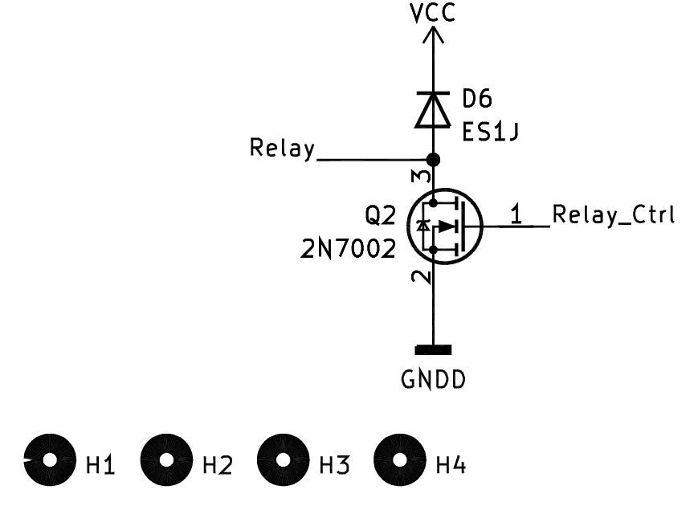
Relay Driver

Slide 40
PCB Architecture and Component Selection

Slide 41
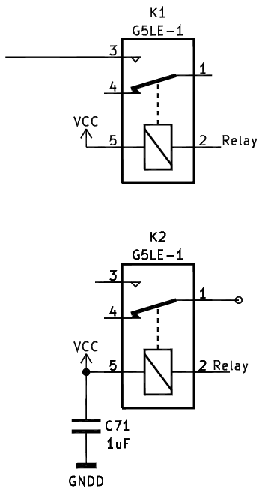
Dual-Relay

Slide 42
Hardware

Slide 43
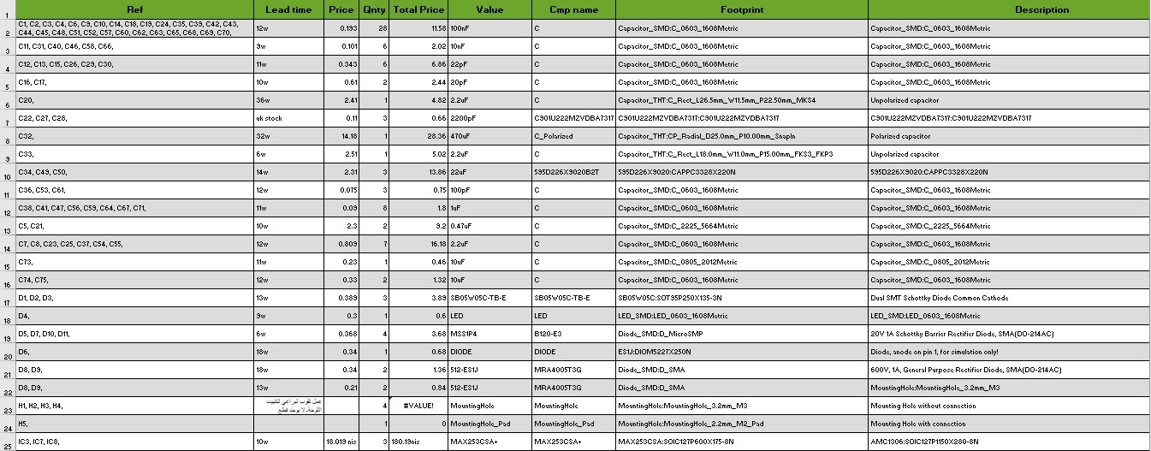
PCB Bill of Materials (BOM)

Slide 44
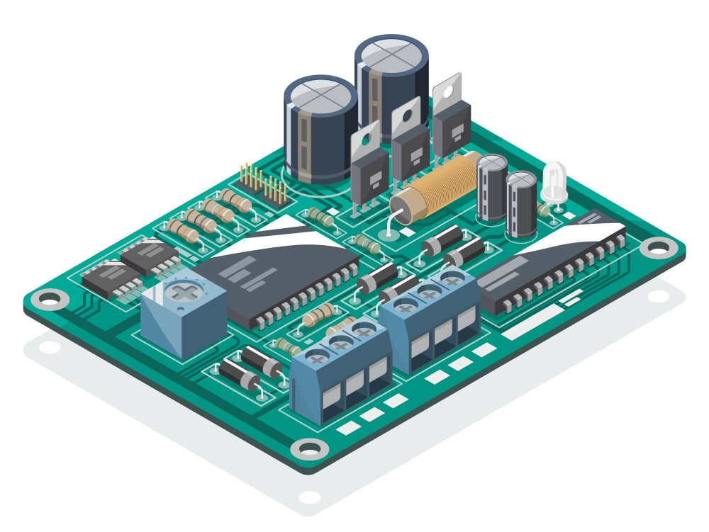
Assembling and soldering electronic components onto a PCB board

Slide 45
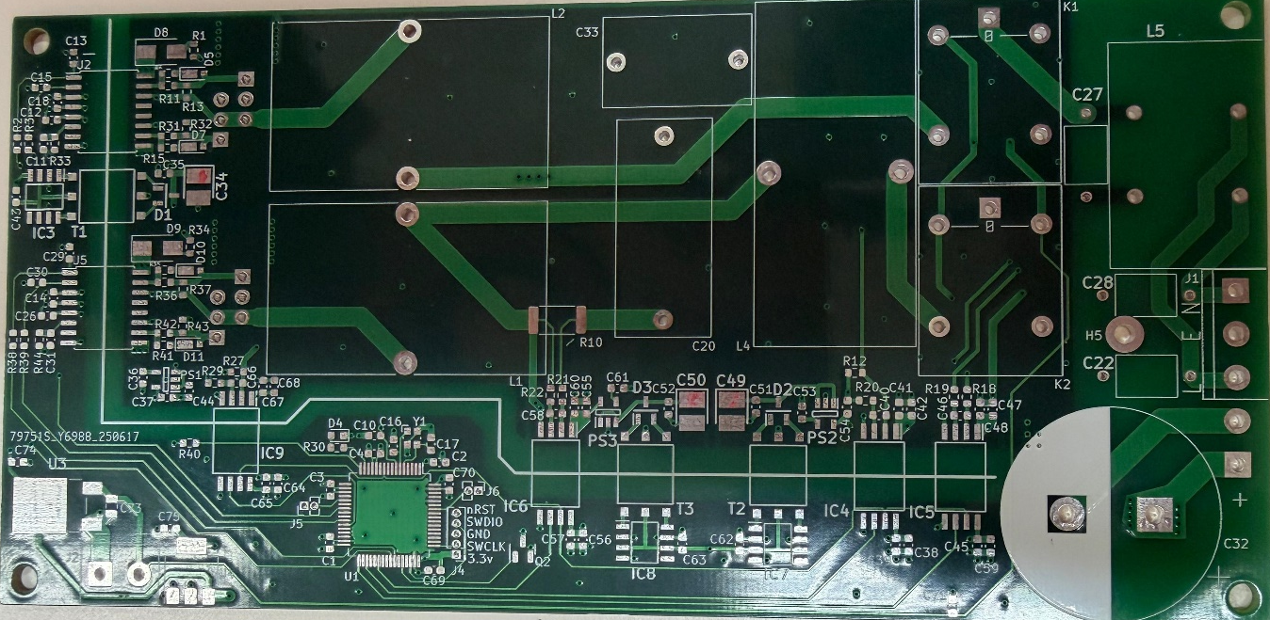
PCB board before assembling

Slide 46
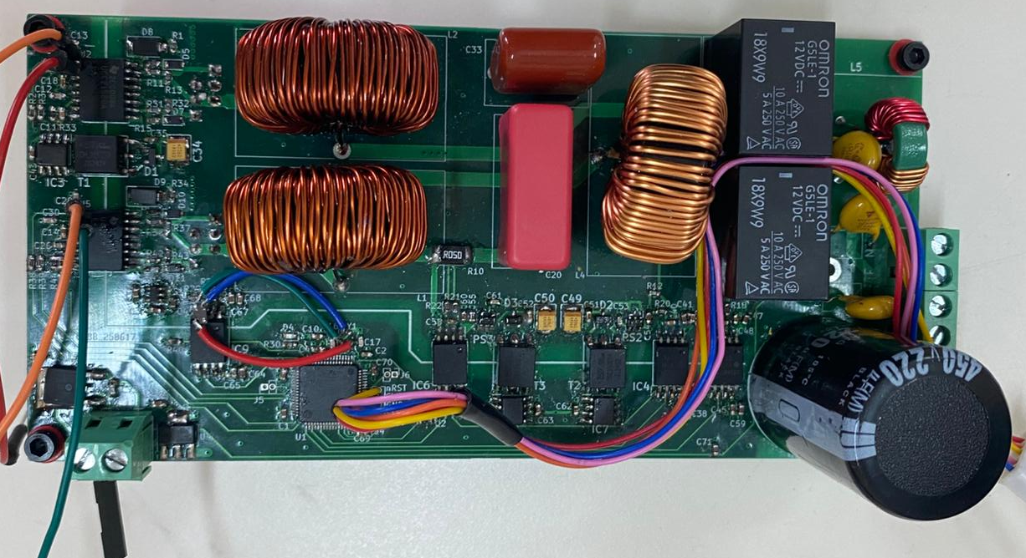
PCB board after assembling

Slide 47
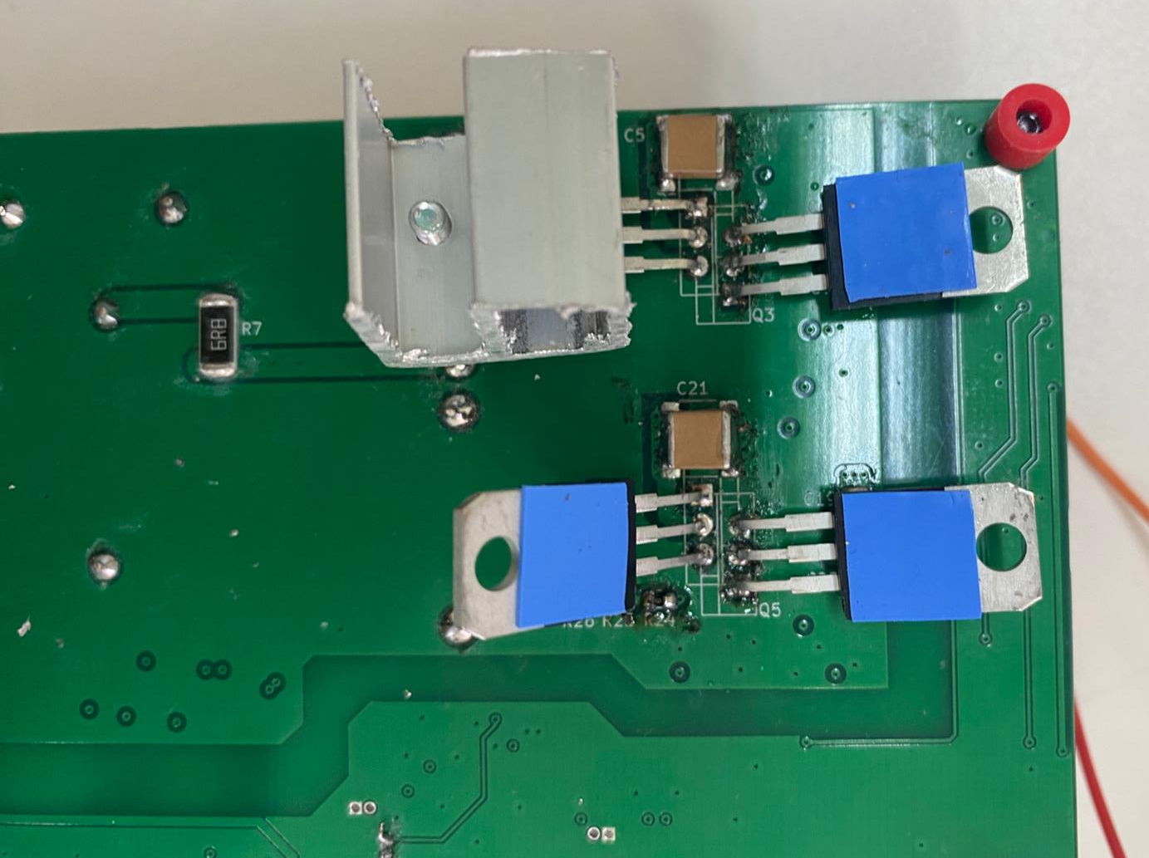

Slide 48
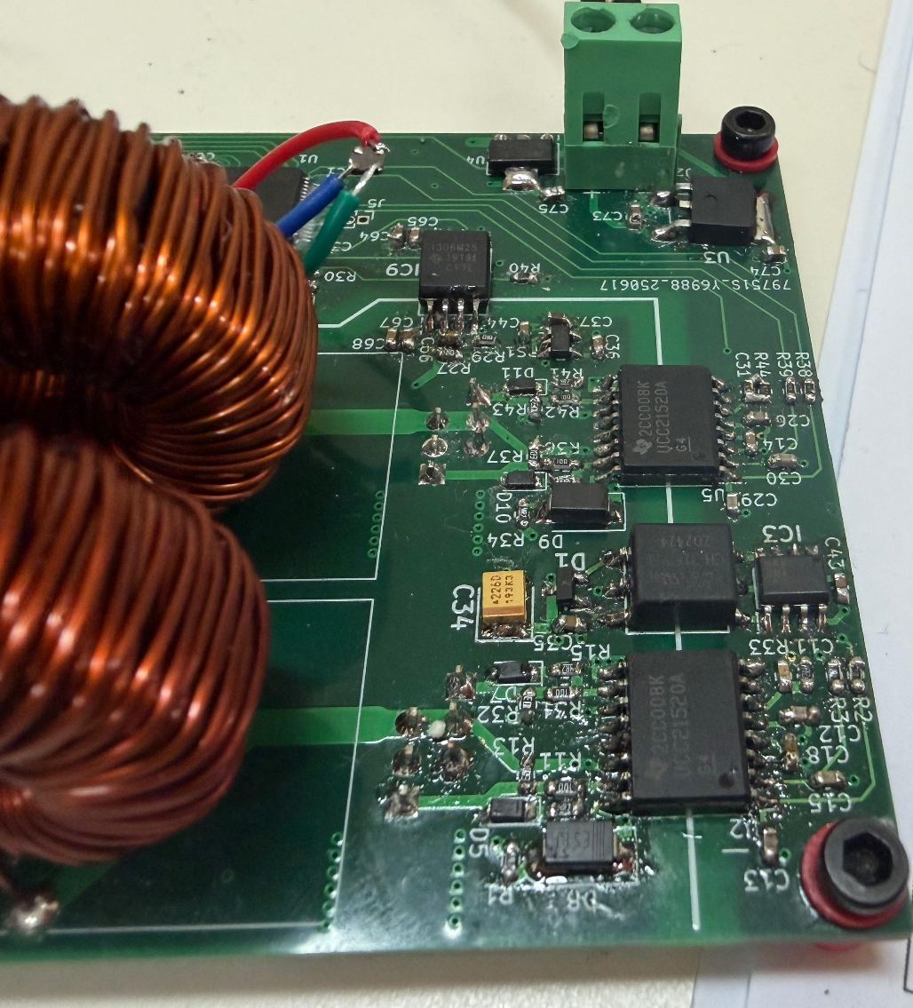
Zoom in PCB board after assembling

Slide 49
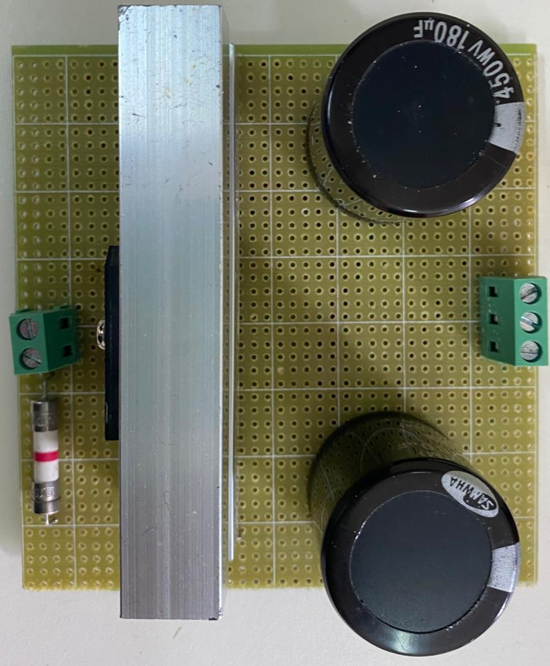
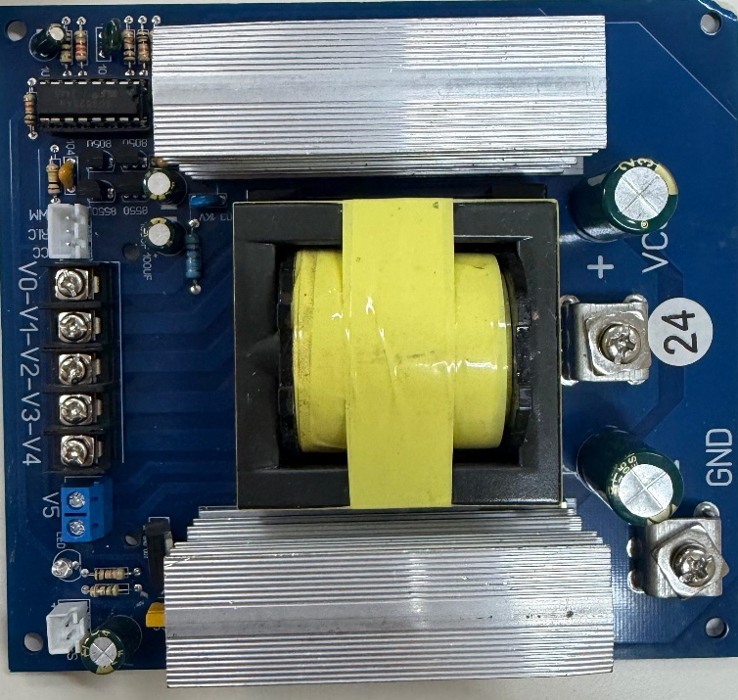
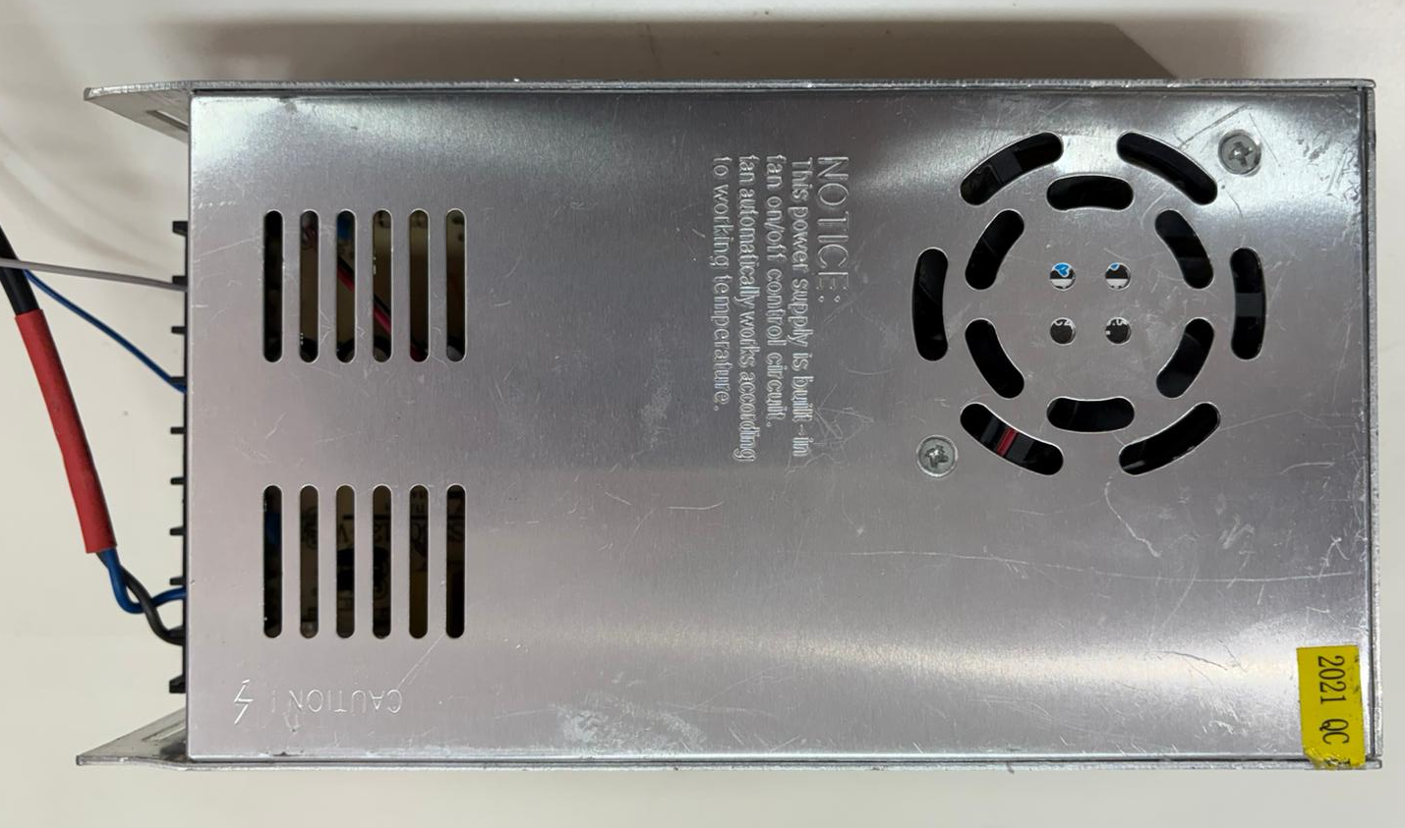
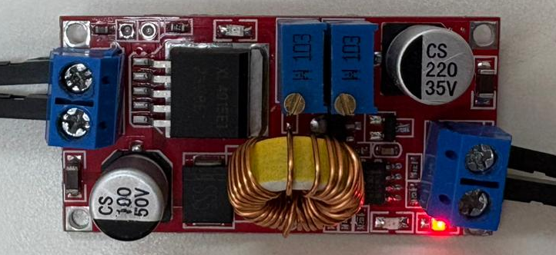
Other Component
AC-to-DC rectifier
Inverter
Power Supply
Buck converter

Slide 50
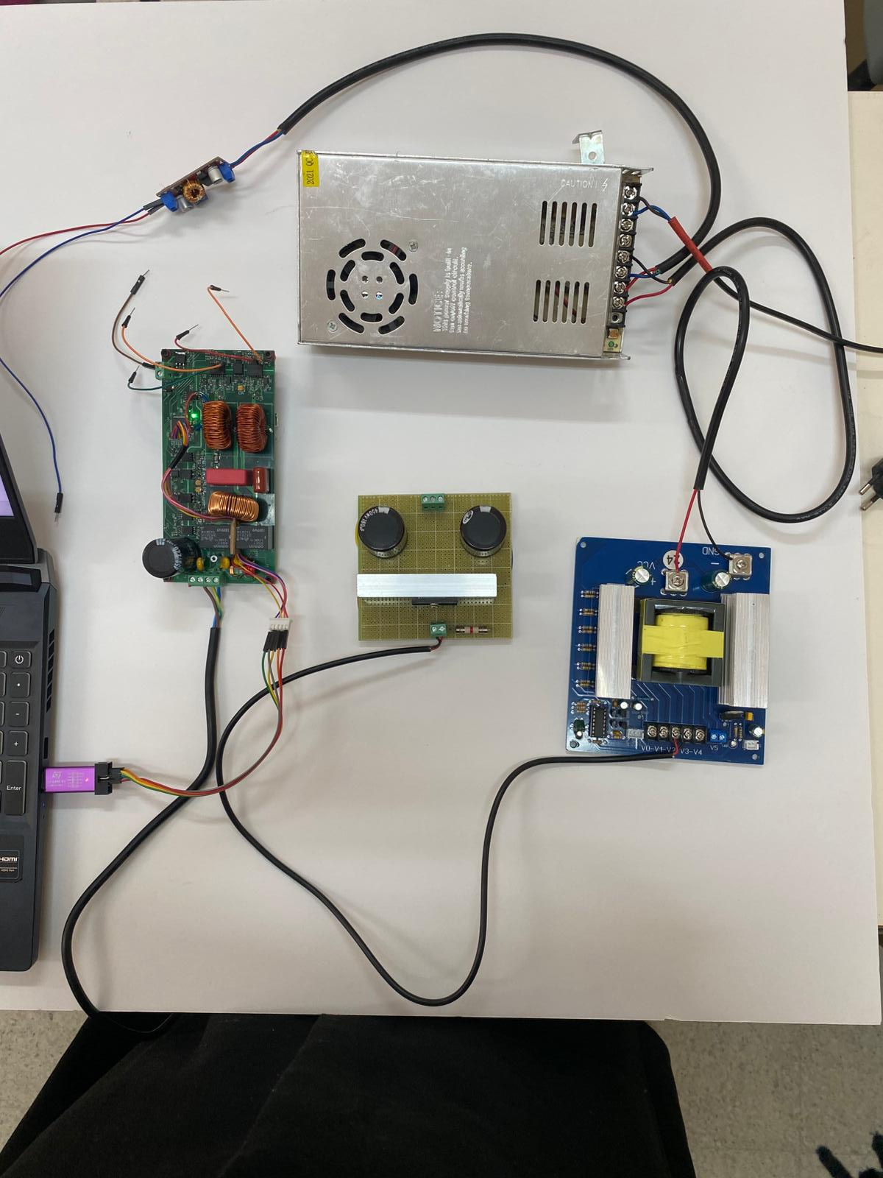

Slide 51
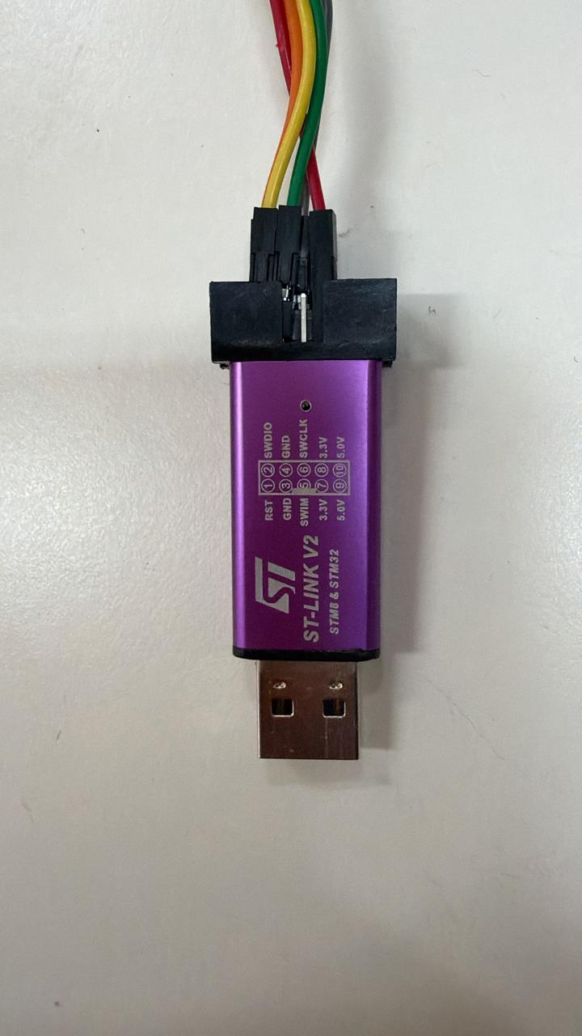
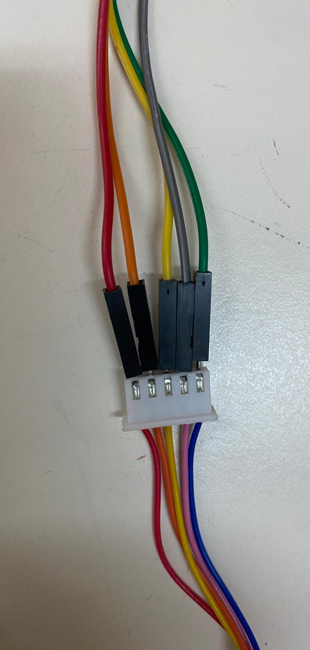
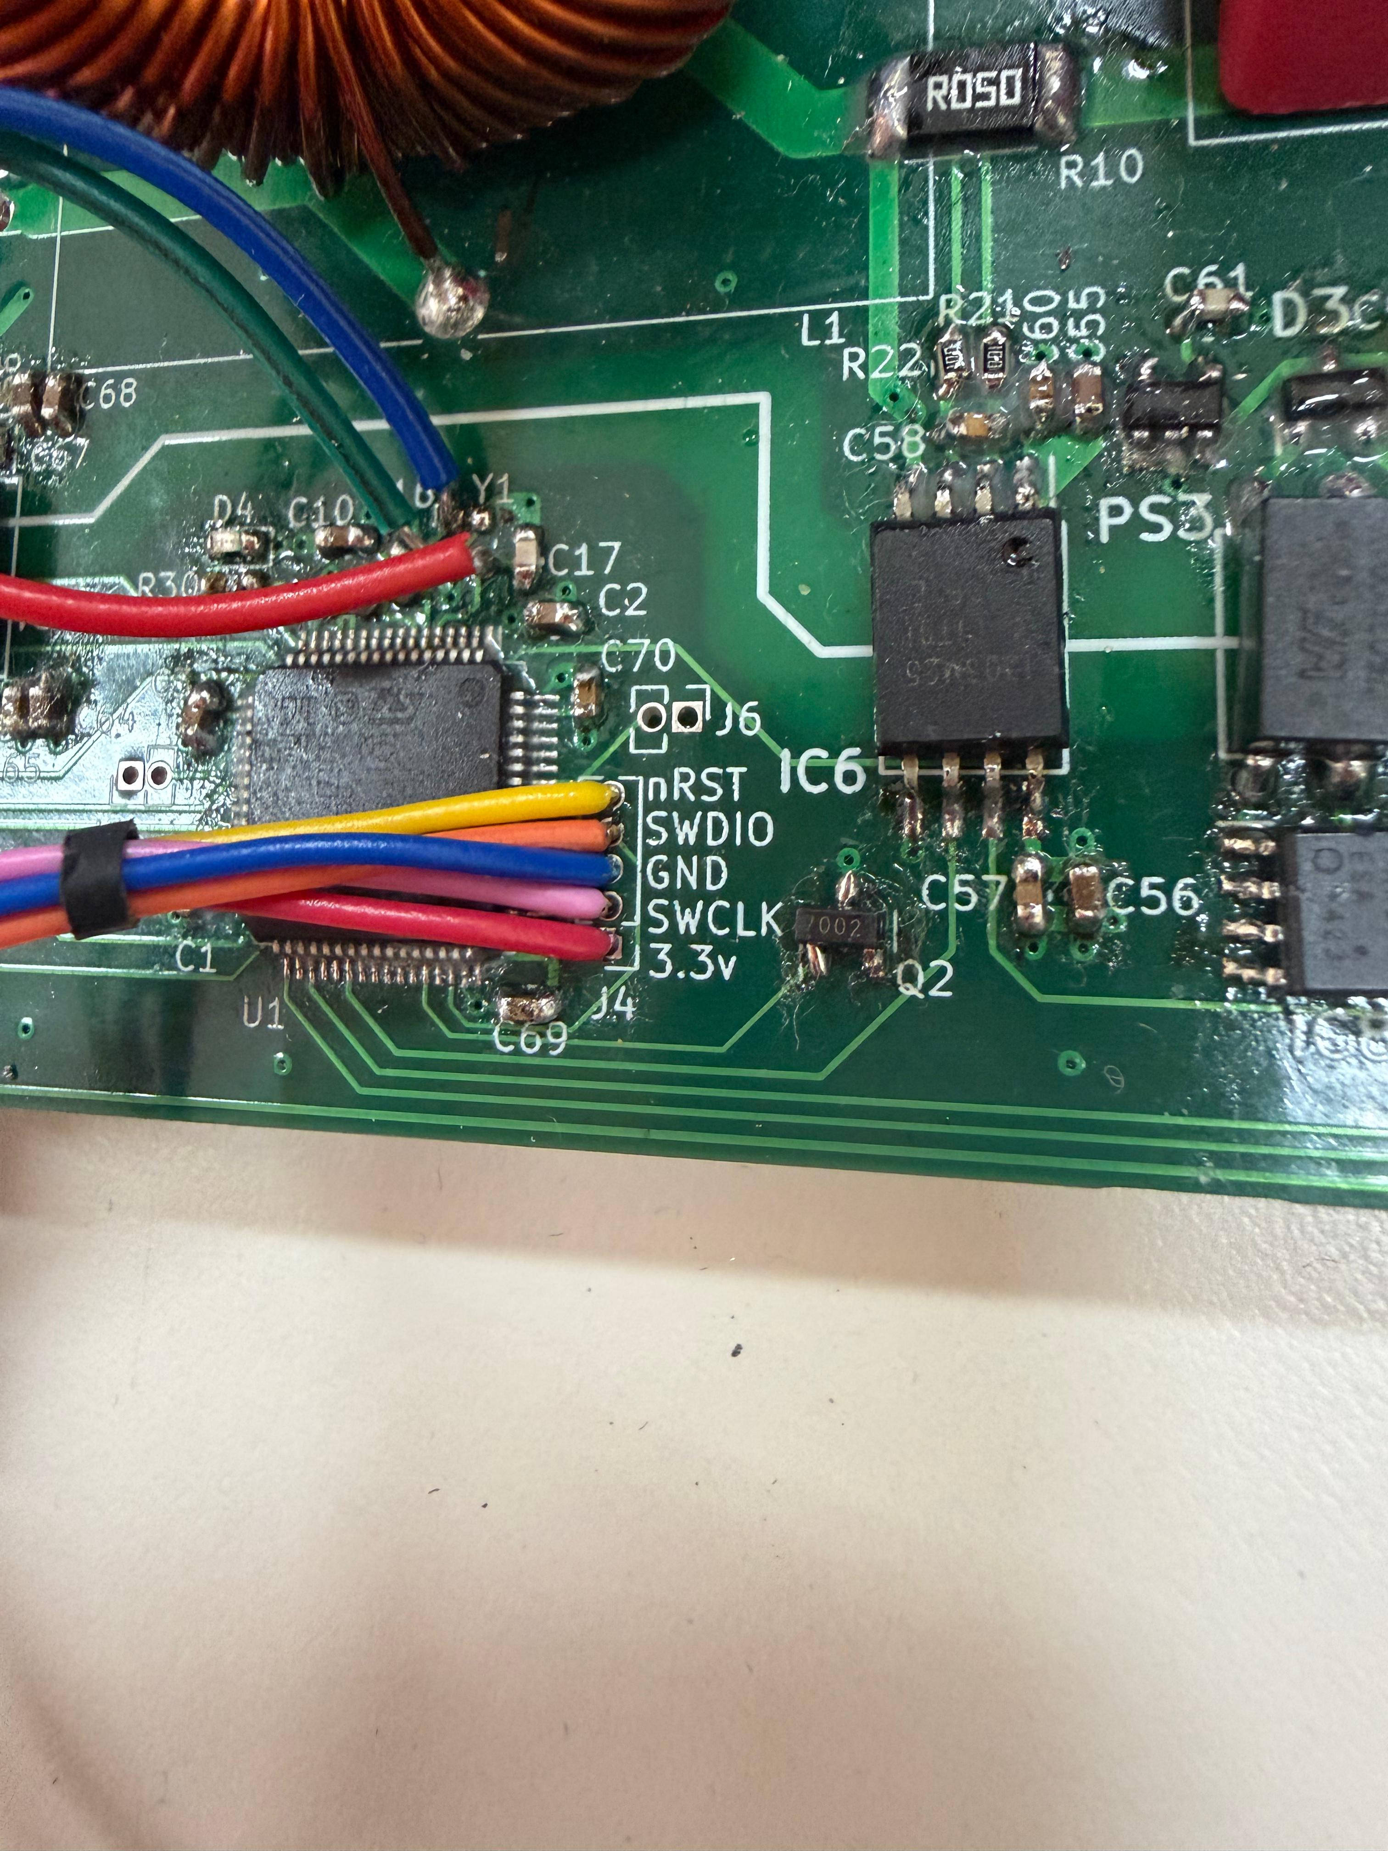
ST-Link Connection

Slide 52
STM32 Development Toolchain

Slide 53
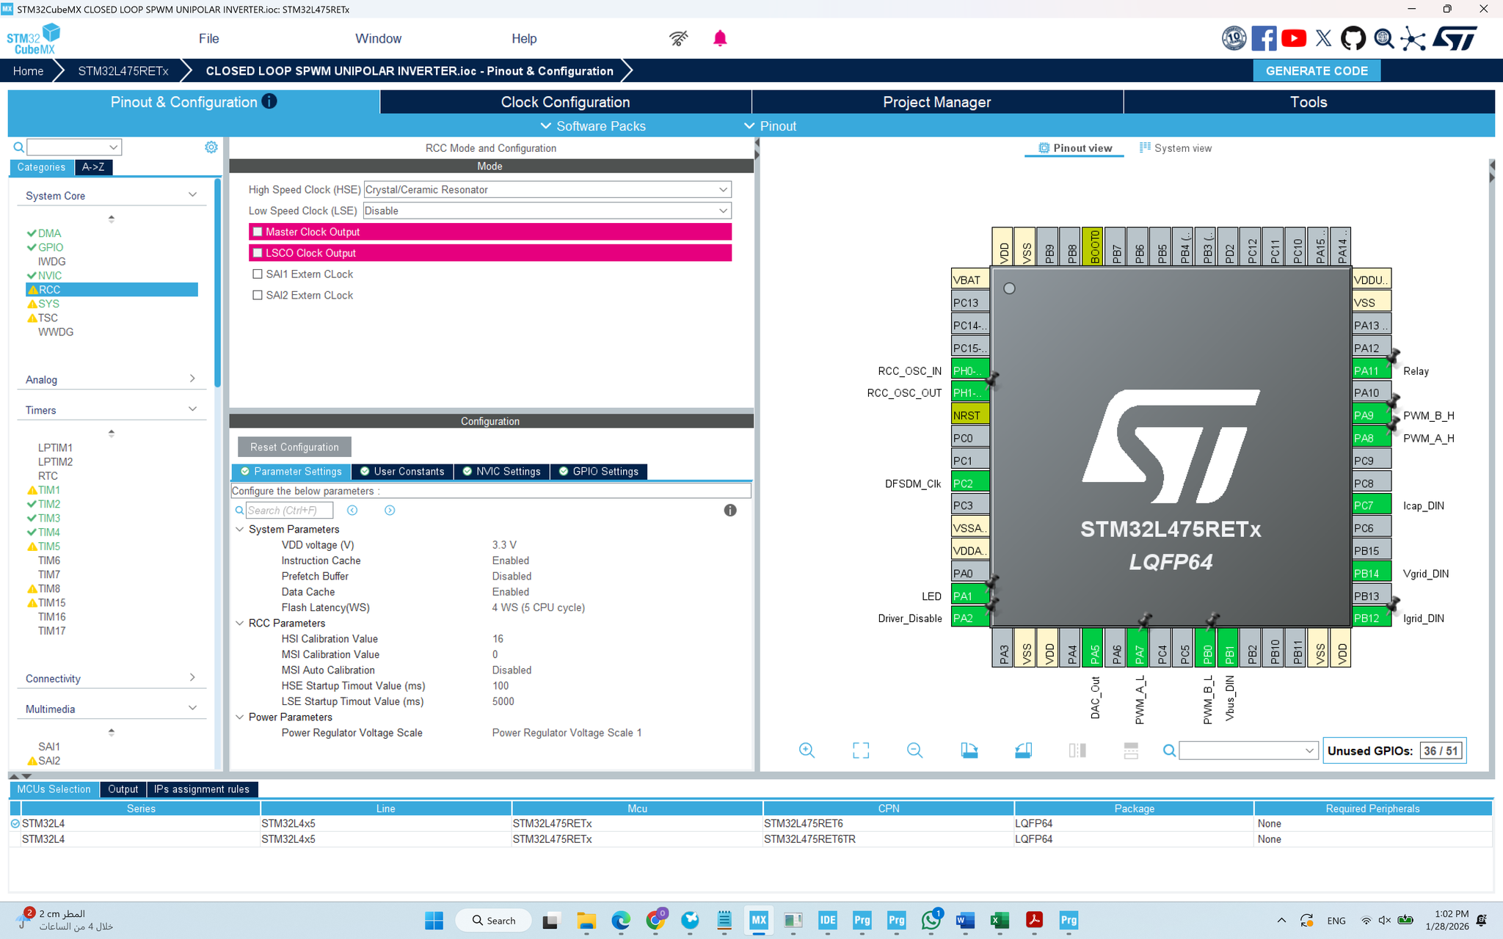
STM32CubeMX: Graphical Configuration Tool

Slide 54
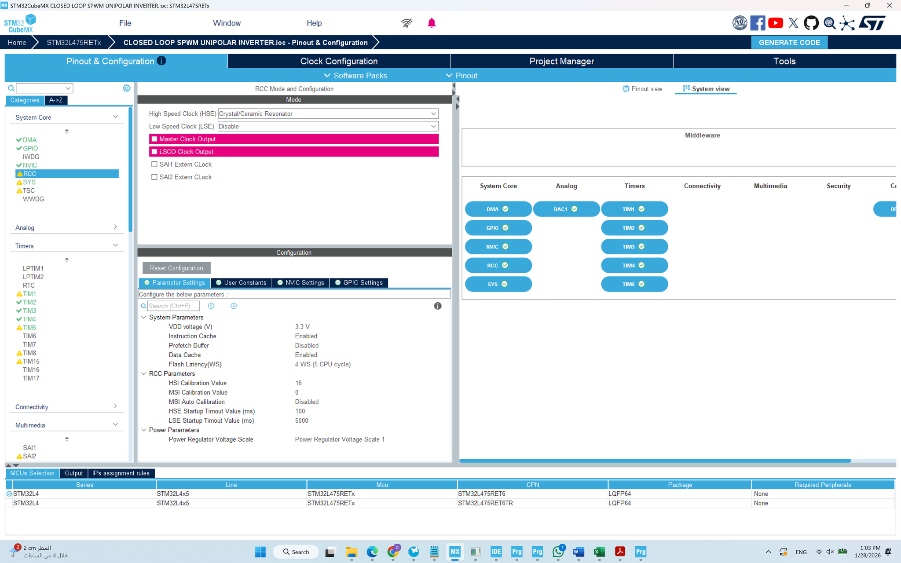
STM32CubeMX: Graphical Configuration Tool

Slide 55
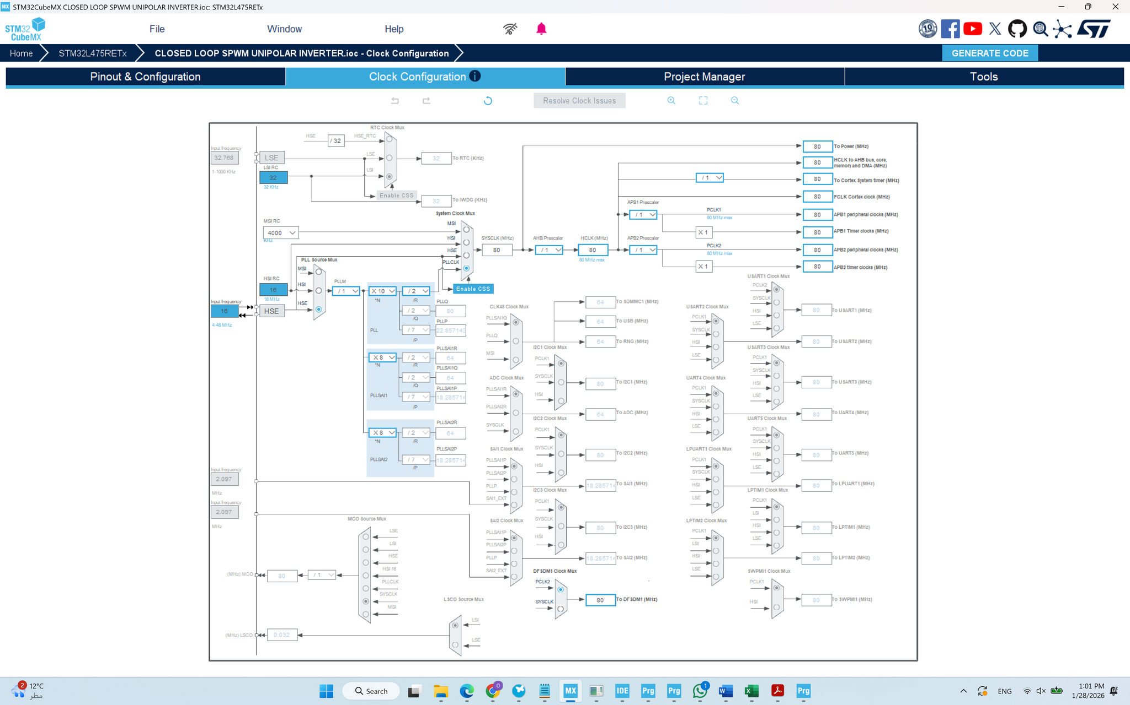
STM32CubeMX: Graphical Configuration Tool

Slide 56
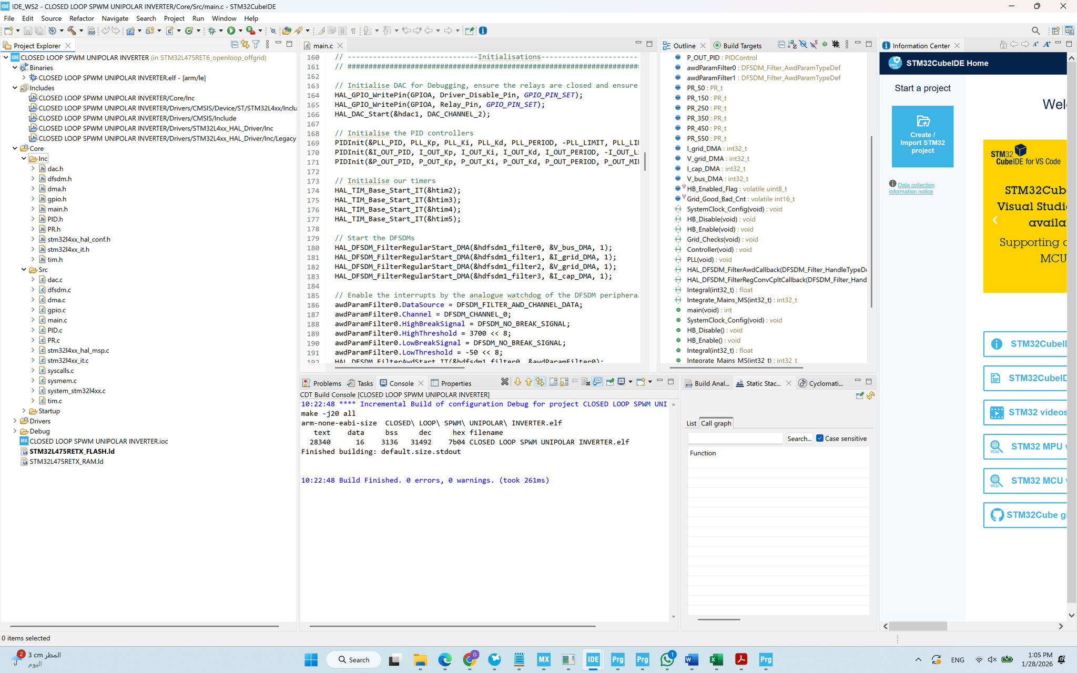
STM32CubeIDE: Integrated Development Environment

Slide 57
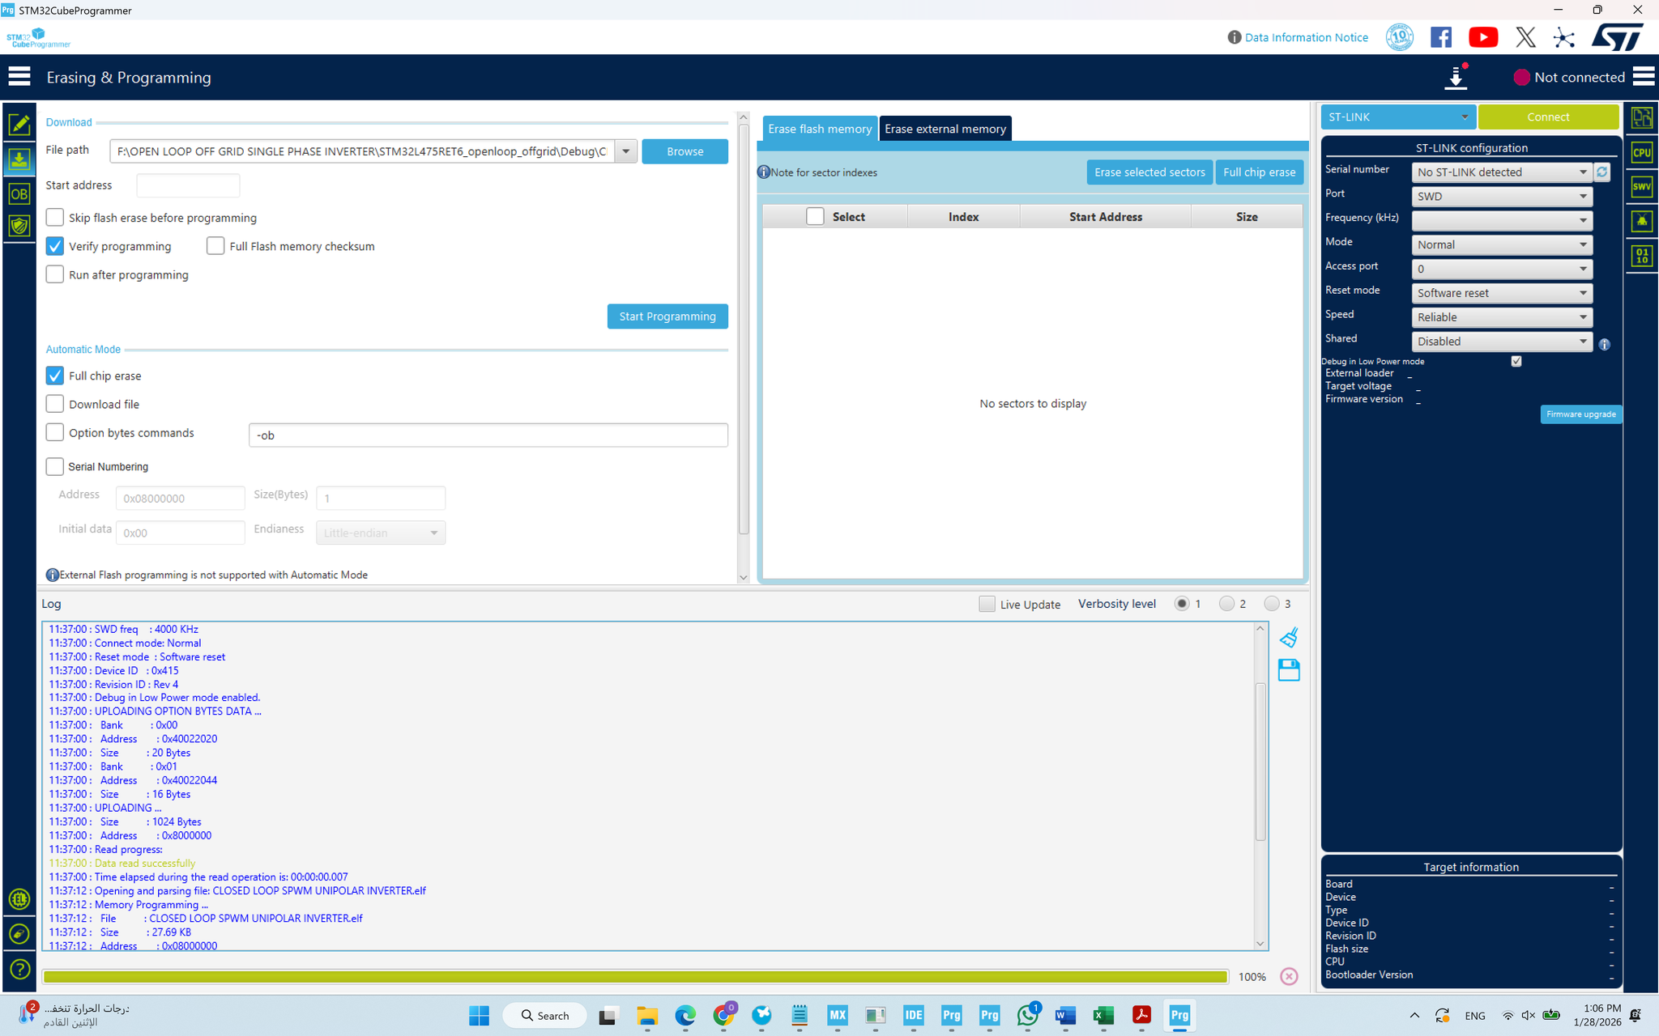
STM32CubeProgrammer: Flashing Tool

Slide 58

Installing the code STM32 main processor

Slide 59


Slide 60
Hardware Results
The practical part, which involved assembling the electronic circuit PCB and its necessary components for proper and complete operation, has been completed.
The circuit's processor, responsible for processing network signals, has been programmed for use in controlling the inverter, enabling it to connect the electrical grid to the solar power system.
The waves generated by the main processor have been verified and measured.

Slide 61
Challenges

Slide 62
Hardware Challenges
Difficulty in procuring the necessary electronic components and requirements for the project from the local market, necessitating their importation.
High prices for electronic components, shipping costs, and customs duties.
Customs clearance issues for some components, resulting in significant delays in their arrival, particularly for the PCB (Printed Circuit Board).
The small size of the electronic components and the difficulty of assembling them, requiring specialized equipment such as magnifying lenses and soldering tools.

Slide 63
Simulation Challenges
Lack of prior knowledge of simulation software.
Insufficient resources to resolve problems encountered during simulation and data acquisition.
Software limitations, such as the unavailability of all electronic components in its library, necessitating the use of different software or the creation of these components from scratch within the software.

Slide 64
Future Work

Slide 65

Future Work for Software
Grid Tied Inverter using Volt Var Controller

Slide 66


