Slide 1
Bubbles Screen
Presented by:
Moath Samaneh
Ahmad abo saa
Supervisor:
Dr. Luay Malhis
Dr.Raed AlQade

Slide 2
Thanks to
Our families
Our supervisors Dr. Luay Malhis Dr.Raed AlQade
Mr. Shadi Sawalha and Dr. Abdelrahim Abusafa
Our friends : Eng. Imad Shakaa, Ibrahim Yasin and Ibrahim Abdul-haq.

Slide 3
Outline
Introduction
Hardware Development
  Tank
  Liquid
  Pumps
  Circuit
Software Development
  Pic controller
  Android application
Development difficulties
Future work

Slide 4
Introduction
The idea is to design a microcontroller-based bubbles screen in order to display text and patterns.
The screen is composed of bubbles generated in a tank of water or other liquids.
The system allows you to use your smartphones to draw the patterns or shapes you want.

Slide 5
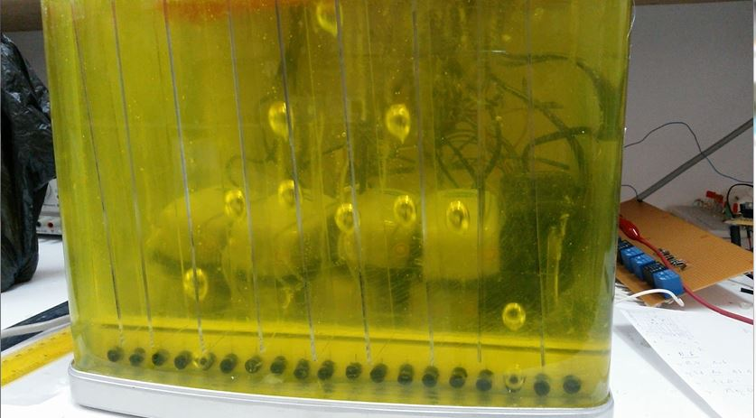

Slide 6
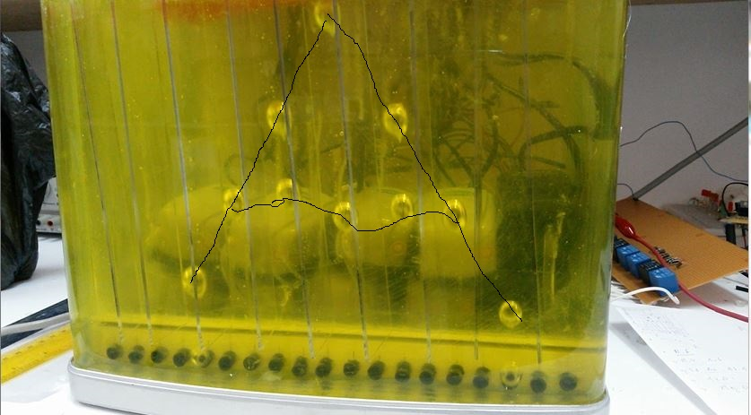

Slide 7
Hardware Development
Main four parts :
  Tank design
  Liquid
  Air Pumps
  Circuit

Slide 8
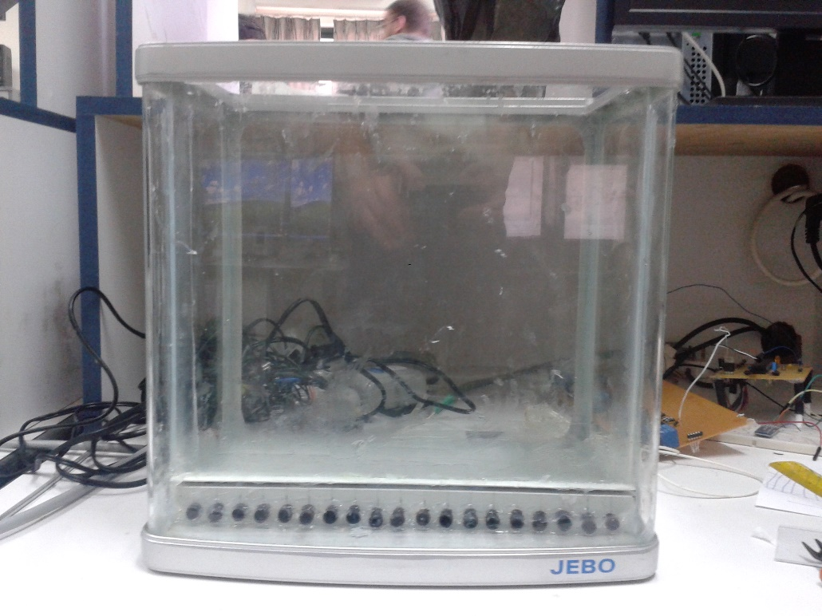
Tank Design
Tank represents the screen
Using a fish tank as the base of the tank

Slide 9
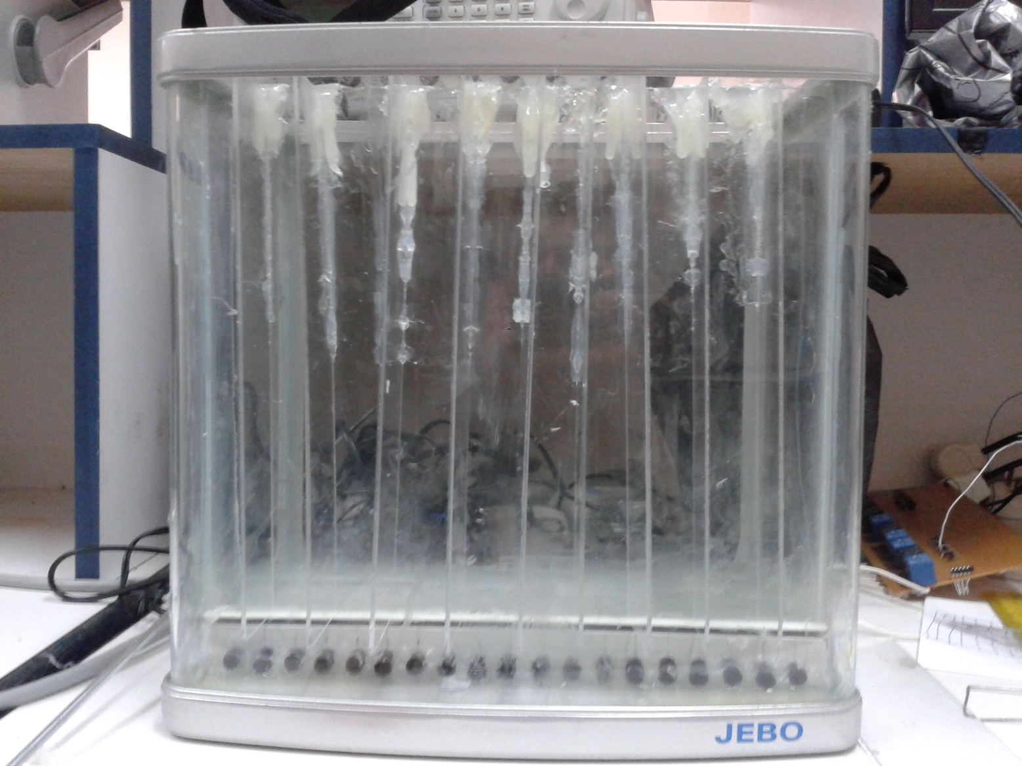
Tank after adding separators

Slide 10
Liquid
The Liquid is one of the most important thing that determine:
  Speed of the bubbles
  Clarity of display
  Color of bubbles
We chose dishes washing liquid after testing many other liquids like:
  Water
  Mineral oil
  Improved (chemically) water
  Olive oil
  Hear oil

Slide 11
Air Pumps
The source of the bubbles
We had two choices
  DC air pumps
  AC air pumps

Slide 12
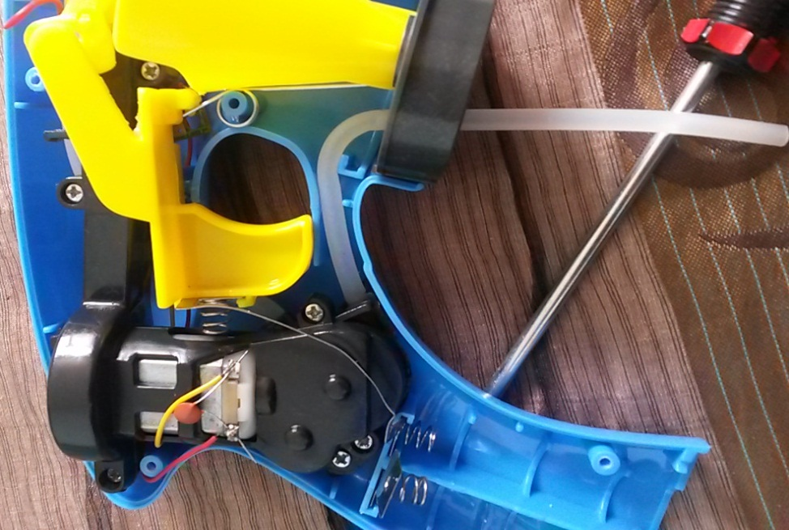
  DC air pumps
After spending time in searching we found a toy that have a DC motor we might use, but unfortunately , it doesn't.
The second choice was to import the DC pumps from abroad, but also this choice didn’t work out, because it tack time to import these pumps, and can’t wait.

Slide 13
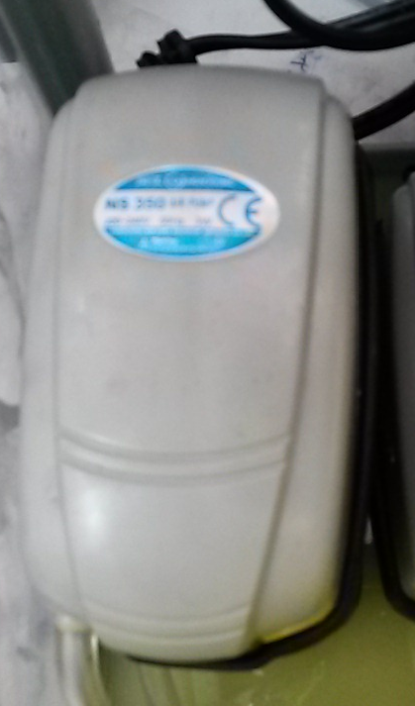
  AC air pumps
. The AC pumps we used is the air pumps used for fish tank to generate the air needed for the fish.
. The main drawbacks of these pumps are the size and the safety issue, as we have to deal with 220 v AC.

Slide 14
Circuit Design
Driving circuit
  Schematic
Air pumps circuit
  Schematic

Slide 15
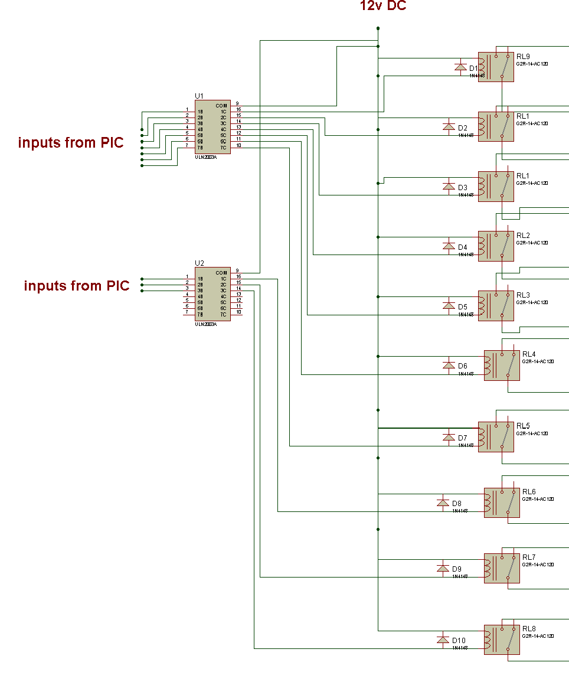
Driving circuit

Slide 16
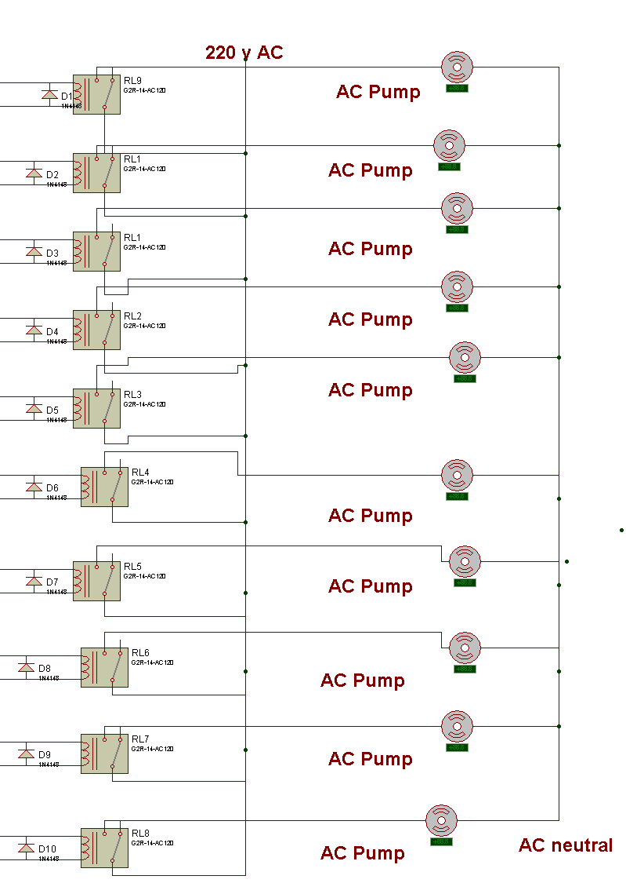
Air pumps circuit

Slide 17
Software Development
Pic controller
  Flow Chart
Android application

Slide 18
Pic controller

Slide 19
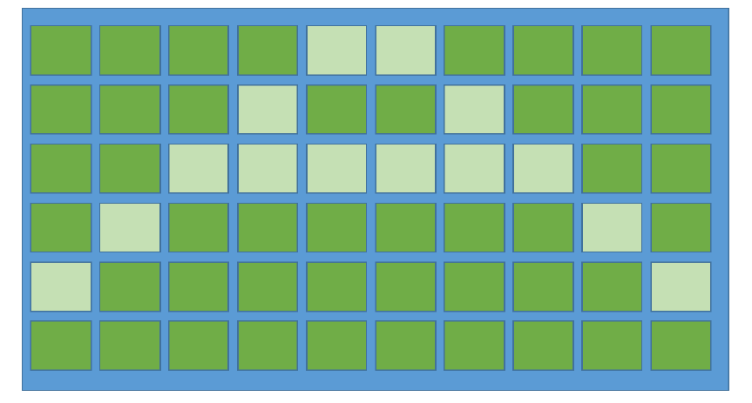
Pic controller
This program control the pumps in order to generate the bubbles with the right creating time and vertical separating time.

Slide 20
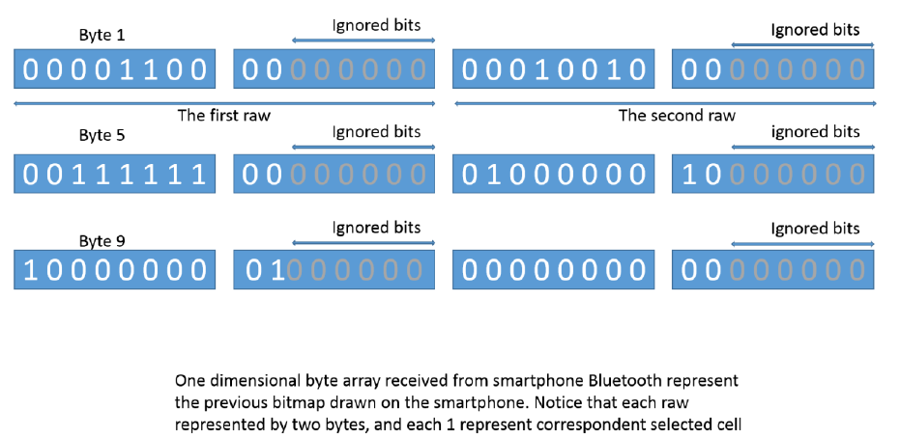
Pic controller cont.

Slide 21
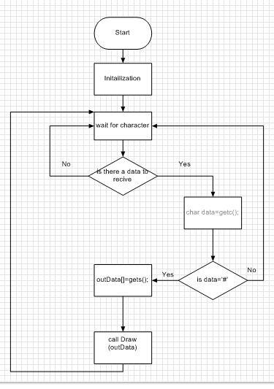
Main Flow Chart

Slide 22
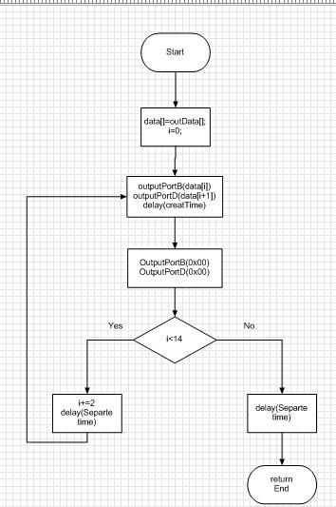
Draw Flow chart

Slide 23
Android Application
Via your smartphone Bluetooth
This application allows you to easily interact with bubbles screen. To display any patterns you want .
The application contains in addition to drawing area, a predefined patterns to display .

Slide 24
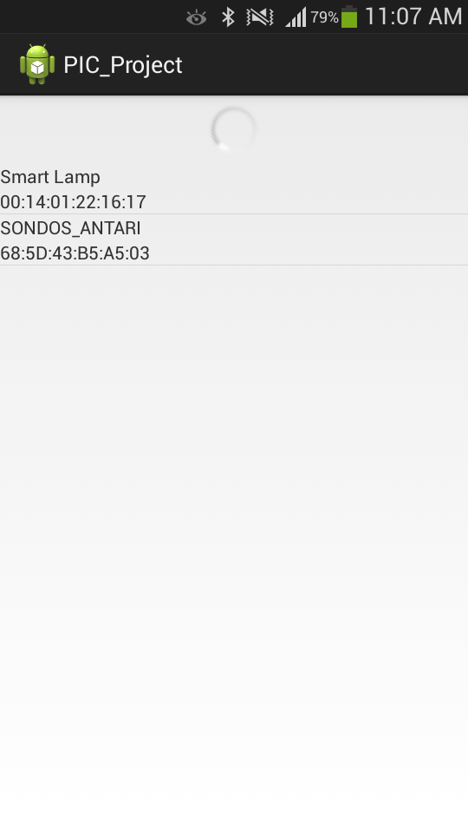
Android application cont.
The main view

Slide 25
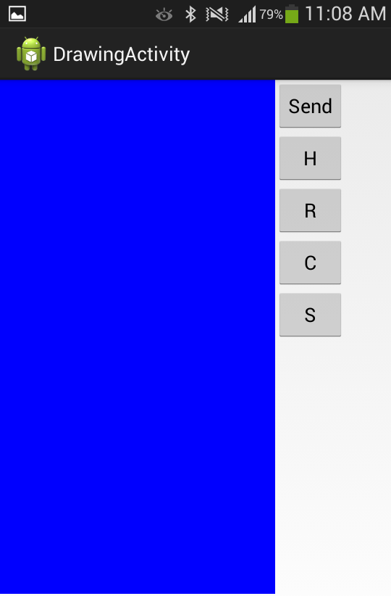
Drawing view

Slide 26
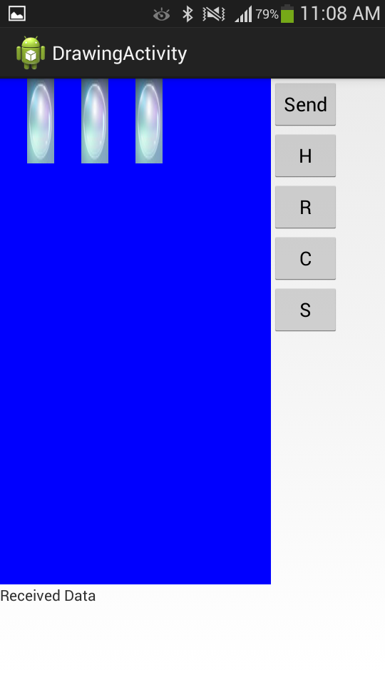
Drawing view

Slide 27
Project features
Small size fit in any place.
Easy to deal with.
Smartphones support.
Can be expand easily to support 20 pumps with some modification.
Relatively low cost

Slide 28
Development difficulties.
Limited resource and limited time for import some parts from abroad so we had to use some alternatives.
Using Ac Pumps as the source of the bubbles. produce many problems such as noise and differences in time.

Slide 29
Future work.
The first thing is to expand our design to 20 pumps so we may display more than one simple character and longer patterns.
Another thing is to Increase the size of the tank in both directions (width and height).
Using Dc air pumps may reduce the cost.

Slide 30
Thanks
Any Questions ?

