Slide 1

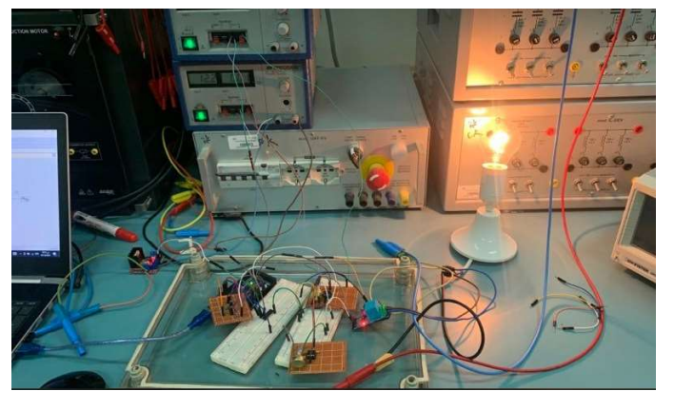
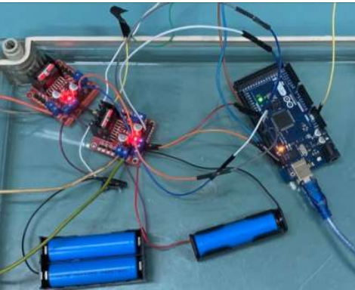

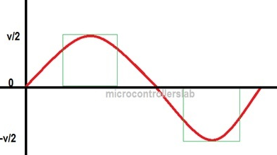
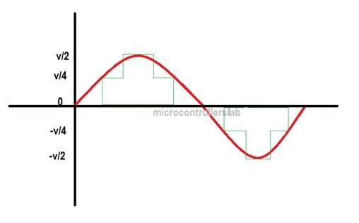
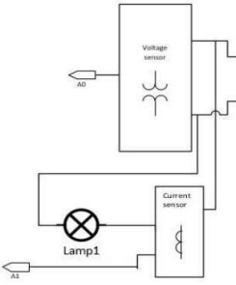
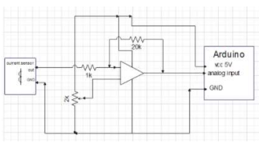
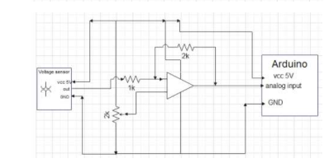
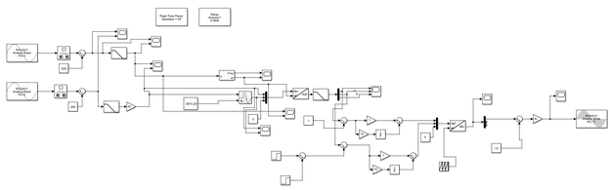
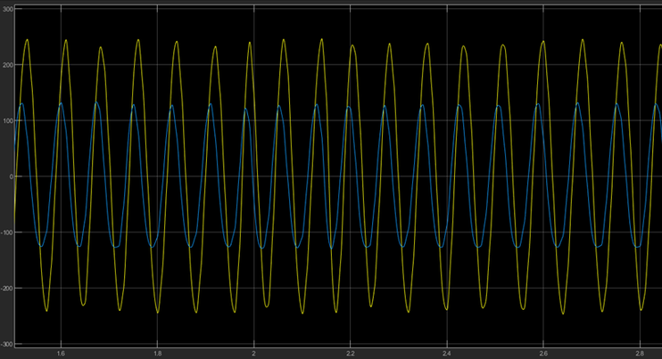
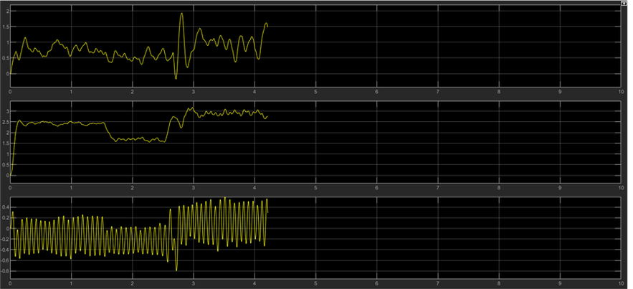
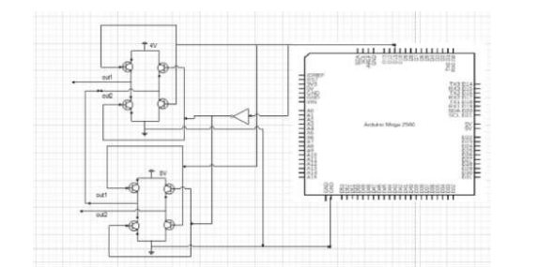
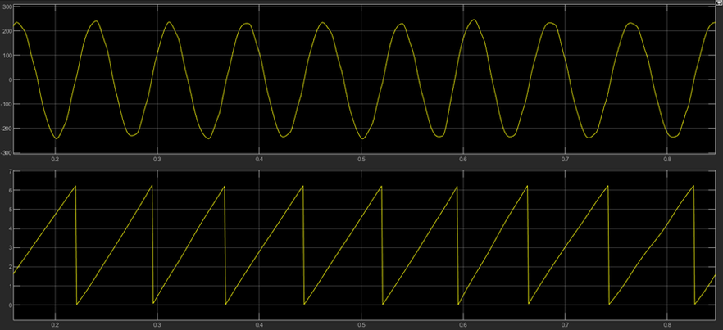
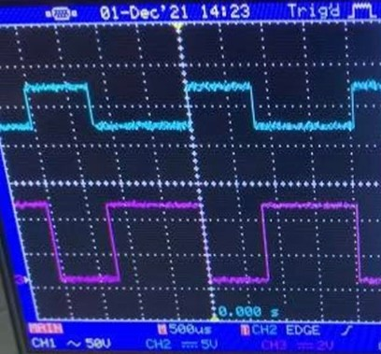
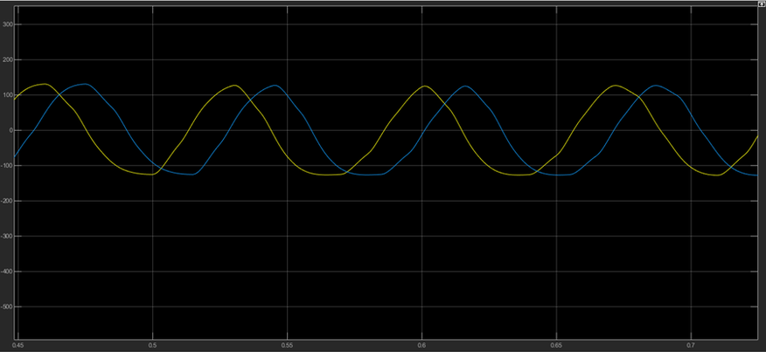
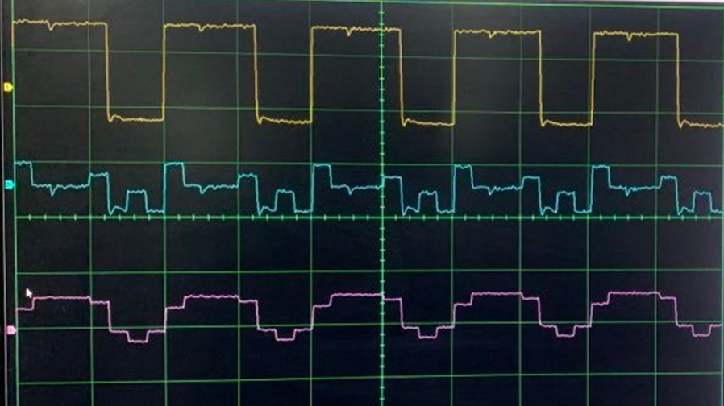
shows the results of the simulation to tracking saliency under the healthy operating conditions as given in table 1 and in cases of single-phase open-circuit fault as given in tables 2, and
PV multi-level based Grid
An-Najah National University Faculty of Engineering
Eng. Razan Shoubi , Eng. Zenat Shashtare and Eng. Yasmeen Nofal
Supervisor: Dr. Kamel Subhi Saleh
Objectives
generate an output signal with low harmonic distortion and closer to sinusoidal form .
control the injection of real and reactive power inject to the grid .
Problem Statement
Current Sensor and Voltage Sensor Testing
H_bridges circuit hardware design
PHOTOVOLTAIC (PV) power supplied to the utility grid is gaining more and more visibility, while the world’s power demand is increasing. Solid state inverters have been shown to be the enabling technology for putting Photovoltaic PV system into the grid. 2-level inverters are used to convert the DC voltage obtained from the Photovoltaic system to AC voltage fed to the utility. However, the use of 2-level inverters causes an increase in the Total Harmonic Distortion (THD) and other Power quality issues due to the harmonics injected by the such inverters.
Increasing attention has been paid to multilevel dc/ac inverters in recent years to obtain output voltage of high quality. One of the more flexible topologies is the asymmetric cascaded H-Bridge multilevel inverter, which will be employed in the project to improve the quality of the output voltage by increasing the number of output voltage level and reducing the harmonic contents .
Methodology
The project consists of two modules: power circuit and control circuit.
The power circuit consists of two H-bridges. The ratio between DC voltage of the two H-Bridges will be 1:2 . This will help to generate maximum number of levels and generate output near sinusoidal.
The control circuit include the using of a microcontroller and current and voltage sensors to generate PWM signal to H-bridges and control the injection of real and reactive power inject to the grid.
Two-level Inverter output.
Multilevel Inverter output.
PV multi-level based Grid.
Current Sensor and Voltage Sensor Testing
Produce the gating signal (PWM) for the inverter
Before presuming with real readings, it was necessary that both sensors be tested, by connecting them as shown .
The output of the amplifier circuits was connected to analog Arduino pins and the results was shown by using matlab program .
The angle obtained by using a PLL , it used to analyze the current into d and q frame.
After getting 𝑖d and 𝑖q components, they are subtracted from reference 𝑖d and 𝑖q component then they introduced into PI controller
After the controlling , convert the d - q components into abc frame to produce the gating signal for the inverter and write it to pin 11 on arduino.
The output of the two sensors has low peak-to-peak values so an amplifier circuits used to increase this values for example the output of the current sensor after using the amplifier increased 20 times, and the output of the voltage sensor increased 2 times.
Amplifier circuit for current sensor.
Amplifier circuit for voltage sensor.
Matlab Simulink module .
H–Bridge Testing
Results
Multi-level inverter consists of two H_bridges connected in series; H–bridge module requires a 5V DC power supply to power the board, and 4V DC battery as an input source to feed the first bridge and 8V DC for the second bridge. The input signals for the bridge supplied from pin 11 in Arduino.
The output of amplifiers circuits.
d-component current , q-component current and zero .
A- the voltage signal ,B- angle (theta).
Schematic for H_bridges circuit .
PWM signal from matlab .
Conclusion
Source current and shifted source.
H-Bridge multi-level inverter used the quality of the output voltage improved by reduced the Total Harmonic Distortion and made
the output waveform closer to a sine wave.
The output frequency of the multi-level inverter is less than 50Hz and that's because of the matlab software running slowly so there
is a time delay between matlab and real time. which resulted in the transformer not receiving the signal.
The output of Multi-level .

