Slide 1

Analysis And Design of A Residential Building For Gravity Load
Graduation Project II
By: Iyad S. Dkaidek
Muath M. Basheer
Supervisor: Dr. Monther Diab

Slide 2
INTRODUCTION

Slide 3
Introduction
Background:
The building is residental
Consists of 9 stories
Areas are as the following
Story | Function | Area (m²)
Basement | Parking | 1064.00
Ground Floor | Shops + Parking | 788.56
1st Floor to 7th Floor | Residential Apartments | 860.80
Staircase | Access to rooftop | 42.68

Slide 4
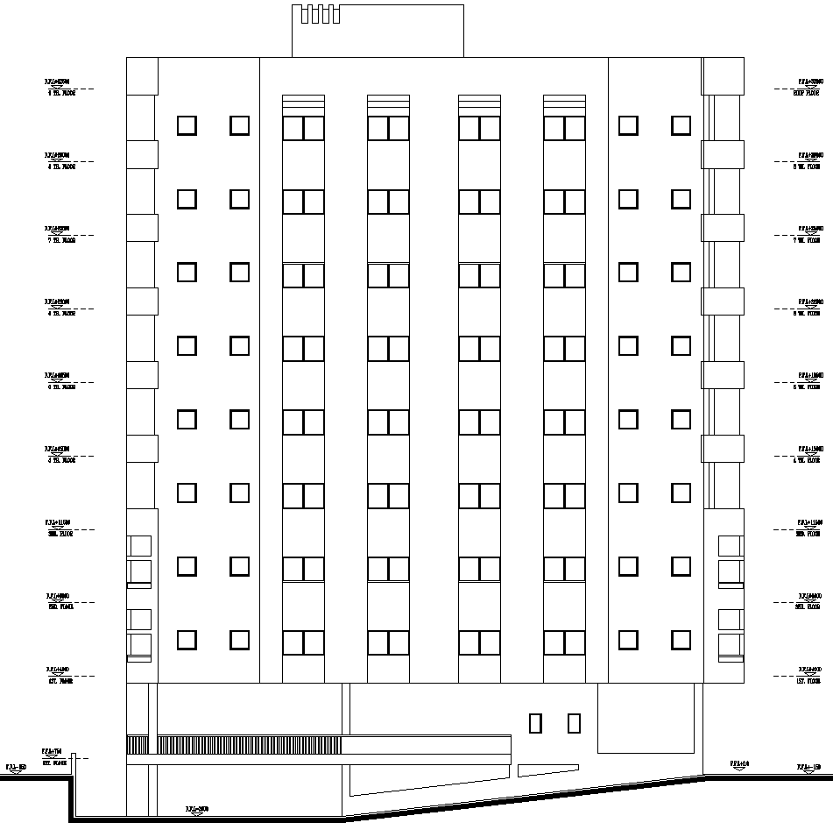
Elevation of the building

Slide 5
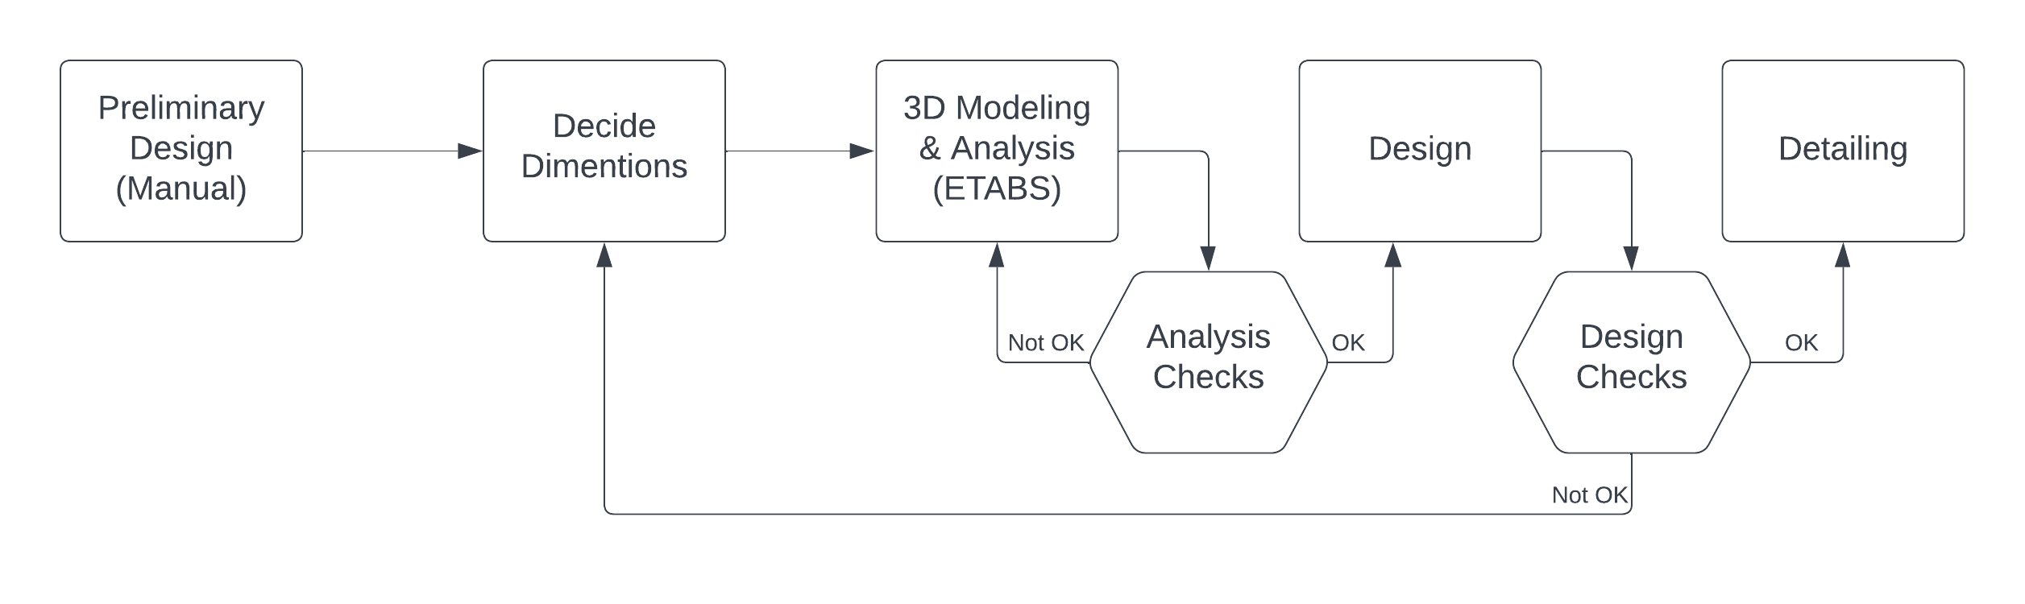
Introduction
Methodology:

Slide 6
Introduction
Objectives:
apply the acquired knowledge during past academic years.
Study the effect of seismic load and related design steps as will be shown in the following project

Slide 7
Introduction
Codes and standards:
ACI 318-14
ASCE 7-16

Slide 8
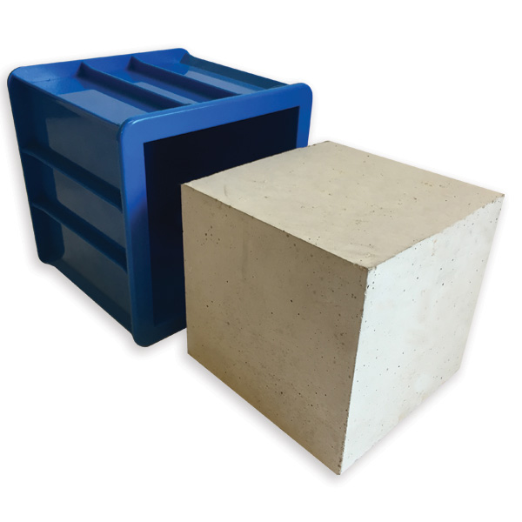
Introduction
Materials:
Concrete (B350)
Compressive Strength fꞌc = 28 MPa
Weight per Unit Volume = 25 kN/m3
Modulus of Elasticity E = 24.87 kN/m2

Slide 9
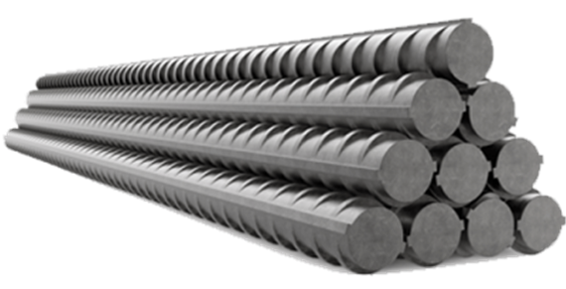
Introduction
Materials:
Steel Rebar
Minimum Yield Stress. Fy = 420 N/mm2
Minimum Tensile Stress. Fu 525 N/mm2
Weight per Unit Volume = 78.5 kN/m3
Modulus of Elasticity E = 210 kN/m2

Slide 10
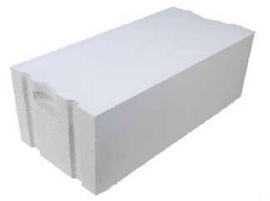
Introduction
Materials:
Y-Tong Block
Dimensions = 60 cm X 30 cm X 25 cm
Weight per Unit Volume = 5.7 kN/m3

Slide 11
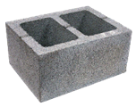
Introduction
Materials:
Concrete Hollow Block
Dimensions 40 cm X 20 cm X Various W.
Weight per Unit Volume 12-15 kN/m3

Slide 12
Introduction
Loads:
Live Load. LL = 2.5 kN/m2 for apartments, and 5 kN/m2 for garage
Dead Load. DL is calculated by the program
Super Imposed Dead Load for slabs 2kN/m2

Slide 13
Introduction
Load combinations for allowable stress design
1.0 D
1.0 D + 1.0 L
1.0 D + 0.7 Ev + 0.7 Eh
1.0 D + 0.525 Ev + 0.525 Eh + 0.75 L + 0.75 S
0.6 D – 0.7 Ev + 0.7 Eh
Load combinations for Strength design
1.4 D
1.2 D + 1.6 L
1.2 D + 1.0 Ev + 1.0 Eh + 1.0 L + 0.2 S
0.9 D – Ev + Eh
1.2 D + 1.0 Ev + 1.0 Emh + 1.0 L + 0.2 S
0.9 D – Ev + Emh

Slide 14
PRELIMINARY DESIGN

Slide 15
PRELIMINARY DESIGN
Introduction:
Slabs
Beams
Columns
Footings
Soil

Slide 16
PRELIMINARY DESIGN
Beam Depth:
 | Simply Supported | One-End Continuous | Both-End continuous | Cantilever
One-Way Ribbed Slabs and Beams | L/16 | L/18.5 | L/21 | L/8
Minimum Depth | Not Applicable | 8.95/18.5=0.48 | 8.4/21=0.4 | Not Applicable

Slide 17
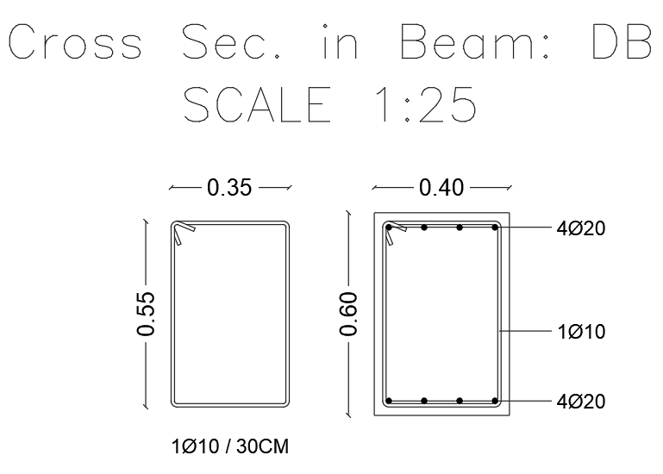
PRELIMINARY DESIGN
Beam Depth:
h min = 480 mm
Take:
h = 600 mm

Slide 18
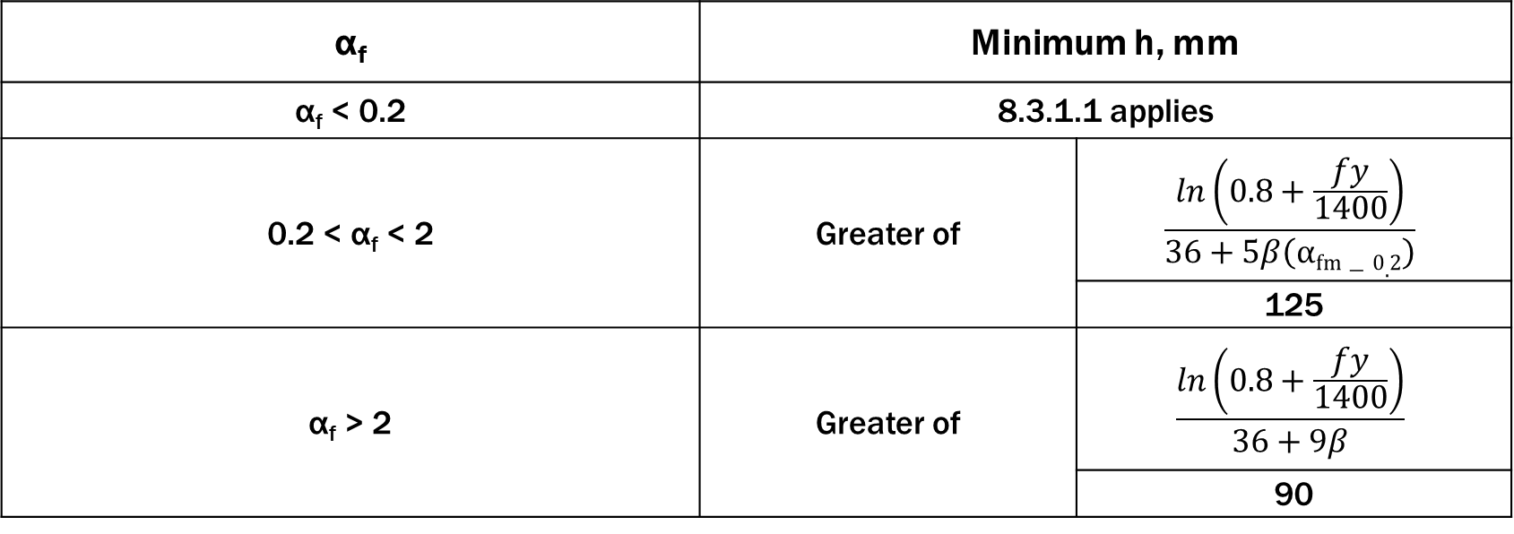
PRELIMINARY DESIGN
Slab Thickness:
α_{f} | Minimum h, mm
α_{f} < 0.2 | 8.3.1.1 applies
0.2 < α_{f} < 2 | Greater of | $$\frac{ln\left(0.8+\frac{fy}{1400}\right)}{36+5β\left(αfm−0.2\right)}$$
 |  | 125
α_{f} > 2 | Greater of | $$\frac{ln\left(0.8+\frac{fy}{1400}\right)}{36+9β}$$
 |  | 90

Slide 19
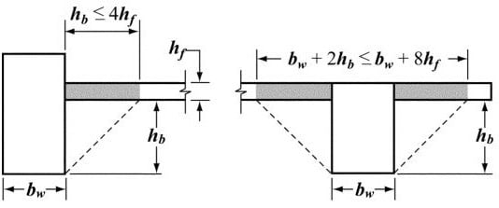
PRELIMINARY DESIGN
Slab Thickness:
αfm = 27
h min = 130 mm
Take:
h = 200 mm

Slide 20

PRELIMINARY DESIGN
Column Dimensions:
Load is determined for columns tributary area
Required dimensions is then determined for calculated load

Slide 21
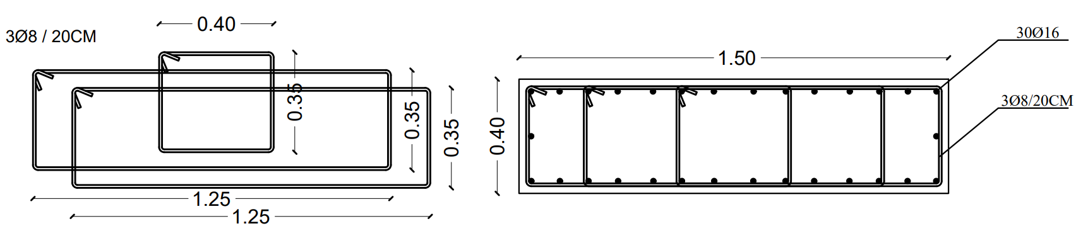
PRELIMINARY DESIGN
Column Dimensions:

Slide 22
3D MODELLING AND CHECKS

Slide 23
3D MODELLING AND CHECKS
Remember:

Slide 24
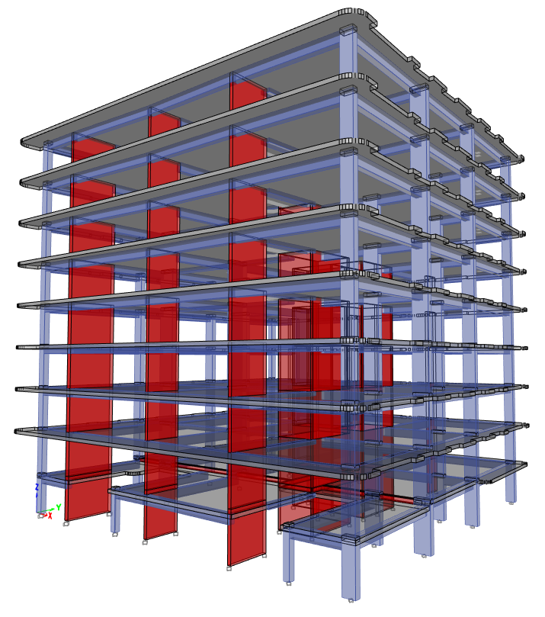
3D MODELLING AND CHECKS
3D Modelling:
Model was prepared using ETABS

Slide 25
3D MODELLING AND CHECKS
Checks:
Checks
Analysis Checks
Design Checks

Slide 26
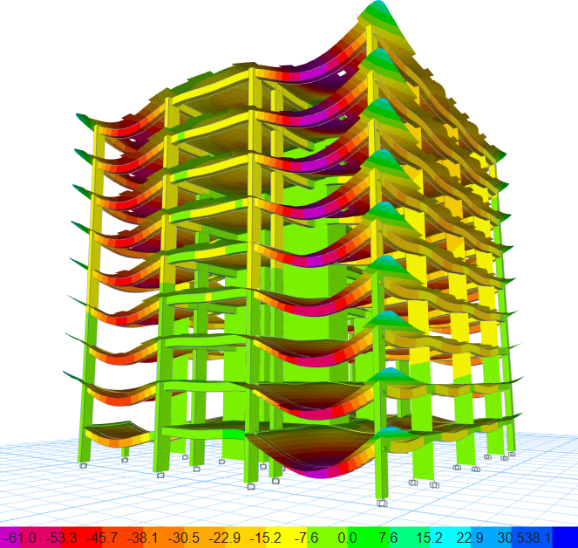
3D MODELLING AND CHECKS
Analysis Checks:
Compatibility Check:

Slide 27
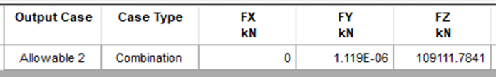
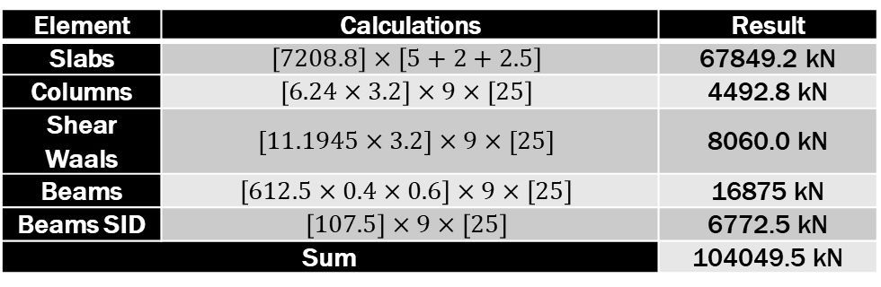
3D MODELLING AND CHECKS
Analysis Checks:
Equilibrium Check:
Manual building weight = 104049.5 kN
ETABS Base Reactions = 109111.8 kN
Error = 4.86 %
Element | Calculations | Result
Slabs | $$\left[7208.8\right]×\left[5+2+2.5\right]$$ | 67849.2 kN
Columns | $$\left[6.24×3.2\right]×9×\left[25\right]$$ | 4492.8 kN
Shear Waals | $$\left[11.1945×3.2\right]×9×\left[25\right]$$ | 8060.0 kN
Beams | $$\left[612.5×0.4×0.6\right]×9×\left[25\right]$$ | 16875 kN
Beams SID | $$\left[107.5\right]×9×\left[25\right]$$ | 6772.5 kN
Sum |  | 104049.5 kN

Slide 28
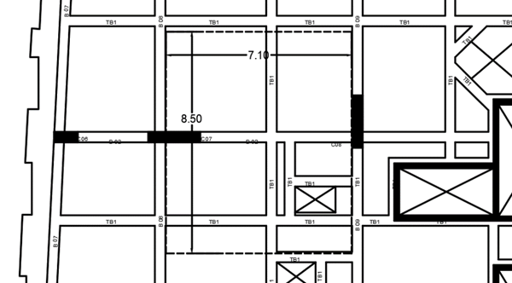
3D MODELLING AND CHECKS
Analysis Checks:
Slab Frame Section Internal Forces Check:
Manual Moment = 664.15 kN.m
ETABS Moment = 653.6 kN.m
Error = 6.1 %

Slide 29
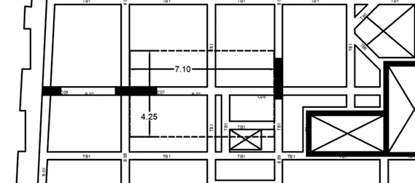
3D MODELLING AND CHECKS
Analysis Checks:
Column Strip Section Internal Forces Check:
Column strip must resist 90% of slab frame moments.
Manual Moment = 597.7 kN.m
ETABS Moment = 557.9 kN.m
Error = 6.7 %

Slide 30
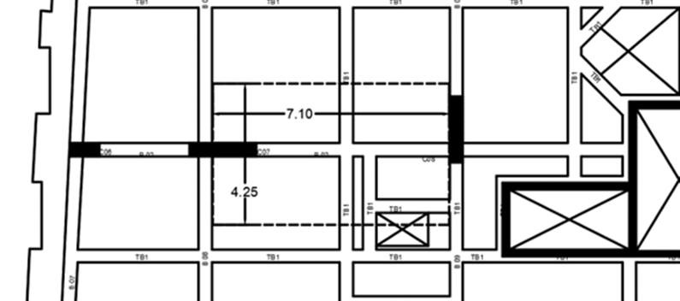
3D MODELLING AND CHECKS
Analysis Checks:
Column Strip Beam Internal Forces Check:
Beam must resist 85% of column strip frame moments.
Manual Moment = 508.1 kN.m
ETABS Moment = 533.1 kN.m
Error = 4.7 %

Slide 31
3D MODELLING AND CHECKS
Analysis Checks:
Column Strip Slab Internal Forces Check:
Beam must resist column strip frame moments that beam didn’t resist.
Manual Moment = 89.6 kN.m
ETABS Moment = 96.4 kN.m
Error = 7.5 %

Slide 32
3D MODELLING AND CHECKS
Analysis Checks:
Middle Strip Internal Forces Check:
Middle strip must resist slab frame frame moments that column strip didn’t resist
Manual Moment = 66.4 kN.m
ETABS Moment = 62.1 kN.m
Error = 6.4 %

Slide 33
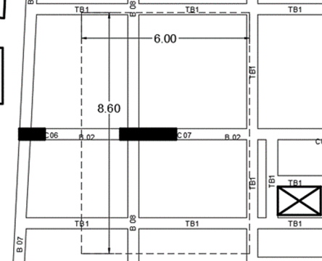
3D MODELLING AND CHECKS
Analysis Checks:
Column Internal Forces Check:
Manual Axial Load = 1290 kN
ETABS Axial Load = 1349.7 kN.m
Error = 4.6 %

Slide 34
3D MODELLING AND CHECKS
Seismic Checks:
Amount of Shear Wall Check:
Total base shear
Seismic factors | SDs | 0.6 | SD1 | 0.2432
 | R | 6 | Ie | 1
Materials | f'c | 28 MPa | Fy | 420 MPa
Total height of building | 35.2 m
Fundamental Period | Ta | 0.607 | Ta Cu | 0.992
 | Cu | 1.4067
Slab dead +SID load |  | 9.25 kN/m2
Number of floors |  | 9 floors
Average area of floors |  | 860 m2
Total weight of building |  | 71595 kN
Total base shear |  | 3400.39 kN

Slide 35
3D MODELLING AND CHECKS
Seismic Checks:
Amount of Shear Wall Check:
No Additional Shear Walls Needed
Amount of S.W to resist shear
Wall width | 200 mm
dbh | 10 mm
Av | 157 mm2
Spacing of shear bars | 150 mm
Length of walls | 9.20 m

Slide 36
3D MODELLING AND CHECKS
Torsional Irregularity Check – X Direction
Floor Number | Δ 1 | Δ 2 | Δ avg | Ratio | Check
9 | 79.8 | 75.2 | 77.5 | 1.03 | No T.I
8 | 70.1 | 56 | 63.05 | 1.11 | No T.I
7 | 59.9 | 56.2 | 58.05 | 1.03 | No T.I
6 | 49.3 | 46.5 | 47.9 | 1.03 | No T.I
5 | 29.1 | 35.8 | 32.45 | 1.10 | No T.I
4 | 28.2 | 26.1 | 27.15 | 1.04 | No T.I
3 | 17.9 | 16.9 | 17.4 | 1.03 | No T.I
2 | 10.1 | 8.9 | 9.5 | 1.06 | No T.I
1 | 3.3 | 2.5 | 2.9 | 1.14 | No T.I
Seismic Checks:
Torsional Irregularity Check:
No Irregularity in X Direction

Slide 37
3D MODELLING AND CHECKS
Seismic Checks:
Torsional Irregularity Check:
No Irregularity in Y Direction
Torsional Irregularity Check – Y Direction
Floor Number | Δ 1 | Δ 2 | Δ avg | Ratio | Check
9 | 92.2 | 72.5 | 82.35 | 1.12 | No T.I
8 | 82.2 | 64.6 | 73.4 | 1.12 | No T.I
7 | 73.3 | 56.1 | 64.7 | 1.13 | No T.I
6 | 61.5 | 46.7 | 54.1 | 1.14 | No T.I
5 | 46.7 | 37.5 | 42.1 | 1.11 | No T.I
4 | 37.2 | 27.1 | 32.15 | 1.16 | No T.I
3 | 25.2 | 18.9 | 22.05 | 1.14 | No T.I
2 | 13.4 | 9.9 | 11.65 | 1.15 | No T.I
1 | 4.2 | 3.3 | 3.75 | 1.12 | No T.I

Slide 38
3D MODELLING AND CHECKS
Seismic Checks:
Drift Check:
no remedial action needs
to be taken in X Direction
Drift Check – X Direction
Floor Number | δx elastic (mm) | δx inelastic (mm) | inelastic drift (mm) | Result
9 | 11.1008 | 55.504 | 2.848 | SAFE
8 | 11.6704 | 58.352 | 2.304 | SAFE
7 | 12.1312 | 60.656 | 1.056 | SAFE
6 | 12.3424 | 61.712 | 0.96 | SAFE
5 | 12.1504 | 60.752 | 3.712 | SAFE
4 | 11.408 | 57.04 | 7.296 | SAFE
3 | 9.9488 | 49.744 | 12.72 | SAFE
2 | 7.4048 | 37.024 | 13.088 | SAFE
1 | 4.7872 | 23.936 | 23.936 | SAFE

Slide 39
3D MODELLING AND CHECKS
Seismic Checks:
Drift Check:
no remedial action needs
to be taken in Y Direction
Drift Check – Y Direction
Floor Number | δx elastic (mm) | δx inelastic (mm) | inelastic drift (mm) | Result
9 | 9.9904 | 49.952 | 10.848 | SAFE
8 | 12.16 | 60.8 | 2.416 | SAFE
7 | 11.6768 | 58.384 | 3.648 | SAFE
6 | 12.4064 | 62.032 | 1.776 | SAFE
5 | 12.7616 | 63.808 | 1.408 | SAFE
4 | 12.48 | 62.4 | 6.08 | SAFE
3 | 11.264 | 56.32 | 15.92 | SAFE
2 | 8.08 | 40.4 | 14.592 | SAFE
1 | 5.1616 | 25.808 | 25.808 | SAFE

Slide 40
3D MODELLING AND CHECKS
Seismic Checks:
P-Delta Check:
no remedial action needs
to be taken in X Direction
P-Delta Check – X Direction
Story | Ps (kN) | K (kN/m) | θ | Result
9 | 14103.6689 | 236787.545 | 0.018613295 | safe
8 | 28104.1497 | 447125.717 | 0.019642231 | safe
7 | 42104.6305 | 629071.323 | 0.020916066 | safe
6 | 56105.1113 | 799736.648 | 0.021923276 | safe
5 | 70105.5921 | 981848.556 | 0.022313011 | safe
4 | 84106.0729 | 1211182.963 | 0.021700394 | safe
3 | 98106.5537 | 1564868.413 | 0.019591614 | safe
2 | 107323.142 | 2326506.06 | 0.014415815 | safe
1 | 82401.1668 | 5383530.276 | 0.004783174 | safe
9 | 14103.6689 | 236787.545 | 0.018613295 | safe
8 | 28104.1497 | 447125.717 | 0.019642231 | safe

Slide 41
3D MODELLING AND CHECKS
Seismic Checks:
P-Delta Check:
no remedial action needs
to be taken in Y Direction
P-Delta Check – Y Direction
Story | Ps (kN) | K (kN/m) | θ | Result
9 | 14103.6689 | 263425.68 | 0.016731082 | safe
8 | 28104.1497 | 491198.947 | 0.017879816 | safe
7 | 42104.6305 | 681146.242 | 0.019316993 | safe
6 | 56105.1113 | 851524.054 | 0.020589961 | safe
5 | 70105.5921 | 1028219.742 | 0.021306727 | safe
4 | 84106.0729 | 1249854.834 | 0.02102896 | safe
3 | 98106.5537 | 1597876.186 | 0.019186905 | safe
2 | 107295.0961 | 2316274.656 | 0.014475709 | safe
1 | 81050.7245 | 6546225.075 | 0.003869154 | safe
9 | 14103.6689 | 263425.68 | 0.016731082 | safe
8 | 28104.1497 | 491198.947 | 0.017879816 | safe

Slide 42
3D MODELLING AND CHECKS
Seismic Checks:
Modal Mass Participation
Ratio Check:
Proposed modes resample
The structure well enough.
Mode | Period (Sec) | SumUX | SumUY | SumRZ
1 | 1.356 | 0.0736 | 0.1716 | 0.4957
2 | 1.057 | 0.6642 | 0.1723 | 0.5893
3 | 0.952 | 0.6807 | 0.68 | 0.7595
4 | 0.377 | 0.6869 | 0.7015 | 0.8623
5 | 0.23 | 0.8618 | 0.7139 | 0.8776
6 | 0.206 | 0.8885 | 0.8658 | 0.8942
7 | 0.179 | 0.8898 | 0.8792 | 0.9338
8 | 0.107 | 0.8902 | 0.8794 | 0.9621
9 | 0.102 | 0.9489 | 0.8813 | 0.9626
10 | 0.089 | 0.9508 | 0.9397 | 0.9645
11 | 0.074 | 0.9508 | 0.9404 | 0.9807
12 | 0.064 | 0.9762 | 0.9405 | 0.9818

Slide 43

3D MODELLING AND CHECKS
Design Checks:
Slab Deflection Check:

Slide 44
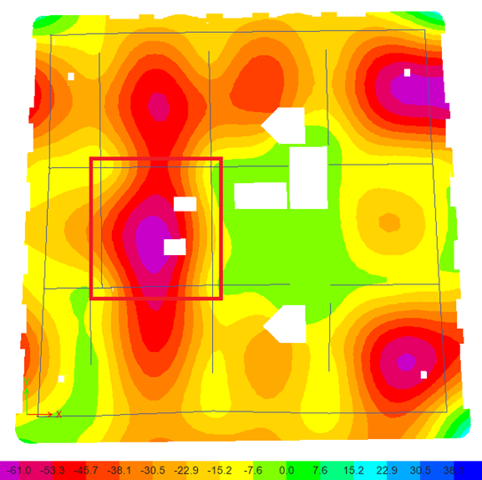

3D MODELLING AND CHECKS
Design Checks:
Slab Deflection Check:

Slide 45
3D MODELLING AND CHECKS
Design Checks:
Slab Shear Check:

Slide 46
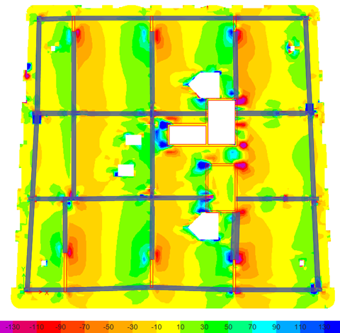
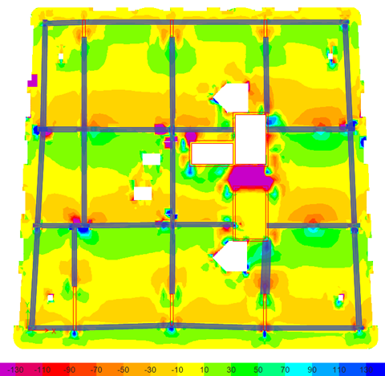
3D MODELLING AND CHECKS
Design Checks:
Slab Shear Check:

Slide 47
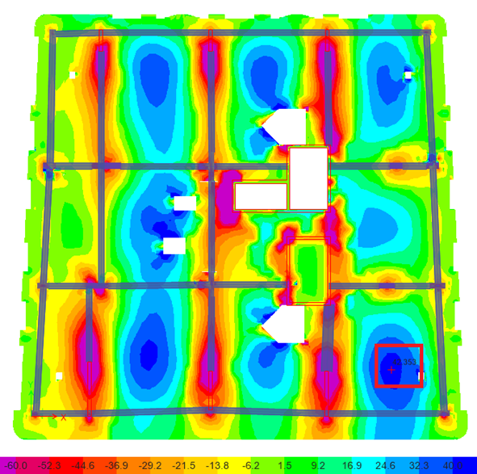
3D MODELLING AND CHECKS
Design Checks:
Slab Design For Flexure:
Required steel = 680 mm2/m which is 5Ø14/Rib

Slide 48
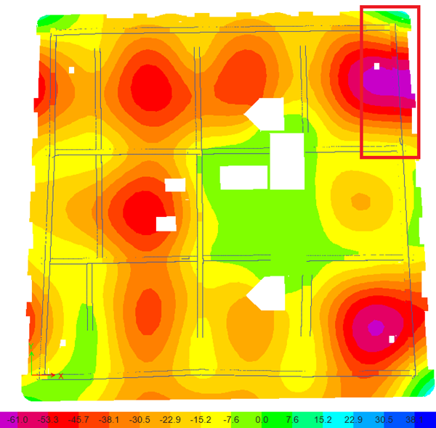
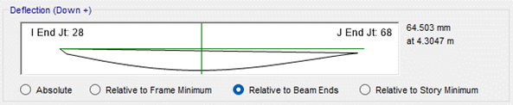
3D MODELLING AND CHECKS
Design Checks:
Beam Deflection Check:

Slide 49
3D MODELLING AND CHECKS
Design Checks:
Beam Deflection Check:
Code 24.2.2 in ACI 318-14 states that Limit shall be permitted to be exceeded if measures are taken to prevent damage to supported or attached elements.

Slide 50
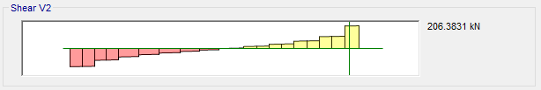
3D MODELLING AND CHECKS
Design Checks:
Beam Design For Shear:

Slide 51
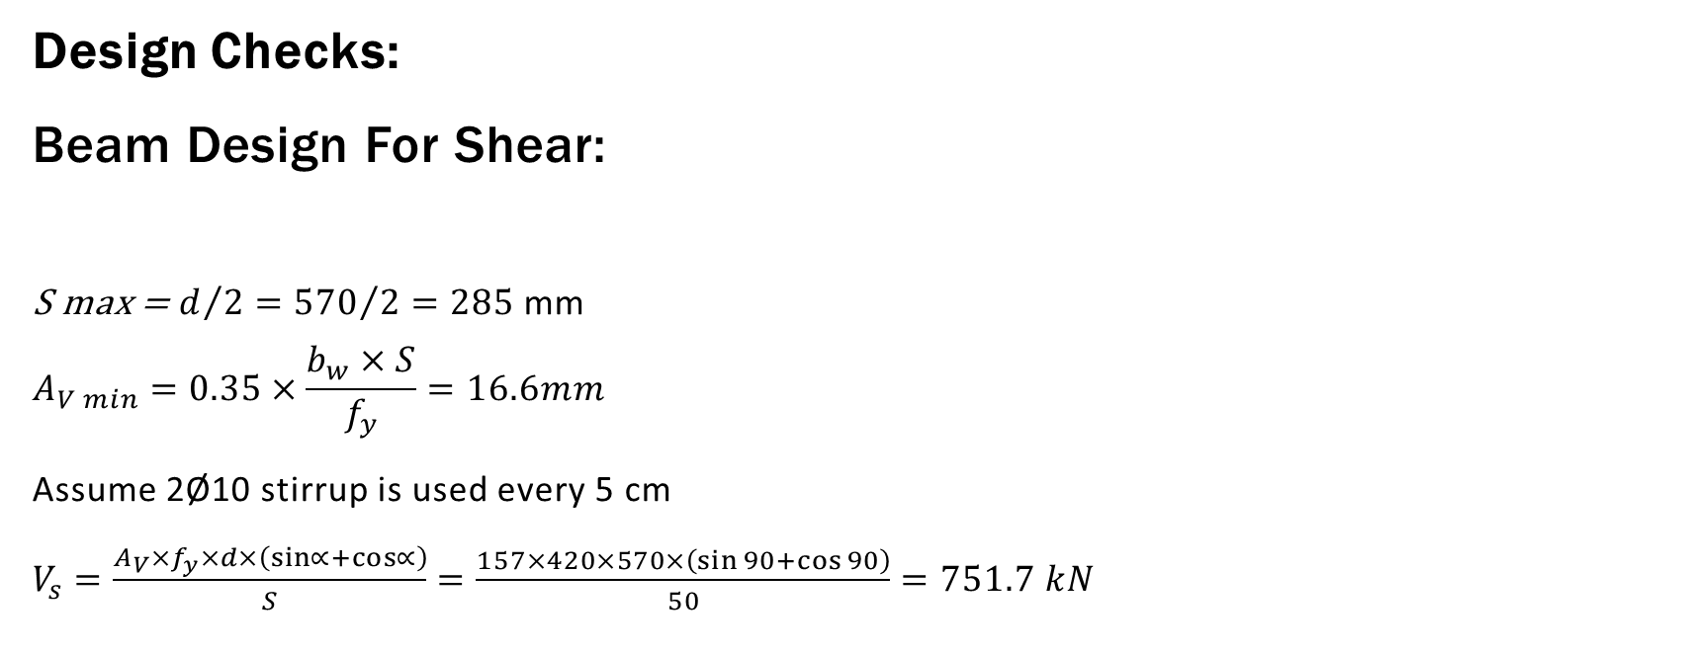
3D MODELLING AND CHECKS
Design Checks:
Beam Design For Shear:
S max = $d/2={570}/{2=285}$ mm
$$A_{V min}=0.35×\frac{b_{w}×S}{f_{y}}=16.6mm$$
Assume 2Ø10 stirrup is used every 5 cm
$V_{s}=\frac{A_{V}×f_{y}×d×\left(\sin{∝}+\cos{∝}\right)}{S}=\frac{157×420×570×\left(\sin{90}+\cos{90}\right)}{50}=751.7 kN$

Slide 52

3D MODELLING AND CHECKS
Design Checks:
Design Columns For Axial Load:

Slide 53
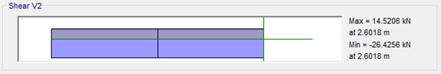
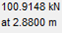
3D MODELLING AND CHECKS
Design Checks:
Design Columns For Shear:
Use Minimum Stirrups

Slide 54
DETAILING

Slide 55
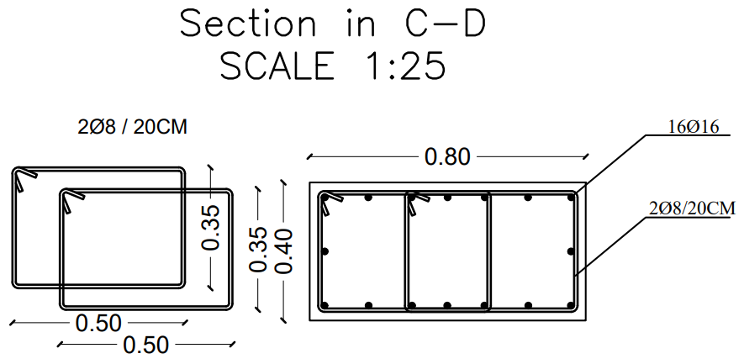
Detailing
Columns Detailing:

Slide 56
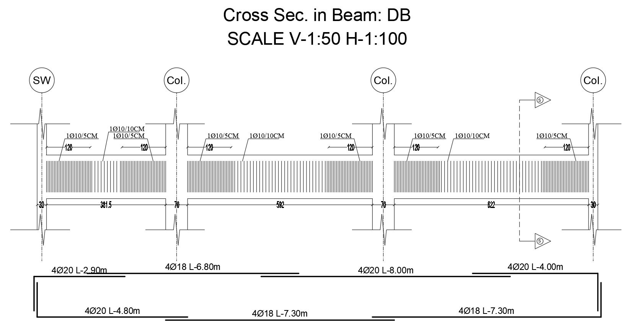
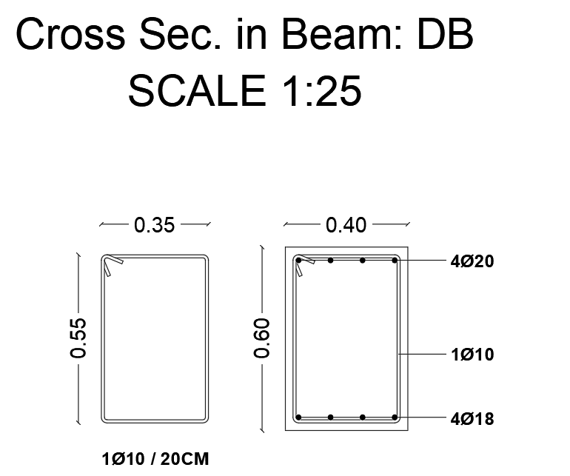
Detailing
Beams Detailing:

Slide 57
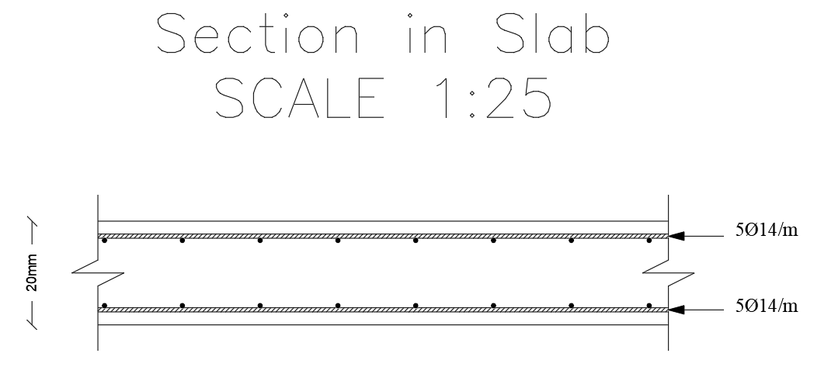
Detailing
Slab Detailing:

Slide 58
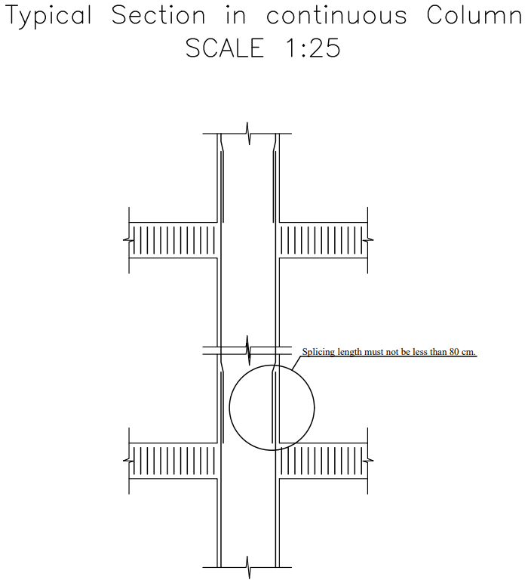
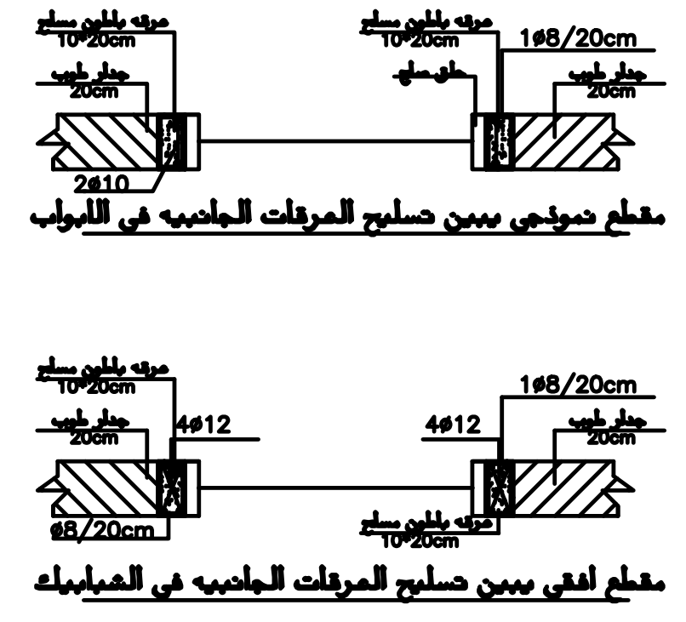
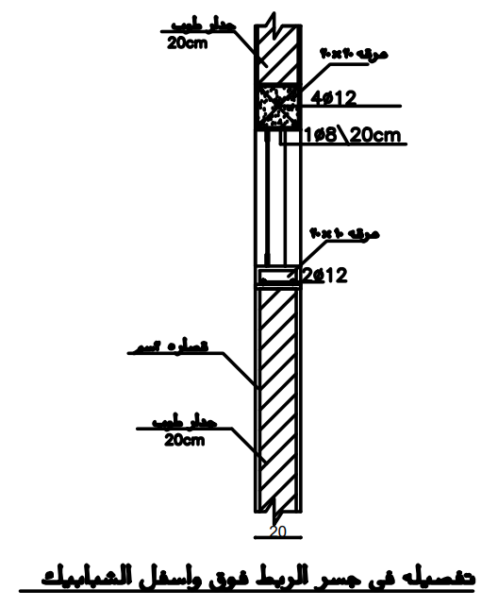
Detailing
General Detailing:

Slide 59
THANK
YOU

