Slide 1
MiWi game CONTROLLER
Darwesh
Shaka’a
Mohammad Alkharraz
With accelerometer

Slide 2
Components:
1-PIC18F4550 ‘has a USB Port’.
2-two PIC18LF4620.
3-Adxl335 ±3g accelerometer.
4-MIWI mrf24j40 “30 meter range” .
5-And a PC.

Slide 3
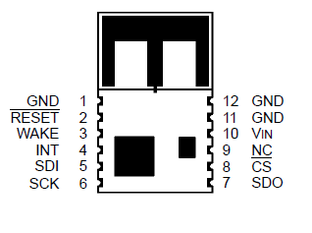
PIC to MRF interface:
PIC
mrf
I/O
CS
SDO
SDI
SDI
SDO
SCK
SCK
INTx
INT
I/O
WAKE
_______
I/O
RESET

Slide 4
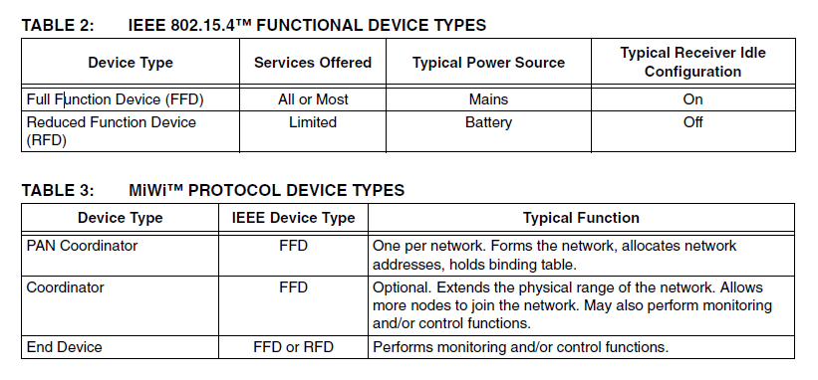
PIC to MRF interface:
Low Power “Total power dissipation = 1 W <they say>”.
Multiple user can connect at the same time “Network star topology”.
Suitable data rate ‘250kbps’.

Slide 5
Game Controller Programming:
1-HID Report Descriptor.
2-Adding the Descriptor to your Code.
3-Sending Data to the PC.
4-The Hardware.

Slide 6
Game Controller Programming:
HID descriptor
HID Report Descriptor is a software created by the USB.org and used to:-
Device Class Definition HID
The Device Class Definition for HID is intended to supplement the USB Specification and provide HID manufacturers with the information necessary to build USB-compatible devices. It also specifies how the HID class driver should extract data from USB devices. The primary and underlying goals of the HID class definition are to:
be as compact as possible to save device data space
allow the software application to skip unknown information
be extensible and robust
support nesting and collections
be self-describing to allow generic software applications

Slide 7
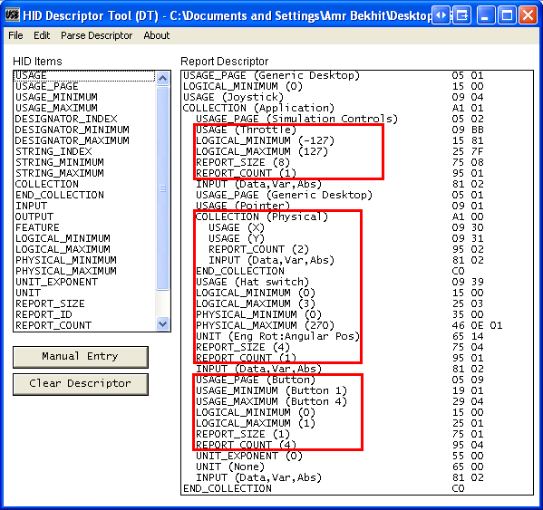
Game Controller Programming:
HID descriptor example

Slide 8
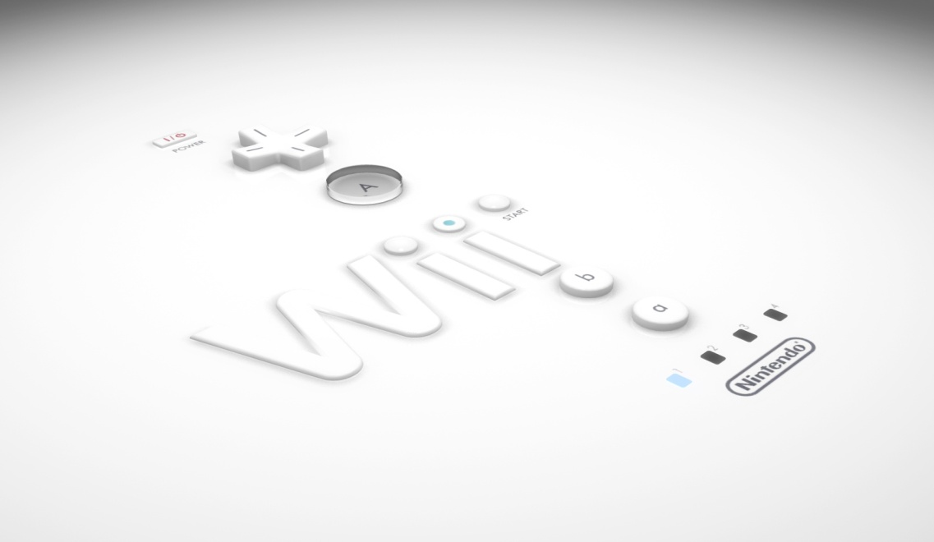
2-Adding the Descriptor to your Code.
Just import the hid header file to your “MpLab” project.
Make sure that the data in the array sent by the ‘hidtxpacket’ is in the same order as the report.

Slide 9
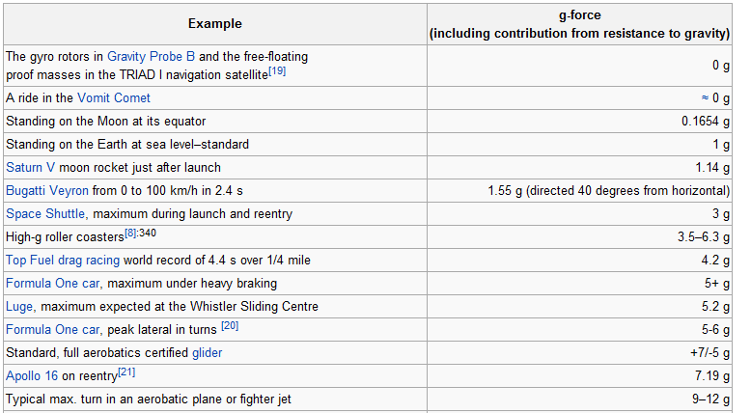
Why ±3g ?
The accelerometer :

Slide 10
Problem we solved…
MiWi keeps stalling ….
MiWi stop working….
Accelerometer sensitivity….
Notes:
resultX =MAX(resultX,412);
resultX =MIN(resultX,609);
resultX=resultX-410;
resultX=(resultX*13)/10;
resultX =MIN(resultX,255);

