Slide 1

An-Najah National University
Faculty of Engineering and Information Technology
Industrial Engineering department
Investigation the Implementation of Statistical Process Control (SPC) Tools in Cosmetics Products
( Palkarm Company Case Study )
Saja Estatiteh
Mufeeda Abu Safieh
Lina Shaksheir
Raghad Ashour
Prepared by
Supervisor : Eng. Tamer Haddad

Slide 2

Outline
Palkarm Company
Problem statement
Objectives
Literature review
Methodology
Palkarm Manufacturing Processes
Palkarm Tests Methods
Data Collection and Analysis
OCAP
SPC Tools
Modified Forms and Work Procedures
Conclusion & Recommendations

Slide 3

Palkarm Company
Founded in 1988.
Palkarm cosmetics company is considered as the largest cosmetics company in Nablus.

Slide 4
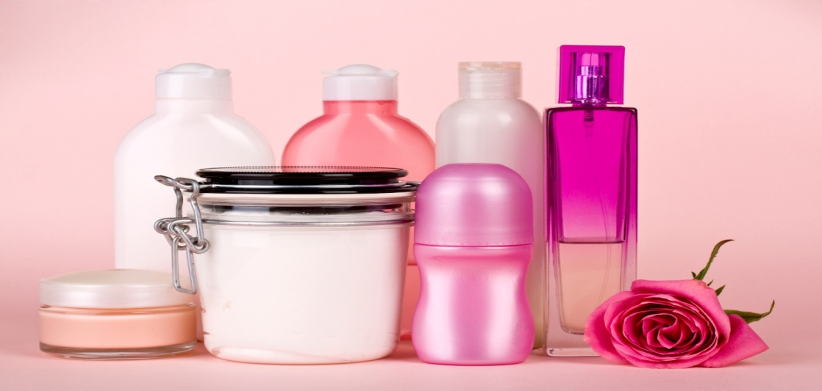
Problem Statement
Cosmetics products must be manufactured at high levels of quality to ensure that they are safe and not hazardous to be used by the customers.
Lack of the variation and inconsistency of the quality.

Slide 5
Objectives
Assessment of the current quality level in the company by applying some of the SPC tools .
Controlling the source of variation and ensure the consistency of the quality.
Detecting the occurrence of assignable causes .

Slide 6
Literature Review
Quality control :
QC includes the operational techniques and the activities that sustain a quality of product or service. (ASQ Statistics Division,1983)
Statistical process control (SPC)
SPC is based on so called Shewhart´s conception of the process variability.
The main function is to reduce variation in an output characteristic by signalizing the change of an undefined process input” (Dasgupta,2003)

Slide 7
Literature Review
Successful Stories
1- The halal cosmetic products in Malaysia are certified and control under JAKIM (Department of Islamic Development Malaysia) and follow the Malaysian Standard requirement.
2-Application of statistical process control in service industry: A case study of the restaurant sector. The research is based on the present service system at a restaurant, located at a university campus in Cyprus.

Slide 8
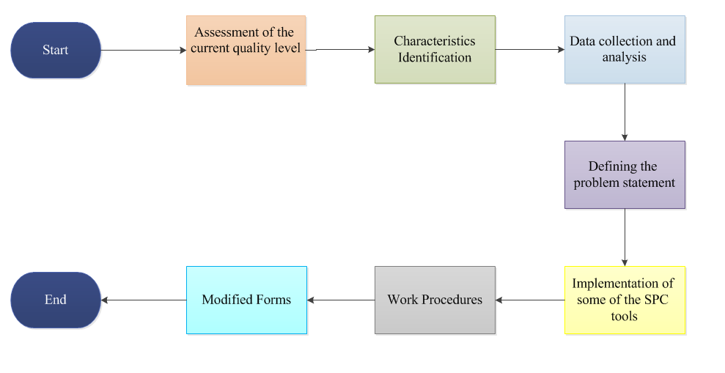
Methodology

Slide 9
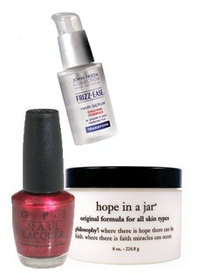
Palkarm Manufacturing Processes
Creams , body lotions and sun block .
Liquid foundation
Nail Polish

Slide 10
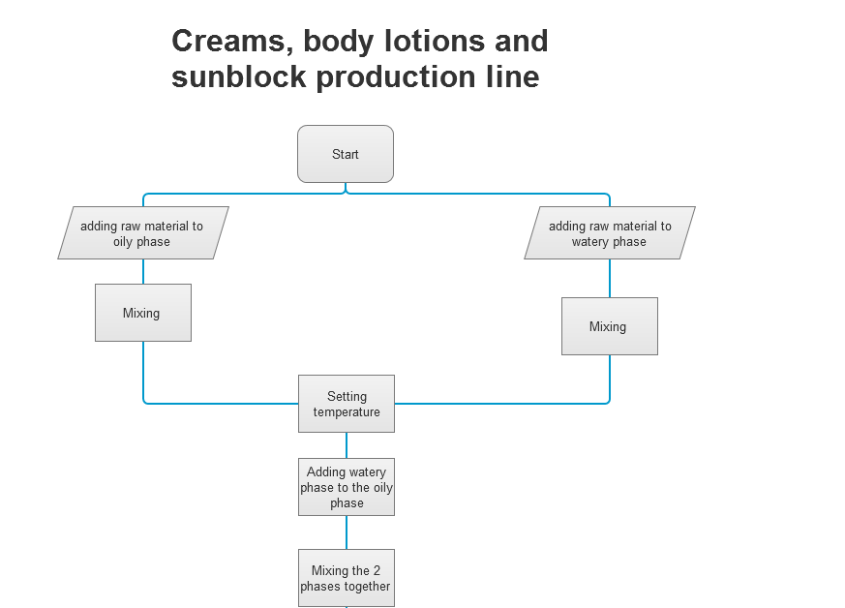

Slide 11
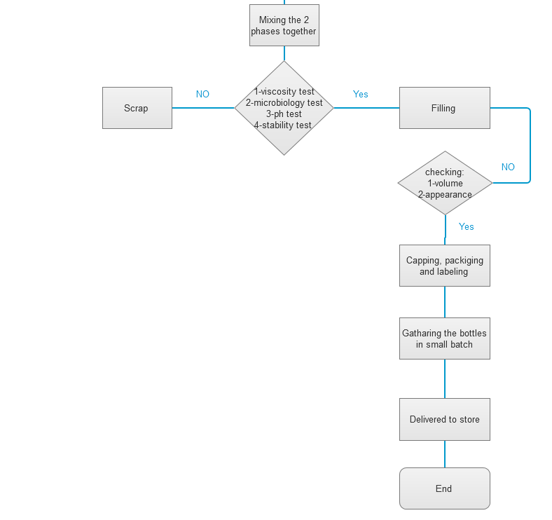

Slide 12
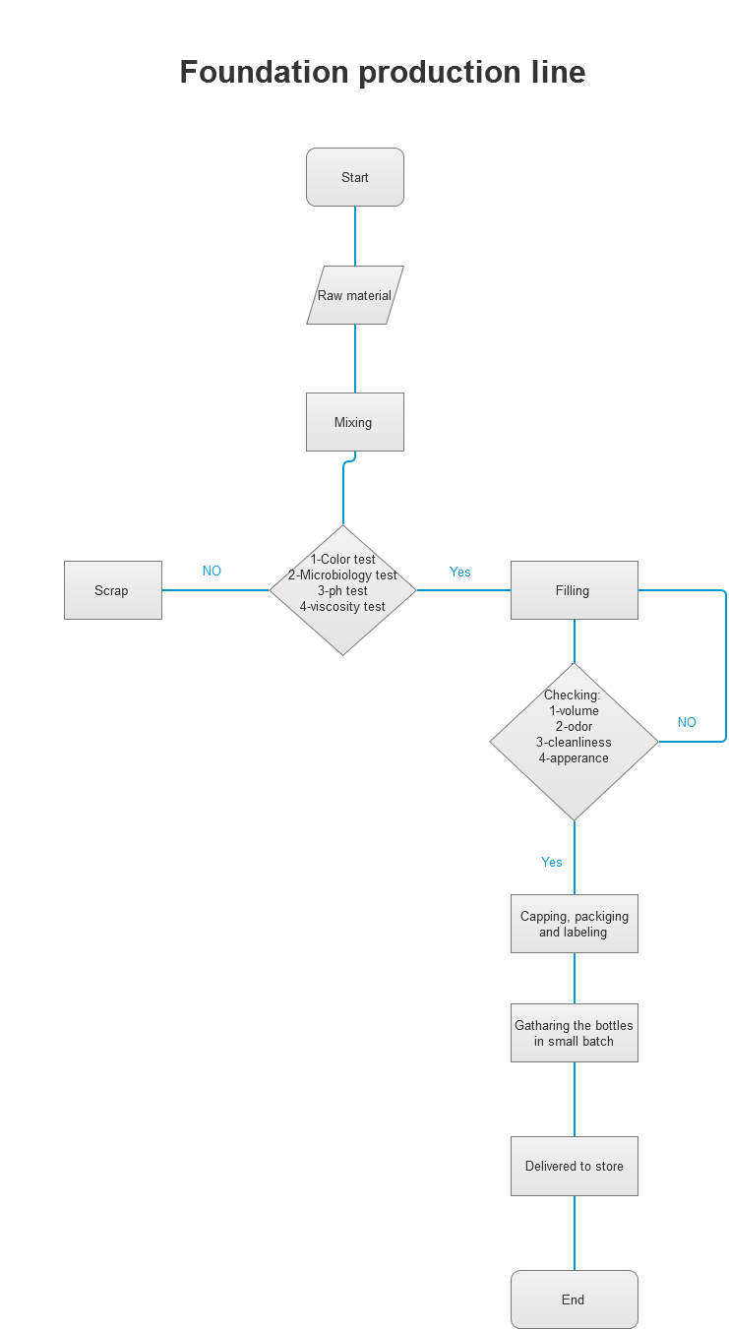

Slide 13
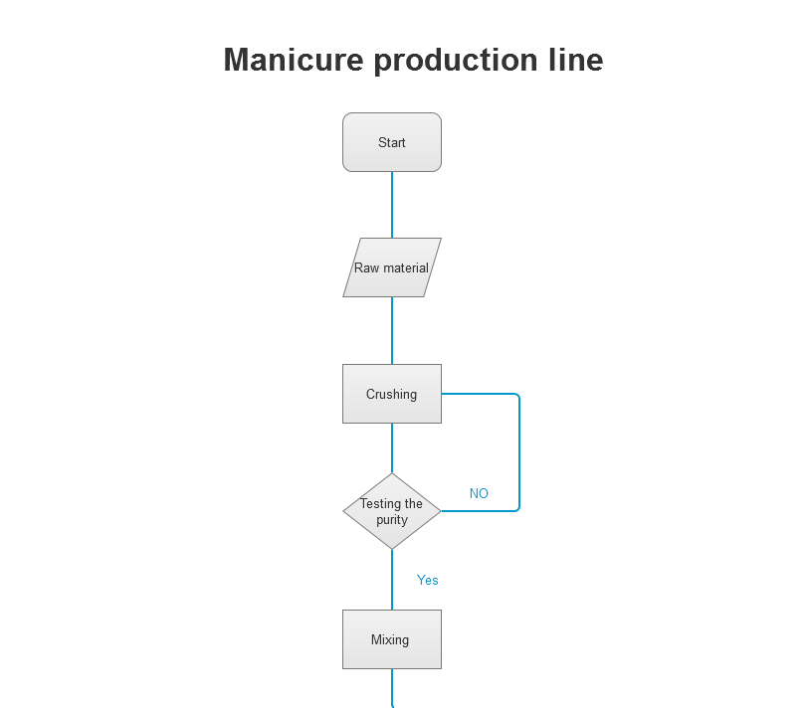

Slide 14
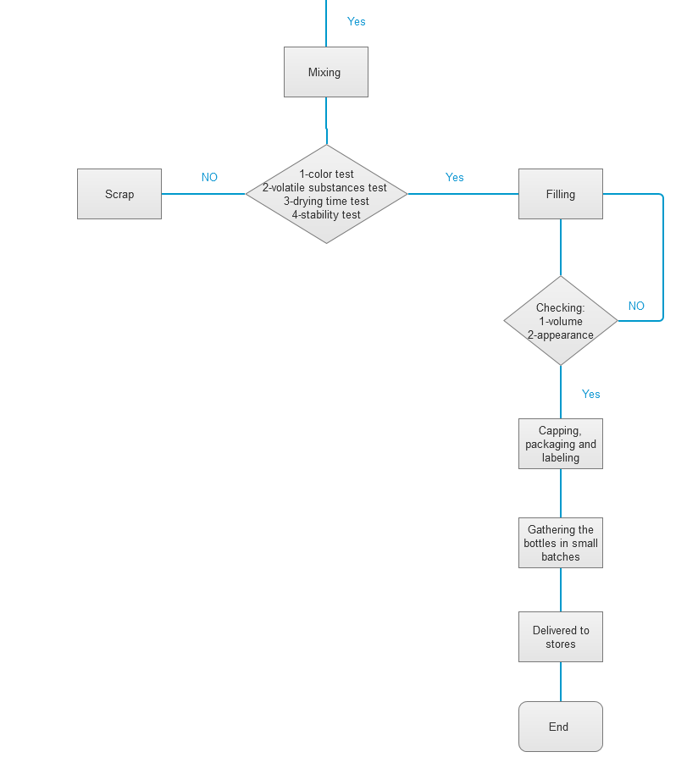

Slide 15
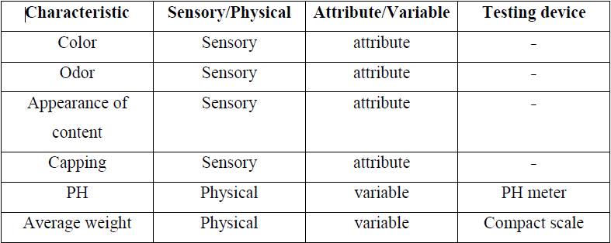
Palkarm Tests Methods
The characteristics of hand cream :

Slide 16
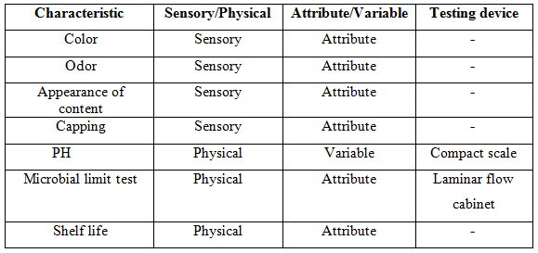
Palkarm Tests Methods
The characteristics of liquid foundation :

Slide 17
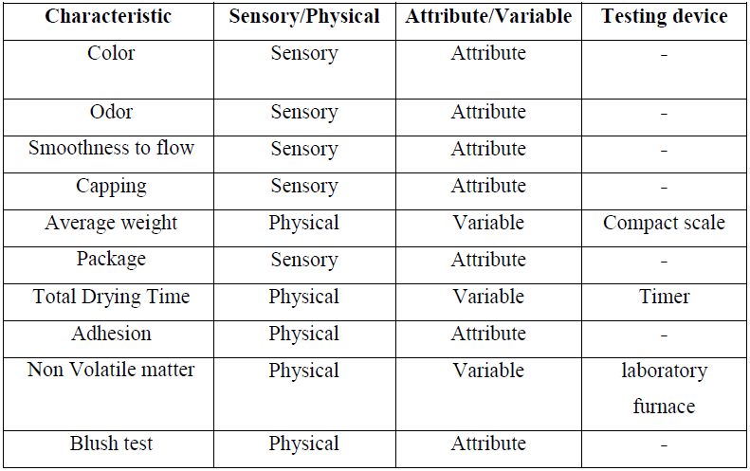
Palkarm Tests Methods
The characteristics of nail polish :

Slide 18
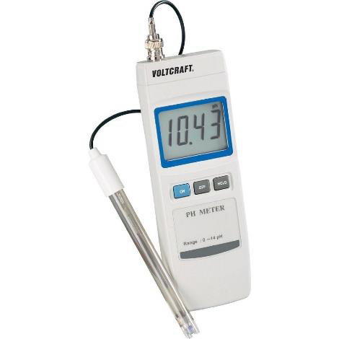
Palkarm Tests Methods
Hand Cream & Liquid Foundation Tests:
1- PH test :
PH level for the sample is measured by a device called PH meter.

Slide 19
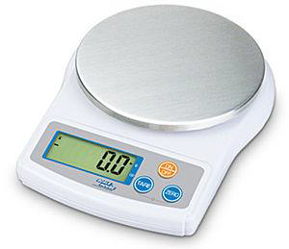
Palkarm Tests Methods
2- The Product Weight :
This test is performed on the final products by taking one sample with a size of 10 products using a
compact scale .

Slide 20
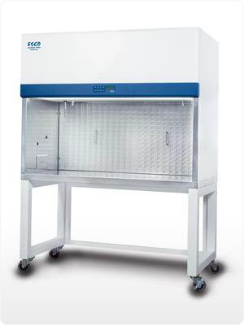
Palkarm Tests Methods
3- The Microbiological tests :
These tests should be done to make sure that the product is free from micro-organisms that cause diseases.

Slide 21
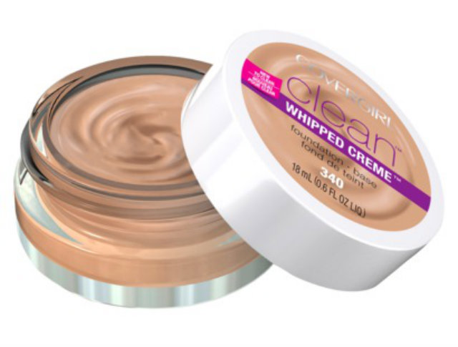
Palkarm Tests Methods
4-The general tests:
These types of tests depend on the senses to decide whether the product should be accepted or not.

Slide 22
Palkarm Tests Methods
Nail Polish Tests:
1-The determination of the non-volatile material:
The non-volatile material (%) = ((w2_w1)/w) *100 , where:
W: the weight of the material taken to be tested (gm).
W1: the weight of the empty glass vessel used in the test (gm).
W2: the weight of the glass vessel containing the material after drying (gm).

Slide 23
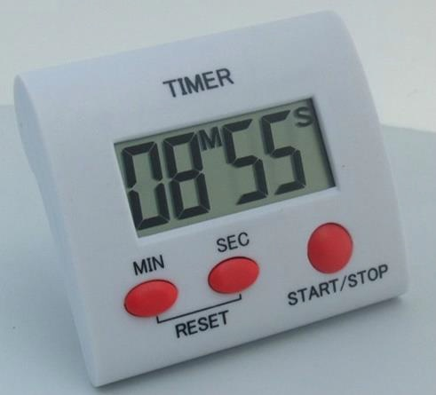
Palkarm Tests Methods
2-The determination of drying time:
A digital timer is needed to record the time spent by the sample to completely dry .

Slide 24
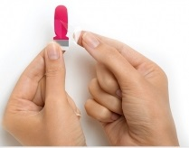
Palkarm Tests Methods
3- Adhesion test :
The material passes the test if more than 10% of material doesn’t peel.

Slide 25
Palkarm Tests Methods
4-Scratch test:
The material passes this test if the surface of the slide doesn't appear down the needle path line.
5-Testing the color change in water (Blush test):
The material is poured on 5cm×15cm area of a tin slide .The slide is placed in the vessel, so that the water covers half of the slide and the other half is exposed to the atmosphere, then is left for 24 hours.

Slide 26
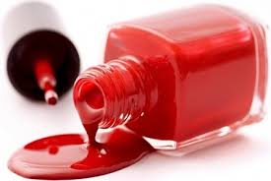
Palkarm Tests Methods
6-The general tests:
These tests include the tests of the color, odor and smoothness of flow of the product.

Slide 27
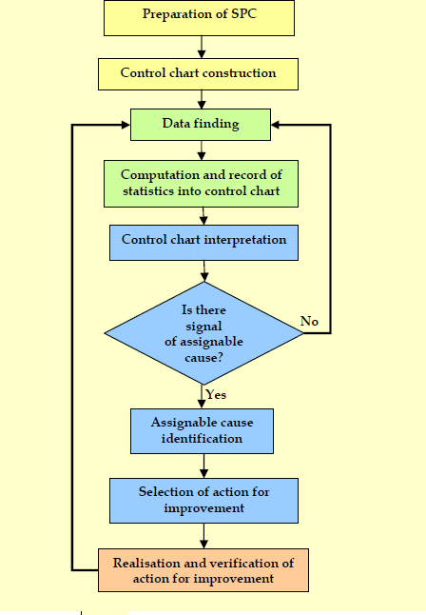
Control chart construction

Slide 28
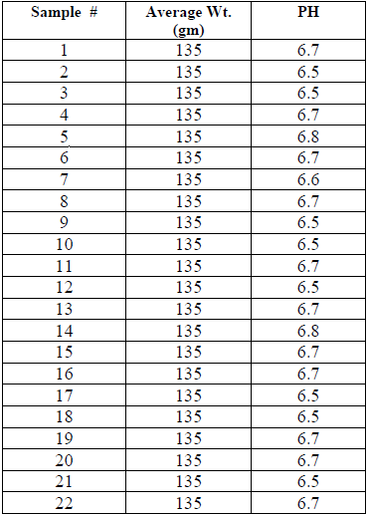
Data Collection and Analysis
Hand Cream:
22 samples
From 2/10/2016
to 30/1/2017.

Slide 29
Data Collection and Analysis
Normality test and control chart for hand cream’s data :

Slide 30
Data Collection and Analysis
Box-cox transformation for hand cream’s data :
.

Slide 31
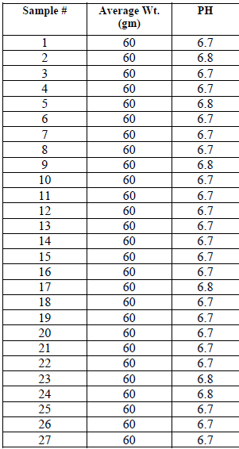
Data Collection and Analysis
Liquid Foundation :
27 samples
From 9/10/2016
to 18/1/2017.

Slide 32
Data Collection and Analysis
Normality test and control chart for liquid foundation’ data:

Slide 33
Data Collection and Analysis
Box-cox transformation for liquid foundation’s data :

Slide 34
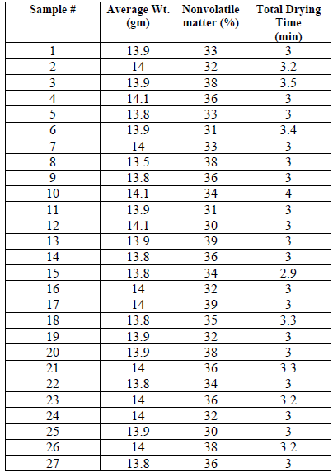
Data Collection and Analysis
Nail Polish
27 samples
From 9/10/2016
to 181/2017

Slide 35
Data Collection and Analysis
Normality test and control chart for nail polish total drying time’s data :

Slide 36
Data Collection and Analysis
Box-cox transformation for nail polish total drying time’s data :

Slide 37
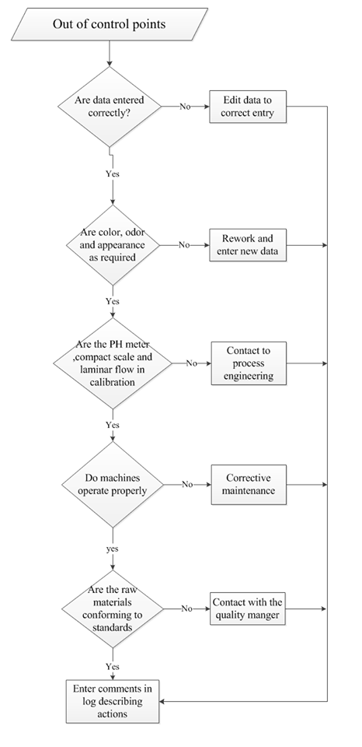
Out of control action plan (OCAP)
OCAP for hand cream
and liquid foundation.

Slide 38
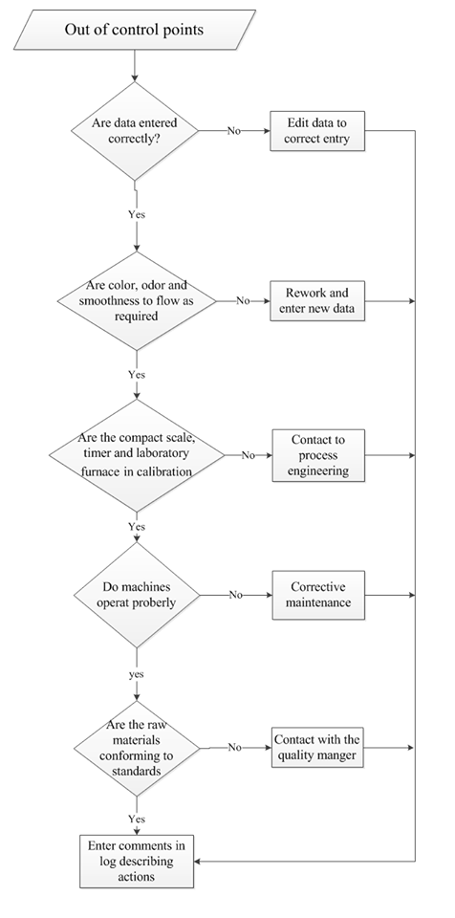
Out of control action plan (OCAP)
OCAP for nail polish.

Slide 39
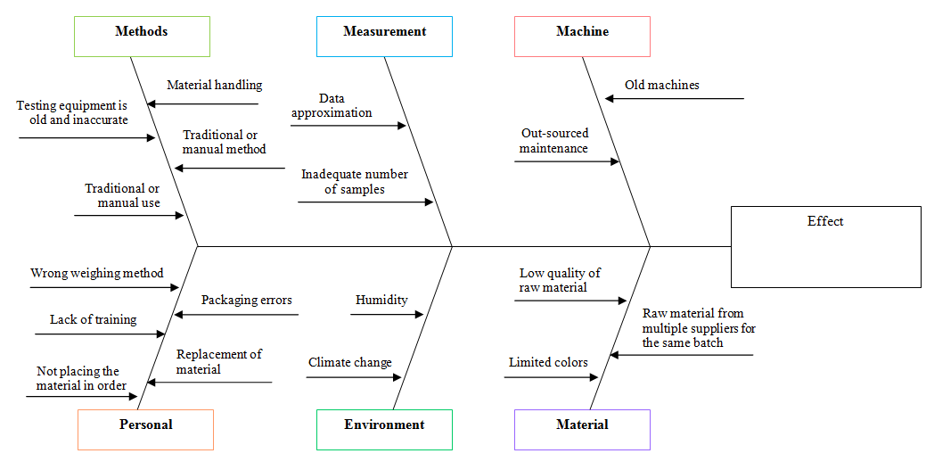
SPC Tools
Fish & bone diagram

Slide 40
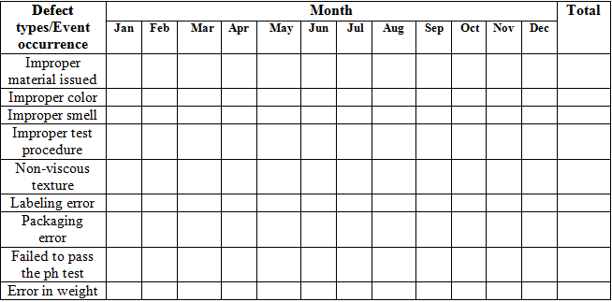
SPC Tools
Check sheet for hand cream :

Slide 41
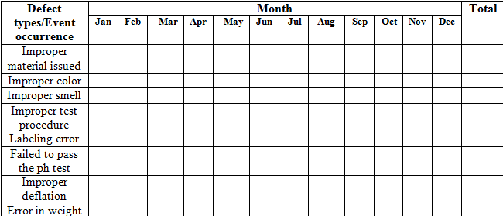
SPC Tools
Check sheet for liquid foundation:

Slide 42
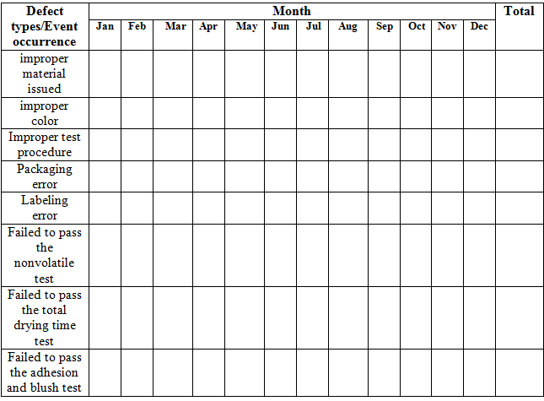
SPC Tools
Check sheet for nail polish:

Slide 43
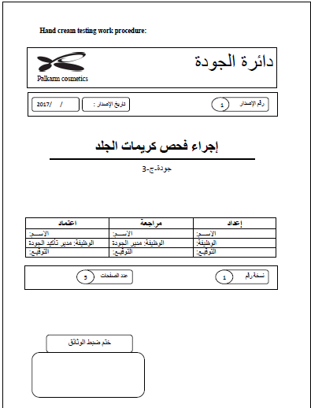
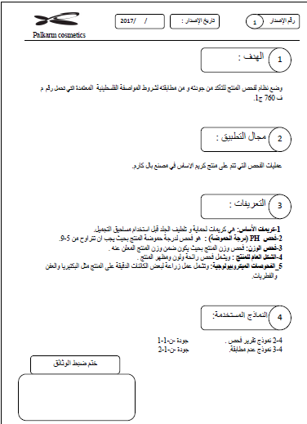
Work procedures

Slide 44
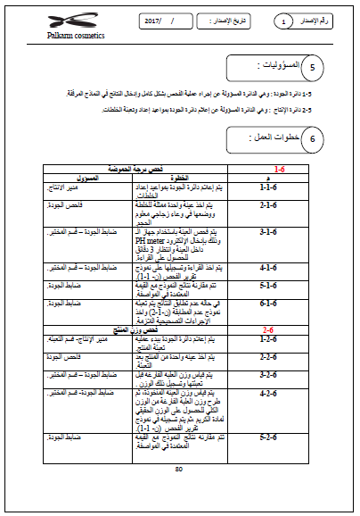
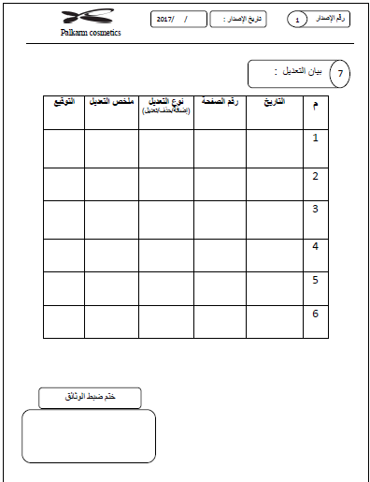
Work procedures

Slide 45
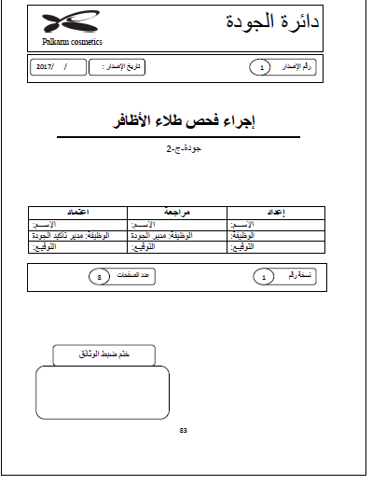
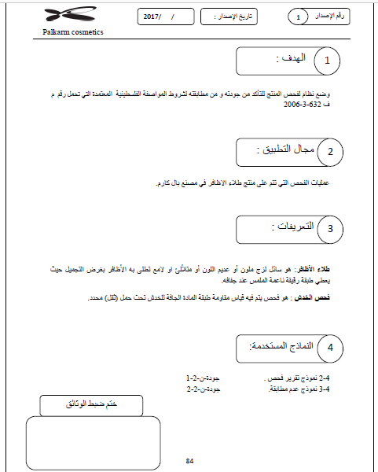
Work procedures

Slide 46
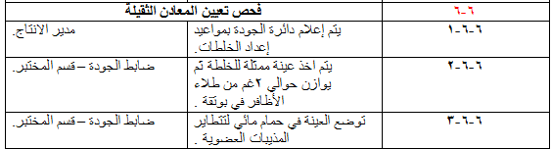
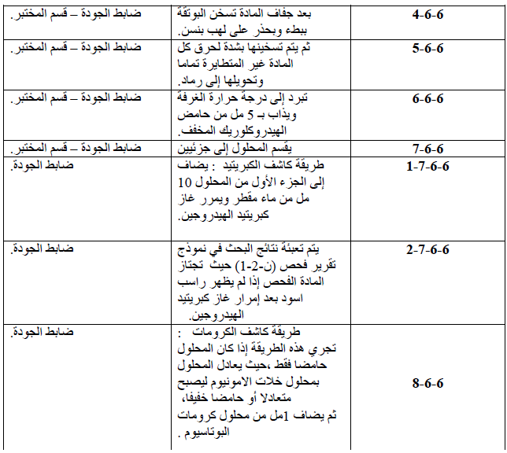

Slide 47
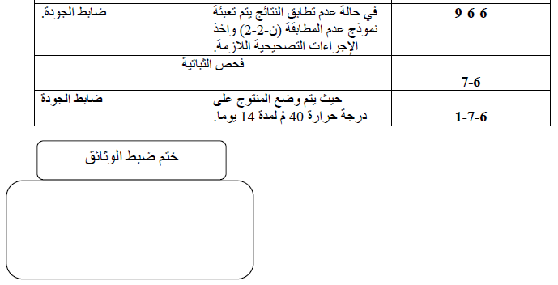

Slide 48
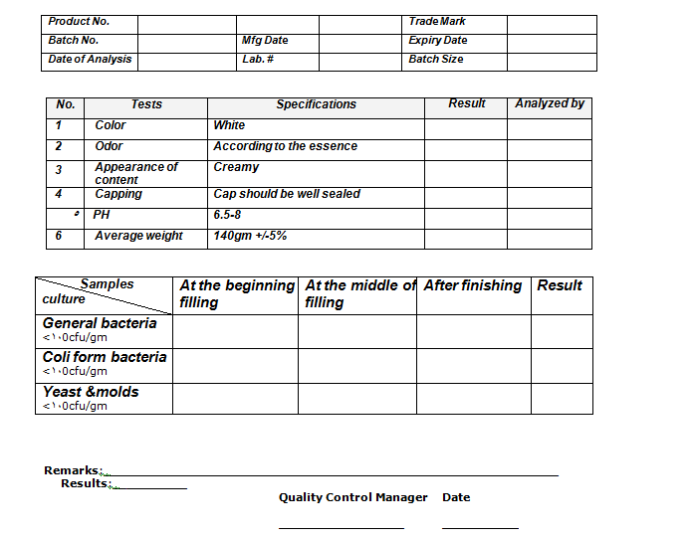
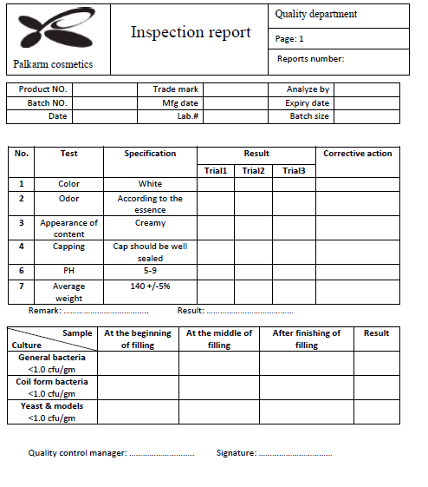
Modified Forms

Slide 49
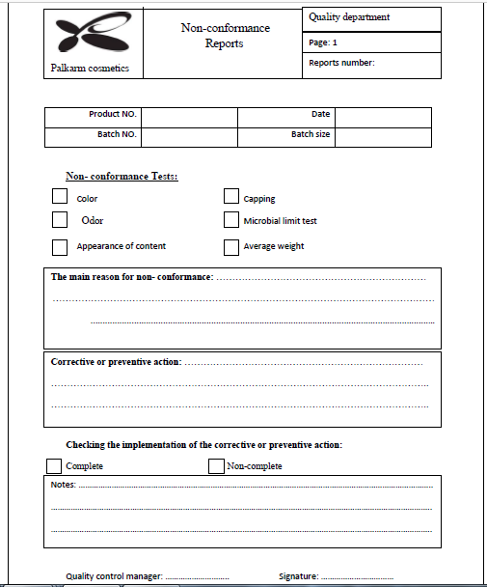

Slide 50
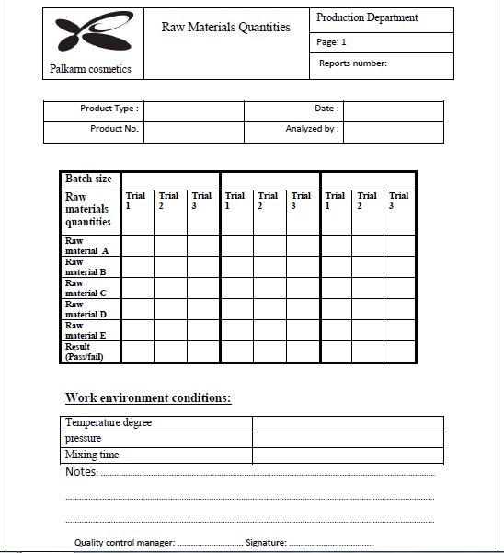

Slide 51
Conclusion
The main issue concerned with the project is the improvement of the data collection methods .Therefore , a work procedures have been established according to the Palestinian standards for each product .
Moreover, an updated version of the forms have been included to improve the methods of collecting and recording data.
In continuation, some of the SPC 7 tools have been applied in addition to an OCAP for the studied products.

Slide 52
Recommendations
Commitment to work procedures, in all its details and steps according to the approved Palestinian standard.
The laboratory should take into consideration the Palestinian standards while performing all the required tests and taking samples.
The utilization of the TQM and SPC concepts and tools for their importance in detecting the main sources of variability

Slide 53
Recommendations
The company should keen to obtain a certified international quality certificates such as ISO.
The development of the testing methods and inspection processes by assigning a team responsible for the continuous research and development on the testing methods and devices.
Adopting a specific form for each product that determines the quantities of raw materials required for each batch

Slide 54
Recommendations
Developing a strong training program for employees whom are responsible for weighing quantities of materials and taking samples.
After the development of data collection methods, the factory's management should focus on the application of the SPC tools, particularly the adoption of the MR control chart that helps in increasing the awareness about the problem.

Slide 55


