Slide 1

An-Najah National University
Faculty of Engineering
Communication Department
Target Tracking using Doppler Radar
Prepared by : Bara’ Sous, Hasan Khalid, Mohammed Alawneh.
Supervisors : Mr. Jamal Kharosheh
Dr. Falah Hasan

Slide 2
Outline
Introduction .
Radar Regulation and Frequency Band .
Doppler Radar Principle .
Distance Measurements .
System Implementation .
Result .
Cost and Constraints .
Conclusion and Future Work.

Slide 3
Introduction
Radar stands for radio detection and ranging. It operates by radiating electromagnetic waves and detecting the echo returned from the targets. The nature of an echo signal provides information about the target range, Speed, direction, and velocity.
The velocity of target is determent from Doppler effect .
The range of the target is found from the time it takes for the transmitted signal travel to the target and back.
The direction or angular position of the target is determined by the arrival angle of the returned signal. A directive antenna with a narrow beamwidth is generally used to find the direction.

Slide 4
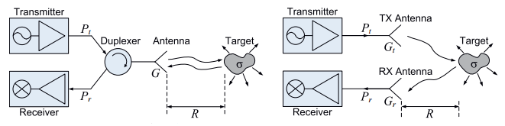
Introduction (Cont.)
Common radar type :
Transceivers Type :
bistatic radar : two separate antennas are used for transmit and receive .
monostatic radar: the same antenna is used for these functions.
(a) Monostatic radar (b) Bistatic Radar
Signal transmit :
Pulse Wave Radar .
Continues Wave Radar .

Slide 5
Radar Regulation
International Telecommunication Union (ITU).
American Institute of Aeronautics and Astronautics(AIAA).
The electronic countermeasures (ECM) .

Slide 6
Radar Frequency Band
Band Designation | Frequency Range | Typical Usage
VHF | 50-330 MHz | Very long-range surveillance
UHF | 300-1,000 MHz | Very long-range surveillance
L | 1-2 GHz. | Long-range surveillance, enroot traffic control
S | 2-4 GHz. | Moderate-range surveillance, terminal traffic control, long-range weather
C | 4-8 GHz. | Long-range tracking, airborne weather
X | 8-12 GHz. | Short-range tracking, missile guidance, mapping, marine radar, airborne intercept
K _{u} | 12-18 GHz. | High resolution mapping, satellite altimetry
K | 18-27 GHz. | Little used (H₂0 absorption)
K _{a} | 27-40 GHz. | Very high resolution mapping, airport surveillance
mm | 40-100+ GHz. | Experimental
Source: AIAA (American Institute of Aeronautics and Astronautics)

Slide 7
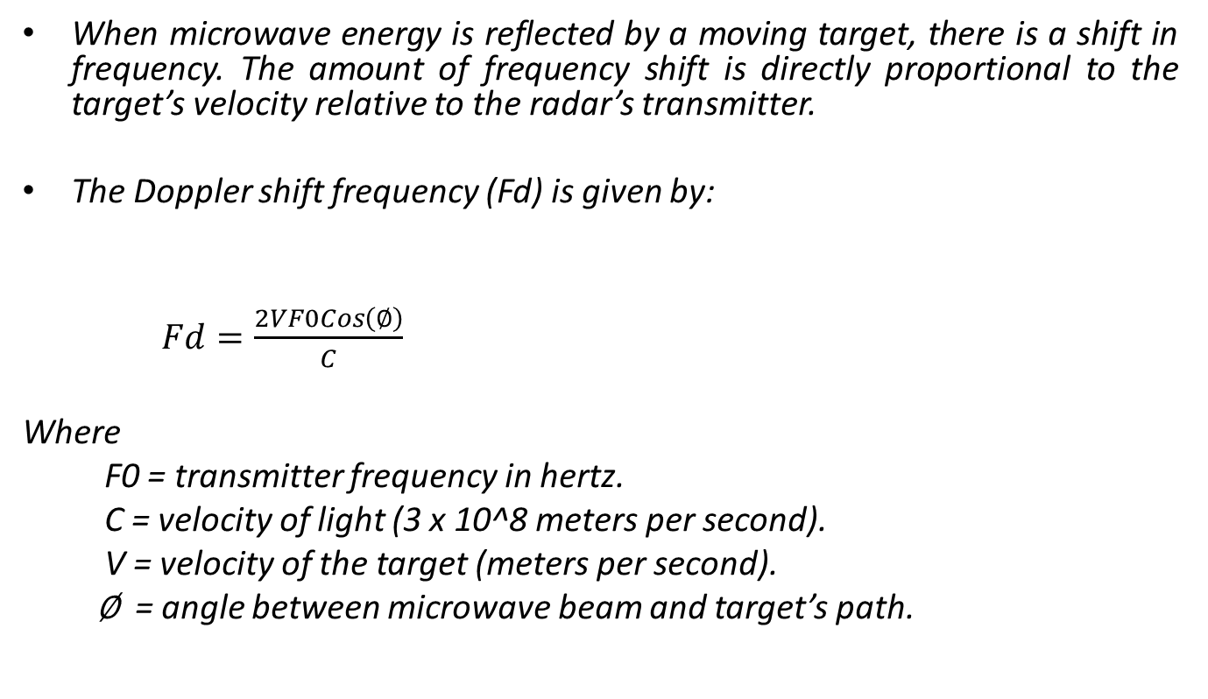
Doppler Radar principle
When microwave energy is reflected by a moving target, there is a shift in frequency. The amount of frequency shift is directly proportional to the target’s velocity relative to the radar’s transmitter.
The Doppler shift frequency (Fd) is given by:
$Fd=\frac{2VF0Cos\left(∅\right)}{C}$
Where
F0 = transmitter frequency in hertz.
C = velocity of light (3 x 10^8 meters per second).
V = velocity of the target (meters per second).
∅ = angle between microwave beam and target’s path.

Slide 8
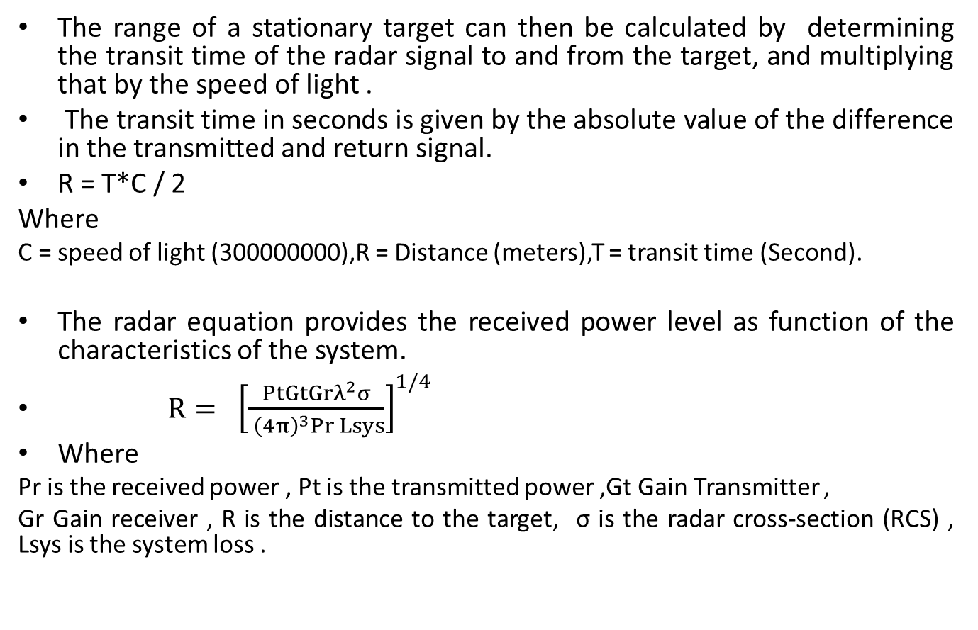
Distance Measurements
The range of a stationary target can then be calculated by determining the transit time of the radar signal to and from the target, and multiplying that by the speed of light .
The transit time in seconds is given by the absolute value of the difference in the transmitted and return signal.
R = T*C / 2
Where
C = speed of light (300000000),R = Distance (meters),T = transit time (Second).
The radar equation provides the received power level as function of the characteristics of the system.
$R{= {\left[\frac{PtGtGrλ^{2}σ}{ {\left(4π\right)}^{3}Pr Lsys}\right]}^{1/4}}$
Where
Pr is the received power , Pt is the transmitted power ,Gt Gain Transmitter ,
Gr Gain receiver , R is the distance to the target, σ is the radar cross-section (RCS) , Lsys is the system loss .

Slide 9
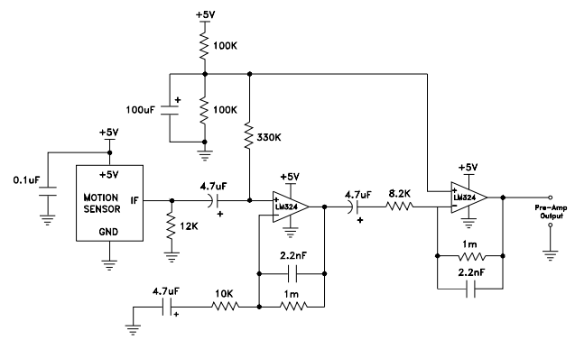
System Implementation

Slide 10
System Implementation (Cont.)
Our hope of this project is implemented a Doppler Radar system (CW And Pulses) system .
To implement this system use many electrical tools such as HB100(Microwave motion sensor), Low Frequency High Gain amplifier(IF-Amp), and microcontroller (Arduino UNO).

Slide 11
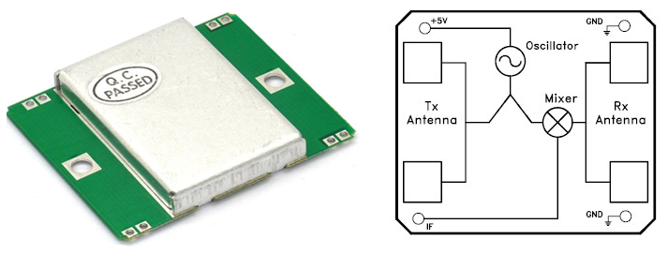
HB100 Module

Slide 12
HB100 Module (Cont.)
Introduction
HB Series of microwave motion sensor module are X-Band Mono-static DRO Doppler transceiver front-end module.
These modules are designed for movement detection, like intruder alarms, occupancy modules and other innovative ideas.
The module consists of Dielectric Resonator Oscillator (DRO), microwave mixer and patch antenna.

Slide 13
HB100 Module (Cont.)
Power Supply
The module operates at +5 Volte DC for Continuous wave (CW) operation ,and pulse wave (PW) with 2KHz and duty cycle 4% .
Transmit Frequency
The module is a low power radio device (LPRD) or intended radiator operate at 10.525 GHz .

Slide 14
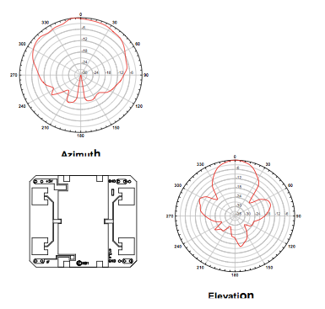
HB100 Module (Cont.)
Radiation Pattern
half power beam width (HPBW) Azimuth = 80 Dig .
half power beam width (HPBW) Elevation = 40 Dig .
Max Power radiate = 20 DBm .

Slide 15
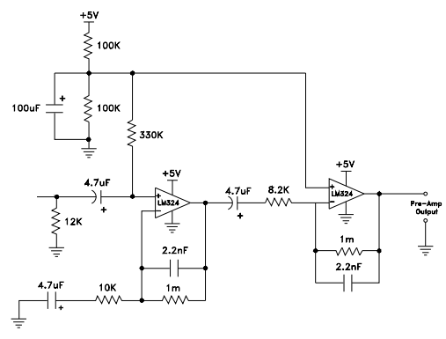
IF Amplifier and Filter

Slide 16
IF Amplifier and Filter (Cont.)
Low Frequency High Gain Amplifier or Intermediate Frequency Amplifier (IF-Amp) is tuned amplifiers used in radar. Their purpose is to provide the majority of the voltage amplification of radar signal.
The characteristic of this Amplifier is:-
Corner frequency around 1000 Hz.
Gain around 40 dB
Low noise and offset.

Slide 17
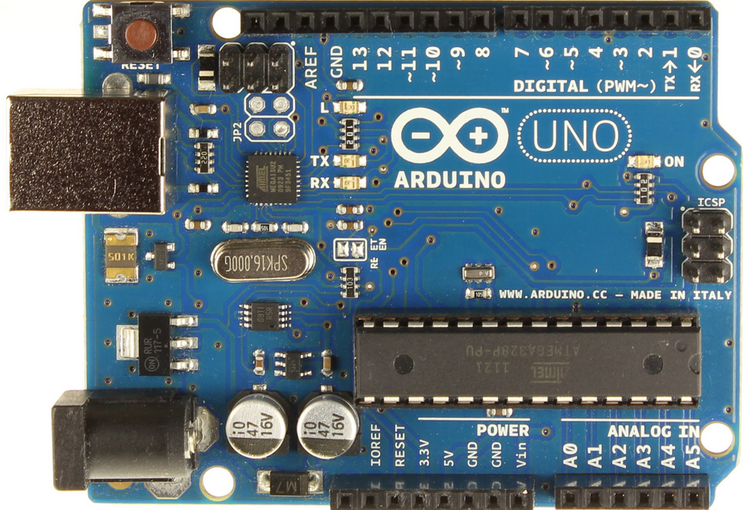
Microcontroller (Arduino UNO)

Slide 18
Microcontroller (Arduino UNO)(Cont.)
The Arduino Uno is a microcontroller board. It has 14 digital input/output pins (of which 6 can be used as PWM outputs), 6 analog inputs, a 16 MHz crystal oscillator, a USB connection, a power jack, an ICSP header, and a reset button. It contains everything needed to support the microcontroller; simply connect it to a computer with a USB cable or power it with a AC-to-DC adapter or battery to get started. The Uno differs from all preceding boards in that it does not use the FTDI USB-to-serial driver chip. Instead, it features the Atmega8U2 programmed as a USB-to-serial converter.

Slide 19
Result
Pulse Doppler radar transmitter produce Radio Frequency (RF) signal , and sent it through the media to sense surrounding environment and estimate target information such as velocity and distance. transmit wave operate at canter frequency at 10.525 GHz, on the other hand system produce thermal noise around 3 dB, but in worst case scenario the system keep the C/N as max as possible around 10 dB .
Receiver estimate the echo signal (wave produce due to reflection and scattering wave from the target) .and estimate the change of frequency (Doppler frequency) to predict the target speed .
Moreover estimate max power receiver and time duration between transmit and receive pulse to predict the target distance .

Slide 20
Result (Cont.)
Deferent Measurements of power ,Doppler Frequency ,Distance and transmit time .
Experiments | Frequency | Speed (Km/H) | Time (MS) | Distance (M)
.1 | 10 | 0.523 | 0.01 | 3
.2 | 23 | 1.200 | 0.02 | 6
.3 | 100 | 5.131 | 0.03 | 9
.4 | 500 | 25.654 | 0.04 | 12
.5 | 1000 | 50.31 | 0.05 | 15
To increase receiver sensitivity make the system operate in high C/N ratio (near 10 dB) .
This result true when angel of arrival small ( AoA <= 15)

Slide 21
Cost
Components | Number | Price
Arduino UNO | 1 | 170 ₪
HB100 radar module | 1 | 30$=107 ₪
LCD | 1 | 50 ₪
Battery | 1 | 10 ₪
Total price | ------------------------------ | 337 ₪

Slide 22
Constraints
System Design and Simulink :
Design the project and determine the main components ,study characteristics of each device like Filters and Amplifiers .
System Implementation :
Collects the main components such as HB100,Arduino UNO .
Design IF Filter and Amplifier .
Build the basic circuit for the project .
Write cod to optimize the error and increase accuracy .

Slide 23
Conclusion
This project use Doppler radar system to determine the velocity and distance of target, the velocity dependent on the Doppler effect (frequency change due to target motion ),and distance dependent on the power receive .
The main component of the system is a filter (determine the system selectivity), and amplifiers (determine the system sensitivity).
This system operate in X-band frequency (10.525 GHz) because this band is high munity for noise and losses.

Slide 24
Future Work
The second steps of this project try to develop the radar system . And determine the target information (Velocity, Distance, Angel of Arrival, and Direction of motion).
The final hopes try to connect radar system with WEP to determine location of target, and determine the environment Probabilities.

Slide 25
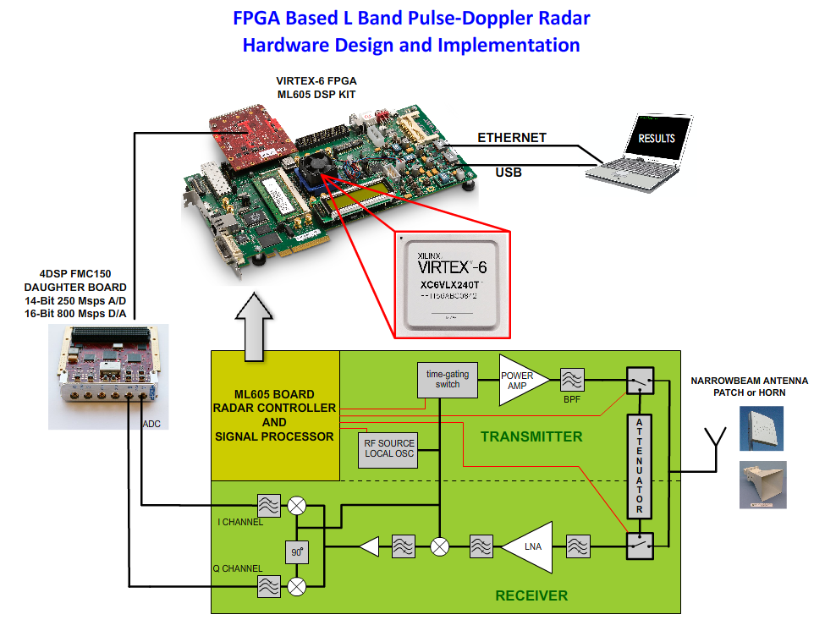
Future Work(Cont.)

Slide 26
Thank You
Any Question

