Slide 1

An-Najah National University
Engineering college
Building Engineering Department
Redesign A Scientific center As A Green Building
Prepared by :
Akram Kojok
Loay Mosleh
Nidal Bawwab
Supervisor :
Dr. Sameh Mona

Slide 2
Outline
Project information
Architectural Design
Introduction to green building
Applications of Palestinian green building guideline
Acoustics design
Structural Design
Mechanical Design
Electrical Design
Extra cost
4

Slide 3
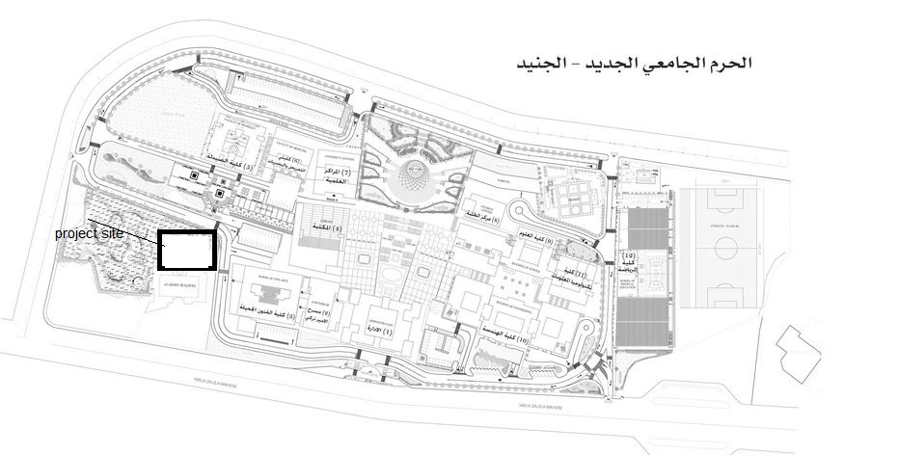
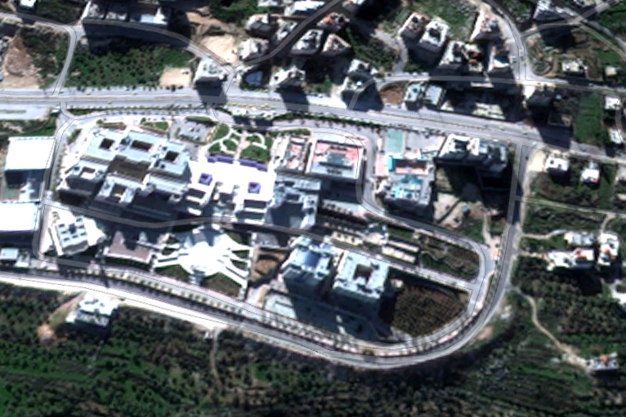
Project information
Our project located in Nablus city at An-Najah university-new campus
Number of floor=7floors
Area of project=6088 m²

Slide 4
Architectural Design
The building is located in a convenient location. And directed towards the north-south. Overlooking the main street inside the campus
The building consists of seven floors, each floor separately from each other in terms of the interior administrations , and each floor has a specific function in the service, either through meetings or doing scientific tests or research work.
The building is available on a car garage basement can be reached through the main street through the belted and extends to the bottom of the building.
2

Slide 5
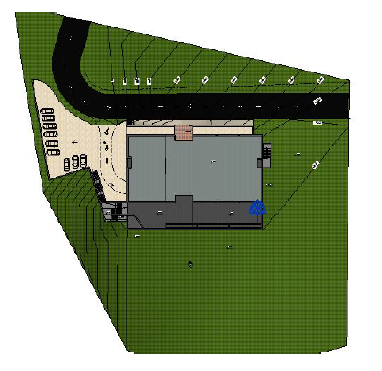
Site plan
N
N

Slide 6
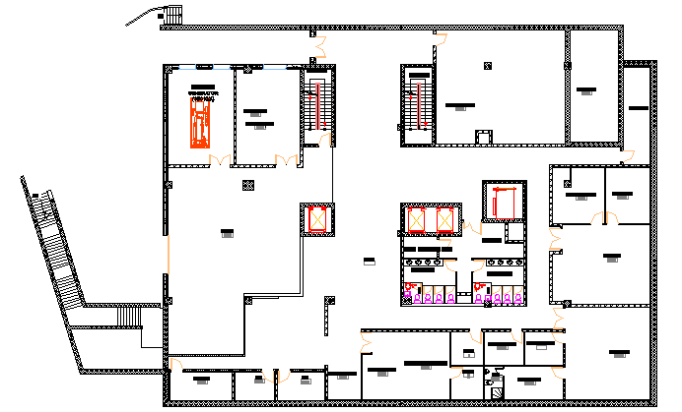
Basement

Slide 7
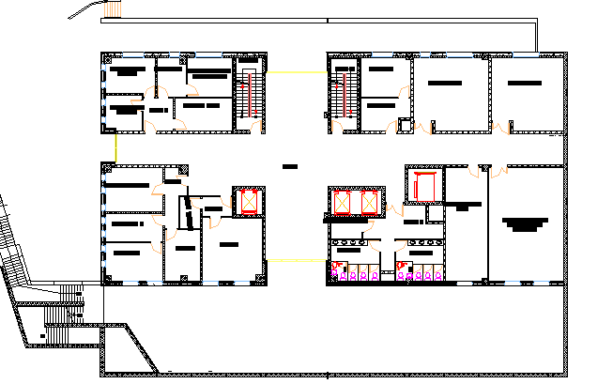
Ground floor

Slide 8
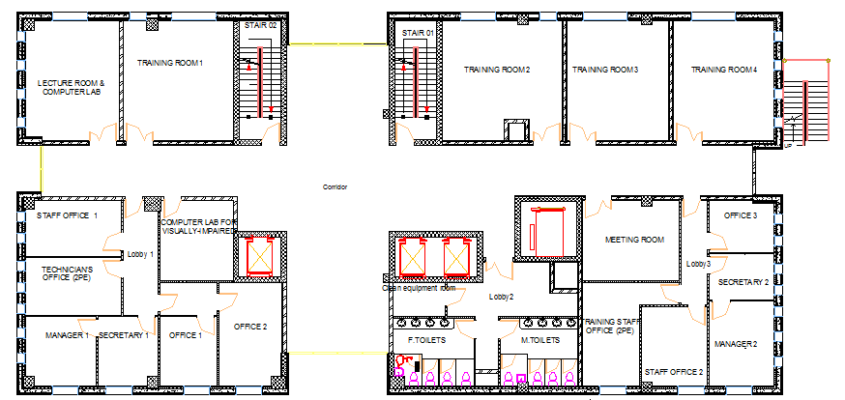
First floor

Slide 9
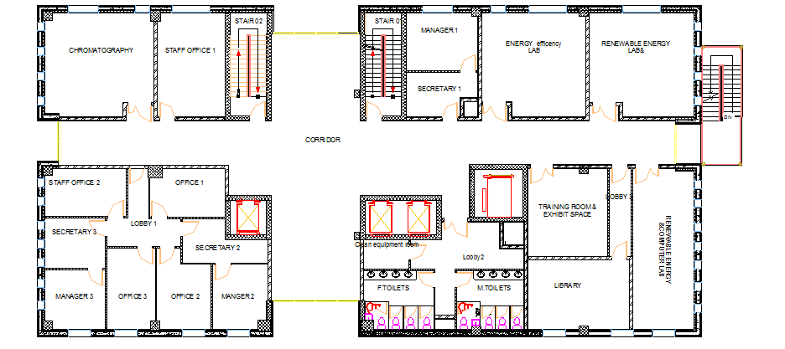
Second floor

Slide 10
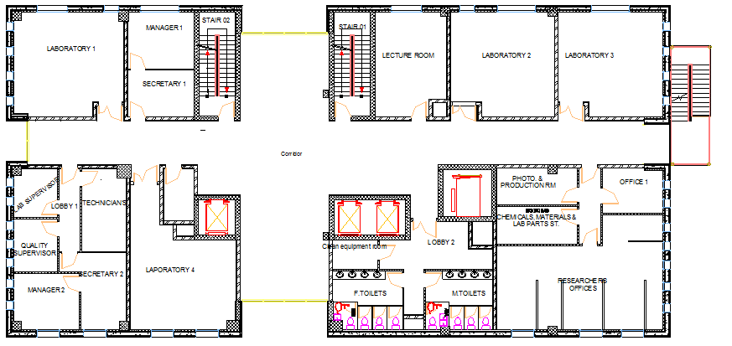
Third floor

Slide 11
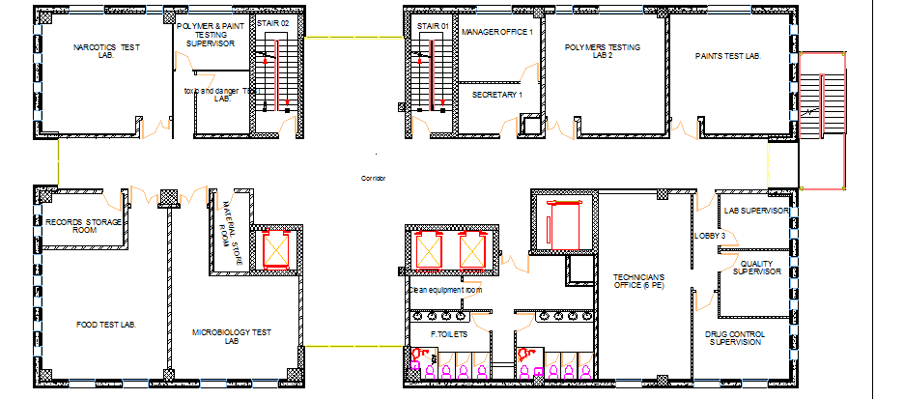
Forth floor

Slide 12
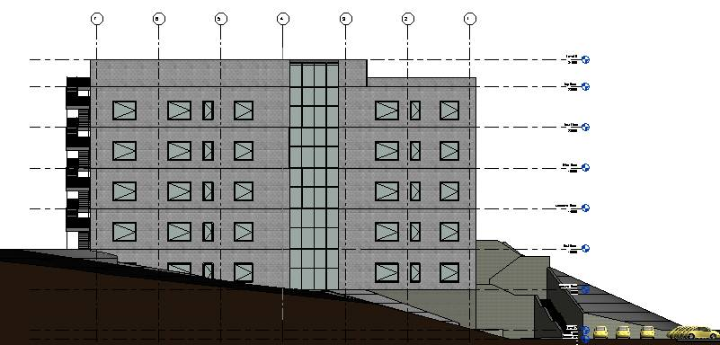
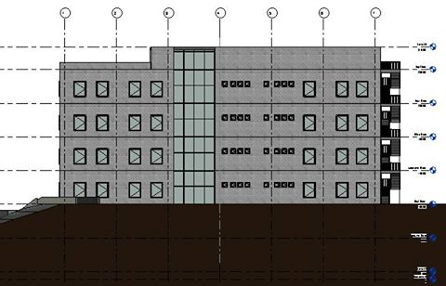
Elevations
North elevation
South elevation

Slide 13
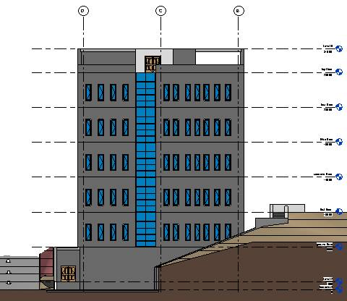
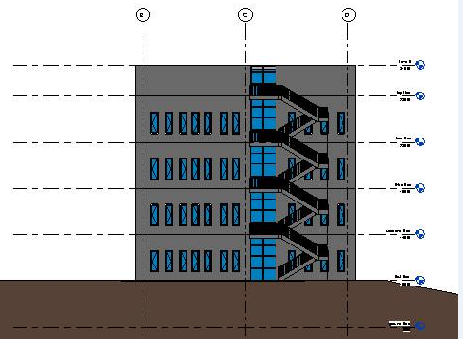
Elevations
West elevation
East elevation

Slide 14
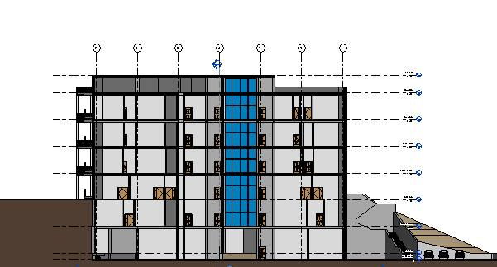
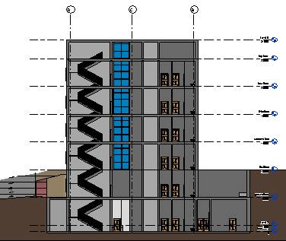
Sections
Section 1
Section 2

Slide 15
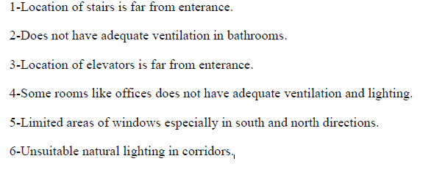

Architecture problems in project

Slide 16
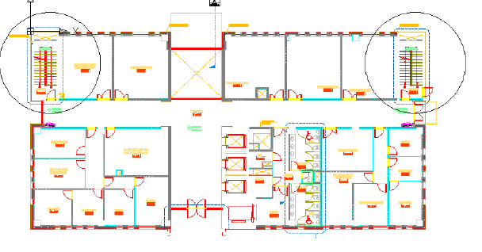
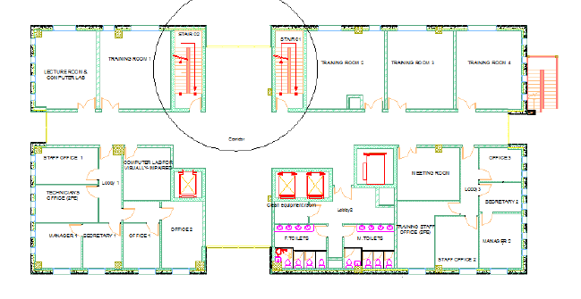
Solution for problems in project
We moved the elevators and stairs and bathrooms, the following figure shows the adjustment.

Slide 17
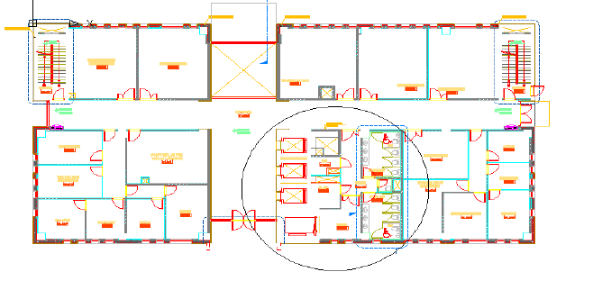
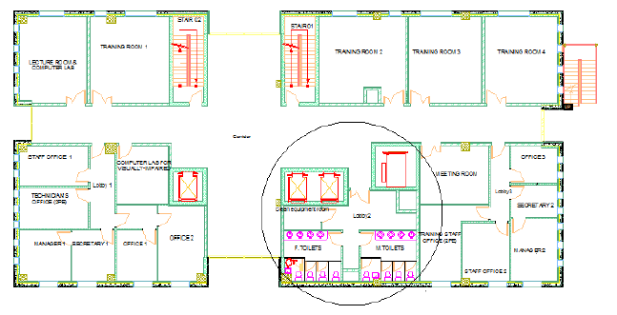
Architecture problems in project

Slide 18
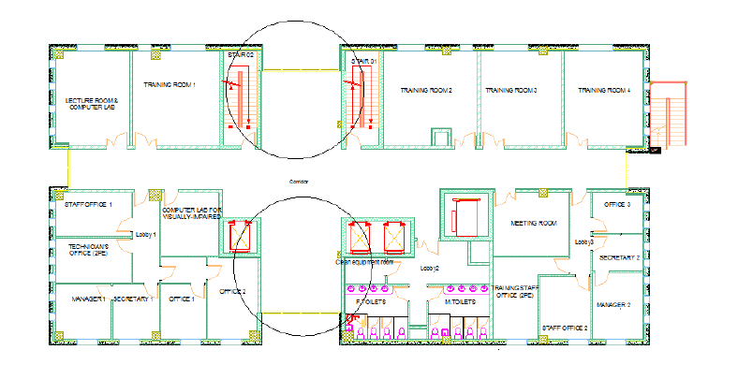
Solution for problems in project
We made voids for ventilation and natural lighting

Slide 19
Introduction to green building
Green building:
the buildings that achieve a balance between the biosphere and the occupants of the building.
The importance of green building:
Energy conservation and renewable energy.
Dependence on natural ventilation and natural lighting.
Reduce environmental pollution
Green building rating systems:
1)LEED
2) Estidama
3)Palestinian green building guideline

Slide 20
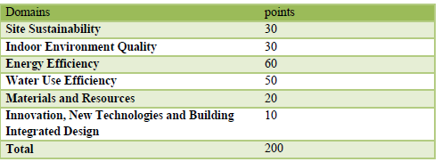
Applications for Palestinian green building guideline
In this chapter we do adjustments and designs procedures in order to achieve points of Palestinian green building guideline.
Requirements for green building that we want to achieve:
2

Slide 21
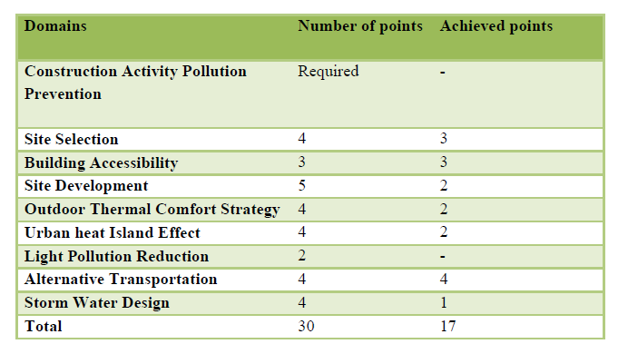
Site Sustainability
2

Slide 22
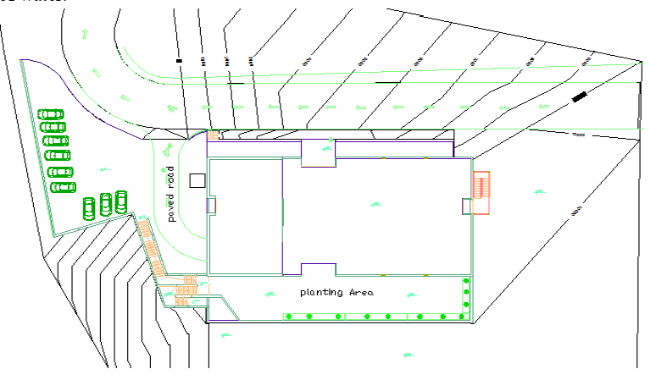
Site Sustainability
We want to explain some point :
Site Development
We achieve this point by:
Planting trees and plants and the use of species that do not consume a large amount of water.
2

Slide 23
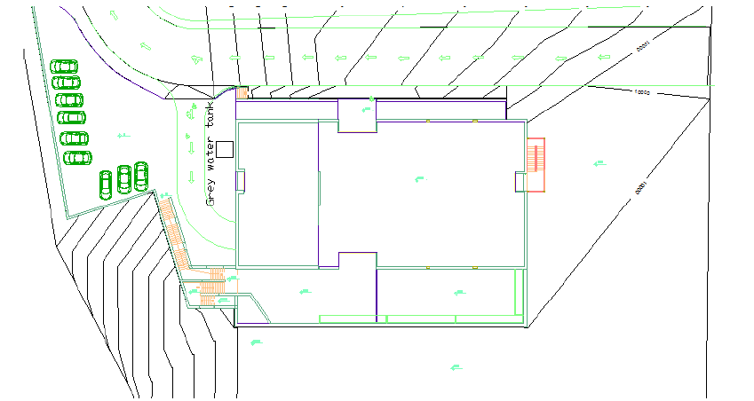
Site Sustainability
Site Development
We Reduce the dependence on potable water to irrigate plants at the site and by use a tank for grey water and use it for irrigate plants
2

Slide 24
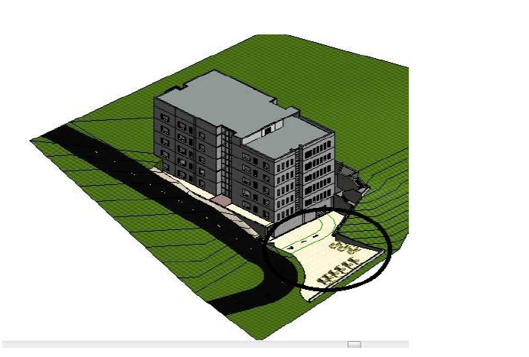
Site Sustainability
Outdoor Thermal Comfort Strategy
We achieve this point by:
Use of high reflectance materials, use stone in external layers of building, and use a paved road .
2

Slide 25
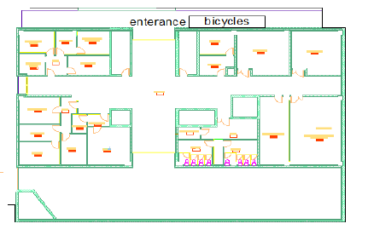
Site Sustainability
Alternative Transportation
We achieve this point by:
Provide a place and mobilization for bicycles use at a distance not more than 200 meters from the entrance of the project .
2

Slide 26
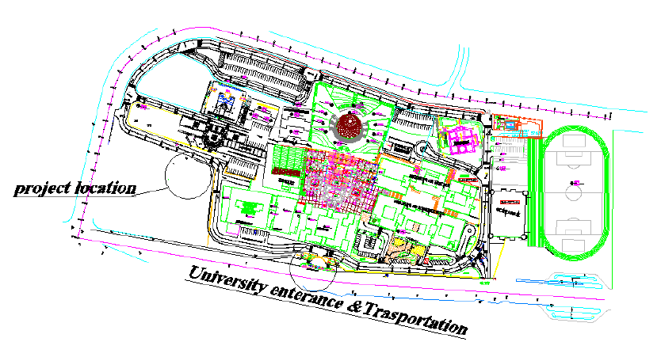
Site Sustainability
Alternative Transportation
The distance between the project`s main enterance and the nearest public transport station not more than 400 m,(around 300m in our project).
2

Slide 27
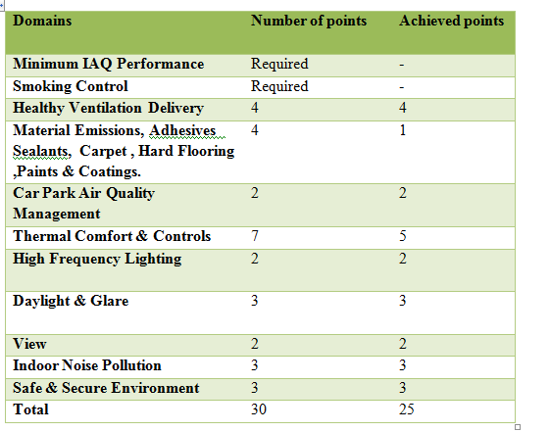
Indoor Environment Quality
2

Slide 28
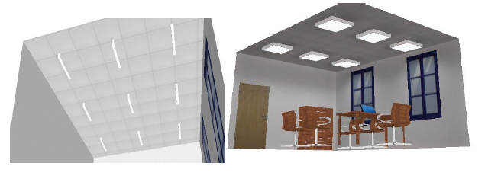
Indoor Environment Quality
We want to explain some point :
High Frequency lighting
We achieve this point by:
No use of incandescent lamp ,only use florescent lamp and Suspended Ceiling lamps.
2

Slide 29
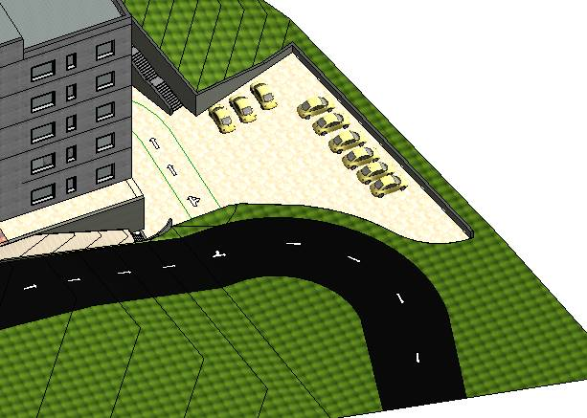
Indoor Environment Quality
Car Park Air Quality Management
We achieve this point by:
External parking with good ventilation.
2

Slide 30
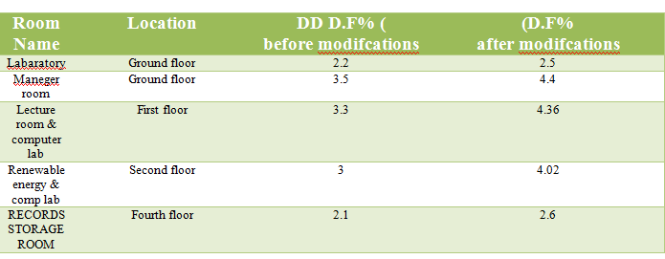
Indoor Environment Quality
Daylight and Glare
We achieve this point by:
We achieve at least 250 lux 75% for used spaces.
2

Slide 31
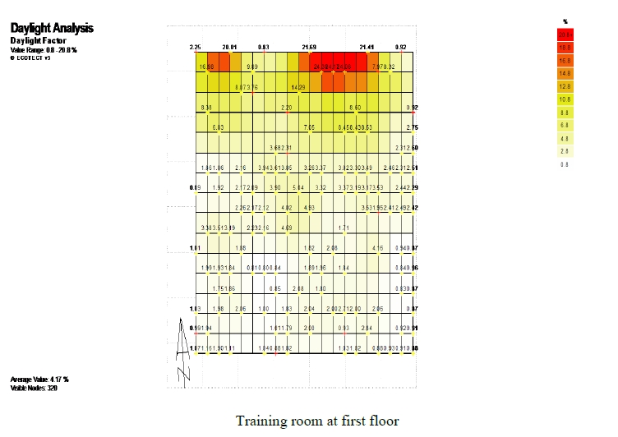
Indoor Environment Quality
Daylight and Glare
2

Slide 32
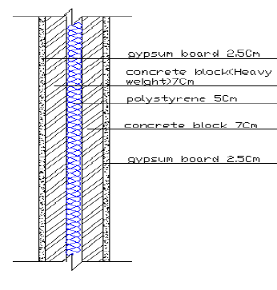
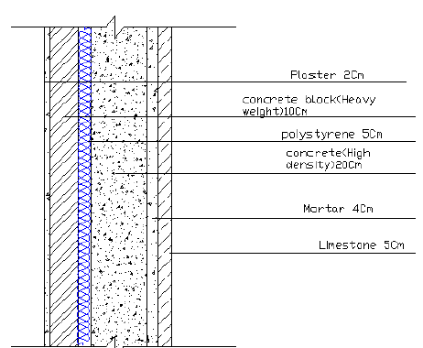
Indoor Environment Quality
Indoor Noise Pollution
The values of Sound transmission coefficient( STC)in the external and internal walls and floor>50db
2
Internal wall
Internal wall

Slide 33
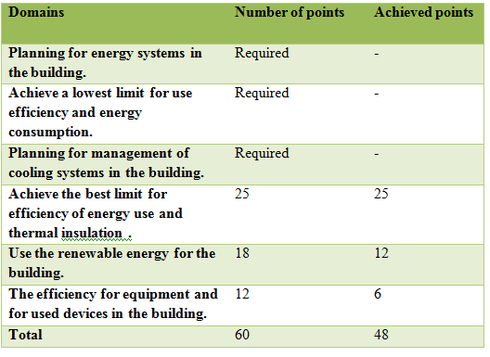
Energy Use Efficiency
2

Slide 34
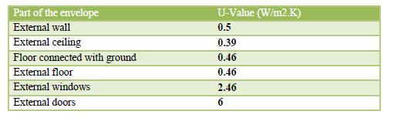
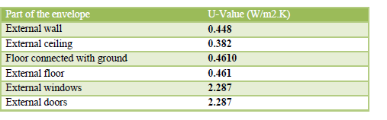
Energy Use Efficiency
We want to explain some point :
Achieve the best limit for efficiency of energy use and thermal insulation
We achieve this point by:
Thermal insulation.
2
Upper values of thermal conductivity
Thermal conductivity in our building

Slide 35
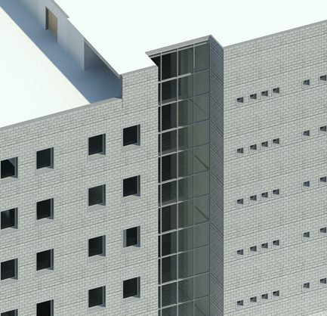
Energy Use Efficiency
We want to explain some point :
Use the renewable energy for the building
We achieve this point by:
Use solar chimney in a south elevation
2

Slide 36
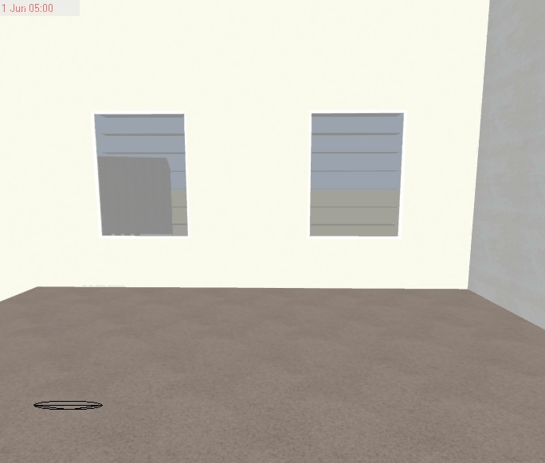
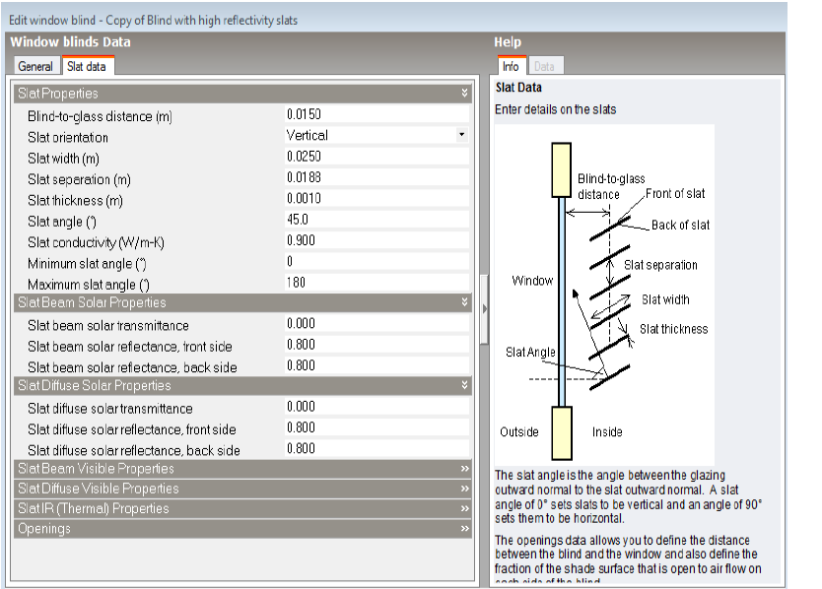
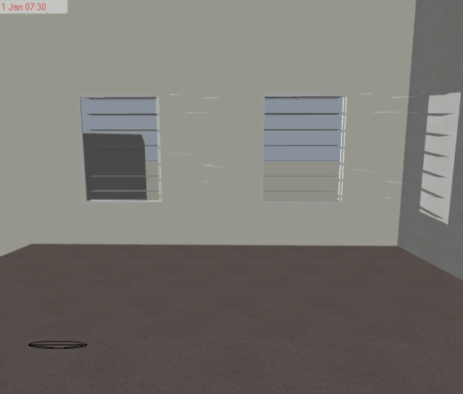
Energy Use Efficiency
We want to explain some point :
Use the renewable energy for the building
Shading method for east ,west and south elevation
2

Slide 37
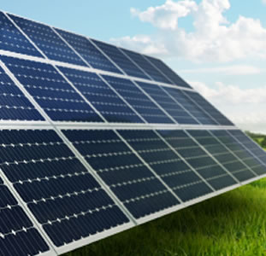
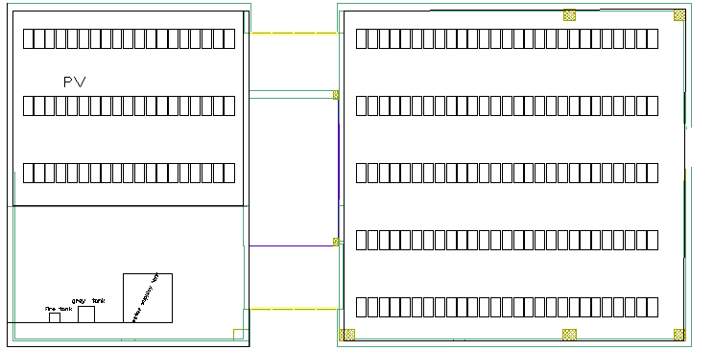
Energy Use Efficiency
We want to explain some point :
Use the renewable energy for the building
Power generation in site:
Photovoltaic cells dimensions (1.2*0.6).
We use 192 Photovoltaic cells.
Total power= 45 kw hr/working day
2

Slide 38
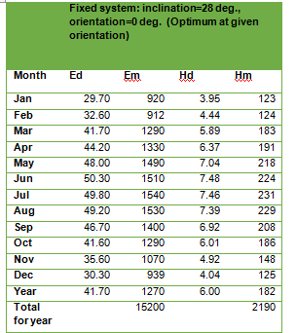
Energy Use Efficiency
We want to explain some point :
Use the renewable energy for the building
Power generation in site:
15200*0.8=12160 NIS
36000*3.7=133200 NIS
133200 /12160=11 we will rover its price
after elevetion years.
2

Slide 39
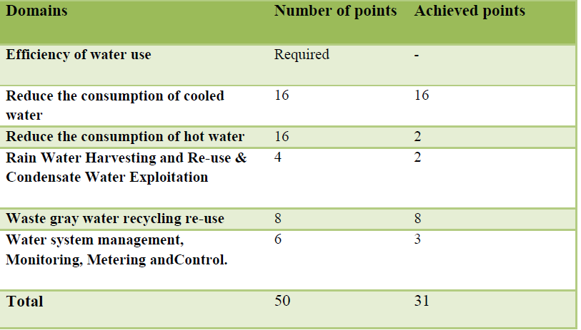
Water Use Efficiency
2

Slide 40
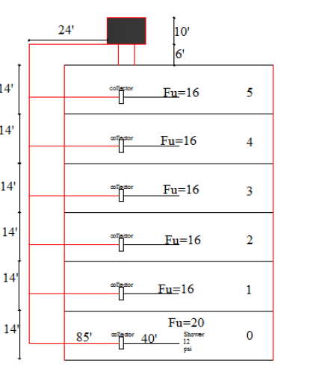
Water Use Efficiency
We want to explain some point :
Efficiency of water use
Water supply systems:
Supply water for drink water and lavatory and shower.
2

Slide 41
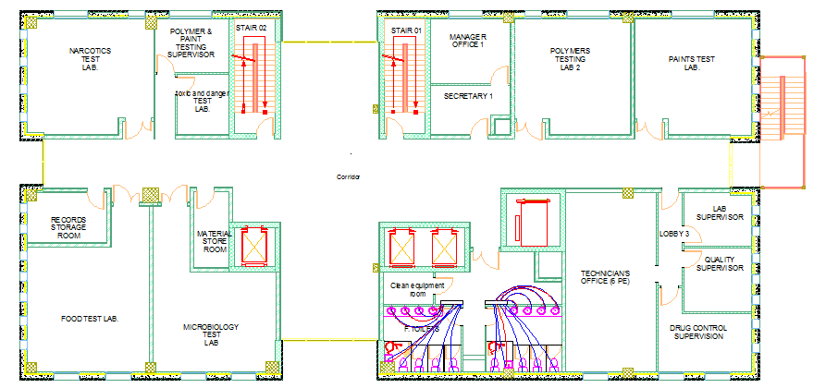
Water Use Efficiency
Efficiency of water use
Water supply systems:
*Galvanized steel for vertical line ,and pvc for horizontal and branch.
2
2 '' for Vertical feeders
1.5'' for Horizontal feeders
3/4'' for Branch

Slide 42
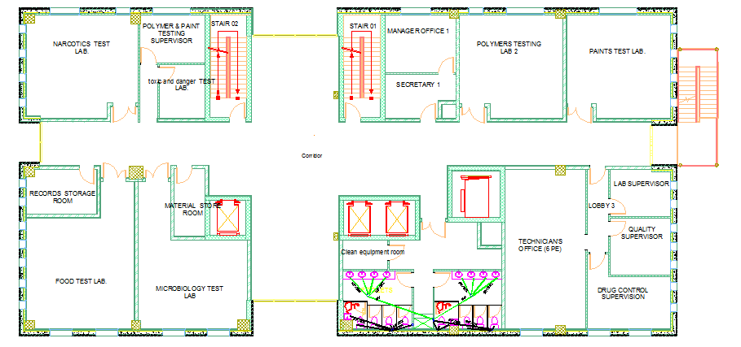
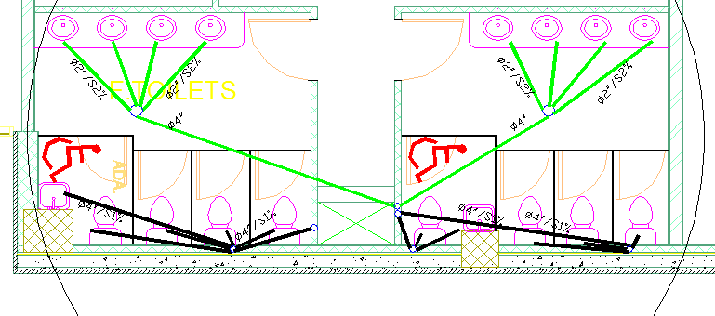
Water Use Efficiency
Waste gray water recycling re-use
Drainge system:
2

Slide 43

Water Use Efficiency
Waste gray water recycling re-use
Drainge system:
*Grey water strategies:
2

Slide 44

Water Use Efficiency
Waste gray water recycling re-use
Drainge system:
*Black water strategies:
2

Slide 45

Material and Resources
2

Slide 46


Material and Resources
This domain is follwod up in the construction phase by using
Construction waste manegment plan.
Regional &Recycled Materials
All materials used in our project from the local industry
(stone ,concrete,blocks,paints……etc).
2

Slide 47

Innovation, New Technologies and Building Integrated Design
2
Integrated Design Approach
We used solar chimney in south elevation ,we increased area of windows).
The use of modern techniques
We used simulation softwares for environmental and structural design.

Slide 48


Conclusion:
2

Slide 49

Acoustics design
Lecture room &computer lab(First floor):
2
RT60=0.71s lies on the suitable interval which ranges from 0.6-1.2 s..OK

Slide 50



Analysis By Design Builder Program

Slide 51



Design Builder Analysis

Slide 52


Design Builder Analysis
Wind Analysis

Slide 53
Natural Ventilation

Slide 54

Structural Design
Design Codes
The American Concrete Institute code ACI 318-11 .
The seismic design according to UBC-97
2
Design will include the following elements :
slab ( tow way solid slab).
beams .
columns .
shear walls.
footings.
The structural design was made by E-TAB program

Slide 55
Structural Design
Compressive strength of concrete (fc)
2
Beams
Shear walls
Columns
Slabs
Footing
240 kg/cm²
Yielding strength of steel (fy)
Steel for flexure , fy = 4200kg/cm²
Bearing capacity of soil q=3 kg/cm2
Density of concrete block =1200kg/cm3

Slide 56
Structural Design
2
Slab dimensions
Slab thickness= 25 cm
Beam dimension
External Beams → (60*80) cm
Internal Beams→ (50*70) cm
Internal beam→ (60*70) cm
Internal beam→ (30*50) cm
Tie beam→ (40*60) cm
Column dimension
Column dimensions were taken from plans
Column type 1→ (60*60) cm
Column type 2→ (70*80) cm

Slide 57


Structural Design
2
Live Load =(2.5-5) KN/m2
  Super imposed Dead load = 4 KN/m2

Slide 58

Structural Design
Structural Design
Columns center
2
2

Slide 59


Structural Design
Structural Design
Beams Layout
2
2

Slide 60


Structural Design
Seismic design
2
Soil Profile : Sc
Importance factor (I) = 1.25
R = 5.5
Cv = 0.32
Ca = 0.24

Slide 61

Structural Design
Seismic design
Structural Design
Seismic design
2
2
0.594 | T from Etabs
0.597 | T from hand calculation
0.5% | Percent (%)
Base shear (V) = 11544.2 kN.

Slide 62


Checks
check deflection:
∆all=l/21=10.2/21=48.5mm
∆E-TAB =26mm
Equilibrium Check:
Live Load
Hand results (KN)= 19005
E-TAB results (KN) = 19104.46
Dead Load
Building Weight
= 94624.65 KN
From E-TAB
Error = 0.0052 %
Error = 1.2 %

Slide 63



Checks
Check For Base Shear :
From E-TAB
Check For Time Period (T)
T From Hand Calculation
(T) From E-TAB
Error = 0.5 %
Base shear (V) From Hand calculation = 11544.2 kN.
Error = 1.36 %

Slide 64




Structural Design
Structural Design
Beams Details
2
2

Slide 65


Structural Design
Structural Design
Coulmn Details
2
2

Slide 66

Structural Design
Structural Design
Footing
2
2

Slide 67


Structural Design
Structural Design
Footing
2
2

Slide 68

Mechanical Design
Hvac system
2

Slide 69



Mechanical Design
Fire system
Fire-hose-system in corridors
2

Slide 70


Mechanical Design
Fire system
Sprinkler system
2

Slide 71

Mechanical Design
Fire system
Dry powder Portable Fire Extinguisher(in labs)
2

Slide 72

Mechanical Design
Emergency exit
2

Slide 73

Electrical Design
Artificial lighting design
2

Slide 74

Electrical Design
Dialux:Training room 1 (First floor)
2

Slide 75



Electrical Design
Dialux:Training room 1 (First floor)
2

Slide 76

Electrical Design
Lighting and switches distribution
2

Slide 77

Electrical Design
Sockets distribution
2

Slide 78

Electrical Design
Circuit breaker for 2nd floor
2

Slide 79

Extra cost
Extra cost comes from:
For the green building the cost will increase 5% according to ordinary building,and the
Cost becomes 4804542.75 NIS,but we will return the additional cost by the time.

Slide 80
2
THANK YOU
FOR ATTENTION

