Slide 1

Moisture to water converter
Atmospheric Water Generator
“AWG”
Submitted To:
Eng. Salameh Abd Alfattah
Prepared By:
Mohammad Shqaiqat
Ahmad Abu Alia
Ahmad Kmail
Majdi Awad

Slide 2
Out Line :
Abstract
Introduction
Heat Pump
Heat Pump Components
Conclusion

Slide 3
Abstract
The water shortages is expected in this region requires us to search for new sources of fresh water either be from atmospheric air.
our project is based on the design of a device that is to absorb moisture from the atmosphere to extract pure water drinkable; this device also helps to reduce the percentage of moisture in the air which constitutes an obstacle to most people.

Slide 4

introduction
An atmospheric water generator (AWG) is a device that extracts water from humid ambient air.
AWG’s cycle similar to refrigeration cycle
It depends on the percentage
of the humidity in the air.

Slide 5
AGW components
Evaporator
Compressor
Condenser
Capillary Tubes
Thermostat
Refrigerant

Slide 6
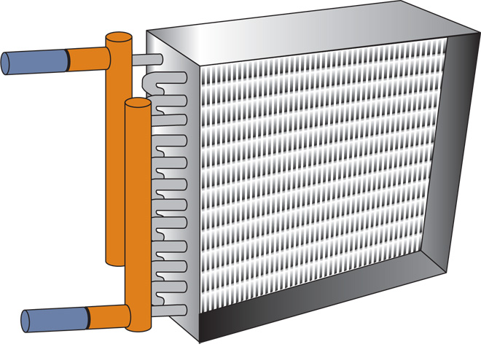
Evaporator
When the liquid refrigerant reaches the evaporator its pressure has been reduced, dissipating its heat content and making it much cooler than the fan air flowing around it.

Slide 7
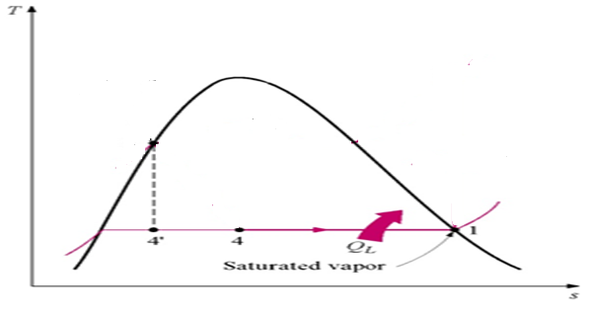
Evaporator
The cycle starts with a cool, low-pressure mixture of liquid and vapour refrigerant entering the evaporator (4) where it absorbs heat from the relatively warm air that is being cooled. This transfer of heat boils the liquid refrigerant in the evaporator, and this superheated refrigerant vapour is drawn to the compressor (1).

Slide 8
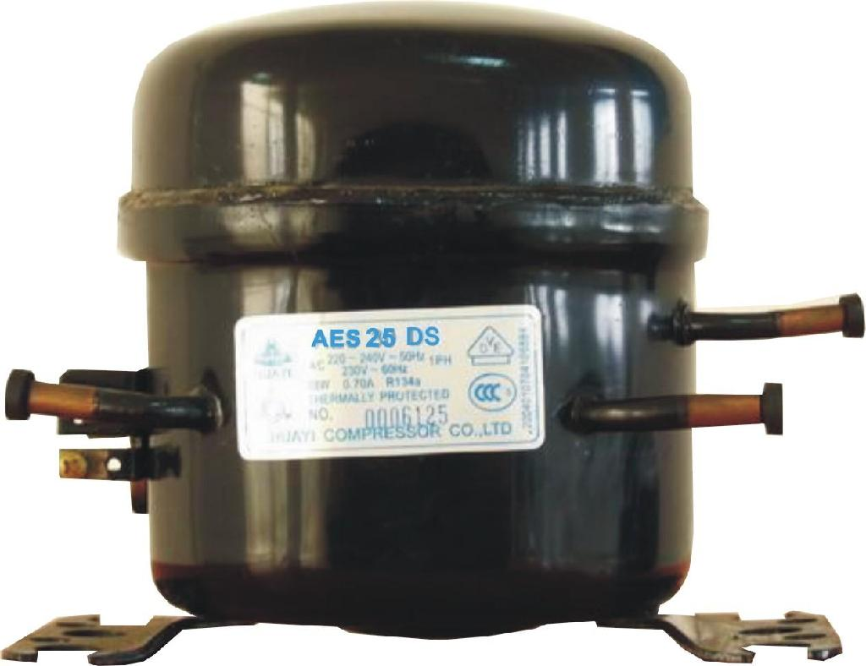
Compressor
when gas or fluid passes through a compressor it gets highly compressed, the temperature also becomes very high.

Slide 9
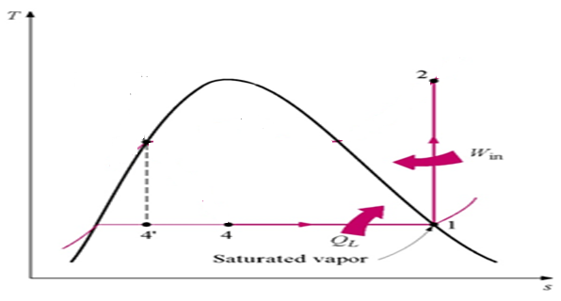
Compressor
The compressor draws in the superheated refrigerant vapour (1) and compresses it to a pressure and temperature (2) high enough that it can reject heat to another fluid. This hot, high-pressure refrigerant vapour then travels to the condenser

Slide 10
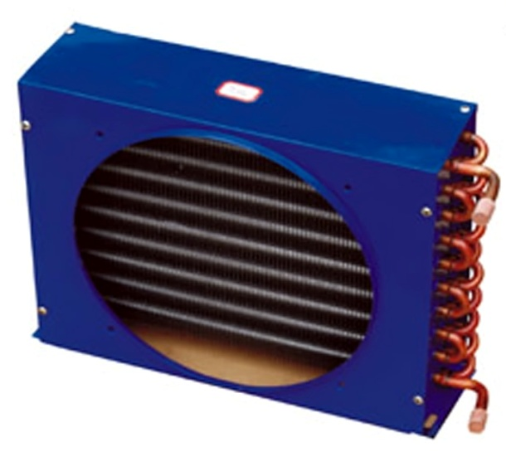
Condenser
When the gas refrigerant reaches the condenser its pressure has been reduced, dissipating its heat content and making it much cooler than the fan air flowing around

Slide 11
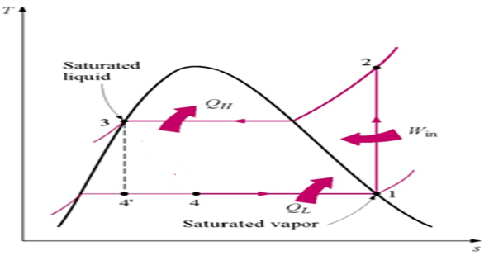
Condenser
Within the condenser, heat is transferred from the hot refrigerant vapour to relatively cool ambient air. This reduction in the heat content of the refrigerant, to become saturated liquid (2_3)

Slide 12
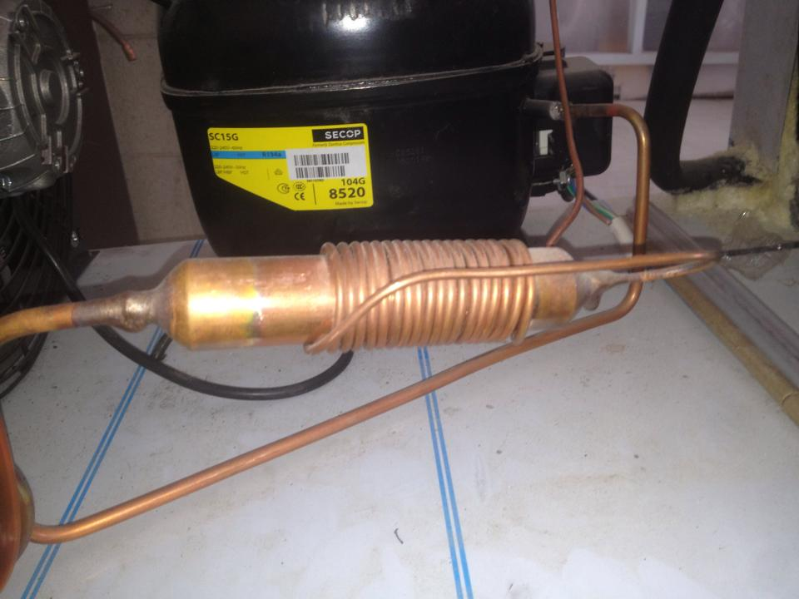
Capillary Tubes
A capillary tube is throttling devices used in refrigeration and air conditioning systems. It is a copper tube that has a small internal diameter. A capillary tube functions by dropping pressure due to its small internal diameter.

Slide 13
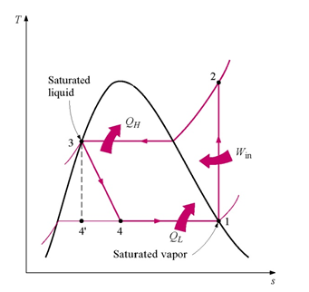
Capillary Tubes
Finally, the high-pressure liquid refrigerant (3) flows through the Capillary Tubes, causing a large pressure drop that reduces the pressure of the refrigerant to that of the evaporator. This pressure reduction causes a small portion of the liquid to boil off, or flash, cooling the remaining refrigerant to the desired evaporator temperature.(3_4)

Slide 14
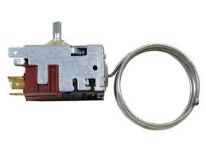
Thermostat
A device that functions to establish and maintain a desired temperature automatically or signals a change in temperature for manual adjustment.

Slide 15
Refrigerant
It is a fluid that use in the cycle to absorb the heat from the surrounding.
In this project the refrigerant R-134 is used because many reasons
Increases cooling capacity by improving lubricate.
Creates better heat exchange.
Provides up to 18% colder air

Slide 16
T-s diagram
T-s diagram is the type of diagram most frequently used to analyze energy transfer system cycles

Slide 17
Psychometric chart
A psychometric chart is a graph of the thermodynamic parameters of moist air at a constant pressure, often equated to an elevation relative to sea level
Parameters as:
Dry-bulb temperature (DBT)
Wet-bulb temperature (WBT)
Specific enthalpy
Humid heat

Slide 18
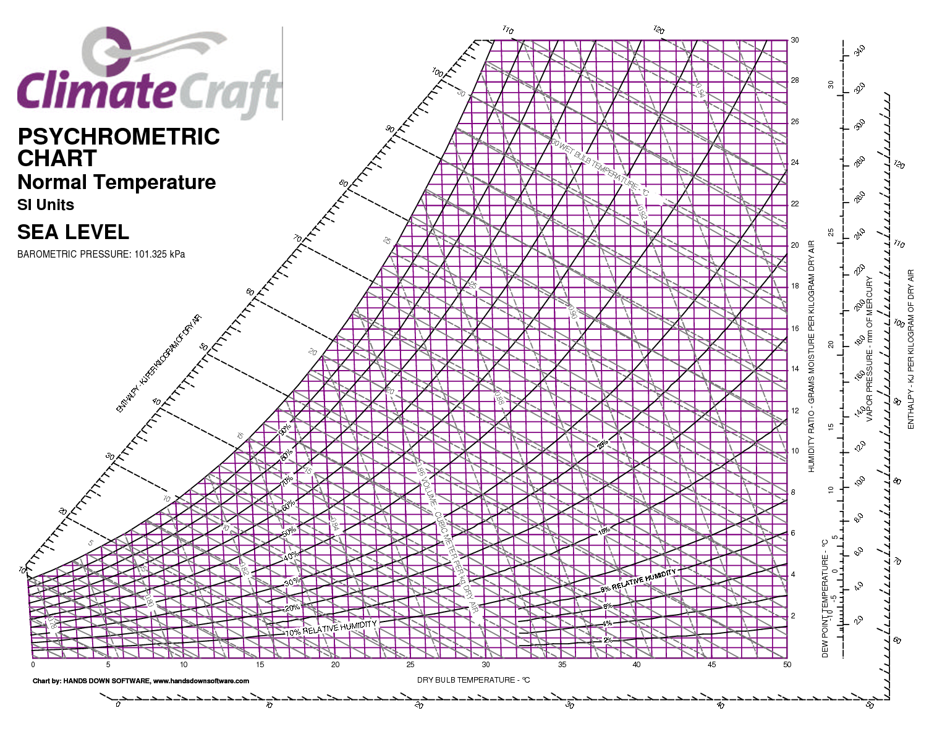
Psychometric chart

Slide 19
Calculations
The results of the project are based on one location, this location at Nablus where the average temperature is around (17C0) and the relative humidity (61%) experiments to find the effect of the temperature and the humidity on the amount of the water extracted
Two main theories ware be used in this calculation
Fluid theories
Refrigeration cycle theories

Slide 20
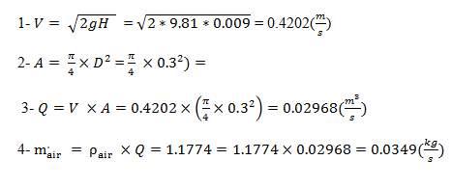
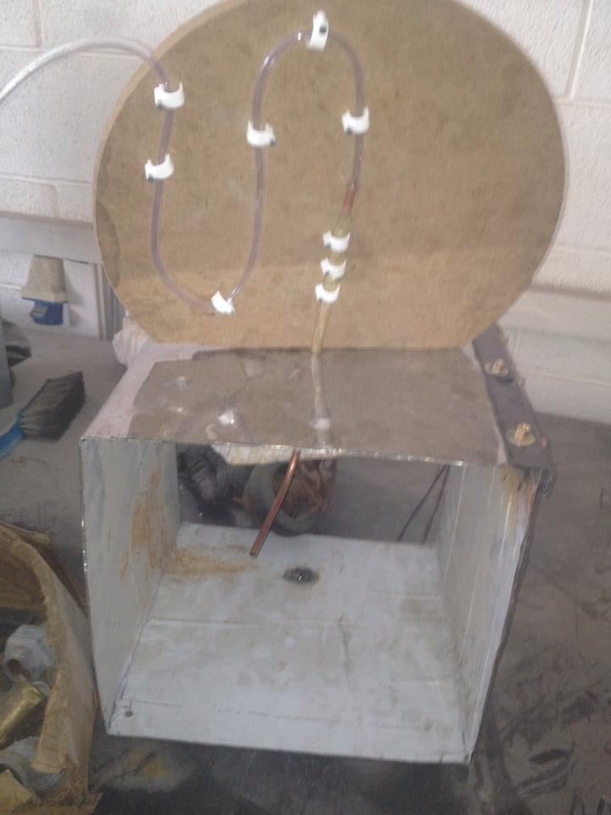
First step
From the (Pitot tube) the pressure head = 9mm

Slide 21
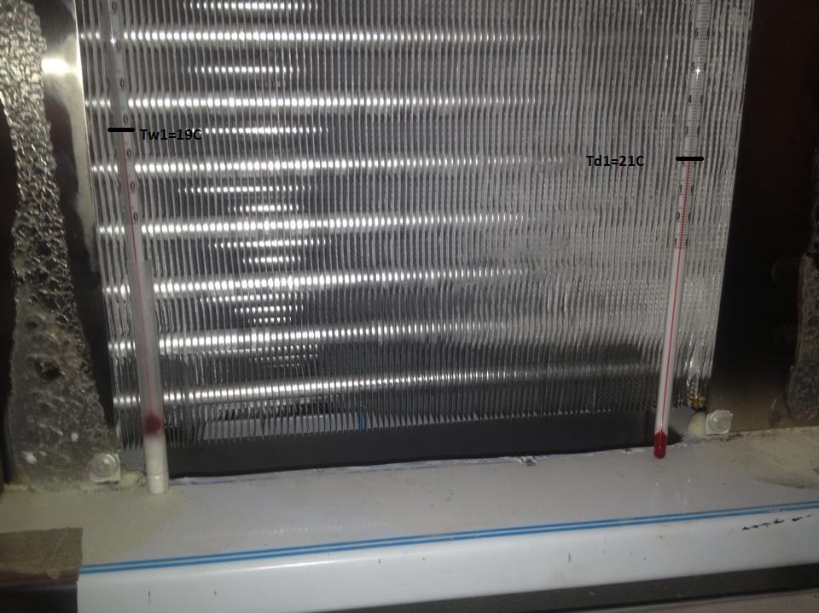
Second step
Find water mass flow rate
The dry and wet blub temperature was founded by using the thermocouples
T_{d 1} = 21 C⁰
T_{w1} = 19 C⁰
T_{d 4} = 23 C⁰
T_{w4} = 21 C⁰

Slide 22
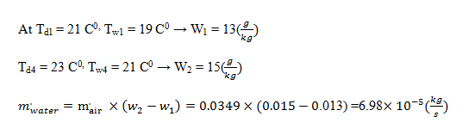
Second step
From last results by using the psychometric chart the humidity ratios can be found

Slide 23
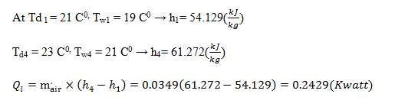
Evaporator calculation
From the psychometric chart
Then

Slide 24
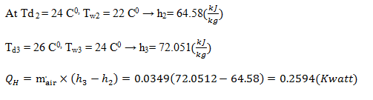
Condenser calculation
Then

Slide 25

Compressor and C.O.P calculation
For compressor
For C.O.P

Slide 26

Electrical consumption
Notes: - the device will operates 18 hour over one day and the price of one kilo watt in Palestine equal 0.60 NIS

Slide 27
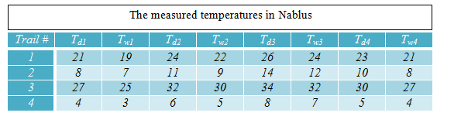
More experiments

Slide 28
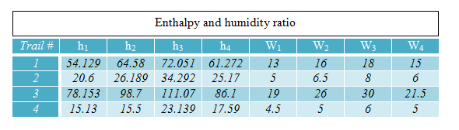
More experiments
Then from the psychometric chart find (the enthalpy and the humidity ratio) as shown below

Slide 29
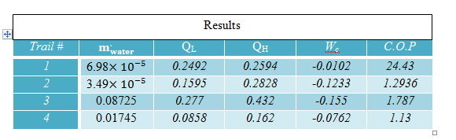
More experiments
Then from last results all calculations can be found as shown

Slide 30
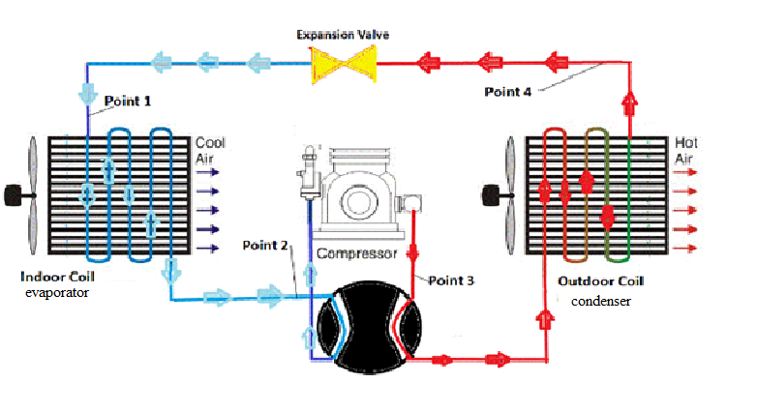
Conclusion
Our project cycle is the cooling cycle where the evaporator inside door and the condenser out side door.

Slide 31
Thank You
Any Question .?

