Slide 1
Scholarships Mobile Application

Slide 2
Introduction
This project is a cross platform mobile application that establishes the main functions for the scholarships office at an-najah national university to simplify the diffusion of scholarship opportunities to both students and staff of the university and to simplify the treatment between the admins and the applicants to scholarships.

Slide 3
Methodology
The project was built using a cross platform language (React Native) works on different mobile platforms with high performance as native applications .
the application targets three categories of users
Main admin : have full administration .
Deans : have limited administration, assigned by the main admin
Users : may be students or staffs to apply to the available scholarships published by the admins.

Slide 4
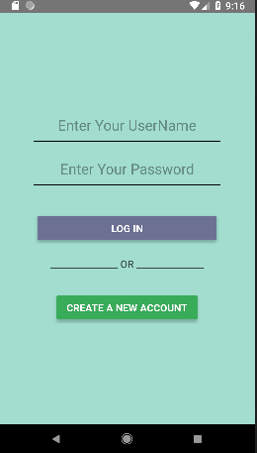
Application structure:
Login page:
for all users
1- Deans : limited adimn access
2- Admins : full access
3- applicants :

Slide 5
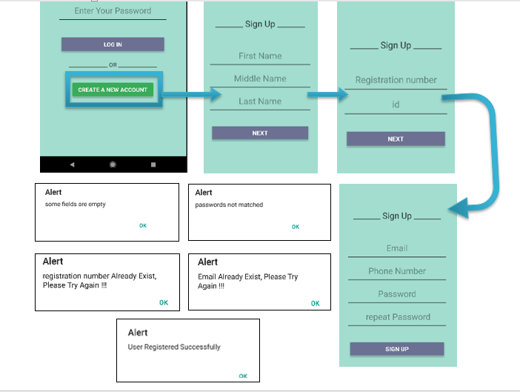
Sign Up:
for applicants only :
collect the users data
with the follwing flow

Slide 6
Applicant profile:
3 tabs :
Home view : shows an information about the scholarship office at an-najah national university
Information view : Ask the user to fill several fields about his/herself ( some field offered in “sign up” will be filled automatically from the database
Options view : will give the user:
an opportunity to browse the published scholarships on the system and to submit a request to a specific ones
the scholarships applied to will be listed and can be browsed
a connectivity information
ability to change the password
logging out the profile ( navigation to the log in page )

Slide 7
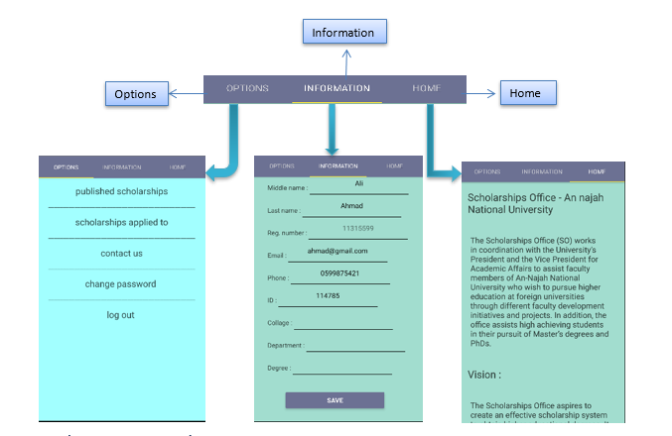
Applicant profile

Slide 8
Admin profile:
Home view : as the applicant
Search view : give the an ability to browse all the users profiles on the system and search them by the name
Options view : will give the admin:
an opportunity to browse the published scholarships on the system, to show the applicants for each scholarship, to show the form of the scholarship and to remove any published scholarship from publishing to prevent users applying to .
an opportunity to create a new scholarship.

Slide 9
Options admin view (continued)
an opportunity to browse the created scholarships, publish them , delete them
an ability to assigning a new dean with limited administration and delete it .
an opportunity to edit the connectivity information .
ability to change the password .
logging out the profile ( navigation to the log in page ).

Slide 10
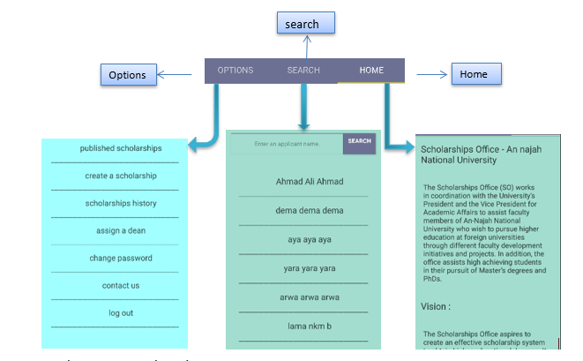
Admin profile

Slide 11
Dean profile:
Will be logged in by the “ log in” view, assigned by the admin, deleted by the admin
Dean profile is an admin profile, but some options are limited
  an opportunity to create a new scholarship.
  an opportunity to browse the created scholarships, publish them , delete them
  an ability to assigning a new dean with limited administration .

Slide 12
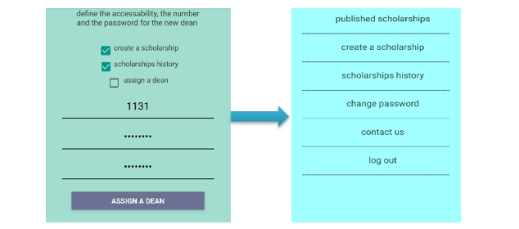
the option tab for a dean without assign a dean option

Slide 13
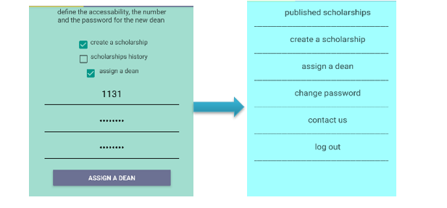
the option tab for a dean without scholarships history option

Slide 14
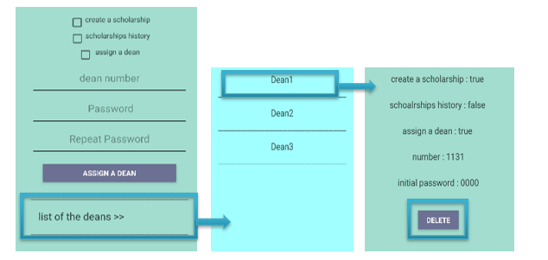
Delete a Dean

Slide 15
some issues caused a waste of time :
React native language doesn’t have an integrated IDE, you need to setup your own IDE to begin programming (an emulator with custom API, SDK tools and platforms, chocolaty package includes ( paython2, SDK, node.js ), collection of react native command lines to create a new project, run it, connect it to the emulator, and downloading libraries).
React-native is not a full standard language, different version and different documentations will make a lot of tutorials useless when you face a specific error with the version you use.

Slide 16
Future Work:
adding a notification tab includes every activity on the system ( adding a new scholarship, notify the applicant if it is accepted in a specific grant )
2. Developing the system to follow the for beneficiaries of grants
3. adding a timing system for publishing an removing the scholarships

