Slide 1
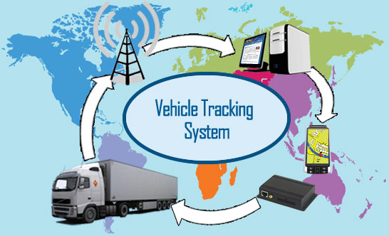
Real Time Vehicles Tracking And Broadcasting Publicity
Prepared by :
1.Doaa Haydariah ''10927646''
2.Nada Joma ''10927895''
Supervised by:
Dr. Saed Tarapiah
-----------------------------------------------------

Slide 2
Outline.
-----------------------------------------------------
1.Motivations
2.Objectives
3.Project Description
4.Results and Discussion
5.Applications
6.Conclusions
7. Recommendations

Slide 3
Motivations.
--------------------------------------------------
Difficulties to locate the current positions of the buses.
Lack of passengers knowledge about the name of regions they pass during the trip.
Provide capabilities to display news-publicity during the trip.

Slide 4
Objectives.
--------------------------------------------------
Determine the bus geographical current locations and send it to the central office.
Display on a screen installed in the bus the current bus position during its route, next bus stop name, publicity and news.

Slide 5
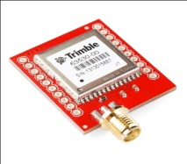
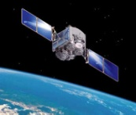
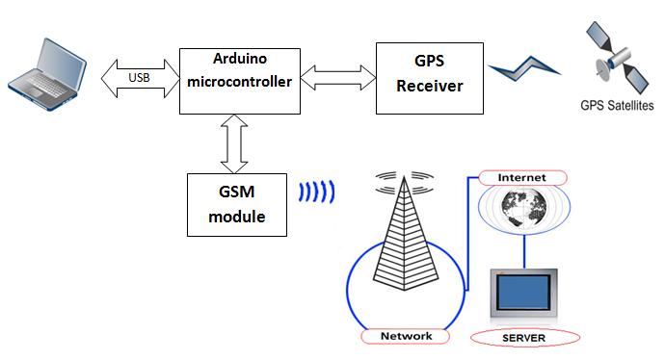
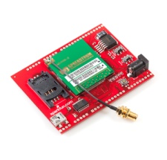
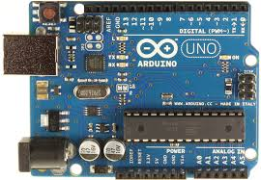


System Block Diagram.
---------------------------
Satellite
GPS module
Aurduino
GSM/GPRS
Server
Display
Notes:
In our project we use the following component:
مع كل كبسة بظهر component
1. gps module
2. gprs module
3. Chock sensor
4. LCd
5. But in our project we use the lcd of our laptob because the lcd is expensive
6. The microcontroler that we use is the aurduino
The conection of these component as you saw

Slide 6

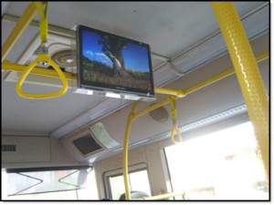
Tow Parts.
--------------------------------------------------
Our Project
Inside the main office.
Inside the Bus.

Slide 7
Inside the main office
--------------------------------------------------
Real Time Vehicles Tracking And Broadcasting Publicity

Slide 8
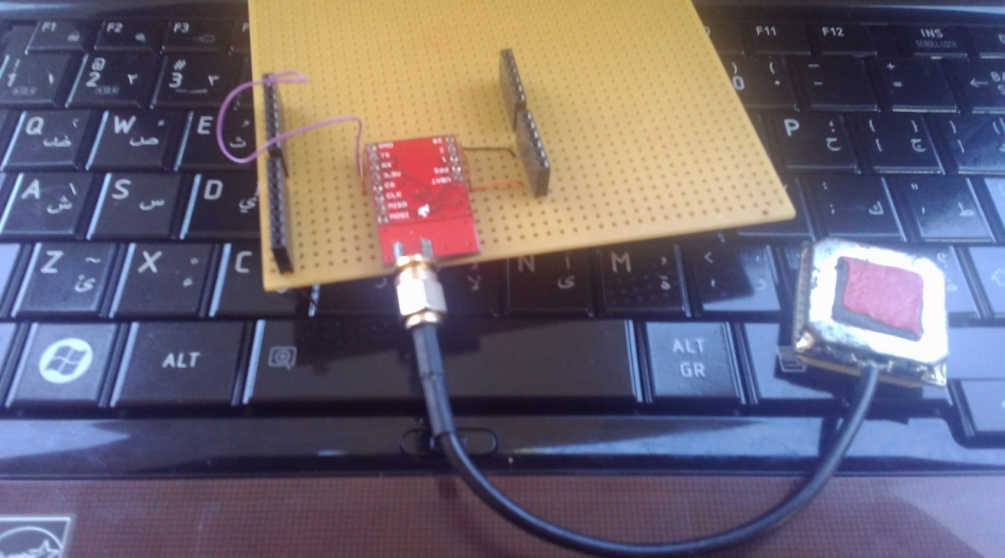
Satellite
GPS module
Aurduino
GSM/GPRS
Server
Display
--------------------------------------------------
What is the purpose of GPs module?
Start
Read from GPS
Longitude: 1256
Latitude: 259
Notes:
It’s used to read the long, latit of it’s curent position

Slide 9
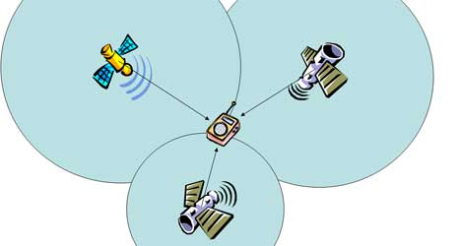
Satellite
GPS module
Aurduino
GSM/GPRS
Server
Display
--------------------------------------------------
How the satellite locate the position?
Notes:
The gps (على ما اعتقد ان مش الجي بي اس هون. اي اشي بالدنيا اله موقع محدد من الستلايت)it requires at least four satellites transmitting coded signals from known positions. Three satellites are required to provide the three distance measurements, and the forth to remove receiver clock error

Slide 10
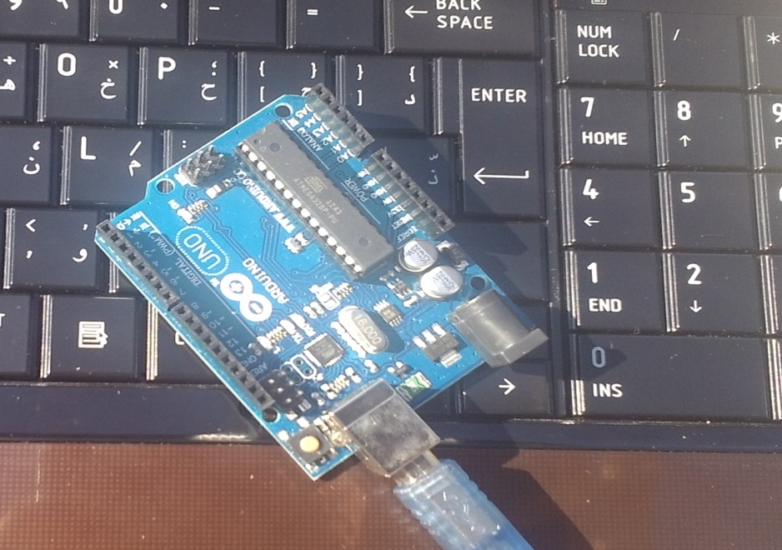
Satellite
GPS module
Aurduino
GSM/GPRS
Server
Display
--------------------------------------------------
Aurduino (microcontroller).

Slide 11
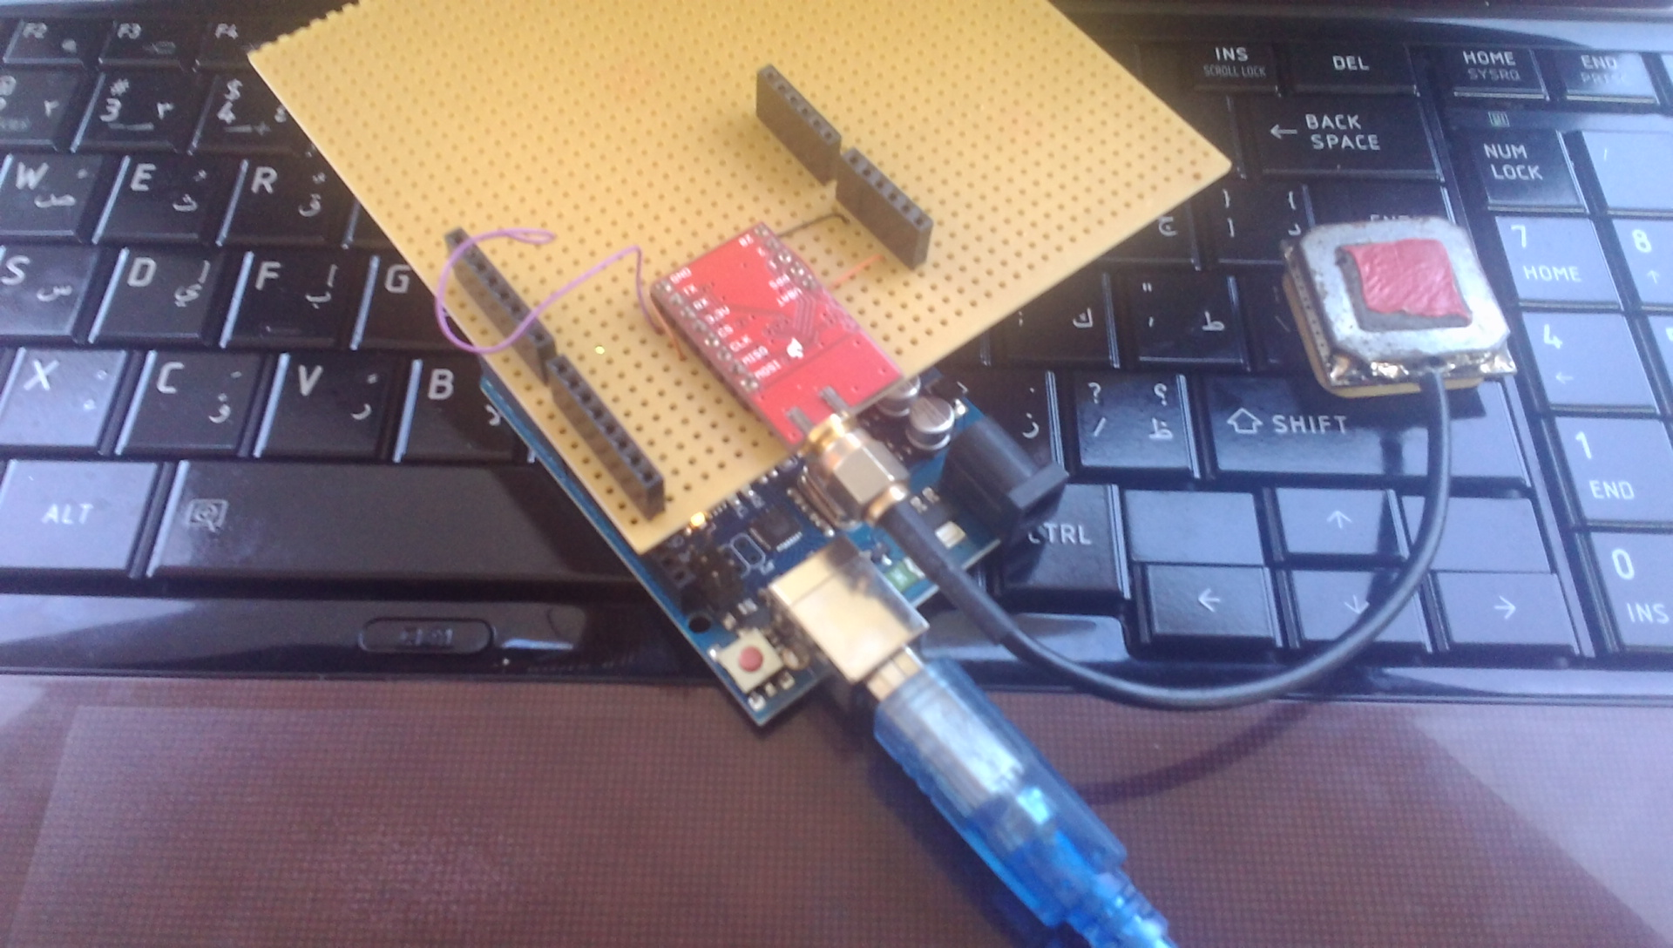
Arduino And GPS Module Connections
--------------------------------------------------------

Slide 12
GPRS Message.
--------------------------------------------------
userid:5,Var_x:32.608937,Var_y:35.890443, time1:2014-2-11 10:29:23

Slide 13
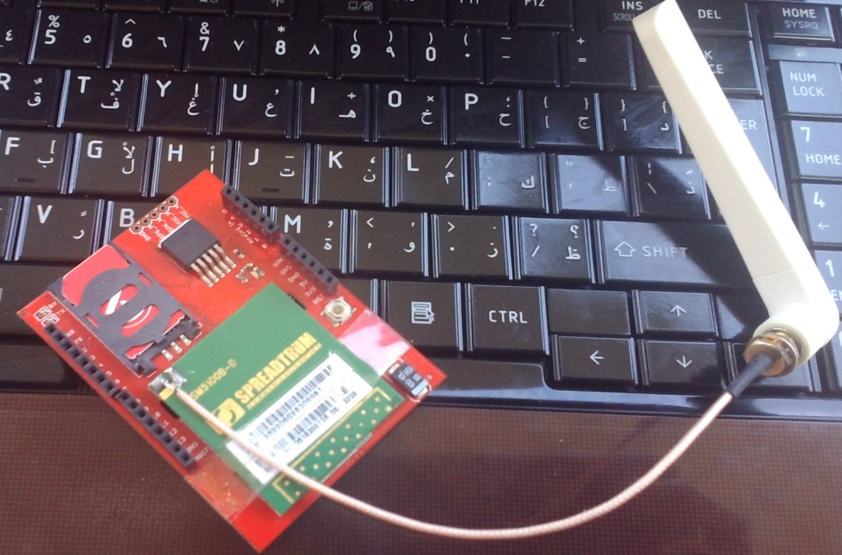
Satellite
GPS module
Aurduino
GSM/GPRS
Server
Display
--------------------------------------------------
GPRS/GSM
Periodically send GPRS msg contain current location

Slide 14
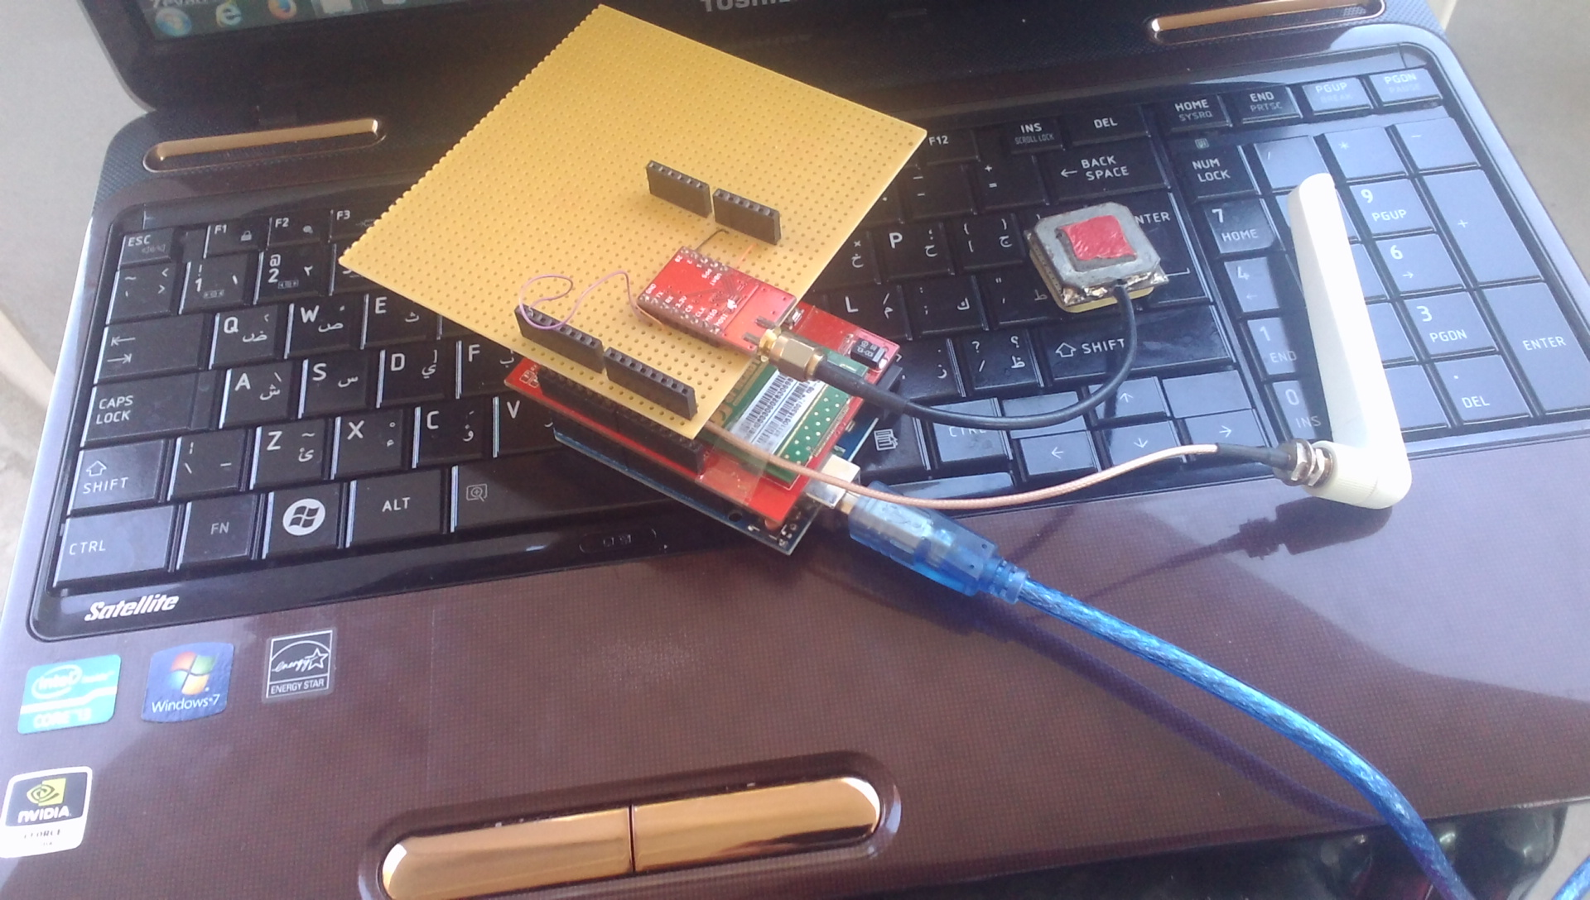
Final Connections.
--------------------------------------------------

Slide 15


Satellite
GPS module
Aurduino
GSM/GPRS
Server
Display
--------------------------------------------------
Notes:
ال pc هو اللابتوب العادي مش سيرفر

Slide 16


Server Side.
--------------------------------------------------
MySQL (Database)
PHP

Slide 17
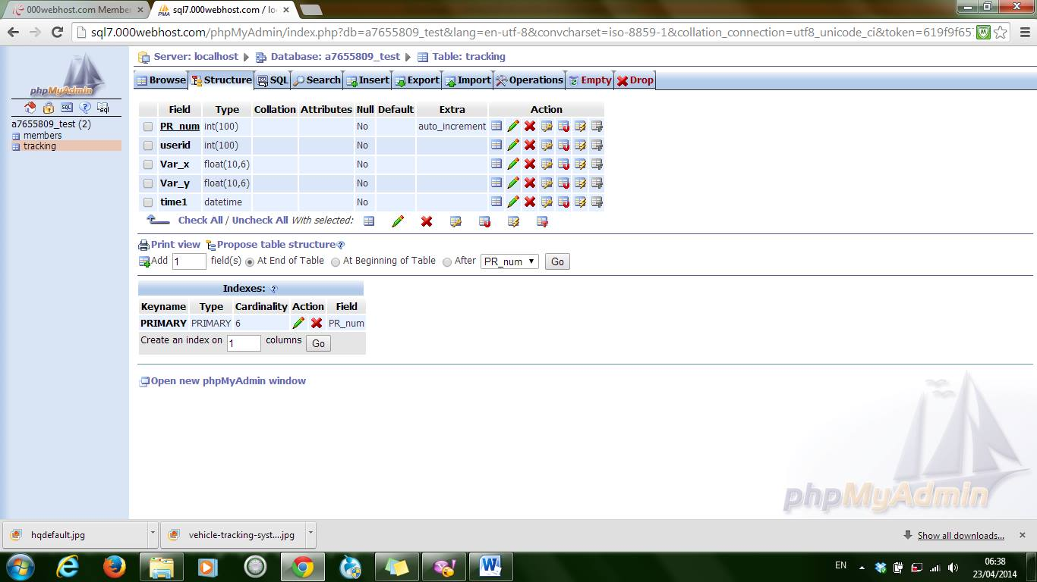
MSQL (Database)
--------------------------------------------------

Slide 18
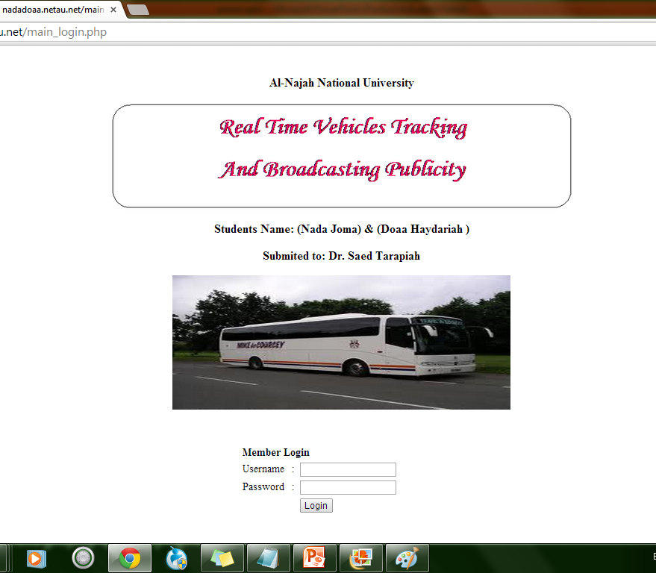

Our Website
--------------------------------------------------

Slide 19
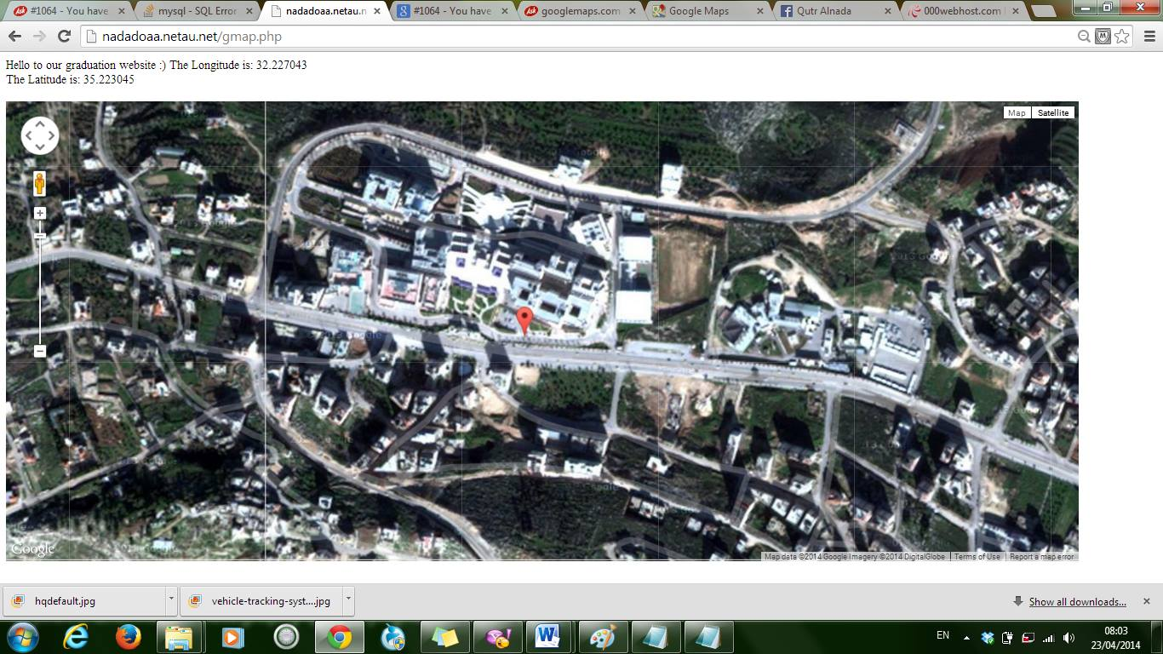
Our Website
--------------------------------------------------

Slide 20
Inside the Bus.
--------------------------------------------------
Real Time Vehicles Tracking And Broadcasting Publicity

Slide 21
Satellite
GPS module
Aurduino
GSM/GPRS
Server
Display
--------------------------------------------------
LCD Display bus
Display on LCD "current bus location and next bus stop ID''

Slide 22


Nablus Town
Rafedia
University
Current Location: Nablus Town Next Location: Rafedia
News And publicity: Today undergone low temperatures

Slide 23
Satellite
GPS module
Aurduino
GSM/GPRS
Server
Display
--------------------------------------------------
If news or publicity is received
No
Ignore

Slide 24
Satellite
GPS module
Web
Aurduino
GSM/GPRS
Server
Display
--------------------------------------------------
If news or publicity is received
No
Yes
Update news, Display on LCD "news" and "publicity"
Ignore

Slide 25
Nablus Town
Rafedia
University
Current Location: Nablus Town Next Location: Rafedia
News And publicity: Today undergone low temperatures

Slide 26
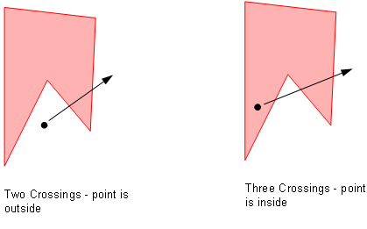
Polygon Test.
--------------------------------------------------

Slide 27
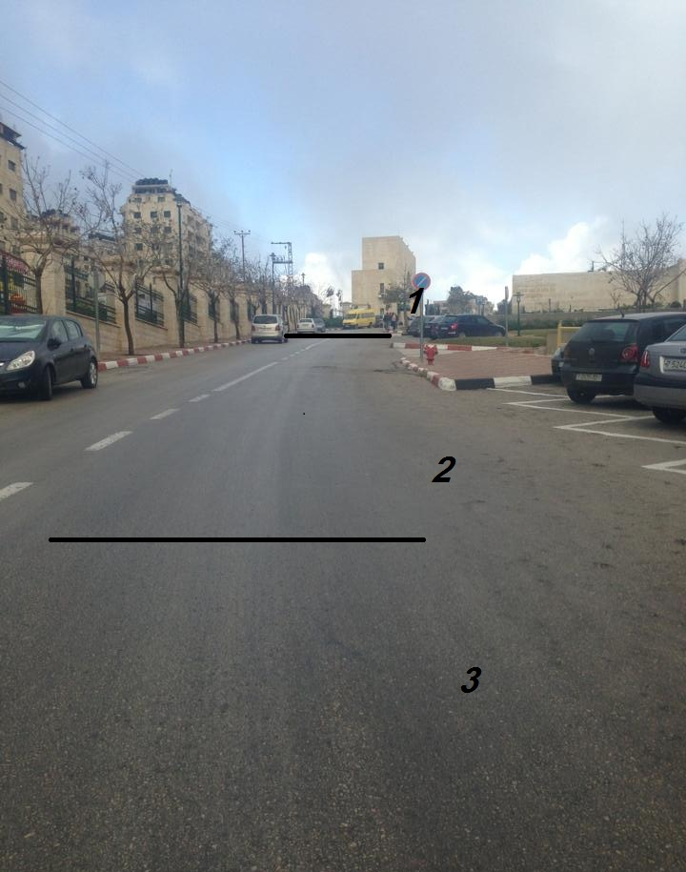
Test Street.
--------------------------------------------------

Slide 28
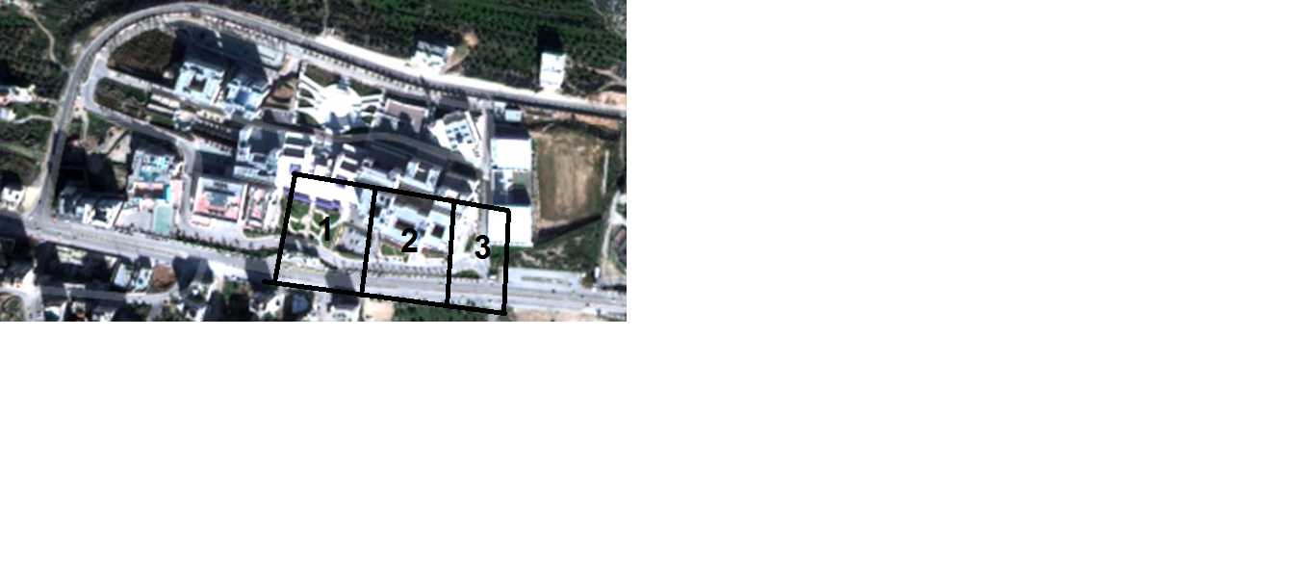
Test Street.
--------------------------------------------------

Slide 29
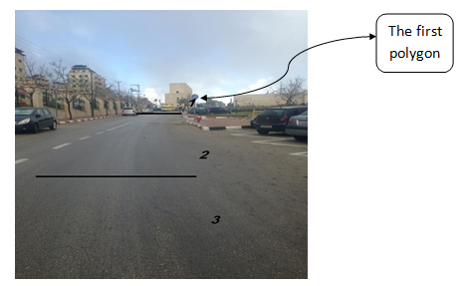
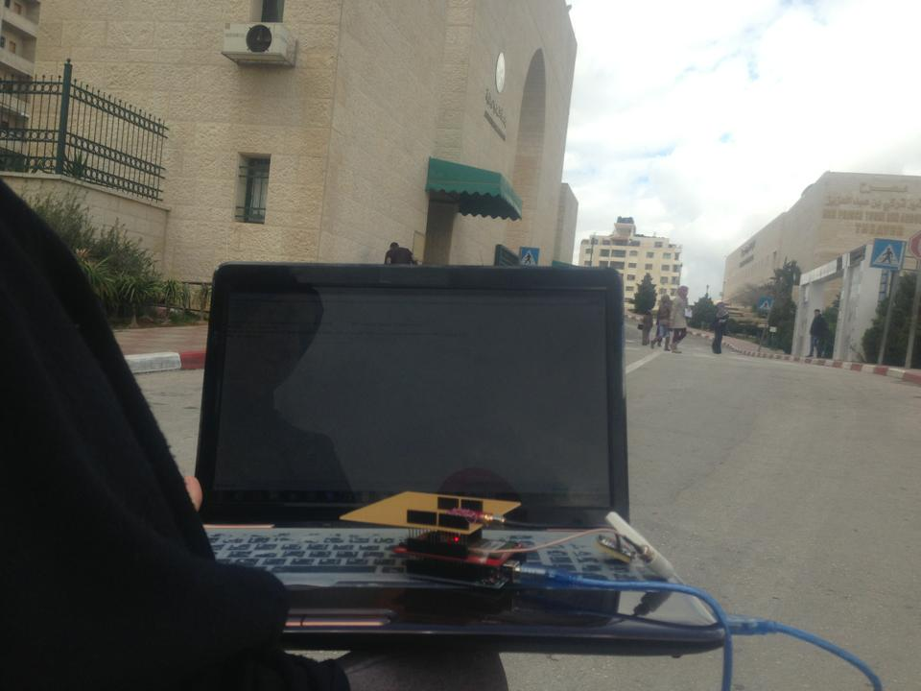
The First Polygon
--------------------------------------------------

Slide 30
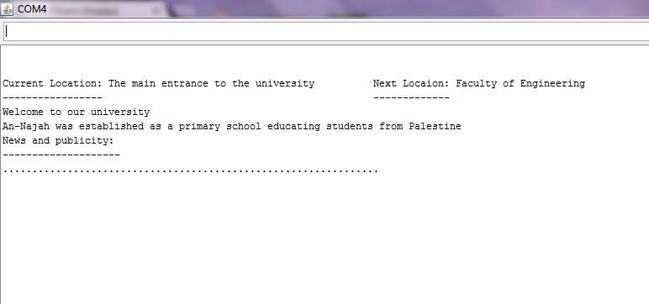
The First Polygon
--------------------------------------------------

Slide 31
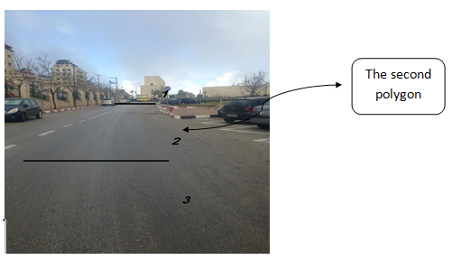
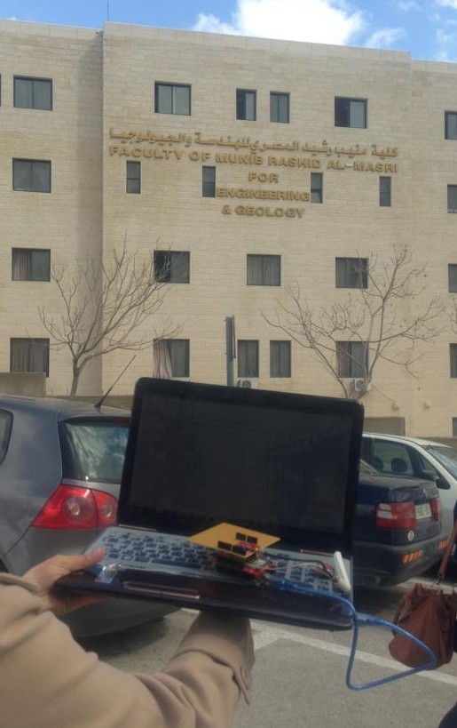
The Second Polygon
--------------------------------------------------

Slide 32
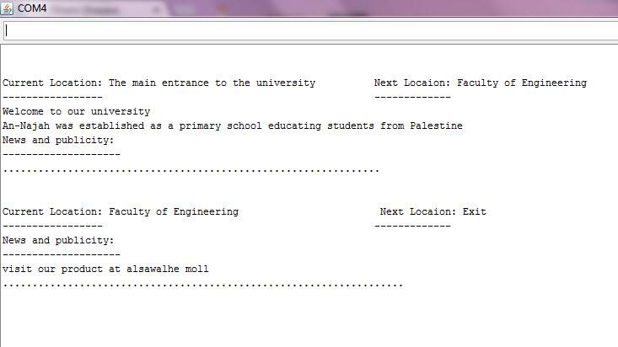

The Second Polygon
--------------------------------------------------

Slide 33
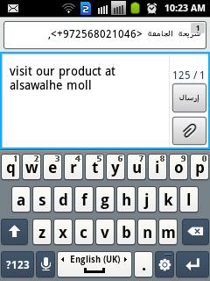
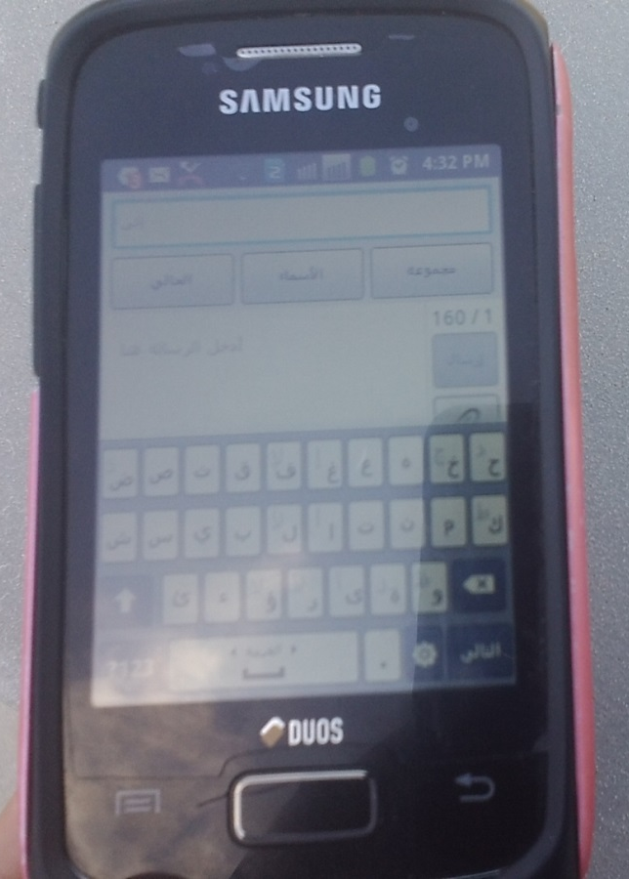
The second Polygon
--------------------------------------------------

Slide 34
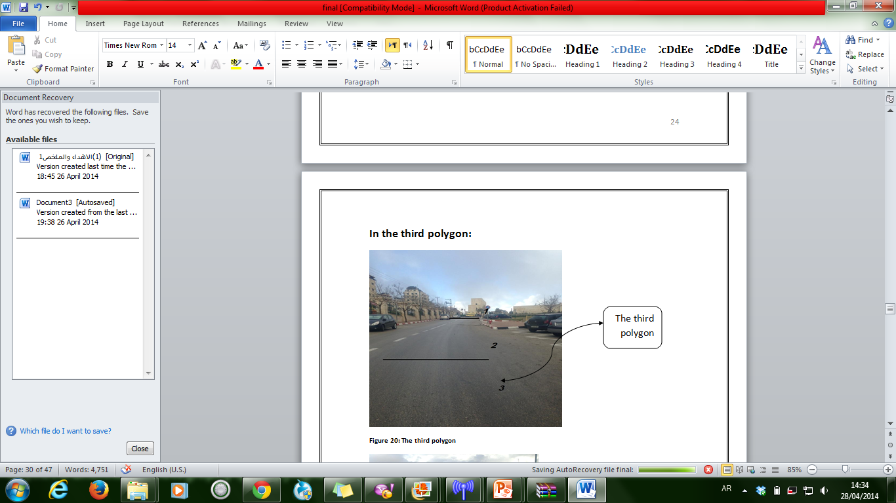
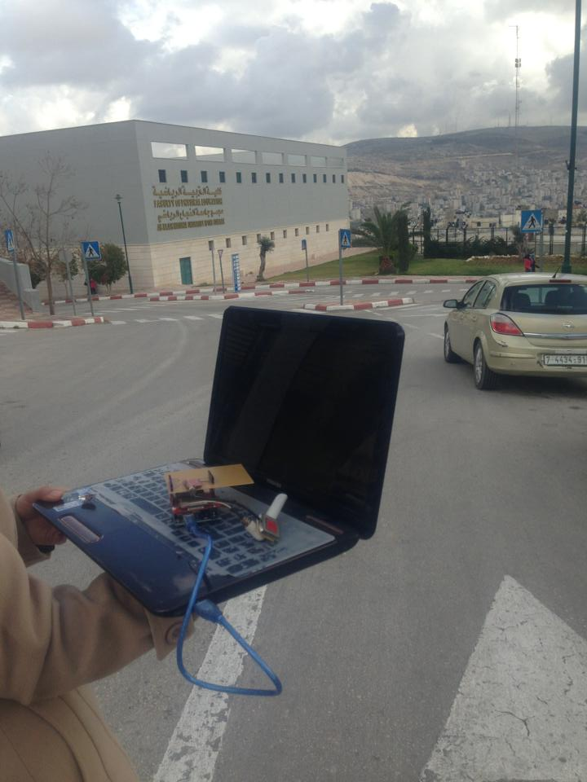
The Third Polygon.
--------------------------------------------------

Slide 35
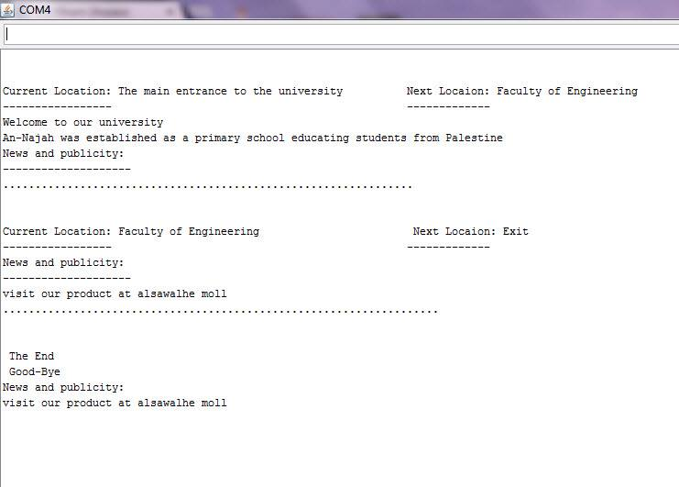
The Third Polygon
--------------------------------------------------

Slide 36
Start
End

Slide 37
Economical feasibility Study
--------------------------------------------------
Aurduino: 170 NIS
GSM module: 500 NIS
GPS module: 250 NIS, with Antenna: 50 NIS
1K byte: 0.0009765625 NIS
---------------------------
Capital investment: 970 NIS

Slide 38
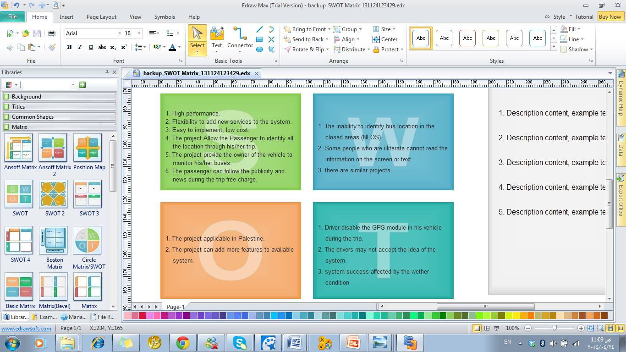
SWOT Analysis
--------------------------------------------------

Slide 39
Possible Applications
--------------------------------------------------
Our model designed to be used in
public bus Transportation Companies
All personal cars
Renting cars
Trains

Slide 40
Conclusions
--------------------------------------------------
Tracking the buses that related to bus Transportation Companies, and provide information to the passengers during their trip has become important issues.
Our model is able to achieve many features, such as tracking buses, and provide information to the passengers.

Slide 41
Recommendations.
--------------------------------------------------
Add MP3 to the system instead of the LCD to allow the illiterate people to know the name of regions they pass during the trip.

Slide 42

Any Questions

Slide 43


Thank You

Slide 46
GPRS Message ----------→ 64
64*1*1.10= 70.4 bytes
1K byte ----→0.0009765625 NIS
4trips*45*0.0009765625= 0.17578125 NIS

Slide 54


Slide 55

Thank You

