Slide 1

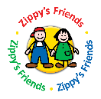
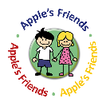
Labeeb’s Friends and Apple’s Friends
around the world
Caroline Egar, Programme Director,
Partnership for Children

Slide 2


Slide 3
What are Labeeb’s Friends and Apple’s Friends?
What’s the theory behind them?
How and where do they work?
What is their impact?

Slide 4

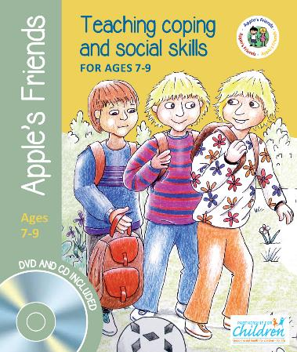

Slide 5
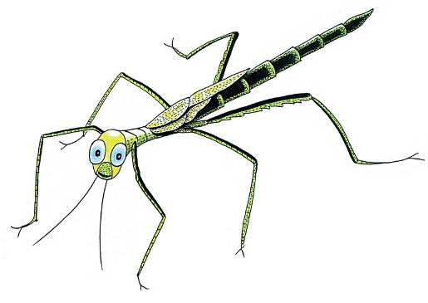
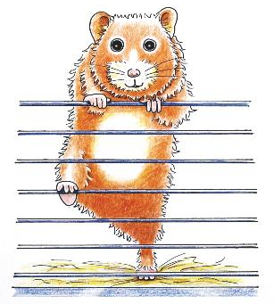
Labeeb and Apple

Slide 7
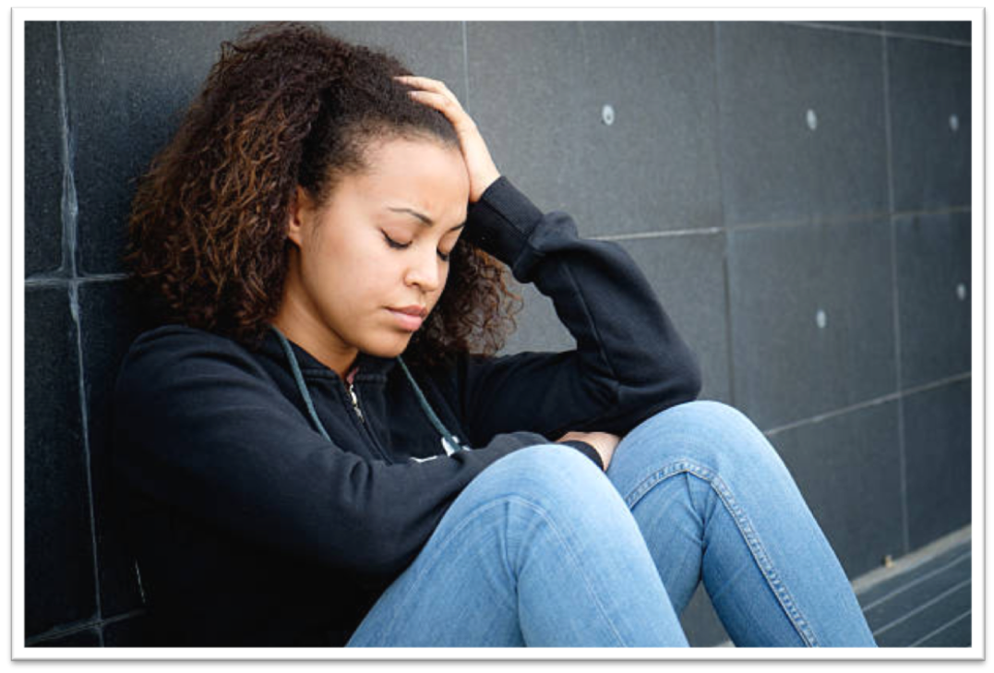
‘I don’t know what to do’

Slide 8

Stress - coping theory
Notes:
Then we turned to the theoretical base and landed on the field of stress coping- theory: According to this theory, equilibrium, or being in balance as illustrated here by a weight - is considered a position of good mental health.

Slide 9
Mental health problems
Difficulties
Notes:
When exposed to adversities, an unbalance will occur, and if being exposed to severe negative events or stressors over time the risk to develop mental health problems increases

Slide 10
Mental health problems
Difficulties
Coping strategies
Ystgaard M, Tambs K, Dalgard O. S. (1999). Life stress, social support and psychological distress in late adolescence: a longitudinal study. Social Psychiatry and Psychiatric Epidemiology 34, 12-19
Notes:
, but only as long as this are not counterbalanced by adequate coping resources, being in the environment as support or in the persons own ability to cope with problems

Slide 11
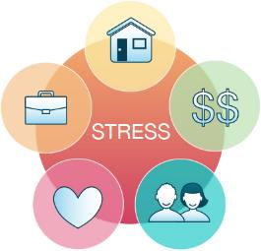
The Concept of Coping
Helpful
Strategy Good
Mental Health
Illustration of Lazarus and Folkman 1984
Personal Interpretation
Coping
Strategies
Unhelpful
Strategy Poor
Mental Health

Slide 13
Labeeb’s Friends and Apple’s Friends:
six modules
    Feelings
    Communication
    Friendship
    Solving problems
    Change and loss
    Moving forward

Slide 14
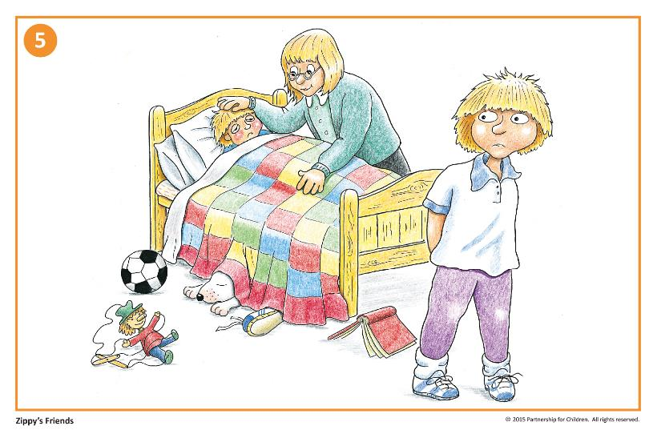

Slide 15
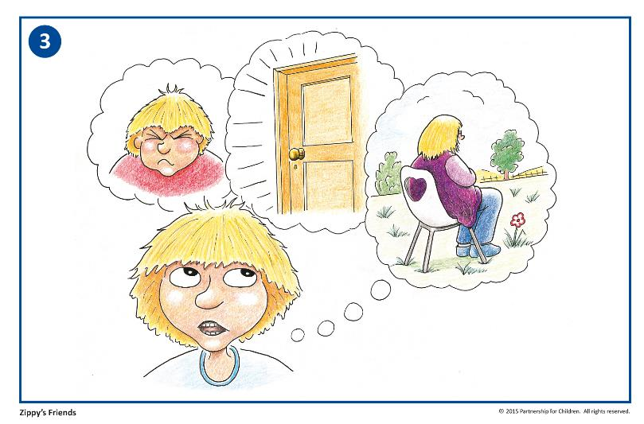

Slide 16
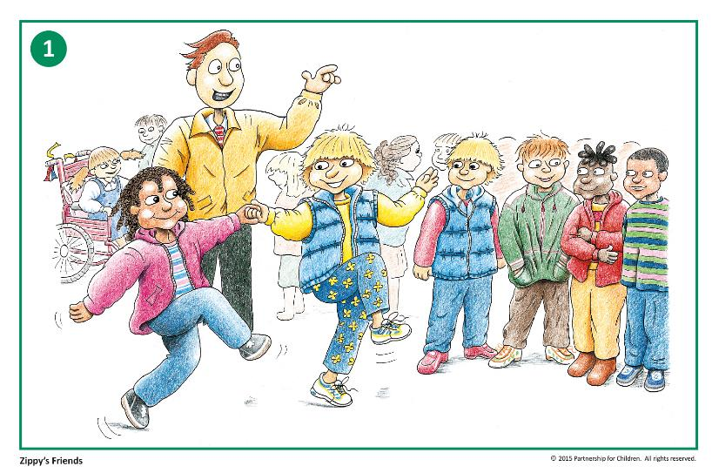

Slide 17
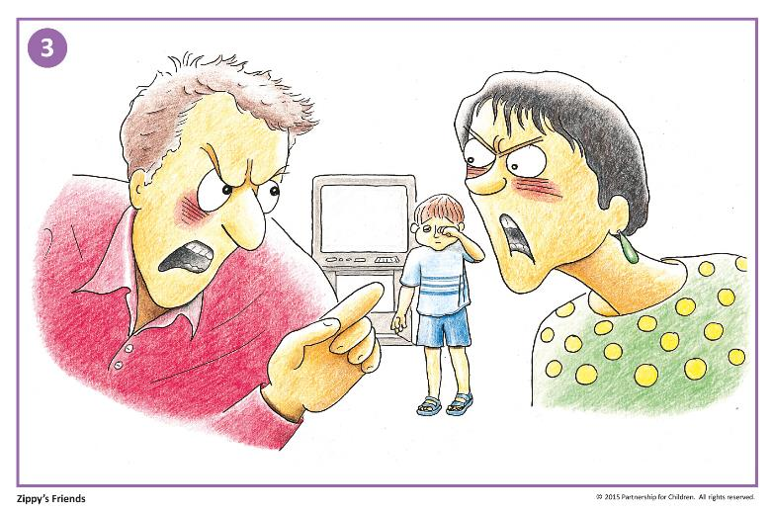

Slide 18
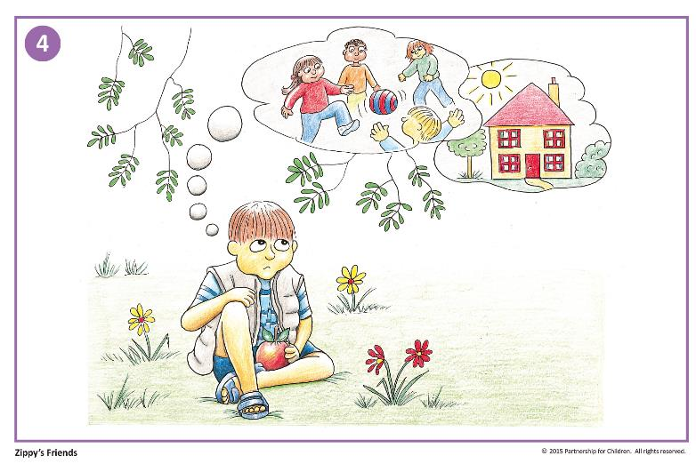

Slide 19
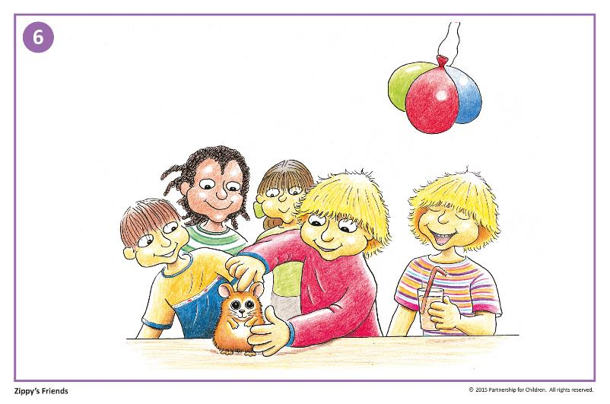

Slide 20
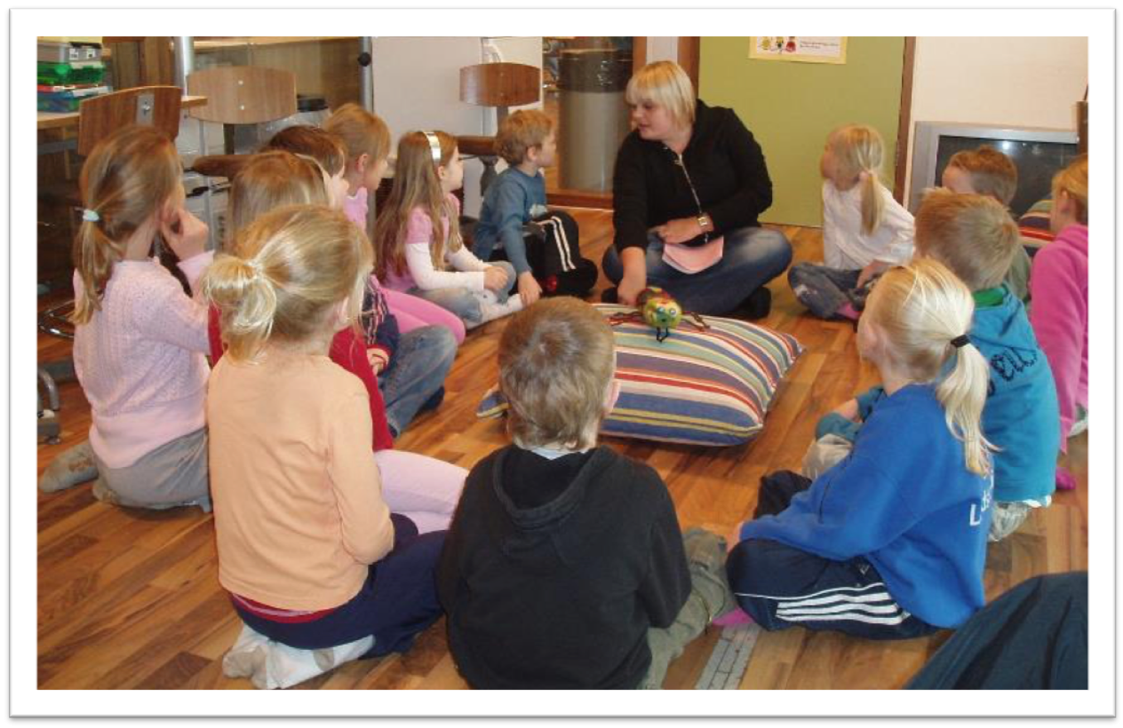

Slide 21
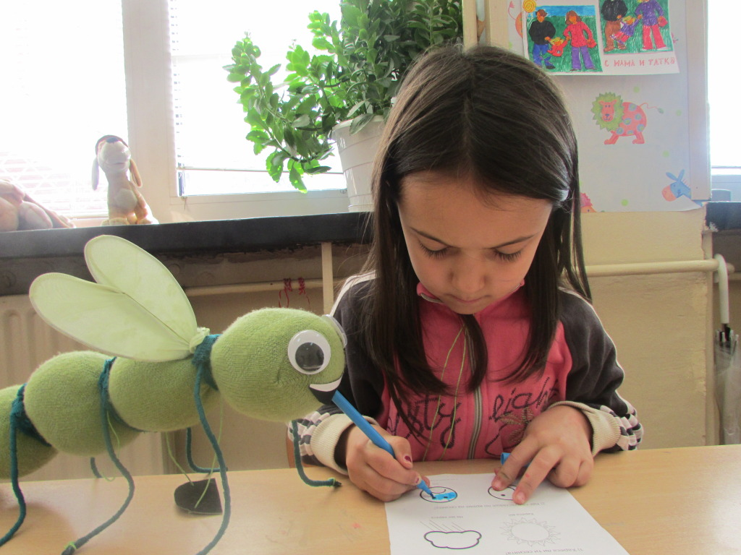

Slide 22
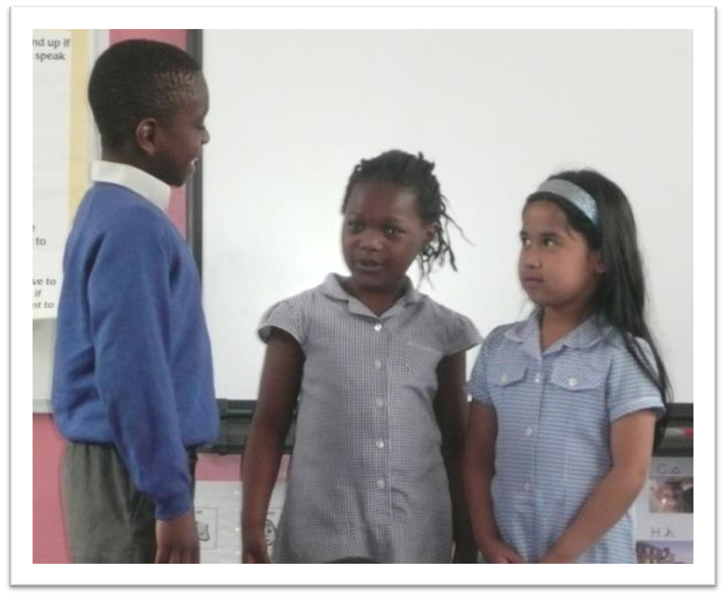

Slide 23
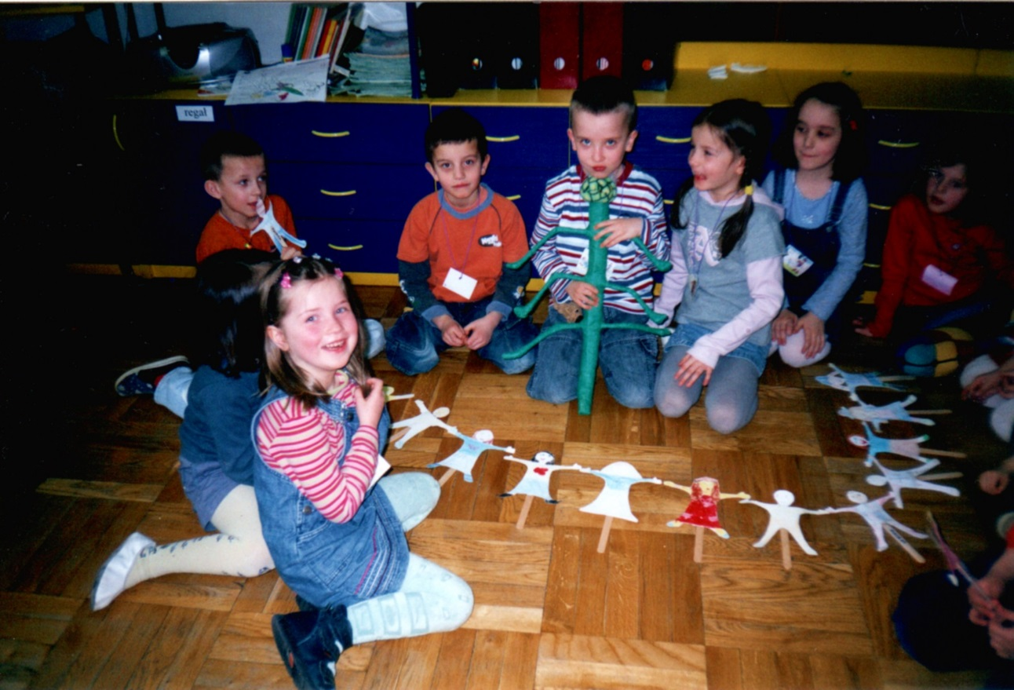

Slide 24
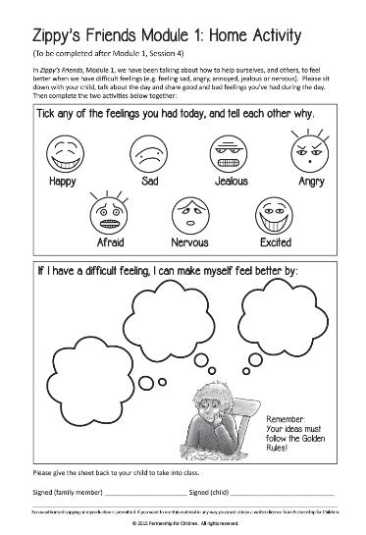

Slide 25
Feedback
I felt better when I learned that others sometimes feel
like I do.
Now I know that there are many ways to get out of bad situations. I never knew there were so many names for emotions.
The children have shown improvements in handling conflicts with friends and their emotions and needs.
We use the Zippy rules to solve real problems, especially at playtime.

Slide 26
The seed has been planted in Zippy’s Friends and harvested in Apple’s Friends.
The skills acquired were reinforced with Apple’s Friends. It was very good, since the children are more mature to understand certain concepts.
My child has become more responsible, helpful, ready to help and to comfort others.

Slide 27
Evaluations: Randomised Control Trials (RCTs)
Norway, 2012 – Holen et al
Improvements in coping skills, academic skills, class climate
Reduction in bullying
Ireland, 2014 – Clarke et al
Improvements in coping skills, self-awareness, empathy,
self-regulation, relationships in class
Netherlands, 2015 – Hegeman
Improvements in coping skills, emotion recognition, motivation
Reduction in hyperactivity, aggressive behaviour

Slide 28
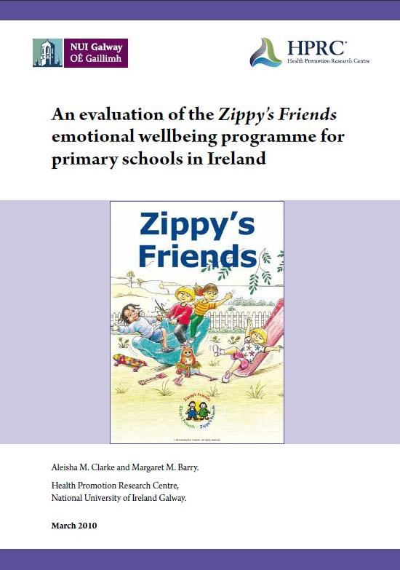
42 Schools
730 Children
Notes:
The first I will talk about is the most rigorous evaluation on ZF to date. It was done in Ireland in 2010 at the National University of Ireland, Galway (a WHO collaborating centre).
It was a randomized control trial.
42 disadvantages schools (730 children) in West Ireland took part.

Slide 29
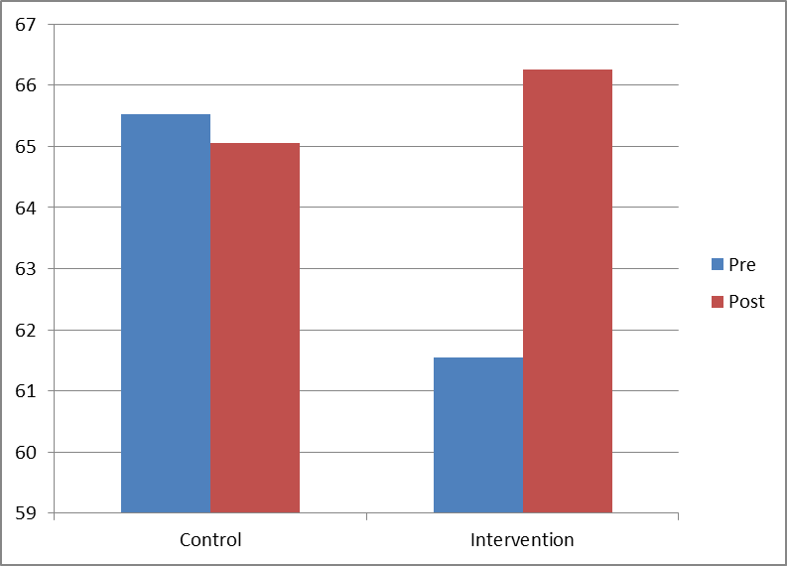
Emotional Literacy Checklist
Similar results across all 5 subscales: self awareness, self regulation, motivation, empathy, social skills.
Notes:
Teachers completed the Emotional Literacy checklist at the start and end of the project.
The overall change in scores are presented in the graph.
As you can see the control group actually started from a higher point but the Intervention group improved much more over the course of the programme.
This pattern was replicated across all 5 subscales.

Slide 30
Reduced hyperactivity
Notes:
This is from a different validated scale: the Strengths and Difficulties questionnaire (SDQ) and shows a significant decrease in hyperactivity measured across the programme.

Slide 31
Teachers reported:
77% of children showed improvement in academic achievement
87% of children transferred their skills beyond the classroom
Notes:
Teachers reported that … (academic ability)
(You could ask participants their opinion about why this might be.)
(transfer beyond classroom)
Transfer beyond classroom is important factor because ZF´s objective is that children learn coping skills for use in real life.
…And over 90% of teachers reported improvements in children’s social skills, verbal communication skills, and relationships with each other

Slide 32
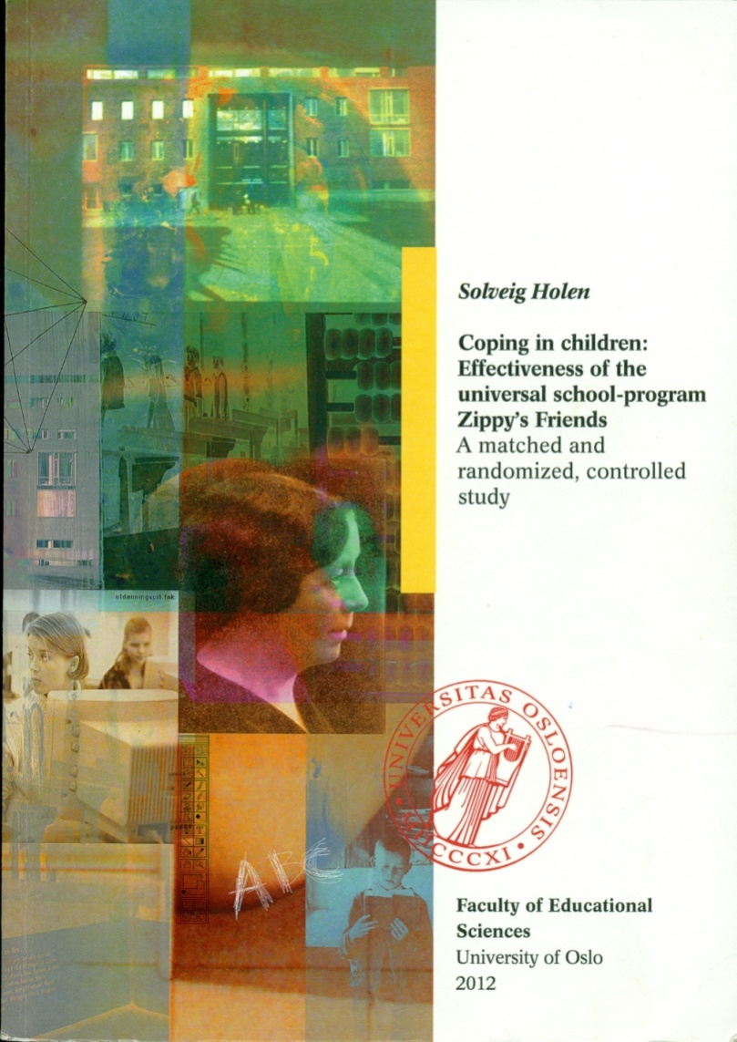
91 Classes
35 Schools
1483 Children
Notes:
The most recent study was conducted in Norway and published in 2012
Almost 1,500 children took part
It made a number of positive findings about the programme’s effects on children, consistent with earlier studies.

Slide 33
Positive impact on coping skills
Based on children's questionnaire:
    Less acting out, less blaming others and less wishful thinking
Based on the parents’ questionnaire:
    Most increase in active problem solving and support seeking strategies
Notes:
Significant findings were: (read slide)

Slide 34
Based on the teachers’ answers:
Improved academic achievement
Improved social climate in the classroom
    Less bullying
    Better cohesion and
    less exclusion
Notes:
In a new finding ZF was found to improve the social climate in the classroom

Slide 35
Teachers’ assessments using SIKS assessment
Notes:
This is results from a German scale developed for young school children. SIKS stands for Social Integration, Classroom Climate and self-concept of school readiness. These graphs are based on the teacher’s version of the scales.
As you can see social integration improves in the intervention group as does class climate and academic skills.
The bullying scores have been inverted so a higher number is a positive result- there was less bullying not more!

Slide 36
Collaborative for Academic, Social and Emotional Learning (CASEL)
317 Studies
324,303 Children
‘evidence-based programmes are intimately linked to improving children’s academic performance’
Notes:
CASEL (Collaborative for Academic, Social, and Emotional Learning): a large US collaborative who conducted a meta-analysis.
[CASEL was co-founded in 1994 by Daniel Goleman, the author of Emotional Intelligence. They are a not-for-profit organisation that works to advance the science and evidence-based practice of social and emotional learning.]
Sometimes HT/parents saying we must focus on academic skills, targets, but this meta-analysis shows that social and emotional learning can in turn help.

Slide 37
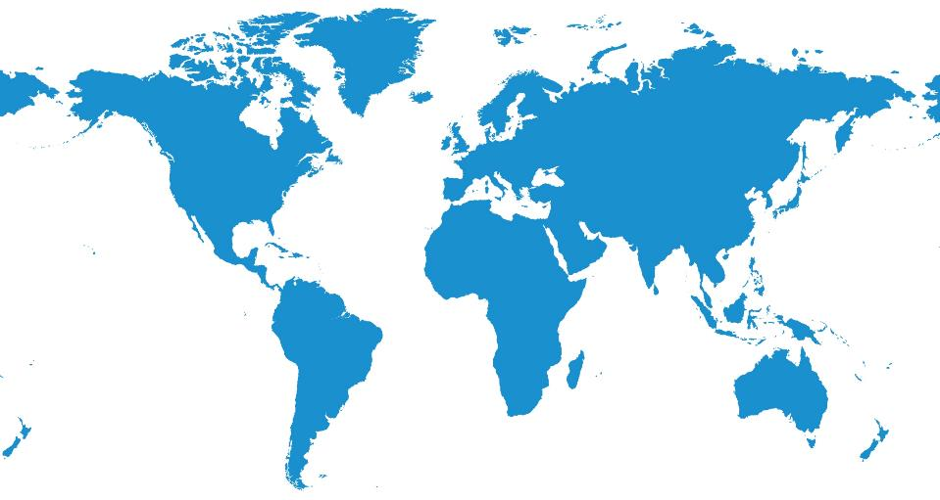
Around the World

Slide 38
Around the World
Iceland
Norway
NW Russia
Canada
Denmark
Ireland
Lithuania
England
Poland
Netherlands
Belgium
Czech Republic
Slovakia
France
USA
New Jersey
Portugal
Bulgaria
South Korea
China
Jordan
Kuwait
Hong Kong
El Salvador
Goa, India
Trinidad & Tobago
Panama
Singapore
Brazil
Mauritius
Argentina

Slide 39
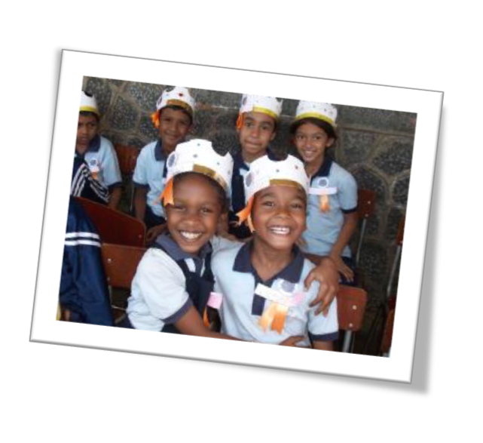
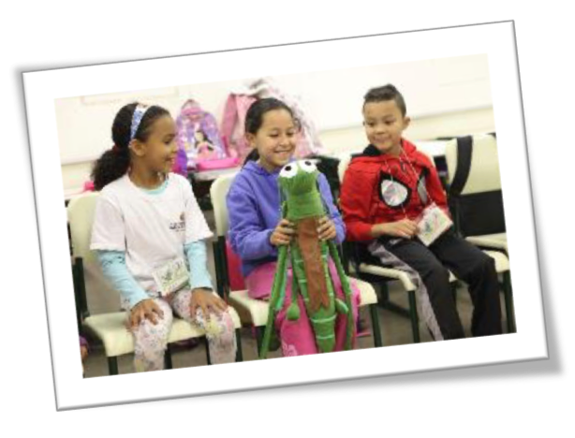
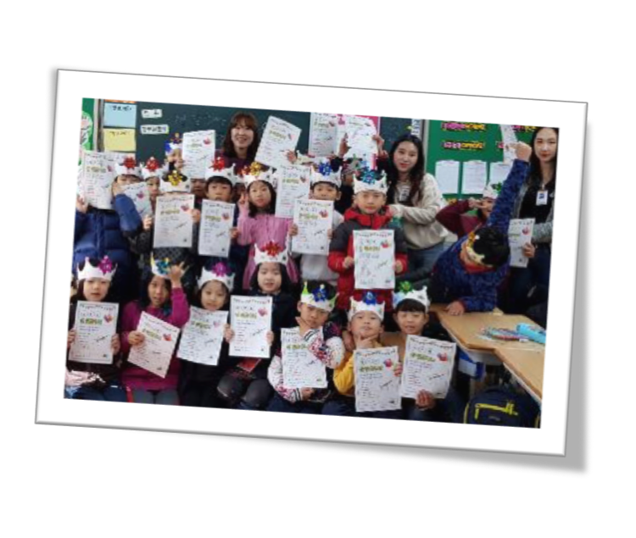
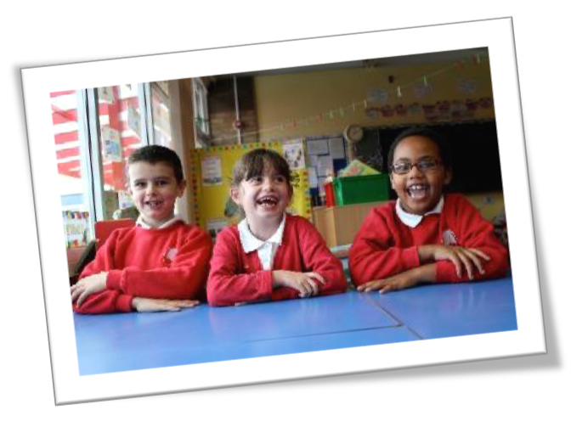
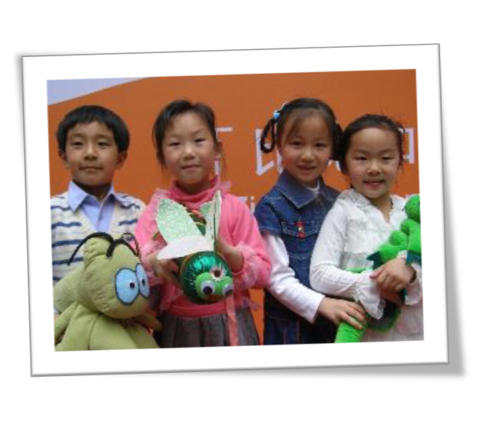

Slide 40
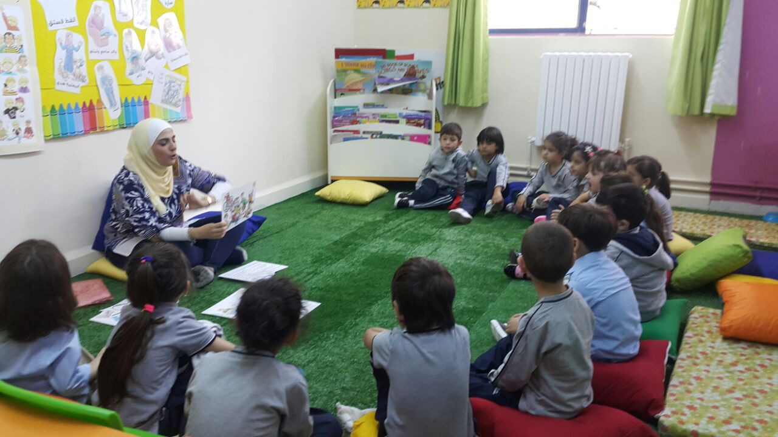

Slide 41
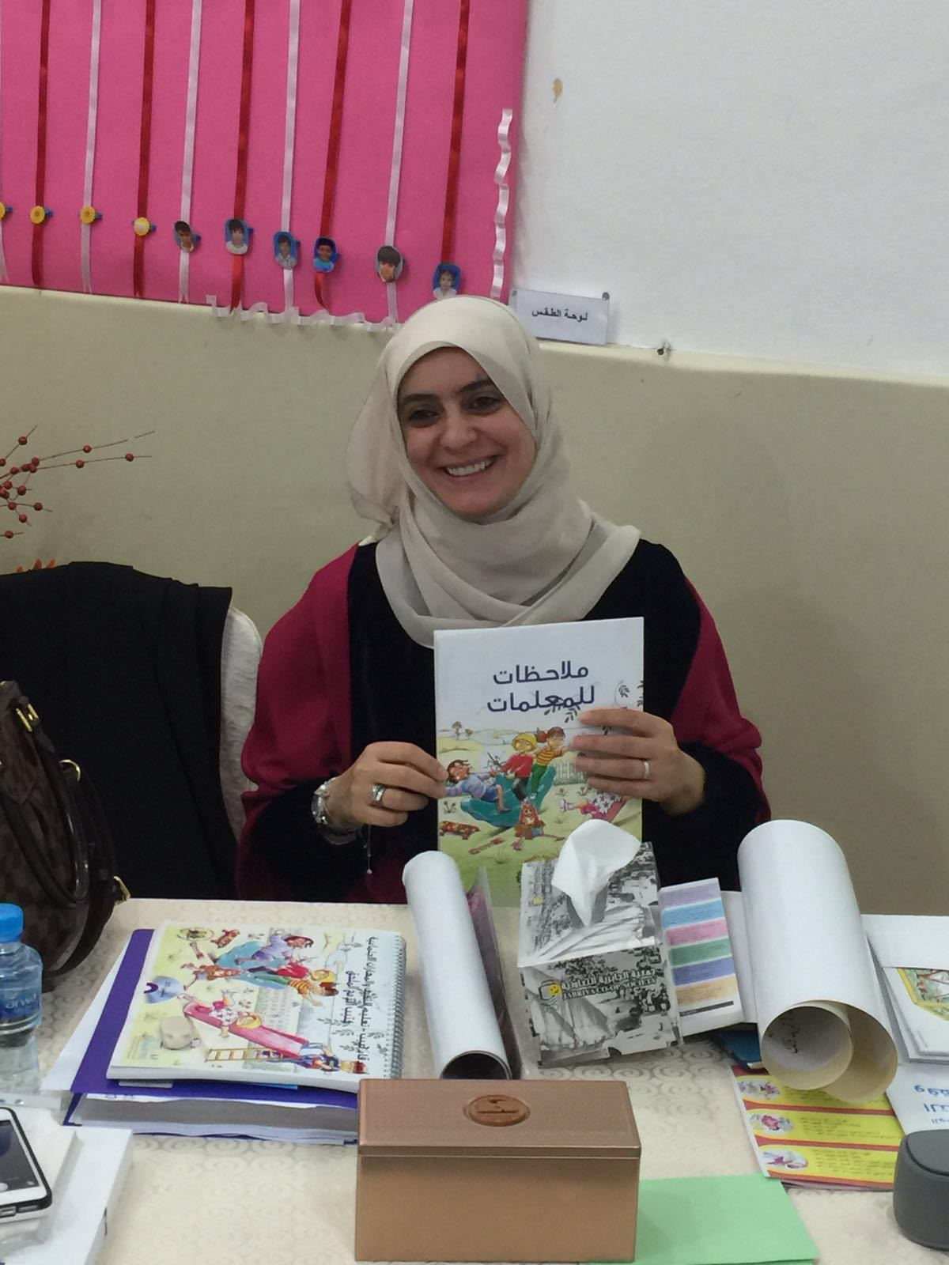

Slide 42







International Recognition

Slide 43
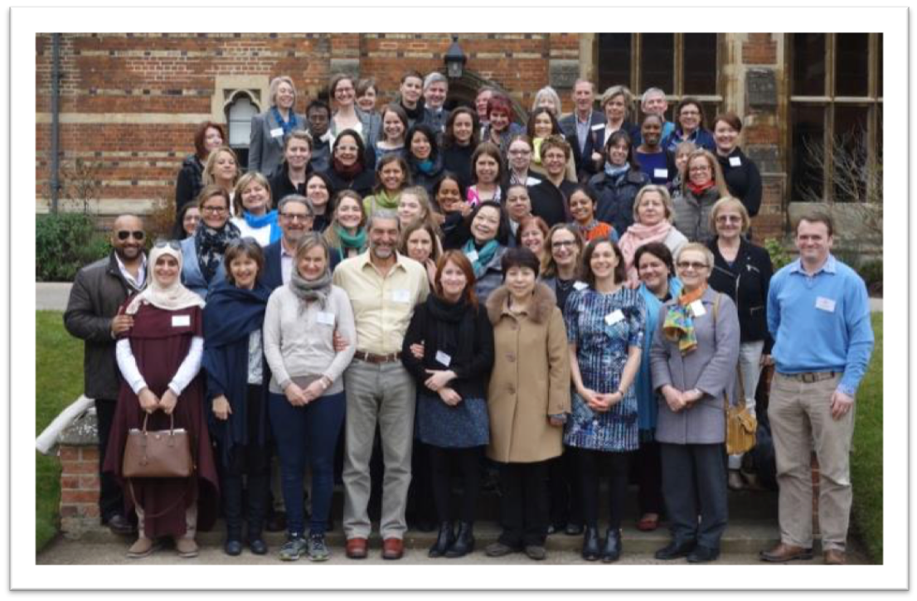
International Workshop 2016

Slide 44
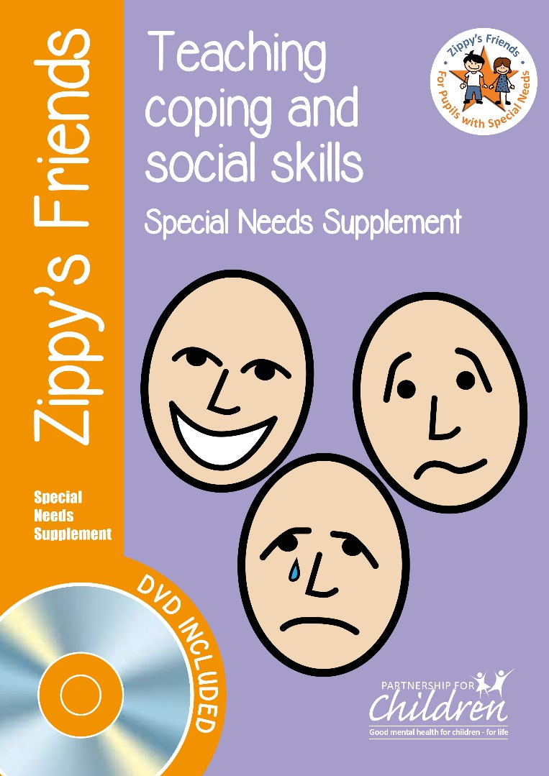
Children with special needs

Slide 45
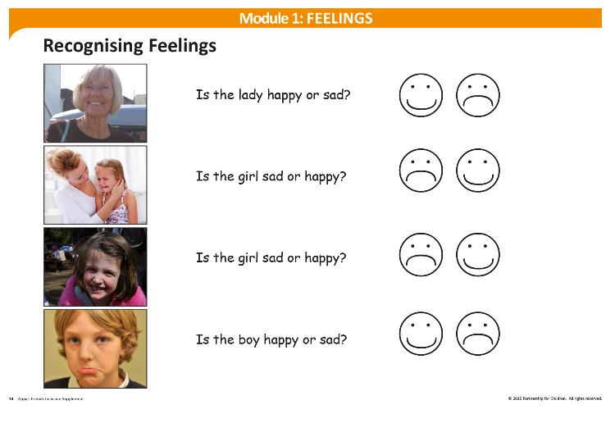

Slide 46
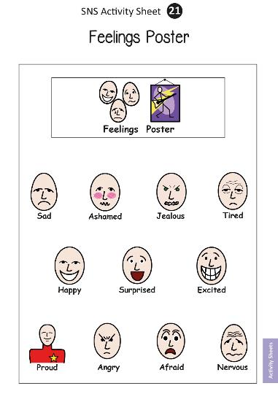

Slide 47
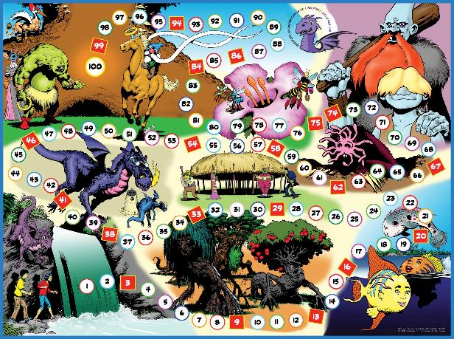
Passport: Skills for Life (ages 9-11)

Slide 48
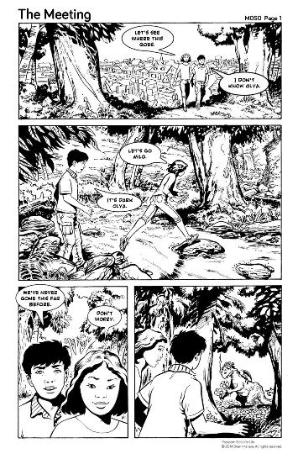

Slide 49
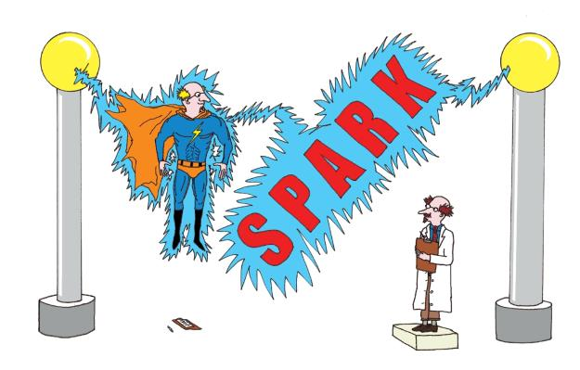
SPARK Resilience (ages 11-12)

Slide 50
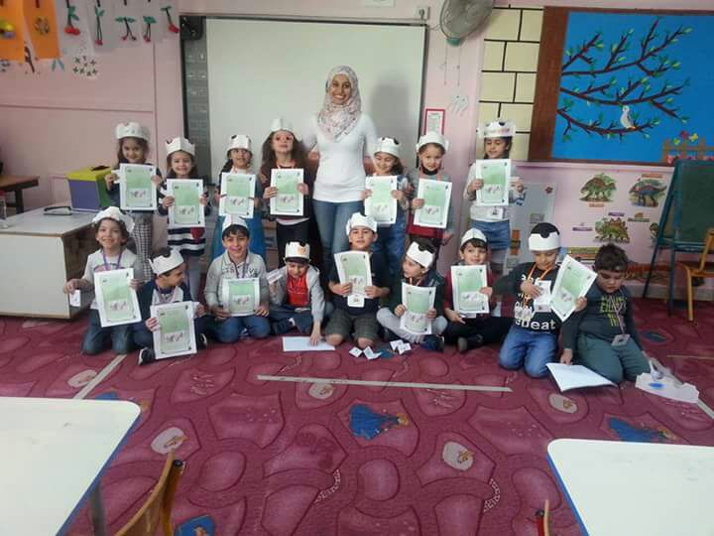

Slide 51

caroline.egar@partnershipforchildren.org.uk
www.partnershipforchildren.org.uk

