Slide 1

An-Najah National University
Engineering Faculty
Civil Engineering Department
Graduation Project II Presentation
Performance Modeling of Nablus–West Wastewater Treatment Plant By using GPS_X
Prepared by : Saja Salatneh
Under supervision of: Dr. Abdel-Fattah Almalah
2015/2016

Slide 2
Outline
Introduction
Objectives
Study Area
Design Methodology
Collected Data.
Results and discussion
Conclusion
Recommendations

Slide 3
Introduction
The principal objective of wastewater treatment is generally to allow municipal and industrial effluents to be disposed of without disturbing natural environment and human health.
Construction and improvement of wastewater treatment plant and sewerage systems in the regions should be taking into consideration by responsible agencies.

Slide 4
Introduction
Wastewater Treatment Plant Models??
Models are representations of the knowledge we have about a system. If we can prepare models that are accurate representations of real systems, then we can use them to conduct experiments which otherwise could not be possible, and so we can use it to :
To verify if the effluents of treatment processes can match the standard guidelines.
Provide insights for plant upgrades, new plant designs, improved operational controls.
To check the stability of the quality of treated water which is to be used in agriculture.

Slide 5
Objectives
Modeling
Checking
Simulation
To develop a model for the recently constructed wastewater treatment plant in the west of Nablus (NW-WWTP).
To find out the effect of different pollution loads on the performance of NW-WWTP
To check if the process of NW-WWTP can produce effluent that meets the Palestinian Guidelines for wastewater reuse

Slide 6
Study Area
Nablus is a city in the northern West Bank, approximately 49 kilometers (30 mi) north of Jerusalem, with a presently population of 210,285.
Topographically, Nablus city has two main catchments, which allow wastewater flows by gravity into wadeis in the West and East of the city.

Slide 7
Study Area
  Overview of NW-WWTP
NW-WWTP is serving the west portion of Nablus city and its western villages to treat the sewage water arriving from Nablus and which later enters Alexander stream in the coastal plane.
The construction of a wastewater treatment plant (WWTP) was begun under the German-Palestinian Financial Co-operation project ''Nablus West Sewerage in Dir Sharaf village and have been planned to be in three stages to meet the design flow in 2020, 2025, 2035.

Slide 8
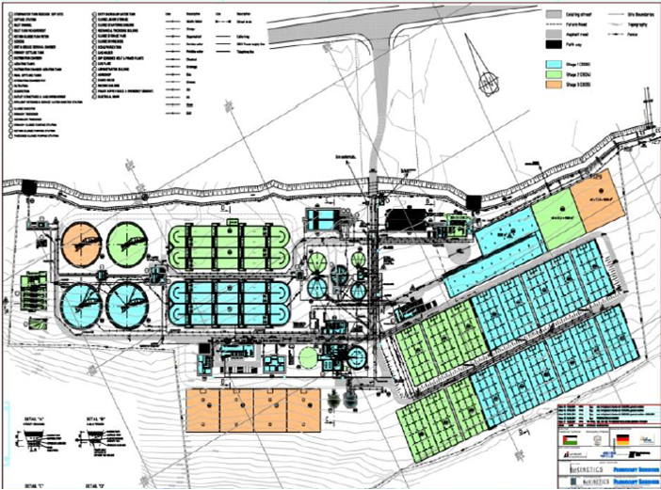
Study Area

Slide 9
Wastewater treatment at NW-WWTP :
Preliminary Treatment :
To remove the material that may cause damage to the plant such as debris and grease.. etc.
Primary Treatment :
To remove settleable, floatable solids and organic mater form the Wastewater
Secondary Treatment:
To remove dissolve solids, colloidal solids and BOD by biological process.

Slide 10
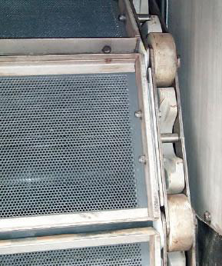
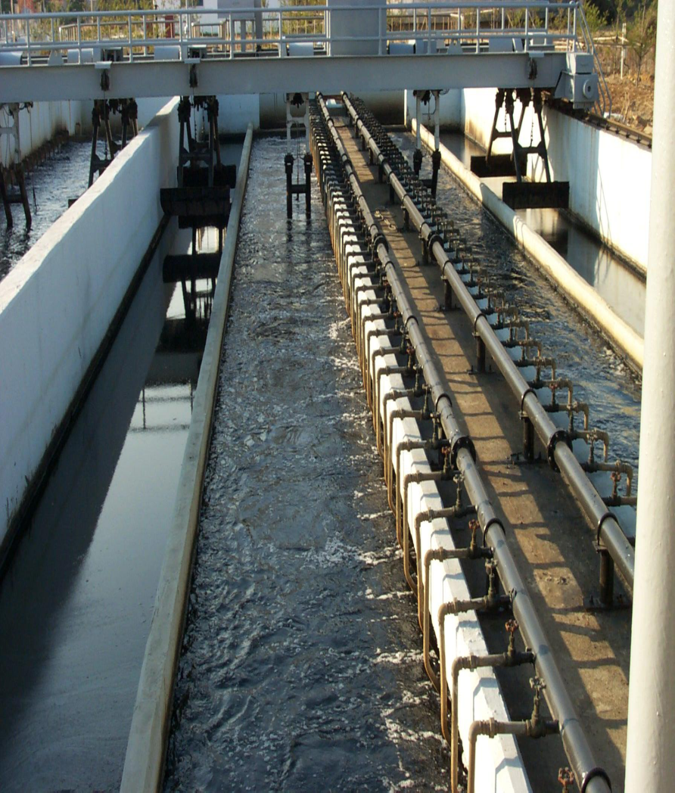
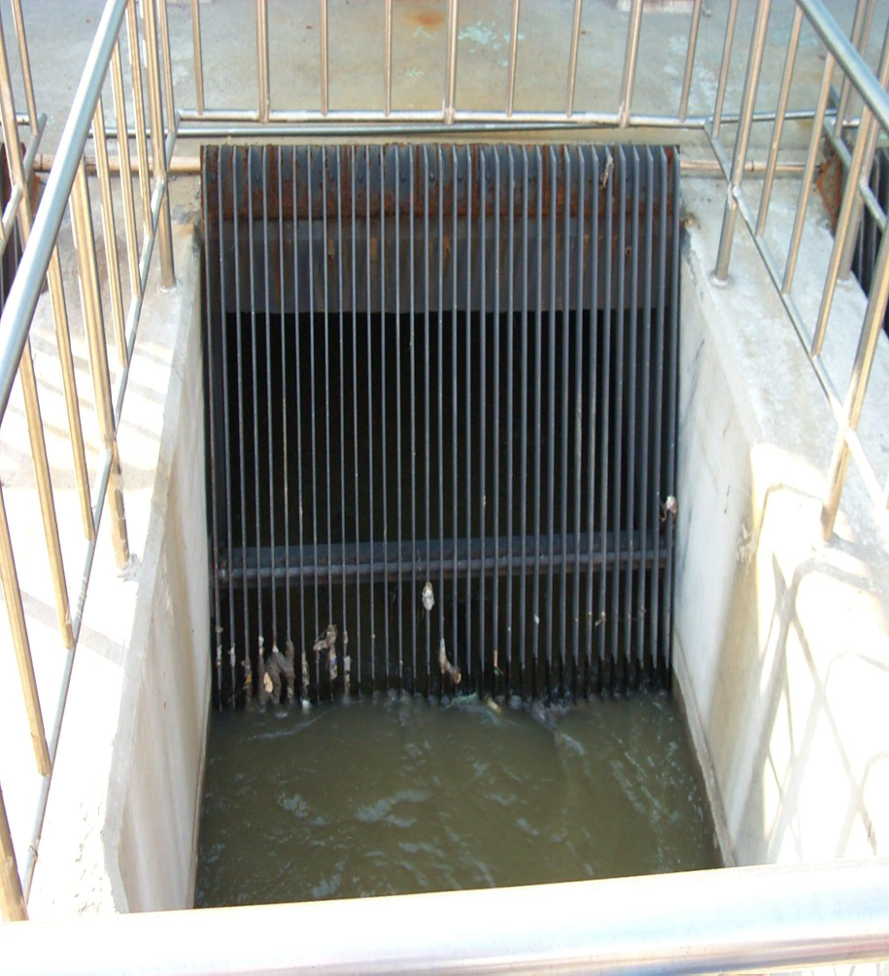
Preliminary Treatment
Fine Screen
Grit Removal
Coarse Screen

Slide 11
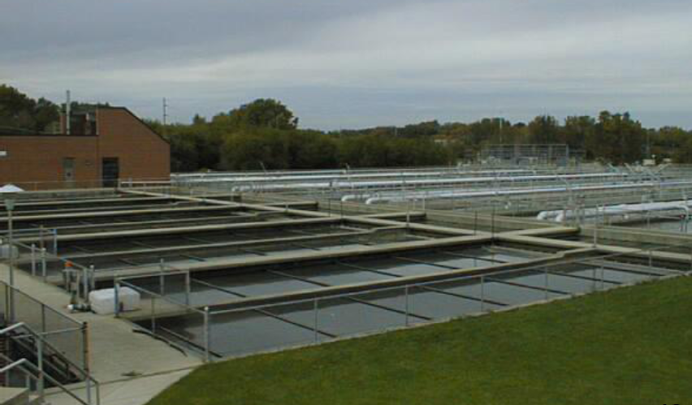
Primary Treatment
Primary Sedimentation Tank

Slide 12
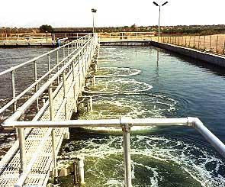
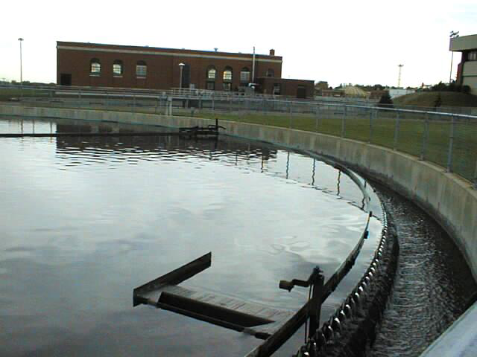
Secondary Treatment
Secondary Sedimentation Tank
Aeration Tank

Slide 13
Layout of NW-WWTP

Slide 14

Collecting data

Slide 15
  Research methodology (Data collection)
The required data to complete the research and to build the model was collected from the competent authorities such as: Nablus-West Waste Water Treatment Plant staff work (NW-WWTP), Nablus Municipality.
The collected data include: Influent flow and its characteristic, treatment plant process and dimensions, the effluent flow and also its quality.

Slide 16
Collected Data
Nablus-West Waste Water Treatment Plant dimensions.
Unit | Unit number | Number | Volume of each unit | Length | Width | Depth | Diameter
Grit Chamber | 225 | 2 | 150 | 31 | 1.95 | 2.5 | *
PST | 230 | 2 | 864 | 27 | 8 | 4 | *
AT | 240 | 2 | 9012 | 90 | 18.9 | 5.3 | *
FST | 260 | 2 | 4326 | * | * | 4.25 | 36
Primary thickener | 431 | 1 | 548 | * | * | 3 | 15
Secondary thickener | 464 | 1 | 395 | * | * | 3.5 | 12
Liquor | 451 | 1 | 1005 | * | * | 5 | 16
Digester | 420 | 1 | 3650 | * | * | 25 | 16
Dry Beds | 472 | 11 | 1035 | 45 | 23 | * | *
Balloon | 511 | 1 | 540 | * | * | * | *
RAS | 442 | 1 | 5*6*5 | * | * | * | *
Sludge storage area | 470 | 1 | 5594 | * | * | * | *

Slide 17
Collected Data
  Design influent wastewater characteristics for NW-WWTP.
Loads and concentrations | 2020 | 2025 | 2035
BODƽ(Kg BODƽ/d)/(mg/l) | 8350/562 | 12375/628 | 16700/610
COD(Kg COD/d)/(mg/l) | 16500/1110 | 24750/1256 | 33000/1205
SS(Kg SS/d)/(mg/l) | 9625/648 | 14438/733 | 19250/703
Total Nitrogen(Kg TKN/d)(mg/l) | 1654/111 | 2081/106 | 3310/121
Total phosphorus (Kg P/d)/(mg/l) | 269/18 | 341/17 | 538/20

Slide 18
Collected Data
  Nablus WWTP designed effluent characteristics .
Loads and concentrations | 2020 | 3025 | 2035
BODƽ(Kg BODƽ/d)/(mg/l) | ≤ 10mg/l | ≤ 10mg/l | ≤ 10mg/l
COD(Kg COD/d)/(mg/l) | -- | ≤ 70mg/l | ≤ 70mg/l
SS(Kg SS/d)/(mg/l) | ≤ 10mg/l | ≤ 10mg/l | ≤ 10mg/l
Total Nitrogen(Kg TKN/d)(mg/l) | -- | ≤ 25mg/l | ≤ 25mg/l
Total phosphorus (Kg P/d)/(mg/l) | -- | ≤ 10mg/l | ≤ 10mg/l

Slide 19
Collected Data
Current influent wastewater characteristics for NW-WWTP.
Loads and concentrations | 2015
BODƽ(Kg BODƽ/d)/(mg/l) | 400
COD(Kg COD/d)/(mg/l) | 1100
SS(Kg SS/d)/(mg/l) | 235
Total Nitrogen(Kg TKN/d)(mg/l) | 77
Total phosphorus (Kg P/d)/(mg/l) | 16.3

Slide 20
Collected Data
  Nablus WWTP measured effluent characteristics.
Loads and concentrations | 2015
BODƽ(Kg BODƽ/d)/(mg/l) | 2
COD(Kg COD/d)/(mg/l) | 55
SS(Kg SS/d)/(mg/l) | 18
Total Nitrogen(Kg TKN/d)(mg/l) | 9
Total phosphorus (Kg P/d)/(mg/l) | 3

Slide 21
Collected Data
  Olive mills wastewater concentrations.
Loads and concentrations | 2015
BODƽ(Kg BODƽ/d)/(mg/l) | 71400
COD(Kg COD/d)/(mg/l) | 153000
SS(Kg SS/d)/(mg/l) | 51000
EC (μc/cm ) | 8.29
PH | 5.04
Density (Kg/m³) | 974

Slide 22
  Palestinian Standards
The extremities of the biological and chemical characteristics | Treated Water Quality
 | High Quality )ِA) | Good Quality (B) | Medium Quality (C) | Low Quality (D)
COD | 50 | 50 | 100 | 150
BOD | 20 | 20 | 40 | 60
TSS | 30 | 30 | 50 | 90
TN | 30 | 30 | 45 | 60
TP | 30 | 30 | 30 | 30
Phenol | .002 | .002 | .002 | .002
NO3-N | 20 | 20 | 30 | 40
NH4-N | 5 | 5 | 10 | 15
Cl | 40 | 400 | 400 | 400
Classification
of treated water according to its quality.

Slide 23
Collecting data
Modeling

Slide 24
Entering Data
Unit’s dimensions
The connectivity between process.
Calibration
Based on the treatment plant lab Results.
Simulation
Plant Designer Data case.
Pollution Loads.
Normal operation case
Influent characteristics.
Operational condition.
GPS-X Modeling

Slide 25
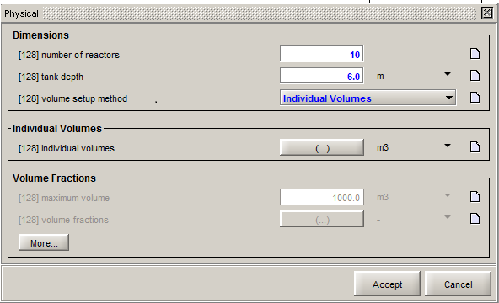
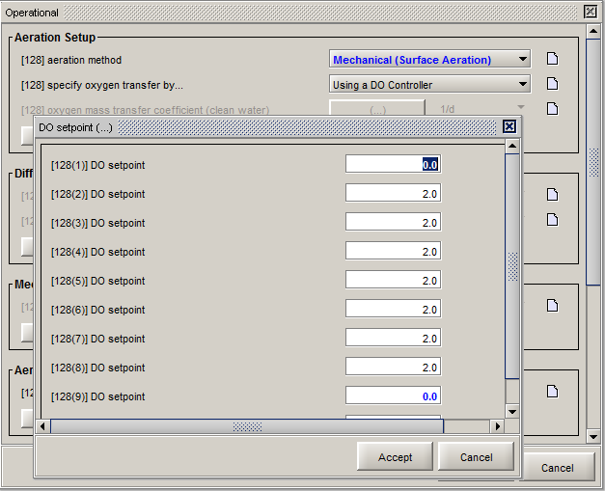
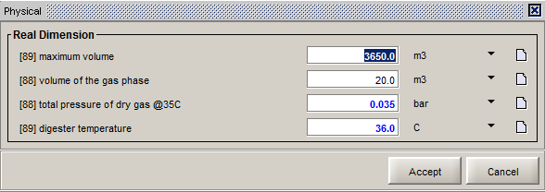
Entering data
Plug flow tank physical characteristics
Plug flow tank operational characteristics
Digester physical characteristics

Slide 26
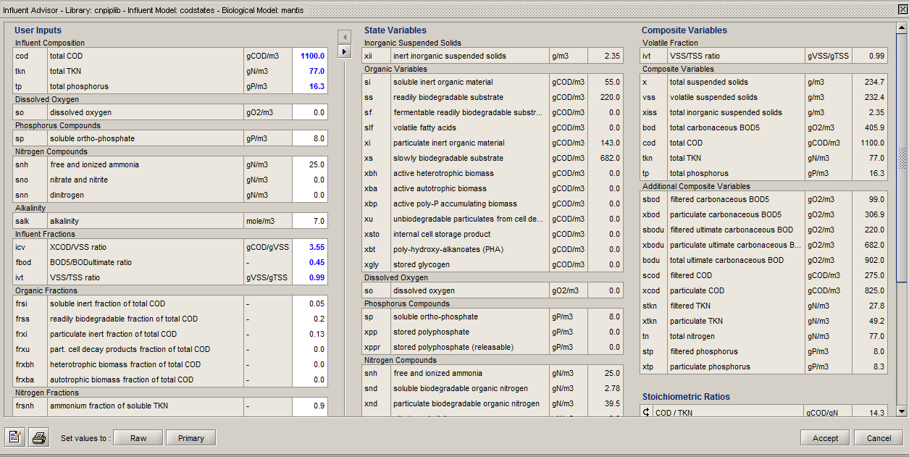
Calibration the model based on the lab data.

Slide 27
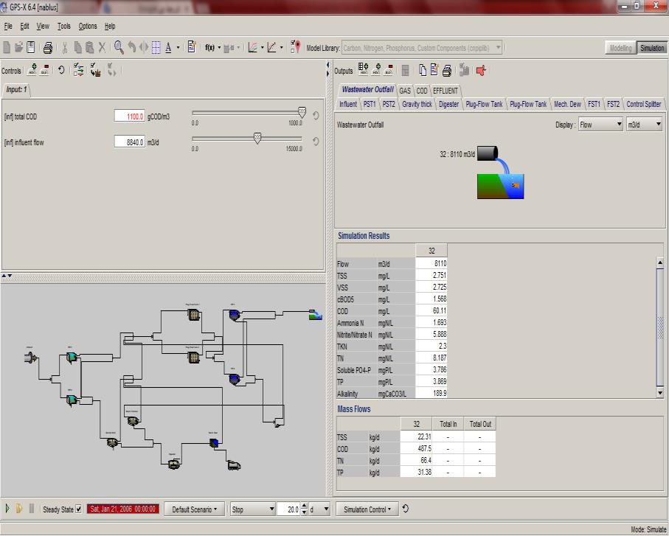
Modeling the plant in case of normal operation.

Slide 28
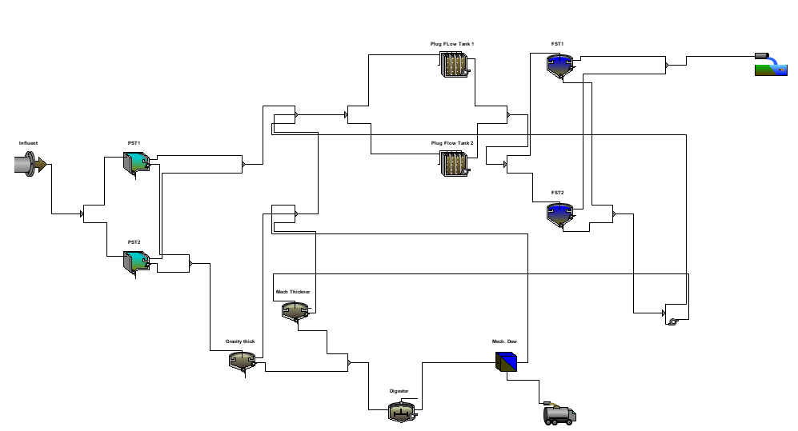
GPS-X Modeling

Slide 29
Collecting data
Modeling
Results

Slide 30
Results and discussion
  First Scenario :Modeling NW-WWTP in case of normal operation.
Parameters | Model Result | Real Result** | %Deviation
COD(mg/L) | 60.30 | 55 | 9.63
BODƽ(mg/L) | 1.53 | 2 | 24
TSS(mg/L) | 2.88 | 18 | 84
Total N( mgN/L) | 8.13 | 9 | 9.66
Total P( mgP/L) | 3.90 | 3 | 30

Slide 31
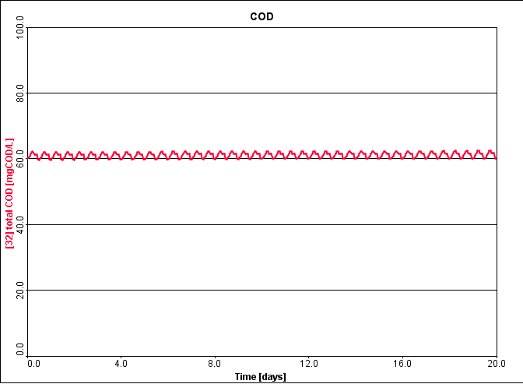
COD effluent from NW-WWT

Slide 32
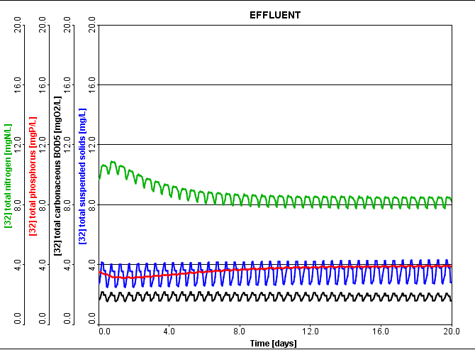
Effluents from NW-WWT

Slide 33
Second Scenario: Modeling NW-WWTP in the future expansion.
Year | Q in | Q out | COD | BOD | TSS | TN | TP | TKN
2015 | 9000 | 8270 | 60.67 | 1.58 | 2.84 | 35.8 | 3.76 | 2.37
2016 | 10000 | 9270 | 61.05 | 1.67 | 3.11 | 34.91 | 3.74 | 2.49
2017 | 11000 | 10270 | 61.42 | 1.75 | 3.37 | 33.96 | 3.72 | 2.60
2018 | 12000 | 11270 | 61.77 | 1.83 | 3.61 | 32.97 | 3.71 | 2.72
2019 | 13000 | 12270 | 62.12 | 1.91 | 3.85 | 31.96 | 3.69 | 2.83
2020 | 15000 | 14270 | 62.73 | 2.07 | 4.27 | 30.28 | 3.59 | 3.07

Slide 34
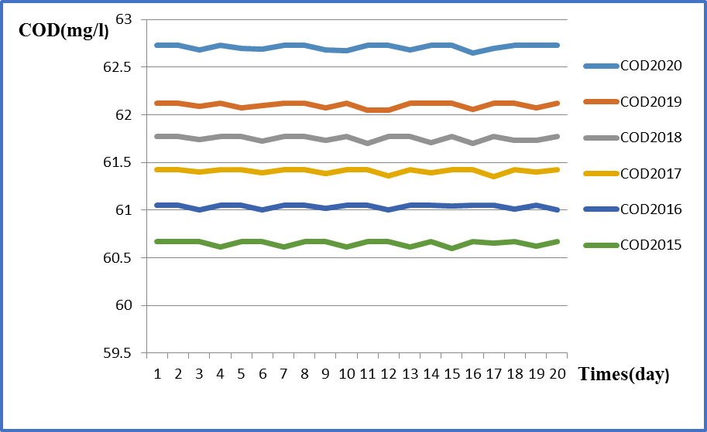
COD Effluent concentrations in case of future expansion.

Slide 36
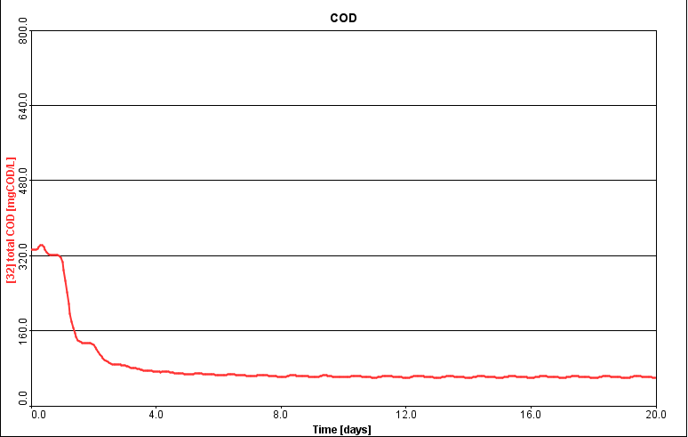
Third Scenario :Modeling the plant in case of discharging Olive mill wastes
“Zeibar” in 2015.

Slide 37
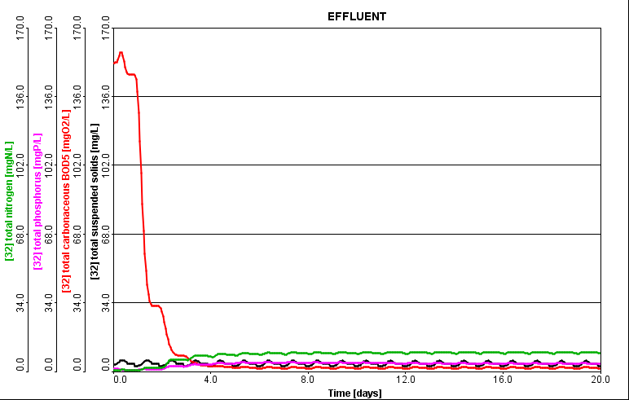
Simulation of the plant in 2015 based on the design values in case of illegal discharge of Olive Mills Wastewater.

Slide 38
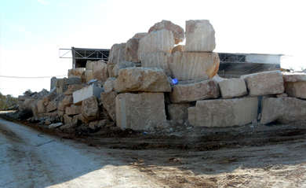
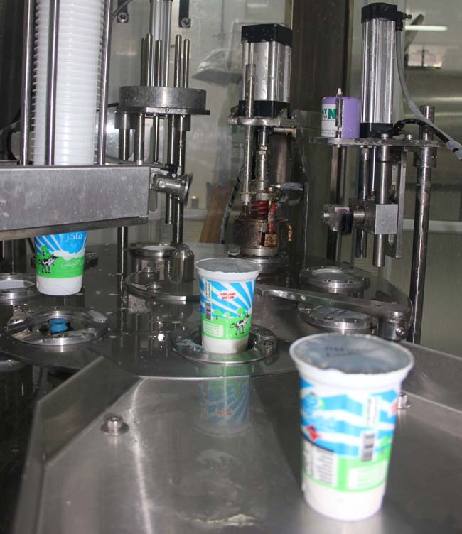
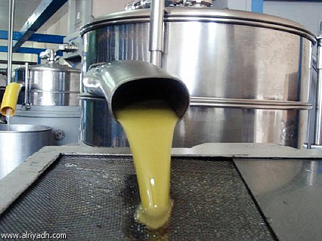
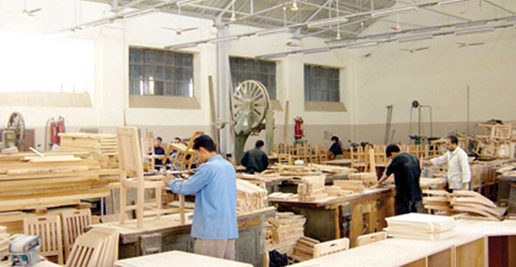
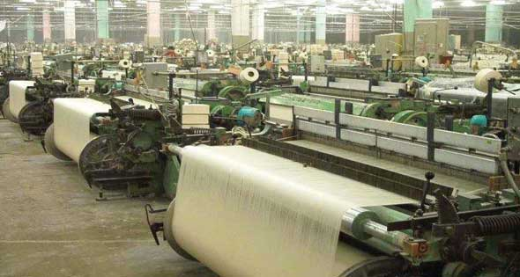
Fourth scenario :Modeling the plant under the effect of discharge of some industrial wastewater

Slide 39
In case of discharging industries with different COD Values but
with 100m³/d average flow.
Type of Industry | Industrial COD(mg/l) | Total Influent COD | Effluent. COD(mg/L) | Effluent COD(Kg/d) | Efficiency (%)
Textile | 450 | 1105.63 | 62 | 936.2 | 94.4
Furniture | 1000 | 1109 | 65 | 981.50 | 94.14
Tahina | 7200 | 1150.33 | 68 | 1026.80 | 94.08
Slaughter house | 34000 | 1327.81 | 78 | 1177.80 | 94.12
Diary | 99000 | 1758.28 | 120 | 1812 | 93.17
Olive oil | 150000 | 2096.03 | 420 | 6342 | 79.96
Mix of more than one industry | 200000 | 2427.15 | 700 | 10570 | 71.16

Slide 40
Mass balance concept used to determine the influent COD concentration .
Sample Calculations
Influent COD=1110mg/l
Influent Flow=15000m³/d
Batch Influent COD=450mg/l
Batch Influent Flow=100m³/d
Using Mass Balance
Total COD =1105.62mg/l

Slide 41
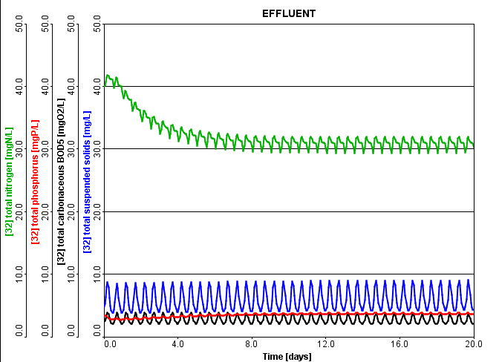
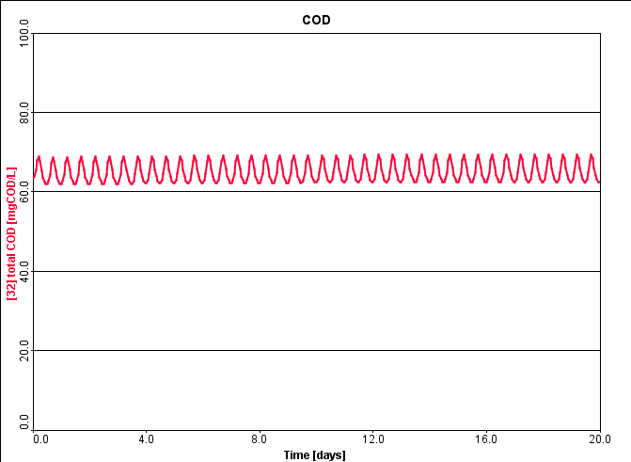
Simulation of the plant in 2020 based on the design values in case of discharge of Textile industries Wastewater.

Slide 42

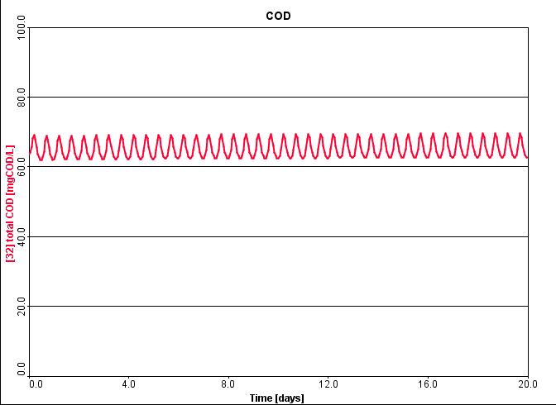
Simulation of the plant in 2020 based on the design values in case of discharge of Furniture industries Wastewater.

Slide 43
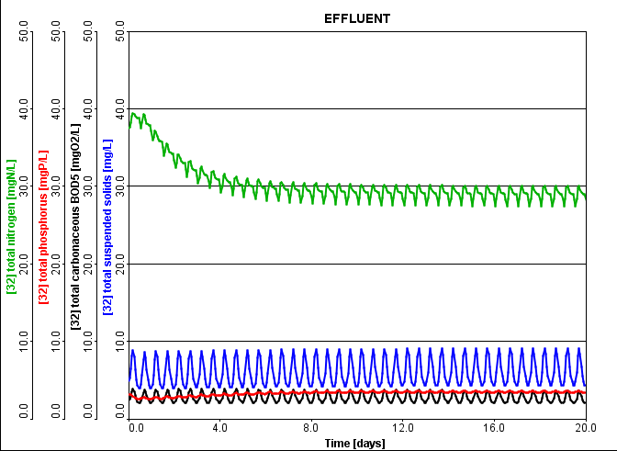
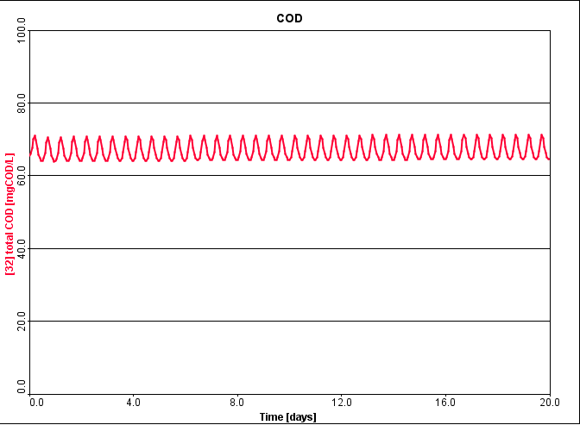
Simulation of the plant in 2020 based on the design values in case of discharge of Tahina industries Wastewater.

Slide 44
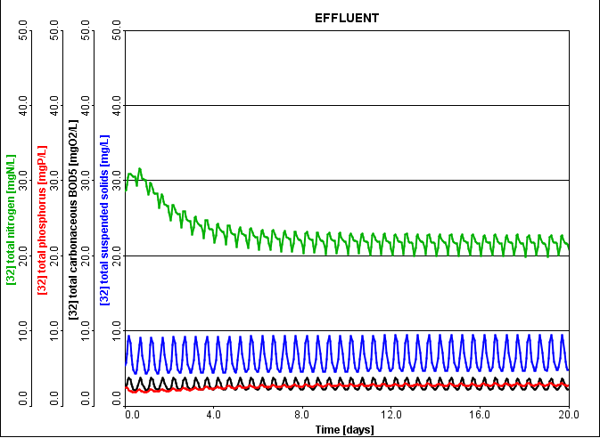
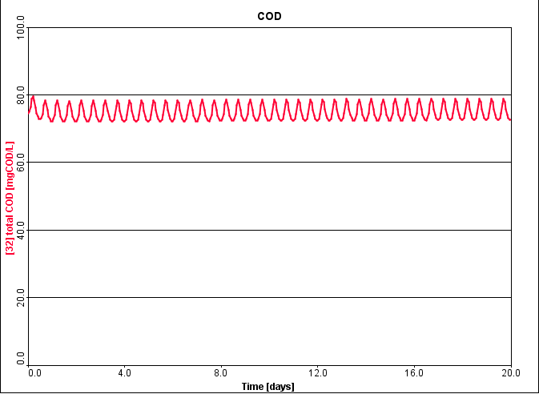
Simulation of the plant in 2020 based on the design values in case of discharge of Slaughterhouse Wastewater.

Slide 45
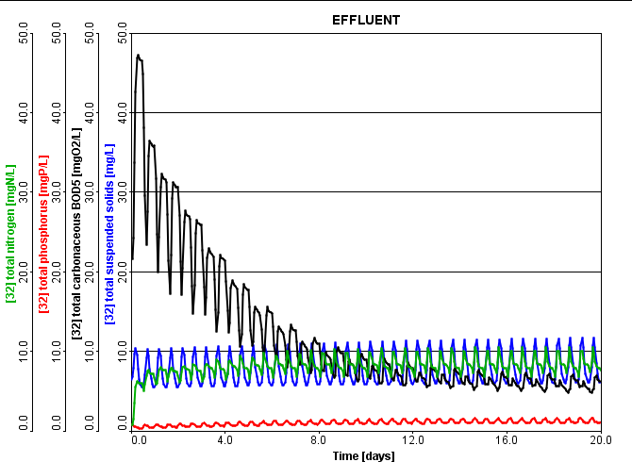
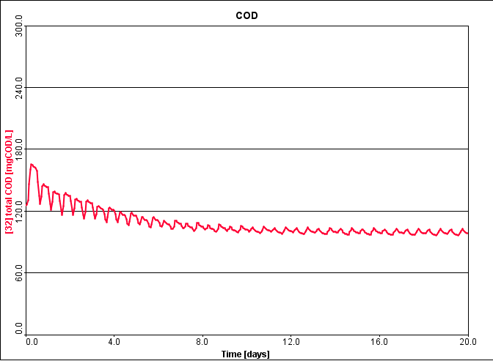
Simulation of the plant in 2020 based on the design values in case of discharge of Diary industries Wastewater.

Slide 46
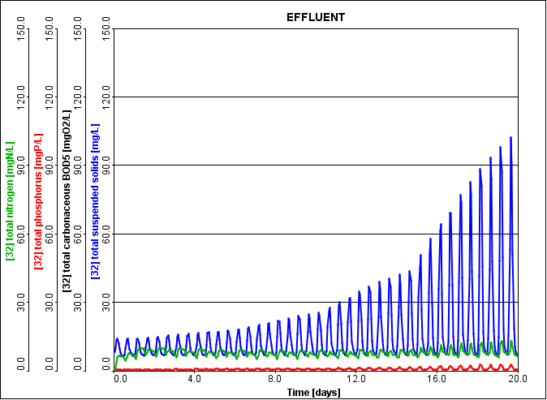
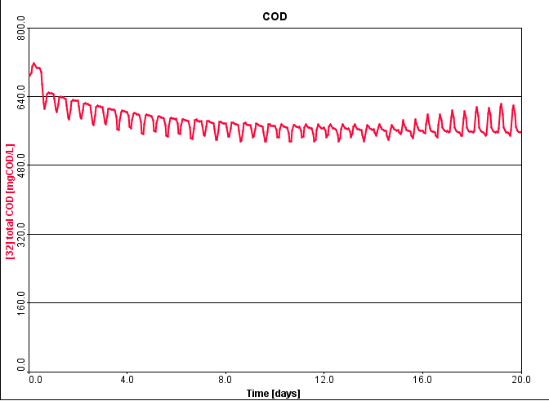
Simulation of the plant in 2020 based on the design values in case of discharge of more than one industry wastewater together.

Slide 47
Conclusion
The efficiency of the treatment plant in the normal operation is 94.5% of COD removal and 99.62% of BOD removal; nitrogen is removed by 89.45% efficiency; total phosphorus in the effluent reached a value of 3.9mg/l with 76% removal.
The plant will continue to operate within the specifications in the coming years until the end of the first phase where the efficiency of the COD removal will vary between 94.53% in 2015to 94.34 at the end of the stage in 2020.
In the season of olives and with illegal discharge of Olive mills Wastewater “Zeibar” into the plant the efficiency decreased from 94.53% to 76.2% in 2015

Slide 48
Industrial wastewater effects on the treatment plant as follows :
In light industry, such as Textile and furniture industries the COD effluent did not change much from the normal situation of the plant where the efficiency was around 94.5% and so the treated water quality was not significantly affected.
In Tahina industries and Slaughter House the efficiency start to decrease form the normal operation but the effluent quality is still nearly acceptable.
In Diary and olive oils industry, the efficiency decreased a lot, and the effluent quality does not achieve the Palestinian Specifications.

Slide 49
Recommendations
Municipality should monitor Wadi –Zeimar and strict regulations should be enacted to prevent illegal connections.
Further researches should be carried out to study the gas production from digester.
The data we have used in this research was collected by taking composite samples depends on the time, regardless of the amount of flow discharging into the plant, leading to inaccuracies in the results therefore it's recommended to use device depends on the time and flow together.

Slide 50
Recommendations
It advised to put measuring devices after each of Primary sedimentation tanks, Mechanical Thickener and Mechanical Dewatering to study the biology characteristics of wastewater before it enters the activated sludge units.
The effluent form NW-WWTP is planned to be used for agricultural purposes, therefore its characteristics have to meet the Palestinian guidelines. Thus, it is possible to rely on a well-calibrated model to improve the operational controls and to study the impact of emergency situations on the quality and to judge whether it will achieve the specifications and can be used for agriculture or not, and then taking the necessary actions.

Slide 51
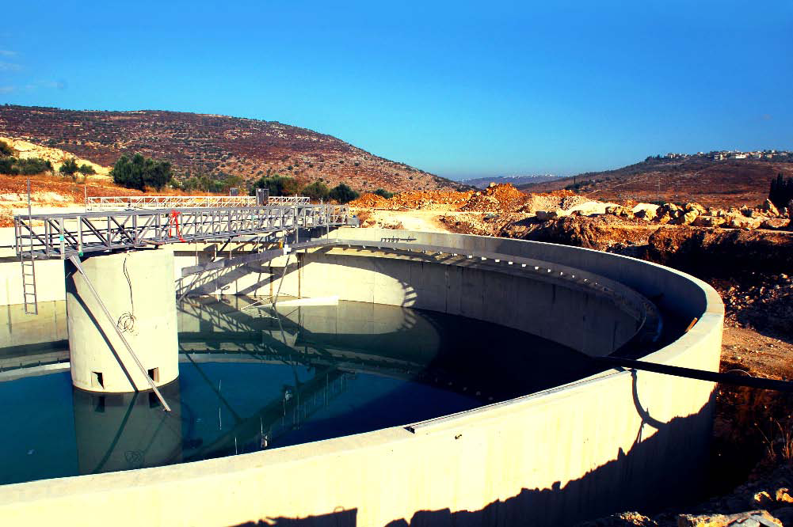
Thank you for your attention

