Slide 1

Use Business Intelligence To Improve Org. Performance
(Nablus municipality)
SUPERVISORS:
DR . MAHER ABU BAKER
& DR.MOHAMMAD DWIKAT
prepared by:
Batool nidal Noor yahya
Doua aqel
Notes:
NOTE:
To change the image on this slide, select the picture and delete it. Then click the Pictures icon in the placeholder to insert your own image.

Slide 2
Out Line
Introduction (what is our project?)
why that solution?
project scope
main Goals
Initial Problem faced & solutions
Project Phases
Main difficulties faced
Future work

Slide 3
Introduction
a goal of every business is to make better decisions to increase their profitability ,improve the business performance & overcome their competitors ; and that goal every day become more difficult to reach using the transactional database as a huge amount of data being stored in daily manner .
we are facing the “big data” , and this data contains very useful information if it’s collected together , and because of the transactional DB limitation ;a need for new model
to cover that need .
That is where business intelligence (BI) comes in. BI turns the massive amount of data from operational systems into a format that is easy to understand, current, and correct so decisions can be made on the data .
.

Slide 4
Project Scope
after a careful and a deep study of municipality ,we found a performance gap in the collection department , and a desire from the computer department to fill this gap.
so ; we started to understanding the business roles and the data flow in the systems used ( Min 2-3 weeks )

Slide 5
Main Goals
prepare and analyze the data come from different source by cleaning it and do some process to be Ready for Nablus municipality to evaluate current situation according to it objectives

Slide 6
Initial problems :
Select the suitable tools
We research a lot for tools and programs to use it in our project like Talend Open Studio for Data Integration , rapidminer , Apatar , jedox , HPCC Systems , Jaspersoft ETL(for reporting and etl and analyze the data ) , kETL , Scriptella , pentaho .
What the next step to do (because the idea is new )
Lack the source of information about the subject
Solution :
Use use Microsoft Sql Server 2008 R2 that provide services include Integration Services( SSIS), Reporting Services and Analysis Services. Analysis Services includes a group of OLAP and data mining

Slide 7
project phases
-ETL
-DataWarehousing
-Olap cube

Slide 8
first phase
Etl(extract, transform, load)

Slide 9
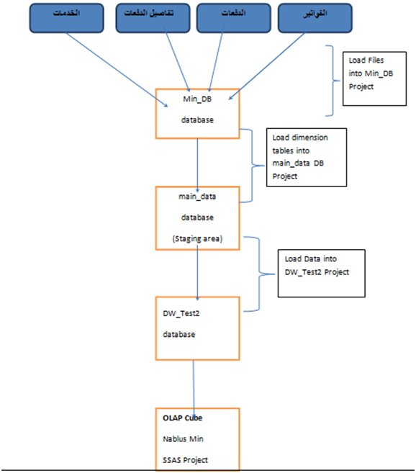
Road Map:

Slide 10
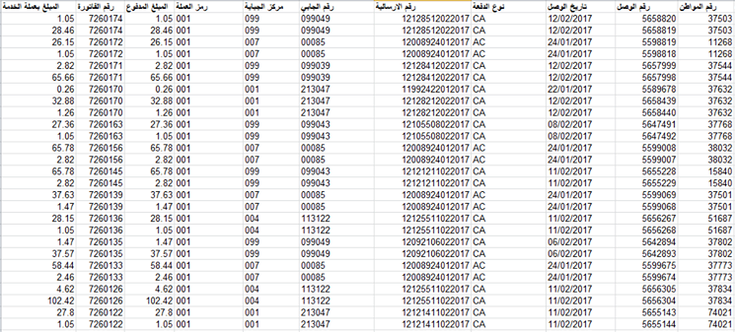
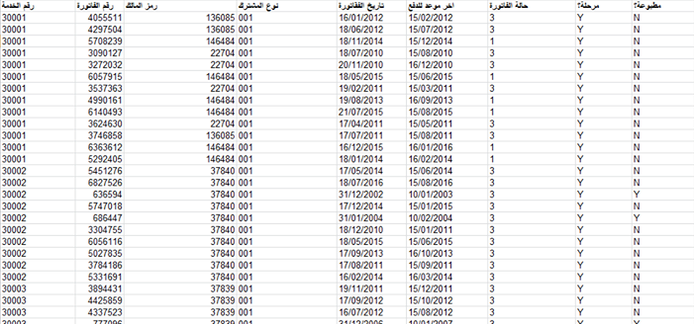
Sample Data before ETL

Slide 11
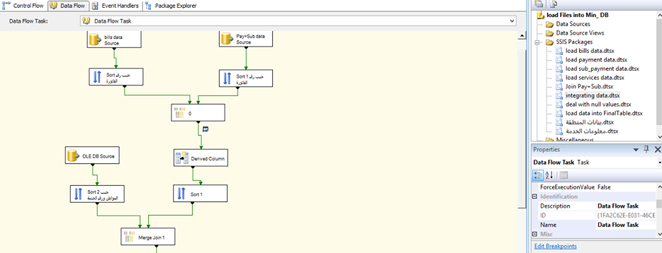
Integration of Data

Slide 12
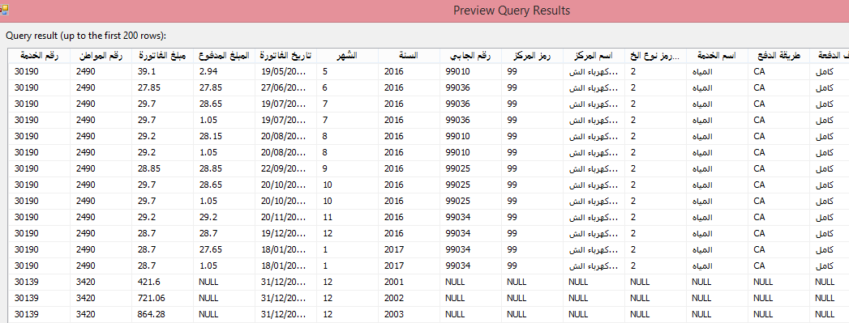
After integrations

Slide 13
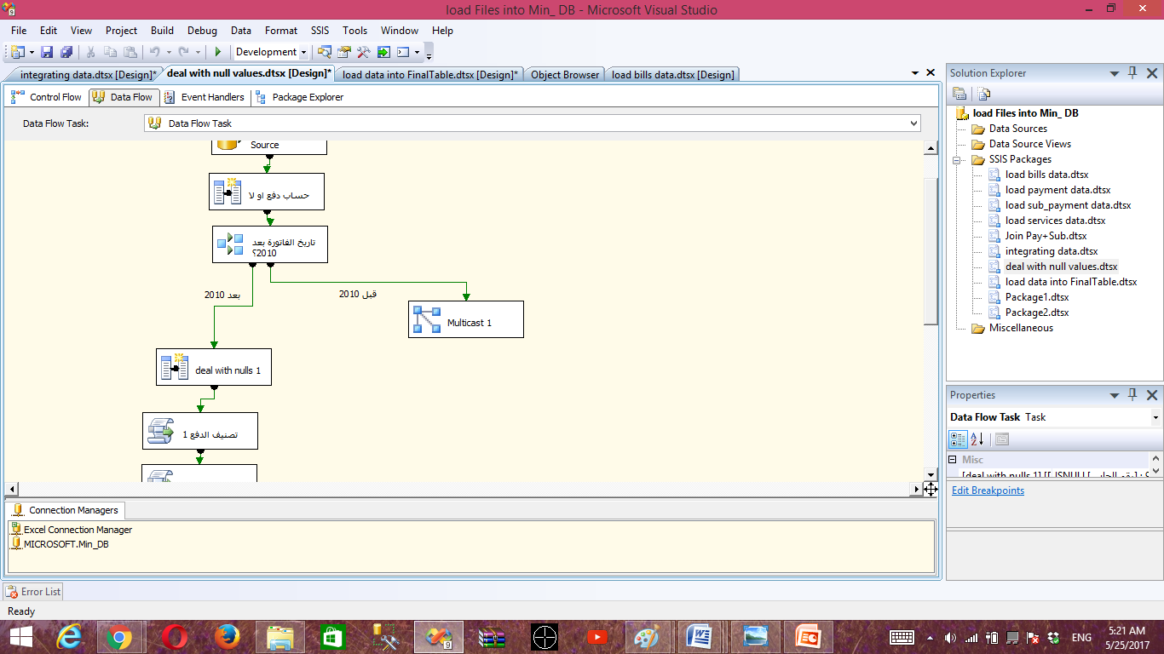
Del with NULL

Slide 14
After dealing with Null

Slide 15
Built data warehouse

Slide 16
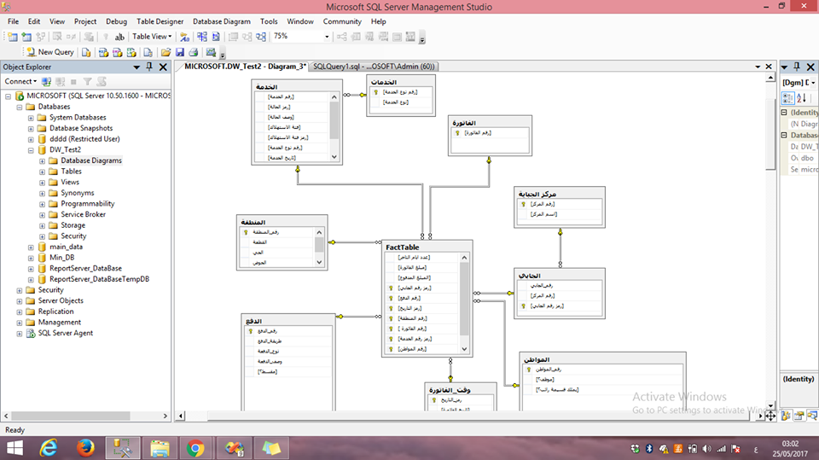
Data warehouse diagram

Slide 17
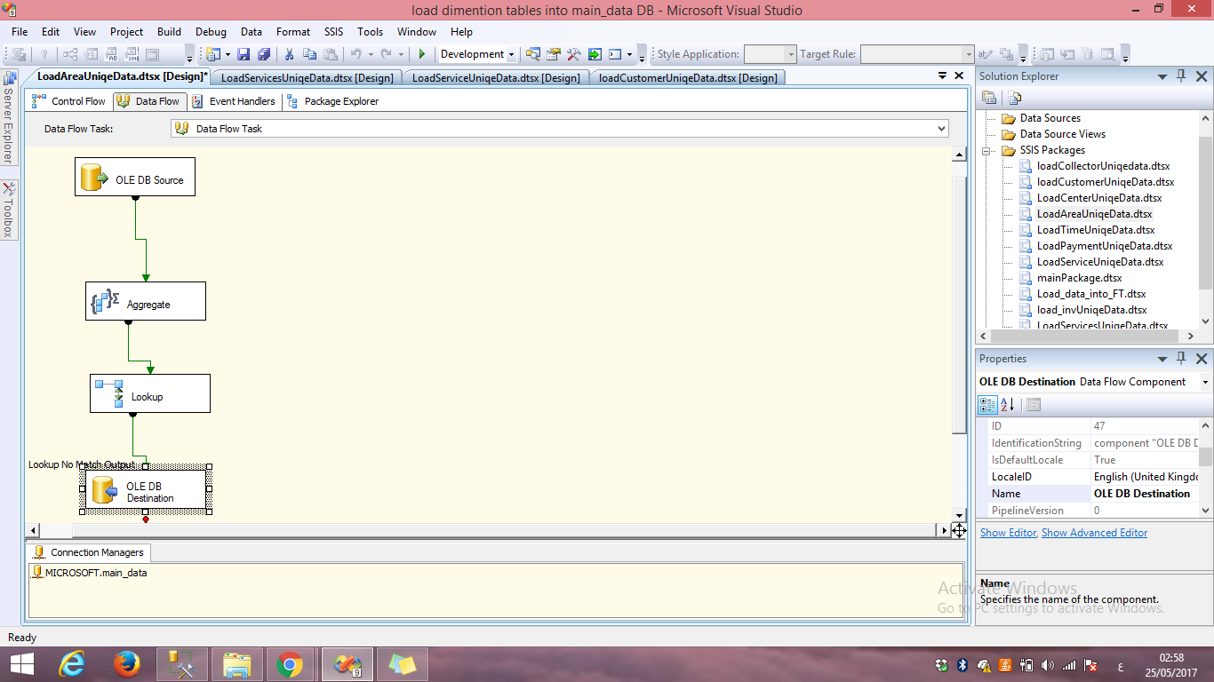
load data into dimensions

Slide 18
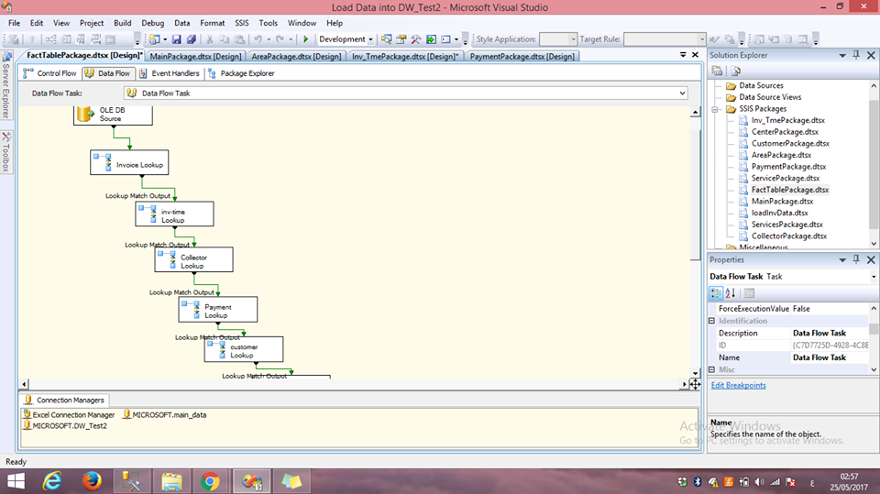
Load data in fact table

Slide 19
Built OLAB Cube

