Slide 1

Water Network Analysis & Design of Ejnesenya
By : Nayef Hani Maqboul
Supervisor: Dr Anan Jayousi

Slide 2
Content
Review of project 1 (existing network).
The design of the new network.
Housing projects.

Slide 3
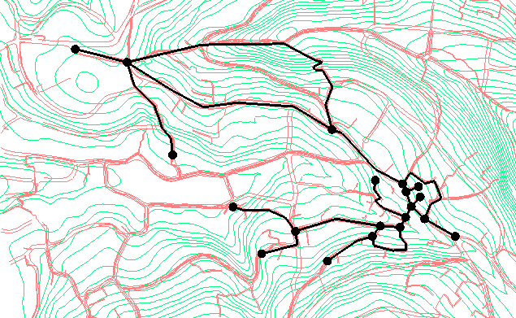
The existing network

Slide 4
Problems in the existing network
Expansion of the residential areas.
Water pressure problems, 20<P<100 m H2O.
Velocity problems, 0.3<V<3 m/s.
Lack of water.
Lack of data and prober mapping of the network.

Slide 5
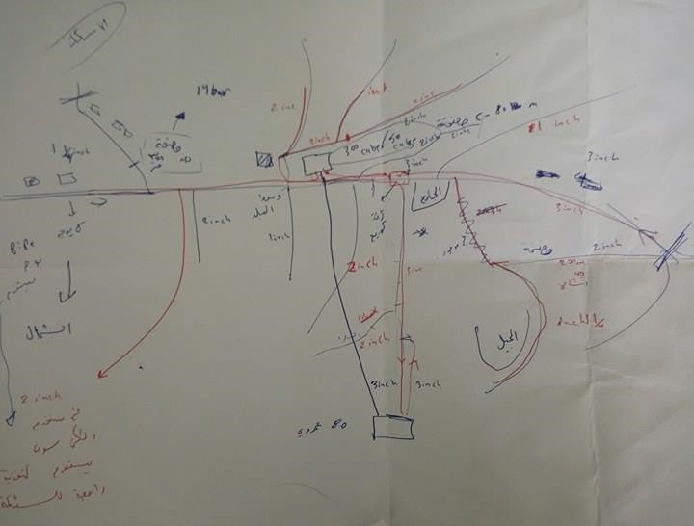

Slide 6
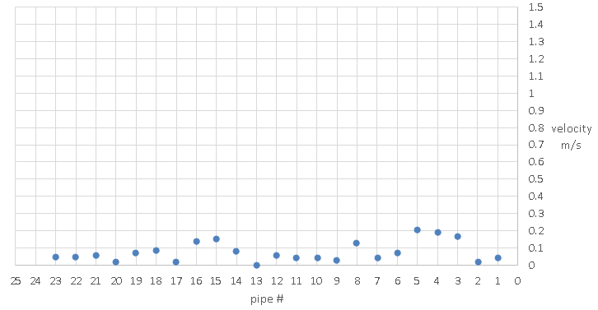

Slide 7
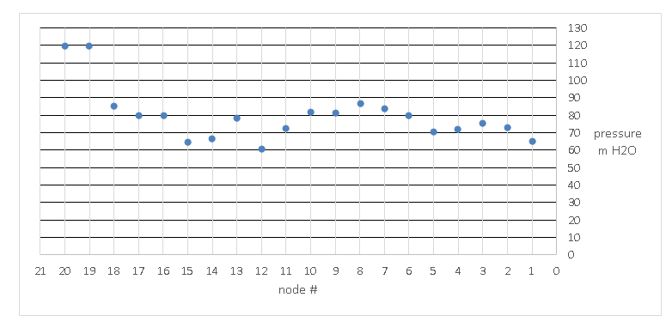

Slide 8
NEW NETWORK DESIGN

Slide 9
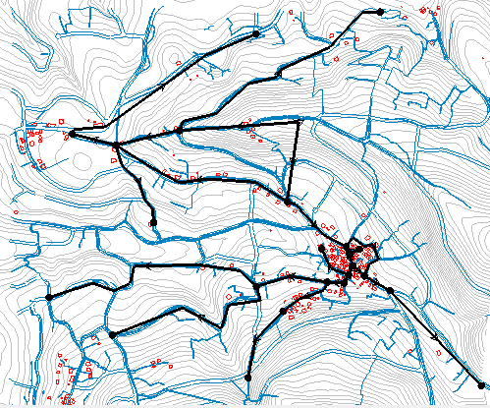
New model

Slide 10
Design criteria
Velocity in pipes : 0.3 < V < 3 m/s.
Pressure in nodes : 20 < P < 100 m H2O.
Design period of 30 years.

Slide 11


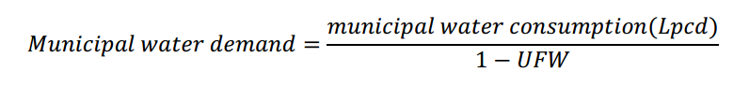
Population estimates & Demand calculation

Slide 12
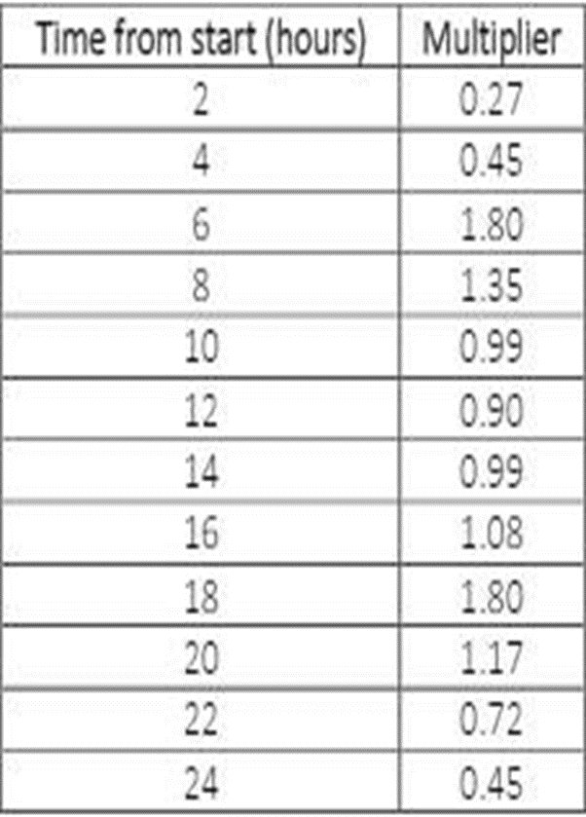
Demand pattern

Slide 13
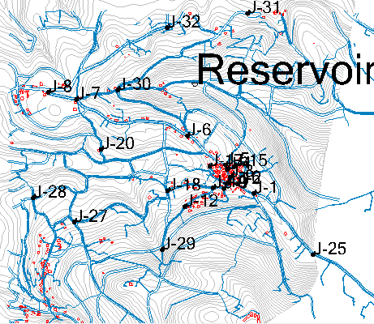
Nodes distribution

Slide 14
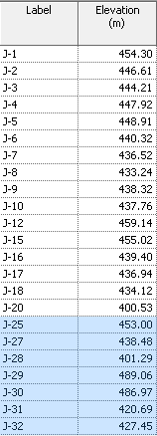
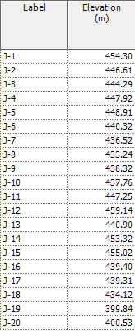

Slide 15
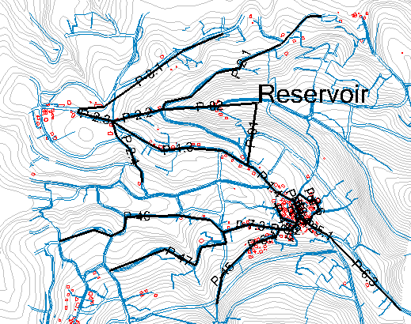
Pipe distribution

Slide 16
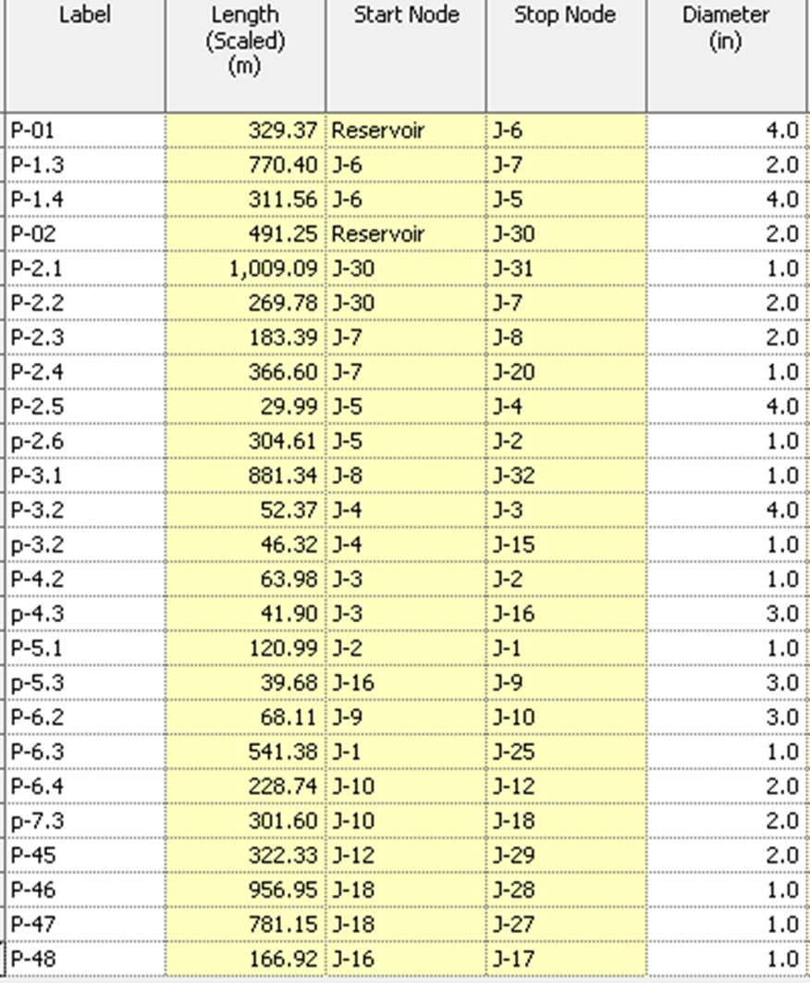
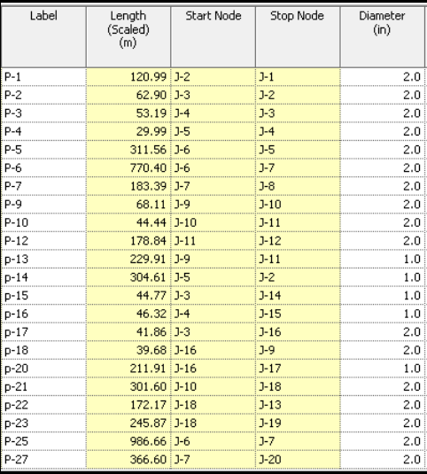

Slide 17
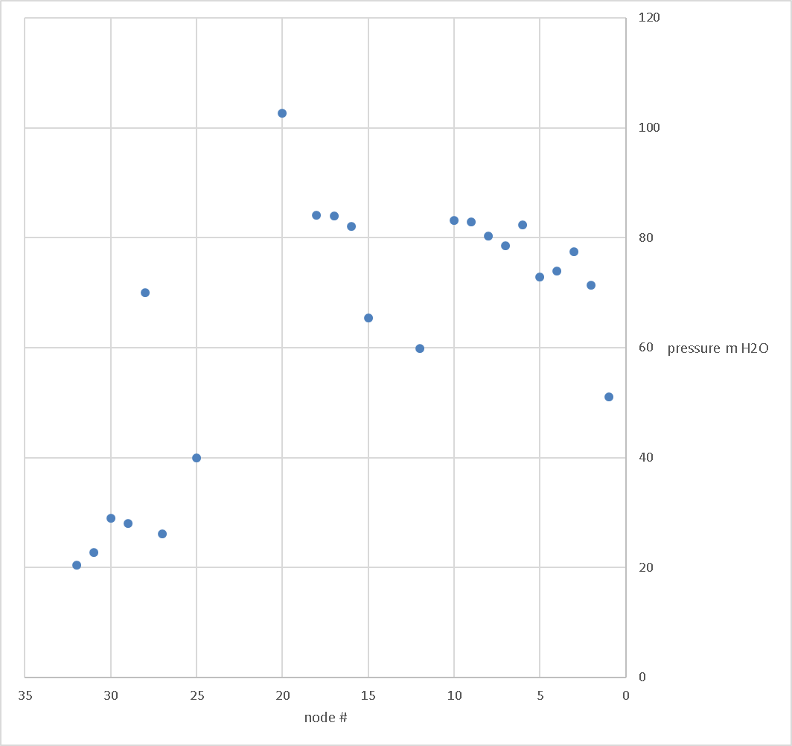

Slide 18
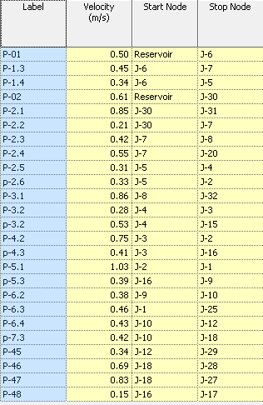

Slide 19
Housing Projects
Housing project A (AL-SHUNNAR).
Housing Project B (ISKAAN AL NAQURA).

Slide 20
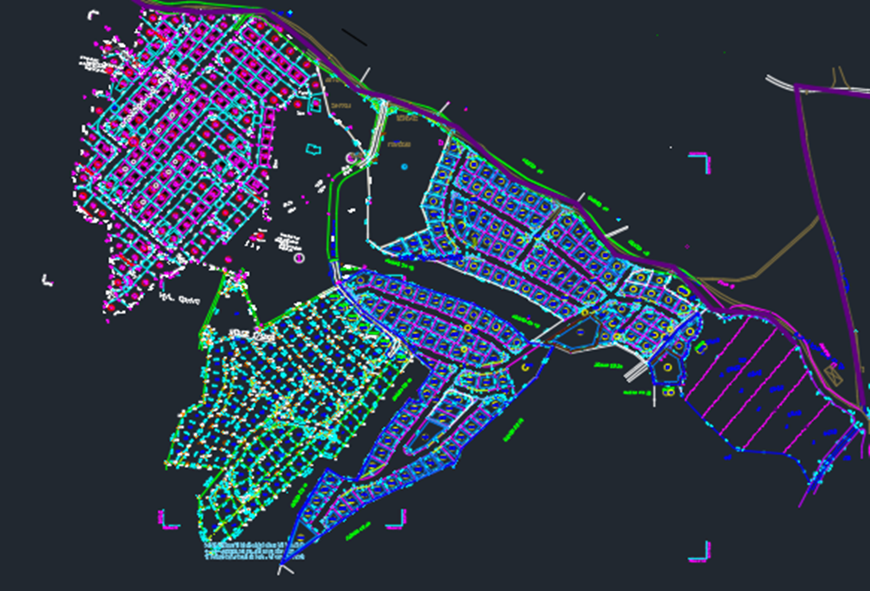
Housing Project A

Slide 21
Population estimates & Demand calculation
Average density = 5 capita per family
Daily Municipal demand = 167.5 liters / capita.day
380 unit
Total demand = 318 m3/day.

Slide 22
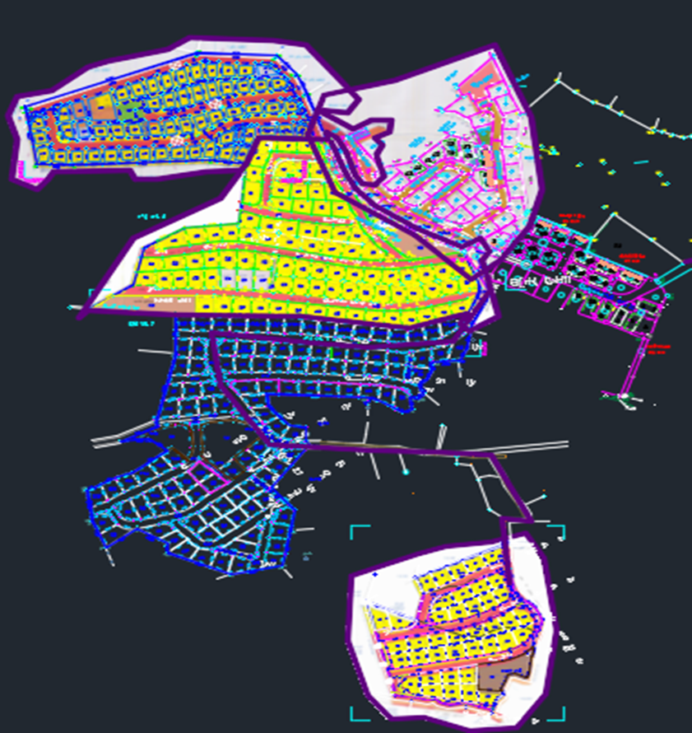
Housing project B

Slide 23
Population estimates & Demand calculation
Average density = 5 capita per family
Daily Municipal demand = 167.5 liters / capita.day
360
Total demand = 301 m3/day.

Slide 24
Total future demand of Ejnesenya = 276 m3/day.
Total demand of the housing projects = 619 m3/day.

Slide 25
ALTERNATIVES

Slide 26
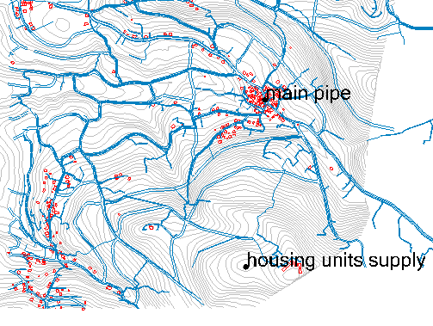
Alternative 1
Main pipe line from feeding line to a reservoir that feeds the projects.

Slide 27
Data obtained
pipe length = 910 meters
Elevation difference = 180 meter
Flow = 620 m3/day
Power horse needed = 17 HP

Slide 28
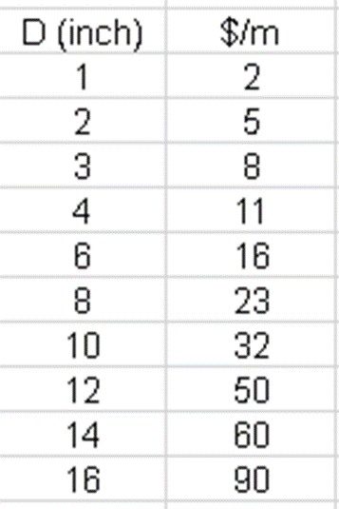
Relevant costs
4 inch pipe of 910 meter length = 10.000 $
3 pumps = estimated 6000 $
Total cost 16.000 $

Slide 29
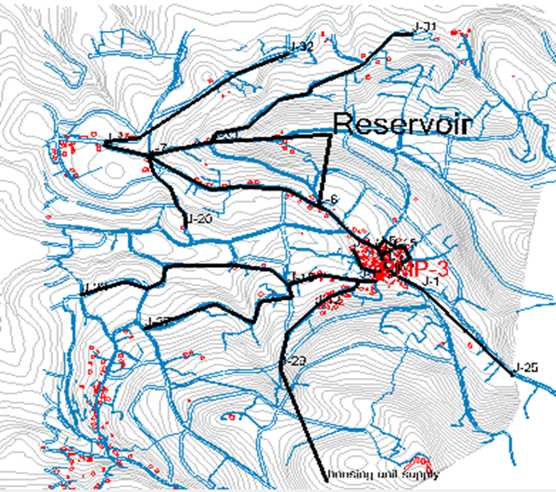
Alternative 2
Connect the projects supply to the new network.

Slide 30
Data obtained
pipe length = 550m
Elevation difference = 170 meter
Flow = 620 m3/day
Power horse needed = 17 HP

Slide 31
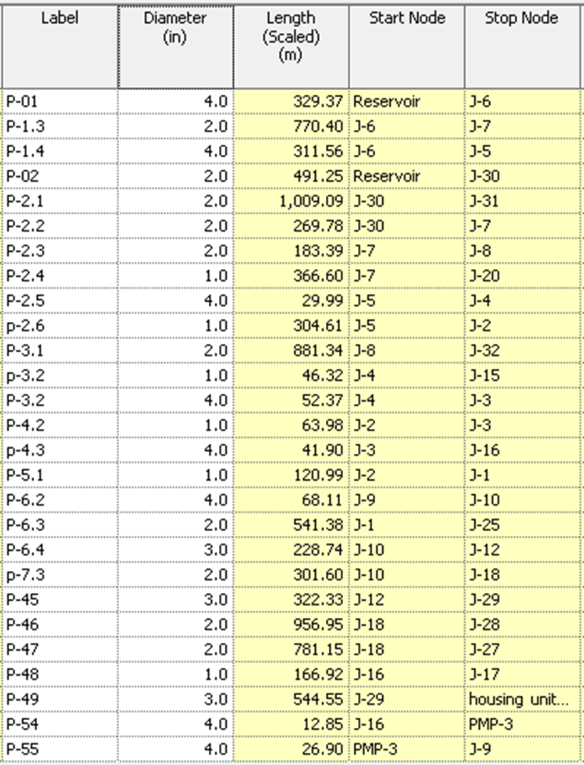
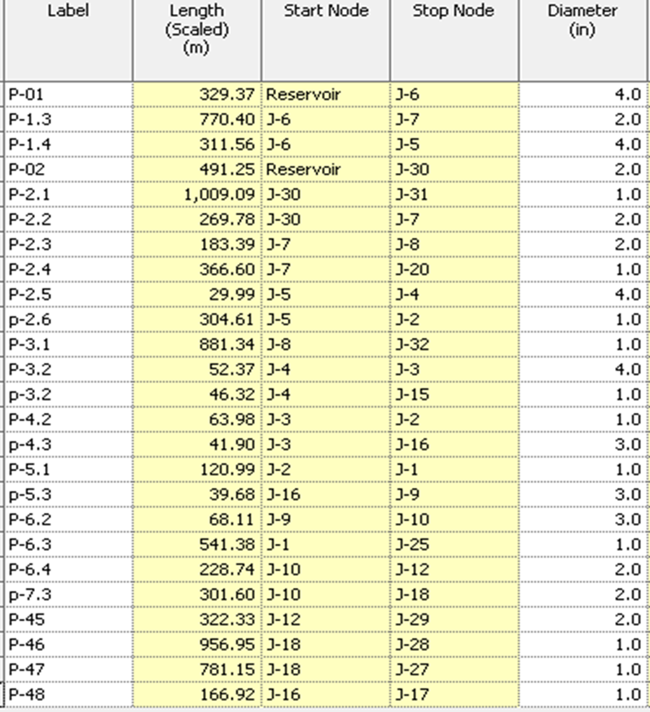
Effects on the network

Slide 32
Other scenarios

Slide 33

Any Questions ?

