Slide 1
Design of sewage networks and WWTP for ASIRA AL-SHAMALYA village
Prepared by :
AHMAD JOMAA
SALAM SALAMA
SALEH HASSON
Submitted to : Dr. HAFEZ SHAHEN

Slide 2
OUTLINE
Introduction
Objectives and significance of the work
Study area
Methodology
Modeling, Analysis and Design its results
Conclusion and recommendation

Slide 3

Introduction
Water take a great importance to humans in everyday life most of the activities we do need water. So that demand is continuously increasing, this means increasing the wastewater production, where wastewater constitutes about 90% of water demand .

Slide 4
Objectives
The main objectives of this project are:
To design a WDN under the current and future conditions.
To design a wastewater collection network.

Slide 5
The importance of the project
Most of people in the village are suffering from getting rid of wastewater, so in our project we can help people to get rid of the wastewater in more environmental friendly way To avoid health issues by an efficient way of getting rid of waste water, and to avoid ground water pollution, making an economical, reliable solution for people by helping them of disposing waste water.

Slide 6
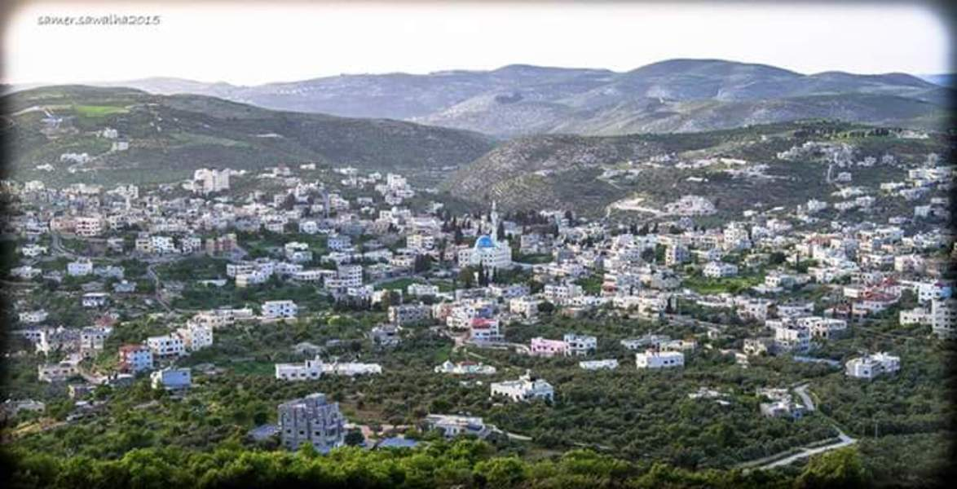
The Study Area : Asira al-shamaliya

Slide 7
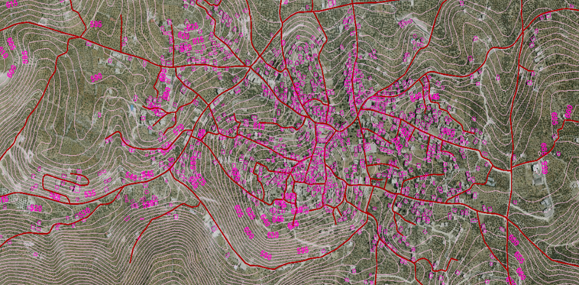
TOPOGRAPHY

Slide 8
TOPOGRAPHY
Maximum elevation = 665 m above MSL
Minimum elevation =510 m above MSL

Slide 9
AREA AND LAND USE
The total area of Asira al-Shamaliya is 34,500 dunums, divided into 44 basins of which 29,300 dunums is agricultural land, the rest are non-agricultural lands, pastures and forests.

Slide 10
DATA COLLECTION
Road network
Contour map
Boundary of study area
Population number and population growth rate
House distribution

Slide 11

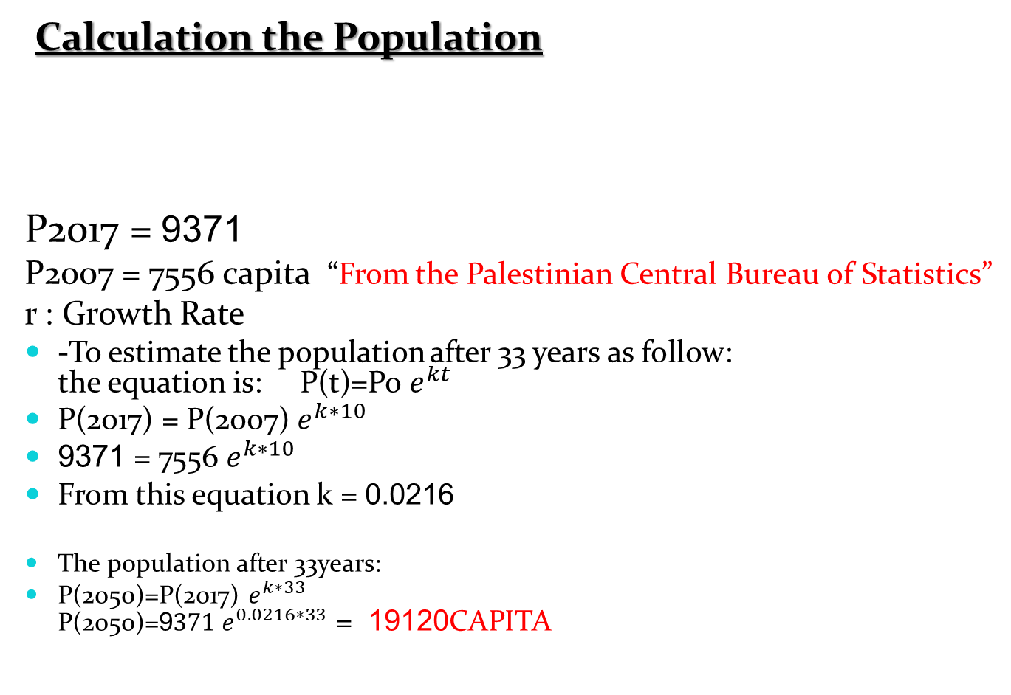
Preparation of data
Calculation the Population
P2017 = 9371
P2007 = 7556 capita “From the Palestinian Central Bureau of Statistics”
r : Growth Rate
-To estimate the population after 33 years as follow:
the equation is: P(t)=Po $e^{kt}$
P(2017) = P(2007) $e^{k∗10}$
9371 = 7556 $e^{k∗10}$
From this equation k = 0.0216
The population after 33years:
P(2050)=P(2017) $e^{k∗33}$
P(2050)=9$371 e^{0.0216∗33}$ = 19120 CAPITA

Slide 12
Calculation of Sanitary Load
Demand = 100L /day .capita
Peak Flow Factor .
PF = 5/(Pop)^0.167
Peak FLOW factor = 3
Wastewater generation 80%
Load calculation = Wastewater generation + infiltration
Wastewater generation =
0.8 * 0.10 *19120* 3 = 4590 m3 /day
Infiltration = 0.2 * 0.8 * 0.10 * 19120 = 310 CM / day
Sanitary load = 4590 + 310 = 4900 CM / day

Slide 13
Equations used in SewerCAD
Design Period (33 Years)
Population in 2050
WWGF : Waste Water Generation Factor = (70 – 90) % .
Take (80%)
Per capita consumption
Infiltration Flow
Unit Count

Slide 14
Draw the Network by SewerCAD program.
Length of conduit will not exceed 60 m.
Avoid making closed loops.
Putting manholes every intersection and curves

Slide 15
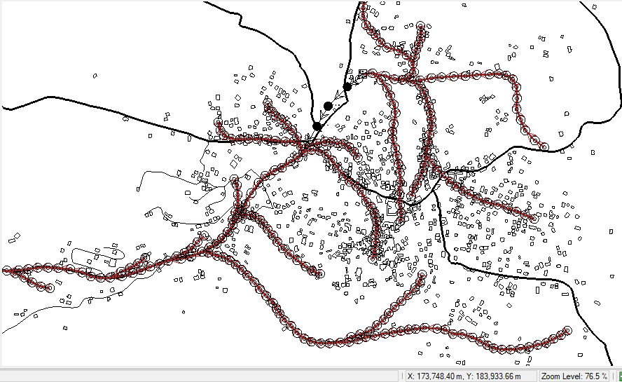
Layout of the network

Slide 16
Criteria’s that we considered in the project
Design Constrains
1. Velocity : The range was used is between (0.3-4) m\sec
2. Slope : The design slope range (0.5-15) %
3. Cover : The range was used is between 1-4 m

Slide 17
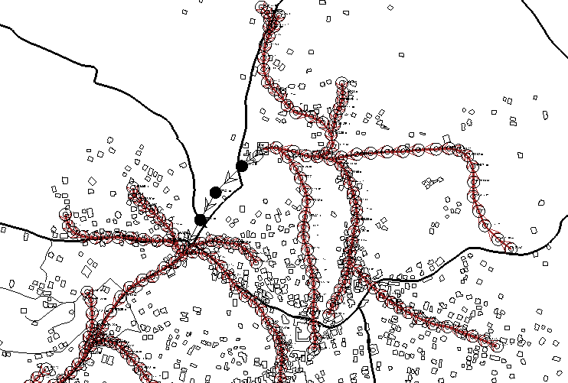
Location of wet well
We have two outfalls in the area.

Slide 18
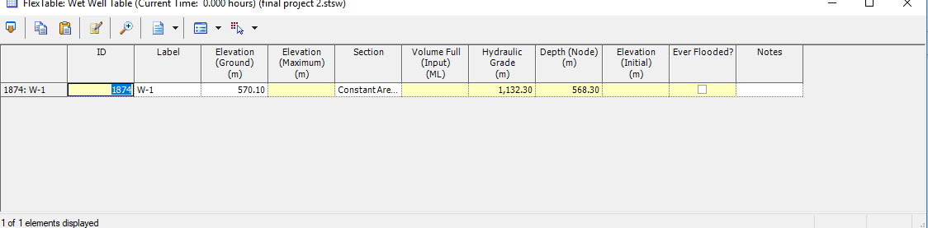
Wet well elevation= 571.10 m .
.

Slide 19
Design the wet well
we consider that the one-third of population will discharge to the wet well .
We are going to estimate the daily avg. consumption to the third of the town currently. Avg consumption daily = pop (2017) * (1/3) = 9371/3 = 3000 capita
QAVG = )100*0.8*3000 +(0.2*100*0.8*3000)(= 288 m3/day
Daily avg consumption in 2050 (after 33 year) = pop (2050)*(1/3 )
Qavg = 100*0.8*6380+0.2(100*0.8*6380) =615m3/day
Thus we would choose a circular w.w with volume 450 m3 which I result will have a diameter 5 m
And depth =6m and Diameter=5 m .

Slide 20
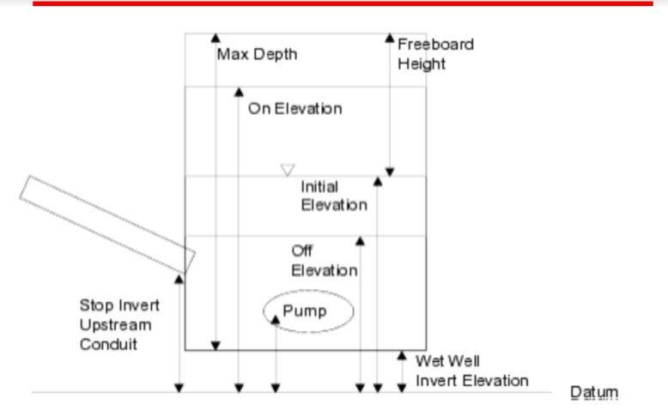

Slide 21
Pump station
, pumping stations are used to move waste to higher elevations , Thus we need to calculate the head including head loss that would be provided to the pump and the flow rate . (Qoperation,hp)
Q =64.96 m3/hour from the network and
Hp = difference from the pump station to the nearest manhole = (12.49 m + HL).we use darcy-wizbaych equation . HL=FL/D *V2/2g
HL = 10 m
Hp =( 10+12.49) =22.49 m we add 3 m to avoid pressure matters .

Slide 22
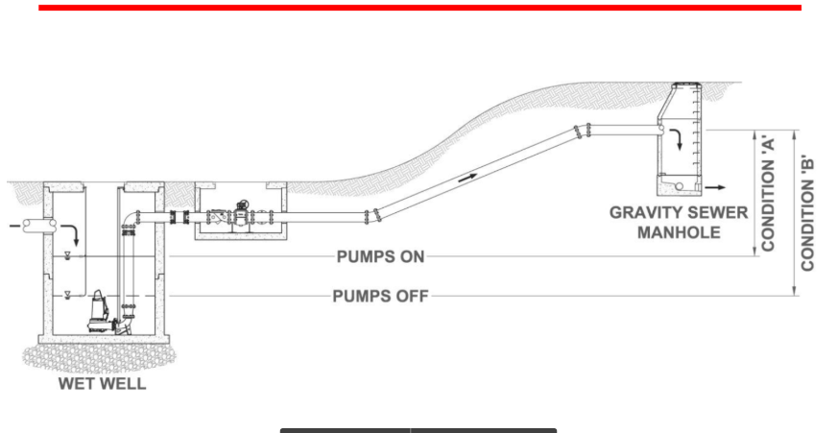

Slide 23
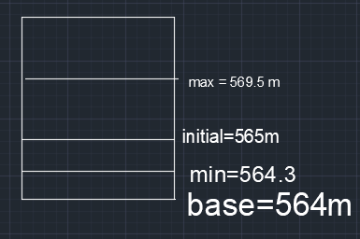
When pump will operate ?

Slide 24
Trunk line
After laying out the network for our project ,we need to get rid of the sewage by conveying or transport it by a sewer trunk line which is connected to the Nablus waste water treatment plant

Slide 25
Trunk line alternatives
Alternate one : construct a trunk line directly form the outfall of the network to the west Nablus wastewater treatment plant .
Alternate two : connect the trunk line to the main trunk line (Nablus main trunk ).

Slide 26
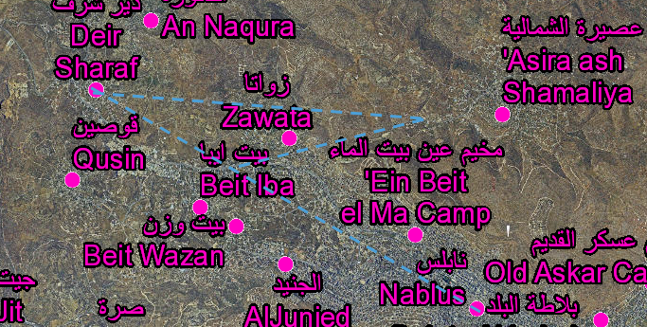
Trunk line alternatives

Slide 27
Deisgn of trunk line
First of all the we have a flow came from network 3372 m3/day *
* And the flow capacity for the main trunk line is 10000 m3/day
* The distance from the outfall to the main trunk line is approx. = 2334.52 m

Slide 28
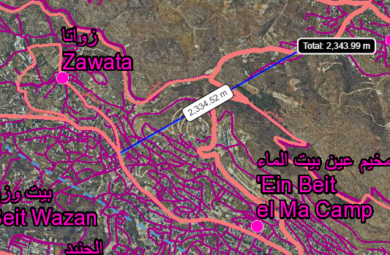
Routing of the trunk line

Slide 29
Desing criteria
*The distance between the manhole in the trunk line should not exceed 100 m
* we assumed that the load is equal distribution at all manhole (3372m3/day divided no of manhole )
* the material would be used is box concrete .
- number of manhole = 26
-load for each manhole = 115 m3/day
Material used : box concrete (2ft * 2ft )

Slide 30
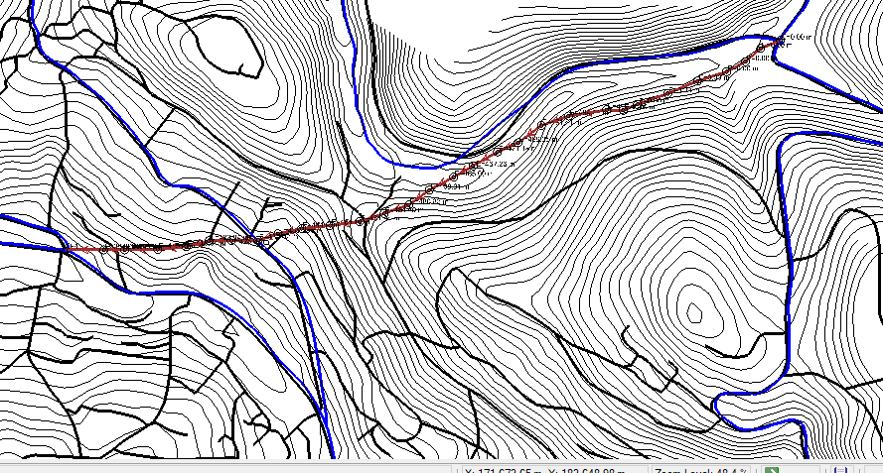
Layout of T.L

Slide 31
RESULTS AND DISCUSSION
After we adjusted the network in SewerCAD informed that the calculations were successful. That means that the design of the network was logical.
Number of manholes | 282
Maximum velocity(m/s) | 4.1
Minimum velocity (m/s) | 0.3
Maximum cover (m) | 2.2
Minimum cover (m) | 1
Maximum slope(%) | 13.6
Minimum slope(%) | 0.5

Slide 32
COST ESTIMATION
Item | Cost $
Excavation | 358866
Sewer | 166517
Manholes | 162150
Asphalt | 146894
Total Cost | 834427

Slide 33
CONCLUSION AND RECOMMENDATION
The following is notes about wastewater collection network for ASIRIA village:
1. Distribution of load on manhole based on predicting and counting houses in the village.
2. The main conduit size in network is (8, 10,12,15)in.
3. All conduit meet the cover constrain (1-4) m
4. All conduit meet velocity constrain (0.3-4) m/s

Slide 34
References
ASIRA. (2017, march 27). Retrieved from burqin: https://goo.gl/L9jrGw
ASIRIA (2017). Retrieved march 27, 2017, from https://en.wikipedia.org/wiki/Burqin
GeoMolg. (2017, march 27). Retrieved from GeoMolg: https://goo.gl/sQgz35
Mohammad Nihad Almasri - Palestine. (2017, march 27). Retrieved from Mohammad
Nihad Almasri - Palestine: https://sites.google.com/site/mohammadnablus/Home
sewerCad. (2017, march). Retrieved from sewerCad: https://www.bentley.com/en/products/product-line/hydraulics-and-hydrology- software/sewercad
Nablus municipal

Slide 35
THANK YOU

